Slide 1
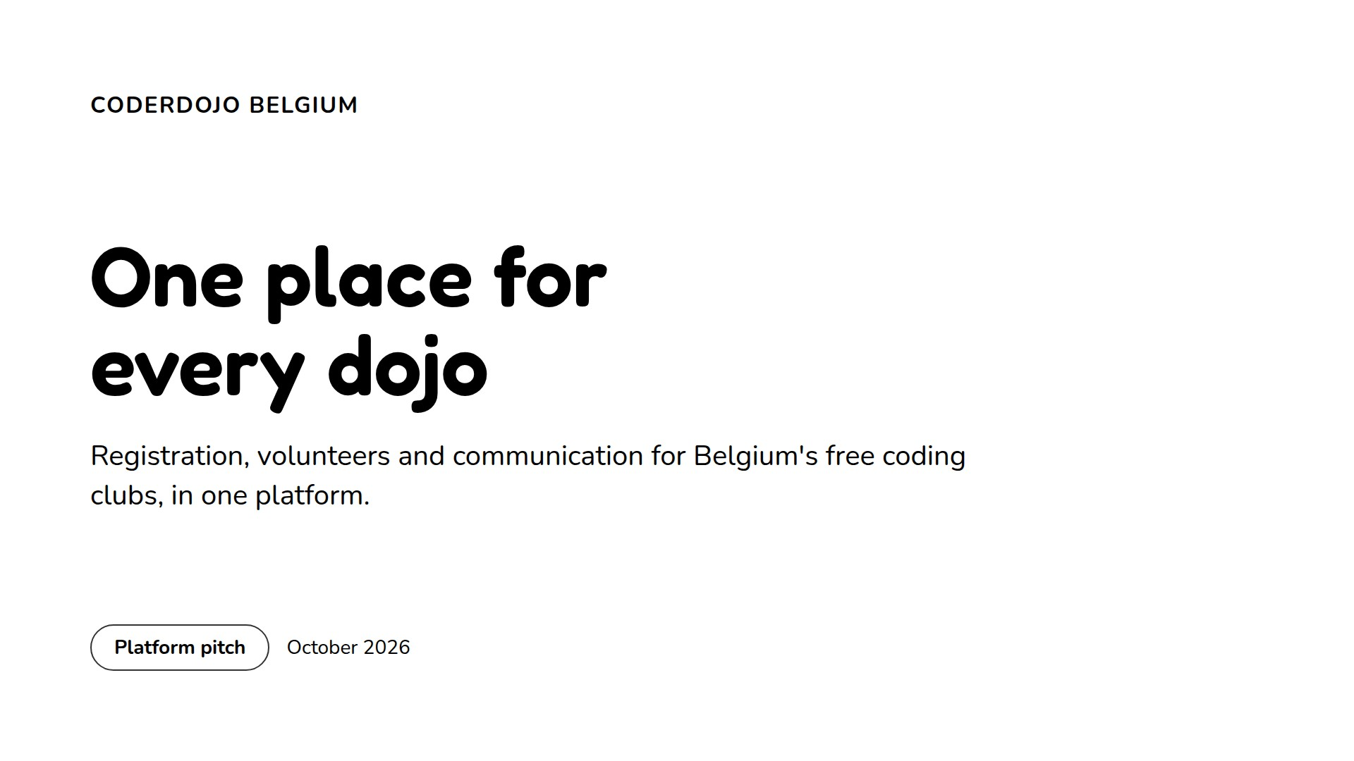
Notes:
Open with the one-line promise: families, volunteers, dojo teams and the organisation all work in the same place.

Slide 2
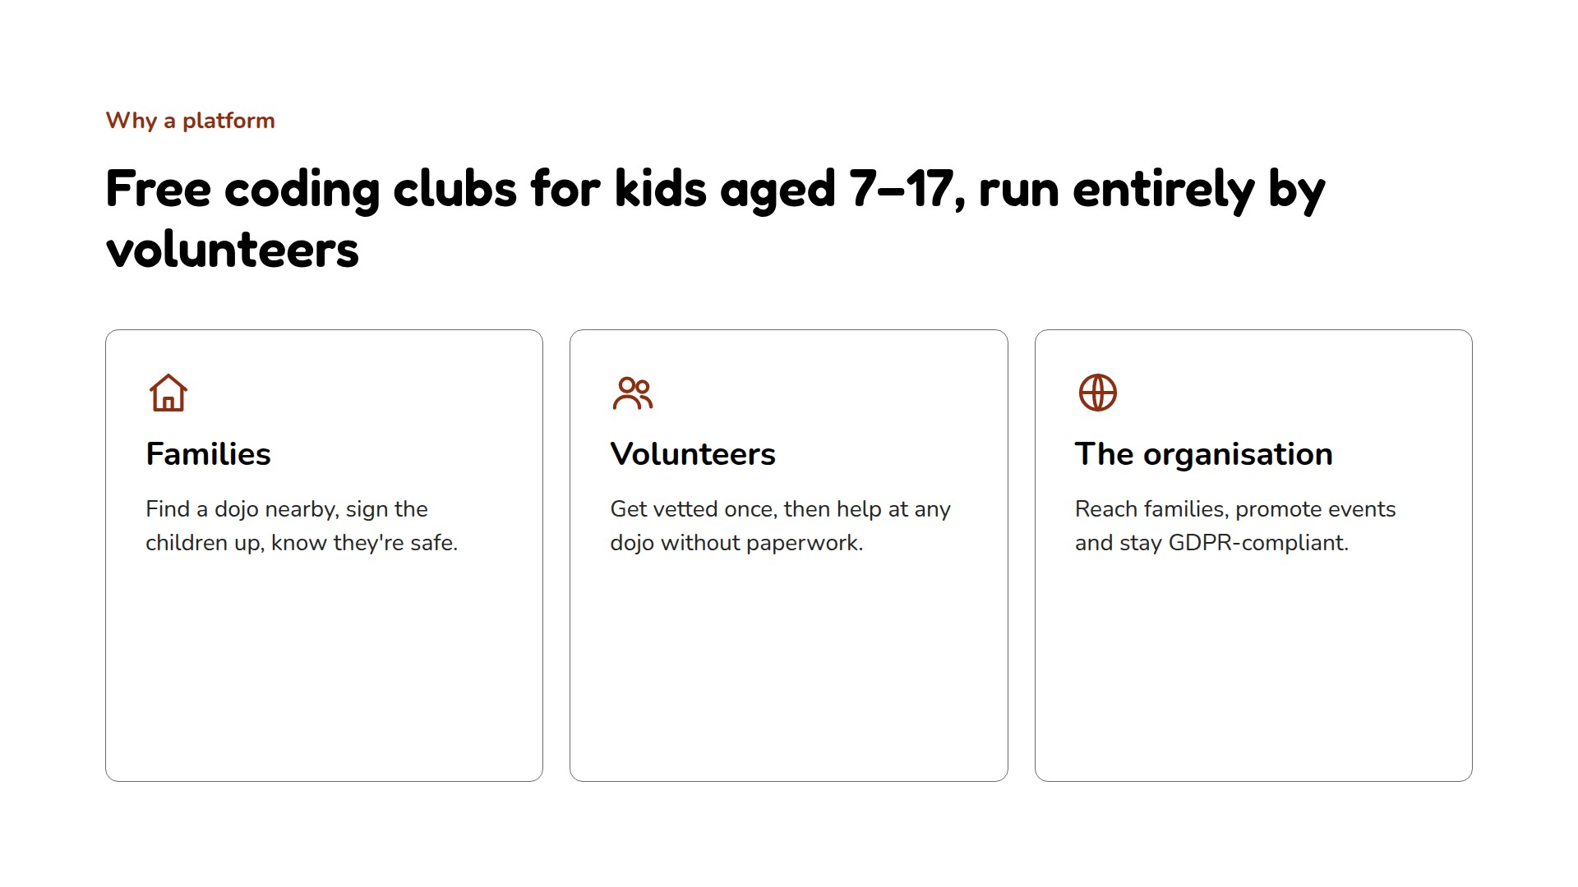
Notes:
Each group had its own spreadsheet, form or mailbox. The platform brings them together.

Slide 3
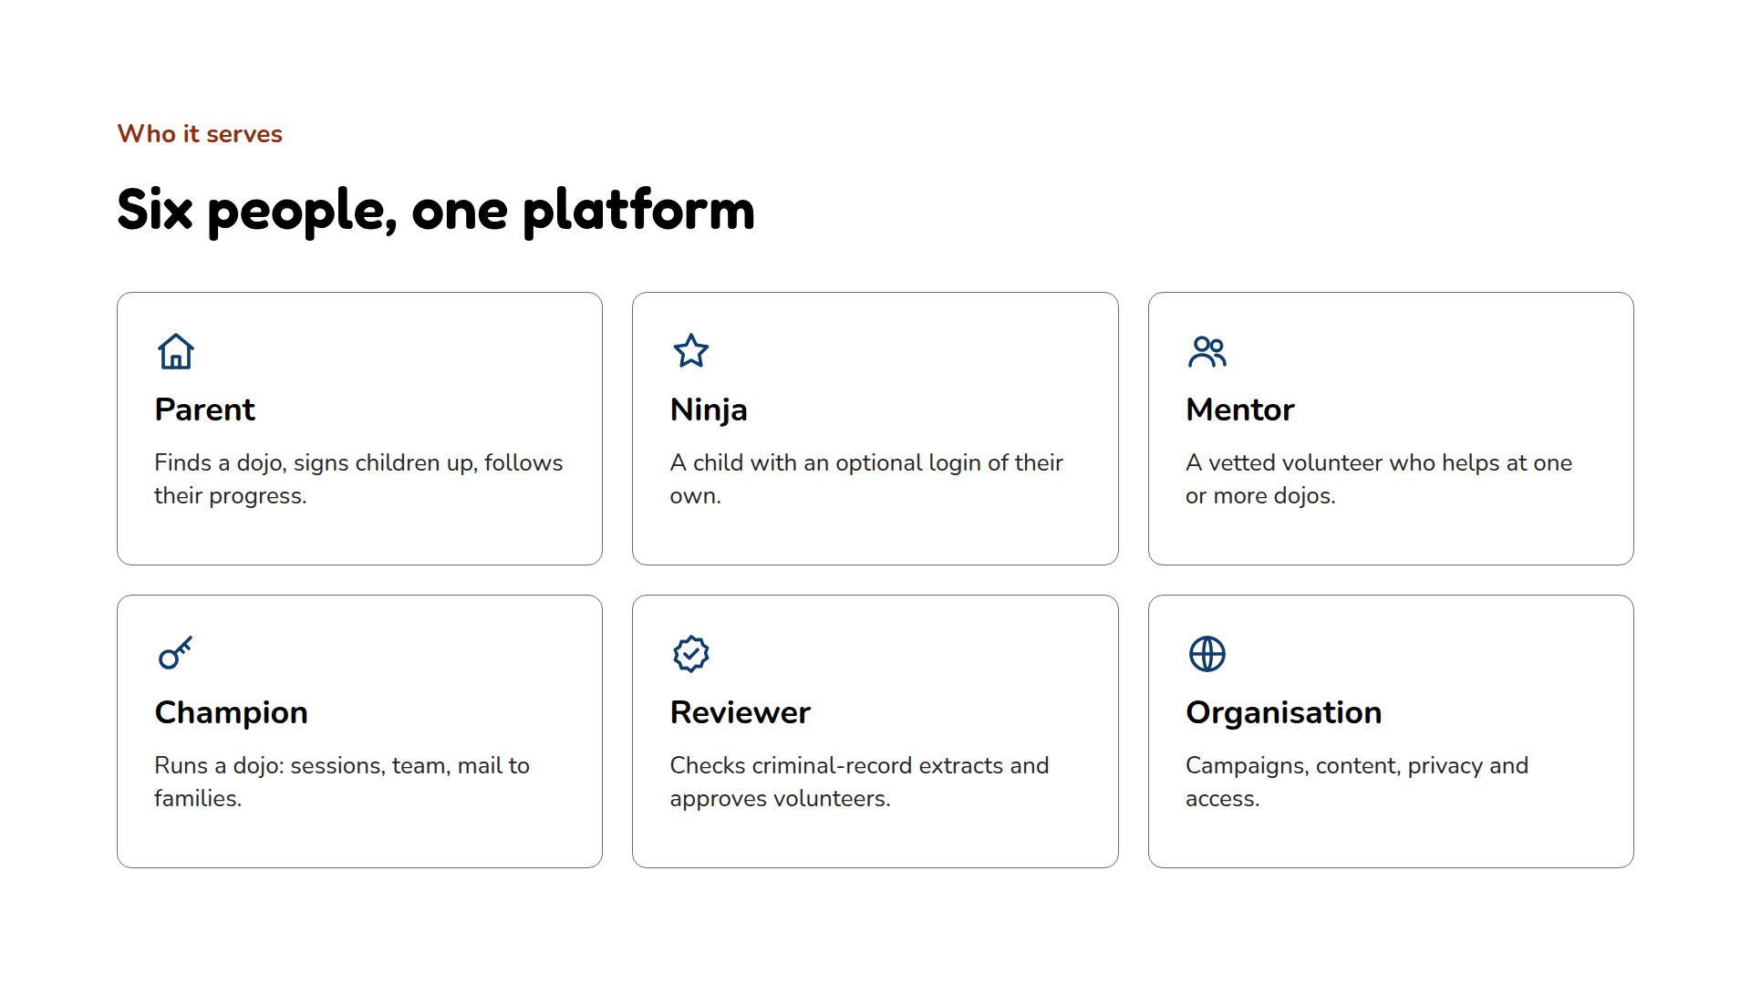
Notes:
The next slides follow each of them through the site, with real screenshots from the development site and its demo data.

Slide 4
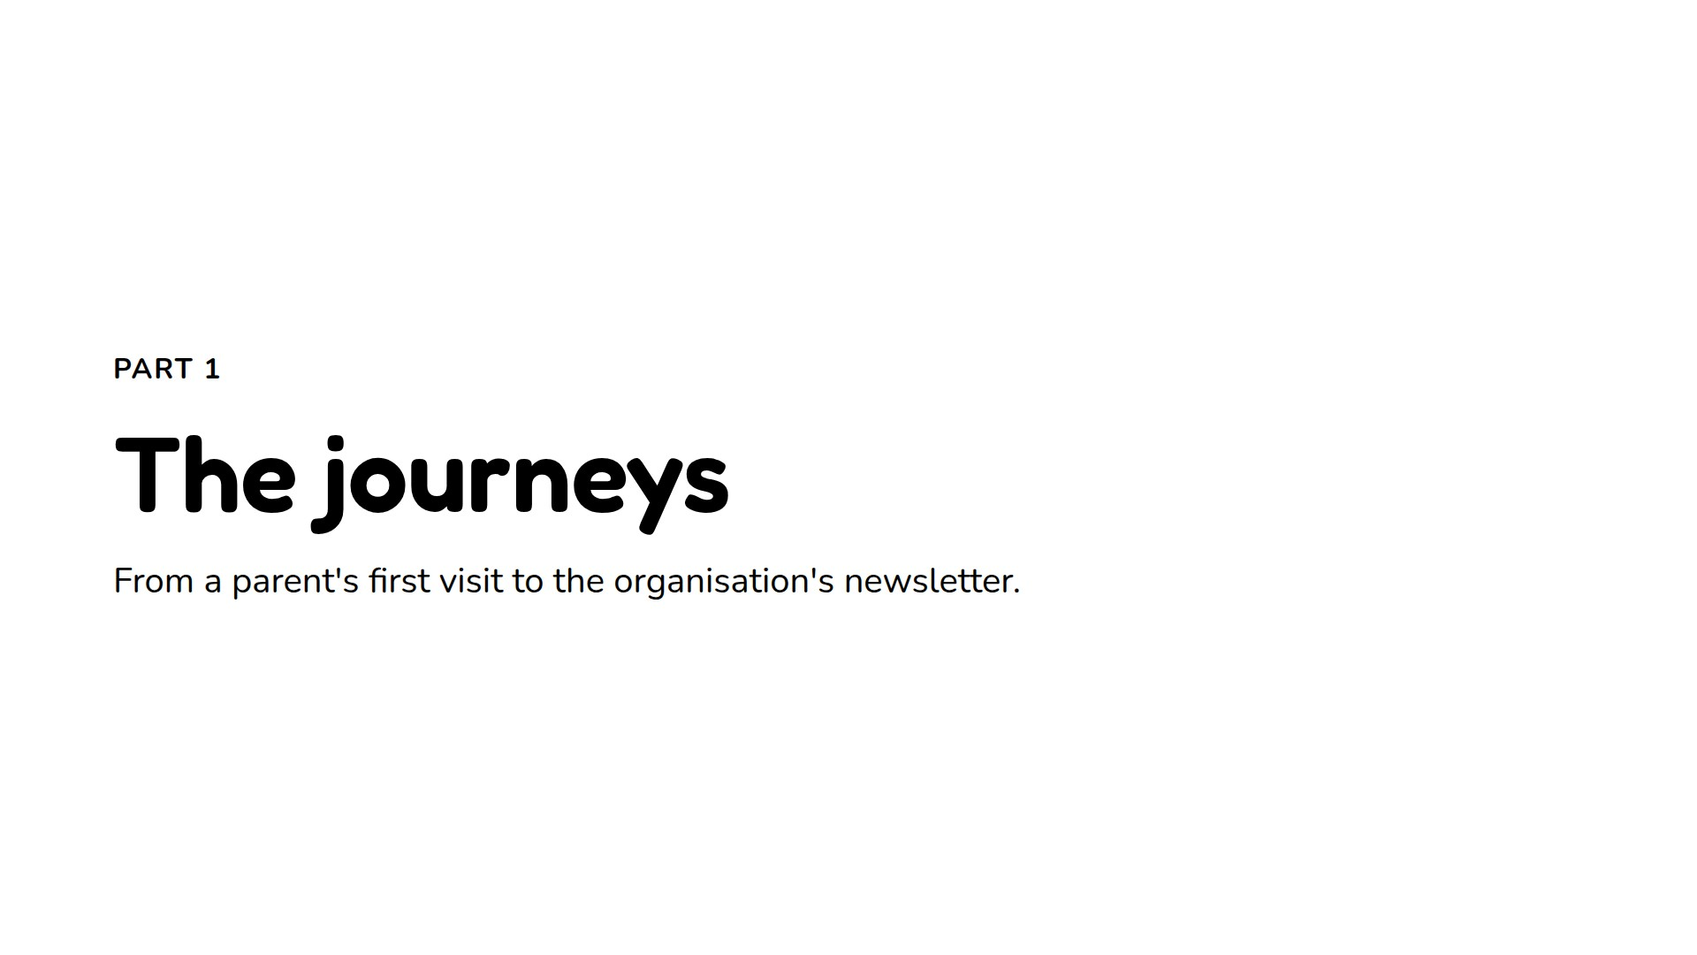
Notes:
Six journeys, each on one or two slides.

Slide 5
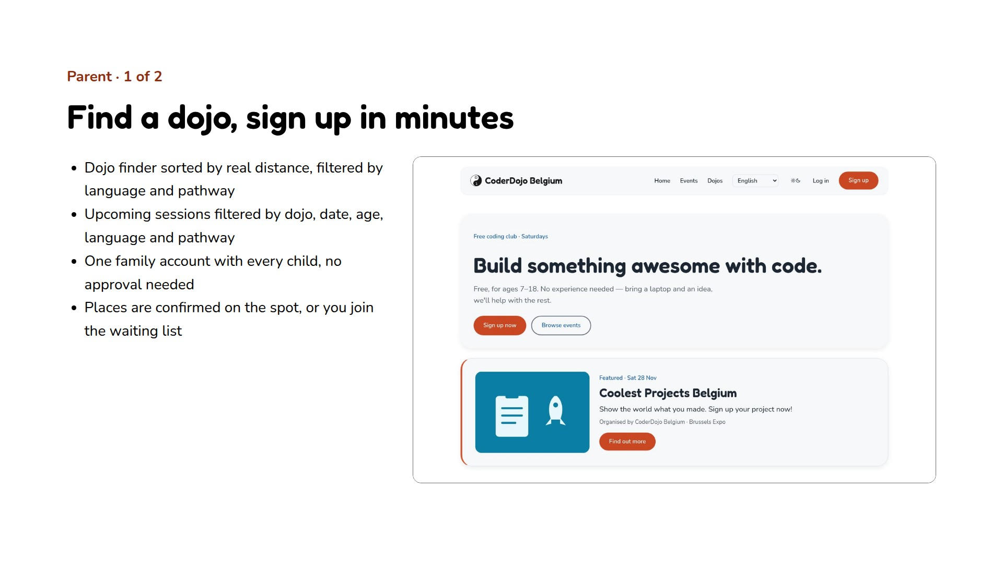
Notes:
No account is needed to look around. Signing up creates the parent's account and every child in one form.

Slide 6
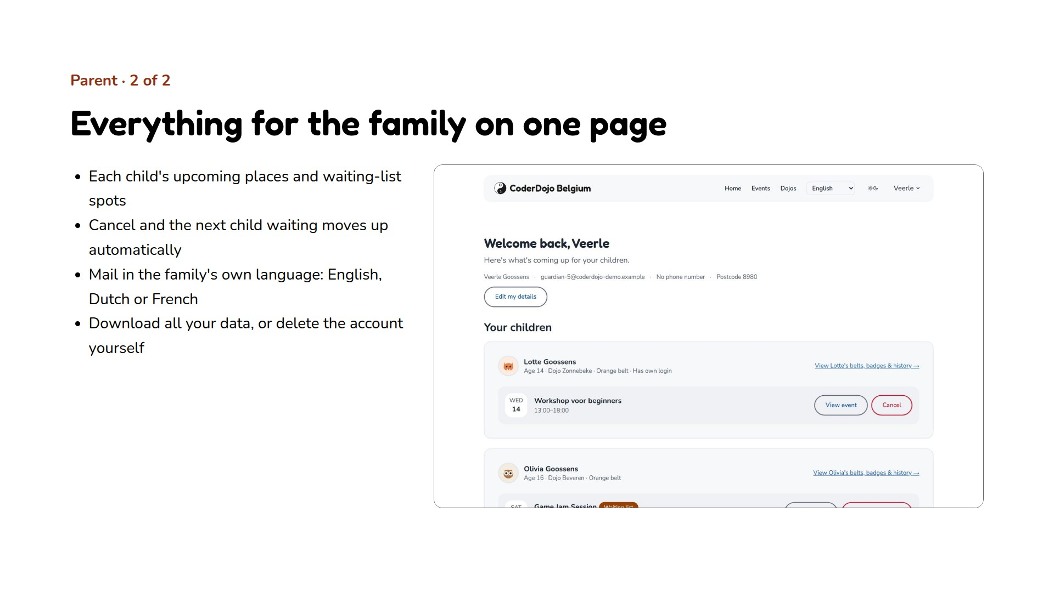
Notes:
The waiting list runs itself: when a place frees up, the first child waiting gets it and the family is mailed.

Slide 7
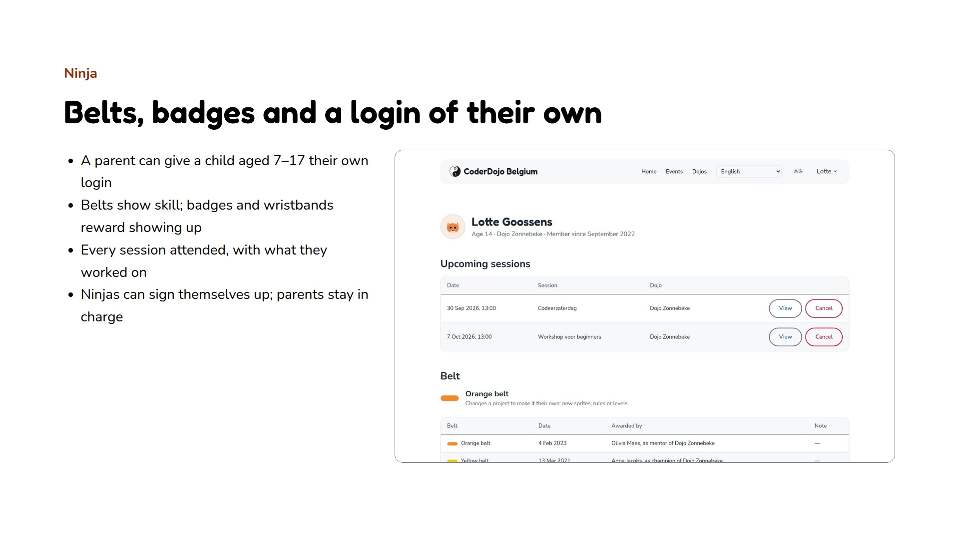
Notes:
A belt is a skill level awarded by the dojo team; badges reward attendance and achievements. Both are kept as history.

Slide 8
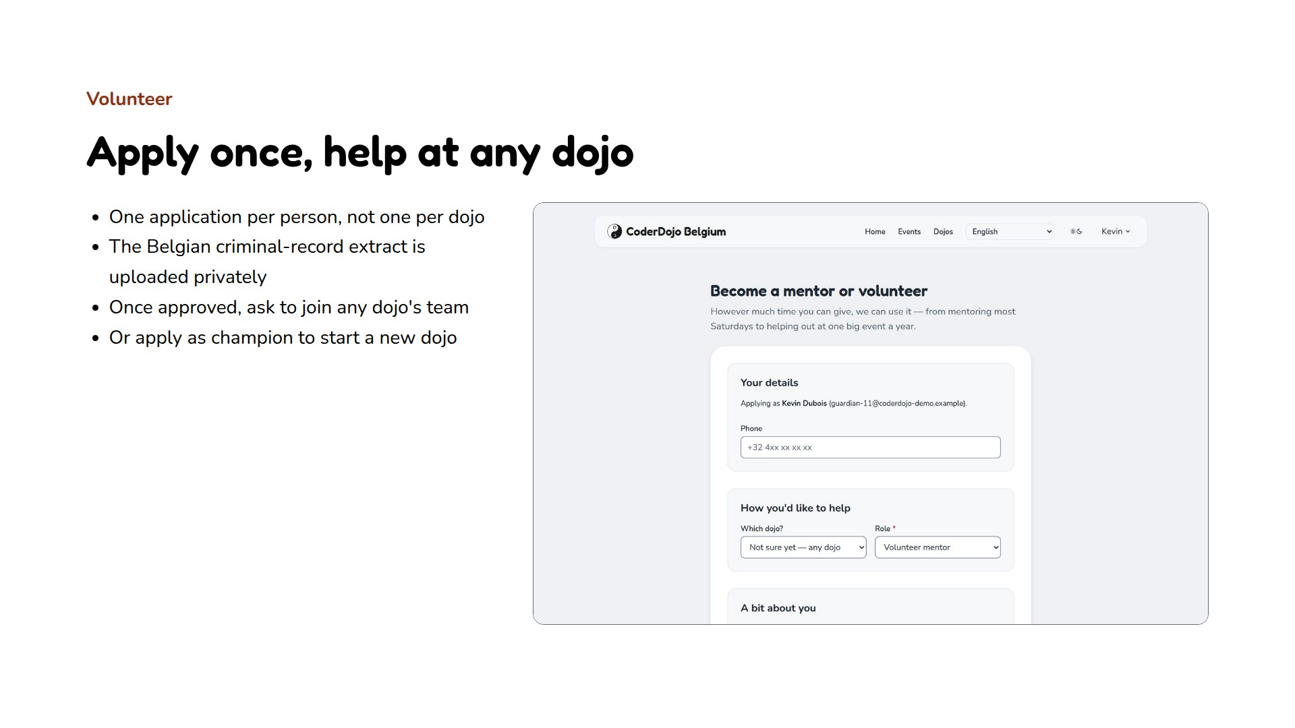
Notes:
The background check lives on the person's account and is valid for a year; a reminder goes out 30 days before it expires.

Slide 9
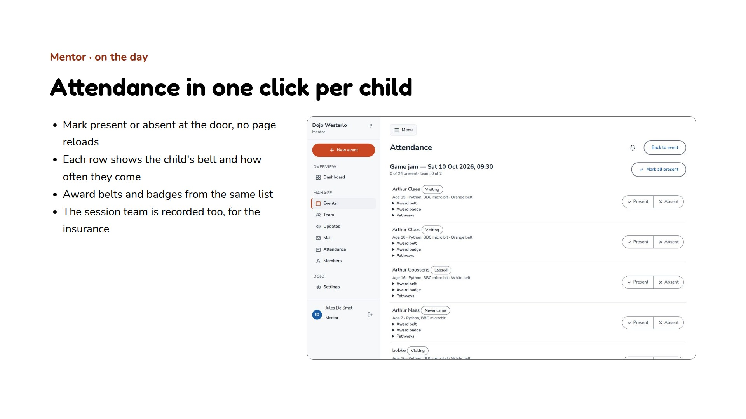
Notes:
Attendance also drives the milestone badges and the nightly engagement figures the organisation uses.

Slide 10
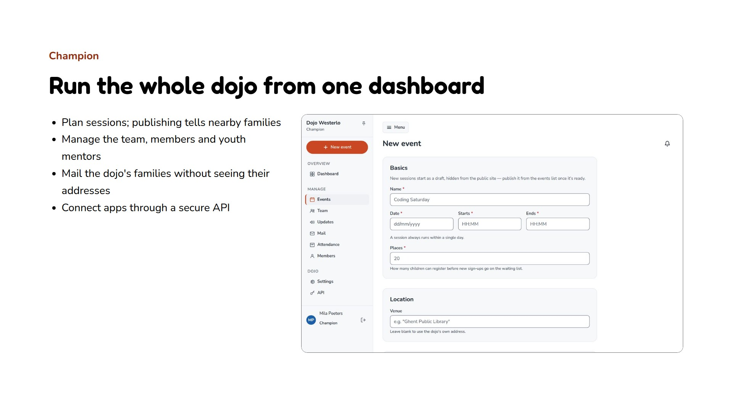
Notes:
Only the champion sees the children's health notes, and only for children with a confirmed place.

Slide 11
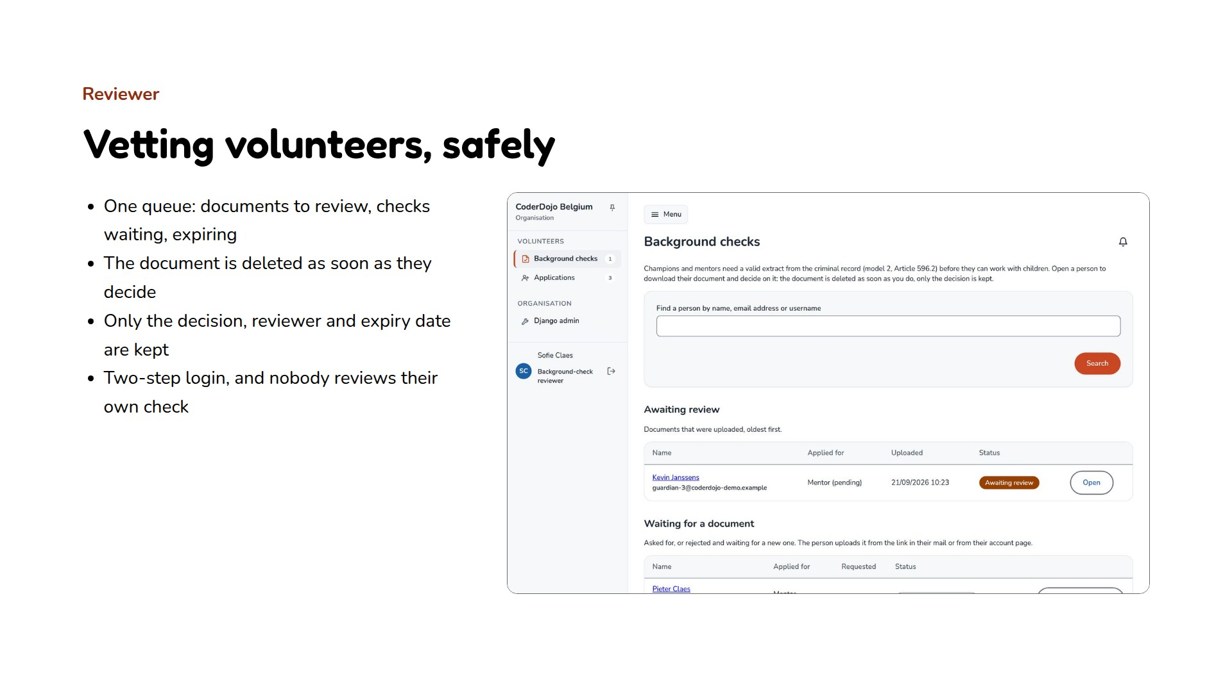
Notes:
A criminal-record extract is the most sensitive document the site handles, so it is kept for the shortest possible time.

Slide 12
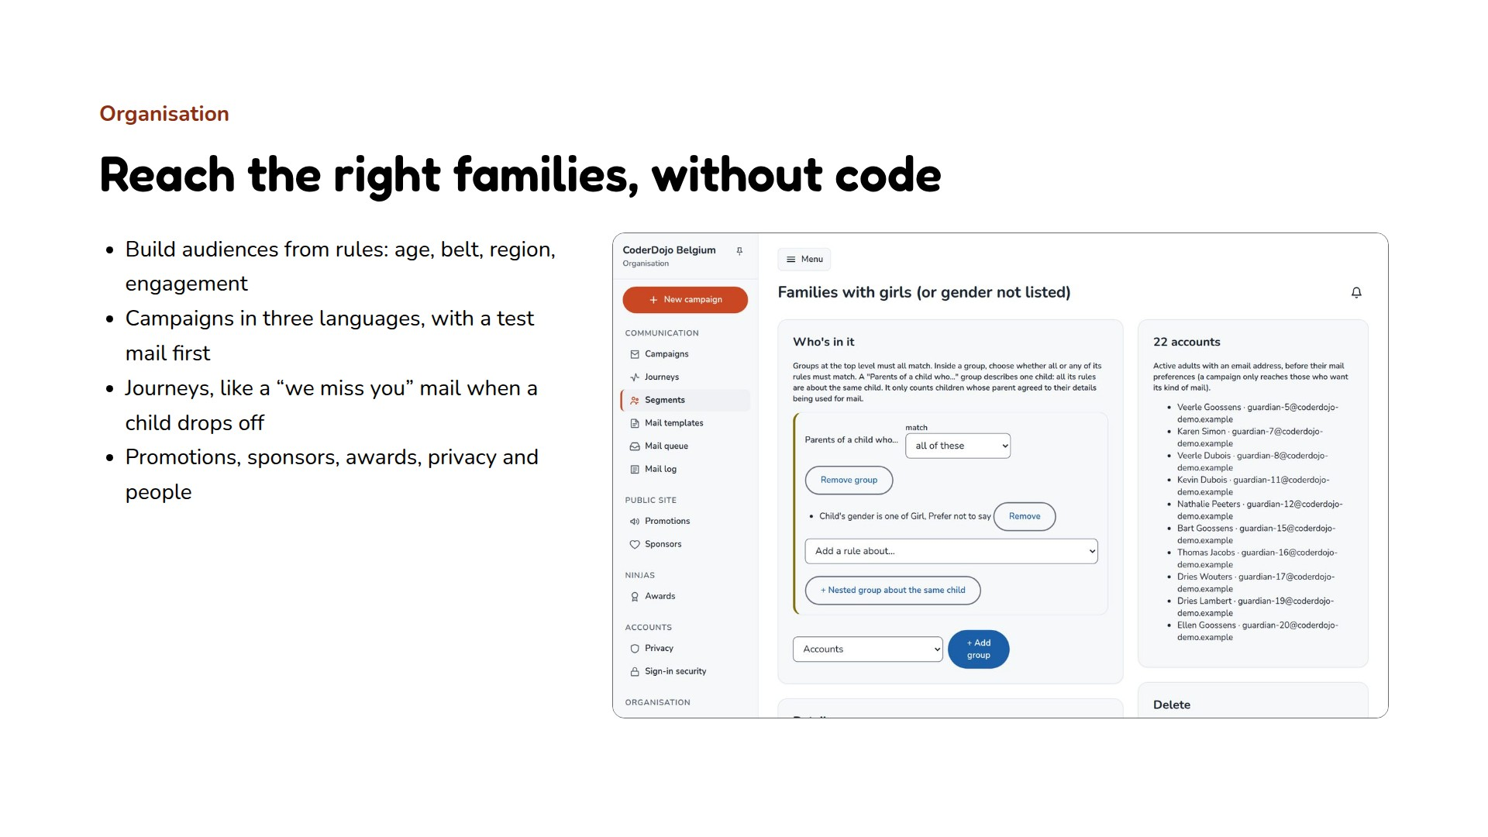
Notes:
Rules about children only reach parents who consented to their child's details being used for mail.

Slide 13
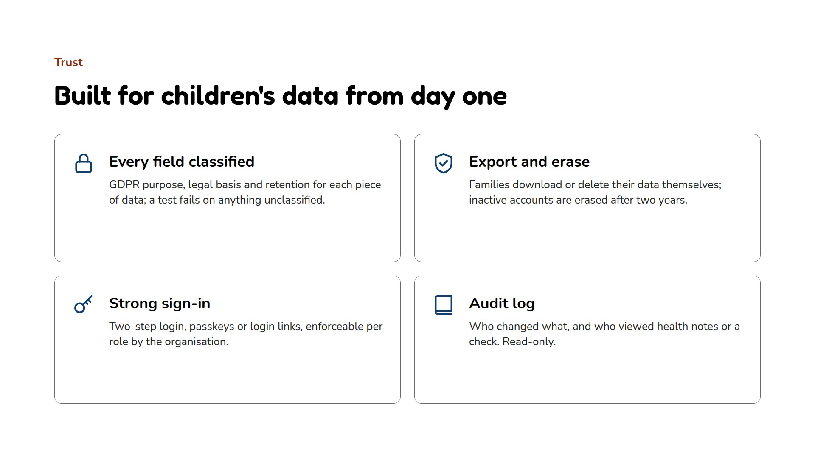
Notes:
Health notes are seen only by the dojo's champion, for children with a confirmed place, and every view is logged.

Slide 14
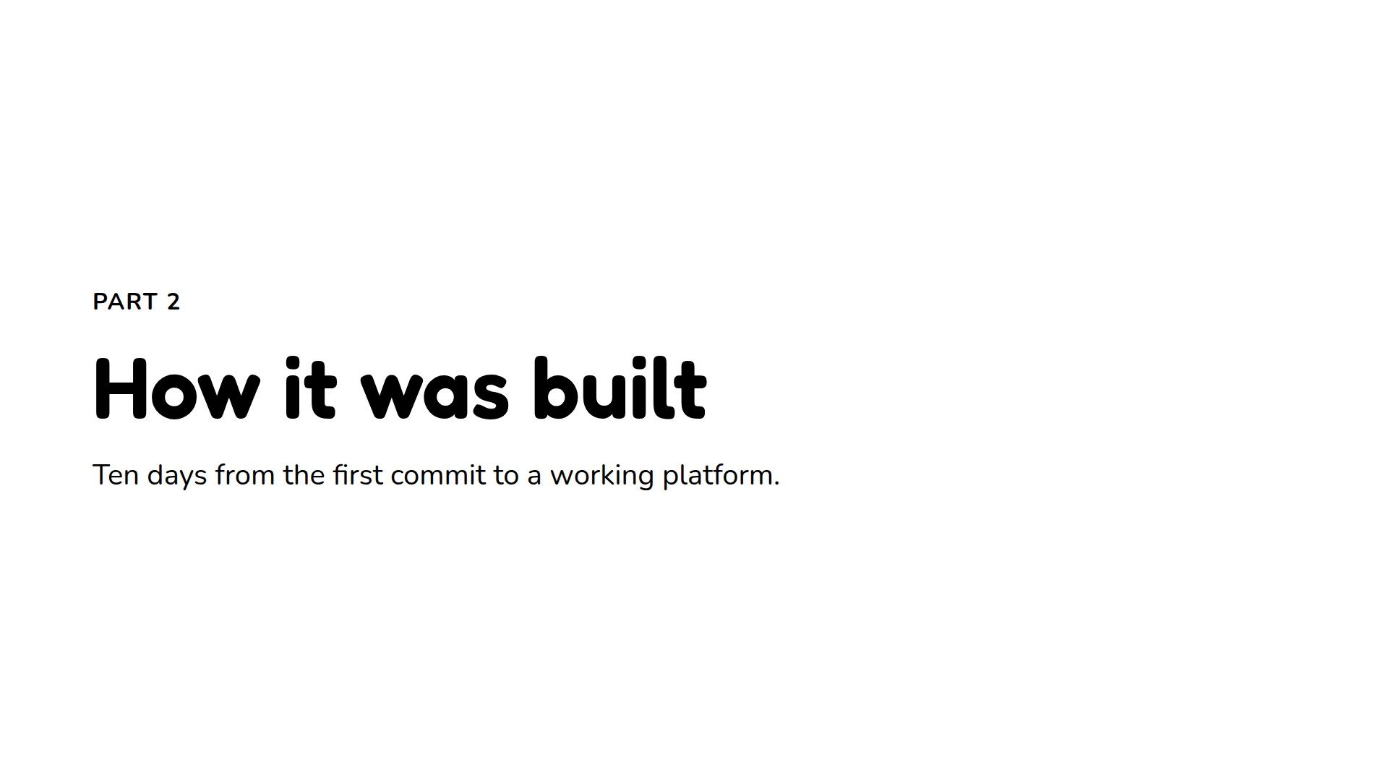
Notes:
The figures come straight from the repository on 5 October 2026. The first ten days built the platform; the days since went into security, capacity, code quality and monitoring.

Slide 15
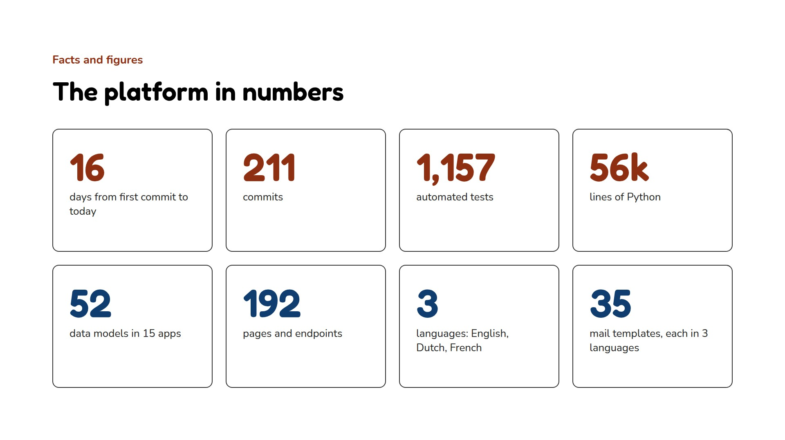
Notes:
Counted in the repository: 211 commits between 20 September and 5 October 2026, 1,157 test functions, about 56,000 lines of Python outside migrations, 52 models, 192 URL routes.

Slide 16
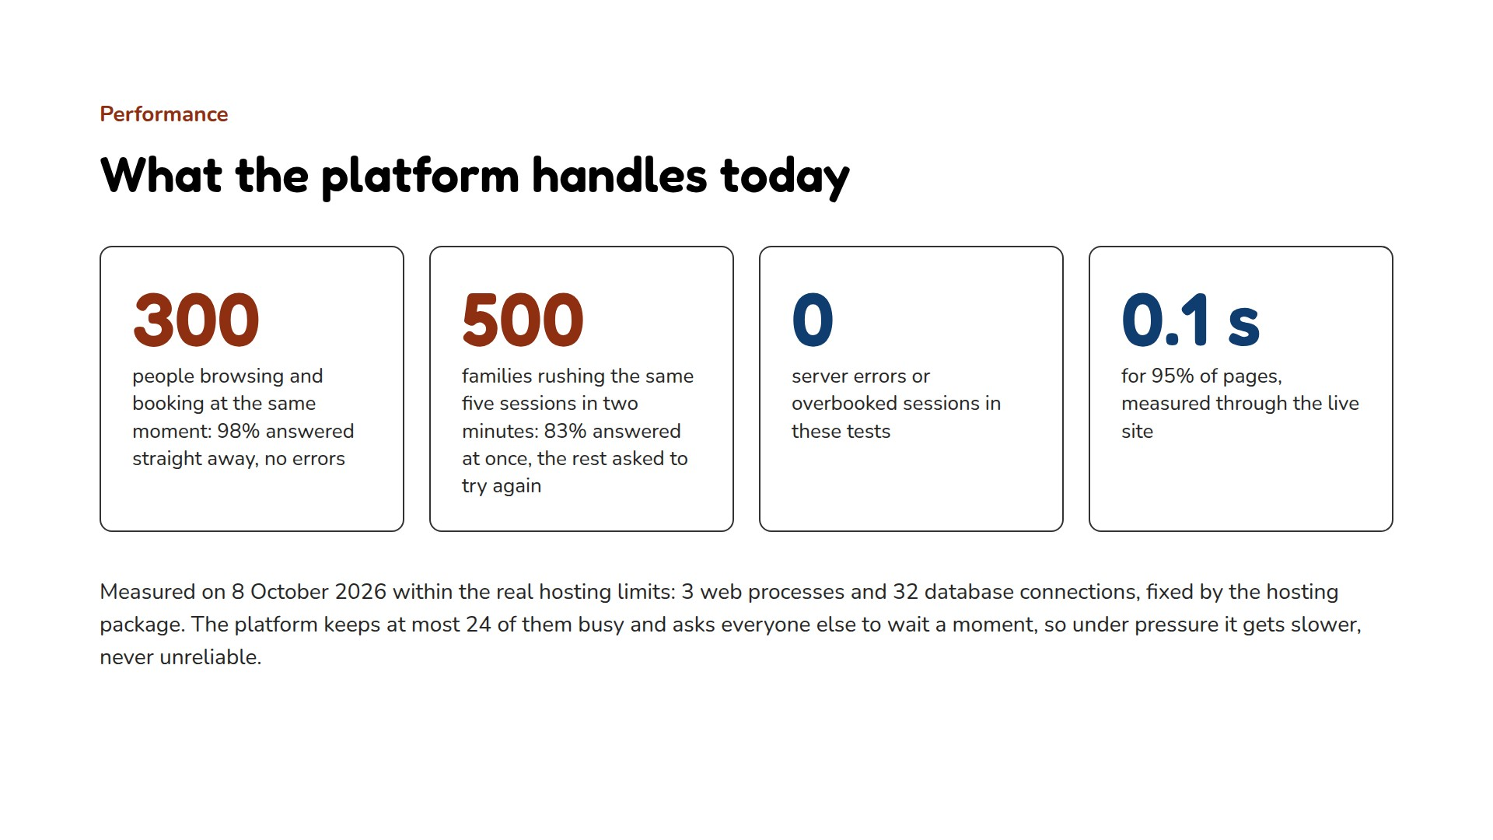
Notes:
Measured on 8 October 2026 on a copy of the site set up with production's exact limits (3 web workers, at most 8 requests each, 32 database connections), plus a test through the live demo domain. 300 users, each clicking every 2 to 8 seconds: 98.1% answered, 1.9% asked to retry, 95% of pages within 96 ms. Rush: 500 families on the same five sessions within two minutes: 83.4% of requests answered, 16.6% got the "try again in a moment" page, no server errors, no session overbooked (a lock on each session decides every booking in turn). Through the live domain: 95% of pages within 110 ms. The 32 connections are part of the hosting package and can't be raised, so more capacity comes from making each page lighter. Details in CAPACITY.md.

Slide 17
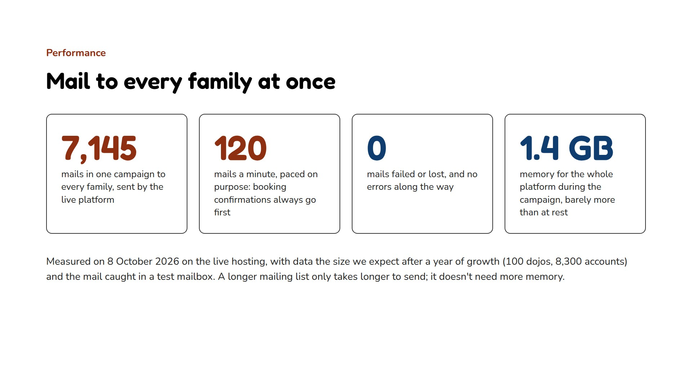
Notes:
Measured on 8 October 2026: the live demo was switched to a throwaway copy of the data at the size of one year of growth (100 dojos, 8,304 accounts), and one campaign went to every adult account, launched the way the organisation dashboard does it. All 7,145 mails were queued within about 4.5 minutes, in chunks of 200, and sent in one hour at a steady 120 a minute, with none failed. The mail went to a test mailbox, never to real people. The whole platform used 1,378 MB at rest and 1,425 MB at the most; the mail worker stayed at 147 MB, under its 160 MB limit. Sending is paced on purpose (7,200 mails an hour), and booking and account mail are picked first, so a family's confirmation still arrives within seconds while a campaign is going out. A bigger audience only takes longer: memory stays the same. Details in CAPACITY.md.

Slide 18
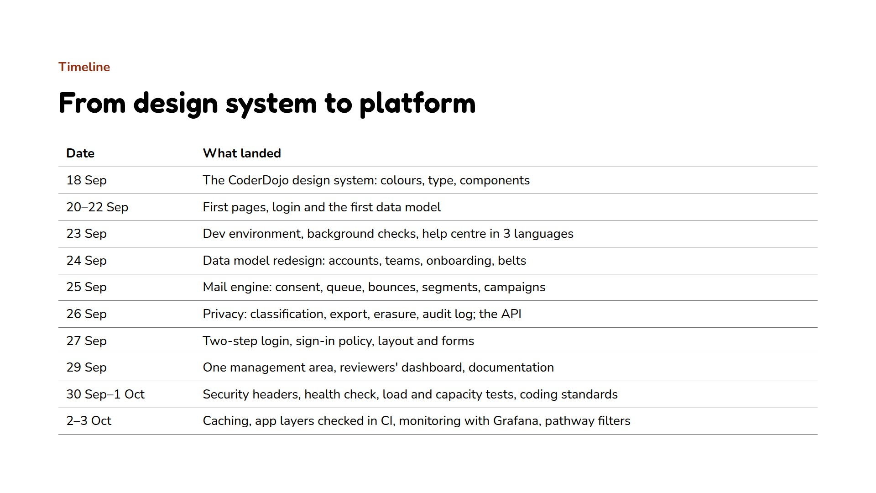
Notes:
Dates from the commit history. The design system came first and the site was built on it.

Slide 19
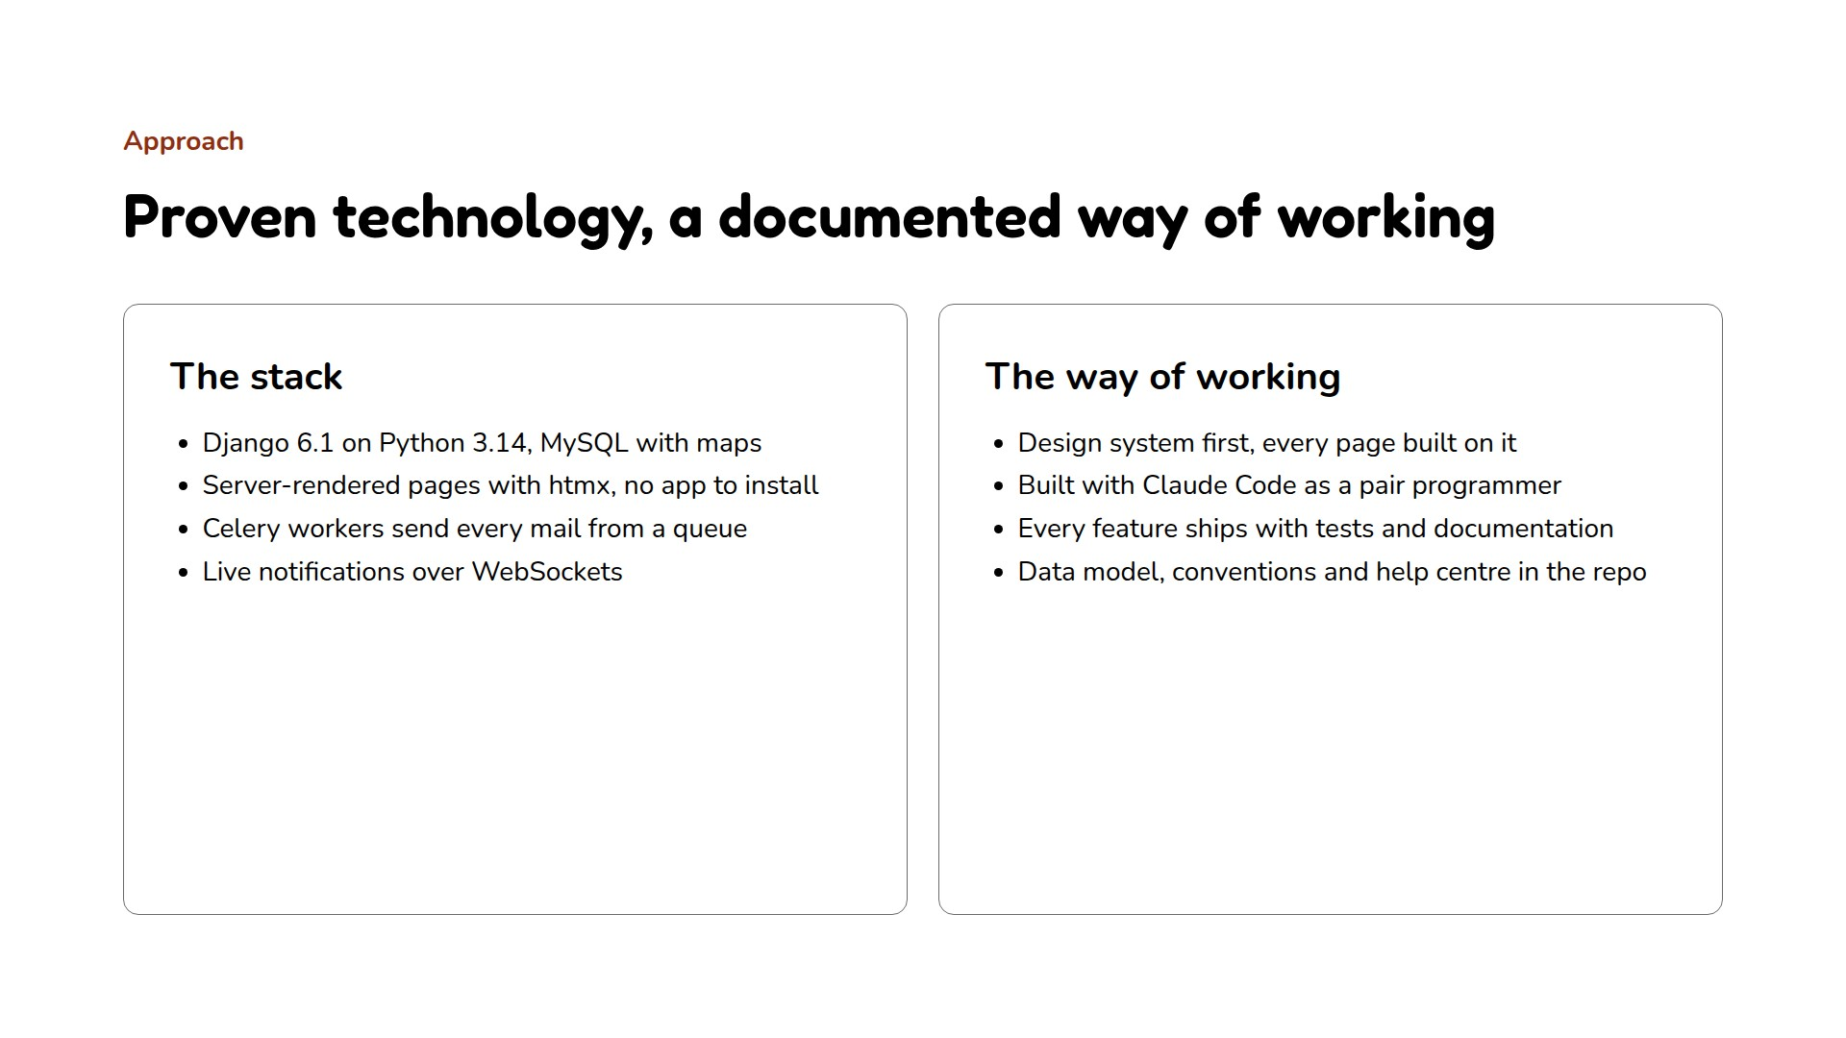
Notes:
DATA_MODEL.md explains the model and every design decision; CLAUDE.md the conventions; the help centre has 35 pages in three languages.

Slide 20
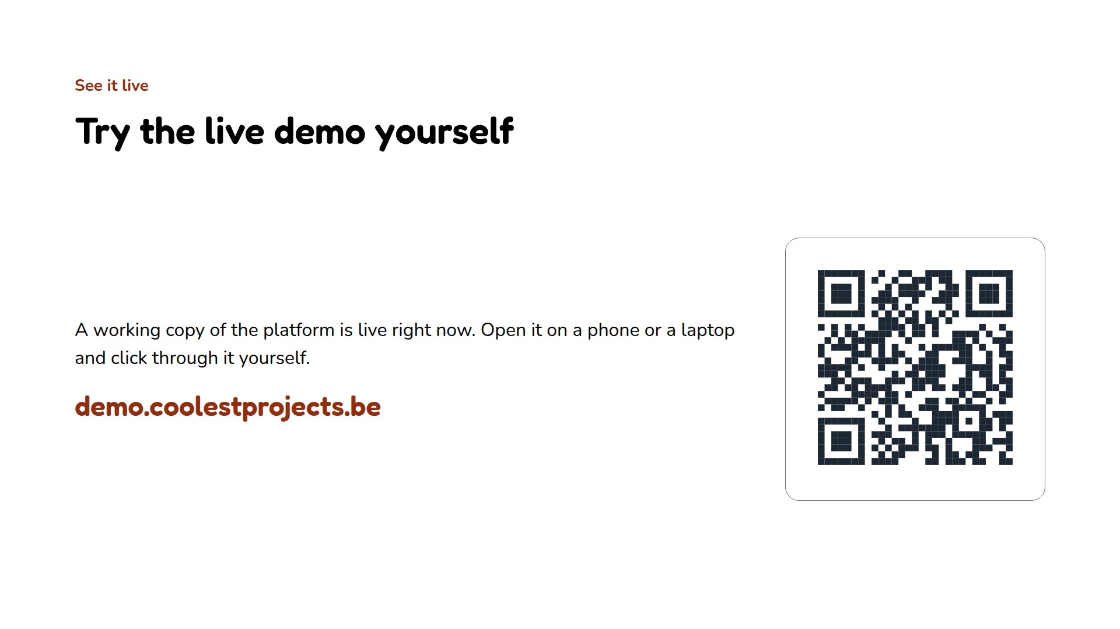
Notes:
Scan the code, or go to demo.coolestprojects.be, to walk through the live demo during or after this pitch.

Slide 21
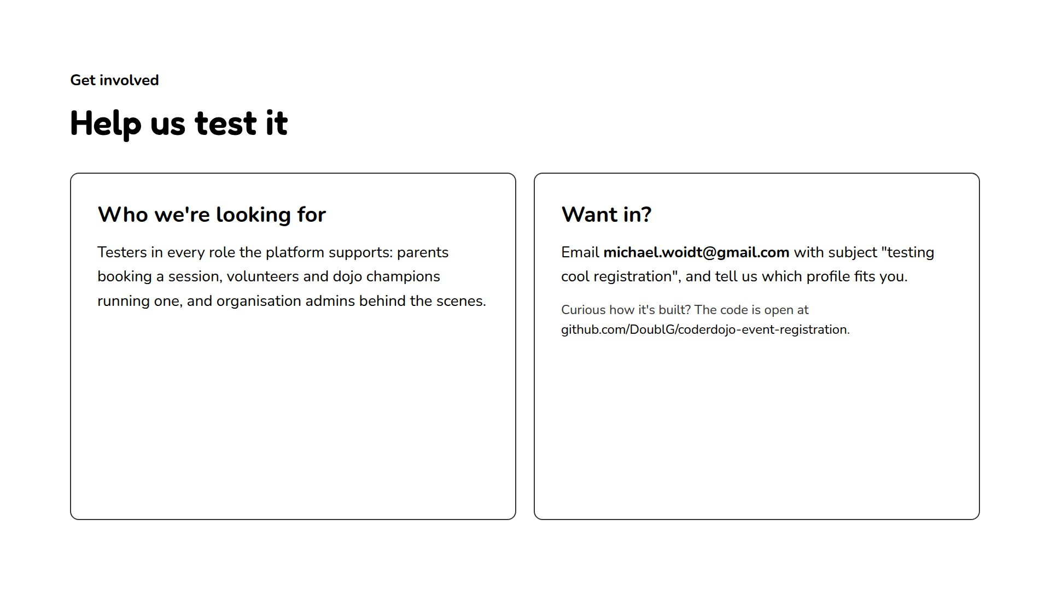
Notes:
Closing slide: the ask is to recruit testers by email, naming which profile fits them, and point anyone curious about the code to the GitHub repository.

