Slide 1


Chat - Hoc
Presented by:
Slava Ustinov
Ron Meiry

Slide 2
Introduction and motivation
Intro:
Our project is a p2p-chat based on the WiFi-direct component.
Our application allows chat between users within the WiFi’s transmission capabilities.
Motivation:
Allowing users to communicate with each other, even though there is no available communication infrastructure (WiFi Hotspot, 3G, etc.) - as often happens in crowded or isolated locations.

Slide 3
Project Goals and Objectives
Goal:
Allowing text message communication between users.
Secondary goals:
Allowing private communication between two users.
Allowing public (chat room) communication between two or more users.
A public chat room may or may not be password protected.

Slide 4
Modules
Communication
Activities
and Activity related
Welcome Socket Thread
New Connection Worker Thread
Send Single String Via Socket Threads
Preferences Activity - used for changing the settings
Chat Activity - shows a running chat
History Activity - shows the history of a chat
Activities
Main Screen Activity - contains the search and history fragments
Files
Chat History Frag
Fragments
Chat Search Frag
File Handling Thread - read/write from/to files
Service MSG Receiver - receiver for all broadcasts coming from the service
WiFi-Direct Broadcast Receiver – listens to peers and connection-state updates
Related: B-Cast Receivers
Additional
Classes
Local Service – manages all chat-room related data structures and handles all socket communication
Related: service
Constants – final static class containing all needed constants and static functions.

Slide 5
Algorithms
Peer Discovery (Physical and logical)
Getting a peer list from the WiFi Direct - Provided by WiFi Direct
Connection to a WiFi group - Provided by WiFi Direct
Each device maintains a list of available peers - Logical peer list. We manage this procedure
Each device sends a discovery request and waits for the peer’s discovery reply
.
Discovery request \ reply message:
MSG Opcode (request\reply)
Self name
(chosen by user)
Self unique
(device’s unique number )
Details
(of all hosted chat rooms)
Message Forwarding
Chat room client (of a public chat room or a private chat) forwards his messages and only his.
Chat room host forwards all the chat-related messages he receives.
His own messages are sent to all the room’s participants.
A messages that comes from a participating peer is forwarded to the rest
of the participants.

Slide 6
Communication Protocol - Model
We’re using a P2P communication with no server. Therefore each device in our network acts both as suppliers and consumers of resources.
Supplier - On each device there is an open welcome socket that accepts messages and offloads them to a worker thread.
Consumer - Each device is also a client that aspires to have a full view of the dynamic network and to allow text message communication with his peers.

Slide 7
Communication Protocol – Mapping the Peer Network
WiFi Direct works in a star topology method. One peer is chosen to be the group owner. When connecting to an existing WiFi group, a peer can only obtain the IP address of the group’s owner and notify the owner of it’s presence.
The application requires a full-mesh topology. Therefore in our application, the owner of the group - who is the only peer known by all others, advertises a message containing information about all the other peers.
When two peers belong to the same group and have each other’s IP addresses , communication can be established - we have a full mesh!
This is how a single peer details broadcast message looks like:
Peer Details Broadcast Advertising Message
MSG Opcode
(Peer Details type)
IP
(for each known user)
unique
(device’s unique number)
name
(user's choice )

Slide 8
Communication Protocol -
Chat Room Maintenance
Our chat-related messages can be divided into 3 categories:
Chat room advertising
Chat room management
Chat messages

Slide 9
Challenges
Creating a fully operational P2P network using Wi-Fi Direct that is able to support any amount of peers.
Building a communication protocol that’ll support all of our desired features, with a thought towards future enhancement.
Creating a friendly and direct user experience.

Slide 10
Achievements
We’ve been able to connect up to 4 mobile devices to a single group while providing reliable communication and proper functionality.
Fast communication between peers.
A flexible protocol that can easily support new message types.

Slide 11
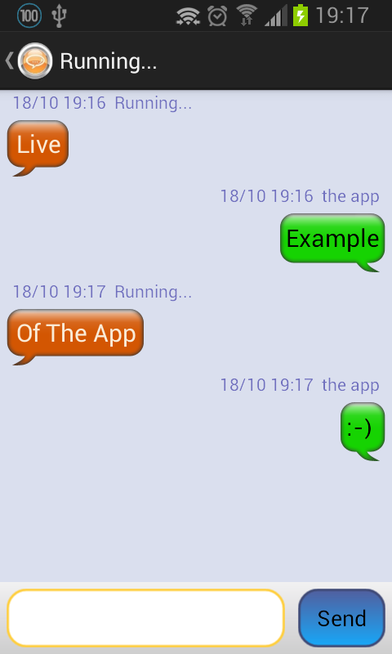
Live example

