Slide 1
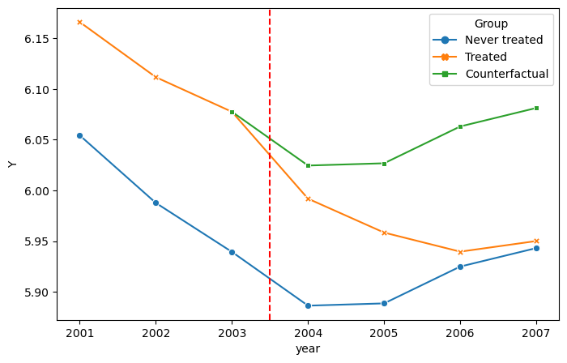

Slide 2
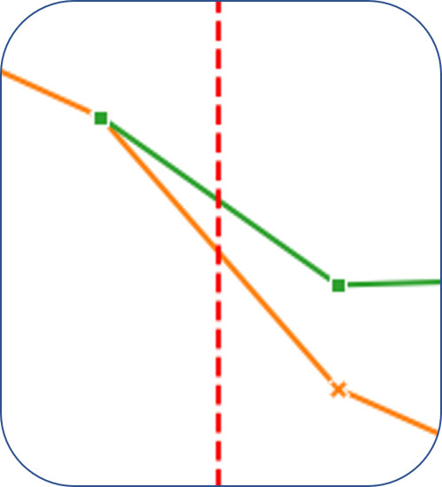



$$E[Y_{i0}(0)|D_{i}=1]$$
$$E[Y_{i1}(0)|D_{i}=1]$$
ATTE
$$E[Y_{i1}(1)|D_{i}=1]$$

Slide 3
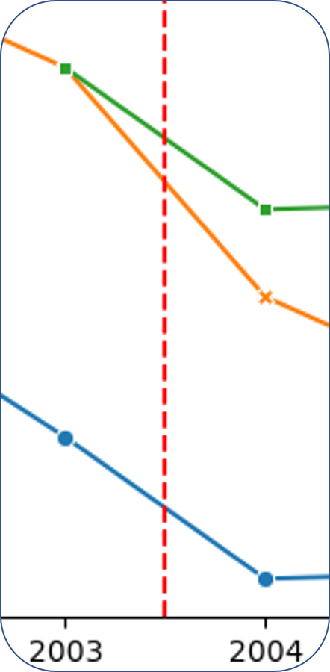





$$E[Y_{i1}(0)|D_{i}=1]$$
$$E[Y_{i0}(0)|D_{i}=1]$$
ATTE
$$E[Y_{i0}\left(0\right)|D_{i}=0]$$
$$E[Y_{i1}(1)|D_{i}=1]$$
$$E[Y_{i1}\left(0\right)|D_{i}=0]$$

Slide 4
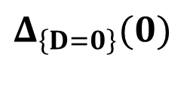
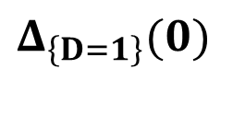
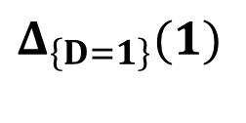
$$E[Y_{i1}(0)|D_{i}=1]$$
$$Δ_{\left\{D=1\right\}}(0)$$
$$E[Y_{i0}(0)|D_{i}=1]$$
$$Δ_{\left\{D=1\right\}}(1)$$
ATTE
ATTE
$$E[Y_{i0}\left(0\right)|D_{i}=0]$$
$$E[Y_{i1}(1)|D_{i}=1]$$
$$E[Y_{i1}\left(0\right)|D_{i}=0]$$
$$Δ_{\left\{D=0\right\}}(0)$$

Slide 6
