Slide 1
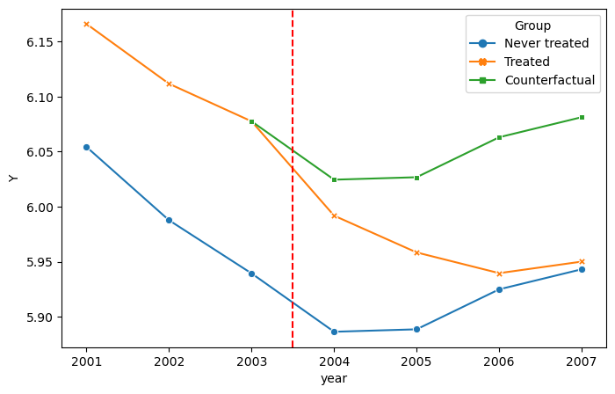

Slide 2
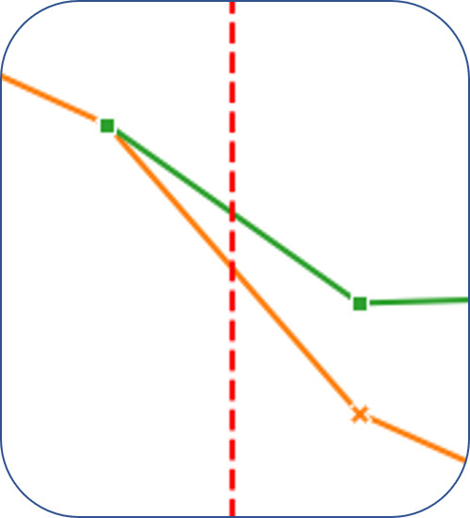



$$E[Y_{0}(0)|D=1]$$
$$E[Y_{1}(0)|D=1]$$
ATTE
$$E[Y_{1}(1)|D=1]$$

Slide 3
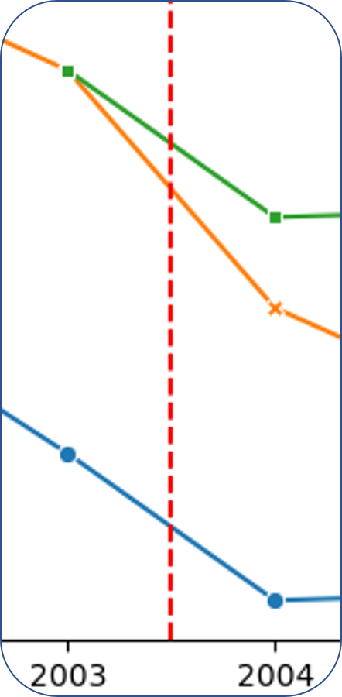





$$E[Y_{1}(0)|D=1]$$
$$E[Y_{0}(0)|D=1]$$
ATTE
$$E[Y_{0}\left(0\right)|D=0]$$
$$E[Y_{1}(1)|D=1]$$
$$E[Y_{1}\left(0\right)|D=0]$$

Slide 4
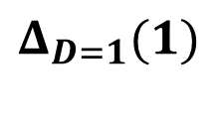




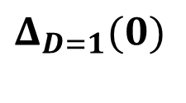


$$E[Y_{1}(0)|D=1]$$
$$Δ_{D=1}(0)$$
$$E[Y_{0}(0)|D=1]$$
$$Δ_{D=1}(1)$$
ATTE
ATTE
$$E[Y_{0}\left(0\right)|D=0]$$
$$E[Y_{1}(1)|D=1]$$
$$E[Y_{1}\left(0\right)|D=0]$$
$$Δ_{D=1}(0)$$

Slide 6
