Slide 1
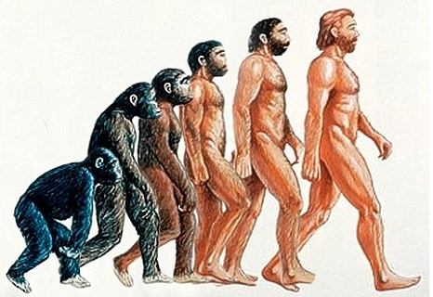
Data Mining:
Genetic Algorithms (遗传算法)
- a global search algorithm

Slide 2
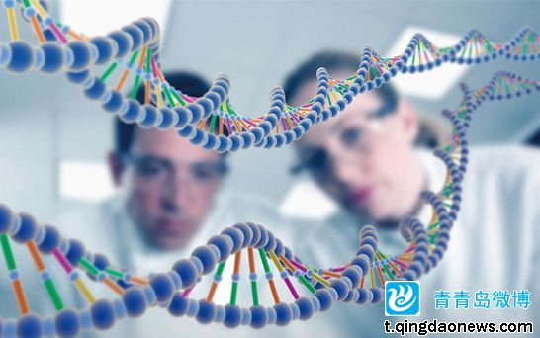
In the last class, we have talked about the neurons in our brains –> Neural Networks (NN)
In this class, we will talk about the biological evolution (进化) and inheritance (遗传) –> Genetic Algorithms (GA)
Interesting topics!

Slide 3
The partial materials of this part are from
Genetic Algorithms: A Tutorial by
Wendy Williams
Revised by Jared

Slide 4
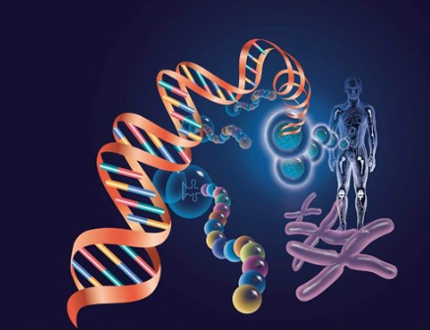
Main Outline
  Biological Evolution and Inheritance
    Natural Selection（自然选择）
    Genetic Inheritance（基因遗传）
  Genetic Algorithms(GA)
    Introduction and Main Concepts
    Considered Issues in GA
      Basic Principles
      Selection
      Crossover
      Mutation
      Reproduction
    Applications

Slide 5
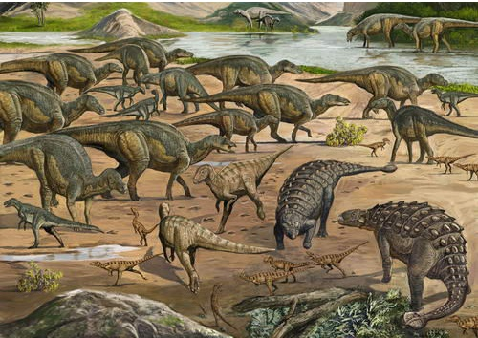
Biological Evolution and
Inheritance (生物进化与遗传)

Slide 6
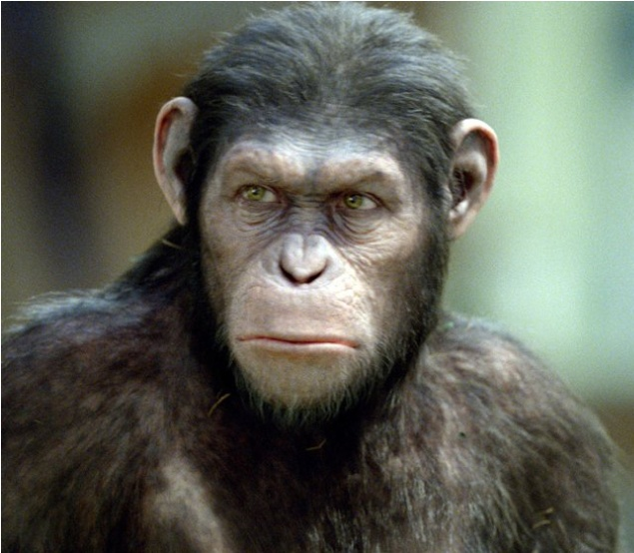
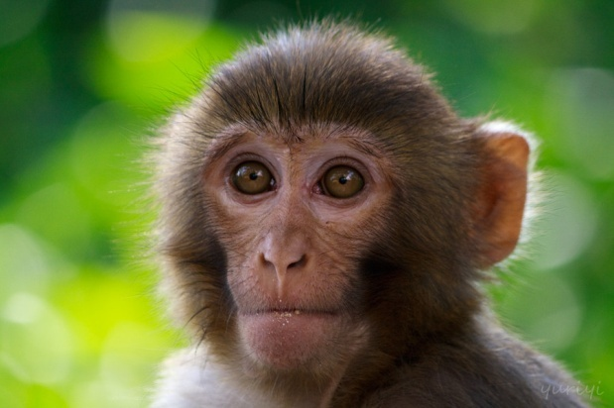
Biological Evolution and
Inheritance (生物进化与遗传)
So, what do we human beings come from?
Monkey？
Ape？
Or, others?

Slide 7
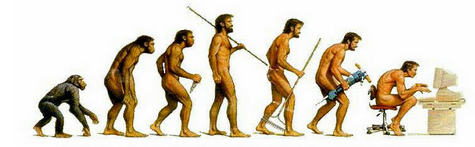
Evolution (进化)
达尔文的进化论
  生物种群从低级、简单的类型逐渐发展成为高级、复杂的类型
  这种现象被称之为“自然选择，适者生存”

Slide 8
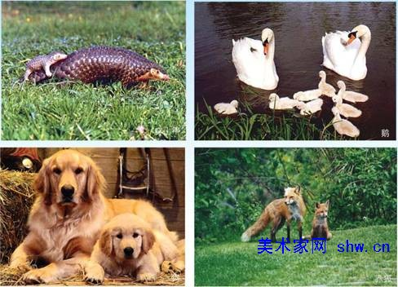
Inheritance (遗传)

Slide 9
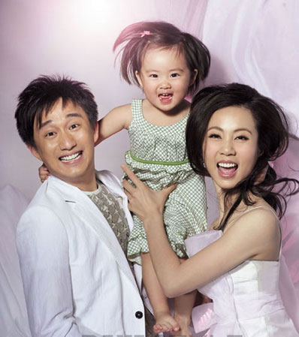
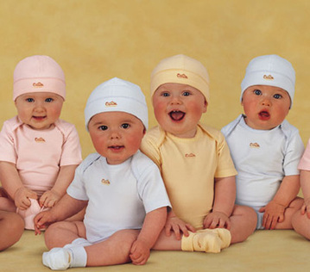
Inheritance (遗传) - human being
These two pictures are all from the public baidu web!

Slide 10
Main Outline
  Biological Evolution and Inheritance
    Natural Selection（自然选择）
    Genetic Inheritance（基因遗传）
  Genetic Algorithms(GA)
    Introduction and Main Concepts
    Considered Issues in GA
      Basic Principles
      Selection
      Crossover
      Mutation
      Reproduction
    Applications

Slide 11
Genetic Algorithms (GA) OVERVIEW
A class of probabilistic optimization algorithms
Inspired by the natural biological evolution （自然的生物进化） process
Uses concepts of “Natural Selection（自然选择）” and “Genetic Inheritance（基因遗传）” (Darwin 1859)
Originally developed by John Holland (1975)
  To understand the adaptive processes of natural systems
  To design artificial systems software that retains the robustness of natural systems

Slide 12
Genetic Algorithms (GA) OVERVIEW
Provide efficient, effective techniques for optimization and machine learning applications
Widely-used today in business, scientific and engineering circles

Slide 13
Genetic Algorithms:相关概念
基因
基因（Gene）是遗传的基本单位，是个体的基本组成单元。
例如，单身基因（2014年科学发现）
个体
在生物学中，个体（Individual）由多个基因组成。遗传算法中，个体代表待优化问题的一个解。
编码与解码
将问题的解转换成基因序列的过程称为编码(Encoding)，编码是由解空间到遗传算法空间的映射。反之，将基因型转换成问题的解的过程称为解码（Decoding)。
遗传算法中，首先需要将问题的解编码成基因序列，在需要确定个体优劣时，再将其解码到解空间进行评估。

Slide 14
Genetic Algorithms:相关概念
种群
生物的遗传进化不能仅通过自身进行，而需要在一个群体中进行，这一群体称为种群(Population)。种群中的单个组成元素是个体。种群规模是遗传算法的参数之一，种群规模的设置可能会影响到遗传算法的优化效果。
适应度
在研究自然界中生物的遗传与进化现象时，生物学中使用适应度(Fitness)这个术语来衡量某个物种对于生存环境的适应程度。
代
在生物的繁衍过程中，个体从出生到死亡即为一代(Generation)，在遗传算法中，代的意思为遗传算法的迭代次数。可作为遗传算法的一个结束标志。

Slide 15
Genetic Algorithms:相关概念
遗传算子
遗传算子(Genetic Operators)指作用在个体上的各种遗传操作。主要包括三种基本的遗传算子：选择算子、交叉算子和变异算子。
  选择(Selection)算子：在适应度的基础上，按照某种规则或方法从当前代的种群中选择出一些适应度高的个体遗传到下一代种群中。
  交叉(Crossover)算子：以某一概率（交叉概率）选择种群中的个体，把两个父个体的部分基因加以替换、重组而生成新的个体。
  变异(Mutation)算子：以某一概率（变异概率）选择种群中的个体，改变其个体中某些基因的值或对其个体进行某种方式的重组。

Slide 16
Comparison between Nature and GA
Genetic Algorithm | Nature
Optimization problem | Environment
Feasible solutions | Individuals living in that environment
Solutions quality (fitness function 适应函数) | Individual’s degree of adaptation to its surrounding environment

Slide 17
Comparison between Nature and GA (cont)
Genetic Algorithm | Nature
A set of feasible solutions | A population of organisms (species)
Stochastic operators （算子） | Selection, recombination and mutation in nature’s evolutionary process
Iteratively applying a set of stochastic operators on a set of feasible solutions | Evolution of populations to suit their environment

Slide 18
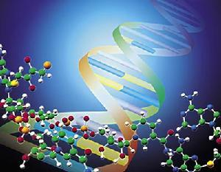
Genetic Algorithm: Introduction
Population of individuals
  Individual is feasible solution to problem
Each individual is characterized by a Fitness function
  Higher fitness is better solution
Based on their fitness, parents are selected to reproduce offspring for a new generation
  Fitter individuals have more chance to reproduce
  New generation has the same size as old generation; old generation dies
Offspring (后代) has combination of
the properties of two parents
If well designed, population will
converge to the optimal solution

Slide 19
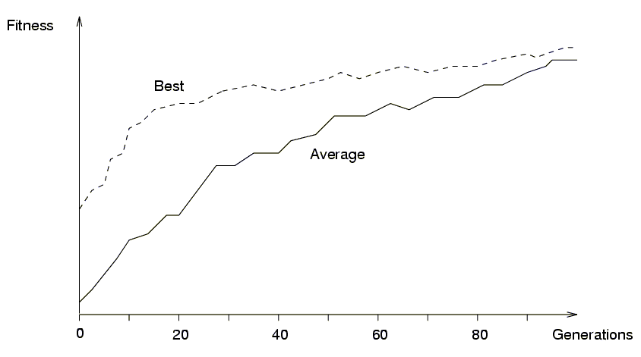
Example of convergence

Slide 20

Components of a GA
A problem to solve, and ...
Encoding 编码 technique (gene, chromosome)
Initialization procedure (creation)
Evaluation function (environment)
Selection of parents (reproduction)
Genetic operators (mutation, recombination)
Parameter settings (practice and art)

Slide 21
Main Outline
  Biological Evolution and Inheritance
    Natural Selection（自然选择）
    Genetic Inheritance（基因遗传）
  Genetic Algorithms(GA)
    Introduction and Main Concepts
    Considered Issues in GA
      Basic Principles
      Selection
      Crossover
      Mutation
      Reproduction
    Applications

Slide 22
Important Issues in GA
Basic implementation issues:
  Coding or Representation
  Reproduction operators: crossover, mutation
  Fitness function
  Population size, crossover rate, mutation rate, ...
  Selection, deletion policies
Termination (Stopping) Criterion
Performance and Scalability
Solution is only as good as the evaluation function (often the hardest part)

Slide 23
The GA Cycle of Reproduction
children
reproduction
modification
modified
children
parents
population
evaluation
evaluated children
deleted
members
discard

Slide 24
Population
Chromosomes (染色体) could be:
  Bit strings (0101 ... 1100)
  Real numbers (43.2 -33.1 ... 0.0 89.2)
  Permutations of element (E11 E3 E7 ... E1 E15)
  Lists of rules (R1 R2 R3 ... R22 R23)
  Program elements (genetic programming)
  ... any data structure ...
population

Slide 25
Reproduction
children
reproduction
parents
population
Parents are selected at random with selection chances biased in relation to chromosome evaluations.

Slide 26
Chromosome Modification
Modifications are stochastically triggered (随机触发)
Operator types are:
  Mutation
  Crossover (recombination)
children
modification
modified children

Slide 27
Evaluation
The evaluator decodes a chromosome and assigns it a fitness measure
The evaluator is the only link between a classical GA and the problem it is solving
modified
children
evaluated
children
evaluation

Slide 28
Deletion
Generational GA:
entire populations are replaced at each iteration
Steady-state GA:
a few members are replaced for each generation
population
discarded or deleted members
discard

Slide 29
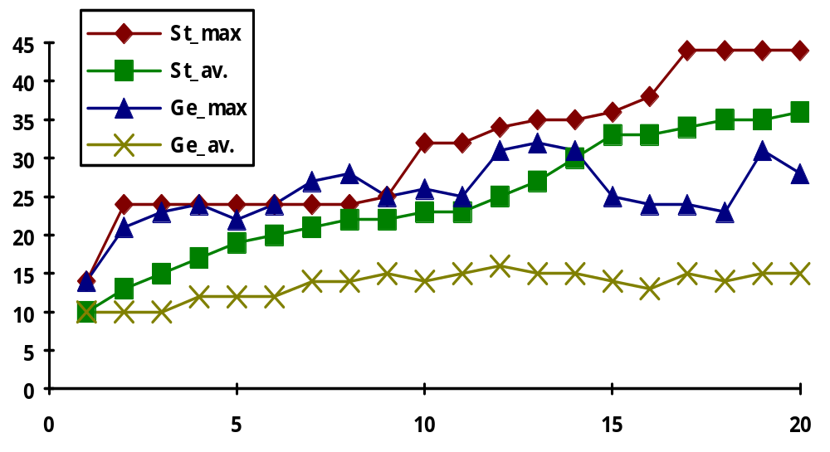
Example run
Maxima and Averages of steady-state and generational replacement

Slide 30
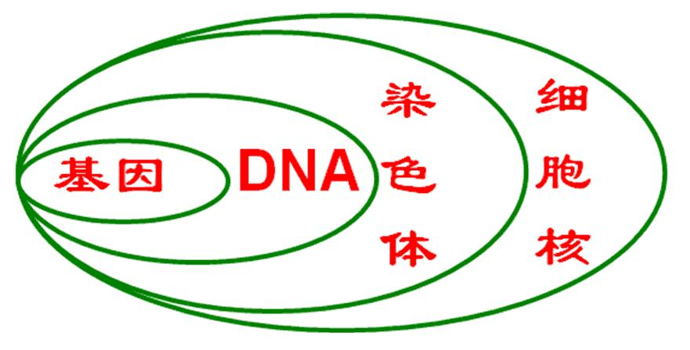
Basic Principles
An individual is characterized by a set of parameters: Genes （基因）
The genes are joined into a string: Chromosome (染色体)
The chromosome forms the genotype （基因型）
The genotype contains all information to construct an organism（生物体）: the phenotype （显型或表现型）
Reproduction is a “dumb” process
on the chromosome of the genotype
Fitness is measured in the real
world (‘struggle for life’) of the
phenotype

Slide 31
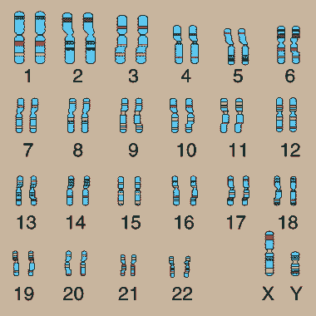
Chromosome of human being (人类染色体)

Slide 32
Basic steps
实际问题
目标（函数）映射
为适应值（函数）
初始种群
(编码成位串形式)
计算个体（染色体）
适应值
Y
输出满足
问题的种群
满意否？
N
选 择
遗传算子
交 叉
变 异
产生新一代种群

Slide 33
Population Size (种群规模)
群体规模是影响遗传算法寻优效率的重要参数之一，它的选取对遗传算法的效能有影响
群体规模过小，会限制群体的多样性，导致搜索过程过早收敛；规模过大，计算量增加，也会削弱算法的效率
问题越难，种群规模应当适当大一些；对于已有信息，尽量减少种群规模。在实际应用中群体个数一般取值在几十到几百之间
初始群体的个体通常都是随机产生的

Slide 34
Population Size (种群规模)
初始种群如何设定？
1.估计最优解在整个问题空间的分布范围，然后在此分布范围内均匀设置初始种群
2.先随机生成一定数目的个体，然后从中选出最好的个体加入种群中，重复这一过程，直到达到种群规模
初始群体的个体通常都是随机产生的

Slide 35
Fitting Function (适应度函数)
适应度函数：体现了个体的生存环境，是通过对目标函数的转换而形成的。
设计适应度函数一般主要满足的条件：
  连续、非负
  适应度函数设计应尽可能简单
  适应度函数对某一类具体问题，应尽可能通用

Slide 36
Genetic Operators: Selection
选择算子(Selection Operator)：种群空间到父体空间的随机映射，按照某种准则或概率分布从当前种群中以高的概率选取那些好的个体组成不同的父体以供生成新的个体
  适应度比例选择
  轮盘式选择
  竞争式选择

Slide 37
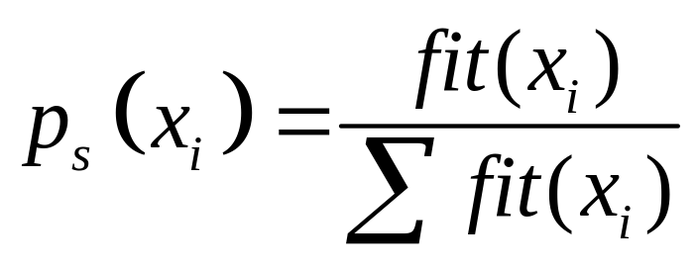
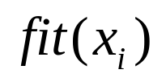
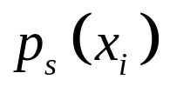
Selection Operator
设种群大小为n, 适应度比例选择
  适应度高的个体被大量复制
  适应度低的被淘汰
  其中， 为个体i的适应度
  为个体i被选择的概率
选择概率

Slide 38
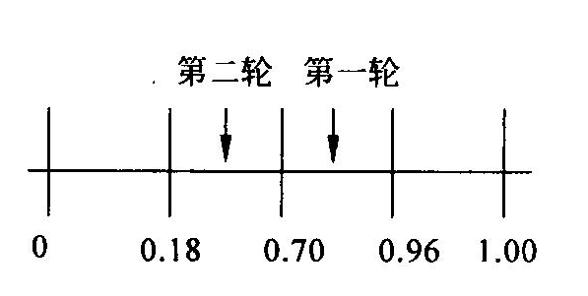
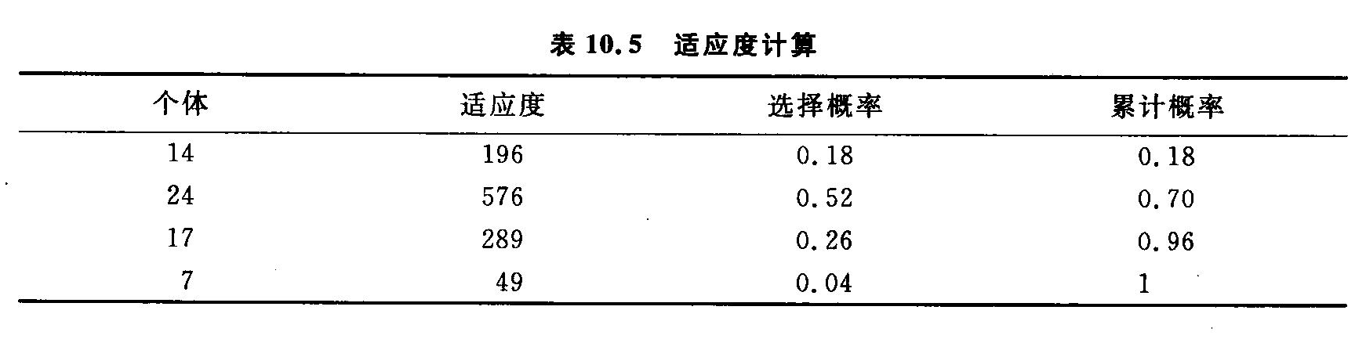
Selection Operator
轮盘式选择
  根据适应度大小分配轮盘面积，面积表示挑选中的概率
  为了选择交叉个体，进行多轮选择
  每次产生一个[0，1]均匀分布的随机数，将该随机数作为选择指针来确定被选个体

Slide 39
Selection Operator
竞争式选择
  首先随机地选取两个以上的个体，具有最大适应度者将被选中到下一次的种群中
  重复选取，一直到新的种群中的个体数与种群规模相同位置

Slide 40
Genetic Operators
Crossover
  Two parents produce two offspring
  There is a chance that the chromosomes of the two parents are copied unmodified as offspring
  There is a chance that the chromosomes of the two parents are randomly recombined (crossover) to form offspring
  Generally the chance of crossover is between 0.6 and 1.0
Mutation
  There is a chance that a gene of a child is changed randomly
  Generally the chance of mutation is low (e.g. 0.001)

Slide 41
Genetic Operators
Crossover
  Generating offspring from two selected parents
    Single point crossover （单点交叉）
    Two point crossover (Multi point crossover) （两点或多点交叉）
    Uniform crossover （均匀交叉）

Slide 42
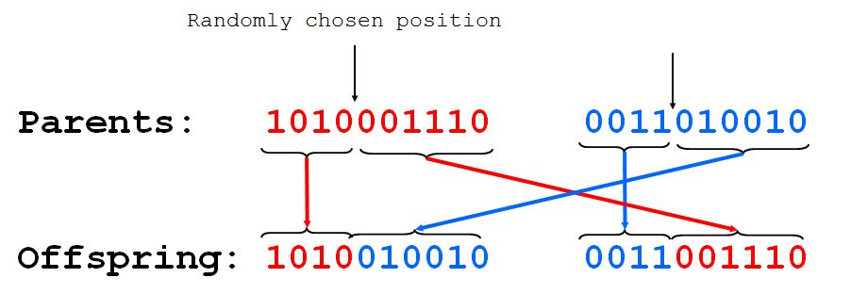
One-point crossover
Randomly one position in the chromosomes is chosen
Child 1 is head of chromosome of parent 1 with tail of chromosome of parent 2
Child 2 is head of 2 with tail of 1

Slide 43
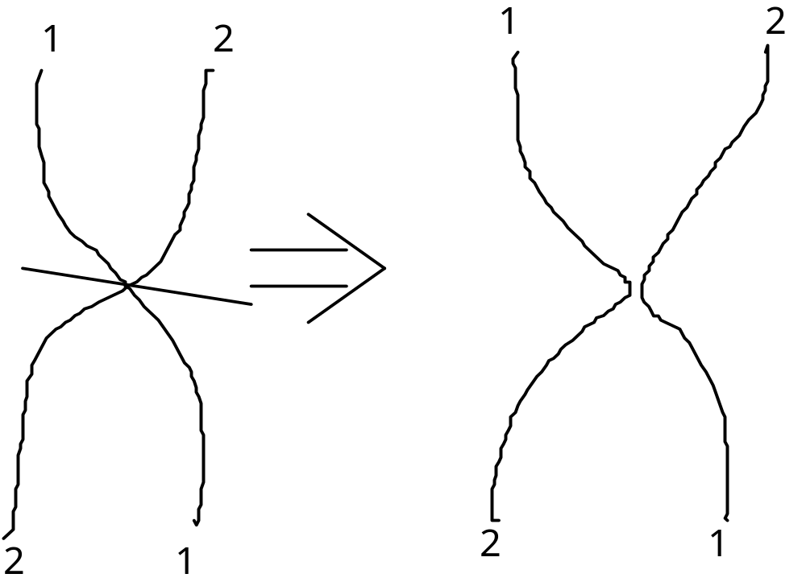
One-point crossover - Nature

Slide 44
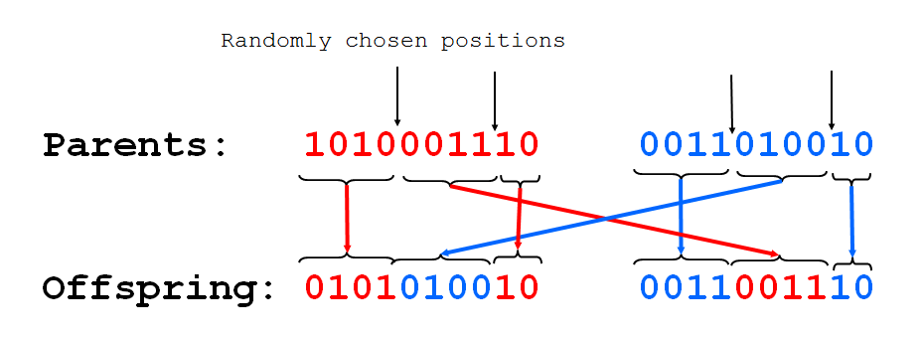
Two-point crossover
Randomly two positions in the chromosomes are chosen
Avoids that genes at the head and genes at the tail of a chromosome are always split when recombined (重组)

Slide 45
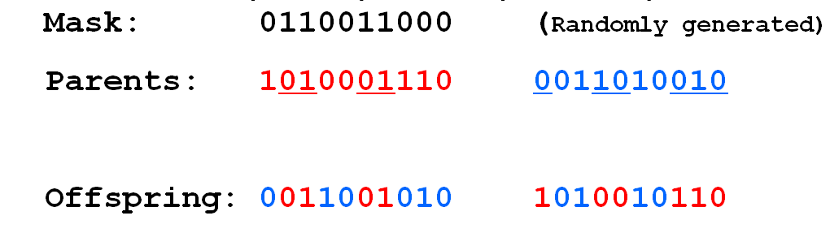
Uniform crossover
A random mask is generated
The mask determines which bits are copied from one parent and which from the other parent
Bit density in mask determines how much material is taken from the other parent (takeover parameter)

Slide 46
Genetic Operators
Uniform crossover
→
Is uniform crossover better than single crossover point?
  Trade off between
    Exploration: introduction of new combination of features
    Exploitation: keep the good features in the existing solution

Slide 47
Genetic Operator (crossover) Comparison
Single point crossover
→
Cross point
Two point crossover (Multi point crossover)
→

Slide 48
Genetic Operators: Mutation
Mutation
  Generating new offspring from single parent
  Maintaining the diversity of the individuals （个体多样性）
    Crossover can only explore the combinations of the current gene pool
    Mutation can “generate” new genes
→

Slide 49
Genetic Operators: Mutation
Control parameters: population size, crossover/mutation probability
  Problem specific
  Increase population size
    Increase diversity and computation time for each generation
  Increase crossover probability
    Increase the opportunity for recombination but also disruption of good combination
  Increase mutation probability
    Closer to randomly search
    Help to introduce new gene or reintroduce the lost gene
Varies the population
  Usually using crossover operators to recombine the genes to generate the new population, then using mutation operators on the new population

Slide 50
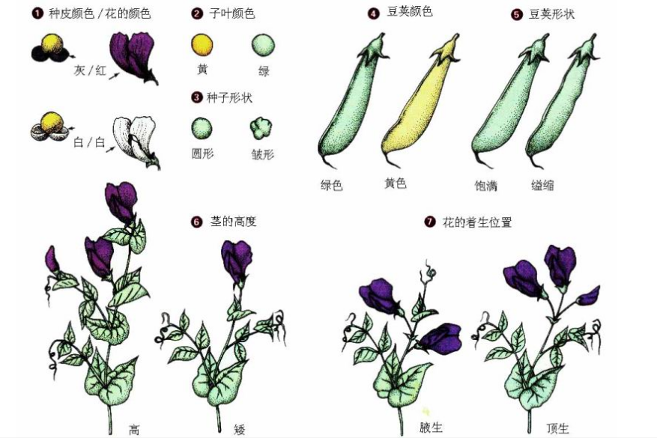
Reproduction: An Example

Slide 51
Main Outline
  Biological Evolution and Inheritance
    Natural Selection（自然选择）
    Genetic Inheritance（基因遗传）
  Genetic Algorithms(GA)
    Introduction and Main Concepts
    Considered Issues in GA
      Basic Principles
      Selection
      Crossover
      Mutation
      Reproduction
    Applications

Slide 52
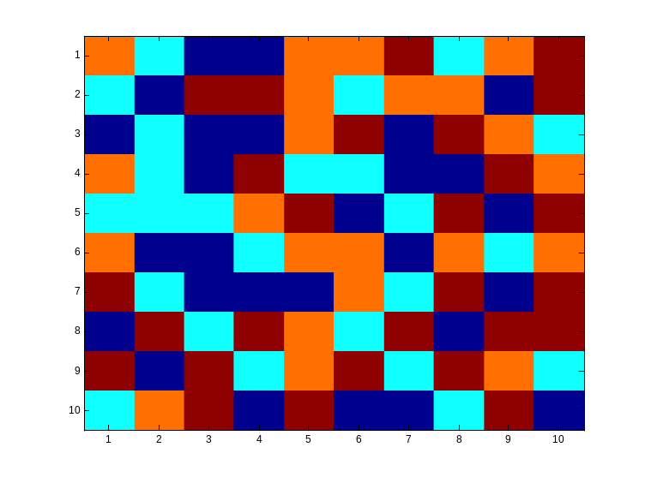
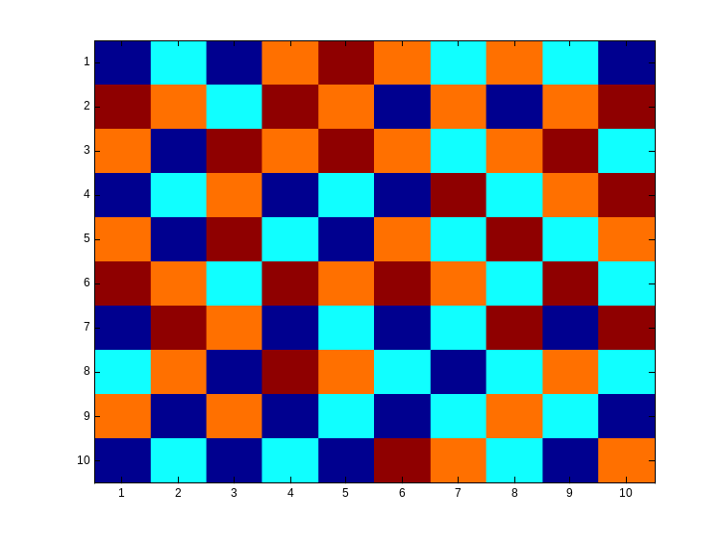
Application: Example 1
Checkboard
  We are given an n by n checkboard in which every field can have a different colour from a set of four colors.
  The goal is to achieve a checkboard in a way that there are no neighbours with the same color (not diagonal)

Slide 53
Checkboard example Cont’d
  Chromosomes represent the way the checkboard is colored.
  Chromosomes are not represented by bitstrings (位串) but by bitmatrices (位矩阵)
  The bits in the bitmatrix can have one of the four values 0, 1, 2 or 3, depending on the color.
  Crossing-over involves matrix manipulation instead of point wise operating.
  Crossing-over can be combining the parential matrices in a horizontal, vertical, triangular or square way.
  Mutation remains bitwise changing bits in either one of the other numbers.

Slide 54
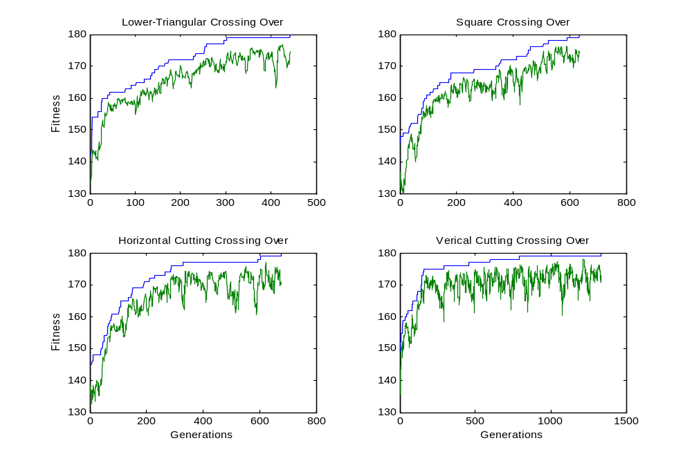
Checkboard example Cont’d
  Fitnesscurves for different cross-over rules:

Slide 55
Application: Example 2
旅行商问题（Traveling Salesman Problem，TSP）
又称旅行推销员问题、货郎担问题。
是最基本的路线问题，该问题是在寻求单一旅行者由起点出发，通过所有给定的需求点之后，最后再回到原点的最小路径成本。
最早的旅行商问题的数学规划是由Dantzig（1959）等人提出。

Slide 56
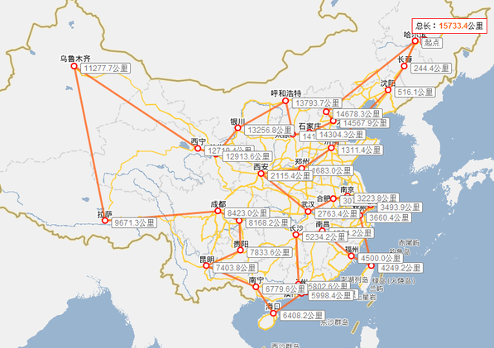
旅行商问题（Traveling Salesman Problem，TSP）
Goal: Find a tour of a given set of cities so that
  each city is visited only once
  the total distance traveled is minimized

Slide 57
Representation
Representation is an ordered list of city
numbers known as an order-based GA.
1) London 3) Dunedin 5) Beijing 7) Tokyo
2) Venice 4) Singapore 6) Phoenix 8) Victoria
CityList1 (3 5 7 2 1 6 4 8)
CityList2 (2 5 7 6 8 1 3 4)

Slide 58
Crossover (交叉)
Crossover combines inversion and recombination (反转与重组):
* *
Parent1 (3 5 7 2 1 6 4 8)
Parent2 (2 5 7 6 8 1 3 4)
Child (5 8 7 2 1 6 3 4)
This operator is called the Order1 crossover.

Slide 59
Mutation (变异)
Mutation involves reordering of the list:
* *
Before: (5 8 7 2 1 6 3 4)
After: (5 8 6 2 1 7 3 4)

Slide 60
TSP Example: 30 Cities

Slide 61
Solution _{i} (Distance = 941)

Slide 62
Solution _{j}(Distance = 800)

Slide 63
Solution _{k}(Distance = 652)

Slide 64
Best Solution (Distance = 420)

Slide 65
Overview of Performance

Slide 66
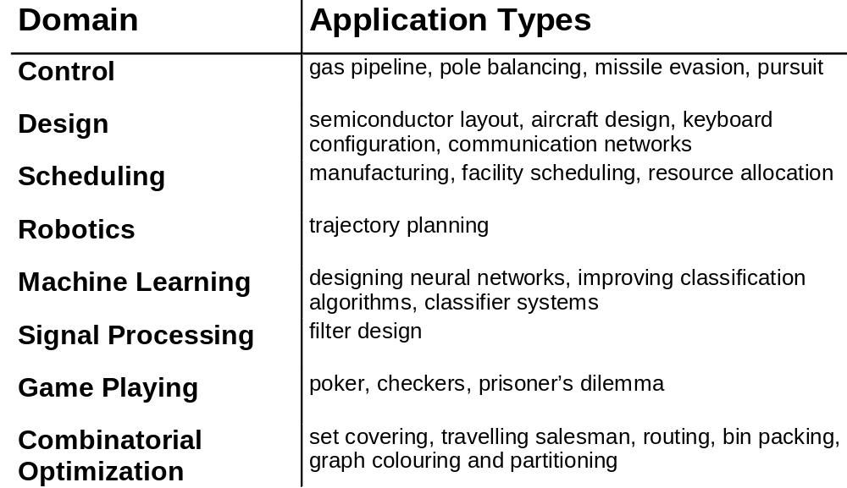
Some GA Application Types

Slide 67
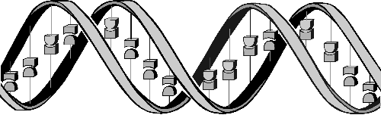
Conclusions
Question: ‘If GAs are so smart, why ain’t they rich?’
Answer: ‘Genetic algorithms are rich - rich in application across a large and growing
number of disciplines.’
- David E. Goldberg, Genetic Algorithms in Search, Optimization and Machine Learning

