Slide 1
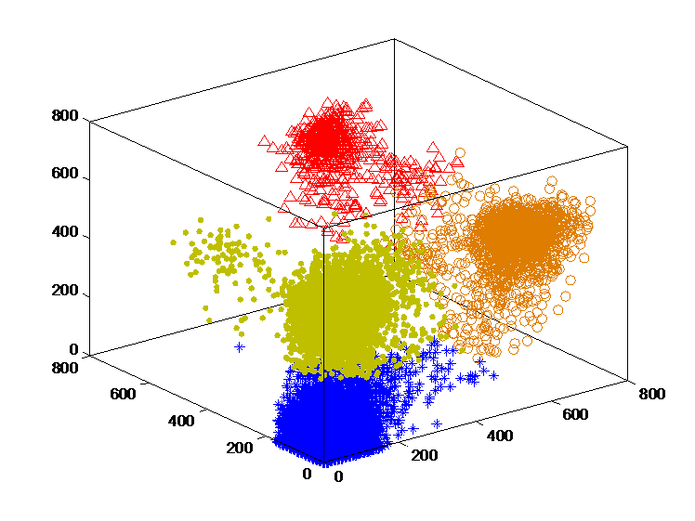
Data Mining:
Clustering Algorithm (聚类算法)
- based on similarity measure (distance)

Slide 2
The partial materials of this part are from
Jiawei Han, Micheline Kamber, and Jian Pei
University of Illinois at Urbana-Champaign &
Simon Fraser University and
Clustering by Qiang Yang, HKUST.
Revised by Jared

Slide 3
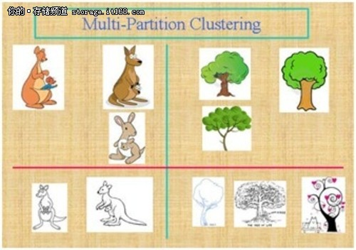
Main Outline
  Clustering Algorithm
    Basic Concept
    Measure the Quality of Clustering
    Applications
    Major Clustering Approaches
  Distance Metric
    Similarity/Dissimilarity Measure
    Euclidean distance, Minkowski distance, Mahalanobis distance
  Partitioning Algorithms: Basic Concept
    k-means
    k-medoids or PAM (Partition Around Medoids)

Slide 4
What is Cluster Analysis?
Cluster: A collection of data objects
  similar (or related) to one another within the same group
  dissimilar (or unrelated) to the objects in other groups
Cluster analysis (or clustering, data segmentation, …)
  Finding similarities between data according to the characteristics found in the data and grouping similar data objects into clusters
Typical applications
  As a stand-alone tool to get insight into data distribution
  As a preprocessing step for other algorithms

Slide 5
What is Clustering?
Attach the same label to data points that are “close” to each other in given set
You can say this “unsupervised classification”: no predefined classes (i.e., learning by observations)
Clustering is alternatively called as “grouping”
Thus, clustering algorithms rely on a distance metric between data points
Sometimes, it is said that for clustering, the distance metric is more important than the clustering algorithm

Slide 6
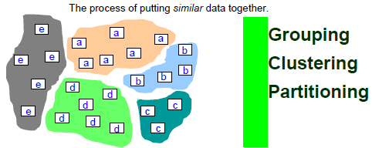
What is Clustering? (Cont)
There is no training data (objects are not labeled)
We need a concept of similarity or distance

Slide 7
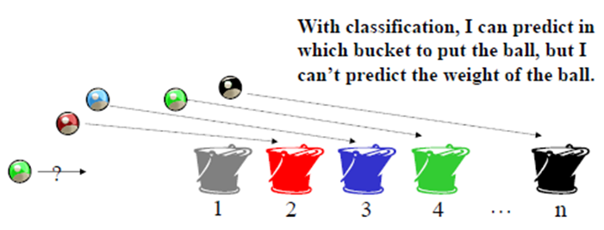
What is Classification?
The goal of data classification is to organize and classify data into different classes.
  A model is first created based on the training data (learning).
  Then, the model is used to classify test and new data.
  Given the model, the label of new data can be predicted.
Example:
Application: medical diagnosis, treatment effectiveness analysis,
protein function prediction, interaction prediction, etc.

Slide 8
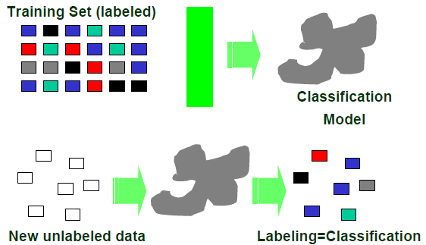
Classification = Learning the Model

Slide 9

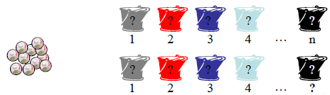
Supervised vs. Unsupervised
Classification = Supervised approach
  We know the class labels and the number of classes
Clustering = Unsupervised approach
  We do not know the class labels and may not know the number of classes

Slide 10
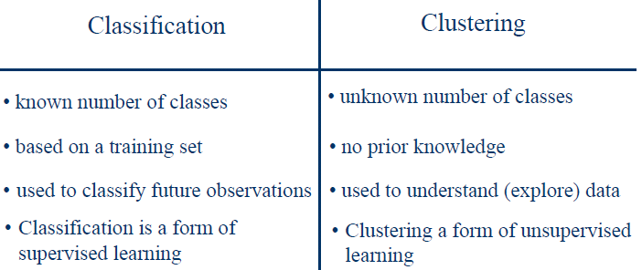
Classification vs. Clustering
(we can compute it without the need
of knowing the correct solution)

Slide 11
Applications of Clustering
Data reduction
  Summarization: Preprocessing for regression, PCA, classification, and association analysis
  Compression: Image processing: vector quantization
Hypothesis (假设) generation and testing
Prediction based on groups
  Cluster & find characteristics/patterns for each group
Finding K-nearest Neighbors
  Localizing search to one or a small number of clusters
Outlier detection: Outliers are often viewed as those “far away” from any cluster

Slide 12
Clustering: Application Examples
Biology: taxonomy of living things: kingdom, phylum, class, order, family, genus and species
Information retrieval: document clustering
Land use: Identification of areas of similar land use in an earth observation database
Marketing: Help marketers discover distinct groups in their customer bases, and then use this knowledge to develop targeted marketing programs
City-planning: Identifying groups of houses according to their house type, value, and geographical location
Earth-quake studies: Observed earth quake epicenters (震中) should be clustered along continent faults (大陆断层)
Climate: understanding earth climate, find patterns of atmospheric and ocean
Economic Science: market research

Slide 13
Basic Steps to Develop a Clustering Task
Feature selection
  Select info concerning the task of interest
  Minimal information redundancy
Proximity measure
  Similarity of two feature vectors
Clustering criterion
  Expressed via a cost function or some rules
Clustering algorithms
  Choice of algorithms
Validation of the results
  Validation test (also, clustering tendency （聚类趋势）test)
Interpretation of the results
  Integration with applications

Slide 14
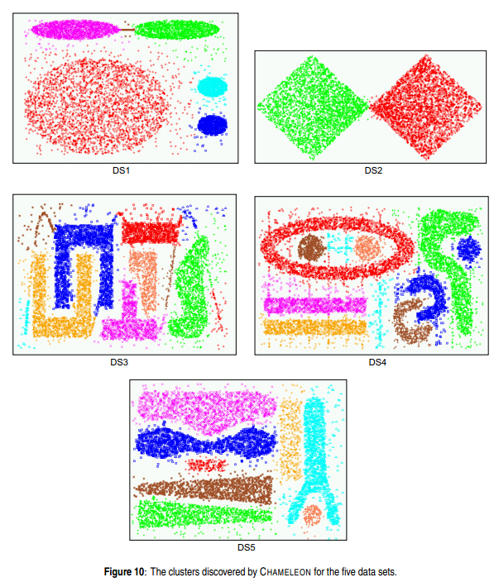
Quality: What Is Good Clustering?
A good clustering method will produce high quality clusters
  high intra-class similarity: compactness within clusters
  low inter-class similarity: separation between clusters
The quality of a clustering method depends on
  the similarity measure used
  its implementation, and
  Its ability to discover some
  or all of the hidden patterns

Slide 15
Measure the Quality of Clustering
Dissimilarity/Similarity metric
  Similarity is expressed in terms of a distance function, typically metric: d(i, j)
  The definitions of distance functions are usually rather different for interval-scaled, boolean, categorical, ordinal ratio, and vector variables
  Weights should be associated with different variables based on applications and data semantics（语义）
Quality of clustering:
  There is usually a separate “quality” function that measures the “goodness” of a cluster.
  It is hard to define “similar enough” or “good enough”
    The answer is typically highly subjective

Slide 16
Considerations for Cluster Analysis
Partitioning criteria
  Single level vs. hierarchical partitioning (often, multi-level hierarchical partitioning is desirable)
Separation of clusters
  Exclusive (e.g., one customer belongs to only one region) vs. non-exclusive (e.g., one document may belong to more than one class)
Similarity measure
  Distance-based (e.g., Euclidian, road network, vector) vs. connectivity-based (e.g., density or contiguity 邻接)
Clustering space
  Full space (often when low dimensional) vs. subspaces (often in high-dimensional clustering)

Slide 17
Requirements and Challenges
Scalability
  Clustering all the data instead of only on samples
Ability to deal with different types of attributes
  Numerical, binary, categorical, ordinal, linked, and mixture of these
Constraint-based clustering
    User may give inputs on constraints
    Use domain knowledge to determine input parameters
Interpretability and usability
Others
  Discovery of clusters with arbitrary shape （任意形状）
  Ability to deal with noisy data
  Incremental clustering and insensitivity to input order
  High dimensionality

Slide 18
Major Clustering Approaches (I)
Partitioning approach:
  Construct various partitions and then evaluate them by some criterion, e.g., minimizing the sum of square errors
  Typical methods: k-means, k-medoids, CLARANS
Hierarchical approach:
  Create a hierarchical decomposition of the set of data (or objects) using some criterion
  Typical methods: Diana, Agnes, BIRCH, CAMELEON
Density-based approach:
  Based on connectivity and density functions
  Typical methods: DBSACN, OPTICS, DenClue
Grid-based approach:
  based on a multiple-level granularity structure
  Typical methods: STING, WaveCluster, CLIQUE

Slide 19
Major Clustering Approaches (II)
Model-based:
  A model is hypothesized for each of the clusters and tries to find the best fit of that model to each other
  Typical methods: EM, SOM, COBWEB
Frequent pattern-based:
  Based on the analysis of frequent patterns
  Typical methods: p-Cluster
User-guided or constraint-based:
  Clustering by considering user-specified or application-specific constraints
  Typical methods: COD (obstacles), constrained clustering
Link-based clustering:
  Objects are often linked together in various ways
  Massive links can be used to cluster objects: SimRank, LinkClus

Slide 20
Main Outline
  Clustering Algorithm
    Basic Concept
    Measure the Quality of Clustering
    Applications
    Major Clustering Approaches
  Distance Metric
    Similarity/Dissimilarity Measure
    Euclidean distance, Minkowski distance, Mahalanobis distance
  Partitioning Algorithms: Basic Concept
    k-means
    k-medoids or PAM (Partition Around Medoids)

Slide 21
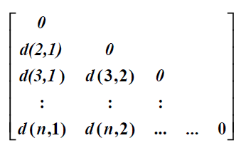
Clustering Algorithms - Distance
Distance/Similarity matrices:
Clustering is based on distances – distance/similarity matrix:
  Represents the distance between objects
  Only need half the matrix, since it is symmetric

Slide 22
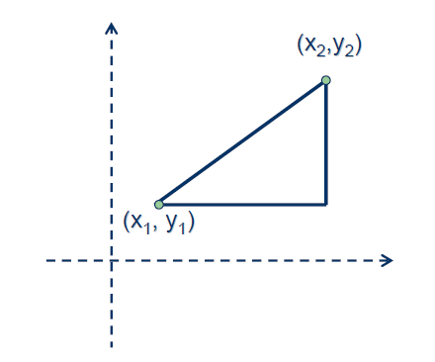
Clustering Algorithms - Distance
Examples of distances:
Euclidean (L₂) distance
Manhattan (L₁) distance
L_{m}: (|x₁-x₂|^{m}+|y₁-y₂|^{m})^{1/m}
L∞: max(|x₁-x₂|,|y₁-y₂|)
Inner product: x₁x₂+y₁y₂
Correlation coefficient
For simplicity, we will concentrate on Euclidean distance

Slide 23
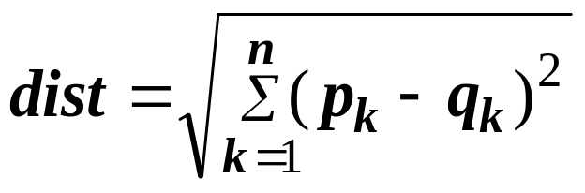
Euclidean Distance
Euclidean Distance
  Where n is the number of dimensions (attributes) and p_{k} and q_{k} are, respectively, the k^{th} attributes (components) or data objects p and q.
Standardization is necessary, if scales differ.

Slide 24
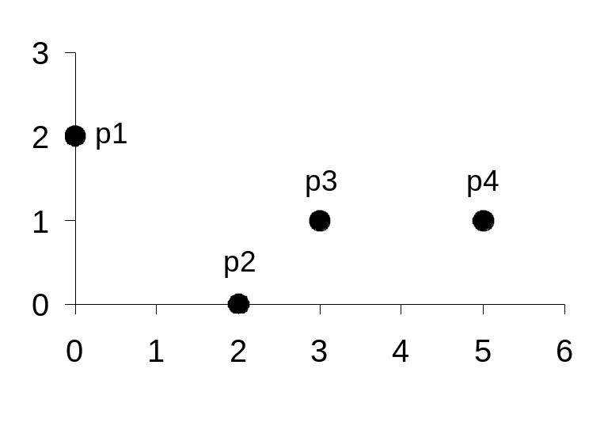
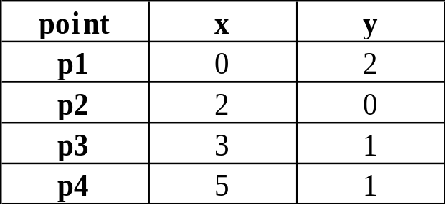
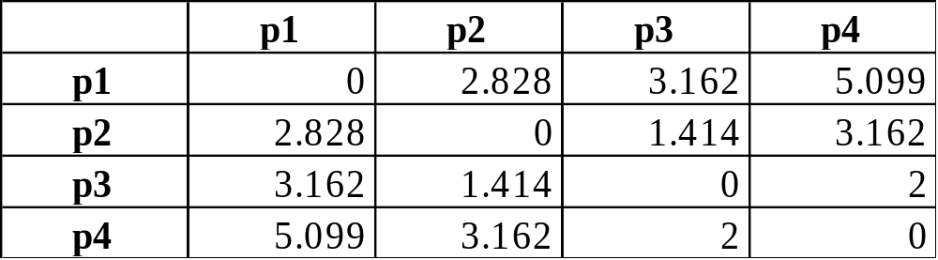
Example of Euclidean Distance
Distance Matrix

Slide 25
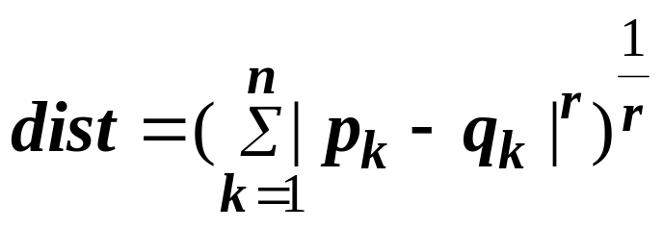
Minkowski Distance
Minkowski Distance (明可夫斯基距离) is a
generalization of Euclidean Distance
Where r is a parameter, n is the number of dimensions (attributes) and p_{k} and q_{k} are, respectively, the kth attributes (components) or data objects p and q.

Slide 26
Minkowski Distance
r = 1. City block (Manhattan, taxicab, L₁ norm) distance. （街区距离 ）
  A common example of this is the Hamming distance, which is just the number of bits that are different between two binary vectors
r = 2. Euclidean distance
r → ∞. “supremum” (L_{max} norm, L∞ norm) distance.
  This is the maximum difference between any component of the vectors
  Example: L_infinity of (1, 0, 2) and (6, 0, 3) = ??
  Do not confuse r with n, i.e., all these distances are defined for all numbers of dimensions.

Slide 27

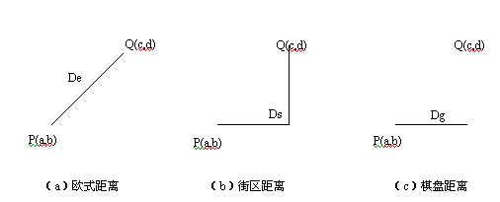
Minkowski Distance
计算点(i,j)和(h,k)间距离常采用的几种方法：
（1）欧氏距离，用 来表示。 L₂ norm distance
（2）街区距离，也称为4-邻域距离。 L₁ norm distance
（3）棋盘距离，也称为8-邻域距离。 L∞ norm distance
这三种距离之间的关系： ，如图所示。街区距离和棋、盘距离都是欧式距离的一种近似。

Slide 28
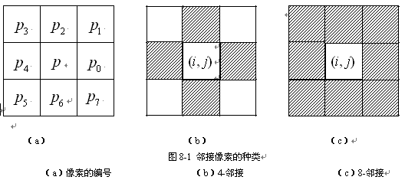


邻域与邻接
  互为4-邻域的两点叫4-邻接 (如p和p_{0,} p₁和p₀)。
  互为8-邻域的两点叫8-邻接 (如p和p_{1,} p₂和p₀) 。

Slide 29
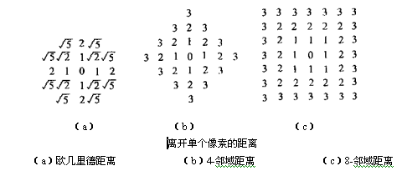
下图中表示了以中心点为原点的各点的距离。从离开一个点的等距离线可以看出，在欧氏距离中大致呈圆形，在棋盘距离中呈方形，在街区距离中呈倾斜45度的正方形。
L₂ norm distance L₁ norm distance L∞ norm distance

Slide 30
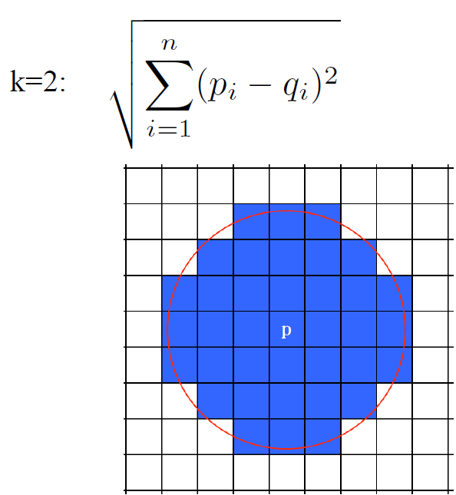
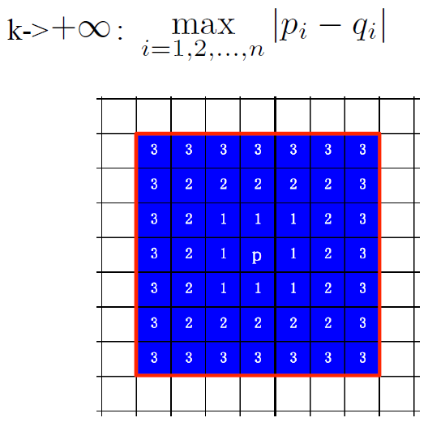
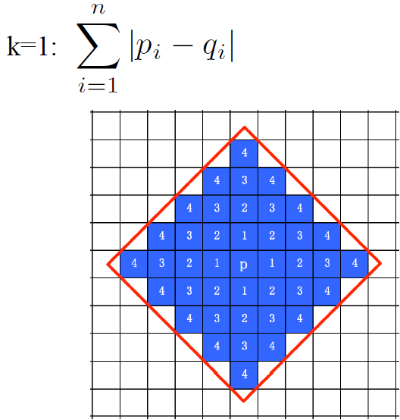
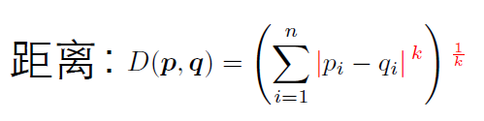
欧式距离
棋盘距离
街区距离

Slide 31
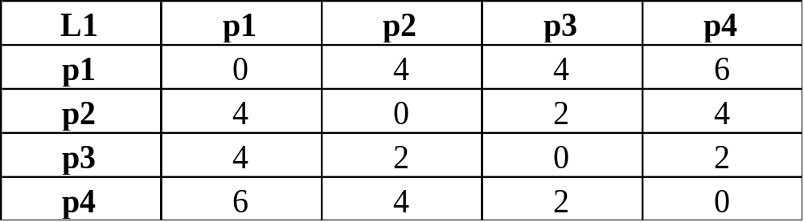
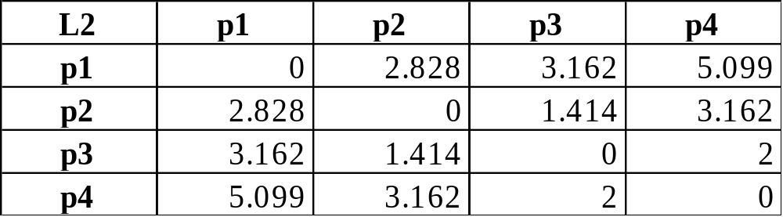
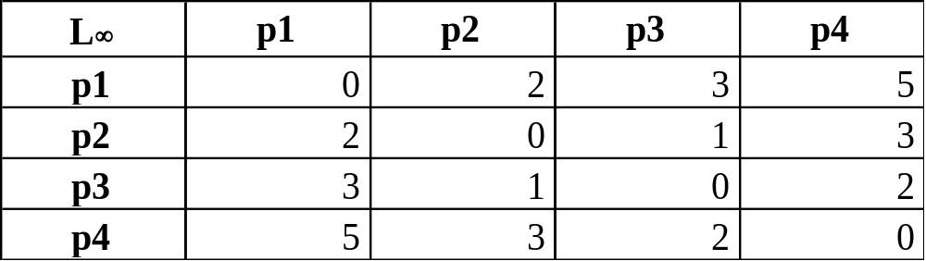
Minkowski Distance
Distance Matrix

Slide 32
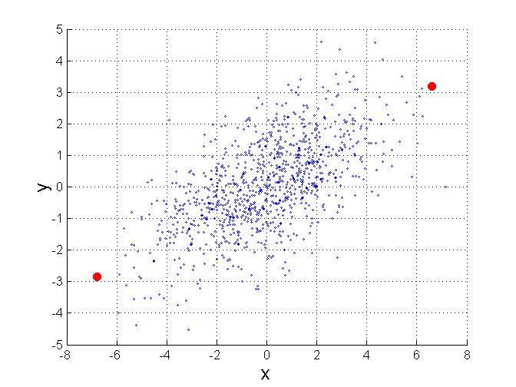
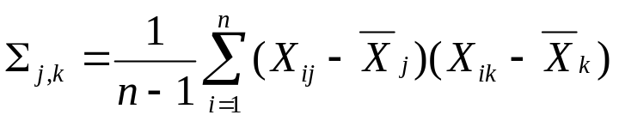
Mahalanobis Distance (马氏距离)
Σ is the covariance matrix of the input data X
B
When the covariance matrix is identity
Matrix, the mahalanobis distance is the
same as the Euclidean distance.
Useful for detecting outliers.
A
P
For red points, the Euclidean distance is 14.7, Mahalanobis distance is 6.

Slide 33
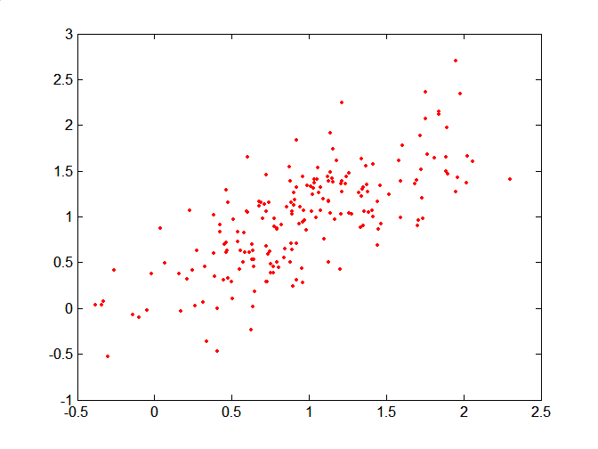
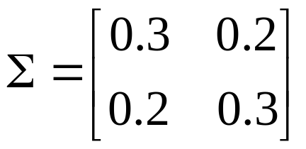
Mahalanobis Distance
Covariance Matrix:
C
B
A: (0.5, 0.5)
B: (0, 1)
C: (1.5, 1.5)
Mahal(A,B) = 5
Mahal(A,C) = 4
A

Slide 34
Common Properties of a Distance
Distances, such as the Euclidean distance, have some well known properties.
  d(p, q) ≥ 0 for all p and q and d(p, q) = 0 only if
  p = q. (Positive definiteness)
  d(p, q) = d(q, p) for all p and q. (Symmetry)
  d(p, r) ≤ d(p, q) + d(q, r) for all points p, q, and r.
  (Triangle Inequality)
where d(p, q) is the distance (dissimilarity) between points (data objects), p and q.
A distance that satisfies these properties is a metric, and a space is called a metric space

Slide 35
Common Properties of a Distance
Similarities, also have some well known properties.
  s(p, q) = 1 (or maximum similarity) only if p = q.
  s(p, q) = s(q, p) for all p and q. (Symmetry)
where s(p, q) is the similarity between points (data objects), p and q.

Slide 36
Similarity Between Binary Vectors
Common situation is that objects, p and q, have only binary attributes
Compute similarities using the following quantities
M₀₁ = the number of attributes where p was 0 and q was 1
M₁₀ = the number of attributes where p was 1 and q was 0
M₀₀ = the number of attributes where p was 0 and q was 0
M₁₁ = the number of attributes where p was 1 and q was 1
Simple Matching （SMC） and Jaccard (杰卡德) Distance/Coefficients
SMC = number of matches / number of attributes
= (M₁₁ + M₀₀) / (M₀₁ + M₁₀ + M₁₁ + M₀₀)
J = number of value-1-to-value-1 matches / number of not-both-zero attributes values
= (M₁₁) / (M₀₁ + M₁₀ + M₁₁)

Slide 37
SMC versus Jaccard: Example
p = 1 0 0 0 0 0 0 0 0 0
q = 0 0 0 0 0 0 1 0 0 1
M₀₁ = 2 (the number of attributes where p was 0 and q was 1)
M₁₀ = 1 (the number of attributes where p was 1 and q was 0)
M₀₀ = 7 (the number of attributes where p was 0 and q was 0)
M₁₁ = 0 (the number of attributes where p was 1 and q was 1)
SMC = (M₁₁ + M₀₀)/(M₀₁ + M₁₀ + M₁₁ + M₀₀) = (0+7) / (2+1+0+7) = 0.7
J = (M₁₁) / (M₀₁ + M₁₀ + M₁₁) = 0 / (2 + 1 + 0) = 0

Slide 38
Cosine Similarity
If d₁ and d₂ are two vectors, then
cos( d₁, d₂ ) = (d₁ • d₂) / ||d₁|| ||d₂|| ,
where • indicates vector dot product and || d || is the length of vector d.
Example:
d₁ = 3 2 0 5 0 0 0 2 0 0
d₂ = 1 0 0 0 0 0 0 1 0 2
d₁ • d₂= 3*1 + 2*0 + 0*0 + 5*0 + 0*0 + 0*0 + 0*0 + 2*1 + 0*0 + 0*2 = 5
||d₁|| = (3*3+2*2+0*0+5*5+0*0+0*0+0*0+2*2+0*0+0*0)^{0.5} = (42) ^{0.5} = 6.481
||d₂|| = (1*1+0*0+0*0+0*0+0*0+0*0+0*0+1*1+0*0+2*2) ^{0.5} = (6) ^{0.5} = 2.245
cos( d₁, d₂ ) = .3150, distance=1-cos(d1,d2)

Slide 39
Main Outline
  Clustering Algorithm
    Basic Concept
    Measure the Quality of Clustering
    Applications
    Major Clustering Approaches
  Distance Metric
    Similarity/Dissimilarity Measure
    Euclidean distance, Minkowski distance, Mahalanobis distance
  Partitioning Algorithms: Basic Concept
    k-means
    k-medoids or PAM (Partition Around Medoids)

Slide 40
The K-Means Clustering Method: for numerical attributes
Given k, the k-means algorithm is implemented in four steps:
  Partition objects into k non-empty subsets
  Compute seed points as the centroids (质心) of the clusters of the current partition (the centroid is the center, i.e., mean point, of the cluster)
  Assign each object to the cluster with the nearest seed point
  Go back to Step 2, stop when no more new assignment

Slide 41
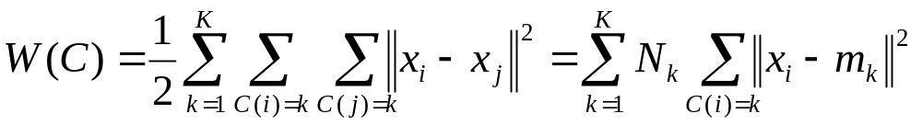
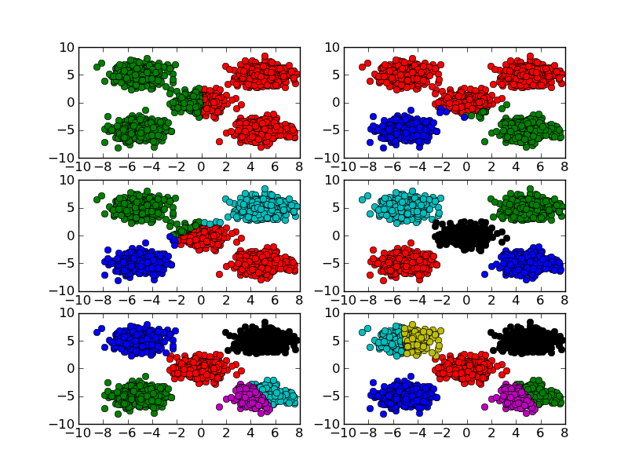
K-means: Setup
x₁,…, x_{N} are data points or vectors of observations
Each observation (vector x_{i}) will be assigned to one and only one cluster
C(i) denotes cluster number for the i^{th} observation
Dissimilarity measure: Euclidean distance metric
K-means minimizes within-cluster point scatter:
where
m_{k} is the mean vector of the k^{th} cluster
N_{k} is the number of observations in k^{th} cluster

Slide 42



The K-Means Clustering Method
Example
10
10
9
9
8
8
7
7
6
6
5
5
4
Assign each objects to most similar center
Update the cluster means
4
3
3
2
2
1
1
0
0
0
1
2
3
4
5
6
7
8
9
10
0
1
2
3
4
5
6
7
8
9
10
reassign
K=2
Arbitrarily choose K object as initial cluster center
reassign
New assignment exists?
Update the cluster means

Slide 43



K-means Clustering
Original Points
Optimal Clustering
Sub-optimal Clustering

Slide 44
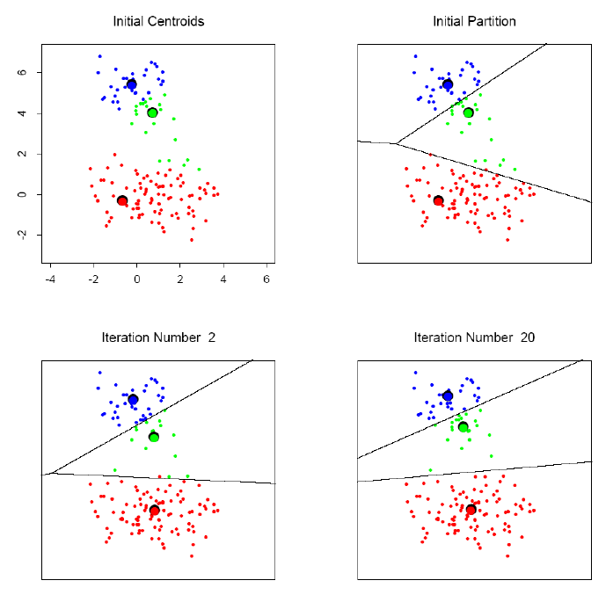
K-means clustering example

Slide 45
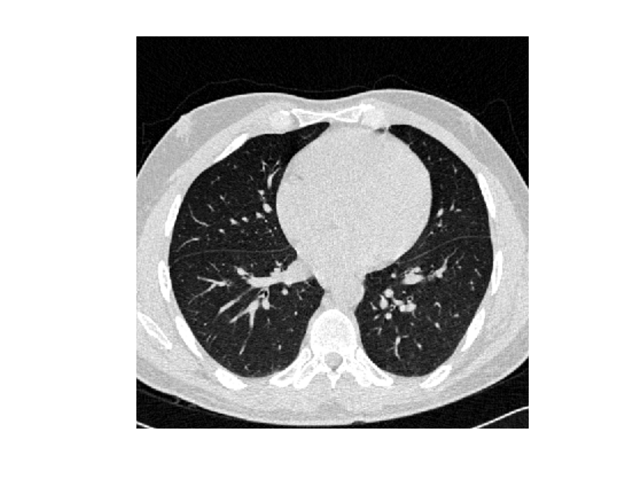
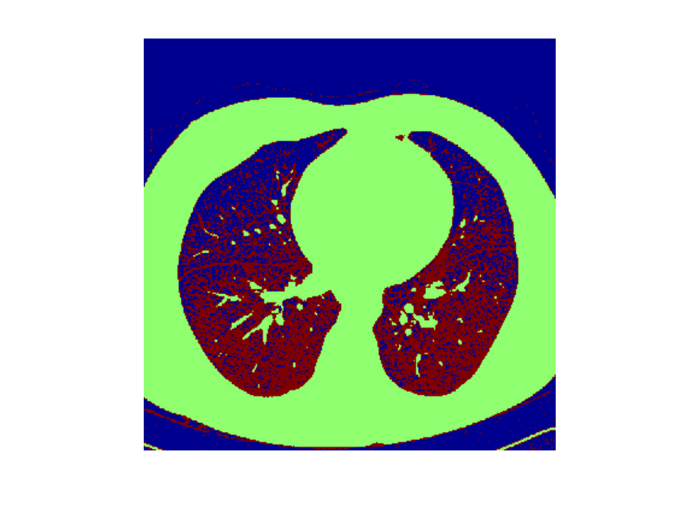
K-means Image Segmentation
An image (I)
Three-cluster image (J) on
gray values of I
Matlab code:
I = double(imread(‘…'));
J = reshape(kmeans(I(:),3),size(I));
Note that K-means result is “noisy”

Slide 46






Importance of Choosing Initial Centroids

Slide 47
Importance of Choosing Initial Centroids

Slide 48
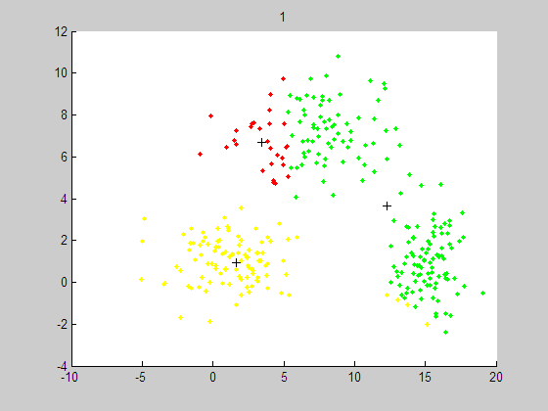
Importance of Choosing Initial Centroids

Slide 49
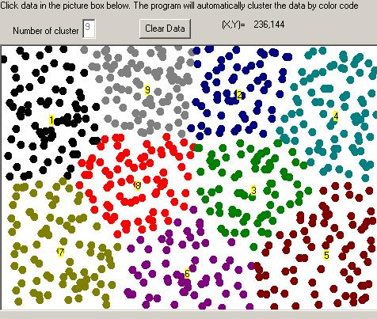
Clustering Results by K-means

Slide 50
Comments on the K-Means Method
Strength: Efficient: O(tkn), where n is # objects, k is # clusters, and t is # iterations. Normally, k, t << n.
Comment: Often terminates at a local optimal
Weakness
  Applicable only to objects in a continuous n-dimensional space
  Need to specify k, the number of clusters, in advance
  Sensitive to noisy data and outliers
  Not suitable to discover clusters with non-convex shapes

Slide 51
From k-Means to K-Medoids
The k-means algorithm is sensitive to outliers !
  Since an object with an extremely large value may substantially distort the distribution of the data.
K-Medoids (K-中心点法): Instead of taking the mean value of the object in a cluster as a reference point, medoids can be used, which is the most centrally located object in a cluster.
10
10
9
9
8
8
7
7
6
6
5
5
4
4
3
3
2
2
1
1
0
0
1
2
3
4
5
6
7
8
9
10
0
0
1
2
3
4
5
6
7
8
9
10

Slide 52
Main Outline
  Clustering Algorithm
    Basic Concept
    Measure the Quality of Clustering
    Applications
    Major Clustering Approaches
  Distance Metric
    Similarity/Dissimilarity Measure
    Euclidean distance, Minkowski distance, Mahalanobis distance
  Partitioning Algorithms: Basic Concept
    k-means
    k-medoids or PAM (Partition Around Medoids)

Slide 53
The K-Medoids Clustering Method
Find representative objects, called medoids, in clusters
Medoids are located in the center of the clusters.
  Given data points, how to find the medoid?
10
9
8
7
6
5
4
3
2
1
0
0
1
2
3
4
5
6
7
8
9
10

Slide 54
K-medoids Clustering
K-means is appropriate when we can work with Euclidean distances
Thus, K-means can work only with numerical, quantitative variable types
Euclidean distances do not work well in at least two situations
  Some variables are categorical
  Outliers can be potential threats
A general version of K-means algorithm called K-medoids can work with any distance measure
K-medoids clustering is computationally more intensive

Slide 55
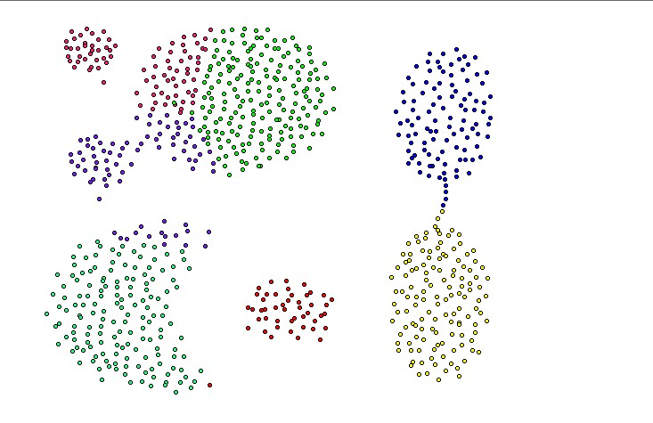
K-medoids Clustering (Cont)
Generalized K-means
Computationally more costly that K-means
Apply when dealing with categorical data
Apply when data points are not available, but only pair-wise distances are available
Converges to local minimum

Slide 56
The K-Medoid Clustering Method
K-Medoids Clustering: Find representative objects (medoids) in clusters
  PAM (Partitioning Around Medoids, Kaufmann & Rousseeuw 1987)
    Starts from an initial set of medoids and iteratively replaces one of the medoids by one of the non-medoids if it improves the total distance of the resulting clustering
    PAM works effectively for small data sets, but does not scale well for large data sets (due to the computational complexity)
Efficiency improvement on PAM
  CLARA (Kaufmann & Rousseeuw, 1990): PAM on samples
  CLARANS (Ng & Han, 1994): Randomized re-sampling

Slide 57
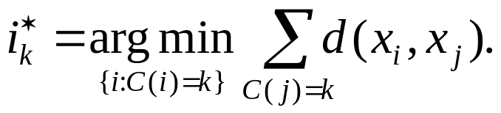

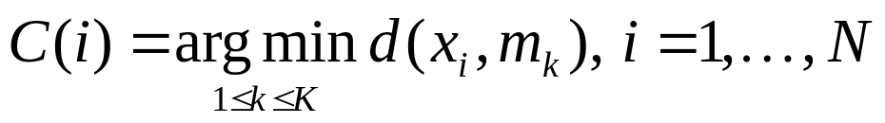
K-medoids Clustering: Setup
Step 1: For a given cluster assignment C, find the observation in the cluster minimizing the total distance to other points in that cluster:
Step 2: Assign
Step 3: Given a set of cluster centers {m₁, …, m_{K}}, minimize the total error by assigning each observation to the closest (current) cluster center:
Iterate steps 1 to 3

Slide 58
PAM (Partitioning Around Medoids)
PAM (Kaufman and Rousseeuw, 1987), built in Splus
Use real object to represent the cluster
  Select k representative objects arbitrarily
  For each pair of non-selected object h and selected object i, calculate the total swapping cost 交换成本 TC_{ih}
  For each pair of i and h,
    If TC_{ih} < 0, i is replaced by h
    Then assign each non-selected object to the most similar representative object
  repeat steps 2-3 until there is no change

Slide 59

PAM: A Typical K-Medoids Algorithm
Total Cost = 20
10
9
8
Arbitrary choose k object as initial medoids
Assign each remaining object to nearest medoids
7
6
5
4
3
2
1
0
0
1
2
3
4
5
6
7
8
9
10
K=2
Randomly select a nonmedoid object,O_{ramdom}
Total Cost = 26
Do loop
Until no change
10
10
9
Compute total cost of swapping
交换成本
9
Swapping O and O_{ramdom}
If quality is improved.
8
8
7
7
6
6
5
5
4
4
3
3
2
2
1
1
0
0
1
2
3
4
5
6
7
8
9
10
0
0
1
2
3
4
5
6
7
8
9
10

Slide 60
Choice of K?
Can W_{K}(C), i.e., the within cluster distance as a function of K serve as any indicator?
Note that W_{K}(C) decreases monotonically with increasing K. That is the within cluster scatter decreases with increasing centroids.
Instead look for gap statistics (successive difference between W_{K}(C)):

Slide 61
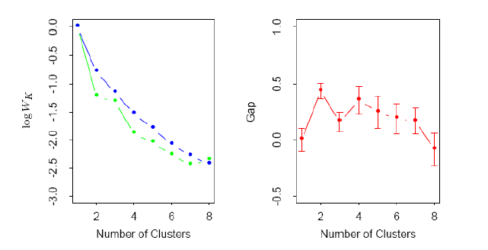
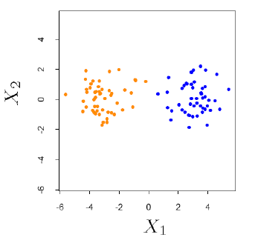
Choice of K…
Log(W_{K}) curve
Gap curve
Data points simulated from two PDFs:
PDF: probability density function
This is essentially a visual heuristic (视觉启发式)

Slide 62
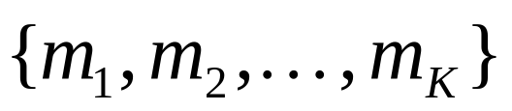
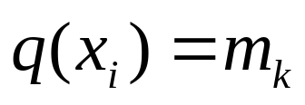
Vector Quantization (VQ)
A codebook (a set of centroids/codewords):
A quantization function:
K-means can be used to construct the codebook
Often, the nearest-neighbor function

Slide 63
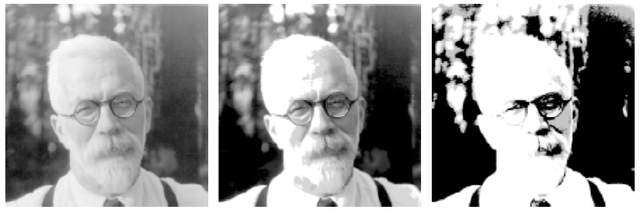
Image Compression by VQ
8 bits/pixel
1.9 bits/pixel,
using 200 codewords
0.5 bits/pixel,
using 4 codewords

Slide 64
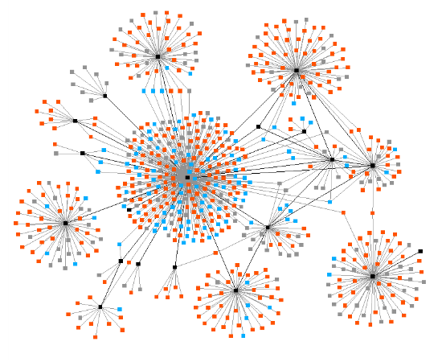
Graph Clustering

Slide 65
Graph clustering
Overlapping terminology:
Clustering algorithm for graphs =
“Community detection” algorithm for networks
Community structure in networks =
Cluster structure in graphs
Partitioning vs. clustering
  Overlap?

Slide 66
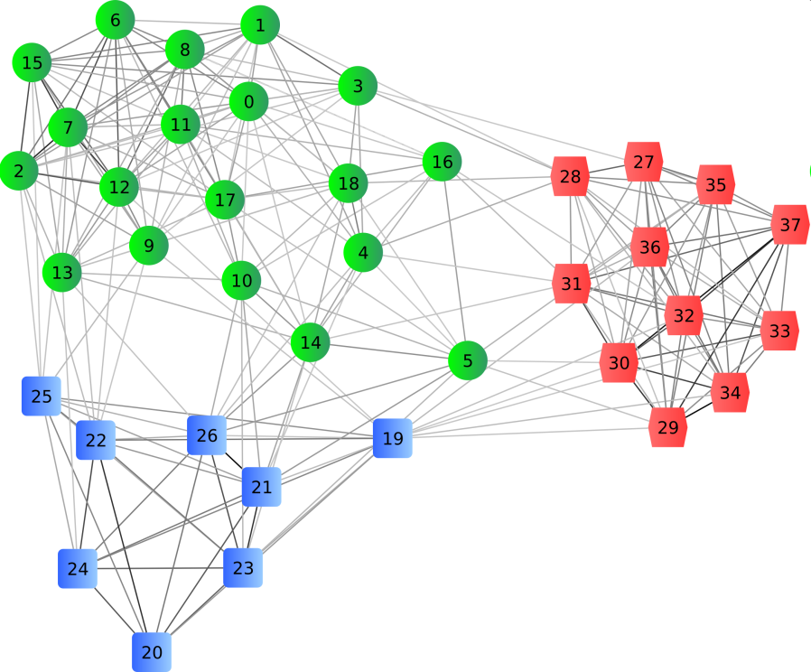
Graph clustering
Decompose a network into subnetworks based on some topological properties
Usually we look for dense subnetworks

Slide 67
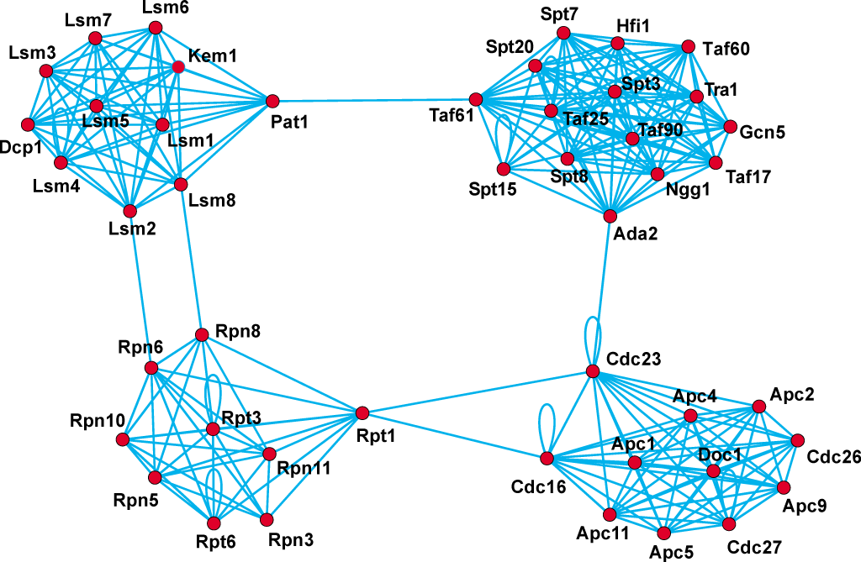
Graph clustering
  Protein complexes (蛋白质复合物) in a PPI network

Slide 68
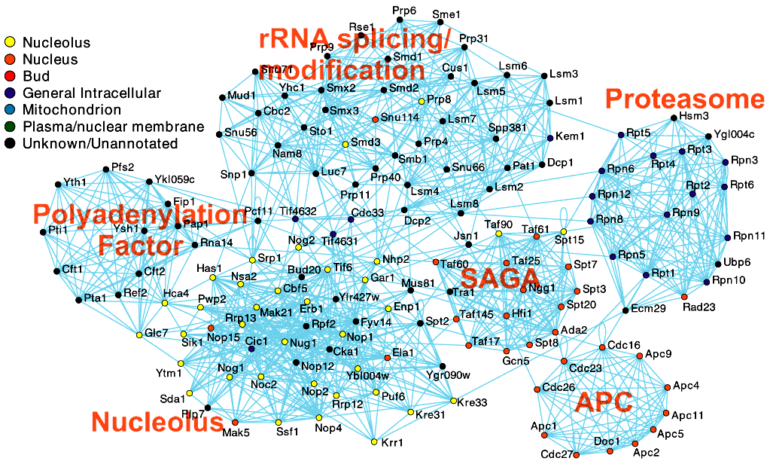
E.g., Nuclear Complexes (核配合物)

Slide 69
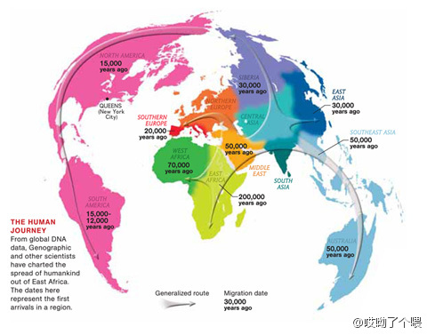
Human Journey (人类历程)

Slide 70
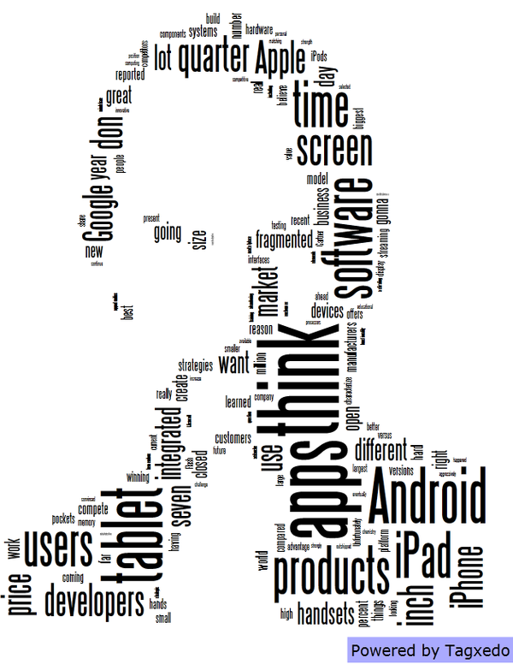
Used Key Words When Jobs is Angry（乔布斯生气时）

Slide 71

High building
distribution
at Manhattan
,US

Slide 72
Graph clustering
Algorithms:
Exact: have proven solution quality and time complexity
Approximate: heuristics are used to make them efficient
Example algorithms:
Highly connected subgraphs (HCS)
Restricted neighborhood search clustering (RNSC)
Molecular Complex Detection (MCODE)
Markov Cluster Algorithm (MCL)

