Slide 1
Data Mining:
Data Classification (数据分类)
Part 2 —Support Vector Machines(SVM,支持向量机)

Slide 2
The partial materials of this part are from
Lecture Notes for Chapter 5
Introduction to Data Mining by Tan, Steinbach, Kumar and
模式识别课程，吴建鑫 南京大学计算机系，2014

Slide 3
Classification: Basic Concepts and Methods
Support Vector Machines (SVM)
  SVM— Introduction
  Linearly separable SVM
    Motivation
    Definition of Margin
    Objective Function
    Solution
  Linearly inseparable SVM
    Kernel Method
  Multi-Class SVM (多类SVM)
    Construction Method

Slide 4
SVM—Support Vector Machines
A relatively new classification method for both
linear and nonlinear data
It uses a nonlinear mapping to transform the original training data into a higher dimension
With the new dimension, it searches for the linear optimal separating hyperplane (i.e., “decision boundary”)
With an appropriate nonlinear mapping to a sufficiently high dimension, data from two classes can always be separated by a hyperplane
SVM finds this hyperplane using support vectors (“essential” training points) and margins (defined by the support vectors)

Slide 5
SVM—History and Applications
Vapnik and colleagues (1992)—groundwork from Vapnik & Chervonenkis’ statistical learning theory in 1960s
Features: training can be slow but accuracy is high owing to their ability to model complex nonlinear decision boundaries (margin maximization)
Used for: classification and numeric prediction
Applications:
  handwritten digit recognition, object recognition, speaker identification, benchmarking time-series prediction tests

Slide 6
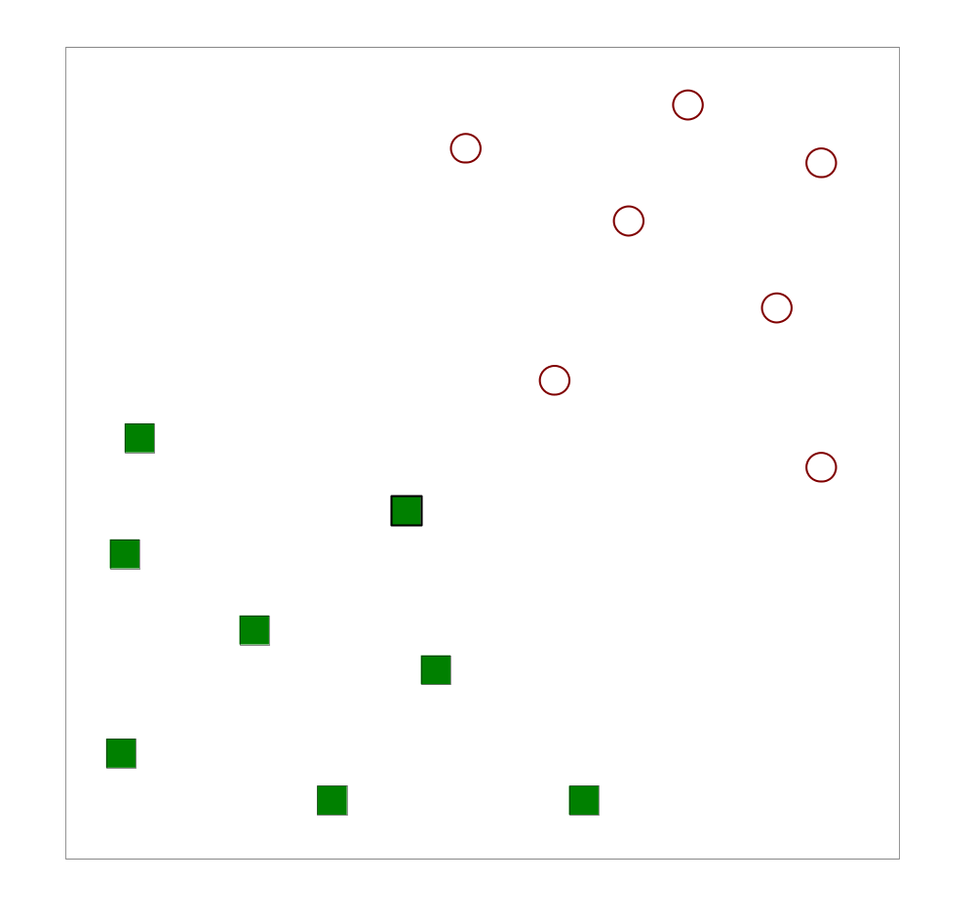
Support Vector Machines (SVM)
Find a linear hyperplane (decision boundary) that will separate the data

Slide 7
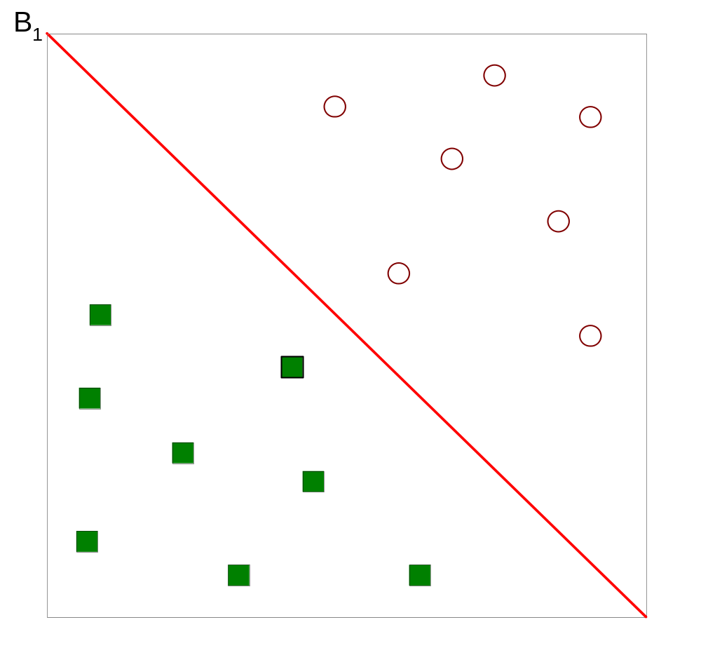
Support Vector Machines
One Possible Solution

Slide 8
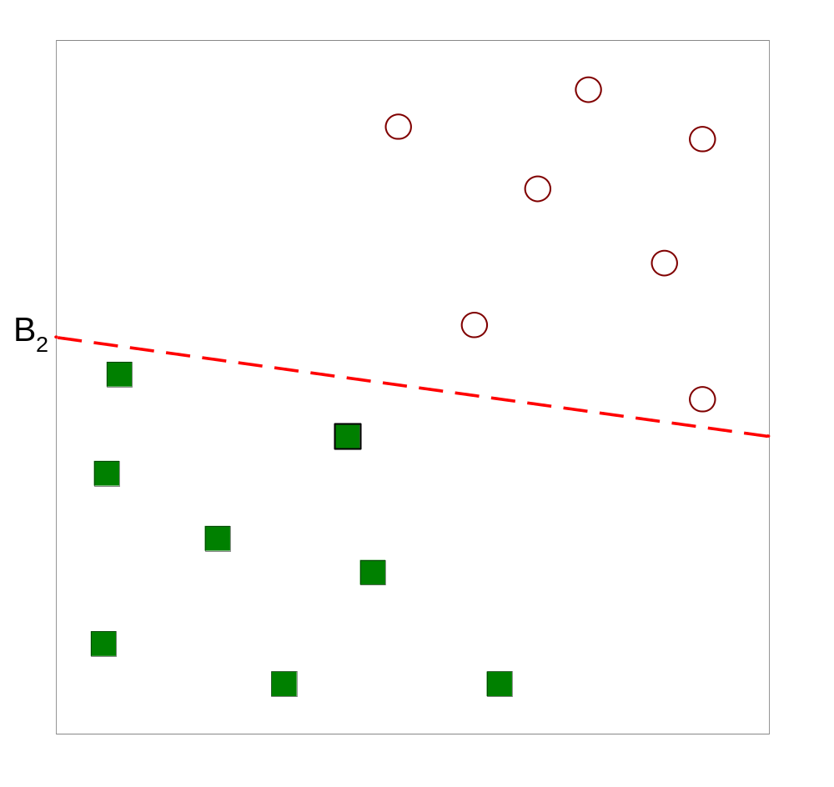
Support Vector Machines
Another possible solution

Slide 9
Support Vector Machines
Other possible solutions

Slide 10
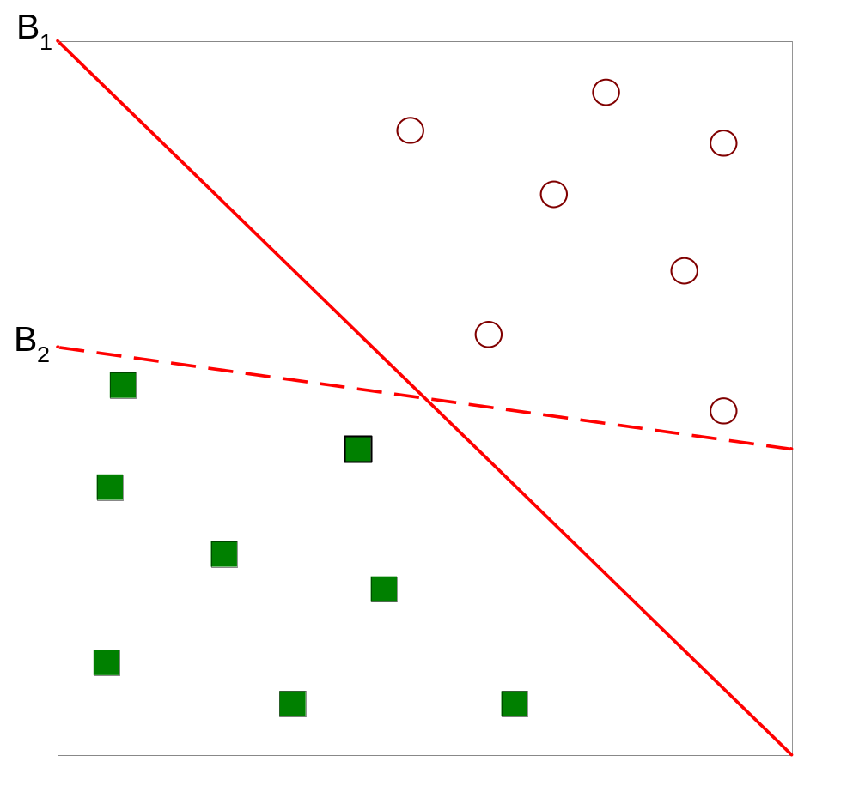
Support Vector Machines
Which one is better? B1 or B2? Why?
How do you define better?

Slide 11
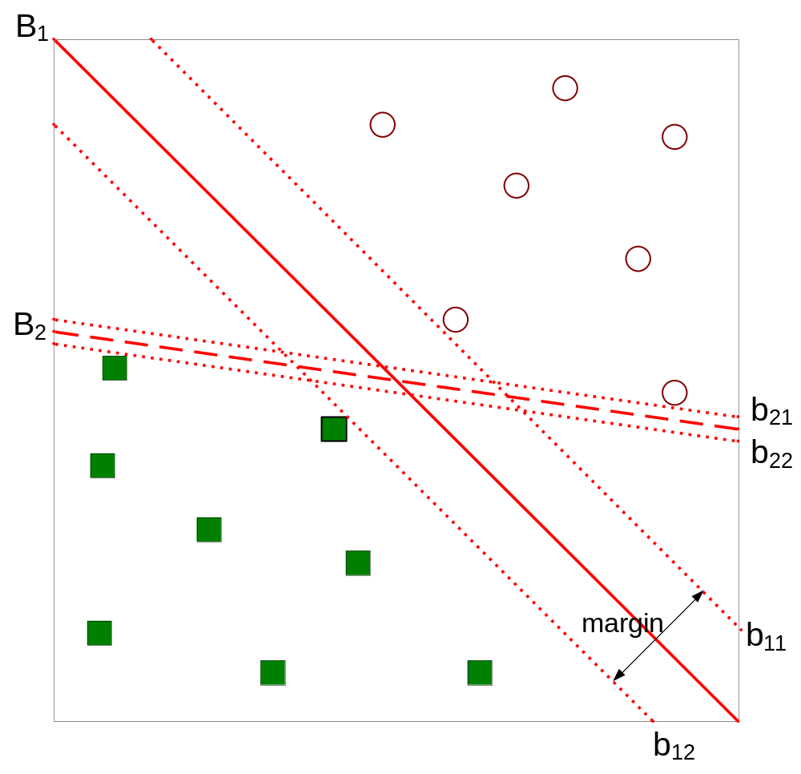
Support Vector Machines
SVM最大化（所有训练样本的）最小边际
有最小边际的点称为支 持向量 (support vectors)
所以叫支持向量机support vector machine
Find hyperplane maximizes the margin => B1 is better than B2

Slide 12
Classification: Basic Concepts and Methods
Support Vector Machines (SVM)
  SVM— Introduction
  Linearly separable SVM
    Motivation
    Definition of Margin
    Objective Function
    Solution
  Linearly inseparable SVM
    Kernel Method
  Multi-Class SVM (多类SVM)
    Construction Method

Slide 13
SVM—When data is linearly separable
Small Margin
Large Margin
Support Vectors
Let data D be (X₁, y₁), …, (X_{|D|}, y_{|D|}), where X_{i} is the set of training samples associated with the class labels y_{i}
There are infinite lines (hyperplanes) separating the two classes but we want to find the best one (the one that minimizes classification error on unseen data)
SVM searches for the hyperplane with the largest margin, i.e., maximum marginal hyperplane (MMH)

Slide 14
SVM— Linearly Separable
A separating hyperplane can be written as
    W ● X + b = 0
  where W={w₁, w₂, …, w_{n}} is a weight vector and b a scalar (bias)
For 2-D it can be written as
    w₀ + w₁ x₁ + w₂ x₂ = 0
The hyperplane defining the sides of the margin:
    H₁: w₀ + w₁ x₁ + w₂ x₂ ≥ 1 for y_{i} = +1, and
    H₂: w₀ + w₁ x₁ + w₂ x₂ ≤ – 1 for y_{i} = –1
Any training tuples that fall on hyperplanes H₁ or H₂ (i.e., the
sides defining the margin) are support vectors
This becomes a constrained (convex) quadratic optimization problem: Quadratic objective function and linear constraints → Quadratic Programming (QP) → Lagrangian multipliers

Slide 15
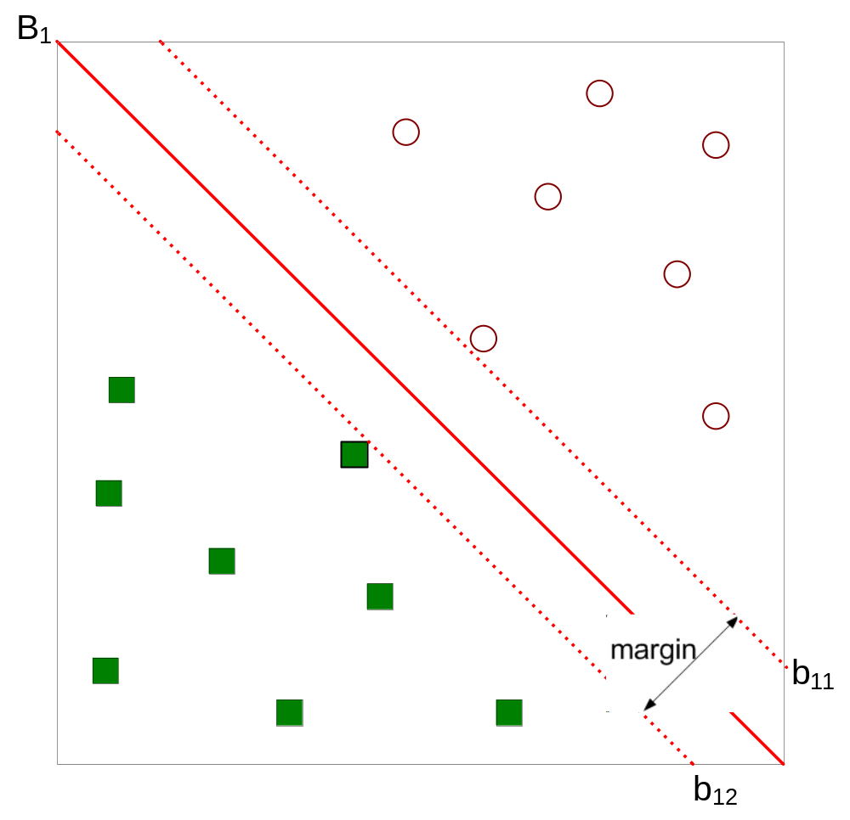



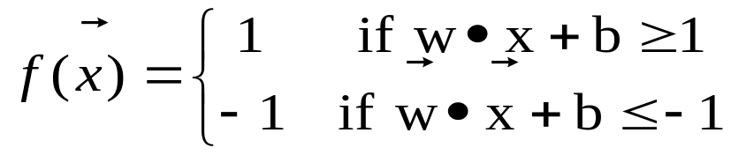
SVM— Linearly Separable
Margin =2/||w||

Slide 16
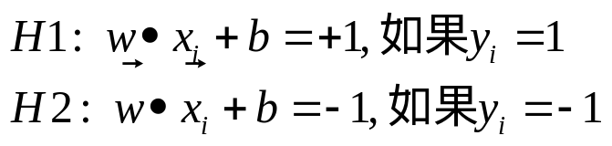
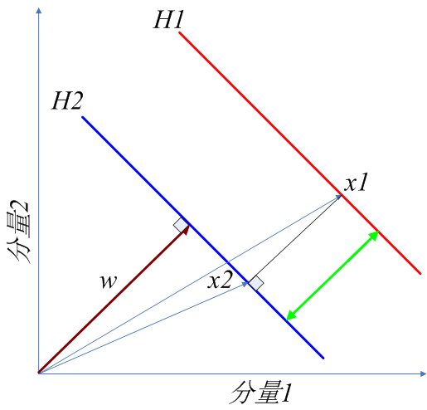





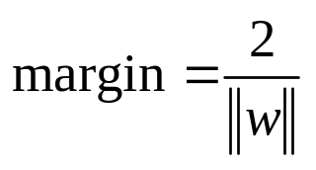
Linearly Separable Support Vector Machines: 计算margin
其中，x1为H1上的数据样本
x2为x1在H2上的投影样本
为距离向量，方向与投影方向w一致, 为 ;
求分类间隔margin，即就H1与H2间的距离：
根据向量计算， + margin*
将上述 带入H1，将 带入H2，相减H1-H2可得：

Slide 17
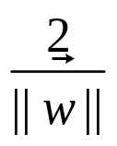
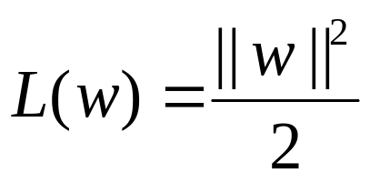
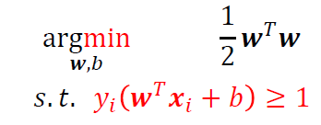

Linearly Separable Support Vector Machines: Objective
We want to maximize:
  Which is equivalent to minimizing:
    This is a constrained optimization problem
      Numerical approaches to solve it (e.g., quadratic programming)

Slide 18
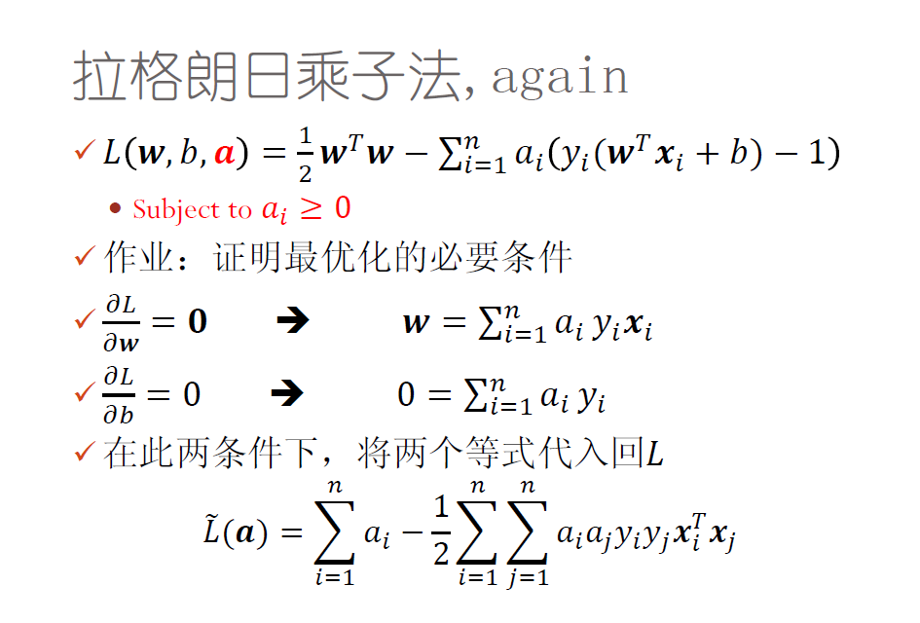

Support Vector Machines: Solution
Objective Function
of SVM:

Slide 19
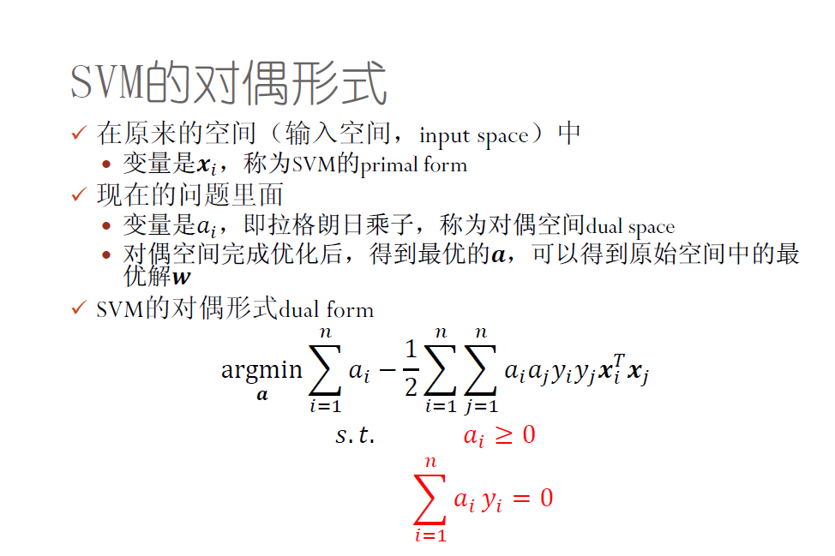
Linearly Separable Support Vector Machines: Solution

Slide 20
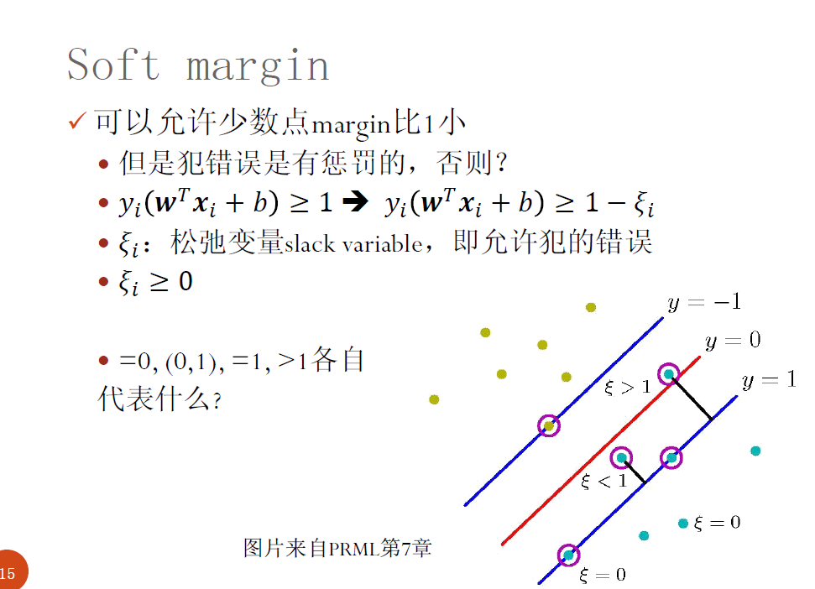
Support Vector Machines: Soft Margin

Slide 21
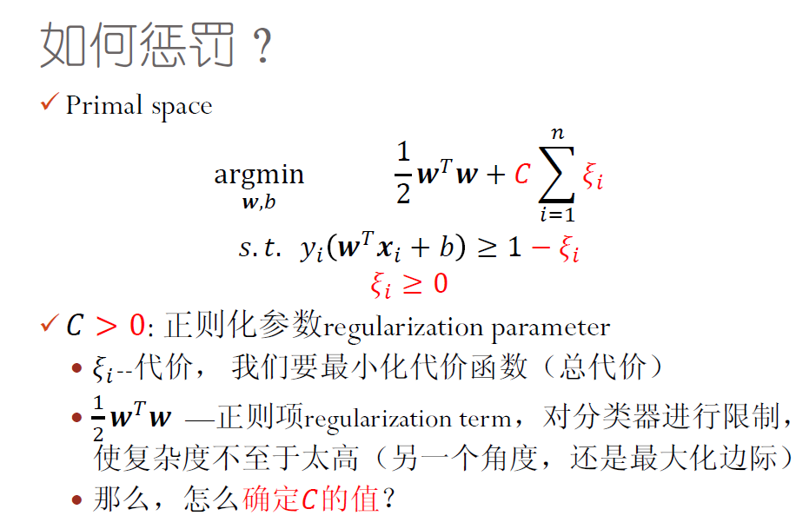
Support Vector Machines: Soft Margin

Slide 22
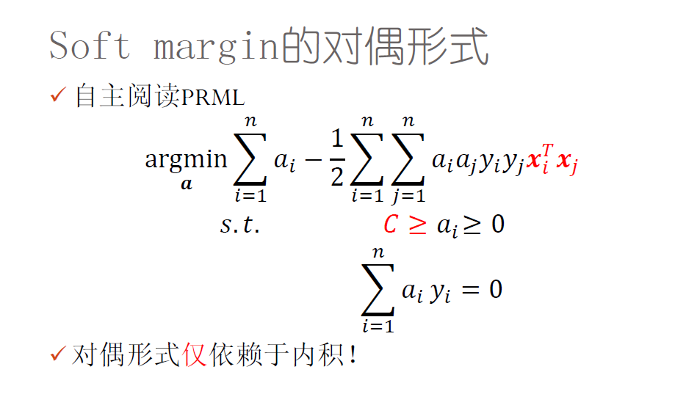
Soft Margin Support Vector Machines

Slide 23
Why Is SVM Effective on High Dimensional Data?
The complexity of trained classifier is characterized by the # of support vectors rather than the dimensionality of the data
The support vectors are the essential or critical training examples —they lie closest to the decision boundary (MMH)
If all other training examples are removed and the training is repeated, the same separating hyperplane would be found
The number of support vectors found can be used to compute an (upper) bound on the expected error rate of the SVM classifier, which is independent of the data dimensionality
Thus, an SVM with a small number of support vectors can have good generalization, even when the dimensionality of the data is high

Slide 24
Classification: Basic Concepts and Methods
Support Vector Machines (SVM)
  SVM— Introduction
  Linearly separable SVM
    Motivation
    Definition of Margin
    Objective Function
    Solution
  Linearly inseparable SVM (Nonlinear SVM)
    Kernel Method
  Multi-Class SVM (多类SVM)
    Construction Method

Slide 25
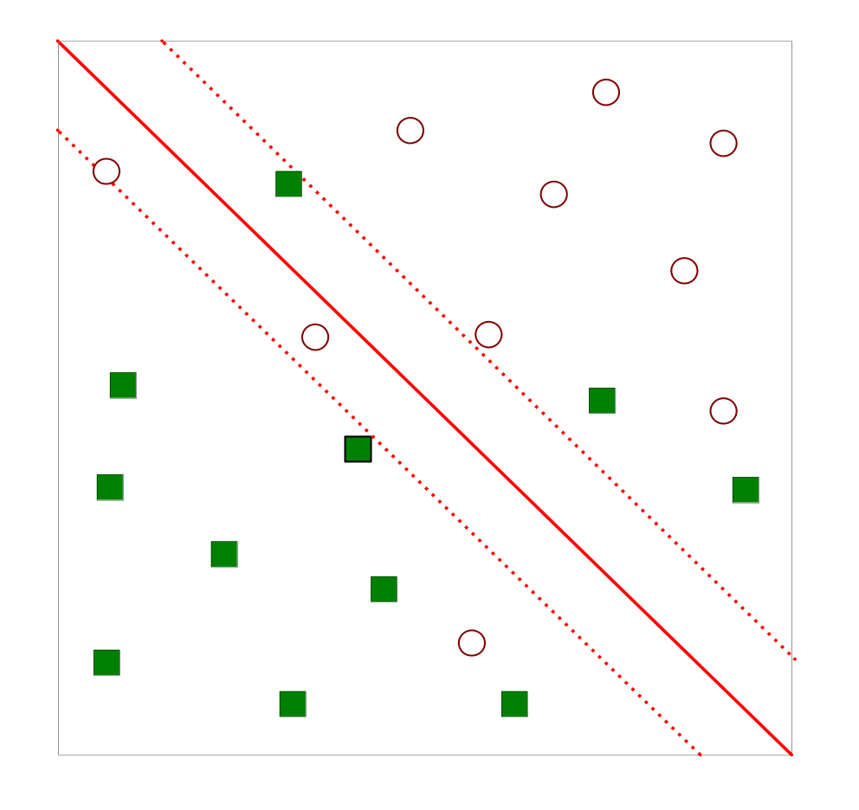
Support Vector Machines
What if the problem is not linearly separable?

Slide 26
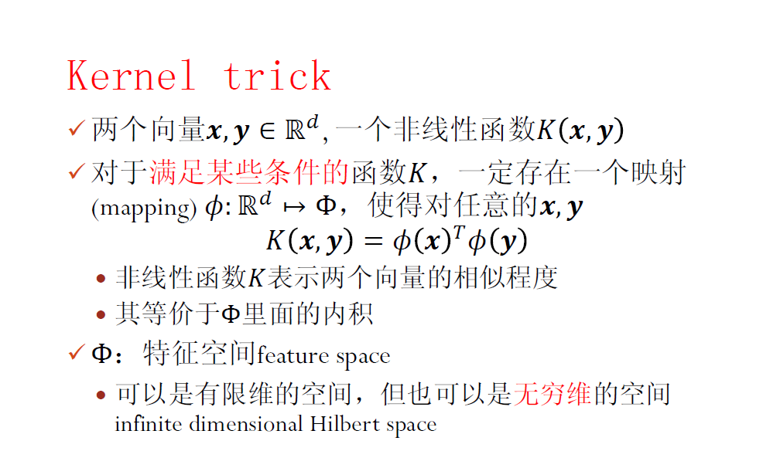
Nonlinear Support Vector Machines

Slide 27
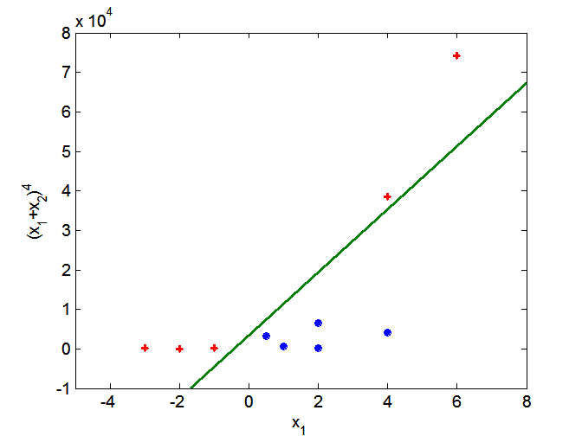
Nonlinear Support Vector Machines
Transform data into higher dimensional space
Search for a linear separating hyperplane in the new space

Slide 28
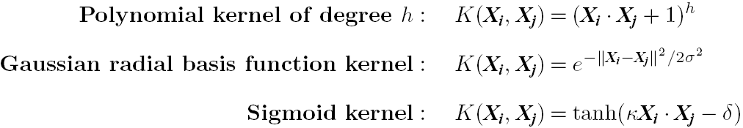
Kernel functions for Nonlinear
Classification
Instead of computing the dot product on the transformed data, it is math. equivalent to applying a kernel function K(X_{i}, X_{j}) to the original data, i.e., K(X_{i}, X_{j}) = Φ(X_{i})’ * Φ(X_{j})
Typical Kernel Functions
Simple linear kernel: K(X_{i}, X_{j}) = X_{i}’ *X_{j}
SVM can also be used for classifying multiple (> 2) classes and for regression analysis (with additional parameters)

Slide 29
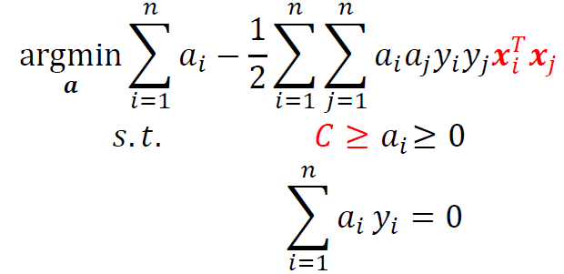
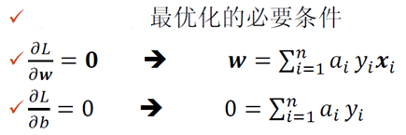
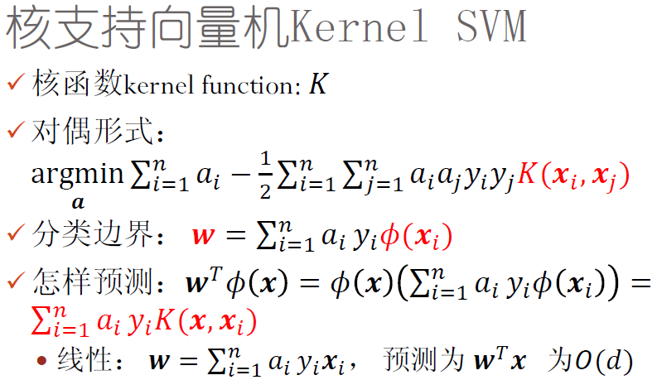
Nonlinear Support Vector Machines
Linear SVM

Slide 30
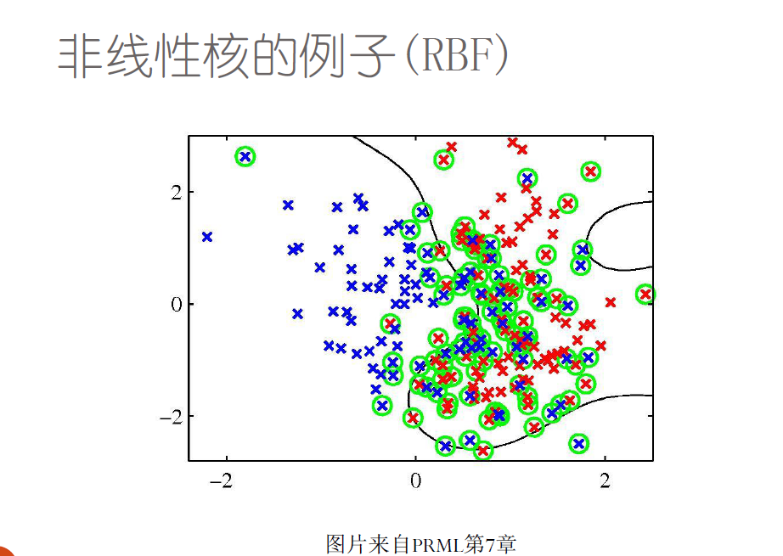

Slide 31
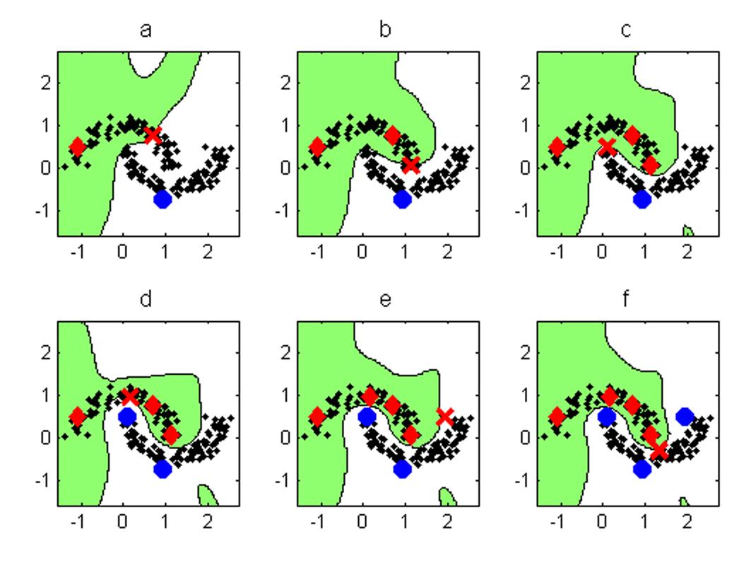
非线性SVM分类的例子

Slide 32
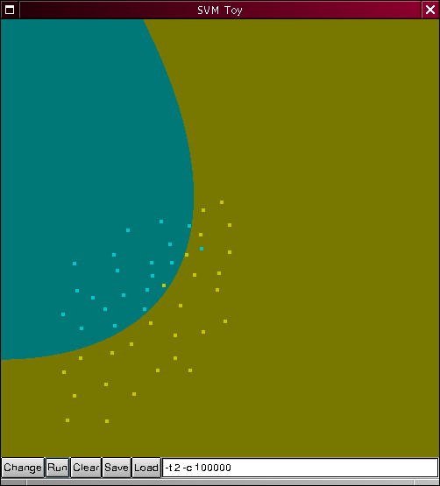
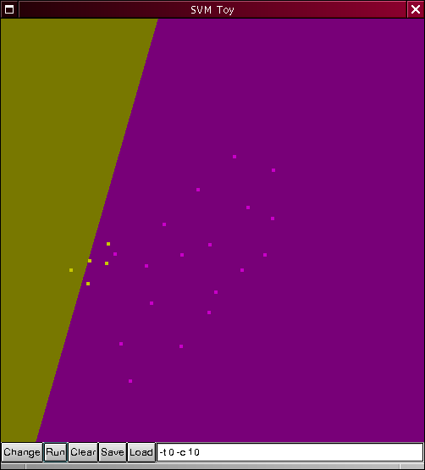
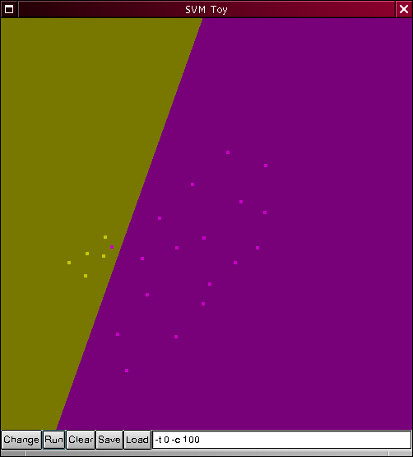
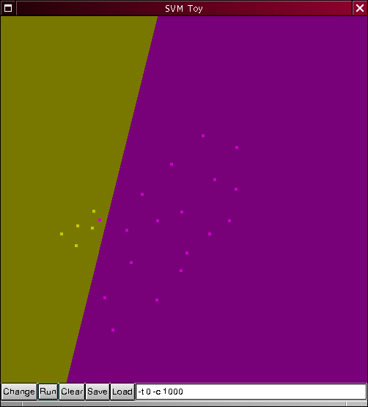
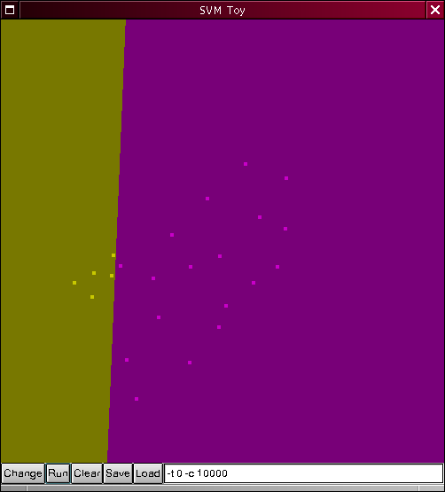


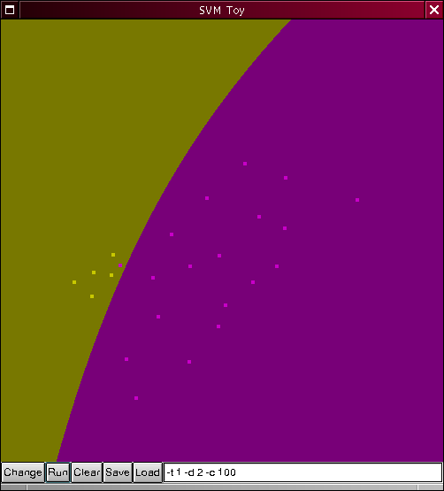
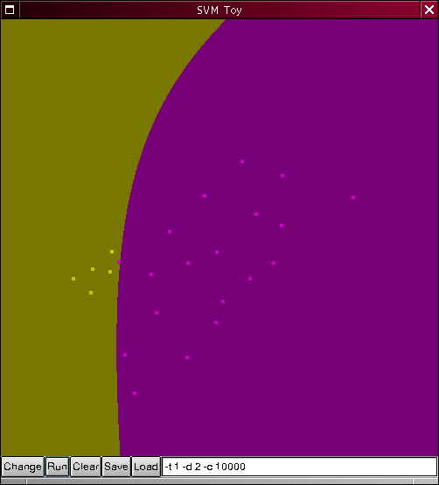
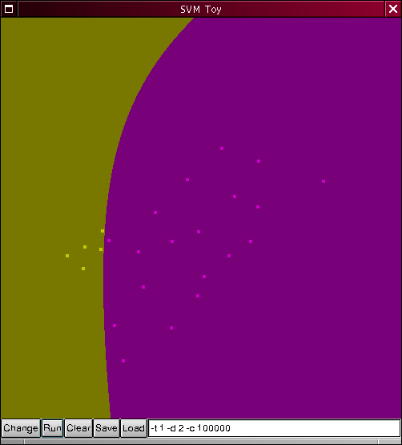
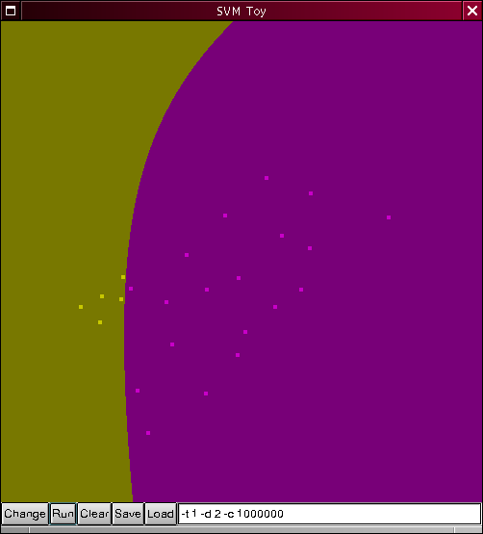
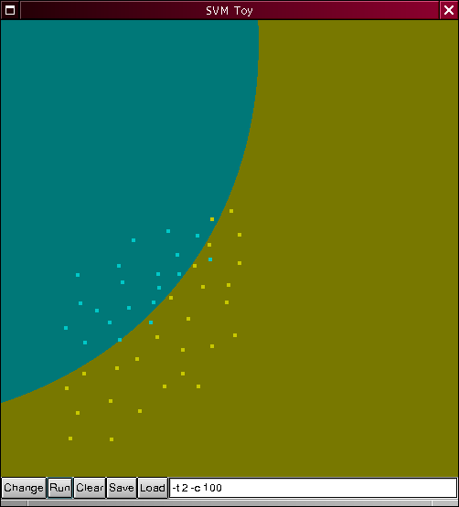
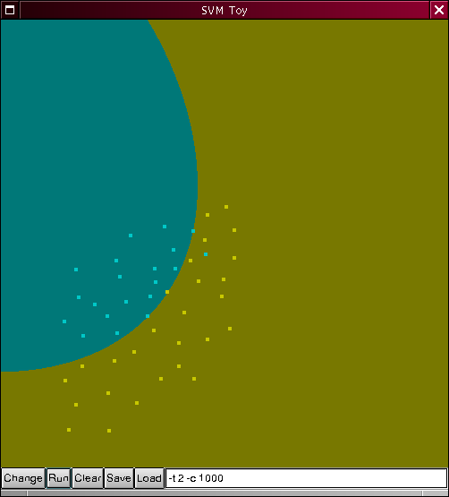
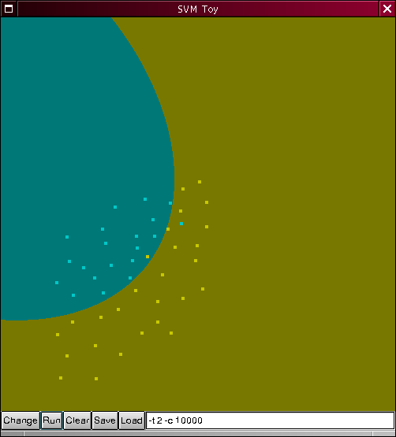
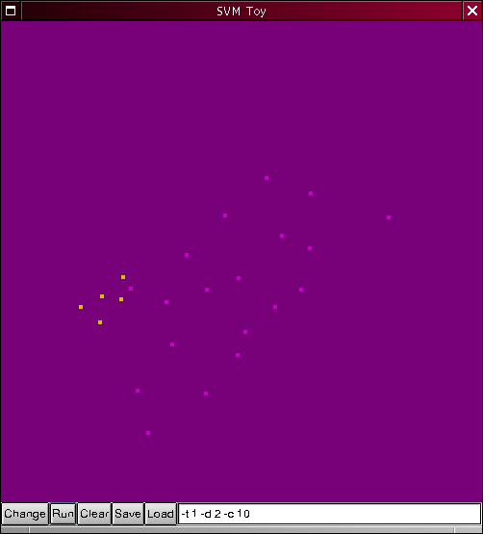
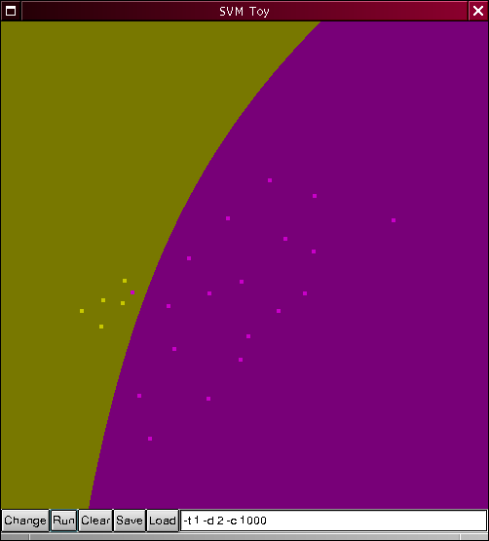
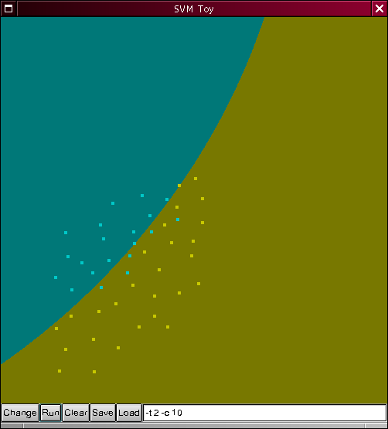
SVM implementations
SVM^{light}
  Simple text data format
  Fast, C routines
bsvm
  Multiple class.
LIBSVM
  GUI: svm-toy
MATLAB svm toolbox
  Graphical interface 2D

Slide 33
Extend Two Classes to More……
Okay, we have learned the approach to handle the kind of classification problems with two classes using SVM.
But, there are more than 2 classes in most real-world applications, such as face recognition, handwritten digit classification.

Slide 34
Classification: Basic Concepts and Methods
Support Vector Machines (SVM)
  SVM— Introduction
  Linearly separable SVM
    Motivation
    Definition of Margin
    Objective Function
    Solution
  Linearly inseparable SVM (Nonlinear SVM)
    Kernel Method
  Multi-Class SVM (多类SVM)
    Construction Method

Slide 35
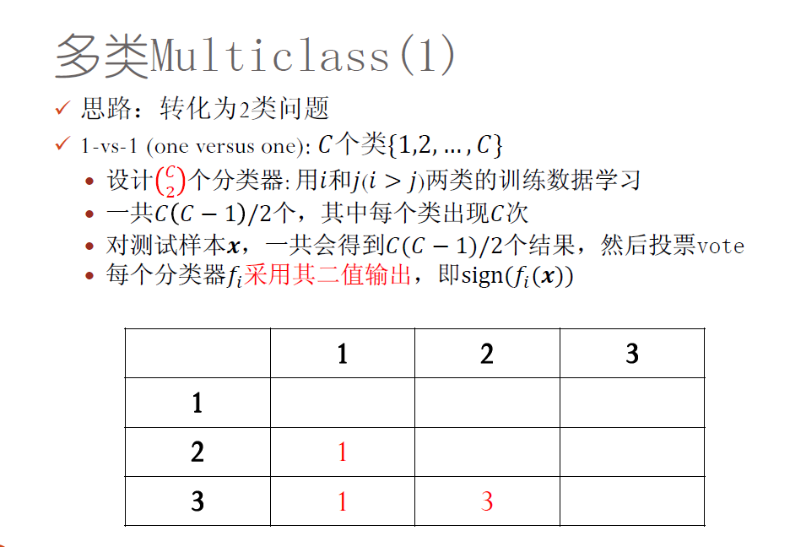
Multi-class SVM classification

Slide 36
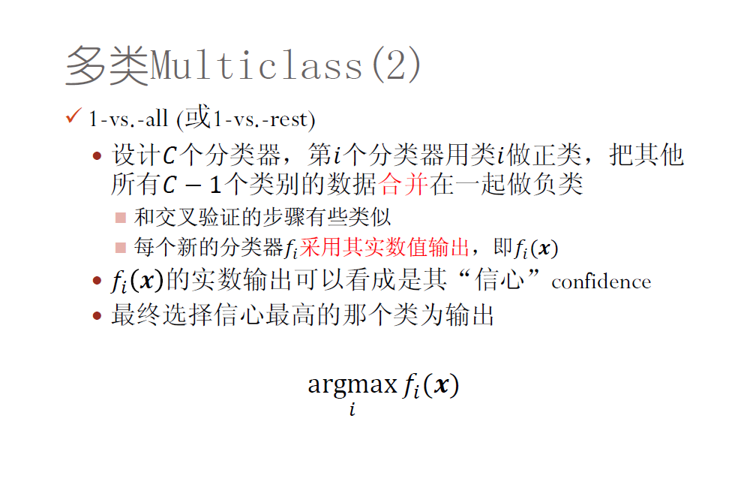
Multi-class SVM classification

Slide 37
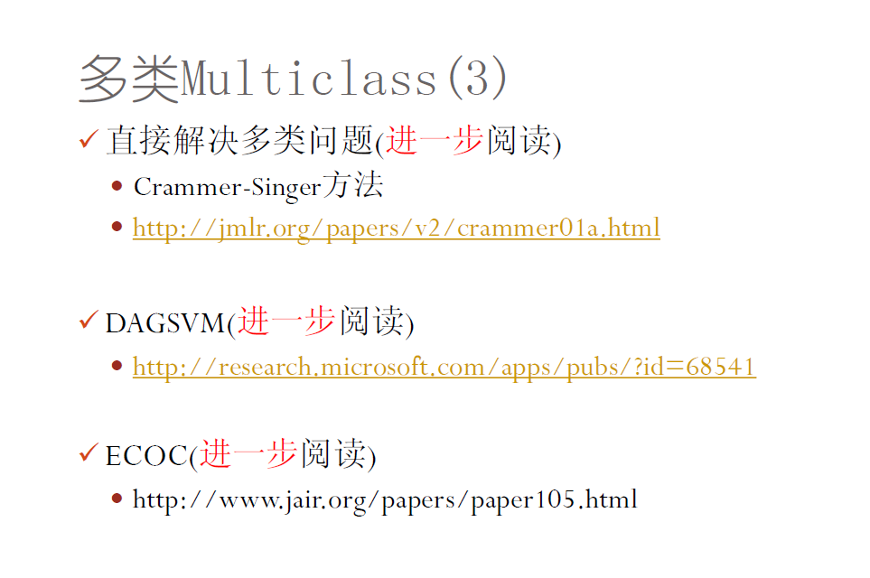
Multi-class SVM classification

Slide 38
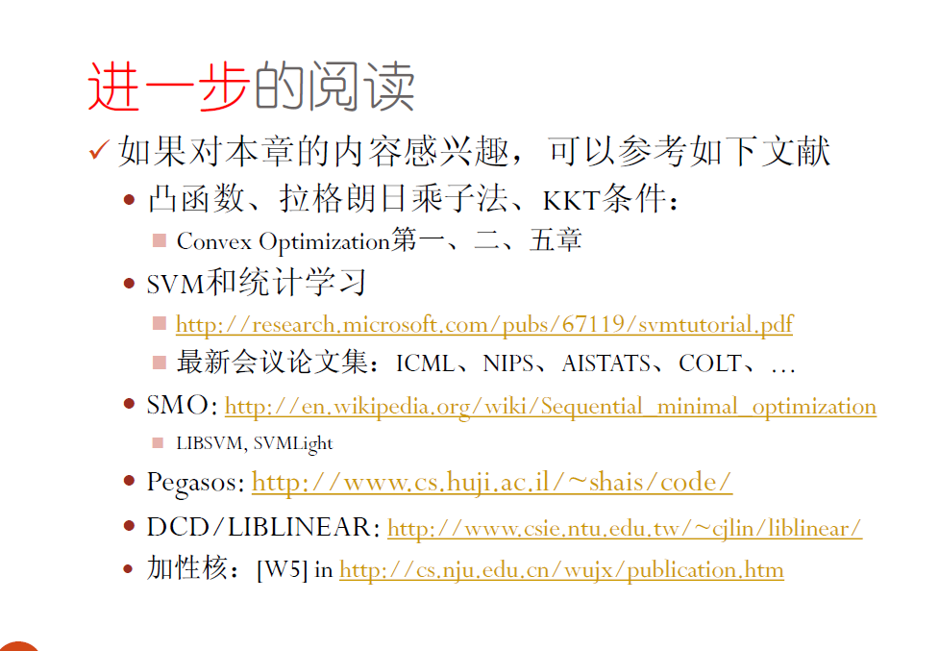

Slide 39
SVM implementations.
SVM^{light} - satyr.net2.private:/usr/local/bin
        svm_learn, svm_classify
bsvm - satyr.net2.private:/usr/local/bin
        svm-train, svm-classify, svm-scale
libsvm - satyr.net2.private:/usr/local/bin
        svm-train, svm-predict, svm-scale, svm-toy
mySVM
MATLAB svm toolbox
Differences: available Kernel functions, optimization, multiple class., user interfaces

