Slide 1
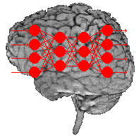
Data Mining:
Data Classification (数据分类)
Part 5 — Neural Networks (神经网络)

Slide 2
The partial materials of this part are from
Lecture Notes for Chapter 5
Introduction to Data Mining by
Tan, Steinbach, Kumar
Revised by Jared

Slide 3
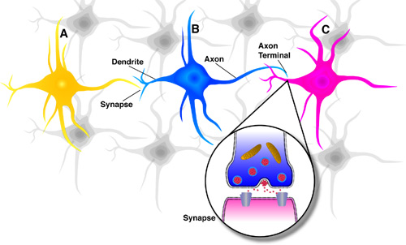
Classification: Basic Concepts and Methods
  Neural Networks (NN)
    Concepts of Artificial Neural Network (ANN)
    History of ANN
    How do our brains work?
  How do ANNs work?
    Single Layer Feed-forward NN
      Linear NN
      Or, And
    Multi-Layer Feed-forward NN
      Nonlinear NN
      XOR
      Back Propagation (BP)

Slide 4
Neural Networks (NN)
Artificial neural network (ANN) is a machine learning approach that models human brain and consists of a number of artificial neurons.
An artificial neural network (ANN) consists of a pool of simple processing units which communicate by sending signals to each other over a large number of weighted connections.
Neuron in ANNs tend to have fewer connections than biological neurons.
Each neuron in ANN receives a number of inputs.
An activation function (激励函数) is used to these inputs which results in activation level of neuron (output value of the neuron).

Slide 5
Neural Networks (Cont.)
An Artificial Neural Network is specified by:
  neuron model: the information processing unit of the NN
  an architecture (架构): a set of neurons and links connecting neurons. Each link has a weight
  a learning algorithm: used for training the NN by modifying the weights to model a particular learning task correctly on the training examples.
The objective is to obtain a NN that is trained and generalizes well.
During the learning phase, the network learns by adjusting the weights so as to be able to predict the correct class label of the input tuples
It should behave correctly on new instances of the learning task.

Slide 6
History of Neural Networks
History traces back (追溯) to the 50’s but became popular in the 80’s with work by Rumelhart, Hinton, and Mclelland
  A General Framework for Parallel Distributed Processing in Parallel Distributed Processing: Explorations in the Microstructure of Cognition
Peaked in the 90’s. Today:
  Hundreds of variants
  Less a model of the actual brain than a useful tool, but still some debate
Numerous applications
  Handwriting, face, speech recognition
  Vehicles that drive themselves
  Models of reading, sentence production, dreaming

Slide 7
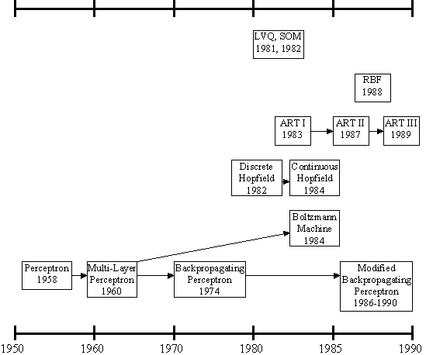
History of Neural Networks
多层感知器：
解决线性不
可分问题
感知器

Slide 8
人工神经网络的发展与类型
人工神经网络的发展
  启蒙阶段：感知器模型
  低潮时期：线性不可分问题
  复兴时期：Hopfield模型
神经网络的类型
  前向型 反馈型 随机型 自组织竞争型
Feedforward neural network
Feedback neural network
Stochastic neural network
Self-organizing competitive neural network

Slide 9
人工神经网络特点
初步的自适应与自组织能力
在学习或训练过程中改变突触权重值，以适应周围环境的要求
泛化能力
泛化能力指对没有训练过的样本，有很好的预测能力和控制能力
非线性映射能力
系统很复杂，或者系统未知，系统信息量很少时，建立精确的数学模型很困难时，神经网络的非线性映射能力则表现出优势
高度并行性
从功能的模拟角度上看，神经网络也应具备很强的并行性

Slide 10
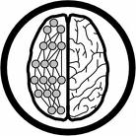
Mechanism of ANNs
An artificial neural network (ANN) is either a hardware implementation or a computer program which strives to simulate the information processing capabilities of its biological exemplar. ANNs are typically composed of a great number of interconnected artificial neurons. The artificial neurons are simplified models of their biological counterparts.
ANN is a technique for solving problems by constructing software that works like our brains.

Slide 11
Neural Network as a Classifier
Strength
  High tolerance to noisy data
  Ability to classify untrained patterns
  Well-suited for continuous-valued inputs and outputs
  Successful on an array of real-world data, e.g., hand-written letters
  Algorithms are inherently parallel
  Techniques have recently been developed for the extraction of rules from trained neural networks
Weakness
  Long training time
  High complexity of the network structure: require a number of parameters typically best determined empirically, e.g., the network topology or “structure.”
  Poor interpretability: Difficult to interpret the symbolic meaning behind the learned weights and of “hidden units” in the network

Slide 12
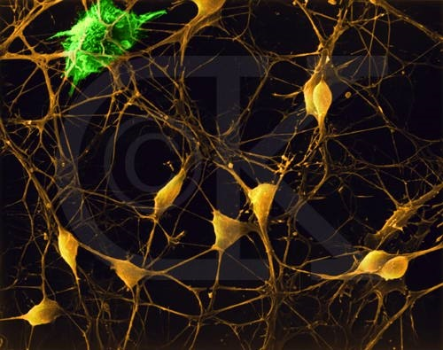
Neurons (神经元) in Brain
Although heterogeneous, at a low level the brain is composed of neurons
  A neuron receives input from other neurons (generally thousands) from its synapses （突触）
  Inputs are approximately summed
  When the input exceeds a threshold the neuron sends an electrical spike that travels from the body, down the axon (轴突), to the next neuron(s)

Slide 13

How do our brains work?
    The Brain is a massively parallel information processing system (大规模并行信息处理系统).
    Our brains are a huge network of processing elements. A typical brain contains a network of 10 billion neurons.

Slide 14
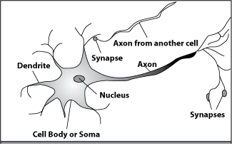
How do our brains work?
A processing element
Dendrites （树突）: Input
Cell body（细胞体）: Processor
Synaptic（突触）: Link
Axon （轴突）: Output

Slide 15
How do our brains work?
A processing element
A neuron is connected to other neurons through about 10,000 synapses （突触）

Slide 16
How do our brains work?
A processing element
A neuron receives input from other neurons. Inputs from dendrites （树突） are combined.

Slide 17
How do our brains work?
A processing element
Once input exceeds a critical level, the neuron discharges a spike ‐ an electrical pulse that travels from the body (细胞体), down the axon（轴突）, to the next neuron(s)

Slide 18
How do our brains work?
A processing element
The axon endings （ 轴突末梢） almost touch the dendrites （树突） or cell body （细胞体）of the next neuron.

Slide 19
How do our brains work?
A processing element
Transmission of an electrical signal from one neuron to the next is effected by neurotransmitters （神经递质）.
Neurotransmitters are chemicals which are released from the first neuron and which bind to the Second. The strength of the signal depends on factors such as the amount of neurotransmitter available.

Slide 20
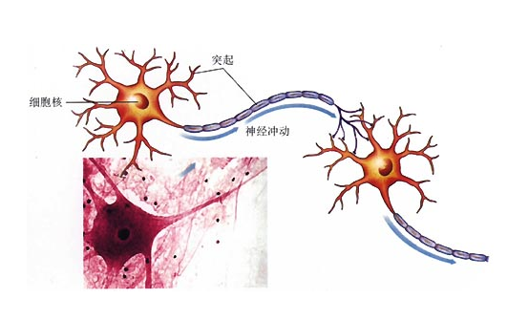
Biological Neural Systems
Neuron switching time : > 10⁻³ secs
Number of neurons (神经元) in the human brain: ~10¹⁰
Connections (synapses) per neuron : ~10⁴–10⁵
Face recognition : 0.1 secs
High degree of distributed and parallel computation
  Highly fault tolerent
  Highly efficient
  Learning is key

Slide 21
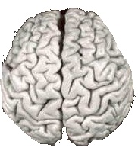

Comparison of Brains and Traditional Computers
200 billion neurons, 32 trillion synapses
Element size: 10⁻⁶ m
Energy use: 25W
Processing speed: 100 Hz
Parallel, Distributed (并行，分布)
Fault Tolerant
Learns: Yes
Intelligent/Conscious: Usually
1 billion bytes RAM but trillions of bytes on disk
Element size: 10⁻⁹ m
Energy watt: 30-90W (CPU)
Processing speed: 10⁹ Hz
Serial, Centralized (串行，
集中)
Generally not Fault Tolerant
Learns: Some
Intelligent/Conscious: Generally No

Slide 22
Biological Inspiration
Idea : To make the computer more robust, intelligent, and learn, …
Let’s model our computer software (and/or hardware) after the brain
“My brain: It's my second favorite organ.”
- Woody Allen (伍迪· 艾伦), from the movie Sleeper

Slide 23
Classification: Basic Concepts and Methods
  Neural Networks (NN)
    Concepts of Artificial Neural Network (ANN)
    History of ANN
    How do our brains work?
  How do ANNs work?
    Single Layer Feed-forward NN
      Linear NN
      Or, And
    Multi-Layer Feed-forward NN
      Nonlinear NN
      XOR
      Back Propagation (BP)

Slide 24
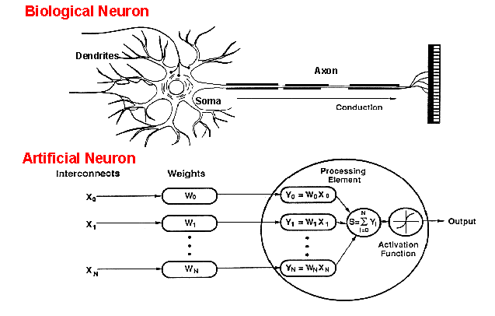
How do ANNs work?
An artificial neuron is an imitation of a human neuron

Slide 25
Network Architectures
Three different classes of network architectures
  single-layer feed-forward
  multi-layer feed-forward
  Recurrent （递归）
The architecture of a neural network is linked with the learning algorithm used to train

Slide 26
Single Layer Feed-forward
Input layer
of
source nodes
Output layer
of
neurons

Slide 27

Perceptrons: Simple NN
inputs
weights
x₁
w₁
Activation function
output
w₂
x₂
Σ
y
.
.
.
θ
a=Σ_{i=1}^{n} w_{i} x_{i}
w_{n}
x_{n}
Xi’s range: [0, 1]
1 if a ≥ θ
y=
0 if a < θ
{

Slide 28
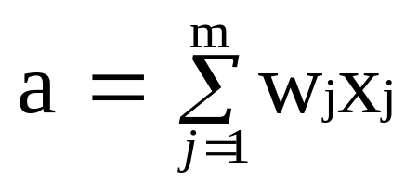
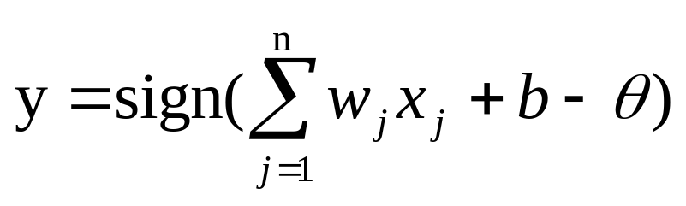
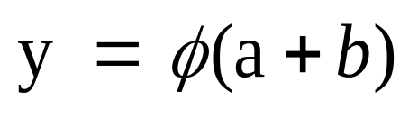
Neuron in NN
The neuron is the basic information processing unit of a NN. It consists of:
  A set of links, describing the neuron inputs, with weights W₁, W₂, …, W_{m}
  An adder function (linear combiner) for computing the weighted sum of the inputs:
  (real numbers)
  Activation function for limiting the amplitude of the neuron output. Here ‘b’ denotes bias.

Slide 29
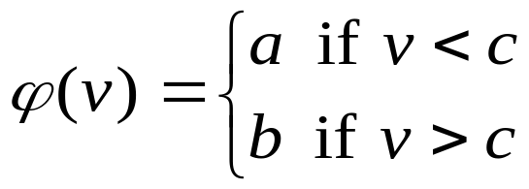
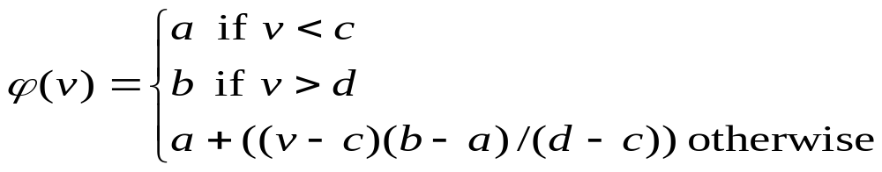
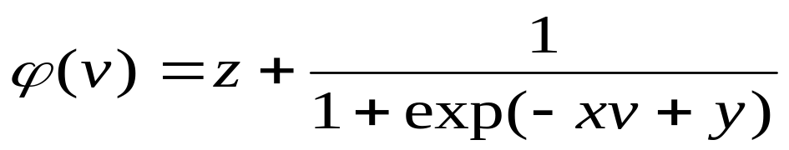
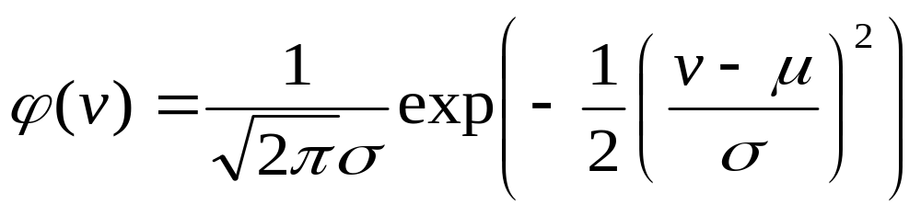
Neuron Models
The choice of activation function determines the neuron model.
Examples:
step function:
ramp function:
sigmoid function with z,x,y parameters
Gaussian function:

Slide 30
Step Function
b
a
c

Slide 31
Ramp Function
b
a
c d

Slide 32
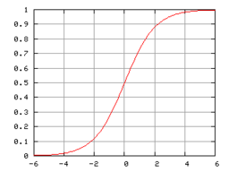
Sigmoid function

Slide 33
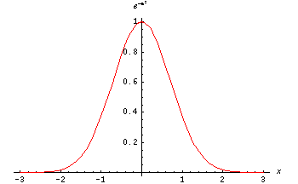
The Gaussian function is the probability function of the normal distribution. Sometimes also called the frequency curve.

Slide 34
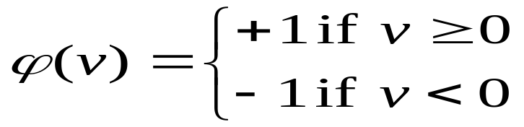
Perceptron: Neuron Model
(Special form of single layer feed forward)
The perceptron (感知器) was first proposed by Rosenblatt (1958), which is a simple neuron that is used to classify its input into one of two categories.
A perceptron (感知器) uses a step function that returns +1 if weighted sum of its input ≥ 0 and -1 otherwise

Slide 35
Perceptron for Classification
The perceptron is used for binary classification.
First, train a perceptron for a classification task.
  Find suitable weights in such a way that the training examples are correctly classified.
  Geometrically try to find a hyper-plane that separates the examples of the two classes.
The perceptron can only model linearly separable classes.
Given training examples of classes C₁, C₂ train the perceptron in such a way that :
  If the output of the perceptron is +1 then the input is assigned to class C₁
  If the output is -1 then the input is assigned to C₂

Slide 36
Decision Surface of a Perceptron
Decision line
w₁ x₁ + w₂ x₂ = θ
1
1
x₂
w
1
0
0
0
x₁
1
0
0

Slide 37
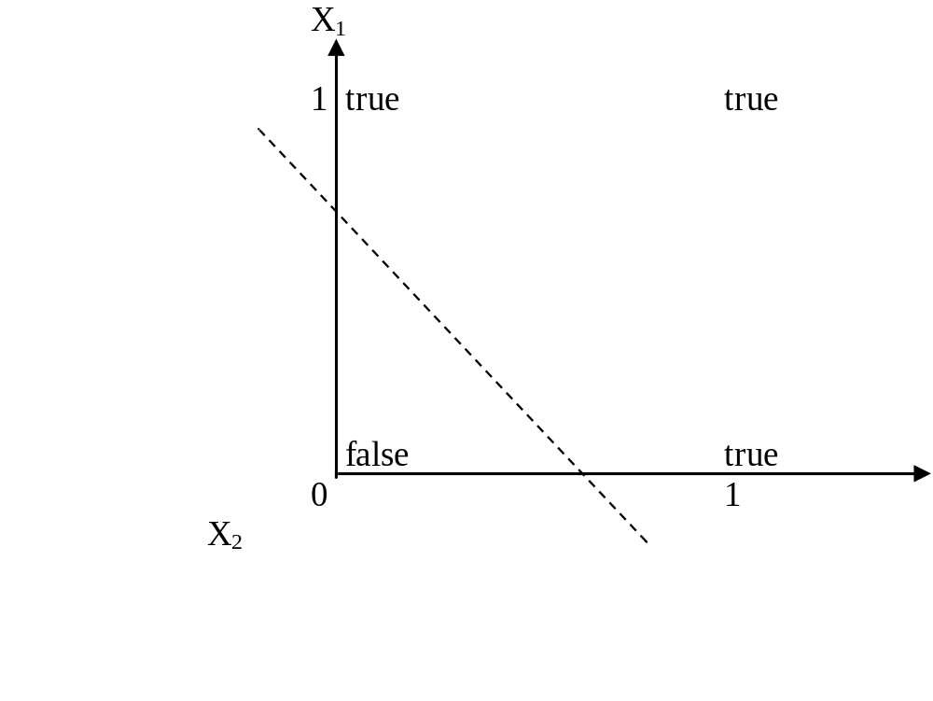
Boolean function OR – Linearly separable
x₁ | x₂ | x₁ or x₂
0 | 0 | 0
0 | 1 | 1
1 | 0 | 1
1 | 1 | 1

Slide 38
Learning Process for Perceptron
Initially assign random weights to inputs between -0.5 and +0.5
Training data is sent to perceptron and its output is observed.
If output is incorrect, the weights will be adjusted accordingly using the following formula.
wi ← wi + (a* xi *e), where ‘e’ is error produced and ‘a’ (-1 < a < 1) is learning rate
  ‘a’ is defined as 0 if output is correct, it is +ve, if output is too low and –ve, if output is too high.
  Once the modification to weights has taken place, the next piece of training data is used in the same way.
  Once all training data have been applied, the process starts again until all the weights are correct and all errors are zero.
  Each iteration of this process is known as an epoch.

Slide 39
Example: Perceptron to learn OR function
Initially consider w1 = -0.2 and w2 = 0.4
Training data say, x1 = 0 and x2 = 0, output is 0.
Compute y = Step(w1*x1 + w2*x2) = 0. Output is correct so weights are not changed.
For training data x1=0 and x2 = 1, output is 1
Compute y = Step(w1*x1 + w2*x2) = 0.4(>0) = 1. Output is correct so weights are not changed.
Next training data x1=1 and x2 = 0 and output is 1
Compute y = Step(w1*x1 + w2*x2) = -0.2(<0) = 0. Output is incorrect, hence weights are to be changed.
Assume a = 0.2 and error e=1
wi = wi + (a * xi * e) gives w1 = 0 and w2 =0.4
With these weights, test the remaining test data.
Repeat the process till we get stable result.

Slide 40
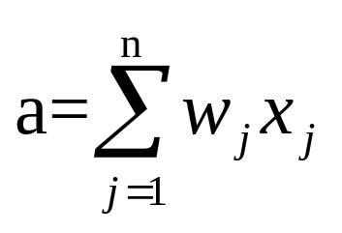
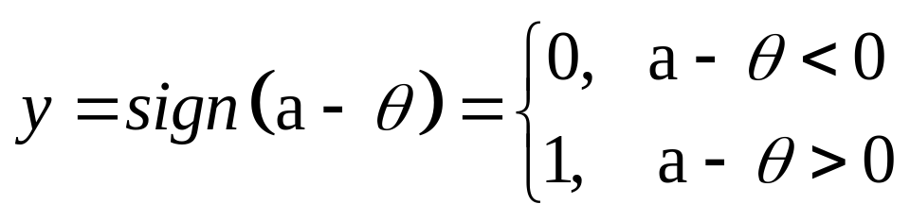
And function: Linear Separability
w₁=1
w₂=1
θ=1.5
x₂
0
1
x₁
0
0
Logical AND
x₁ | x₂ | a | y
0 | 0 | 0 | 0
0 | 1 | 1 | 0
1 | 0 | 1 | 0
1 | 1 | 2 | 1

Slide 41
Perceptron: Limitations
The perceptron can only model linearly separable functions,
  those functions which can be drawn in 2-dim graph and single straight line separates values into two part.
Boolean functions given below are linearly separable:
  AND
  OR
  COMPLEMENT
It cannot model the XOR function since it is not linearly separable.
  When the two classes are not linearly separable, it may be desirable to obtain a linear separator that minimizes the mean squared error.

Slide 42
Classification: Basic Concepts and Methods
  Neural Networks (NN)
    Concepts of Artificial Neural Network (ANN)
    History of ANN
    How do our brains work?
  How do ANNs work?
    Single Layer Feed-forward NN
      Linear NN
      Or, And
    Multi-Layer Feed-forward NN
      Nonlinear NN
      XOR
      Back Propagation (BP)

Slide 43
XOR – Nonlinearly separable function
A typical example of non-linearly separable function is XOR
This function takes two input arguments with values in {0,1} and returns one output in {0,1},
Here 0 and 1 are encoding of the truth values false and true,
The output is true (1) if and only if the two inputs have different truth values. 同0异1
XOR is nonlinearly separable function which can not be modeled by perceptron.
For such functions we have to use multilayer feed-forward network.
0
1
1
0

Slide 44
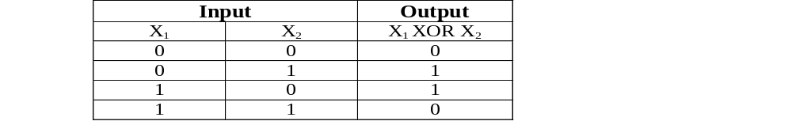
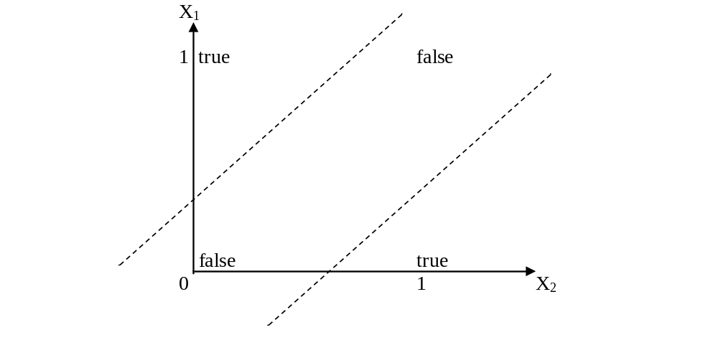
These two classes (true and false) cannot be separated using a line. Hence XOR is non linearly separable.

Slide 45
XOR function: Linear
inseparability
0
1
w₁=?
w₂=?
θ= ?
x₁
1
0
Logical XOR
x₁ | x₂ | y
0 | 0 | 0
0 | 1 | 1
1 | 0 | 1
1 | 1 | 0
Single layer
perceptron failed!!

Slide 46
Multi layer feed-forward NN (FFNN)
FFNN is a more general network architecture, where there are hidden layers between input and output layers.
Hidden nodes do not directly receive inputs nor send outputs to the external environment.
FFNNs overcome the limitation of single-layer NN.
They can handle non-linearly separable learning tasks.
Input
layer
Output
layer
Hidden Layer
3-4-2 Network

Slide 47
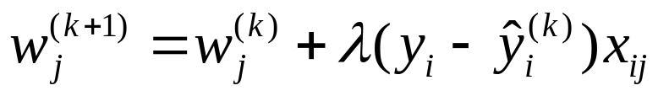
A Multi-Layer Feed-Forward Neural Network
Output vector
Output layer
Hidden layer
w_{ij}
Input layer
Input vector: X
Notes:
MK: Note – different notation than used in book. Will have to standardize notation.

Slide 48
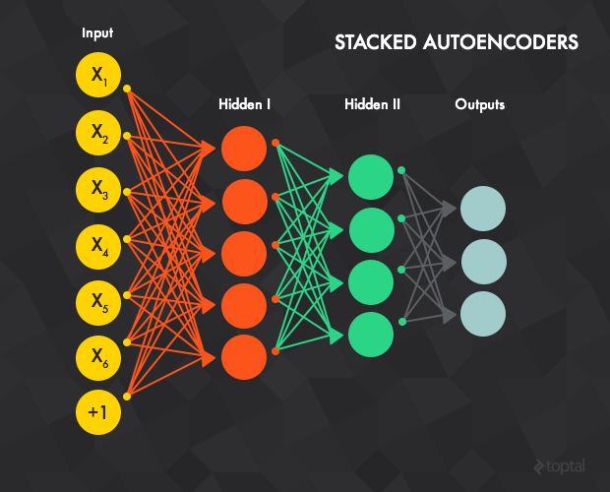
A Multi-Layer Feed-Forward Neural Network

Slide 49
Use multi-layer NN to learn nonlinear XOR function
How to set the weights?
0
1
x₁
1
0
3
x1
w35
Logical XOR
w23
x₁ | x₂ | y
0 | 0 | 0
0 | 1 | 1
1 | 0 | 1
1 | 1 | 0
5
x2
4

Slide 50
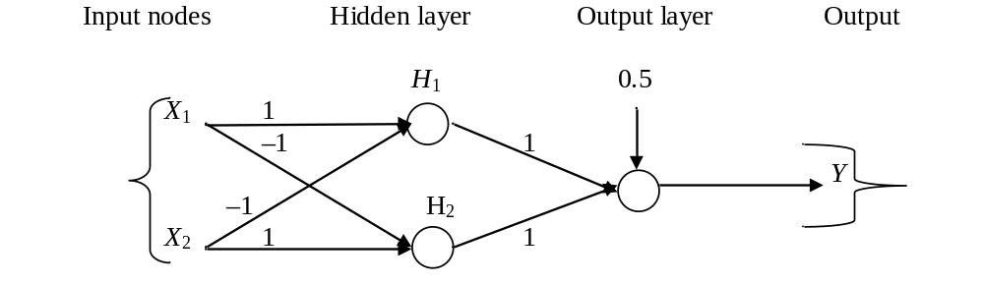
FFNN for XOR
The following ANN for XOR has two hidden nodes that realizes this non-linear separation and uses the sign (step) activation function.
Arrows from input nodes to two hidden nodes indicate the directions of the weight vectors (1,-1) and (-1,1).
The output node is used to combine the outputs of the two hidden nodes.
θ2=
θ1=0

Slide 51
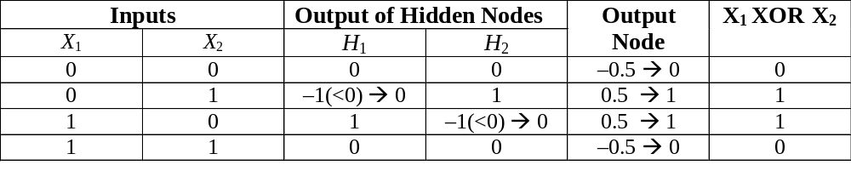
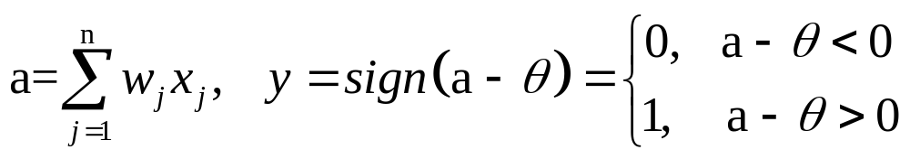

weight vectors for
hidden and output: (1,-1) (-1,1) (1,1)
θ1=0
θ2=

Slide 52
Defining a Network Topology
Decide the network topology: Specify # of units in the input layer, # of hidden layers (if > 1), # of units in each hidden layer, and # of units in the output layer
Normalize the input values for each attribute measured in the training samples to [0.0—1.0]
One input unit per domain value, each initialized to 0
Output, if for classification with more than two classes, one output unit per class is used
Once a network has been trained and its accuracy is unacceptable, repeat the training process with a different network topology or a different set of initial weights

Slide 53
BackPropagation (BP)
The Backprop algorithm iteratively process a set of training tuples and compare the network's prediction with the actual known target value.
Goal: searches for weight values that minimize the total mean squared error of the network over the training set.
Backprop consists of the repeated application of the following two steps:
  Forward pass: the network is activated on one example and the error of (each neuron of) the output layer is computed.
  Backward pass: the network error is used for updating the weights. Starting at the output layer, the error is propagated backwards through the network, layer by layer. This is done by recursively computing the local gradient of each neuron.

Slide 54
Back Propagation
Back-propagation training algorithm
Backprop adjusts the weights of the NN in order to minimize the network total mean squared error.
Network activation
Forward Step
Error propagation
Backward Step

Slide 55
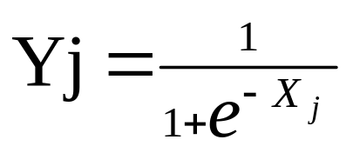
Back Propagation (Cont.)
Consider a network of three layers.
Let us use i to represent nodes in input layer, j to represent nodes in hidden layer and k represent nodes in output layer.
w_{ij} refers to weight of connection between a node in input layer and node in hidden layer.
The following equation is used to derive the output value Yj of node j
where, X_{j} = ∑ x_{i} . w_{ij} - θ_{j} , 1≤ i ≤ n;
n is the number of inputs to node j, and θ_{j} is threshold for node j

Slide 56
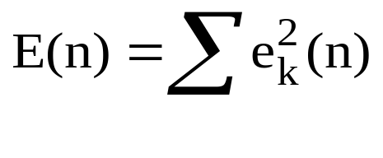
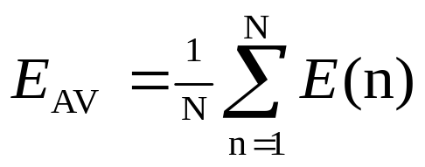
Total Mean Squared Error
The error of output neuron k after the activation of the network on the n-th training example (x(n), d(n)) is:
e_{k}(n) =| d_{k}(n) – y_{k}(n) |
    where d(n) is the ground-truth value of the sample.
The network error is the sum of the squared errors of the output neurons:
The total mean squared error (均方误差) is the average of the network errors of the training examples.

Slide 57
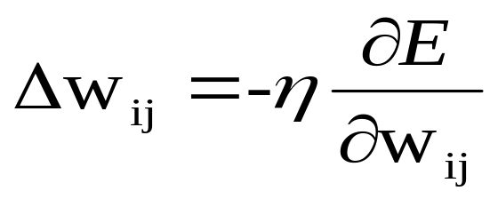
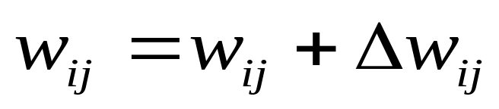
Weight Update Rule
The Backprop weight update rule is based on the gradient descent method:
  It takes a step in the direction yielding the maximum decrease of the network error E.
  This direction is the opposite of the gradient of E.
Iteration of the Backprop algorithm is usually terminated when the sum of squares of errors of the output values for all training data in an epoch is less than some threshold such as 0.01

Slide 58
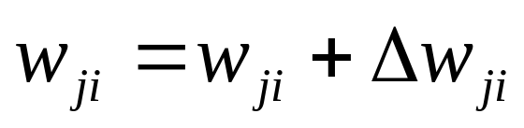
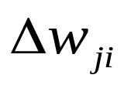
Backprop learning algorithm
(incremental-mode)
n=1;
initialize weights randomly;
while (stopping criterion not satisfied or n <max_iterations)
  for each example (x,d)
  - run the network with input x and compute the output y
  - update the weights in backward order starting from those of the output layer:
  with computed using the (generalized) Delta rule
  end-for
n = n+1;
end-while;

Slide 59
Supervised &Unsupervised Training of NN
We just discussed a form of supervised learning
  A “teacher” tells the network what the correct output is based on the input until the network learns the target concept
  Back-propagation algorithm is a typical supervised NN method
We can also train networks where there is no teacher, called unsupervised learning. The network learns a prototype based on the distribution of patterns in the training data. Such networks allow us to:
  Discover underlying structure of the data
  Encode or compress the data
  Transform the data

Slide 60
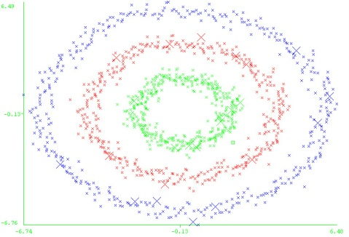
Supervised
Training of NN
In this sort of learning, the human teacher’s experience is used to tell the NN which outputs are correct and which are not.
This does not mean that a human teacher needs to be present at all times, only the correct classifications gathered from the human teacher on a domain needs to be present.
The network then learns from its error, that is, it changes its weight to reduce its prediction error.

Slide 61
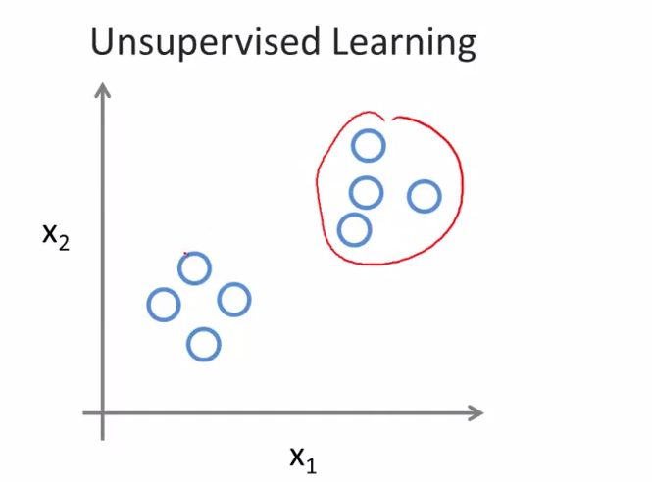
Unsupervised
Training of NN
No external teacher and is based on only local information, also called self-organization, in the sense that it self-organizes data presented to the network and detects their emergent collective properties.
The network is then used to construct clusters of similar patterns.

Slide 62
Neural Network in Use
Since neural networks are best at identifying patterns or trends
in data, they are well suited for prediction or forecasting
needs including:
  sales forecasting, industrial process control
  customer research , data validation , risk management
Classification
  including patterns and sequences recognition, novelty detection and sequential decision making.
    (radar systems, face identification, handwritten text recognition, three-dimensional object recognition; and facial recognition)
Data processing
  including filtering, clustering blinds source separation and compression.
    (data mining, e-mail Spam filtering)

