Slide 1
Natural Language Processing

Slide 2
Terms
NLP: Natural Language Processing
NLU: Natural Language Understanding
NLC: Natural Language Computing
HLP: Human Language Processing
HLU: Human Language Understanding
HLC: Human Language Computing
CL: Computational Linguistics

Slide 3

Definitions
The sub-domain of artificial intelligence concerned with the task of developing programs possessing some capability of ‘understanding’ a natural language in order to achieve some specific goal
NLP
A transformation from one representation (the input text) to another (internal representation)
understanding

Slide 4
Aspects of language processing
Word, lexicon: lexical analysis
  Morphology, word segmentation
Syntax
  Sentence structure, phrase, grammar, …
Semantics
  Meaning
  Execute commands
Discourse analysis
  Meaning of a text
  Relationship between sentences (e.g. anaphora)

Slide 5

Morphological Analysis
Individual words are analyzed into their components
Discourse Analysis
Resolving references Between sentences
Stages of NLP
Pragmatic Analysis
To reinterpret what was said to what was actually meant
Syntactic Analysis
Linear sequences of words are transformed into structures that show how the words relate to each other
Semantic Analysis
A transformation is made from the input text to an internal representation that reflects the meaning

Slide 6
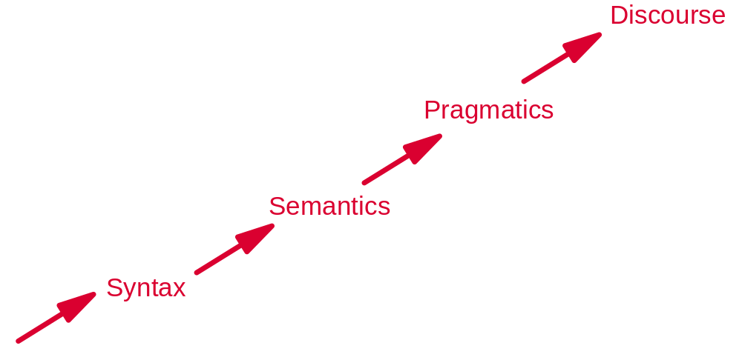

The Steps in NLP
**we can go up, down and up and
down and combine steps too!!
**every step is equally complex

Slide 7
The steps in NLP (Cont.)
Morphology: Concerns the way words are built up from smaller meaning bearing units.
Syntax: concerns how words are put together to form correct sentences and what structural role each word has
Semantics: concerns what words mean and how these meanings combine in sentences to form sentence meanings

Slide 8
The steps in NLP (Cont.)
Pragmatics: concerns how sentences are used in different situations and how use affects the interpretation of the sentence
Discourse: concerns how the immediately preceding sentences affect the interpretation of the next sentence
2/20/2007
Husni Al-Muhtaseb

Slide 9
Simple Applications
Word counters (wc in UNIX)
Spell Checkers, grammar checkers
Detect new words
Predictive Text on mobile handsets
2/20/2007
Husni Al-Muhtaseb

Slide 10
Bigger Applications
Intelligent computer systems
NLU interfaces to databases
Computer aided instruction
Information retrieval
Intelligent Web searching
Data mining
Machine translation
Speech recognition
Natural language generation
Question answering

Slide 11
Brief history
1950s
  Early MT: word translation + re-ordering
  Chomsky’s Generative grammar
  Bar-Hill’s argument
1960-80s
  Applications
    BASEBALL: use NL interface to search in a database on baseball games
    LUNAR: NL interface to search in Lunar
    ELIZA: simulation of conversation with a psychoanalyst
    SHREDLU: use NL to manipulate block world
    Message understanding: understand a newspaper article on terrorism
    Machine translation
  Methods
    ATN (augmented transition networks): extended context-free grammar
    Case grammar (agent, object, etc.)
    DCG – Definite Clause Grammar
    Dependency grammar: an element depends on another
1990s-now
  Statistical methods
  Speech recognition
  MT systems
  Question-answering
  …

Slide 12
Classical symbolic methods
Morphological analyzer
Parser (syntactic analysis)
Semantic analysis (transform into a logical form, semantic network, etc.)
Discourse analysis
Pragmatic analysis

Slide 13
Morphological analysis
Goal: recognize the word and category
Using a dictionary: word + category
Input form (computed)
Morphological rules:
  Lemma + ed -> Lemma + e (verb in past form)
  …
Is Lemma in dict.? If yes, the transformation is possible
Form -> a set of possible lemmas

Slide 14
Parsing (in DCG)
s --> np, vp. det -->[a]. det --> [an].
np --> det, noun. det --> [the].
np --> proper_noun. noun --> [apple].
vp --> v, ng. noun --> [orange].
vp --> v. proper_noun --> [john].
proper_noun --> [mary].
v --> [eats].
v --> [loves].
Eg. john eats an apple.
proper_noun v det noun
np
np vp
s

Slide 15
Semantic analysis
john eats an apple. Sem. Cat (Ontology)
proper_noun v det noun object
[person: john] λYλX eat(X,Y) [apple]
np animated non-anim
[apple]
np vp person animal food …
[person: john] eat(X, [apple])
s vertebral … fruit …
eat([person: john], [apple])
apple …

Slide 16
Parsing & semantic analysis
Rules: syntactic rules or semantic rules
  What component can be combined with what component?
  What is the result of the combination?
Categories
  Syntactic categories: Verb, Noun, …
  Semantic categories: Person, Fruit, Apple, …
Analyses
  Recognize the category of an element
  See how different elements can be combined into a sentence
  Problem: The choice is often not unique

Slide 17
Word Sense Resolution
Many words have many meanings or senses
We need to resolve which of the senses of an ambiguous word is invoked in a particular use of the word
I made her duck. (made her a bird for lunch or made her move her head quickly downwards?)
2/20/2007
Husni Al-Muhtaseb

Slide 18
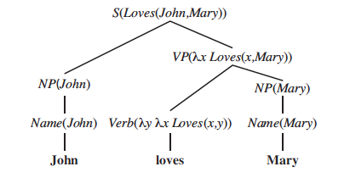
Write a semantic analysis grammar
S(pred(obj)) -> NP(obj) VP(pred)
VP(pred(obj)) -> Verb(pred) NP(obj)
NP(obj) -> Name(obj)
Name(John) -> John
Name(Mary) -> Mary
Verb(λyλx Loves(x,y)) -> loves

Slide 19
Discourse analysis
Anaphora
  He hits the car with a stone. It bounces back.
Understanding a text
  Who/when/where/what … are involved in an event?
  How to connect the semantic representations of different sentences?
  What is the cause of an event and what is the consequence of an action?
  …

Slide 20
Pragmatic analysis
Practical usage of language: what a sentence means in practice
  Do you have time?
  How do you do?
  It is too cold to go outside!
  …

Slide 21
Example
stems
Surface form
I (pronoun) want (verb)
to (prep)
to(infinitive) print (verb)
Ali (noun)
‘s (possessive) .init (adj)
file (noun)
file (verb)
I want to print Ali’s .init file
Morphological
analysis

Slide 22
Syntactic
Example
S
analysis
stems
NP
VP
I (pronoun) want (verb)
to (prep)
to(infinitive) print (verb)
Ali (noun)
‘s (possessive) .init (adj)
file (noun)
file (verb)
S
PRO
V
Parse tree
NP
VP
I
want
PRO
V
NP
ADJ
NP
I
print
ADJ
N
Ali’s
.init
file

Slide 23
Semantic Net
Example
I
Ali
who
S
who
Who’s
NP
want
print
file
VP
what
what
S
type
PRO
V
.init
NP
VP
I
want
PRO
V
NP
ADJ
NP
Semantic
I
print
ADJ
N
analysis
Parse tree
Ali’s
.init
file

Slide 24
Example
To whom the pronoun ‘I’ refers
To whom the proper noun ‘Ali’ refers
What are the files to be printed
Discourse
I
Ali
who
who
Who’s
Pragmatic
want
print
file
what
what
type
Semantic Net
.init
Execute the command
lpr /ali/stuff.init

Slide 25
Stages of NLP
Syntactic Analysis
user
stems
Morphological Analysis
parse tree
Surface form
Semantic Analysis
lexicon
Pragmatic Analysis
Perform action
Internal representation
Discourse Analysis
Resolve references
2/20/2007
Husni Al-Muhtaseb

Slide 26
Problems
Ambiguity
  Lexical/morphological: change (V,N), training (V,N), even (ADJ, ADV) …
  Syntactic: Helicopter powered by human flies
  Semantic: He saw a man on the hill with a telescope.
  Discourse: anaphora, …
Classical solution
  Using a later analysis to solve ambiguity of an earlier step
  Eg. He gives him the change.
  (change as verb does not work for parsing)
  He changes the place.
  (change as noun does not work for parsing)
  However: He saw a man on the hill with a telescope.
    Correct multiple parsings
    Correct semantic interpretations -> semantic ambiguity
    Use contextual information to disambiguate (does a sentence in the text mention that “He” holds a telescope?)

Slide 27




Ambiguity
The boy saw the man on the mountain with a telescope
Prepositional phrase attachment

Slide 28
Ambiguity
The boy saw the man on the mountain with a telescope
Prepositional phrase attachment

Slide 29
Ambiguity
The boy saw the man on the mountain with a telescope
Prepositional phrase attachment

Slide 30
Ambiguity
The boy saw the man on the mountain with a telescope
Prepositional phrase attachment

Slide 31
Rules vs. statistics
Rules and categories do not fit a sentence equally
  Some are more likely in a language than others
  E.g.
    hardcopy: noun or verb?
      P(N | hardcopy) >> P(V | hardcopy)
    the training …
      P(N | training, Det) > P(V | training, Det)
Idea: use statistics to help

Slide 32
Statistical analysis to help solve ambiguity
Choose the most likely solution
  solution* = argmax _{solution} P(solution | word, context)
  e.g. argmax _{cat} P(cat | word, context)
  argmax _{sem} P(sem | word, context)
  Context varies largely (precedent work, following word, category of the precedent word, …)
How to obtain P(solution | word, context)?
  Training corpus

Slide 33
Statistical language modeling
Goal: create a statistical model so that one can calculate the probability of a sequence of tokens s = w₁, w₂,…, w_{n} in a language.
General approach:
Training corpus
s
Probabilities of the observed elements
P(s)

Slide 34
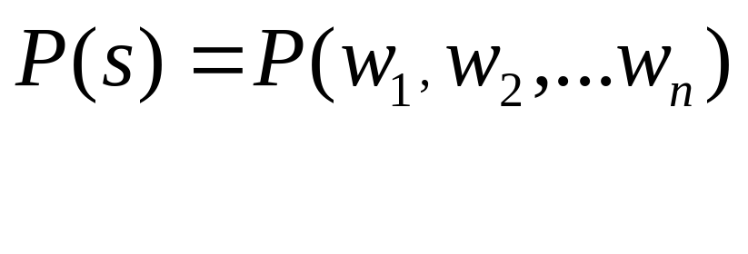
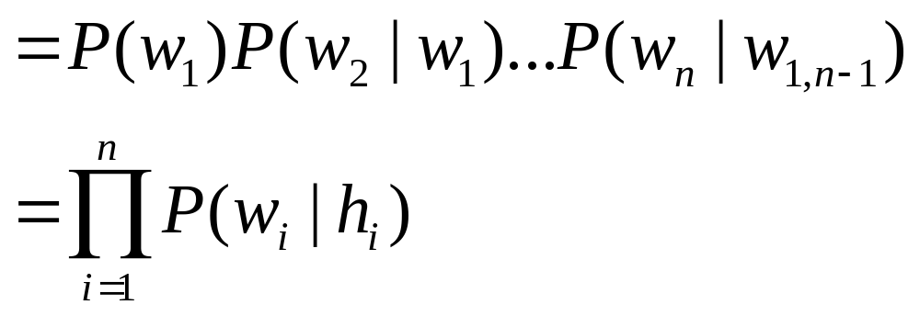
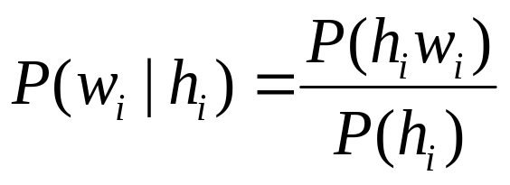
Prob. of a sequence of words
Elements to be estimated:
If h_{i} is too long, one cannot observe (h_{i}, w_{i}) in the training corpus, and (h_{i}, w_{i}) is hard generalize
Solution: limit the length of h_{i}

Slide 35
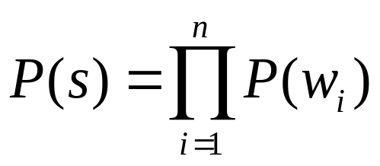
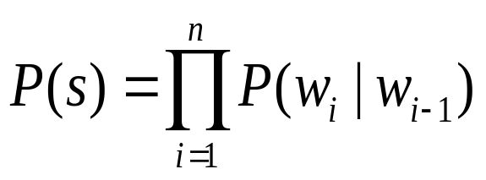
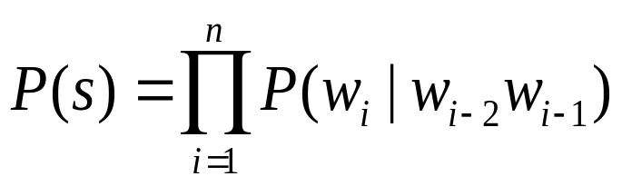
n-grams
Limit h_{i} to n-1 preceding words
Most used cases
  Uni-gram:
  Bi-gram:
  Tri-gram:

Slide 36
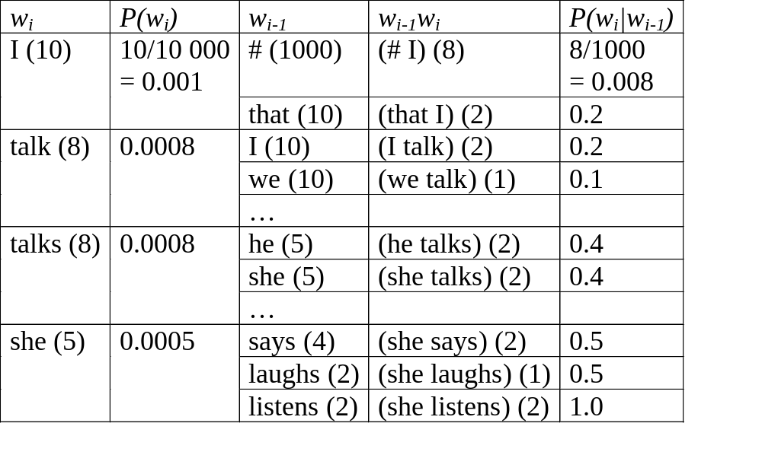
A simple example
(corpus = 10 000 words, 10 000 bi-grams)
Uni-gram: P(I, talk) = P(I) * P(talk) = 0.001*0.0008
P(I, talks) = P(I) * P(talks) = 0.001*0.0008
Bi-gram: P(I, talk) = P(I | #) * P(talk | I) = 0.008*0.2
P(I, talks) = P(I | #) * P(talks | I) = 0.008*0

Slide 37
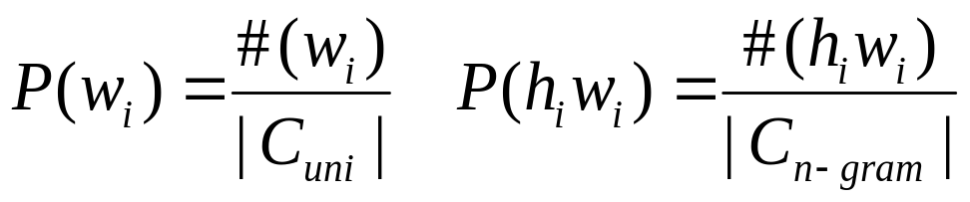
Estimation
History: short long
modeling: coarse refined
Estimation: easy difficult
Maximum likelihood estimation MLE
  If (h_{i} m_{i}) is not observed in training corpus, P(w_{i}|h_{i})=0
  P(they, talk)=P(they|#) P(talk|they) = 0
    never observed (they talk) in training data
  smoothing

Slide 38
Smoothing
Goal: assign a low probability to words or n-grams not observed in the training corpus
P
MLE
smoothed
word

Slide 39
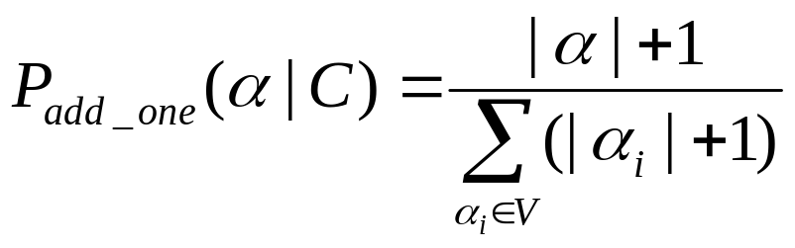
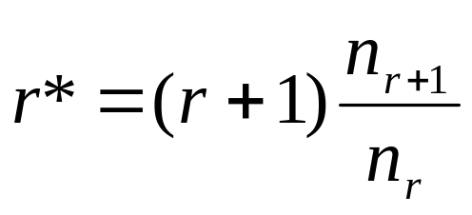
Smoothing methods
n-gram: α
Change the freq. of occurrences
  Laplace smoothing (add-one):
  Good-Turing
  change the freq. r to
  nr = no. of n-grams of freq. r

Slide 40
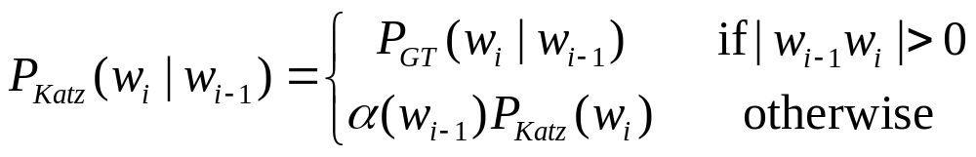
Smoothing (cont’d)
Combine a model with a lower-order model
  Backoff (Katz)
  Interpolation (Jelinek-Mercer)

Slide 41
Examples of utilization
Predict the next word
  argmax _{w} P(w | previous words)
Used in input (predict the next letter/word on cellphone)
Use in machine aided human translation
  Source sentence
  Already translated part
  Predict the next translation word or phrase
  argmax _{w} P(w | previous trans. words, source sent.)

Slide 42
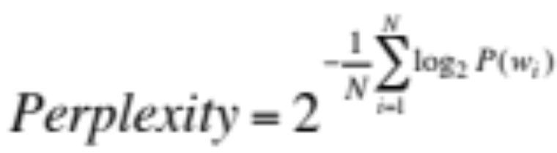
Quality of a statistical language model
Test a trained model on a test collection
  Try to predict each word
  The more precisely a model can predict the words, the better is the model
Perplexity (the lower, the better)
  Given P(w_{i}) and a test text of length N
  Harmonic mean of probability
  At each word, how many choices does the model propose?
    Perplexity=32 ~ 32 words could fit this position

Slide 43
State of the art
Sufficient training data
  The longer is n (n-gram), the lower is perplexity
Limited data
  When n is too large, perplexity decreases
  Data sparseness (sparsity)
In many NLP researches, one uses 5-grams or 6-grams
Google books n-gram (up to 5-grams)https://books.google.com/ngrams

Slide 44
More than predicting words
Speech recognition
  Training corpus = signals + words
  probabilities: P(signal|word), P(word2|word1)
  Utilization: signals sequence of words
Statistical tagging
  Training corpus = words + tags (n, v)
  Probabilities: P(word|tag), P(tag2|tag1)
  Utilization: sentence sequence of tags

Slide 45
Example of utilization
Speech recognition (simplified)
argmax_{w1, …, wn} P(w₁, …, w_{n}|s₁, …, s_{n})
= argmax_{w1, …, wn} P(s₁, …, s_{n}|w₁, …, w_{n}) * P(w₁, …, w_{n})
= argmax_{w1, …, wn} Π_{I} P(s_{i}|w₁, …, w_{n})*P(w_{i}|w_{i-1})
= argmax_{w1, …, wn} Π_{I} P(s_{i}|w_{i})*P(w_{i}|w_{i-1})
  Argmax - Viterbi search
  probabilities:
    P(signal|word),
    P(*** | ice-cream)=P(*** | I scream)=0.8;
    P(word2 | word1)
    P(ice-cream | eat) > P(I scream | eat)
  Input speech signals s₁, s₂, …, s_{n}
    I eat ice-cream. > I eat I scream.

Slide 46
Example of utilization
Statistical tagging
  Training corpus = word + tag (e.g. Penn Tree Bank)
  For w₁, …, w_{n}:
    argmax_{tag1, …, tagn} Π_{I} P(w_{i}|tag_{i})*P(tag_{i}|tag_{i-1})
  probabilities:
    P(word|tag)
    P(change|noun)=0.01, P(change|verb)=0.015;
    P(tag2|tag1)
    P(noun|det) >> P(verb|det)
  Input words: w₁, …, w_{n}
    I give him the change.
    pronoun verb pronoun det noun >
    pronoun verb pronoun det verb

Slide 47
Some improvements of the model
Class model
  Instead of estimating P(w2|w1), estimate P(w2|Class1)
  P(me|take) v.s. P(me|Verb)
  More general model
  Less data sparseness problem
Skip model
  Instead of P(w_{i}|w_{i-1}), allow P(w_{i}|w_{i-k})
  Allow to consider longer dependence

Slide 48
State of the art on POS-tagging
POS = Part of speech (syntactic category)
Statistical methods
Training based on annotated corpus (text with tags annotated manually)
  Penn Treebank: a set of texts with manual annotations http://www.cis.upenn.edu/~treebank/

Slide 49
State of the art of MT
Vauquois triangle (simplified)
concept
semantic
semantic
syntax
syntax
word
word
Source language
Target language

Slide 50
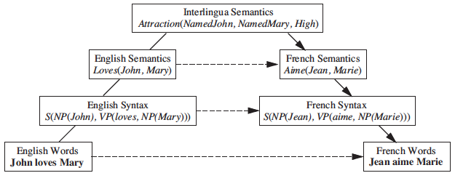
Triangle of Vauguois

Slide 51
State of the art of MT (cont’d)
General approach:
  Word / term: dictionary
  Phrase
  Syntax
  Limited “semantics” to solve common ambiguities
Typical example: Systran

Slide 52
Word/term level
Choose one translation word
Sometimes, use context to guide the selection of translation words
  The boy grows: grandir
  … grow potatoes: cultiver

Slide 53
phrase
Pomme de terre -> potatoe
Find a needle in haystacks ->大海捞针

Slide 54
Statistical machine translation
argmax _{F} P(F|E) = argmax _{F} P(E|F) P(F) / P(E)
= argmax _{F} P(E|F) P(F)
P(E|F): translation model
P(F): language model, e.g. trigram model
More to come later on translation model

Slide 55
Spoken Dialogue System
Us e r
Discourse
Speech
Semantic
Recognition
Interpretation
Interpretation
Speech
Response
Dialogue
Synthesis
Generation
Management

Slide 56
Parts of the Spoken Dialogue System
Signal Processing: Convert the audio wave into a sequence of feature vectors.
Speech Recognition: Decode the sequence of feature vectors into a sequence of words.
Semantic Interpretation: Determine the meaning of the words.
Discourse Interpretation: Understand what the user intends by interpreting utterances in context.
Dialogue Management: Determine system goals in response to user utterances based on user intention.
Speech Synthesis: Generate synthetic speech as a response.

Slide 57


Speech Recognition (1 of 3)
Input Analog Signal Freq. spectrogram
(microphone records voice) (e.g. Fourier transform)
Hz
time
NLP - Prof. Carolina Ruiz

Slide 58
Speech Recognition (2 of 3)
Frequency spectrogram
  Basic sounds in the signal (40-50 phonemes) (e.g. “a” in “cat”)
    Template matching against db of phonemes
      Using dynamic time warping (speech speed)
  Constructing words from phonemes (e.g. “th”+”i”+”ng”=thing)
    Unreliable/probabilistic phonemes (e.g. “th” 50%, “f” 30%, …)
    Non-unique pronunciations (e.g. tomato),
    statistics of transitions phonemes/words (hidden Markov models)
Words

Slide 59
Speech Recognition - Complications
No simple mapping between sounds and words
  Variance in pronunciation due to gender, dialect, …
    Restriction to handle just one speaker
  Same sound corresponding to diff. words
    e.g. bear, bare
  Finding gaps between words
    “how to recognize speech”
    “how to wreck a nice beach”
  Noise

Slide 60
Levels of Sophistication in a Dialogue System
Touch-tone replacement:
System Prompt: "For checking information, press or say one." Caller Response: "One."
Directed dialogue:
System Prompt: "Would you like checking account information or rate information?" Caller Response: "Checking", or "checking account," or "rates."
Natural language:
System Prompt: "What transaction would you like to perform?" Caller Response: "Transfer Rs. 500 from checking to savings.“

Slide 61
Some success stories - ELIZA
young woman: Men are all alike.
eliza: In what way?
young woman: They're always bugging us about something specific or other.
eliza: Can you think of a specific example?
young woman: Well, my boyfriend made me come here.
eliza: Your boyfriend made you come here?
young woman: He says I'm depressed much of the time.
eliza: I am sorry to hear you are depressed.
young woman: It's true. I'm unhappy.
eliza: Do you think coming here will help you not to be unhappy?
young woman: I need some help, that much seems certain.
eliza: What would it mean to you if you got some help?
young woman: Perhaps I could learn to get along with my mother.
eliza: Tell me more about your family.
young woman: My mother takes care of me.

Slide 62
ELIZA – Cont’d
eliza: Who else in your family takes care of you?
young woman: My father.
eliza: Your father.
young woman: You are like my father in some ways.
eliza: What resemblance do you see?
young woman: You are not very aggressive but I think you don't want me to notice that.
eliza: What makes you think I am not very aggressive?
young woman: You don't argue with me.
eliza: Why do you think I don't argue with you?
young woman: You are afraid of me.
eliza: Does it please you to believe I am afraid of you?
young woman: My father is afraid of everybody.
eliza: What else comes to mind when you think of your father?
young woman: Bullies.
eliza: Does that have anything to do with the fact that your boyfriend made you come here?

Slide 63
Methods used in Eliza
Find a trigger in the input of the user (e.g. father)
Evoke a possible candidate pattern (e.g. family or mother) (~limited parsing)
Compose a sentence by filling in the slots of the pattern (picking some elements from the user input)
If no appropriate pattern is found, ask a general question, possibly related to the user input

Slide 64
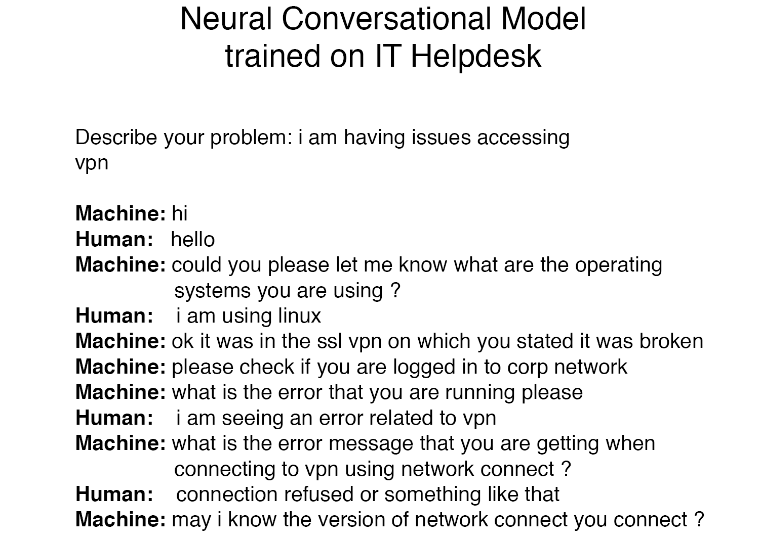

Slide 65
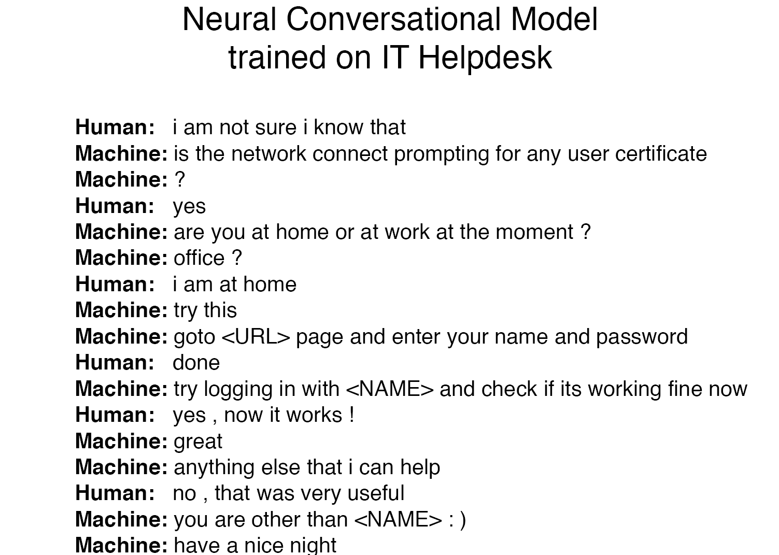


Slide 66
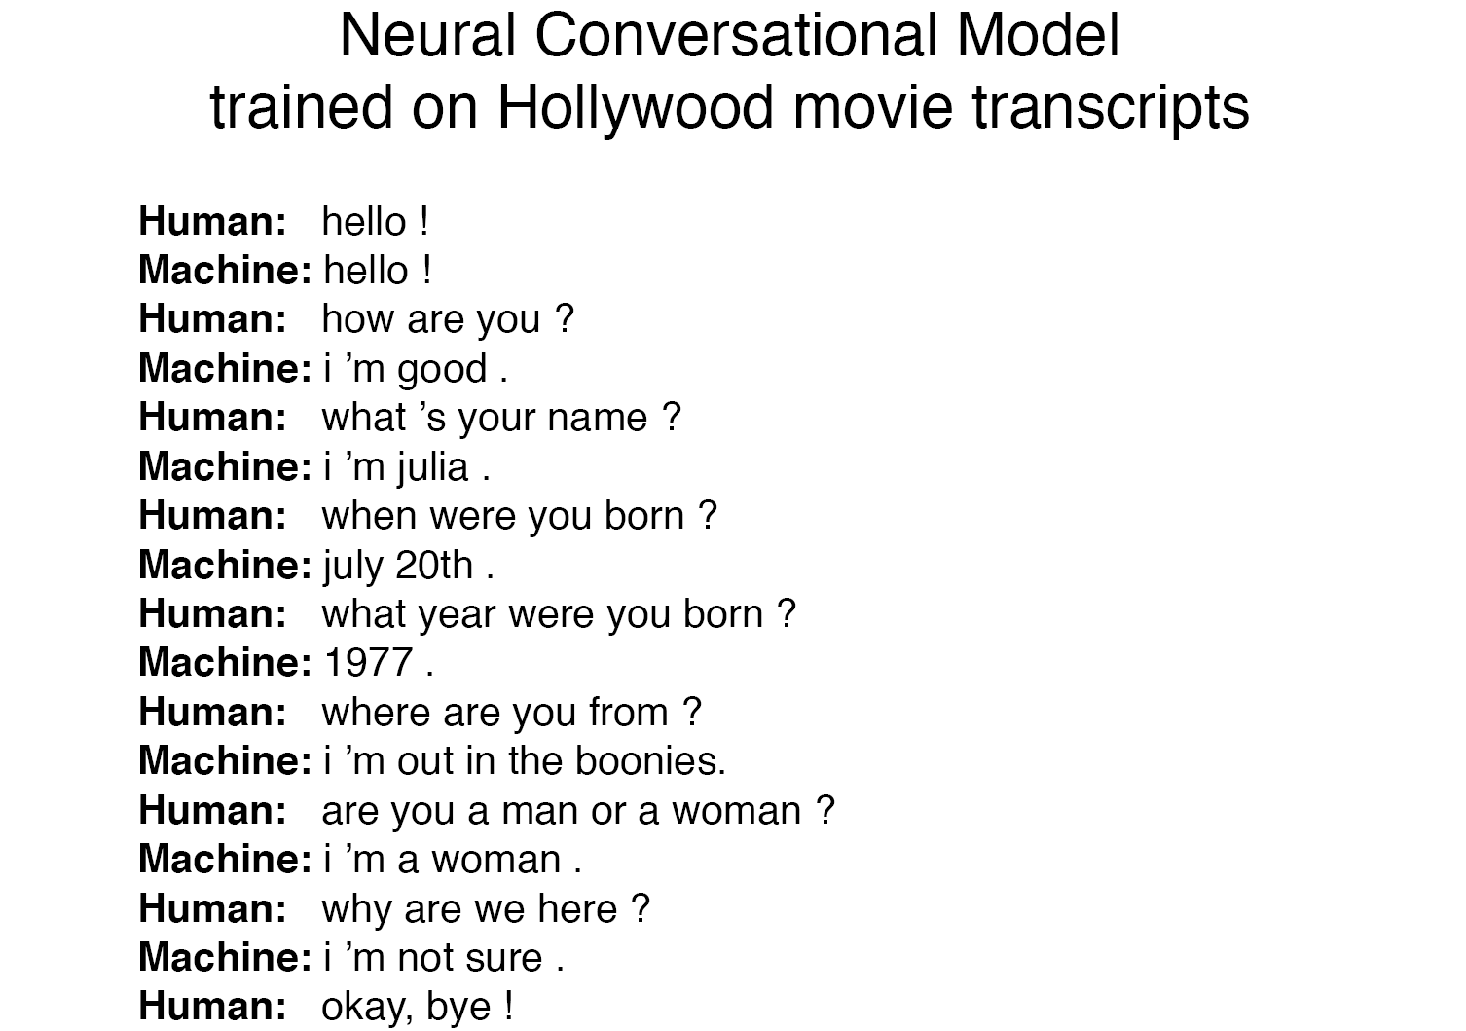

Slide 67
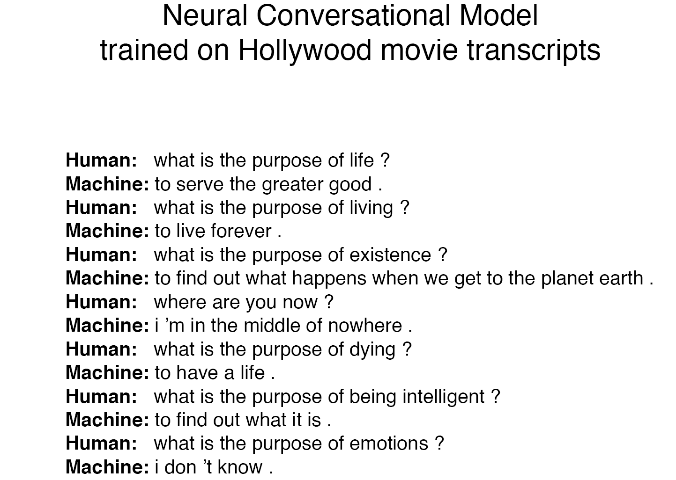

Slide 68
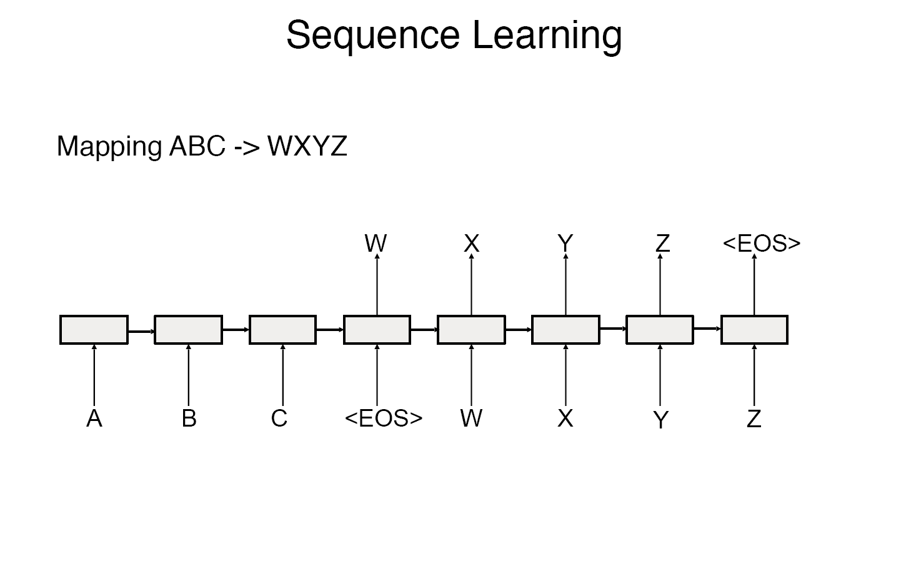

Slide 69
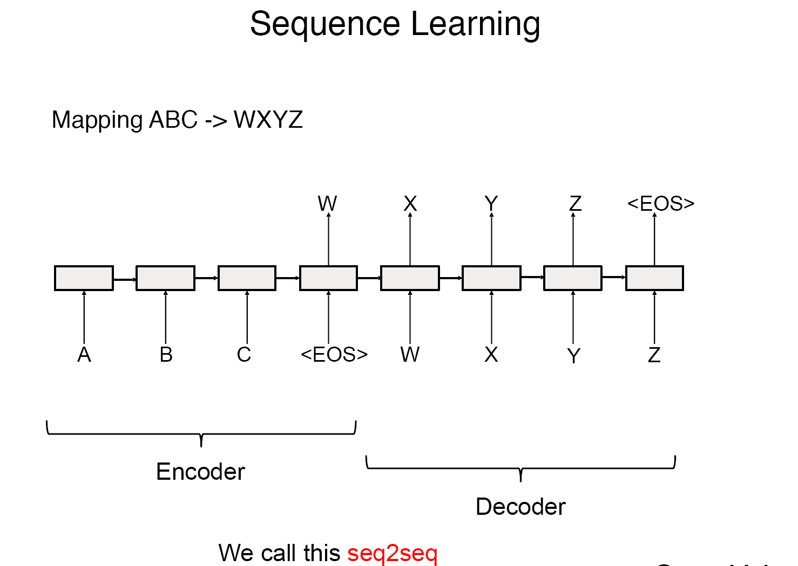

Slide 70
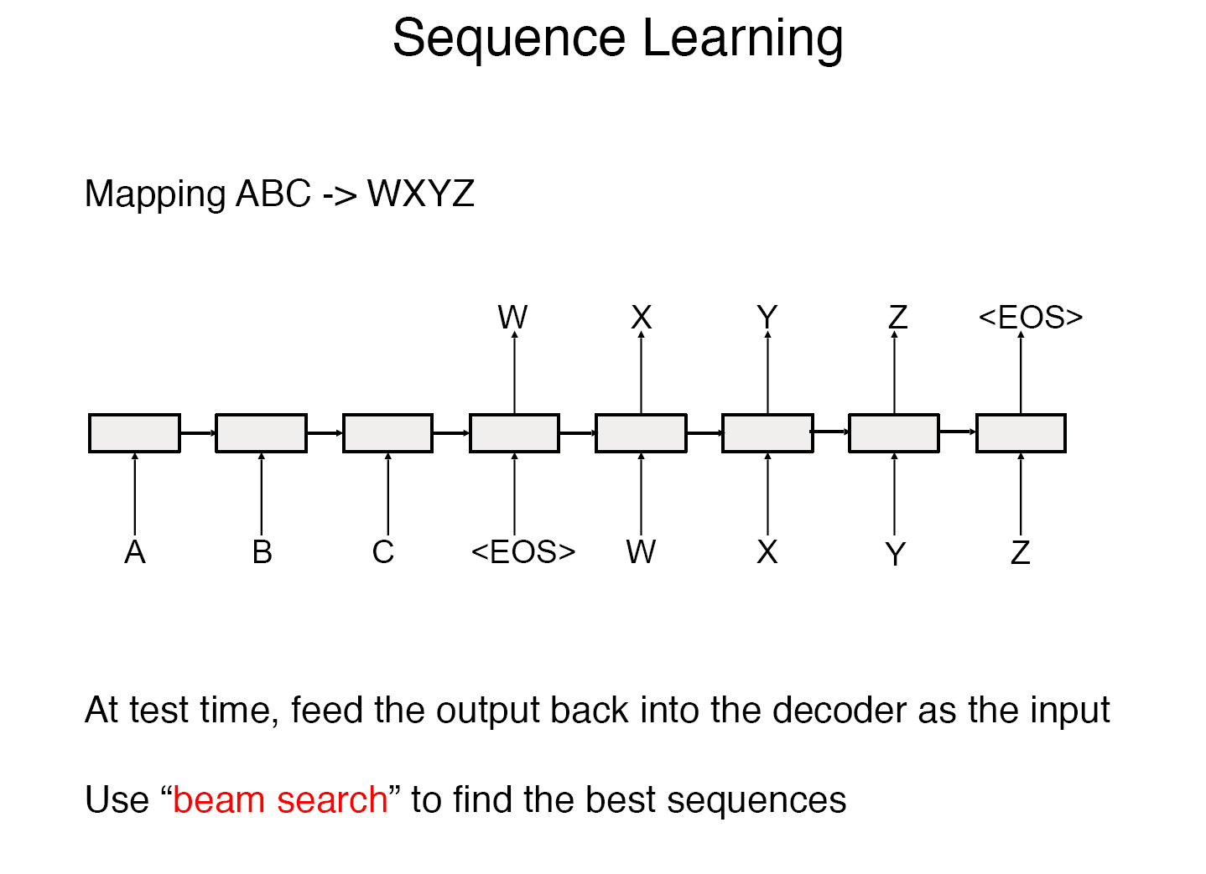

Slide 71
Summary
Traditional NLP approaches: symbolic, grammar, …
More recent approaches: statistical
For some applications: statistical approaches are better (tagging, speech recognition, …)
For some others, traditional approaches are better (MT)
Trend: combine statistics with rules (grammar)
  E.g.
  Probabilistic Context Free Grammar (PCFG)
  Consider some grammatical connections in statistical approaches
NLP still a very difficult problem

