Slide 1
LLMs IN FINANCE - IMPLEMENTATION PRESENTATION
Rebuilding FinMem the way the paper describes it -
and testing it without the crimes.
A leakage-free reproduction of Yu et al. (2023) - FinMem: A Performance-Enhanced LLM Trading Agent with Layered Memory and Character Design
Dan Shoshan - Nimrod Sagi
MBA Data-Science Seminar - backbone gpt-4.1-mini - test window Jan-Jun 2026

Slide 2
OBJECTIVE
What we set out to test
In our paper talk we charged FinMem with three “crimes” that make its headline Sharpe of 2.67 untrustworthy. The implementation asks one question:
Is FinMem worth anything once the crimes are removed and it is built as the paper actually describes?
01
02
03
Look-ahead / pre-training leakage
Zero transaction frictions
Test-set hyperparameter tuning
The paper's test window sits inside GPT-4's training data - the model already knows the outcome.
Returns reported with no commission, spread, or slippage.
“The setting that achieved the highest return” was chosen after seeing the test set.
Our answer in one line: build the paper's architecture honestly, run it on data the model has never seen, charge real costs, freeze every parameter in advance - then measure.
FinMem - Implementation - Shoshan & Sagi
1

Slide 3
SCOPE
Reproduced, adapted, and added
REPRODUCED
ADAPTED
ADDED
Authors' code as the skeleton (puppy/)
5 tickers: TSLA NFLX AMZN MSFT COIN
Layered memory: shallow/mid/deep + reflection
FAISS vector store, top-K retrieval
FinBERT sentiment, persona prompts
ada-002 embeddings (paper spec)
Train -> test protocol
Post-cutoff window 2025-26 (no leakage)
gpt-4.1-mini backbone (GPT-4-Turbo retired)
Gemini 3 Flash-Lite summariser
guardrails contract re-implemented for py3.12
Self-adaptive persona switch (3-day CR sign)
7-day momentum observation
Long-only unit position; real cost sweeps
Portfolio layer (our extension)
No-memory ablation
LC-Trader long-context baseline (no FinMem)
Leakage test suite T1-T4
Deep-layer retention fix + filing seeding
Metrics audit + canonical recompute
Decision / memory deep-dive per ticker
FinMem - Implementation - Shoshan & Sagi
2

Slide 4
20-SECOND SLIDE
What they shipped vs. what the paper claims
Seven places where the released GitHub code diverges from the paper's description:
TAG
PAPER IMPLIES
SHIPPED CODE ACTUALLY DOES
B7
FinBERT labels read correctly
Fed P(Negative) as the “positive” score
B8
Self-adaptive risk persona
Only a static risk-seeking line ships
F2
Deep memory retains key info
3-day revolving door - zero filings kept
D20
Shallow decay Q = 14 (justified)
Repo ships Q = 3
-
Long-only narrative
Sell opens a costless short
-
10-K/10-Q inform decisions
Filings before the window never ingested
-
Momentum window as described
Hard-coded 3-day vs 7-day, inconsistent
FinMem - Implementation - Shoshan & Sagi
3

Slide 5
ENGINEERING
What we built to reach the paper's architecture
Local FinBERT (finbert-tone)
Embeddings
FAISS per-layer indices
ran on RTX 3090; fixed scrambled-label bug (B7)
ada-002 (paper spec) via API; bge-large fallback
one vector store per layer, cosine relevance
Validation layer
Self-adaptive persona
Extended reflection
guardrails contract re-built for Python 3.12
two-sided risk rule the code never shipped (B8)
M=7-day self-review written into deep memory
Deep-layer retention
Filing seeding
Leakage suite T1-T4
no demotion + pure-age recency so filings persist
inject latest 10-K/10-Q at sim start, true filed date
assert no future-dated data ever reaches the agent
FinMem - Implementation - Shoshan & Sagi
4

Slide 6
ARCHITECTURE
System design
Data pipeline
FinMem agent x5
Portfolio layer
Evaluation
Alpaca news + SEC 10-K/Q + yfinance prices -> Gemini summary -> FinBERT sentiment
Profiling (adaptive persona) Layered memory (FAISS) retrieve -> reason -> act immediate + extended reflection
1 daily call over all 5 decisions + reasoning -> portfolio weights (our extension)
metrics +/- costs Wilcoxon, bootstrap B&H + no-memory baselines
Frozen before any test run - commit 96d724d : K=5 - M=7 - decay Q=14/90/365 - ada-002 - long-only - temperature pinned
MODELS & COST - whole project ran for ~$10
Summariser
Decision agent
Embeddings
Sentiment
Gemini 3 Flash-Lite
gpt-4.1-mini
ada-002
FinBERT (local 3090)
cutoff Jan 2025 - $6.95
cutoff Jun 2024 - free pool +$1.66
paper spec - ~$1.50
free
FinMem - Implementation - Shoshan & Sagi
5

Slide 7
MODELS & COST
What we compared online - and why we chose what we chose
Two hard constraints drove every choice: model cutoff must PRECEDE the 2025-26 data (no leakage), and keep the whole project under ~$15.
Role
Option compared
List price / 1M tok
Verdict
Decision
gpt-4.1-mini
$0.40 / $1.60
[CHOSEN] cutoff Jun-2024 (pre-data), cheap, reliable JSON
Decision
GPT-5.5
$1.25 / $10.0
rejected - cutoff too recent -> leakage; ~6x cost
Decision
GPT-4-Turbo (paper's)
$10 / $30
rejected - retired; ~25x cost; cutoff inside paper window
Decision
DeepSeek-V4
$0.27 / $1.10
rejected - cutoff & evaluation uncertainty
Summariser
Gemini 3 Flash-Lite
$0.10 / $0.40
[CHOSEN] cutoff Jan-2025, long context, high throughput
Embeddings
ada-002
$0.10
[CHOSEN] exact paper spec
Embeddings
embedding-3-small
$0.02
rejected - 5x cheaper but off paper spec
Sentiment
FinBERT (local 3090)
$0
[CHOSEN] paper spec, runs locally, free
Actual spend
Gemini $6.95 - ada-002 ~$1.50 - gpt-4.1-mini $1.66 (free pool) - FinBERT $0 - LC-Trader $2.47 (96% prompt-cached, -71%) = ~$12.6 total
FinMem - Implementation - Shoshan & Sagi
6

Slide 8
METHOD
Experimental design & how we avoided leakage
EVERY MODEL CUTOFF PRECEDES THE DATA
THREE CRIMES -> THREE FIXES
Train window
2025-07-01 -> 2025-12-31
Leakage
Test window
2026-01-02 -> 2026-06-01
All model cutoffs before the 2025-26 data window
gpt-4.1-mini cutoff
Jun 2024 - before data
Frictions
Gemini 3 cutoff
Jan 2025 - before test
Every metric at 0 and 10 bps + a 0-50 bps break-even sweep
FinBERT
pre-2021
Test tuning
Leakage suite T1-T4
dates valid & 16:00-rule - filings keyed by filed-date - env serves only <= today - summaries inherit source date
All hyperparameters frozen in a dated commit before the first test run
FinMem - Implementation - Shoshan & Sagi
7

Slide 9
INTEGRITY
Leakage suite T1-T4 - how we earn "leakage-free"
Four asserts run on every simulated day. A single future-dated record anywhere fails the run.
Valid dates + 16:00 rule
Filings keyed by filed-date
T1
Every record carries a timezone-aware timestamp. News published after 16:00 ET counts only for the NEXT trading session - no same-day look-ahead.
T2
10-K/10-Q enter memory on their true SEC filedAt, never their period-end. Filings filed just before the window are seeded at sim start with the real filed date.
Env serves only <= today
Summaries inherit source date
T3
On day t the market environment exposes prices/news/filings dated <= t only. Hard assert: max(context date) <= cur_date, or the run aborts.
T4
A Gemini summary carries the publish date of the article it summarises, so derived text cannot smuggle a future date past T3. (This caught bug B10.)
FinMem - Implementation - Shoshan & Sagi
8

Slide 10
OUR EXTENSION
A second question: one prompt, a whole portfolio
FinMem trades each stock in isolation. We asked: in a million-token-context world, can a single unified daily prompt manage a 5-stock portfolio? Each test day one extra gpt-4.1-mini call receives all five agents' decisions + reasoning and outputs portfolio weights (long-only, cash allowed).
Portfolio layer
Equal-weight B&H
The finding
It traded return for safety:
halved the drawdown
but lagged on return in a choppy, mostly-down window.
-3.6%
-0.4%
Sharpe -0.53
Sharpe +0.11
Max DD -10.0%
Max DD -20.5%
Reading: the unified-prompt portfolio brain behaves like a conservative risk manager - it parks weight in cash under stress. Useful for capital preservation, not raw return. A clean proof-of-concept that long-context single-prompt portfolio control is feasible, if not yet profitable.
FinMem - Implementation - Shoshan & Sagi
9

Slide 11
RESULTS
Headline results - leakage-free, costs included
Cumulative return over the test window (Jan-Jun 2026), unit long-only, full-window pricing. Four strategies.
Ticker
FinMem-Ours
No-memory
LC-Trader
Buy & Hold
Winner
TSLA
-23.1%
-5.5%
-7.9%
-5.1%
B&H
NFLX
+3.8%
+19.8%
+2.1%
-5.6%
No-mem
AMZN
+15.5%
+24.5%
+15.3%
+15.3%
No-mem
MSFT
-3.9%
-6.0%
-3.6%
-2.2%
B&H
COIN
-18.5%
-24.2%
-20.7%
-22.8%
Ours
MEAN
-5.3%
+1.7%
-2.9%
-4.1%
No-mem
Both stripped-down baselines beat the full FinMem apparatus on the mean. Ranking: No-memory +1.7% > LC-Trader -2.9% > Buy & Hold -4.1% > FinMem-Ours -5.3%. Ours vs B&H Wilcoxon p=0.69 (n.s.); Ours vs No-mem p=0.075.
FinMem - Implementation - Shoshan & Sagi
10

Slide 12
RESULTS
Risk-adjusted results - Sharpe ratio by ticker
Annualised Sharpe over the test window (Jan-Jun 2026), same four strategies and long-only conventions as the return table. Higher = better.
Ticker
FinMem-Ours
No-memory
LC-Trader
Buy & Hold
Winner
TSLA
-1.92
-0.37
-0.33
-0.14
B&H
NFLX
+0.44
+1.56
+0.32
-0.19
No-mem
AMZN
+1.67
+2.74
+1.31
+1.31
No-mem
MSFT
-0.20
-0.56
-0.12
0.00
B&H
COIN
-0.70
-1.49
-0.35
-0.44
LC-Trader
MEAN
-0.15
+0.38
+0.16
+0.11
No-mem
No-memory has the best mean Sharpe (0.38); FinMem-Ours is the only negative-mean strategy (-0.15). Ours clears 0 on just 2 of 5 tickers (NFLX, AMZN) - the memory apparatus does not improve risk-adjusted return.
FinMem - Implementation - Shoshan & Sagi
11

Slide 13
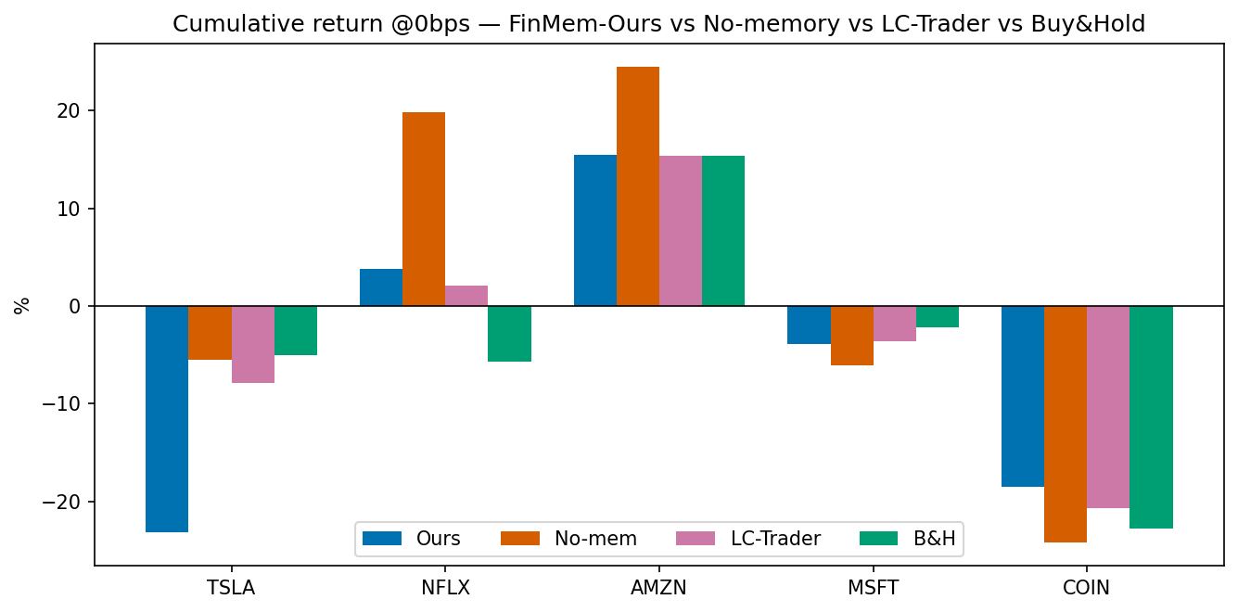
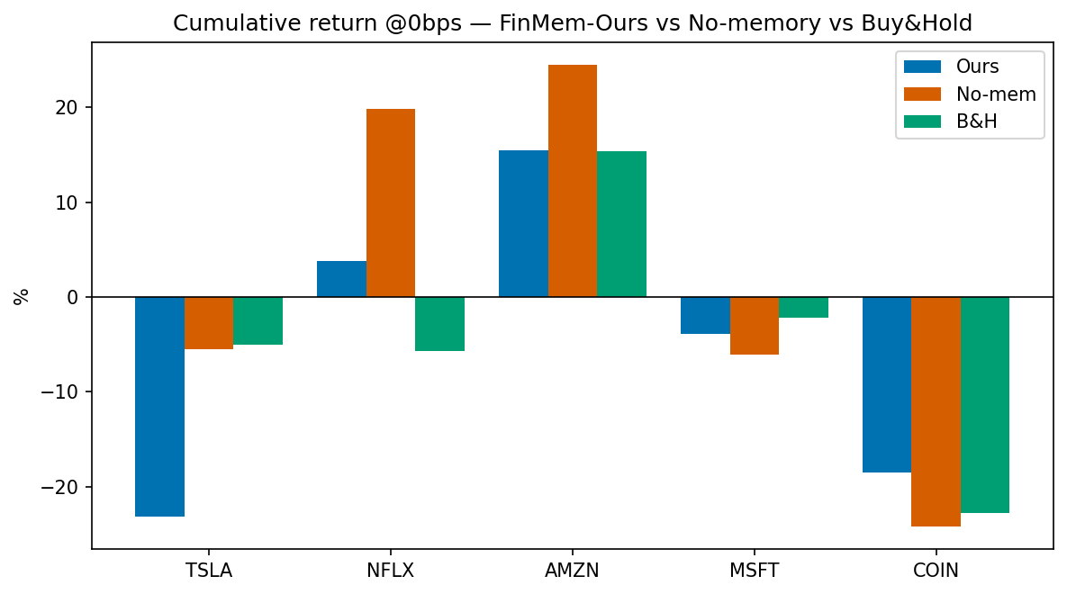
RESULTS
Cumulative return by ticker
Read
NFLX is the one clear FinMem win (+3.8% vs -5.6%).
AMZN matches B&H; both stripped baselines (no-memory, LC-Trader) lead on the mean.
TSLA is the worst miss (-23% vs -5%) - it stayed long into the April drawdown.
4 of 5 tickers fell over the window - a hard test, not a bull market.
FinMem - Implementation - Shoshan & Sagi
12

Slide 14
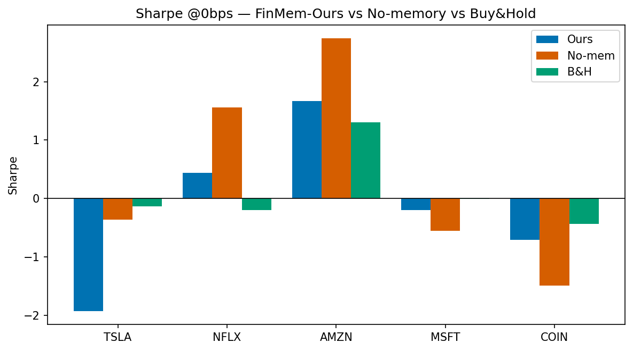
RESULTS
Risk-adjusted return - Sharpe ratio by ticker
The Sharpe picture mirrors the returns.
No-memory has the highest mean Sharpe (0.38); Buy & Hold 0.11; LC-Trader 0.16; FinMem-Ours is lowest at -0.15.
Only AMZN and NFLX clear 0 for FinMem-Ours; the full memory apparatus does not improve risk-adjusted return out-of-sample.
FinMem - Implementation - Shoshan & Sagi
13

Slide 15
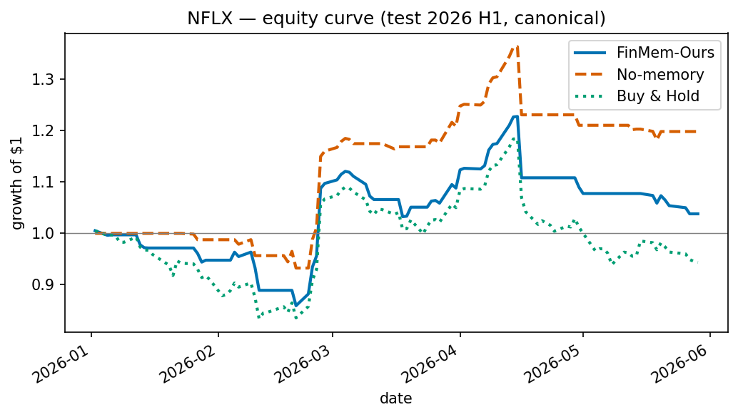
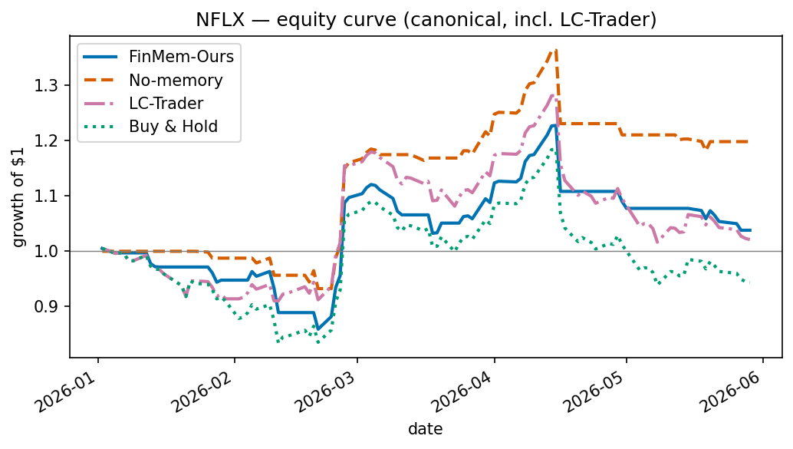
RESULTS
Risk-adjusted return & an equity curve
NFLX equity curve - FinMem-Ours (win) vs no-memory vs Buy & Hold. Sharpe: Ours 0.44, no-mem 1.56, B&H -0.19.
FinMem - Implementation - Shoshan & Sagi
14

Slide 16
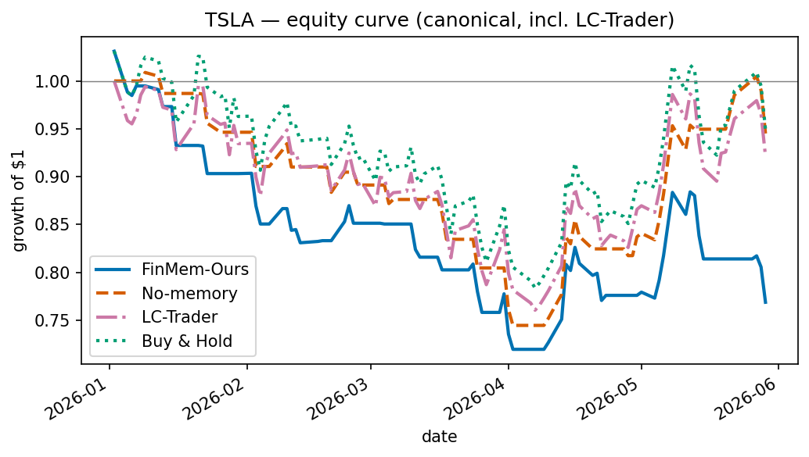
RESULTS
TSLA example - the worst miss, all four strategies
FinMem-Ours -23.1%
It whipsawed long into the spring drawdown - selling defensively, then buying back on a 7-day momentum flip right before single-day drops.
Every stripped-down peer lost far less: no-memory -5.5%, LC-Trader -7.9%, Buy & Hold -5.1%.
TSLA is where memory + momentum-chasing hurt the most.
FinMem - Implementation - Shoshan & Sagi
15

Slide 17
REALITY CHECK
Our Sharpe vs. the paper's reported Sharpe
The paper reports these Sharpe ratios on its leaky, frictionless, tuned 2022-23 window. Ours are leakage-free with costs:
Ticker
Paper (FinMem)
Ours (FinMem-Ours)
Delta
TSLA
2.67
-1.92
-4.6
NFLX
2.01
0.44
-1.6
AMZN
0.23
1.67
+1.4
MSFT
1.84
-0.20
-2.0
COIN
1.62
-0.70
-2.3
Not one ticker reproduces the paper's Sharpe. AMZN is the only case we beat it - and even there the memory-free agent is stronger still.
FinMem - Implementation - Shoshan & Sagi
16

Slide 18
CORE FINDING
Did the layered memory help? - the ablation
Same agent, memory OFF
The paradox we document
+1.7%
mean return, no-memory
The memory machinery fully engaged:
- 1000+ memories retained per ticker (fix worked)
- deep layer holds 119 self-written reflections
- the agent cites its own reflections (NFLX: 78x)
- adaptive persona switches 21x over the window
... yet none of it improved returns out-of-sample.
The architecture is real and active; its value is not.
vs FinMem-Ours -5.3%
vs Buy & Hold -4.1%
Memory-free wins on 3 of 5 tickers.
Pooled Wilcoxon p = 0.075; median memory effect -28 bps/day (negative => memory hurt).
FinMem - Implementation - Shoshan & Sagi
17

Slide 19
CORE FINDING
No-memory = FinMem's architecture minus its memory module
The ablation is not a different agent - it is the SAME agent with retrieval switched off.
KEEPS (identical to FinMem-Ours)
DROPS (the memory module only)
- Self-adaptive risk persona (3-day CR switch)
- The FinMem decision/reflection prompt
- 7-day momentum observation
- guardrails JSON validation contract
- Train -> test protocol, same gpt-4.1-mini backbone
- Layered-memory retrieval - every layer returns 'No information'
- No FAISS / ada-002 similarity lookups
- No extended reflections fed back into decisions
- Sees ONLY persona + momentum + risk line each day
Ablation ladder - strip features away and mean return IMPROVES (cum. return @0bps):
No-memory
LC-Trader
Buy & Hold
FinMem-Ours
>
>
>
+1.7%
-2.9%
-4.1%
-5.3%
LC-Trader has NO FinMem at all (no persona/memory/retrieval); it still beats full FinMem-Ours. Every removed layer of scaffolding helped, not hurt.
FinMem - Implementation - Shoshan & Sagi
18

Slide 20
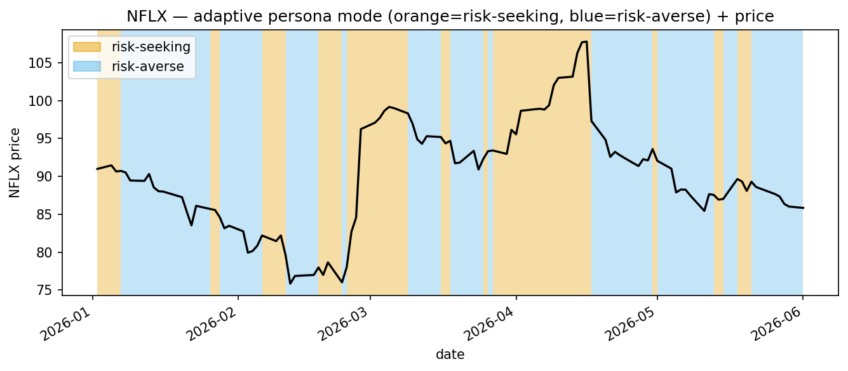
BEHAVIOUR
The adaptive persona genuinely operates
Same engine, two stances
Risk-seeking - NFLX Jan 2:
“...strong positive fundamentals... bullish option activity...” -> BUY
Risk-averse - NFLX Jan 7:
“As a risk-averse investor holding shares, the negative momentum...” -> SELL
This two-sided switch is exactly what the released code never shipped (B8).
NFLX risk mode by day - 43 risk-seeking / 59 risk-averse, 21 switches.
FinMem - Implementation - Shoshan & Sagi
19

Slide 21
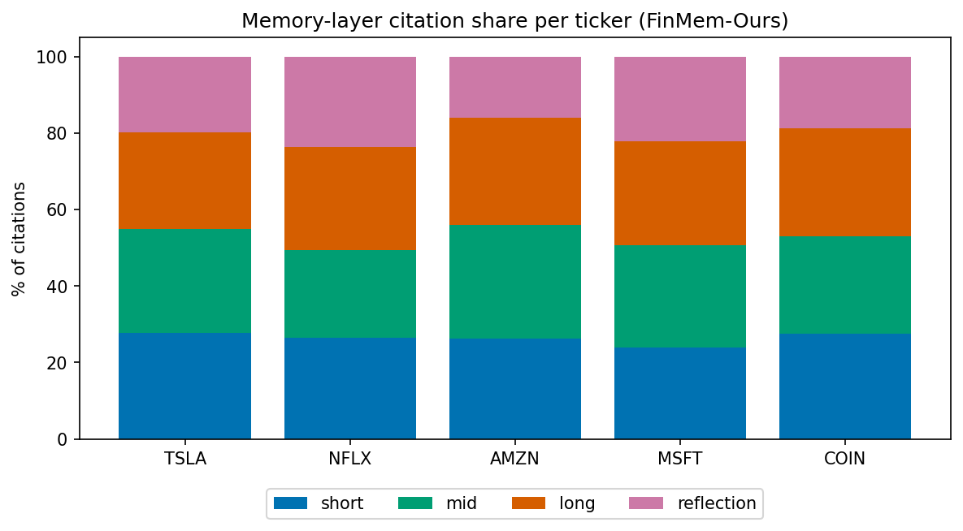
MEMORY
What the agent leaned on
Balanced across layers
citations split ~26/22/27/23% over short / mid / deep / reflection - every layer is used.
It trusts itself
NFLX's single most-cited memory is one of the agent's own extended reflections (78x).
But retrieval can't adapt
the retrieval query is the static persona - same text every day. Day-to-day overlap of cited memories is 50-68%: stable, but not situation-aware.
FinMem - Implementation - Shoshan & Sagi
20

Slide 22
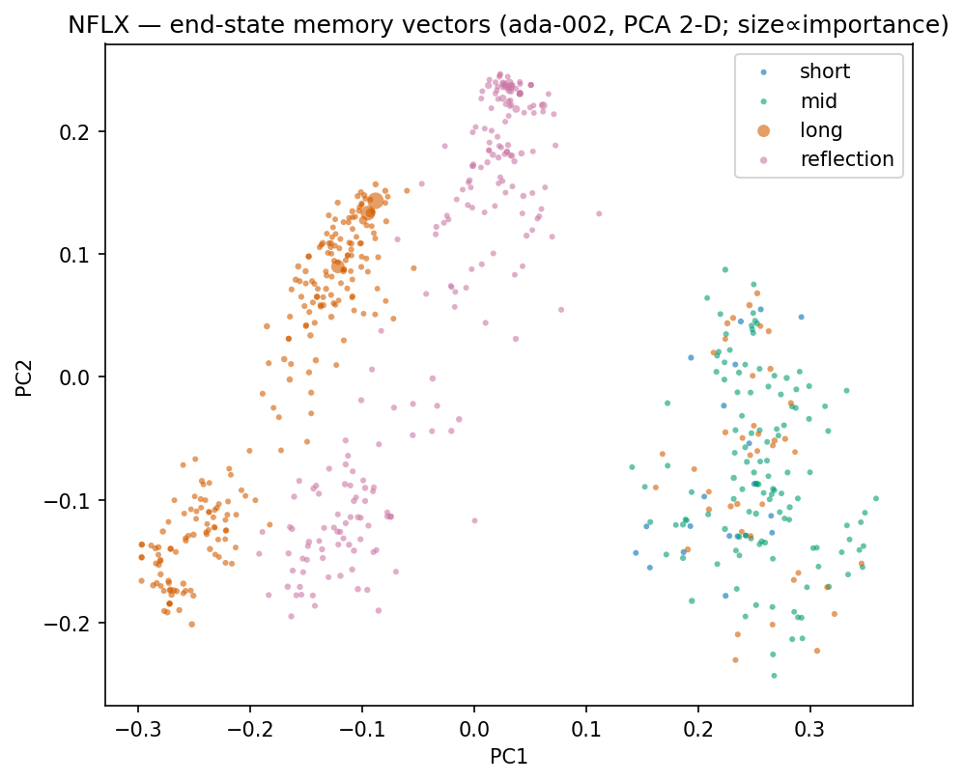
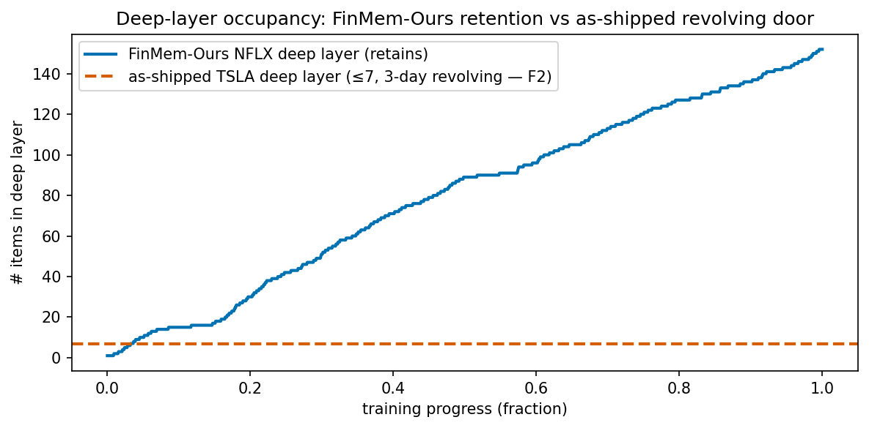
MEMORY
Inside the memory: vector store & the retention fix
The F2 fix in one chart: the as-shipped deep layer was a 3-day revolving door that kept zero filings; ours retains 1000+ memories so reflections and filings actually accumulate.
NFLX memory vectors (PCA), coloured by layer.
FinMem - Implementation - Shoshan & Sagi
21

Slide 23
TRANSPARENCY
A real prompt the agent received
NFLX - 2026-01-07 - decision = SELL
PERSONA: You are an expert of NFLX (Netflix)... streaming, original content, ad tier, gaming.
TASK: make an investment decision; consider short / mid / long / reflection memory + 7-day momentum.
... When cumulative return is negative, you are a RISK-AVERSE investor; negative information
carries greater weight. (this clause is injected only on down-momentum days)
LONG-TERM MEM 236: Sony CEO praises Netflix partnership; 'KPop Demon Hunters' most-streamed...
REFLECTION 161 [conf=high]: responding positively to NFLX earnings beats tends to be favourable...
MOMENTUM: cumulative return over the past 7 days is negative.
JSON OUT: {investment_decision, summary_reason, <layer>_memory_index:[ids]}
FinMem - Implementation - Shoshan & Sagi
22

Slide 24
MODEL OUTPUTS
What it told us to justify its trades (verbatim)
The agent's own saved reasoning on its four biggest single-day losses - each a 'buy' straight into a next-day drop.
MSFT 2026-01-28
buy -> -10.0%
NFLX 2026-04-16
buy -> -9.7%
"The decision to buy Microsoft is supported by overwhelmingly positive sentiment across all timeframes, strong analyst buy/outperform ratings with high price targets, and robust long-term growth driven by AI innovation and Azure cloud expansion..."
"...overwhelmingly positive short-term and mid-term information including analyst upgrades, optimistic outlooks on subscriber growth, revenue increases, and strategic expansions..." (bought into an earnings-driven drop)
COIN 2026-03-23
buy -> -9.8%
TSLA 2026-04-01
buy -> -5.4%
"The cumulative return over the past 7 days is positive, indicating positive momentum. Despite short-term volatility and mixed-to-negative news, the mid- and long-term fundamentals of Coinbase remain strong..."
"Despite high valuation ratios and some negative revenue growth, Tesla exhibits strong short-term bullish signals including accelerating AI development, significant sales growth in China, and a consistent Buy consensus..." (344 P/E)
Common thread: a recurring bullish tilt + 7-day momentum-chasing repeatedly took it long into news-driven single-day reversals.
FinMem - Implementation - Shoshan & Sagi
23

Slide 25
MEMORY
The memory texts it actually leaned on (verbatim)
NFLX 2026-01-02 (buy): the real memories the agent cited - including its own extended reflections. It cites itself.
#161 extended reflection - conf high
#480 extended reflection - conf high
"Consistently responding positively to NFLX's short-term earnings beats and optimistic analyst outlooks on revenue and subscriber growth tends to result in favorable next-day returns..."
"The trading decisions for NFLX appear to be more successful when driven by positive earnings beats, strong revenue and subscriber growth, and successful content..."
#236 news - long-term layer
#674 reflection-term
"Netflix stock trended Friday as Sony Pictures CEO Ravi Ahuja praised their partnership, specifically the success of 'KPop Demon Hunters,' which became Netflix's most-streamed title..."
"Despite slightly negative momentum in the past 7 days, the overall information indicates strong positive fundamentals and growth potential for NFLX. The short-term data shows bullish option activity..."
Deep layer, retrieved months later - TSLA extended reflection 2025-10-03: "Relying heavily on short-term bullish analyst forecasts, such as Dan Ives' $2T valuation, tends to correlate with modest positive next-day returns, yet does not protect from losses during negative fundamental news..."
These deep reflections persisted 100+ days (our F2 retention fix) and were cited long after - the memory machinery demonstrably worked, even though it did not improve returns.
FinMem - Implementation - Shoshan & Sagi
24

Slide 26
ERROR ANALYSIS
When it worked, when it didn't - and why
Worked: NFLX (+3.8% vs -5.6%)
Failed: TSLA (-23% vs -5%)
Risk-averse switching cut exposure during down-momentum stretches; it sold into weakness and avoided part of the slide buy-and-hold ate.
Whipsaw: sold defensively, then bought back on a 7-day momentum flip right before single-day drops (bought Apr 1, next day -5.4%). High turnover, wrong timing.
Why it chose wrong - biggest single-day losses (decision = buy, then next day):
TSLA Apr 1
-5.4%
bought on AI/China bullishness despite a 344 P/E and falling momentum
NFLX Apr 16
-9.7%
bought on analyst upgrades into an earnings-driven drop
MSFT Jan 28
-10.0%
'overwhelmingly positive sentiment' - straight into an earnings miss
COIN Mar 23
-9.8%
positive 7-day momentum overrode mixed/negative news
Common thread: a recurring bullish tilt + momentum-chasing led it long into news-driven single-day reversals.
FinMem - Implementation - Shoshan & Sagi
25

Slide 27
INTEGRITY
We audited our own numbers - and caught two bugs
Practising what we preached: an independent recompute disagreed with our first results. We found two metric bugs and corrected every number.
Terminal-day truncation
Returns were priced one day short, dropping June 1 - a -4.6% TSLA day. Buy & Hold TSLA read -0.5%; the true figure is -5.1%.
Shorting-on-sell
Metrics treated 'sell' as opening a short, inflating every strategy - NFLX no-memory showed +57% when the true long-only figure is +19.8%.
Canonical convention now enforced in code:
carry-forward unit long-only x simple next-day return, compounded on the full price series - with a regression assertion that fails the run unless Buy & Hold = P[last]/P[first]-1.
The audit itself is a result: exactly the discipline the original paper skipped.
FinMem - Implementation - Shoshan & Sagi
26

Slide 28
WRAP-UP
Lessons & conclusions
1
The architecture reproduces; the alpha does not.
2
Memory engaged but didn't pay.
Built honestly, FinMem ties or trails Buy & Hold (mean -5.3% vs -4.1%); no result approaches the paper's Sharpe of 2.67.
The memory-free agent was the best of three. The layered memory is real, active, self-referential - and net-negative out-of-sample.
3
Honest backtesting changes the answer.
4
Where this goes next.
Leakage-free dates, real costs, frozen parameters, and a metrics audit each pulled results toward - or below - the benchmark.
Situation-aware retrieval queries, multi-agent role specialisation, richer cost / turnover / capacity modelling, and longer post-cutoff windows are the natural next tests of whether layered memory can be made to pay.
FinMem - Implementation - Shoshan & Sagi
27

Slide 29
Trust nothing in a backtest
you haven't audited - including your own.
FinMem, rebuilt as described and tested honestly: a real cognitive architecture, an unproven edge.
Dan Shoshan - Nimrod Sagi Thank you - questions welcome

Slide 30
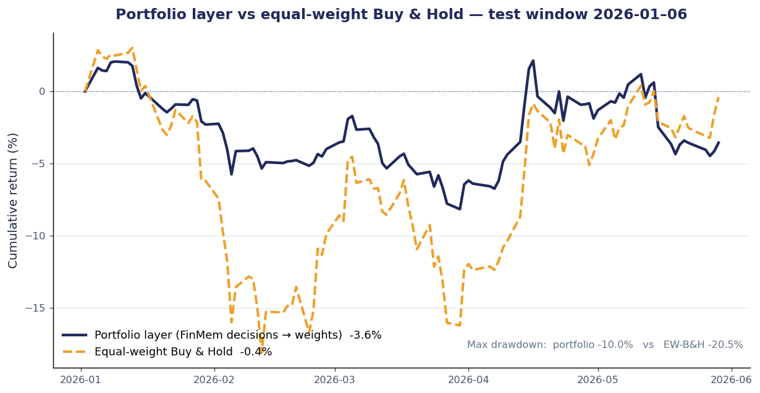
OUR EXTENSION - APPENDIX
Portfolio layer - output example & equity curve
One gpt-4.1-mini call/day maps the 5 FinMem decisions -> long-only weights. No persona, no memory, no risk switch - a thin allocator over the agents.
Example output - 2026-01-02
Analyst decisions in:
TSLA buy - NFLX buy - AMZN buy - MSFT buy - COIN hold
Target weights out:
TSLA 0.25 NFLX 0.25 AMZN 0.25
MSFT 0.20 COIN 0.00 CASH 0.05
Reasoning (verbatim):
"All stocks except COIN have strong buy recommendations despite recent short-term momentum weakness... COIN is held at zero due to mixed short-term signals and recent volatility... keeping 5% in cash for flexibility."
Traded return for safety: avg 47% in cash halved the drawdown (-10.0% vs -20.5%) but lagged on return (-3.6% vs -0.4%) in a mostly-down window.
Shares only the backbone + JSON re-ask/fallback with FinMem - none of its scaffolding.
FinMem - Implementation - Shoshan & Sagi
29

