Slide 1
RyderGyde AI Planning
19-Dec-2025

Slide 2








Focusing on 1-3 for This Presentation
Assignment & Work Done
Prioritizing Use Cases
Phased Use Cases & Implementation
  The Azure AI Environment
  Technical builds and additions
  Staffing
Technology Deep Dive (Appendix)
  Current to Future State
  Description of roles and Functions
  QA/Refinement Processes
  Azure Utilization

Slide 3
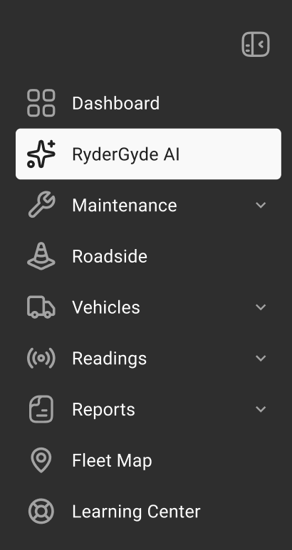
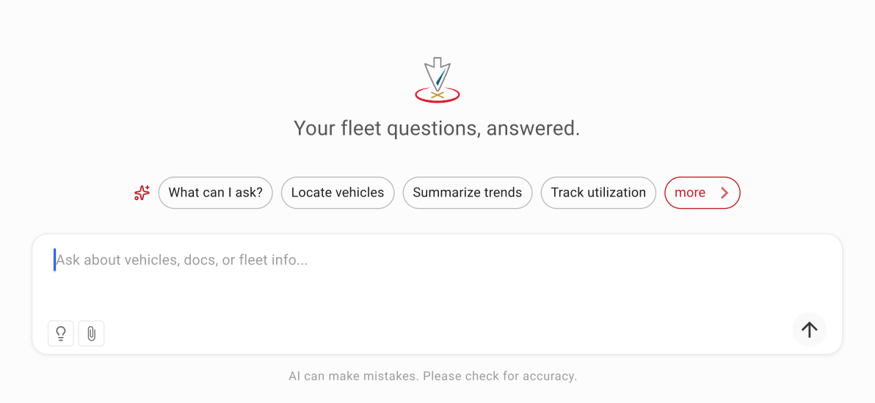
4 Week Product and Technology Strategy Assignment
Initial ask:
Review of RyderGyde use cases and development of new ones
Recommendations for AI releases in H1 and H2 2026 and beyond
Technical requirements and staffing for AI releases
Additional Concerns and areas to explore:
Competitive rather than catch up with the market
Build versus buy
Recommendations on AI QA and ongoing refinement

Slide 4



Completed Analysis of Documents and Interviews
Review of internal and competitive documents:
TASD
Penske public materials
Internal AI strategy
Telematics
PAB findings
Interviews/Meetings
Andrei Vassilliev
Deepak Kumar
Sarah Young
Mitch McHenry
Jose Ferretti
Thomas Chey
Rochak Tarika
Todd Ewing
Mayda Domenech
Steve Goodwin
99s RyderGyde team
Help Center
Help Center & AI Assistant POC
Enabling customers to answer any question.
Focus on content development, and technical approach through Q4.

Slide 5



Use Case Priorities are Shaped by Triangulating User Value against
Market and Technology Constraints
User Value
The richest source of data, particularly for high value use cases, is in Snowflake and accessed through GraphQL. We will need new integrations to access this data directly.
Read-only data includes facts about vehicles (with latency and ownership challenges). Help center content, ready in Q2, is also read-only.
Phased Planning
Market &
Competitive
Conditions
Technology
& Data
Constraints
Typically, product strategies are based on use cases and their value to end-users. Every RyderGyde use case has resource, technology, data, and ownership constraints that must be considered as well..
Additionally, competitive market conditions and user expectations around AI impact priorities and planning.
Our recommendations are based on the need to provide value, take early action, and adapt to these constraints.

Slide 6




Framework for Prioritizing Use Cases & Features
Value to Customer
Three segments:
Driver
Fleet Managers
Senior people overseeing Fleet Managers
Future segmentation should be include fleet size where fleet and geographic coverage, where users have different needs.
Data Readiness
Includes accuracy, time lags, ease of access, and performance times. Ownership of data and APIs and challenges of coordinating across ownership silos is also a significant constraint.
Competitive Impact
Penske is well out front in offering and marketing. RyderGyde's AI for everybody, competes indirectly with Penske. (The Penske competitive gap analysis will not be complete by the end of this project.)
Level of Effort
In addition to absolute levels, there are organizational barriers impacting timing and resources to account for.
A spreadsheet with a complete list of use cases, scores, and commentary is provided as a separate document.

Slide 7
Readiness: Ready-Only Data promises quick start
Accuracy | Outside of the shop systems, data is believed to be largely accurate, but none of data sources have been QAed for AI uses yet.
Data Latency | The syncing of data varies between systems and group needs. Variances arise from human batching of data entry in the shop, timing of batch updates across systems, etc.
Completeness of Data | Variance in completeness of data is primarily due to telematics level where vehicles can be on different systems and flags can be turned on or off based on contract terms. Telematics coverage is very high for the largest customers.
Performance | Some APIs and software components are not designed for or owned by RyderGyde. Performance levels of tools needed to access data poses obstacles to the timing of their use.
Ownership | Custom APIs and some 3rd party components are owned by other groups, creating dependencies for changes in access or timing. Authorization concerns are being addressed.
A spreadsheet with scoring data sources for readiness is included

Slide 8
Focus on the Assistive and Guarded Actions Initially
CATEGORY | DESCRIPTION | CHARACTERISTICS | EXAMPLES | RISK | TARGET TIMING
Assistive (Read-Only) | Conversational access to existing data with no system actions | No write operations; low blast radius; easy to QA and audit | Vehicle status; Maintenance summaries; Reporting; Analytics | Low | H1-2026
Guarded Actions (Human in-the- Loop) | AI suggests actions that require explicit user approval, or make directional recommendationS | Reversible actions; clear confirmation; ABAC enforced | Schedule service appointments; Data upload validation; Parameterized reports | Med | H2-2026 (Conditional)
Autonomous (Always on Agentic) | AI plans and executes actions independently | Long-lived state; retry / compensation logic; high governance needs | Vehicle pre-securing; Autonomous dispatch; Auto-rescheduling | High | 2027+

Slide 9


Starting with Geolocation Telematics based on Priorities
Different Fleet Support for levels of Telematics Engagement
Initial focus on Location and Odometer due to internal constraints
Implications for phasing:
In the early "AI for everybody" stages, telematics-based use cases should be limited to odometer and location readings to avoid missing information and misleading conclusions.
Ryder could more quickly provide robust telematics AI for larger customers with fully-equipped fleets. These use cases add value for highest LTV customers and could upsell smaller fleets on telematics enablement.
Robust use of telematics beyond odometer and location readings, are phased for 2027, but start in H2-2026.

Slide 10

Recommending an Azure AI based Chat Platform
We will develop a chat platform and underlying AI processes for RyderGyde that leverages the best current capabilities of Azure AI and the Ryder Azure Platform.
After the foundational architecture is developed, we will integrate existing data and knowledge sources quickly.
In parallel, we will develop new data and knowledge sources via direct integrations for the Azure AI platform to enable all use cases.

Slide 11
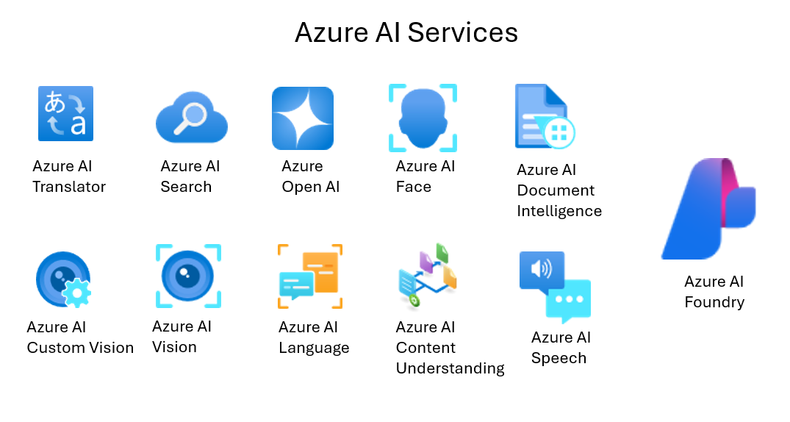






Defining what Azure AI Services we can Leverage
RyderGyde Data
Fleet-specific account data accessed via RyderGyde.
AI Assistant
Conversational tool that ties together many sources for intuitive, proactive guidance.
Help Center
Curated content with product line information, how-tos, FAQ, training, and more.
Insights
AI-powered recommendations.

Slide 12
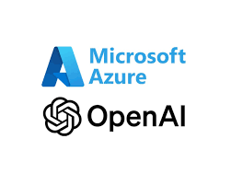
Using the latest Microsoft Azure AI Platform and Capabilities
We will leverage many of the latest technologies and capabilities of the Azure AI platform
Our Creation, Management and Deployment of Agents will happen with Microsoft Foundry (formerly Azure AI Foundry)
Azure has greatly improved its AI capabilities and tools this year
Microsoft Foundry empowers non-technical teammates to adjust and optimize AI Models, Agents, Guardrails, and Language Services
Outside of Foundry and the existing tools we will leverage, such as Azure Search AI, our biggest software development challenge is in the development and release of new MCP servers to provide direct access to data.
These MCP Servers will feed into the AI Gateway within Foundry for RyderGyde (and other FMS future projects)

Slide 13
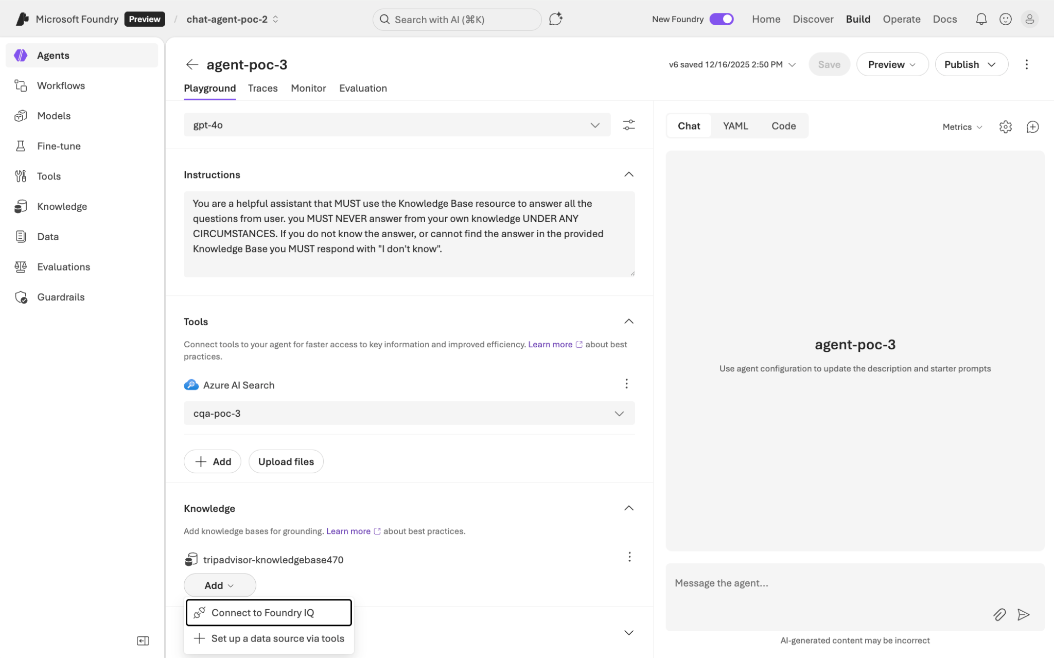
Foundry Provides Many Data Integrations we need in the Ecosystem
Foundry provides multiple ways to manage and create different
Agents
Agentic workflows
Fine tuned Models
Evaluations
Guardrails
These are all features and capabilities we would previously have to develop on our own.

Slide 14
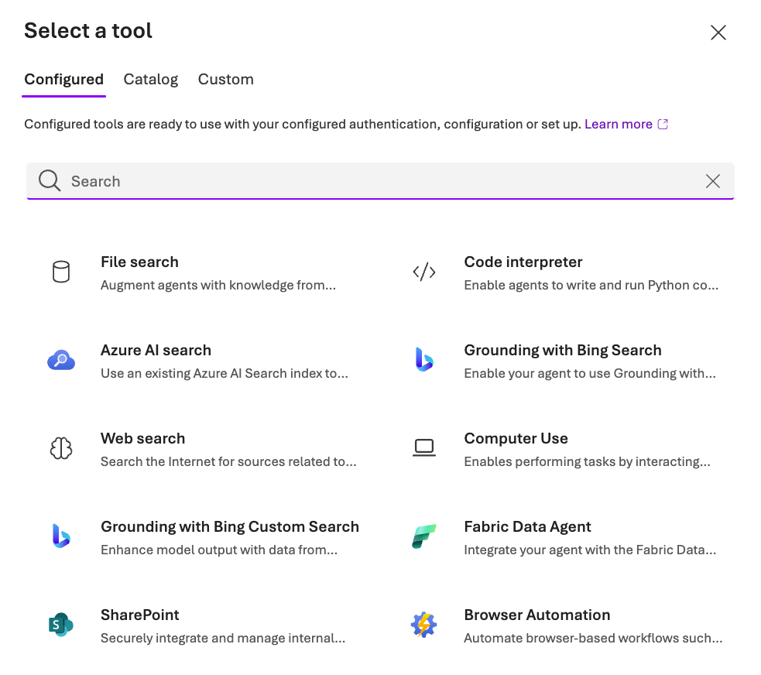
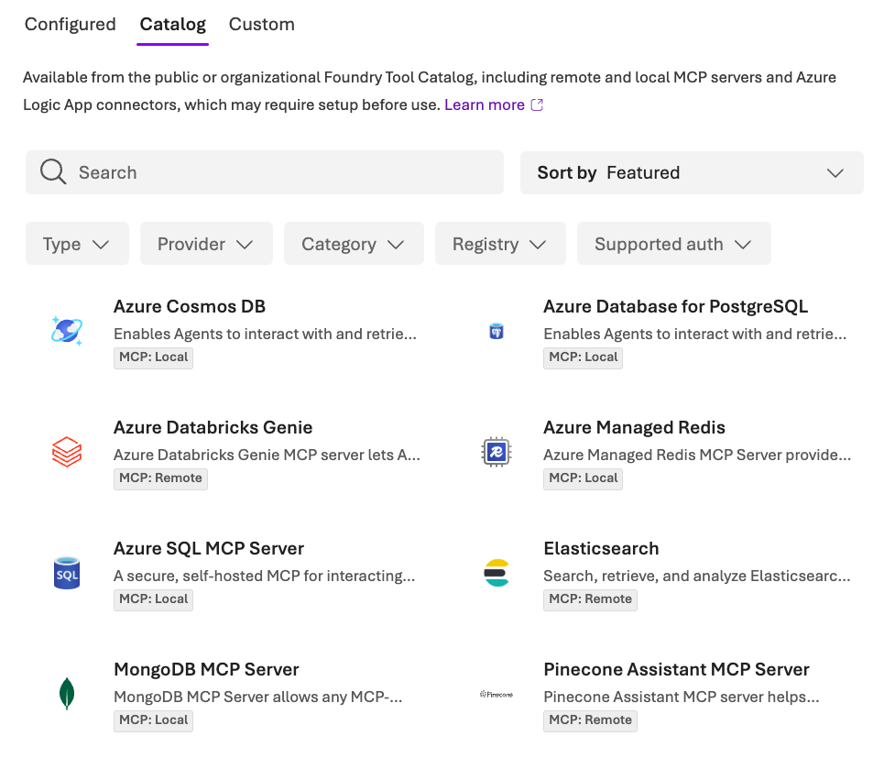
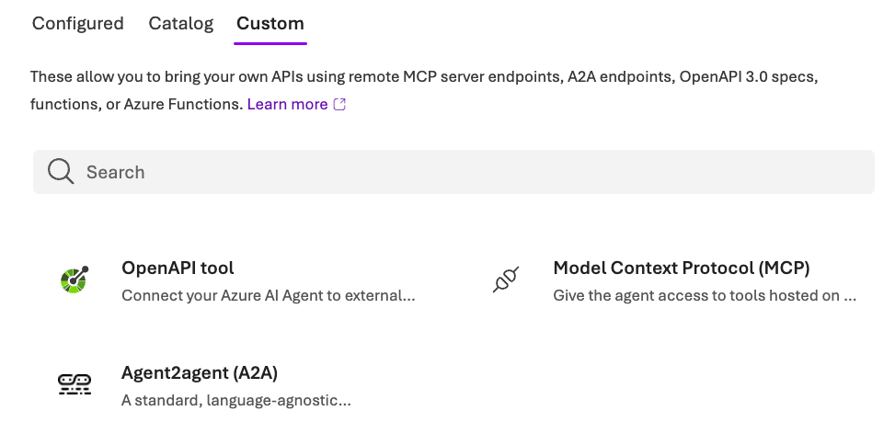
Azure Provides Many Data Integrations In Their Ecosystem

Slide 15
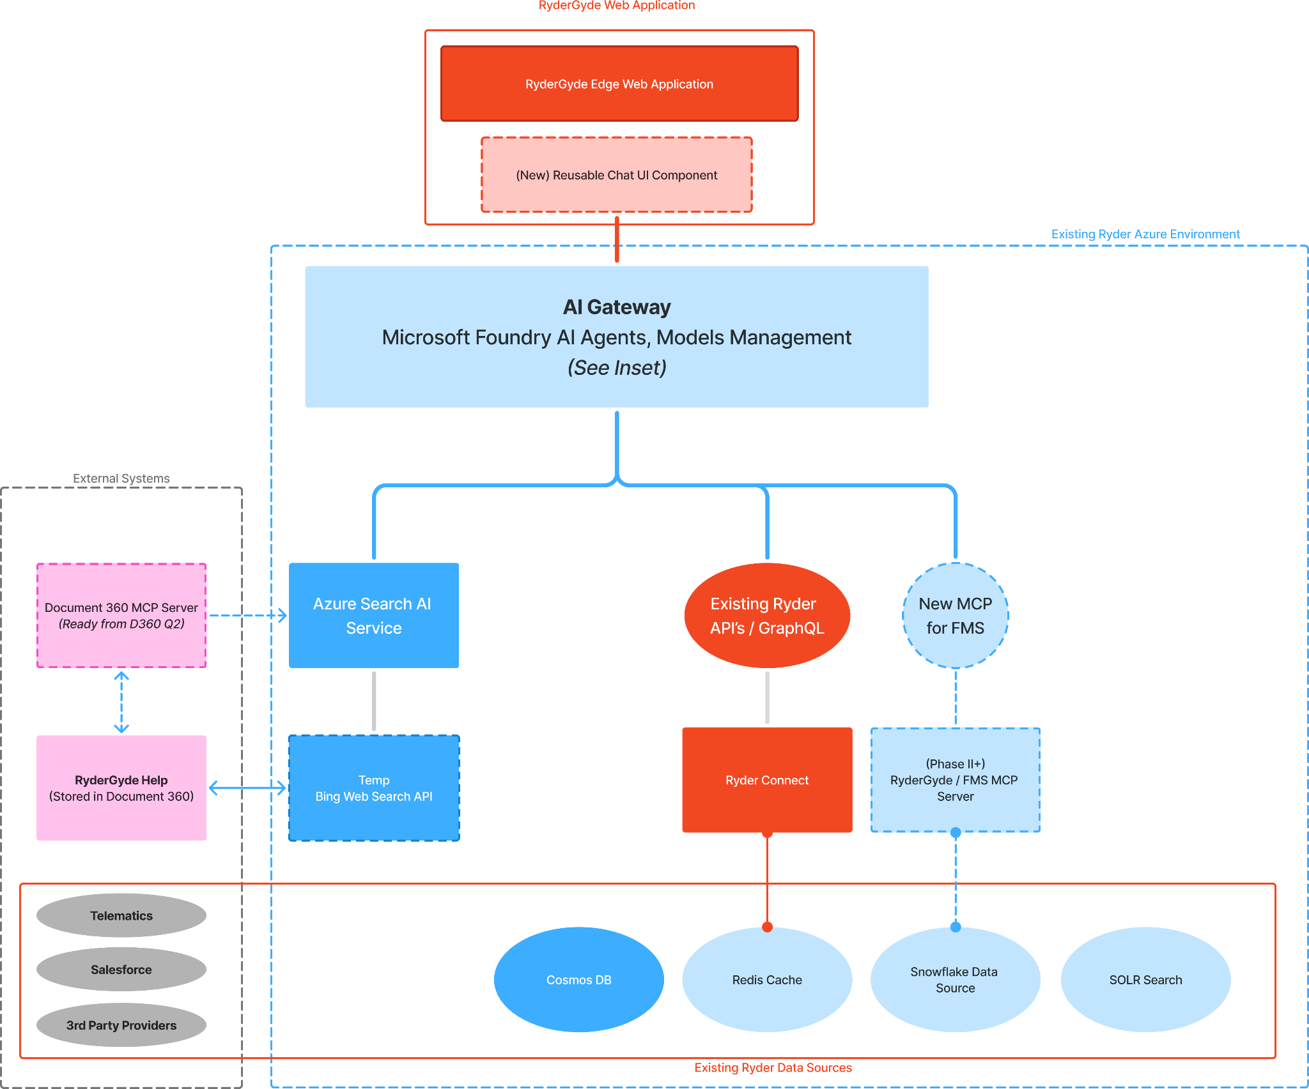
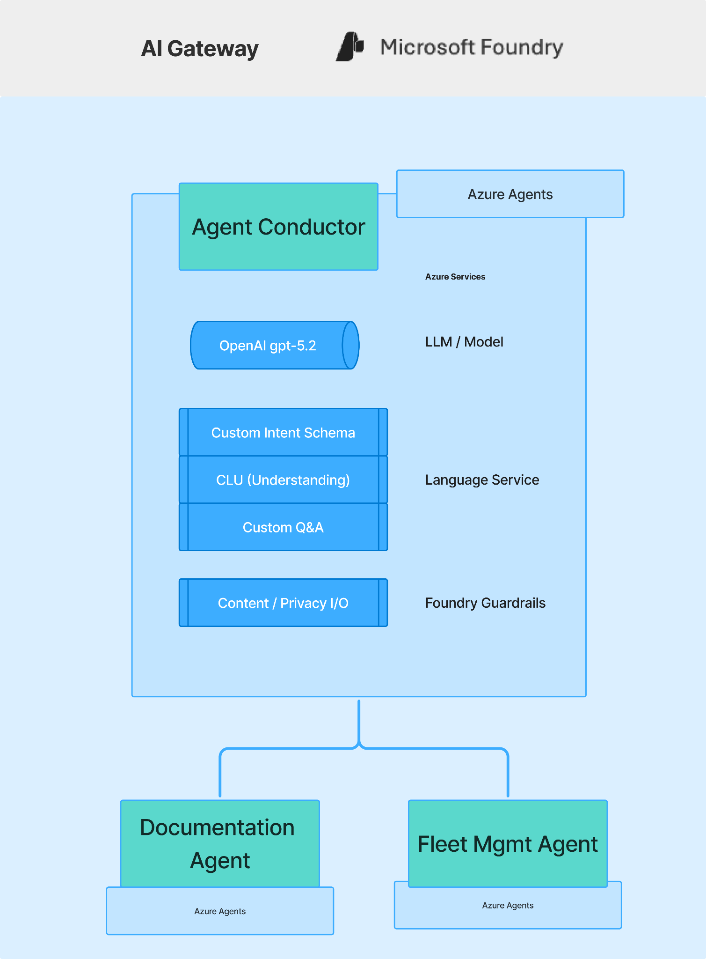
Azure Platform Architecture Overview

Slide 16
Plan begins with a foundation and builds increasingly robust and complex use cases over time
Phase | Description | Notes | Timing and AI scope
0 | Foundation | Creation/setup of basic components in Azure Foundry to support conversational AI, ML analytics, and agentic AI: AI gateway, orchestration layer, etc. Establish reusable UI components for conversational AI. | Q1 Foundation
I | Retrieval of vehicle facts and help docs | Vehicle documents, "Where's my truck?", PM and threshold reminders from odometer and GPS are possible for early 2026. Help Center documents could be Q1, but Q2 is more likely. | Q1 - Q2 2026 Read only
II | To-Dos & Threshold Alerts | Closely related to retrieval of facts, involving little AI, this would be proactive alerts triggered by time, odometer and GPS readings, shop status and traffic. Actions coming from this kind of AI are highly brittle and unforgiving of error, therefore alerts only. | H2-2026. with prep work in H1 Guarded action possible
III | Diagnostics | Higher value use cases involve vehicle and fleet data, providing recommendations on utilization and rent, lease, buy decisions. Automated actions are not advised for these use case, but recommendations and advisories would be useful to customers. | H2-2026 and 2027. Guarded action. Foundational work supports use cases below.
IV | Benchmarks, Trends, Predictive | Highest value use cases, directly competitive with Penske. Requires generation of benchmarks, trend baselines, customer cohorts and behavior patterns. Use cases highlight trends and insights with accompanying directional recommendations. | 2027, stretch for H2 2026 Guarded action Autonomous Agentic AI possible

Slide 17
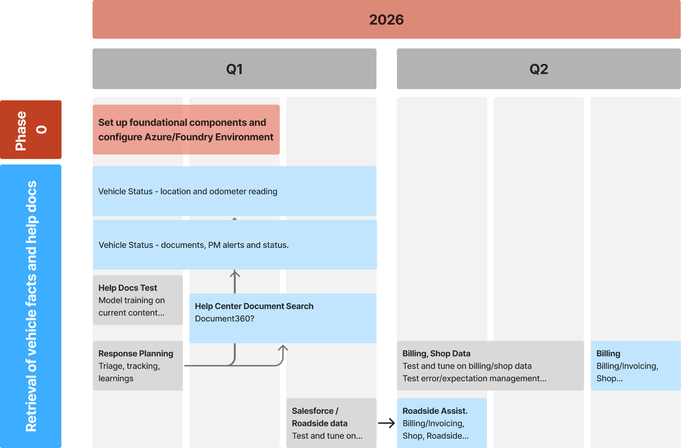
Phase 0 focuses on foundation and read-only use cases addressing known customer pain points

Slide 18
Phase I – Retrieval of Vehicle and Help Data
(Q1 2026)
 | Use Cases and Work | Notes
Q1-2026 | Use cases to retrieve Vehicle Documents, odometer readings, and PM alerts (9 Total Supported User Stories) | New code based on current POC structure. Risk: managing hallucinations, first time doing AI QA
Q1-2026 | "Where's my truck?", vehicle visibility. | Leverage GPS, lay groundwork for longer-term integration with shop/service data.
Q1-2026 | Help Content Document Search | Potentially dependent on Document360 implementation Risks: Higher level of training and QA needed
Q1-2026 | Prep data and models for Q2 efforts | Parallel path to implementation (Grey items on timeline)

Slide 19
Phase II – Q2 2026
(stretch cases shaded red)
 | Use Case | Notes
Q2-2026 | Driver To-Do List | Primarily PM planning and document collection. Shop statuses are not reliable.
Q2-2026 | Roadside Case submission | Dependent on Salesforce integration and revised workflow with call center.
H1-2026 | Fleet Utilization – Basic | Basic level presents existing report functionality. Potential to automate the addition of recommendations.
H1-2026 | Fleet Manager To Do List | High value to FMs so they can plan their week or month. Low AI risk as this is mostly triggered by dates and vehicle thresholds. Lays groundwork for higher value use cases.
H1-2026 | Allotted miles | High value feature starting with basic threshold reporting (on tires, filters, etc.). Can evolve to cost analyses and custom prevention warnings.
H1-2026 | Vehicle Health | Requires data analysis to determine threshold that trigger warnings. Provides high value through simple use of fault code combinations.

Slide 20
Phase III – H2 2026
(stretch cases shaded red)
 | Use Case | Notes
H2-2026 | Shop Status, Invoice, Billing Data | Bigger stretch. Involves data with accuracy and visibility problems (shop status), and time lag (invoice, billing, shop).
H2-2026 | Enhanced FM To-Do | Adds to H1 release, and includes billing, invoicing, and slightly time-lagged shop work and roadside statuses. Affords advance planning and cost management.
H2-2026 | Enhanced/Agentic Running Hot | Continues to alert drivers and FMs of problems with vehicles not starting, and goes farther to offer to secure a vehicle for use instead. (This can be combined with PM triggers.
H2-2026 | Utilization Recommendations | Enhances Utilization Level reports with benchmark-driven recommendations for more robust help in the sizing and composition of fleet, as well as use levels.
H2-2026 | Advanced Utilization Recommendation and Analysis | Extends the recommendations to include estimated cost savings for sizing, rent/buy/lease, decisions and changes to vehicles.

Slide 21
Phase IV – 2027
(stretch cases shaded red)
 | Use Case | Notes
H1-2027 | Benchmarked / Personalized Maintenance Recommendation | Tells fleet managers how well their PM is working compared to comparable fleets and how their own fleet patterns fluctuate and can be improved. Recommendations for reducing costs and cost savings estimates are possible.
H1-2027 | Driver Cost & Performance Vehicle Cost & Performance | Metrics associated with drivers and vehicles can be highlighted with recommendations for ways of improving vehicle wear and tear, fuel costs, and down time.
H1-2027 | Benchmarked and Personalized Fleet Recommendations | Reports that compare a customer’s fleet metrics to benchmarks from Ryder (overall, by industry, composition, and region) and with analysis and recommendations for patterns detected in the customer’s operations YoY.
H1-2027 | Advanced Fleet Recommendations | Includes improvements from benchmarking and feedback loops. Adds route optimization (or recommendations) and geographic route and vehicles usage issues.

Slide 22
Key tech builds by phase
Phase 0 | Phase 1 | Phase II | Phase III | Phase IV
Standing up Azure Foundry environment and components for conversational AI, ML analytics, and agentic AI Includes setting up AI gateway, orchestration layer, agents for routing, frontend chat component | Data prep and models for odometer, GPS, vehicle docs, and help content Golden test cases and answer patterns for QA Observability Layer Working conversation layer for help and vehicle mileage | Data preparation - shop, billing, invoicing, fleet utilization, fault code data, vehicle documents (incl. Sharepoint aggregation and Snowflake) Training and tuning of models - for new use cases, validation of output from models. | Foundation Expansion - action schemas, write-intent orchestration, ABAC, retries, rollback, and compensation logic Agent Runtime & State - workflows, persistence, human in the loop checkpoint, escalation paths Data Preparation - to align remaining sources, or account for gaps in AI results. Agentic Observability, QA & Governance - full audit trail, action-level telemetry, error tracking, agent testing, etc. | Benchmarking Layer - cohorts, metrics, confidence scoring, bias controls. Feature Store & Analytics Foundation - trend analysis, freshness guarantees, lineage and versioning for auditability. Recommendation & Decision Engine - ranked and scored recommendations, cost impact estimates Explainability, QA & Governance - for benchmarking and recommendations. Regression and bias testing, full audit trail.
NB: Foundational elements of Phase 0 will be built/setup in Q1 and refined throughout the initiative

Slide 23
Summary of Use Case Phasing 2026 – H1-2027
 | Use Case
Q1-2026 | Vehicle Documents, odometer, and PM alerts (9 Total Supported User Stories)
Q1-2026 | "Where's my truck?", vehicle visibility.
Q1-2026 | Help Content Document Search
Q2-2026 | Driver To-Do List
Q2-2026 | Roadside Case submission
Q2-2026 | Fleet Utilization – Basic
Q2-2026 | Fleet Manager To Do List
Q2-2026 | Allotted miles
Q2-2026 | Vehicle Health
H2-2026 | Shop Status, Invoice, BIlling Data
H2-2026 | Enhanced FM To-Do
H2-2026 | Enhanced/Agentic Running Hot
H2-2026 | Utilization Recommendations
H2-2026 | Advanced Utilization Recommendation and Analysis
H1-2027 | Benchmarked / Personalized Maintenance Recommendation
H1-2027 | Driver & Vehicle Cost & Performance
H1-2027 | Benchmarked and Personalized Fleet Recommendations
H1-2027 | Advanced Fleet Recommendations
See separate timeline for estimated durations, completion months, and predecessors.

Slide 24
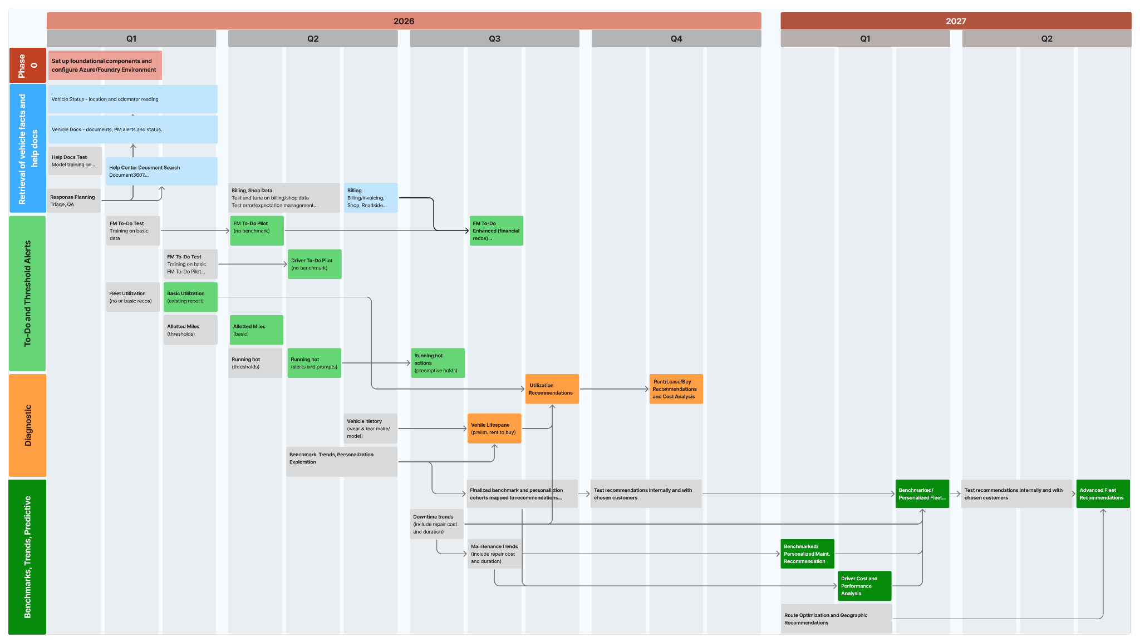

Slide 25
2026 Timelines are based on a 4.0 FTE Dev team
 | Q1-Q2 - Phases 0, I, II |  |  | Q3-Q4 - Phases III, IV +
1.0 | Product Owner - Jared |  | 1.0 | Product Owner - Jared
1.0 | Project/Product Management |  | 1.0 | Project/Product Management
0.5 | Business Analyst - Kip |  | 1.0 | AI Business Analyst - New Hire
1.0 | AI Engineering Tech Lead - Acacio |  | 1.0 | AI Engineering Tech Lead - Acacio
1.5 | Backend / ML Engineer |  | 1.5 | Backend / ML Engineer
1.0 | Full Stack / Frontend Engineer |  | 0.5 | Full Stack / Frontend Engineer
0.25 | QA Automation Engineer |  | 0.25 | QA Automation Engineer
0.25 | DevOps / SRE Engineer |  | 0.25 | DevOps / SRE Engineer
We recommend phasing in the AI Business / Product Analyst role until we reach Phase 2, or in Phase 1, so that the initial build team can create the platform and tools for this resource to use.

Slide 26
Recap
The 99s team has completed the research and analysis, and developed a prioritized list of features for the RyderGyde AI Product Roadmap through 2027
The recommendation to leverage Azure AI services including Microsoft Foundry follows the Ryder AI COE’s direction of service providers
The team has provided a schedule against resource recommendations for Q1&Q2

Slide 27
Appendix
Technology Planning

Slide 28
Future-State Architecture & Delivery Plan
Guiding Principles
Read-only first
Initial AI capabilities will be informational and assistive, not action-triggering.
Leverage existing RyderGyde architecture
The AI layer will consume existing APIs, caches, and integrations through a controlled orchestration layer (MCP).
Centralized orchestration, not point integrations
AI and UI must not directly integrate with backend systems independently.
Security, ABAC, and compliance are non-negotiable
AI must inherit RyderGyde’s identity and authorization model.
Observability and QA are first-class concerns
AI behavior must be measurable, auditable, and improvable.

Slide 29
Future-State Architecture & Delivery Plan
Future-State Architecture Overview
The future-state architecture introduces five new logical layers, without disrupting existing RyderGyde services.
AI Experience Layer
The customer-facing interface embedded in RyderGyde that enables conversational, read-only access to system insights without exposing backend complexity.
AI Gateway
The control plane that orchestrates AI interactions by managing prompts, retrieval workflows, tool calls, and model execution while enforcing performance, safety, and cost guardrails.
MCP Orchestration Layer (Master Control Program)
The centralized domain orchestration layer that aggregates data from RyderGyde and enterprise systems, enforces security and authorization policies, applies caching and performance controls, and exposes AI- and UI-ready APIs.
Retrieval Layer (Vector + Traditional Search)
The semantic and keyword search layer that indexes approved operational data and documents to provide accurate, contextual grounding for AI responses.
Central Observability & QA Layer
The cross-cutting monitoring and validation layer that captures end-to-end telemetry, evaluates AI behavior and retrieval quality, supports auditability, and enables continuous improvement through feedback loops.

Slide 30
Future-State Architecture & Delivery Plan
AI-Enabled RyderGyde: Layered Architecture Overview
Objective:
Introduce AI into RyderGyde safely, incrementally, and at scale without disrupting existing systems.
Approach:
A layered architecture that separates:
Customer experience
AI control & safety
Backend orchestration
Data grounding
Quality, security, and observability

Slide 31
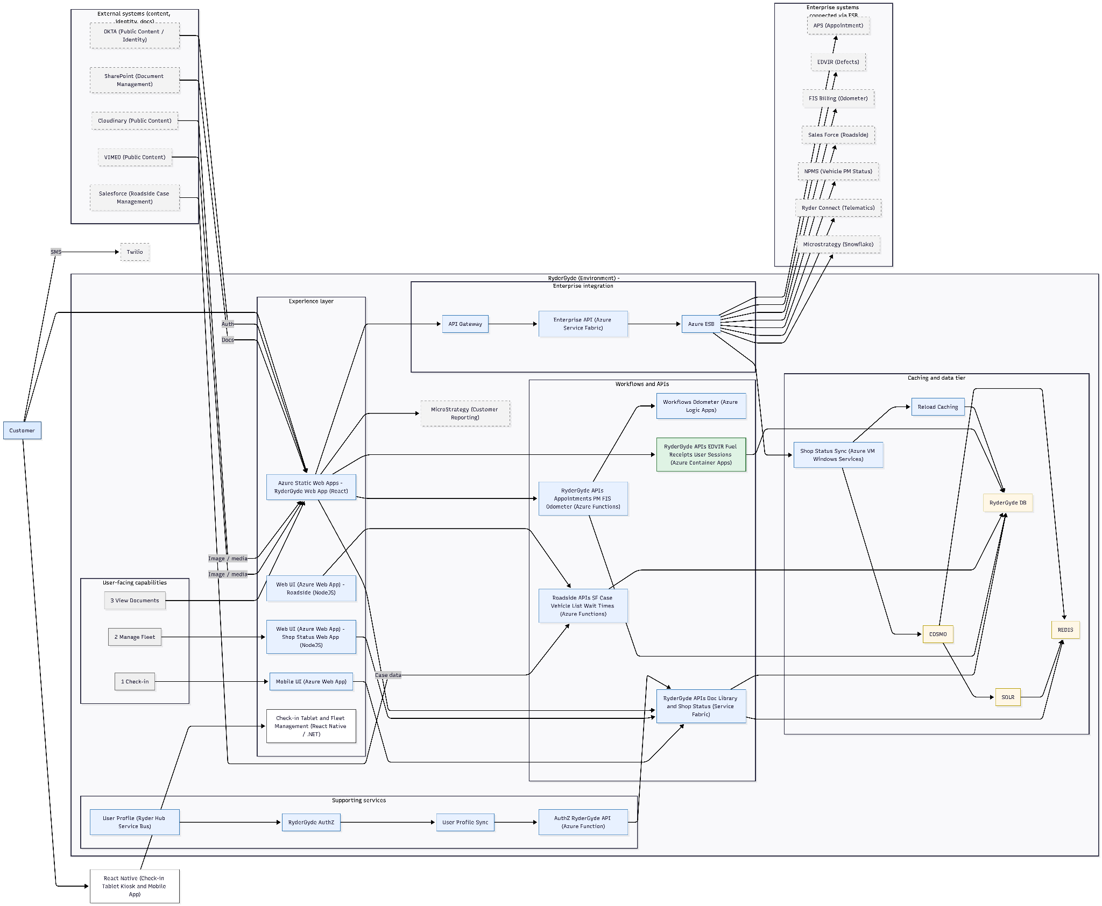
Current State Architecture

Slide 32
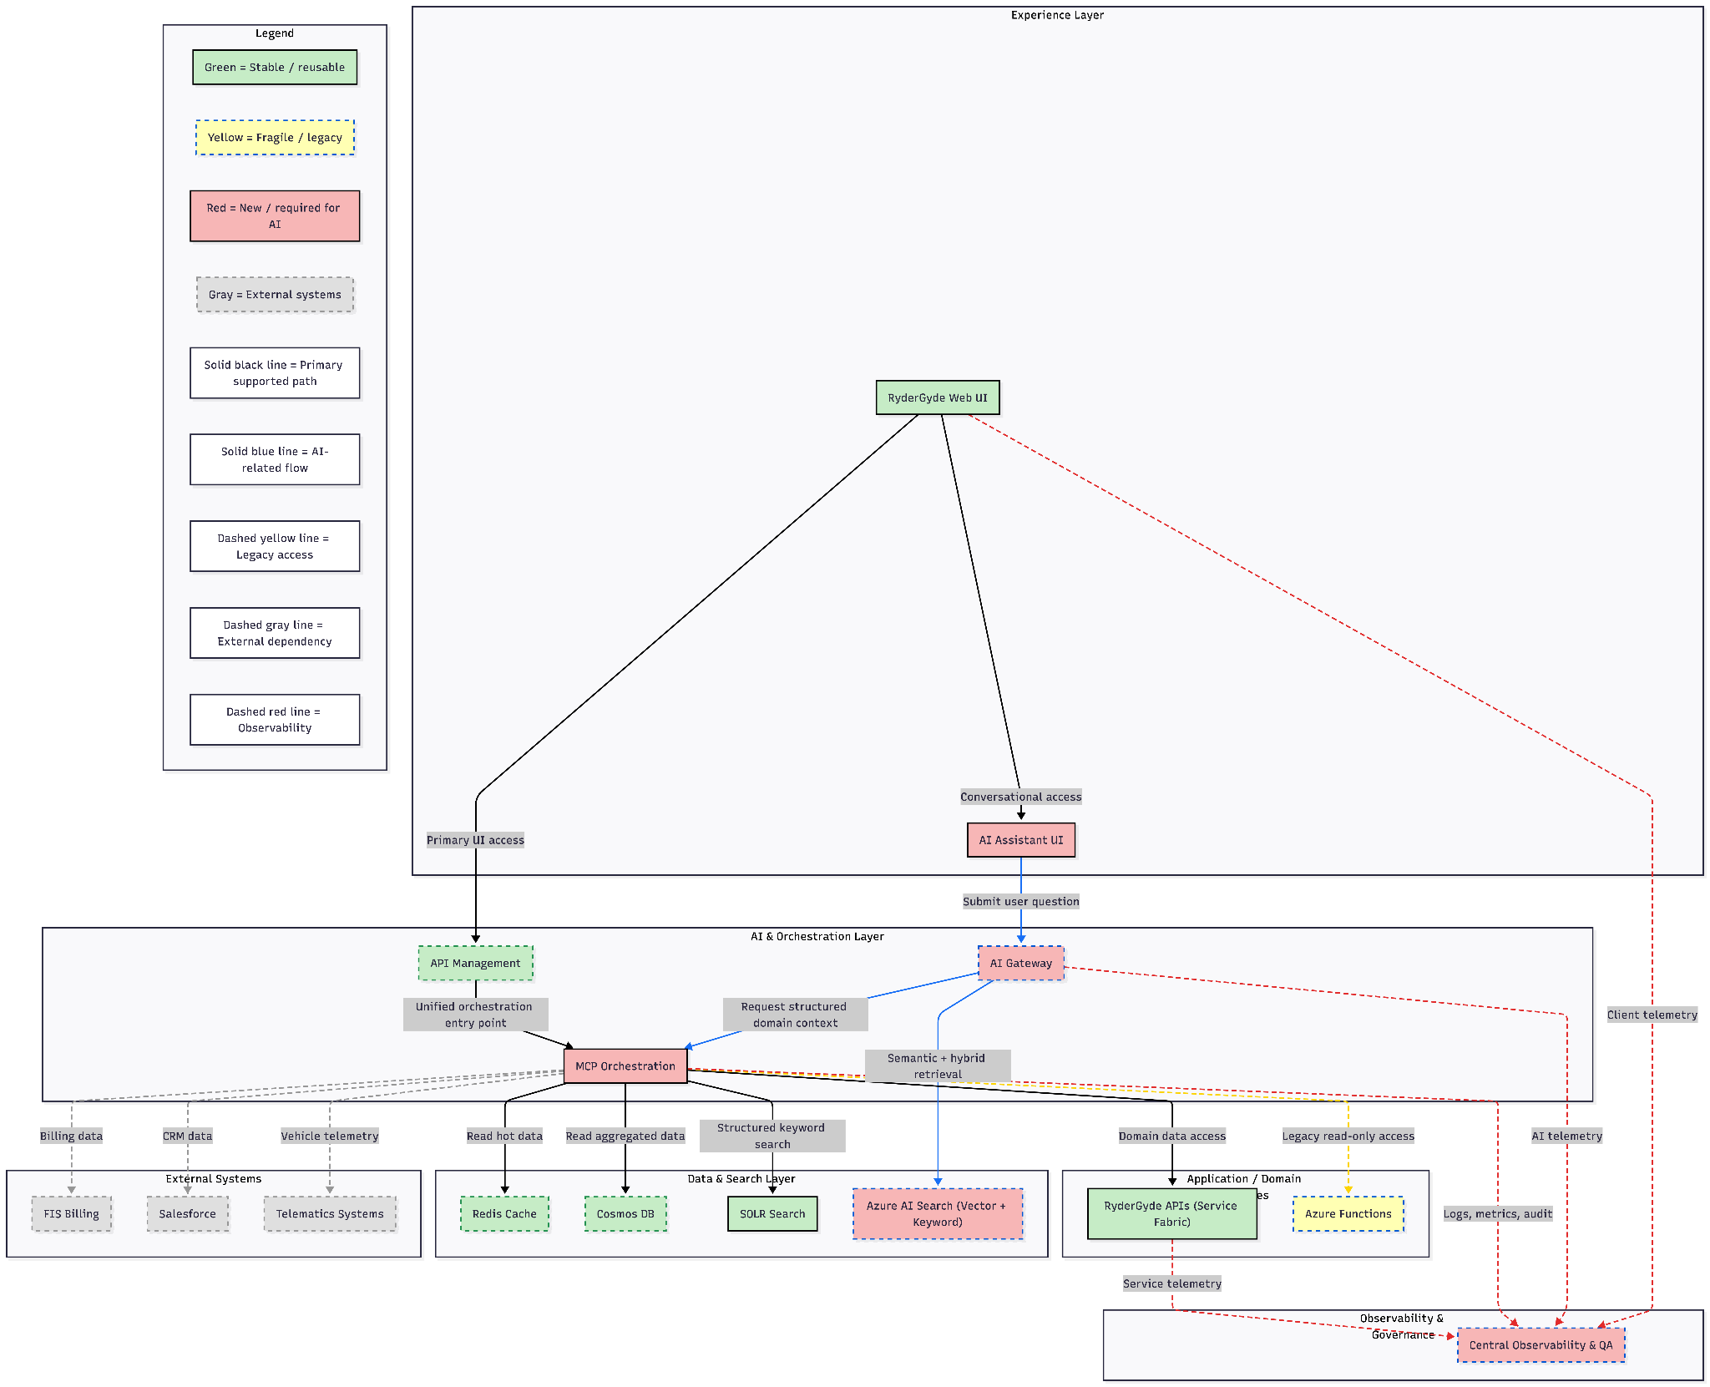
Future State Architecture

Slide 33
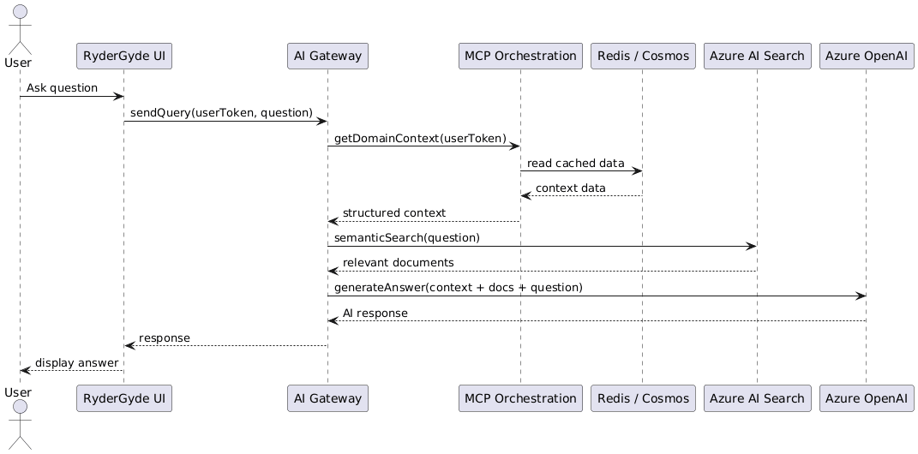
Future Solution Diagram
Sequence Diagram (Read-Only AI Use Case)
Example: “What’s the current status of my vehicle and upcoming maintenance?”
User asks question in RyderGyde UI
UI calls AI Gateway with user token
AI Gateway:
  Calls MCP for structured context
  Calls Azure AI Search for documents
MCP:
  Validates Attribute-Based Access Control
  Reads Redis/Cosmos
  Falls back to APIs if needed
AI Gateway:
  Assembles prompt
  Calls Azure OpenAI
Response returned to UI
Telemetry logged to Observability layer

Slide 34
Future-State Architecture & Delivery Plan
AI Experience Layer
Primary Azure Services
Azure App Service / Static Web Apps
Azure Front Door (optional)
Okta / Azure AD integration
Application Insights (client telemetry)
What It Does
Embedded chat experience in RyderGyde
Conversational, read-only access to insights
No direct backend access
Why This Layer Exists
Enables customers to interact with complex operational data conversationally, without changing existing workflows or exposing backend complexity.

Slide 35
Future-State Architecture & Delivery Plan
AI Gateway
Primary Azure Services
Azure Container Apps (or AKS)
Azure OpenAI Service
Azure API Management (optional)
Azure Key Vault
Application Insights
What It Does
Orchestrates prompts and retrieval
Manages tool/function calls
Controls model usage, latency, and cost
Prevents uncontrolled backend access
Why This Layer Exists
Centralizes AI usage to ensure safety, cost control, performance, and consistent behavior across all AI interactions.

Slide 36
Future-State Architecture & Delivery Plan
MCP Orchestration Layer (Model Context Protocol)
Primary Azure Services
Azure Container Apps
Azure API Management
Azure Redis Cache
Azure Cosmos DB
Azure Functions
Azure Service Bus (as needed)
What It Does
Aggregates data across RyderGyde systems
Enforces ABAC and security policies
Applies caching, throttling, and fallbacks
Exposes AI- and UI-ready domain APIs
Why This Layer Exists
Acts as the single, trusted integration layer that protects backend systems, ensures consistent answers, and enables AI and UI to scale safely.

Slide 37
Future-State Architecture & Delivery Plan
Retrieval Layer (Vector + Traditional Search)
Primary Azure Services
Azure AI Search (vector + keyword)
Azure OpenAI Embeddings
Azure Blob Storage
Azure Data Factory / Logic Apps
What It Does
Indexes approved operational data and documents
Supports semantic and keyword search
Grounds AI responses in real Ryder data
Why This Layer Exists
Reduces hallucinations and ensures AI responses are accurate, explainable, and based on trusted sources.

Slide 38
Future-State Architecture & Delivery Plan
Central Observability & QA Layer
Primary Azure Services
Azure Monitor
Application Insights
Log Analytics
Azure Managed Grafana
Azure DevOps / GitHub Actions
What It Does
End-to-end tracing (UI → AI → MCP → backend)
AI behavior and retrieval quality monitoring
Cost, latency (p95), and drift tracking
Auditability and compliance support
Why This Layer Exists
Makes AI behavior visible, measurable, and improvable — ensuring trust, compliance, and long-term quality.

Slide 39
Core Technical Roles (Build the Architecture)
Solution / Platform Architect (50–75%)
Why this role exists
Owns future-state architecture decisions
Prevents fragmentation between UI, AI, and backend
Defines MCP boundaries, data contracts, and guardrails
Key responsibilities
Architecture design & evolution
Tradeoff decisions (performance, security, cost)
Alignment with existing RyderGyde systems
Backend Engineer
MCP / Orchestration Engineer (100%)
Why this role exists
MCP is the backbone — without it, AI and UI diverge
Key responsibilities
Build MCP APIs
Implement ABAC and policy enforcement
Aggregate data from Redis, Cosmos, SOLR, APIs
Enforce read-only guarantees

Slide 40
AI & Data Roles (Enable Intelligence Safely)
Backend Engineer
AI Engineer (RAG / LLM) (100%)
Why this role exists
Turns architecture into a real AI experience
Key responsibilities
RAG pipeline design
Prompt orchestration
Tool calling via MCP
Latency, cost, and grounding optimization
AI observability integration
Search / Data Engineer (50%)
Why this role exists
Retrieval quality determines AI quality
Key responsibilities
Azure AI Search configuration
Vector + keyword retrieval strategies
Indexing pipelines
Metadata and filtering strategy

Slide 41
Platform, Quality, and Product Roles
Cloud & Integration Engineer
DevOps Engineer (50%)
Why this role exists
Ensures reliability and scalability from day one
Key responsibilities
Azure infrastructure
APIM, networking, identity
CI/CD and environment setup
Performance tuning
Search / Data Engineer (50%)
Why this role exists
Retrieval quality determines AI quality
Key responsibilities
Azure AI Search configuration
Vector + keyword retrieval strategies
Indexing pipelines
Metadata and filtering strategy
Product Owner – AI (25–50%)
Why this role exists
Prevents “AI for everybody” from diluting value
Key responsibilities
Prioritize high-value, read-only use cases
Define success metrics
Own rollout and adoption strategy
Act as business feedback loop

Slide 42
Appendix
About Azure OpenAI and Microsoft Foundry

Slide 43
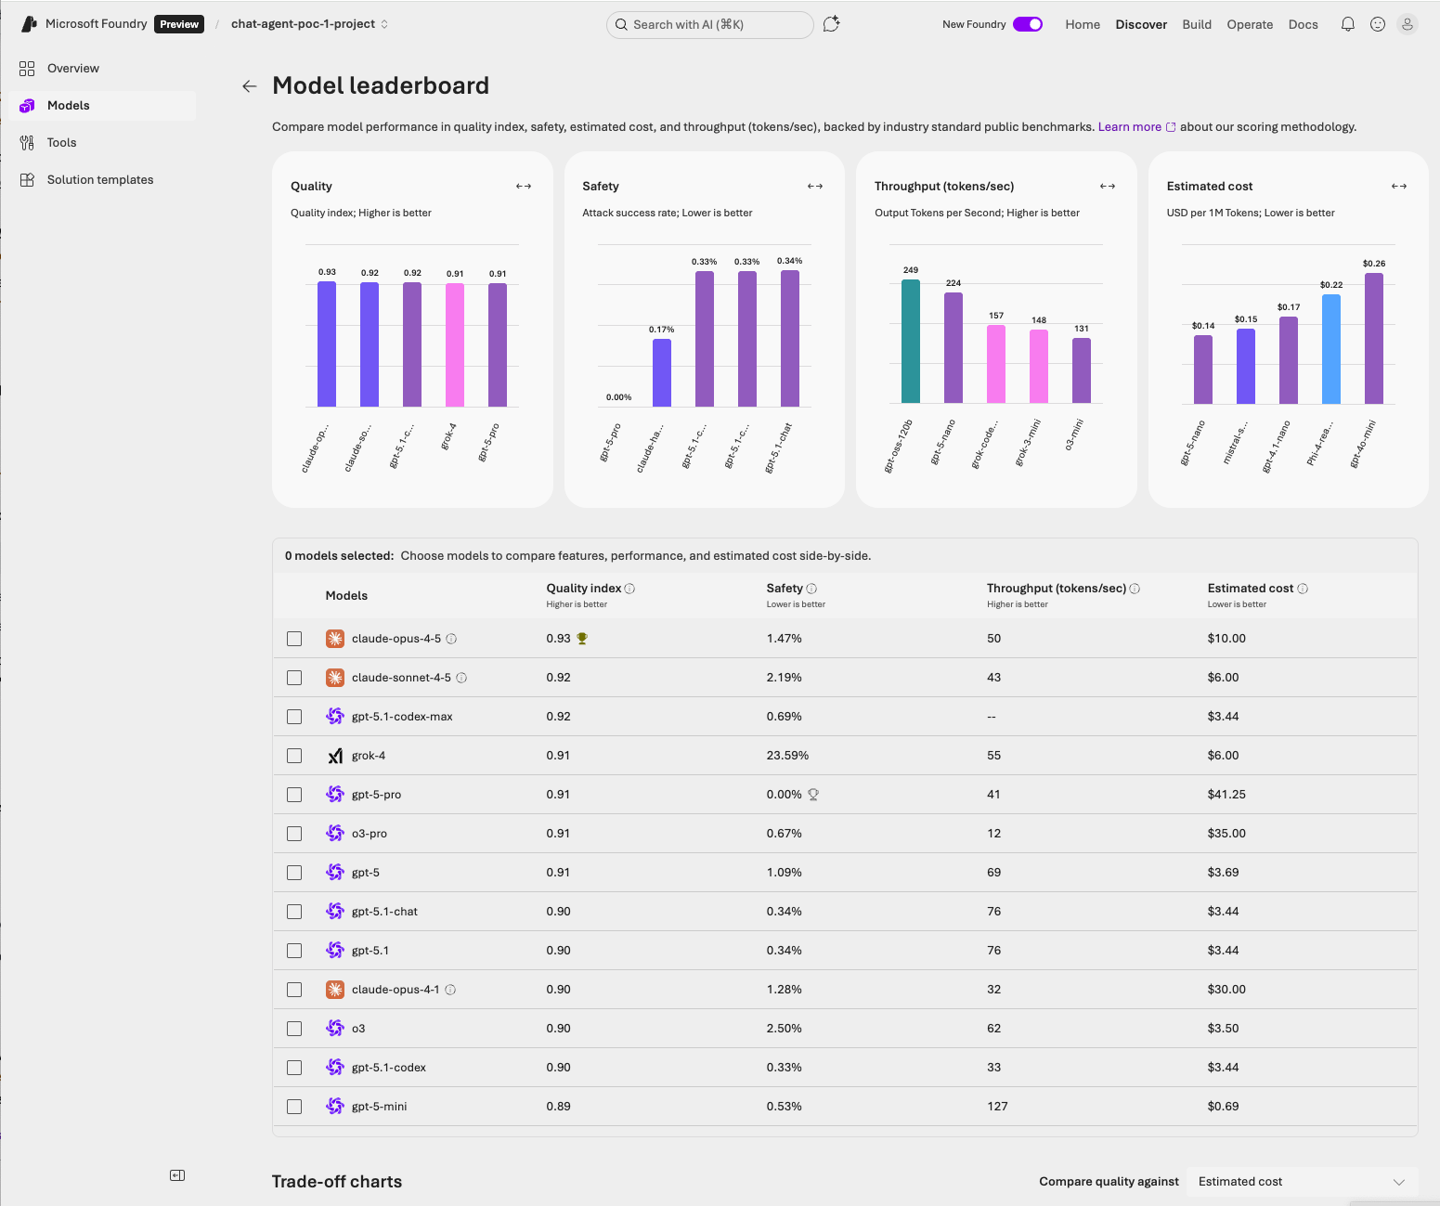
Appendix
MSFT Foundry
Azure OpenAI is continually deploying new features and capabilities that our architecture will be able to leverage quickly.
To the right you can see the latest benchmarking of available Models via Azure OpenAI

Slide 44
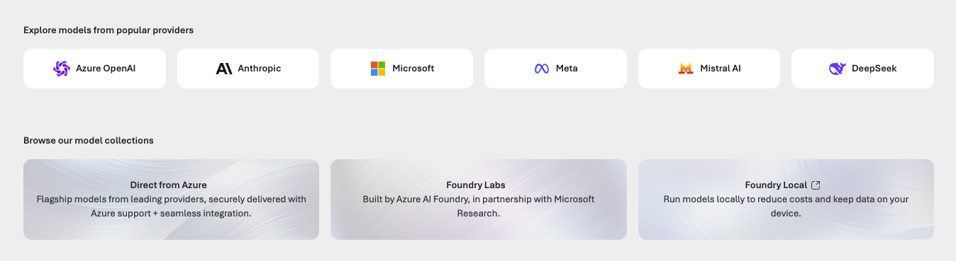
Appendix
Interchangeable Access to all major models
We will initially focus on Azure OpenAI, but can also bring in other best-in-class models as needed for different agentic applications - or build and host our own.
To the right you can see the latest benchmarking of available Models via Azure OpenAI

Slide 45
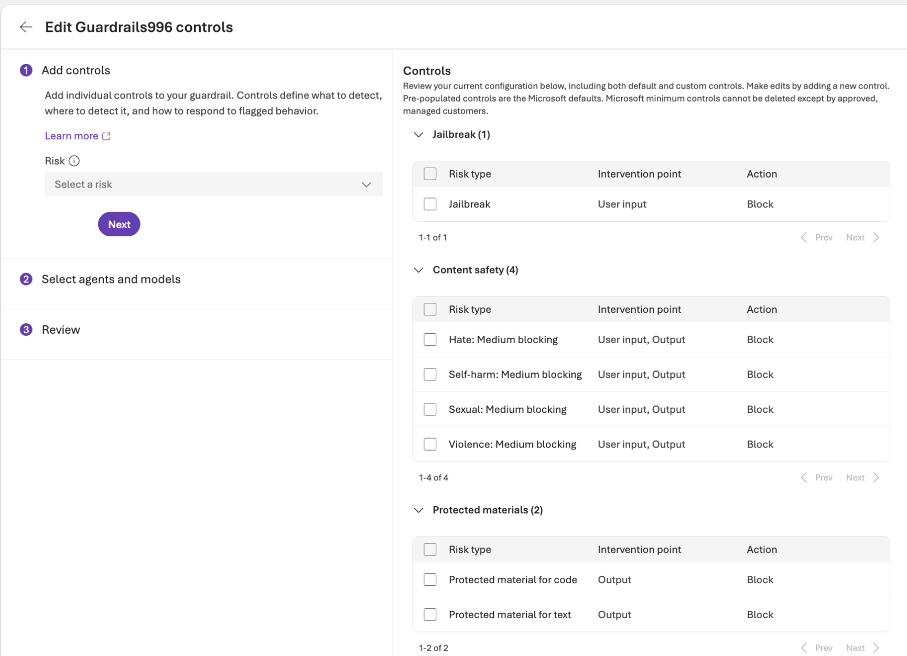
Appendix
Guardrails
Controls against multiple types of risk, managed and developed by Azure, but able to be customized as needed.

Slide 46
End of file

