Slide 1
Project Overview

Slide 2
Project Overview
Develop a predictive solution to forecast product-level seed demand across U.S. states to support Corteva's sales, inventory, and supply chain planning.
Problem Context:
Corteva offers diverse seed products with unique traits
Demand varies by state, product, and sales year
Accurate forecasting is critical to avoid stockouts, reduce surplus, and optimize distribution

Slide 3
Project Impact
Optimize Inventory
Increase Sales & Reduce Waste
Reduce overstock or understock
Reduce lost sales due to stockouts
Increase upsell opportunities
Minimize excess inventory and storage costs
Strategic Insights for Decision Making
Help identify products declining in demand and may need to be phased out, or vice versa
Enable analyzing which product traits drive sales in specific state
Enable "what if" scenario planning
Notes:
Operational efficiency gains
Business value delivered; upsell: encouraging customers to purchase additional / higher value products (eg, with better traits, larger volumns) in potential high-demand regions
Strategic insights for decision making

Slide 4
Business Metrics
Business-driven Metrics for Value Capturing:
Inventory optimization: # units overstock or understock
State wise calculation
Demand under fulfillment rate: % true demand under-captured by predictions (aka. 1 – fulfillment rate)
Customers loss
Money loss for potential sale
Demand over fulfillment rate: % true demand over predicted
Storage extra fee
Seeds waste
Improvement over baseline forecast
Notes:
Fulfilment rate = \sum_i{min(pred, true) / \sum{true}
Over fulfillment rate = \sum{max(pred-true, 0) / \sum{true}
Need to compare with baseline method!

Slide 5
Data Exploration and Modeling

Slide 6
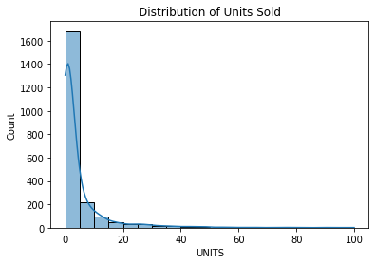
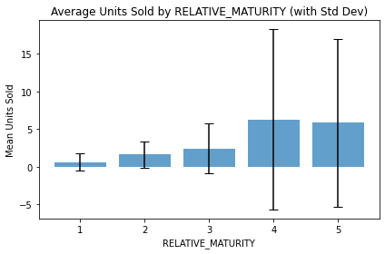
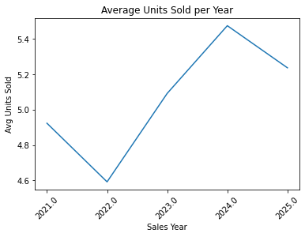
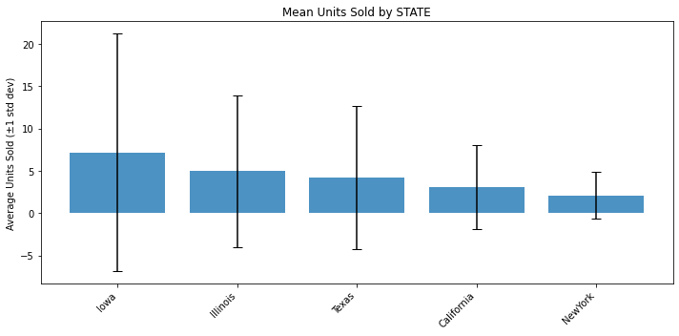
EDA & Visualization
Target Distribution
Ordinal Features vs Target (Product Attributes)
Categorical Feature Impact (State, Product, Lifecycle)
Temporal Trend

Slide 7
Data Enrichment
Features
Environment (External source)
Market (Internal source)
Customer (Internal source)
Weather
Drought index
Soil quality
Pest & disease reports
Promotions
Competitors, market share
Loyalty
Average field size per state
Methods:
Acquiring Real Data
Simulating Fake Data (statistical distribution, genAI etc.)
2. Data Size
Manually gather more data if possible
Synthetically generate data (small perturbations, genAI etc.)
Notes:
Data enriched: drought index, competitor pressure, market campaign, state avg field size, weather volatility, disease outbreak risk
Genai: create fake fare skus, unobserved combos of features; extract features from unstructured data

Slide 8
Preprocessing
Sum units for rows with same product, state, salesyear
Remove outliers of units > 100
Encoding categorical features: one hot encoding
Impute missing
Categorical features: most frequent
Numerical features: mean

Slide 9
Choice of Models
Is it a machine learning regression problem, or a time series forecast, since for each product the attributes are the same?
Feature | Characteristic
Product Attributes | Static over time
Time | Discrete ("SALESYEAR")
Target | Changes by year
Objective | Predict future demand per product per state
Machine learning regression
Time series forecast
Goal is to predict future units sold by learning from historical values
Treat product + state as a time series group
! Very sparse data points since only 1 – 3 years of data per [product, state]
! Static features cannot be used
More confident in predicting sales in known years
! Some features are highly correlated (eg., product and product attributes)
A hybrid approach: Tree-based model that use time-aware features
Notes:
LIFECYCLE changes by state with same year
ML models learn patterns from the relationships between features; can’t recognize temporal trends

Slide 10
Models
A hybrid model that combines the strengths of:
ML models (many features, not afraid of sparse data, external signals are key)
Time series (lag features, trends, time-based structure)
Explicit model construction:
Time-aware and calendar features
Lags in units (last 1 year)
Product age
Domain features
Product attributes
Geographic context
Tree-based Model (LGBM, XGBoost etc.)
Handle non-linear interactions
Handle missing data
Model Training:
Cross-validation for parameters tuning
Loss function is RMSE
Notes:
Hybrid models: powerful when target variable evolves over time but have rich data
Why tree-based: combines numerical, cat, ordinal without extensive preprocessing; use lag; robust in nonlinearity and feature interactions

Slide 11


Trained Model's Performance
State | N | MAE
California | 82 | 1.96
NewYork | 57 | 1.13
Illinois | 34 | 5.54
Iowa | 62 | 5.96
Texas | 23 | 3.98
Mean Absolute Error (MAE) = 3.39
Meaning the average absolute deviation from the true sold values in test data
State-wise MAE
R2 = 0.65
Meaning how much variance the model explains
Hit Rate
Because around 70% of the data has targets <= 5, the hit rate for overall test data is not good.
However, what we can show is that by bucketizing our test data, the hit rate is much higher in the bucket with higher targets.
For example, I bucketized the test data into 3 groups: target <= 10, [11 – 20], >= 20
Bin | N | HitRate@30% | MAE
≤10 | 223 | 17.65% | 1.83
11–20 | 20 | 35% | 8.1
>20 | 15 | 46.67% | 20.35
Potential Questions & Concerns
Notes:
When actual demand is low, a 2-unit error can result in a 200% hit rate miss for target unit sold = 1. Does it affect a lot in real-world decisions?

Slide 12
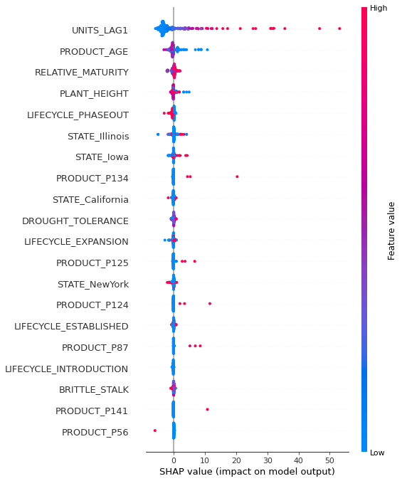
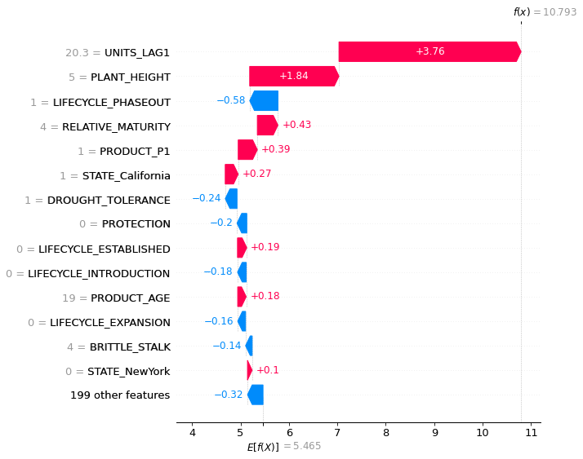
Business Questions & Concerns
What if business stakeholders are unsure about low-selling SKUs model performance?
We can improve by segmented modeling
Penalize more on small targets in model training
Add business rules / hard rules for edge cases
How does this model make predictions?
Driving features using model’s feature importance or SHAP
Global interpretation
Local interpretation
Notes:
Hard rules example: if sales 0 for the last 2 years, predict 0

Slide 13
Solution Delivery

Slide 14








Architecture (Using Azure Cloud Service)
Question: Do we need batch prediction, or real-time prediction?
Here I am assuming using the architecture of online deployment.
ML Inference
Deployment
Git
Containerized using Docker
Pushed to Azure Container Registry
Hosted on Azure Web Apps
Maintenance:
Azure DEVOPs for CI/CD if used
Periodic retraining, monitoring, and improving
Regular communication with stakeholders
Push code
Trigger
Azure DEVOPs Pipeline
Develop
Azure Repos / GitHub
Create image
Push image
Deploy image
Docker
Azure Container Registry
Azure Web Apps
Users
Read
Azure Blob Storage
Protected by VNET
Notes:
Git and Azure DEVOPS for CICD
DEVOPs not necessary if retrains once per year, but can be beneficial with benefits of reliability and reproducibility
Architecture requires collaborations with different departments, including DE, Security, Infra

Slide 15
User Interface
Frontend: Interactive UI
Features
Inputs: product, state, sales year -> Predictions
Support bulk upload
Visuals: predictions results across states, historical trends; optional: add chat box using LLM for quick customized visualizations
User Access:
Adding VNET
SSO sign in
Demo

Slide 16
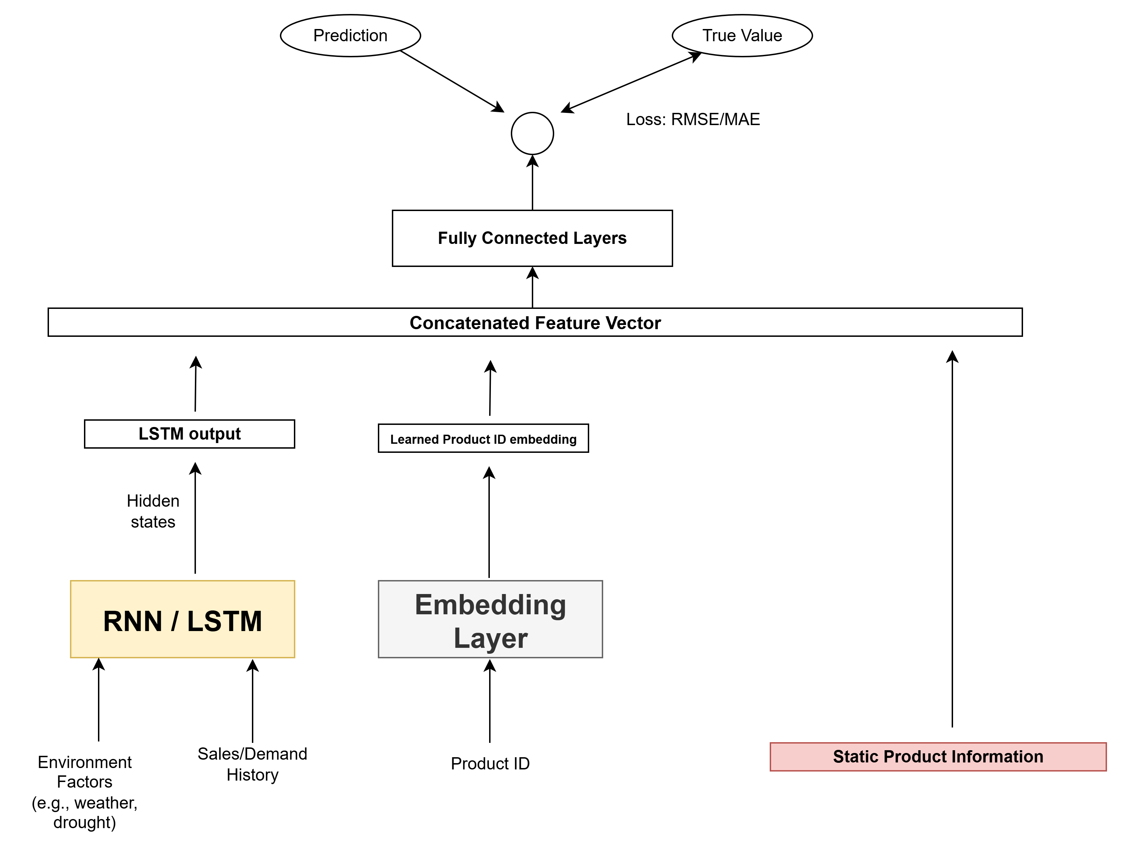
Future Improvements
Fallback Model for first year product
Train a second model without lag features
Switch logic in prediction based on whether lag is Null
Adding chatbot to UI
LLM has access to data source, model’s pipelines
Functionality: questions about data, make predictions, analyzing and making visualizations of data
Log transform target
Right skewed -> log transformation
Neural Network
NN embedding layer
When we link more data and have multiple years ( > 5) of data, we can potentially use deep neural network. In this setup, we can use embedding layer to learn the embedding of plant id, instead of using one hot encoding which makes it very sparse.
Can user more years of lags
NN structure

Slide 17
Thank You!

