Slide 1
CS639: Data Management for Data Science
Lecture 7: Wrapping up RDBMS
Theodoros Rekatsinas

Slide 2
Announcements
Final date: To be set. Issue with admins.
Questions on PA2?
Submission Template
Please follow instructions
Research projects posted
Please sign up to multiple projects that you find interesting
Sign up in Slack

Slide 3
Today’s Lecture
Finish SQL
Overview of an RDBMS
Transactions and ACID

Slide 4
1. SQL (Aggregation and Group By)

Slide 5
Aggregation
SELECT AVG(price)
FROM Product
WHERE maker = “Toyota”
SELECT COUNT(*)
FROM Product
WHERE year > 1995
SQL supports several aggregation operations:
SUM, COUNT, MIN, MAX, AVG
Except COUNT, all aggregations apply to a single attribute

Slide 6
Aggregation: COUNT
COUNT applies to duplicates, unless otherwise stated
SELECT COUNT(category)
FROM Product
WHERE year > 1995
Note: Same as COUNT(*). Why?
We probably want:
SELECT COUNT(DISTINCT category)
FROM Product
WHERE year > 1995

Slide 7
More Examples
Purchase(product, date, price, quantity)
SELECT SUM(price * quantity)
FROM Purchase
What do these mean?
SELECT SUM(price * quantity)
FROM Purchase
WHERE product = ‘bagel’

Slide 8
Simple Aggregations
Purchase
Product | Date | Price | Quantity
bagel | 10/21 | 1 | 20
banana | 10/3 | 0.5 | 10
banana | 10/10 | 1 | 10
bagel | 10/25 | 1.50 | 20
SELECT SUM(price * quantity)
FROM Purchase
WHERE product = ‘bagel’
50 (= 1*20 + 1.50*20)

Slide 9
Grouping and Aggregation
Purchase(product, date, price, quantity)
SELECT product,
SUM(price * quantity) AS TotalSales
FROM Purchase
WHERE date > ‘10/1/2005’
GROUP BY product
Find total sales after 10/1/2005 per product.
Let’s see what this means…

Slide 10
Grouping and Aggregation
Semantics of the query:
1. Compute the FROM and WHERE clauses
2. Group by the attributes in the GROUP BY
3. Compute the SELECT clause: grouped attributes and aggregates

Slide 11
1. Compute the FROM and WHERE clauses
SELECT product, SUM(price*quantity) AS TotalSales
FROM Purchase
WHERE date > ‘10/1/2005’
GROUP BY product
Product | Date | Price | Quantity
Bagel | 10/21 | 1 | 20
Bagel | 10/25 | 1.50 | 20
Banana | 10/3 | 0.5 | 10
Banana | 10/10 | 1 | 10
FROM

Slide 12
2. Group by the attributes in the GROUP BY
SELECT product, SUM(price*quantity) AS TotalSales
FROM Purchase
WHERE date > ‘10/1/2005’
GROUP BY product
Product | Date | Price | Quantity
Bagel | 10/21 | 1 | 20
Bagel | 10/25 | 1.50 | 20
Banana | 10/3 | 0.5 | 10
Banana | 10/10 | 1 | 10
GROUP BY
Product | Date | Price | Quantity
Bagel | 10/21 | 1 | 20
 | 10/25 | 1.50 | 20
Banana | 10/3 | 0.5 | 10
 | 10/10 | 1 | 10

Slide 13
3. Compute the SELECT clause: grouped attributes and aggregates
SELECT product, SUM(price*quantity) AS TotalSales
FROM Purchase
WHERE date > ‘10/1/2005’
GROUP BY product
Product | Date | Price | Quantity
Bagel | 10/21 | 1 | 20
 | 10/25 | 1.50 | 20
Banana | 10/3 | 0.5 | 10
 | 10/10 | 1 | 10
Product | TotalSales
Bagel | 50
Banana | 15
SELECT

Slide 14
HAVING Clause
SELECT product, SUM(price*quantity)
FROM Purchase
WHERE date > ‘10/1/2005’
GROUP BY product
HAVING SUM(quantity) > 100
Same query as before, except that we consider only products that have more than
100 buyers
HAVING clauses contains conditions on aggregates
Whereas WHERE clauses condition on individual tuples…

Slide 15
General form of Grouping and Aggregation
SELECT S
FROM R₁,…,R_{n}
WHERE C₁
GROUP BY a₁,…,a_{k}
HAVING C₂
Why?
S = Can ONLY contain attributes a₁,…,a_{k} and/or aggregates over other attributes
C₁ = is any condition on the attributes in R₁,…,R_{n}
C₂ = is any condition on the aggregate expressions

Slide 16
General form of Grouping and Aggregation
SELECT S
FROM R₁,…,R_{n}
WHERE C₁
GROUP BY a₁,…,a_{k}
HAVING C₂
Evaluation steps:
Evaluate FROM-WHERE: apply condition C₁ on the attributes in R₁,…,R_{n}
GROUP BY the attributes a₁,…,a_{k}
Apply condition C₂ to each group (may have aggregates)
Compute aggregates in S and return the result

Slide 17
Group-by v.s. Nested Query
Author(login, name)
Wrote(login, url)
Find authors who wrote ≥ 10 documents:
Attempt 1: with nested queries
SELECT DISTINCT Author.name
FROM Author
WHERE COUNT(
SELECT Wrote.url FROM Wrote WHERE Author.login = Wrote.login) > 10
This is SQL by a novice

Slide 18
Group-by v.s. Nested Query
Find all authors who wrote at least 10 documents:
Attempt 2: SQL style (with GROUP BY)
SELECT Author.name
FROM Author, Wrote
WHERE Author.login = Wrote.login
GROUP BY Author.name
HAVING COUNT(Wrote.url) > 10
This is SQL by an expert
No need for DISTINCT: automatically from GROUP BY

Slide 19
Group-by vs. Nested Query
Which way is more efficient?
Attempt #1- With nested: How many times do we do a SFW query over all of the Wrote relations?
Attempt #2- With group-by: How about when written this way?
With GROUP BY can be much more efficient!

Slide 20
2. Overview of an RDBMS

Slide 21
RDBMS Architecture
How does a SQL engine work ?
SQL Query
Relational Algebra (RA) Plan
Optimized RA Plan
Execution
Declarative query (from user)
Translate to relational algebra expression
Find logically equivalent- but more efficient- RA expression
Execute each operator of the optimized plan!

Slide 22
Logical vs. Physical Optimization
SQL Query
Relational Algebra (RA) Plan
Logical optimization (we will only see this one):
Find equivalent plans that are more efficient
Intuition: Minimize # of tuples at each step by changing the order of RA operators
Physical optimization:
Find algorithm with lowest IO cost to execute our plan
Intuition: Calculate based on physical parameters (buffer size, etc.) and estimates of data size (histograms)
Optimized RA Plan
Execution

Slide 23
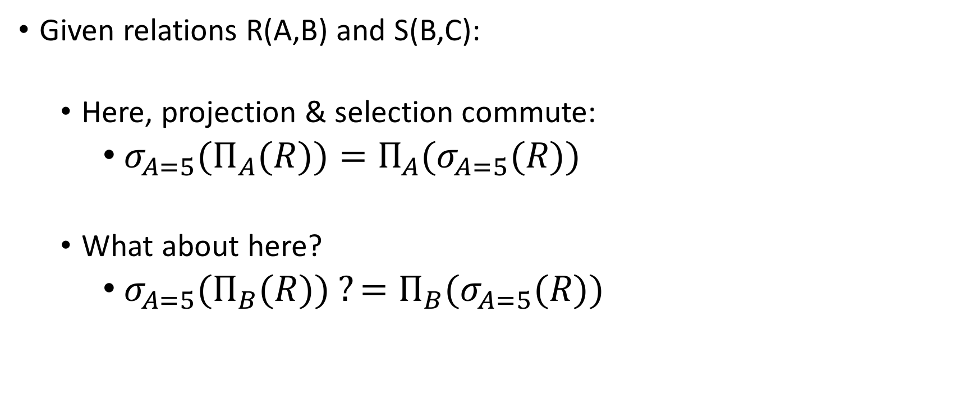
Recall: Logical Equivalence of RA Plans
Given relations R(A,B) and S(B,C):
Here, projection & selection commute:
${σ_{A=5}(Π}_{A}(R))=Π_{A}(σ_{A=5}(R))$
What about here?
${σ_{A=5}(Π}_{B}(R)) ?=Π_{B}(σ_{A=5}(R))$

Slide 24

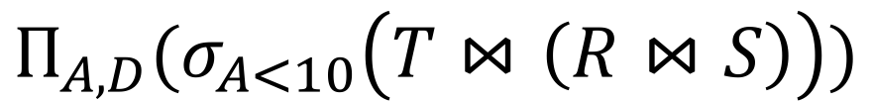
Translating to RA
R(A,B) S(B,C) T(C,D)
$$Π_{A,D}$$
SELECT R.A,S.D
FROM R,S,T
WHERE R.B = S.B
AND S.C = T.C
AND R.A < 10;
σ_{Α<10}
T(C,D)
R(A,B)
S(B,C)
$$Π_{A,D}(σ_{A<10}\left(T⋈\left(R⋈S\right)\right))$$

Slide 25
Logical Optimization
Heuristically, we want selections and projections to occur as early as possible in the plan
Terminology: “push down selections” and “pushing down projections.”
Intuition: We will have fewer tuples in a plan.
Could fail if the selection condition is very expensive (say runs some image processing algorithm).
Projection could be a waste of effort, but more rarely.

Slide 26
Optimizing RA Plan
Push down selection on A so it occurs earlier
R(A,B) S(B,C) T(C,D)
$$Π_{A,D}$$
SELECT R.A,S.D
FROM R,S,T
WHERE R.B = S.B
AND S.C = T.C
AND R.A < 10;
σ_{Α<10}
T(C,D)
R(A,B)
S(B,C)
$$Π_{A,D}(σ_{A<10}\left(T⋈\left(R⋈S\right)\right))$$

Slide 27

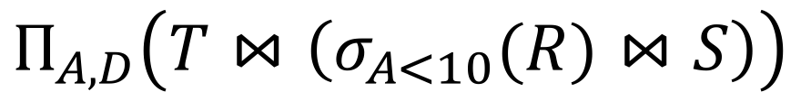
Optimizing RA Plan
Push down selection on A so it occurs earlier
R(A,B) S(B,C) T(C,D)
SELECT R.A,S.D
FROM R,S,T
WHERE R.B = S.B
AND S.C = T.C
AND R.A < 10;
$$Π_{A,D}$$
T(C,D)
σ_{Α<10}
S(B,C)
$$Π_{A,D}\left(T⋈\left(σ_{A<10}(R)⋈S\right)\right)$$
R(A,B)

Slide 28
Optimizing RA Plan
Push down projection so it occurs earlier
R(A,B) S(B,C) T(C,D)
SELECT R.A,S.D
FROM R,S,T
WHERE R.B = S.B
AND S.C = T.C
AND R.A < 10;
$$Π_{A,D}$$
T(C,D)
σ_{Α<10}
S(B,C)
$$Π_{A,D}\left(T⋈\left(σ_{A<10}(R)⋈S\right)\right)$$
R(A,B)

Slide 29
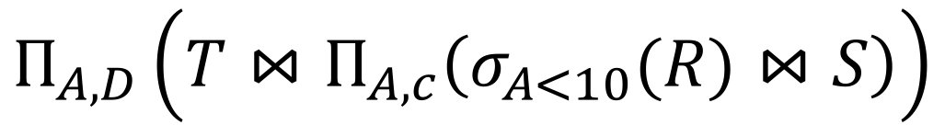


Optimizing RA Plan
We eliminate B earlier!
R(A,B) S(B,C) T(C,D)
In general, when is an attribute not needed…?
$$Π_{A,D}$$
SELECT R.A,S.D
FROM R,S,T
WHERE R.B = S.B
AND S.C = T.C
AND R.A < 10;
$$Π_{A,C}$$
T(C,D)
$$Π_{A,D}\left(T⋈Π_{A,c}\left(σ_{A<10}(R)⋈S\right)\right)$$
σ_{Α<10}
S(B,C)
R(A,B)

Slide 30
3. Transactions and ACID

Slide 31
Transactions: Basic Definition
A transaction (“TXN”) is a sequence of one or more operations (reads or writes) which reflects a single real-world transition.
In the real world, a TXN either happened completely or not at all
START TRANSACTION
UPDATE Product SET Price = Price – 1.99 WHERE pname = ‘Gizmo’
COMMIT

Slide 32
Transactions: Basic Definition
A transaction (“TXN”) is a sequence of one or more operations (reads or writes) which reflects a single real-world transition.
In the real world, a TXN either happened completely or not at all
Examples:
Transfer money between accounts
Purchase a group of products
Register for a class (either waitlist or allocated)

Slide 33
Transactions in SQL
In “ad-hoc” SQL:
Default: each statement = one transaction
In a program, multiple statements can be grouped together as a transaction:
START TRANSACTION
UPDATE Bank SET amount = amount – 100
WHERE name = ‘Bob’
UPDATE Bank SET amount = amount + 100
WHERE name = ‘Joe’
COMMIT

Slide 34
Transaction Properties: ACID
Atomic
State shows either all the effects of txn, or none of them
Consistent
Txn moves from a state where integrity holds, to another where integrity holds
Isolated
Effect of txns is the same as txns running one after another (ie looks like batch mode)
Durable
Once a txn has committed, its effects remain in the database
ACID continues to be a source of great debate!

Slide 35
ACID: Atomicity
TXN’s activities are atomic: all or nothing
Intuitively: in the real world, a transaction is something that would either occur completely or not at all
Two possible outcomes for a TXN
It commits: all the changes are made
It aborts: no changes are made

Slide 36
Transactions
A key concept is the transaction (TXN): an atomic sequence of db actions (reads/writes)
Atomicity: An action either completes entirely or not at all
Acct | Balance
a10 | 20,000
a20 | 15,000
Transfer $3k from a10 to a20:
Debit $3k from a10
Credit $3k to a20
Acct | Balance
a10 | 17,000
a20 | 18,000
Written naively, in which states is atomicity preserved?
Crash before 1,
After 1 but before 2,
After 2.
DB Always preserves atomicity!

Slide 37
ACID: Consistency
The tables must always satisfy user-specified integrity constraints
Examples:
Account number is unique
Stock amount can’t be negative
Sum of debits and of credits is 0
How consistency is achieved:
Programmer makes sure a txn takes a consistent state to a consistent state
System makes sure that the txn is atomic

Slide 38
ACID: Isolation
A transaction executes concurrently with other transactions
Isolation: the effect is as if each transaction executes in isolation of the others.
E.g. Should not be able to observe changes from other transactions during the run

Slide 39
Challenge: Scheduling Concurrent Transactions
The DBMS ensures that the execution of {T₁,…,T_{n}} is equivalent to some serial execution
One way to accomplish this: Locking
Before reading or writing, transaction requires a lock from DBMS, holds until the end
Key Idea: If T_{i} wants to write to an item x and T_{j} wants to read x, then T_{i}, T_{j} conflict. Solution via locking:
only one winner gets the lock
loser is blocked (waits) until winner finishes
A set of TXNs is isolated if their effect is as if all were executed serially
What if T_{i} and T_{j} need X and Y, and T_{i} asks for X before T_{j,} and T_{j} asks for Y before T_{i}?
-> Deadlock! One is aborted…
All concurrency issues handled by the DBMS…

Slide 40
ACID: Durability
The effect of a TXN must continue to exist (“persist”) after the TXN
And after the whole program has terminated
And even if there are power failures, crashes, etc.
And etc…
Means: Write data to disk

Slide 41
Ensuring Atomicity & Durability
DBMS ensures atomicity even if a TXN crashes!
One way to accomplish this: Write-ahead logging (WAL)
Key Idea: Keep a log of all the writes done.
After a crash, the partially executed TXNs are undone using the log
Write-ahead Logging (WAL): Before any action is finalized, a corresponding log entry is forced to disk
We assume that the log is on “stable” storage
All atomicity issues also handled by the DBMS…

Slide 42
Challenges for ACID properties
In spite of failures: Power failures, but not media failures
Users may abort the program: need to “rollback the changes”
Need to log what happened
Many users executing concurrently
Can be solved via locking (we’ll see this next lecture!)
And all this with… Performance!!

Slide 43
A Note: ACID is contentious!
Many debates over ACID, both historically and currently
Many newer “NoSQL” DBMSs relax ACID
In turn, now “NewSQL” reintroduces ACID compliance to NoSQL-style DBMSs…
ACID is an extremely important & successful paradigm, but still debated!

Slide 44
Summary of DBMS
DBMS are used to maintain, query, and manage large datasets.
Provide concurrency, recovery from crashes, quick application development, integrity, and security
Key abstractions give data independence
DBMS R&D is one of the broadest fields in CS. Fact!

