Slide 1
CS639: Data Management for Data Science
Lecture 9: The MapReduce Programming Model
and Algorithms in MapReduce
Theodoros Rekatsinas

Slide 2
Logistics/Announcements
Minor change on schedule
Friday lecture covered by Paris Koutris
We will skip Monday’s lecture (I am in the bay area)

Slide 3
Today’s Lecture
The MapReduce Abstraction
The MapReduce Programming Model
MapReduce Examples

Slide 4
1. The MapReduce Abstraction

Slide 5
The Map Reduce Abstraction for Distributed Algorithms
Distributed Data Storage
Map
(Shuffle)
Reduce

Slide 6
The Map Reduce Abstraction for Distributed Algorithms
Distributed Data Storage
map
map
map
map
map
map
Map
(Shuffle)
reduce
reduce
reduce
reduce
Reduce

Slide 7
The Map Reduce Abstraction for Distributed Algorithms
Distributed Data Storage
map
map
map
map
map
map
Map
(Shuffle)
reduce
reduce
reduce
reduce
Reduce

Slide 8
Map
Reduce
Shift
(docID=1, v1)
(docID=2, v2)
(docID=3, v3)
….
(w1, 1)
(w2, 1)
(w3, 1)
(w1, [1, 1, …])
(w2, [1, 1,…])
(w3, [1, …])
(w1, 73)
(w2, 31)
(w3, 15)
(w1, 1)
(w2, 1)
…
…

Slide 9
The Map Reduce Abstraction for Distributed Algorithms
MapReduce is a high-level programming model and implementation for large-scale parallel data processing
Like RDBMS adopt the the relational data model, MapReduce has a data model as well

Slide 10
MapReduce’s Data Model
Files!
A File is a bag of (key, value) pairs
A bag is a multiset
A map-reduce program:
Input: a bag of (inputkey, value) pairs
Output: a bag of (outputkey, value) pairs

Slide 11
2. The MapReduce Programming Model

Slide 12
User input
All the user needs to define are the MAP and REDUCE functions
Execute proceeds in multiple MAP – REDUCE rounds
MAP – REDUCE = MAP phase followed REDUCE

Slide 13
MAP Phase
Step 1: the MAP phase
User provides a MAP-function:
Input: (input key, value)
Output: bag of (intermediate key, value)
System applies the map function in parallel to all (input key, value) pairs in the input file

Slide 14
REDUCE Phase
Step 2: the REDUCE phase
User provides a REDUCE-function:
Input: (intermediate key, bag of values)
Output: (intermediate key, values)
The system will group all pairs with the same intermediate key, and passes the bag of values to the REDUCE function

Slide 15
MapReduce Programming Model
Input & Output: each a set of key/value pairs
Programmer specifies two functions:
map (in_key, in_value) -> list(out_key, intermediate_value)
Processes input key/value pair
Produces set of intermediate pairs
reduce (out_key, list(intermediate_value)) -> (out_key, list(out_values))
Combines all intermediate values for a particular key
Produces a set of merged output values (usually just one)

Slide 16
Example: what does the next program do?
map(String input_key, String input_value):
//input_key: document id
//input_value: document bag of words
for each word w in input_value:
EmitIntermediate(w, 1);
reduce(String intermediate_key, Iterator intermediate_values):
//intermediate_key: word
//intermediate_values: ????
result = 0;
for each v in intermediate_values:
result += v;
EmitFinal(intermediate_key, result);

Slide 17
Example: what does the next program do?
map(String input_key, String input_value):
//input_key: document id
//input_value: document bag of words
word_count = {}
for each word w in input_value:
increase word_count[w] by one
for each word w in word_count:
EmitIntermediate(w, word_count[w]);
reduce(String intermediate_key, Iterator intermediate_values):
//intermediate_key: word
//intermediate_values: ????
result = 0;
for each v in intermediate_values:
result += v;
EmitFinal(intermediate_key, result);

Slide 18
3. MapReduce Examples

Slide 19
Word length histogram
How many big, medium, small, and tiny words are in a document?
Big = 10+ letters
Medium = 5..9 letters
Small = 2..4 letters
Tiny = 1 letter

Slide 20
Word length histogram
Split the document into chunks and process each chunk on a different computer
Chunk 2
Chunk 1

Slide 21
Word length histogram
Output
(Big , 17)
(Medium, 77)
(Small, 107)
(Tiny, 3)
Chunk 2
Chunk 1
Map Chunk 1 (204words)

Slide 22
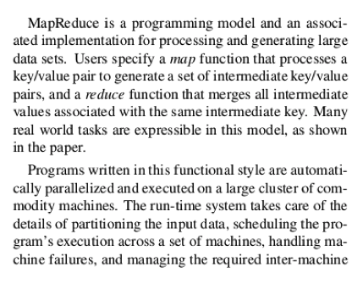
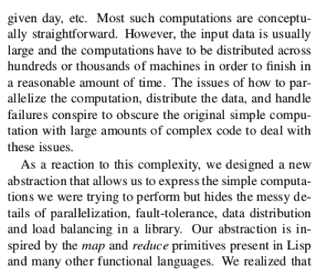
Word length histogram
Map task 1
Output
(Big, 17)
(Medium, 77)
(Small, 107)
(Tiny, 3)
(Big, 17)
(Big, 20)
(Big, 37)
(Medium, 77)
(Medium, 71)
(Medium, 148)
Map task 2
(Small, 107)
(Small, 93)
(Small, 200)
Output
(Big, 20)
(Medium, 71)
(Small, 93)
(Tiny, 6)
(Tiny, 3)
(Tiny, 6)
(Tiny, 9)

Slide 23
Build an Inverted Index
Input:
doc1, (“I love medium roast coffee”)
doc2, (“I do not like coffee”)
doc3, (“This medium well steak is great”)
doc4, (“I love steak”)
Output:
“roast”, (doc1)
“coffee”, (doc1, doc2)
“medium”, (doc1, doc3)
“steak”, (doc3, do4)

Slide 24
Let’s design the solution!
Input:
doc1, (“I love medium roast coffee”)
doc2, (“I do not like coffee”)
doc3, (“This medium well steak is great”)
doc4, (“I love steak”)
Output:
“roast”, (doc1)
“coffee”, (doc1, doc2)
“medium”, (doc1, doc3)
“steak”, (doc3, do4)

