Slide 1
CS639: Data Management for Data Science
Lecture 13: Statistical Inference
Theodoros Rekatsinas

Slide 2
Announcements
We have graded most of the exams
We will be announcing grades by Wednesday
Next PA will come after the spring break

Slide 3
Where are we?
Covered data management systems (how to manipulate data)
For this part of the class we will cover modeling and statistical analysis (how to obtain insights)
In the last part of the class we will discuss how to communicate our findings (how to visualize findings)

Slide 4
Today’s Lecture
Intro to Statistical Inference
Central Limit Theorem and Statistics of Distributions
Confidence Intervals
Hypothesis Testing

Slide 5
1. Statistical Inference

Slide 6
Statistical Inference
Statistical inference: The process of making guesses about the truth from sample data.
Sample statistics
Truth (not observable)
Sample (observation)
*hat notation ^ is often used to indicate “estitmate”
Population parameters
Make guesses about the whole population

Slide 7
Statistics vs. Parameters
Sample Statistic – any summary measure calculated from data; e.g., could be a mean, a difference in means or proportions, an odds ratio, or a correlation coefficient
E.g., the mean vitamin D level in a sample of 100 people is 63 nmol/L
E.g., the correlation coefficient between vitamin D and cognitive function in the sample of 100 people is 0.15
Population parameter – the true value/true effect in the entire population of interest
E.g., the true mean vitamin D in all middle-aged humans is 62 nmol/L
E.g., the true correlation between vitamin D and cognitive function in all middle-aged humans is 0.15

Slide 8
Examples of Sample Statistics
Single population mean
Single population proportion
Difference in means (t-test)
Difference in proportions (Z-test)
Odds ratio/risk ratio
Correlation coefficient
Regression coefficient
…

Slide 9
Example 1: cognitive function and vitamin D
Hypothetical data loosely based on [1]; cross-sectional study of 100 middle-aged and older European men.
Estimation: What is the average serum vitamin D in middle-aged and older European men?
Sample statistic: mean vitamin D levels
Hypothesis testing: Are vitamin D levels and cognitive function correlated?
Sample statistic: correlation coefficient between vitamin D and cognitive function, measured by the Digit Symbol Substitution Test (DSST).
1. Lee DM, Tajar A, Ulubaev A, et al. Association between 25-hydroxyvitamin D levels and cognitive performance in middle-aged and older European men. J Neurol Neurosurg Psychiatry. 2009 Jul;80(7):722-9.

Slide 10
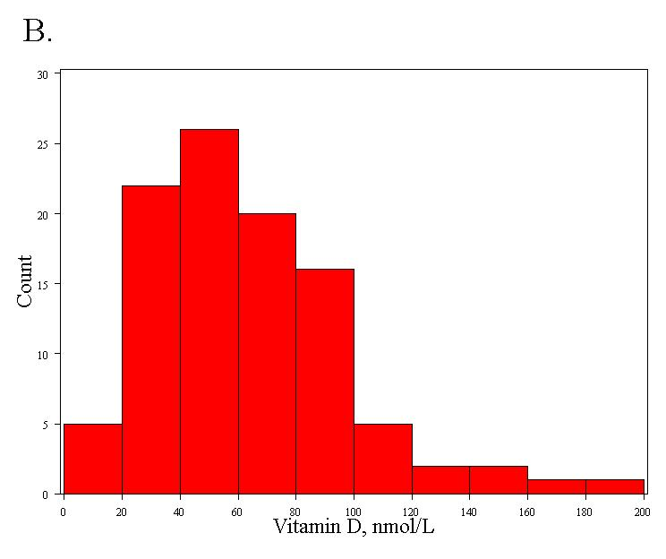
Distribution of a trait: vitamin D
Right-skewed!
Mean= 63 nmol/L
Standard deviation = 33 nmol/L

Slide 11
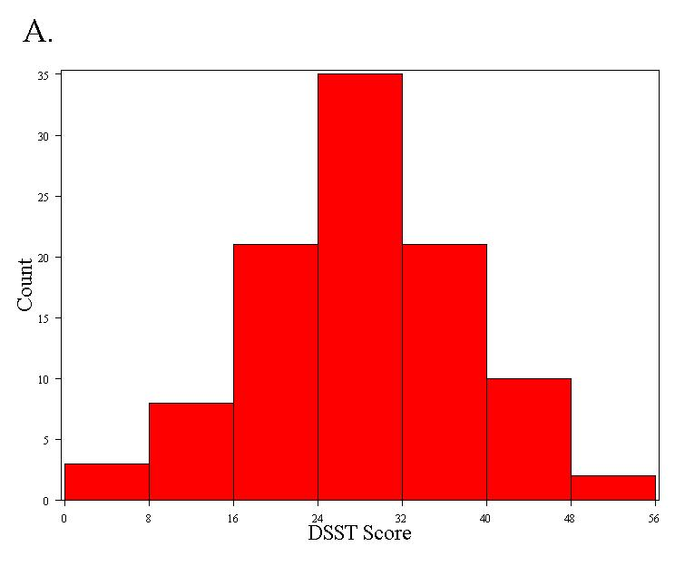
Distribution of a trait: DSST
Normally distributed
Mean = 28 points
Standard deviation = 10 points
Notes:
Digit Symbol Substitution Tes

Slide 12
Distribution of a statistic
Statistics follow distributions too…
But the distribution of a statistic is a theoretical construct.
Statisticians ask a thought experiment: how much would the value of the statistic fluctuate if one could repeat a particular study over and over again with different samples of the same size?
By answering this question, statisticians are able to pinpoint exactly how much uncertainty is associated with a given statistic.
Notes:
Digit Symbol Substitution Tes

Slide 13
Distribution of a statistic
Two approaches to determine the distribution of a statistic:
1. Computer simulation
Repeat the experiment over and over again virtually!
More intuitive; can directly observe the behavior of statistics.
2. Mathematical theory
Proofs and formulas!
More practical; use formulas to solve problems.
Notes:
Digit Symbol Substitution Tes

Slide 14
Example of computer simulation
How many heads come up in 100 coin tosses?
Flip coins virtually
Flip a coin 100 times; count the number of heads.
Repeat this over and over again a large number of times (we’ll try 30,000 repeats!)
Plot the 30,000 results.
Notes:
Digit Symbol Substitution Tes

Slide 15
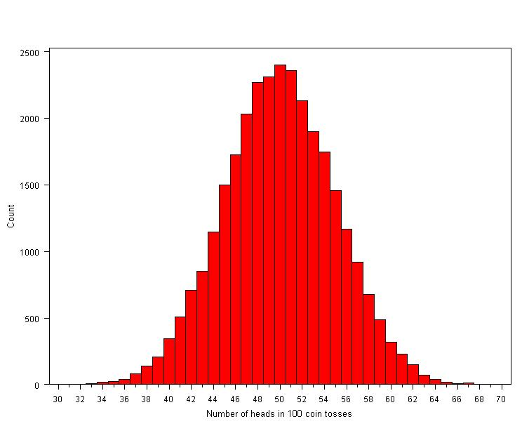
Coin tosses
Conclusions:
We usually get between 40 and 60 heads when we flip a coin 100 times.
It’s extremely unlikely that we will get 30 heads or 70 heads (didn’t happen in 30,000 experiments!).
Notes:
Digit Symbol Substitution Tes

Slide 16
Distribution of the sample mean, computer simulation
1. Specify the underlying distribution of vitamin D in all European men aged 40 to 79.
Right-skewed
Standard deviation = 33 nmol/L
True mean = 62 nmol/L (this is arbitrary; does not affect the distribution)
2. Select a random sample of 100 virtual men from the population.
3. Calculate the mean vitamin D for the sample.
4. Repeat steps (2) and (3) a large number of times (say 1000 times).
5. Explore the distribution of the 1000 means.
Notes:
Digit Symbol Substitution Tes

Slide 17
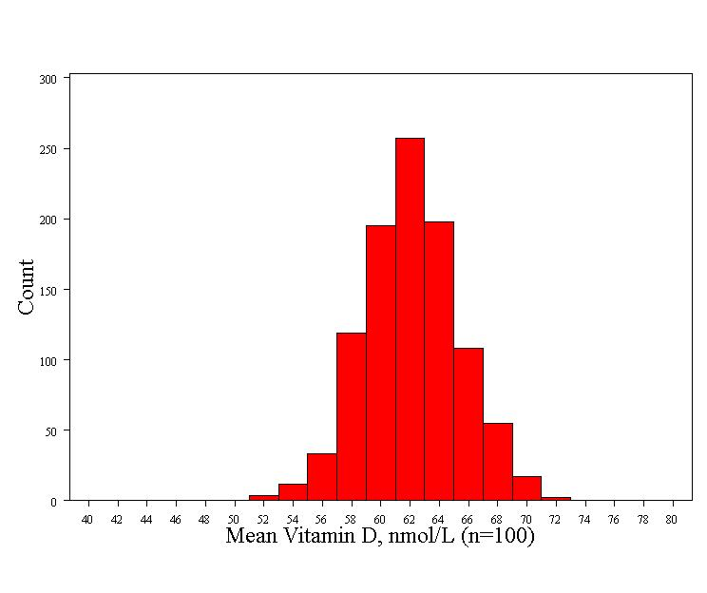
Distribution of mean vitamin D (a sample statistic)
Normally distributed! Surprise!
Mean= 62 nmol/L (the true mean)
Standard deviation = 3.3 nmol/L
Notes:
Digit Symbol Substitution Tes

Slide 18
Distribution of mean vitamin D (a sample statistic)
Normally distributed (even though the trait is right-skewed!)
Mean = true mean
Standard deviation = 3.3 nmol/L
The standard deviation of a statistic is called a standard error
The standard error of a mean =
Notes:
Digit Symbol Substitution Tes

Slide 19
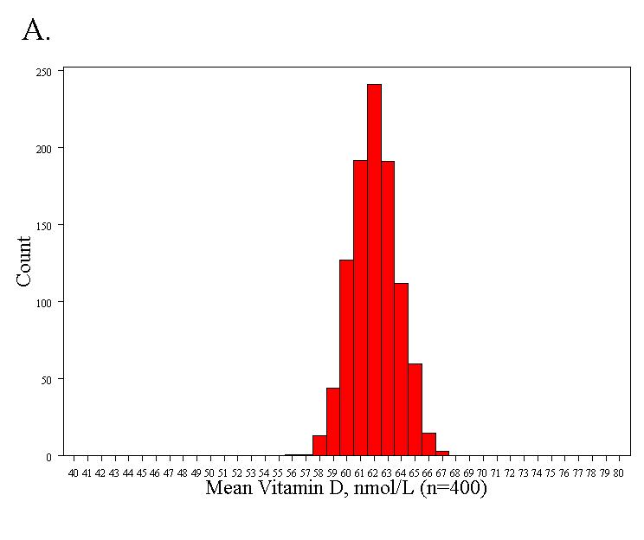
If we increase the sample size to n=400
Standard error = 1.7 nmol/L
Notes:
Digit Symbol Substitution Tes

Slide 20
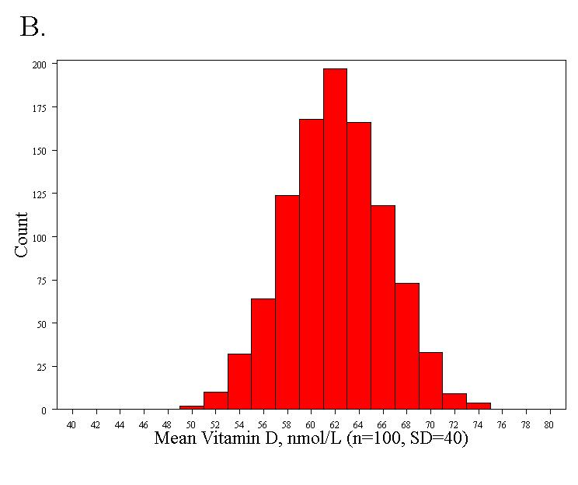
If we increase the variability of vitamin D (the trait) to SD = 40
Standard error = 4.0 nmol/L
Notes:
Digit Symbol Substitution Tes

Slide 21
2. CLT and Statistics of Distributions

Slide 22
The Central Limit Theorem
If all possible random samples, each of size n, are taken from any population with a mean μ and a standard deviation σ, the sampling distribution of the sample means (averages) will:
1. have mean:
2. have standard deviation:
3. be approximately normally distributed regardless of the shape of the parent population (normality improves with larger n).
Notes:
Digit Symbol Substitution Tes

Slide 23
Symbol Check
The mean of the sample means.
The standard deviation of the sample means. Also called “the standard error of the mean.”
Notes:
Digit Symbol Substitution Tes

Slide 24
Proof
If X is a random variable from any distribution with known mean, E(x), and variance, Var(x), then the expected value and variance of the average of n observations of X is:
Notes:
Digit Symbol Substitution Tes

Slide 25
Computer simulation of the CLT
1. Pick any probability distribution and specify a mean and standard deviation.
2. Tell the computer to randomly generate 1000 observations from that probability distributions
E.g., the computer is more likely to spit out values with high probabilities
3. Plot the “observed” values in a histogram.
4. Next, tell the computer to randomly generate 1000 averages-of-2 (randomly pick 2 and take their average) from that probability distribution. Plot “observed” averages in histograms.
5. Repeat for averages-of-10, and averages-of-100.
Notes:
Digit Symbol Substitution Tes

Slide 26
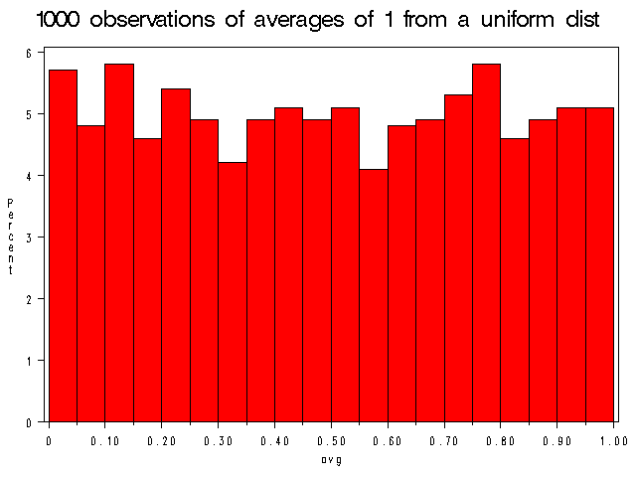
Uniform on [0,1]: average of 1 (original distribution)
Notes:
Digit Symbol Substitution Tes

Slide 27
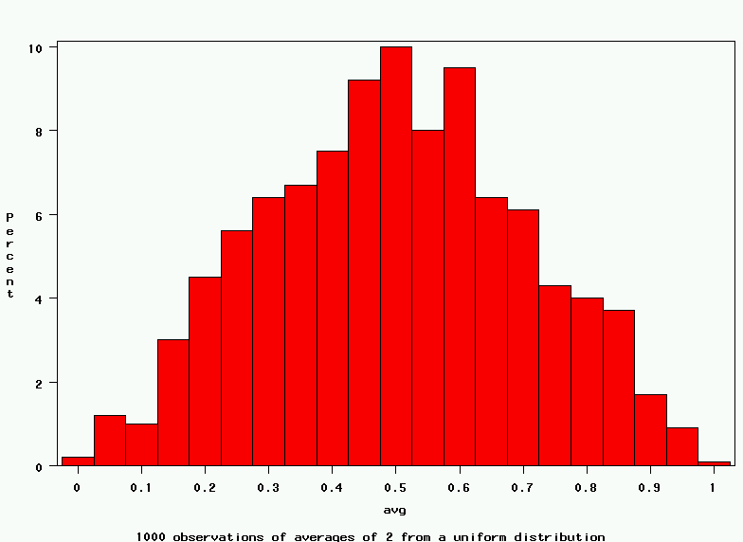
Uniform: 1000 averages of 2
Notes:
Digit Symbol Substitution Tes

Slide 28
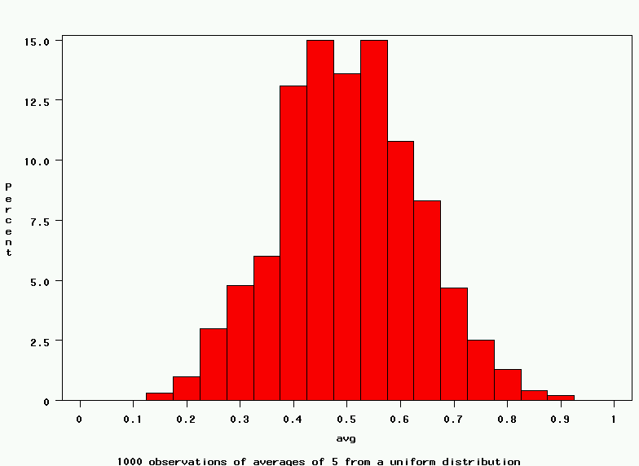
Uniform: 1000 averages of 5
Notes:
Digit Symbol Substitution Tes

Slide 29
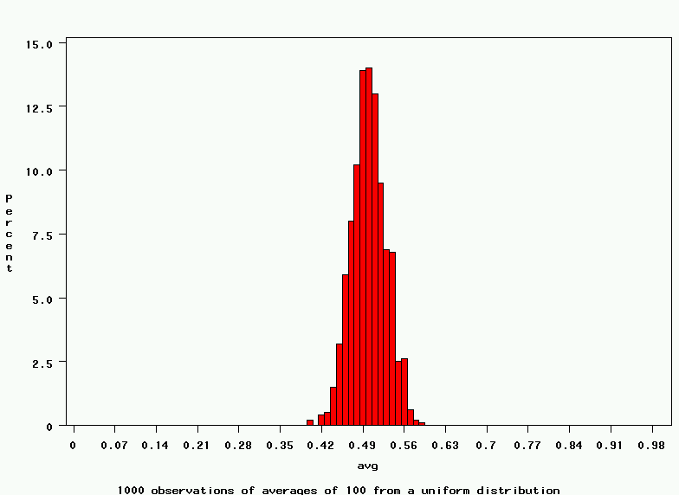
Uniform: 1000 averages of 100
Notes:
Digit Symbol Substitution Tes

Slide 30
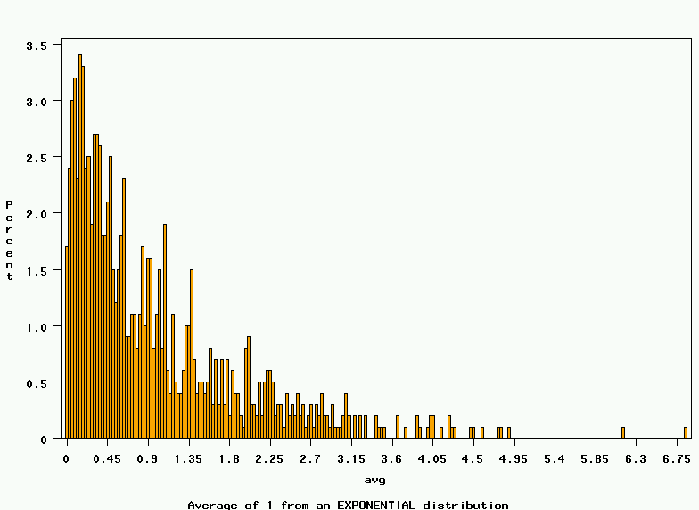
~Exp(1): average of 1 (original distribution)
Notes:
Digit Symbol Substitution Tes

Slide 31
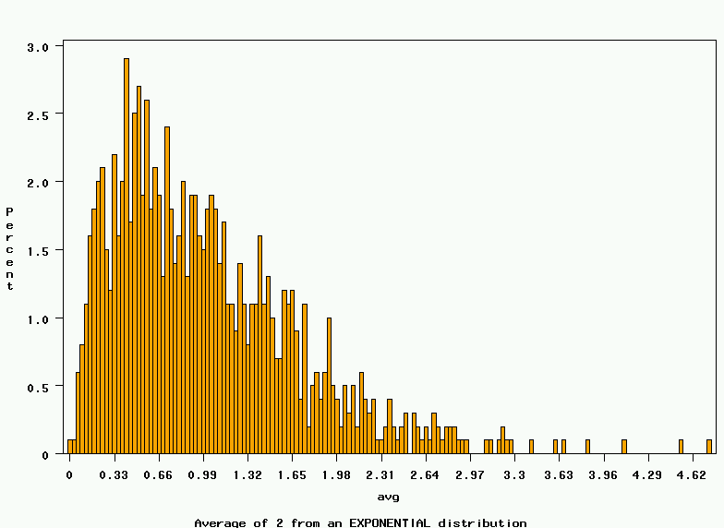
~Exp(1): 1000 averages of 2
Notes:
Digit Symbol Substitution Tes

Slide 32
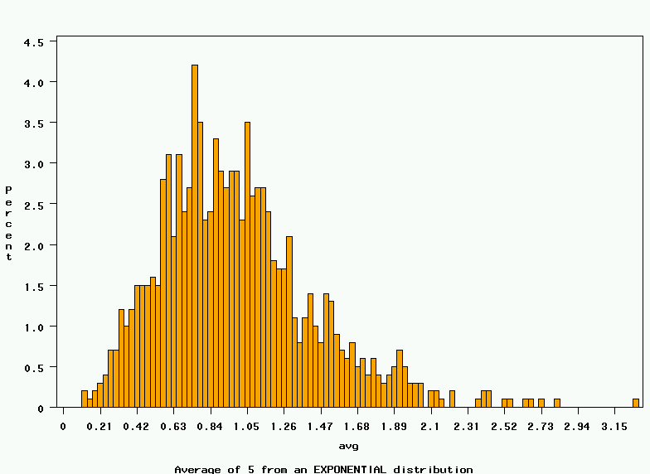
~Exp(1): 1000 averages of 5
Notes:
Digit Symbol Substitution Tes

Slide 33
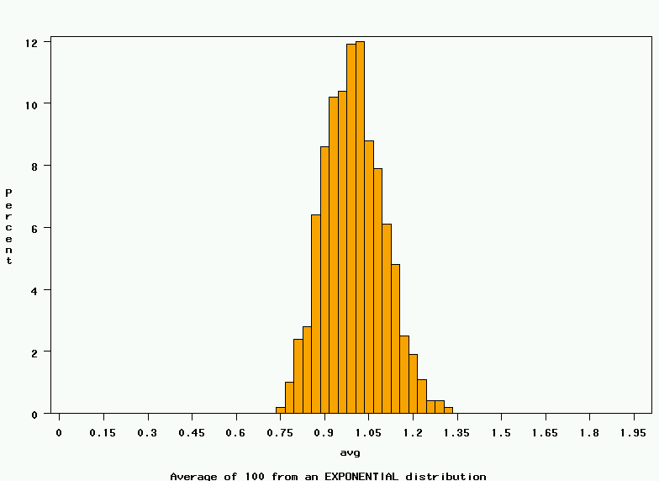
~Exp(1): 1000 averages of 100
Notes:
Digit Symbol Substitution Tes

Slide 34
~Exp(1): 1000 averages of 100
Notes:
Digit Symbol Substitution Tes

Slide 35
The Central Limit Theorem
If all possible random samples, each of size n, are taken from any population with a mean μ and a standard deviation σ, the sampling distribution of the sample means (averages) will:
1. have mean:
2. have standard deviation:
3. be approximately normally distributed regardless of the shape of the parent population (normality improves with larger n).
Notes:
Digit Symbol Substitution Tes

Slide 36
CLT: caveats for small samples
For small samples:
The sample standard deviation is an imprecise estimate of the true standard deviation (σ); this imprecision changes the distribution to a T-distribution.
A t-distribution approaches a normal distribution for large n (≥100), but has fatter tails for small n (<100)
If the underlying distribution is non-normal, the distribution of the means may be non-normal.
Notes:
Digit Symbol Substitution Tes

Slide 37
Examples of Sample Statistics
Single population mean
Single population proportion
Difference in means (t-test)
Difference in proportions (Z-test)
Odds ratio/risk ratio
Correlation coefficient
Regression coefficient
…

Slide 38
Distribution of correlation coefficient?
1. Specify the true correlation coefficient
Correlation coefficient = 0.15
2. Select a random sample of 100 virtual men from the population.
3. Calculate the correlation coefficient for the sample.
4. Repeat steps (2) and (3) 15,000 times
5. Explore the distribution of the 15,000 correlation coefficients.

Slide 39
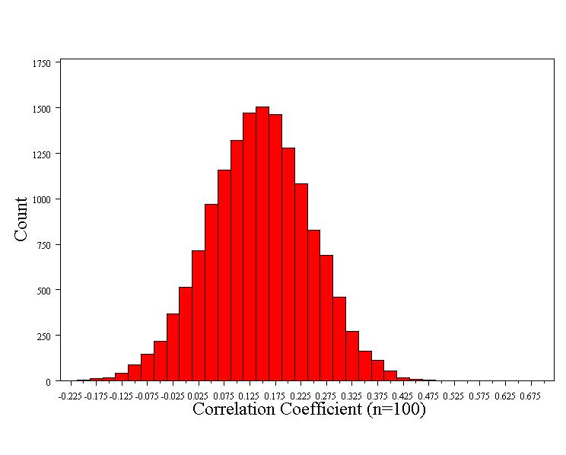
Distribution of correlation coefficient
Normally distributed!
Mean = 0.15 (true correlation)
Standard error = 0.10

Slide 40
Distribution of correlation coefficient
1. Shape of the distribution
Normally distributed for large samples
T-distribution for small samples (n<100)
2. Mean = true correlation coefficient (r)
3. Standard error ≈

Slide 41
Many statistics follow normal (or t-) distribution
Means/difference in means
T-distribution for small samples
Proportions/difference in proportions
Regression coefficients
T-distribution for small samples
Natural log of the odds ratio

Slide 42
3. Confidence Intervals

Slide 43
Estimation – confidence intervals
What is a good estimate for the true mean vitamin D in the population (the population parameter)?
63 nmol/L +/- margin of error

Slide 44
95% confidence interval
Goal: capture the true effect (e.g., the true mean) most of the time.
A 95% confidence interval should include the true effect about 95% of the time.
A 99% confidence interval should include the true effect about 99% of the time.

Slide 45
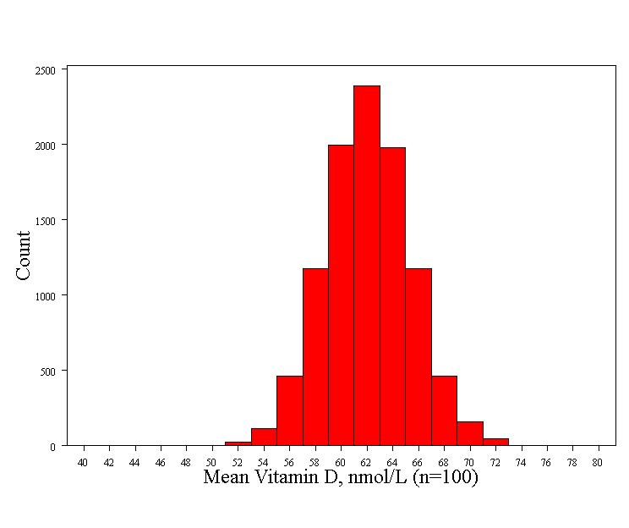
Recall: 68-95-99.7 rule for normal distributions! These is a 95% chance that the sample mean will fall within two standard errors of the true mean= 62 +/- 2*3.3 = 55.4 nmol/L to 68.6 nmol/L
Mean - 2 Std error=55.4
Mean
Mean + 2 Std error =68.6
To be precise, 95% of observations fall between Z=-1.96 and Z= +1.96 (so the “2” is a rounded number)…

Slide 46
95% confidence interval
There is a 95% chance that the sample mean is between 55.4 nmol/L and 68.6 nmol/L
For every sample mean in this range, sample mean +/- 2 standard errors will include the true mean:
For example, if the sample mean is 68.6 nmol/L:
95% CI = 68.6 +/- 6.6 = 62.0 to 75.2
This interval just hits the true mean, 62.0.

Slide 47
95% confidence interval
Thus, for normally distributed statistics, the formula for the 95% confidence interval is:
sample statistic ± 2 x (standard error)
Examples:
95% CI for mean vitamin D:
63 nmol/L ± 2 x (3.3) = 56.4 – 69.6 nmol/L
95% CI for the correlation coefficient:
0.15 ± 2 x (0.1) = -.05 – .35

Slide 48
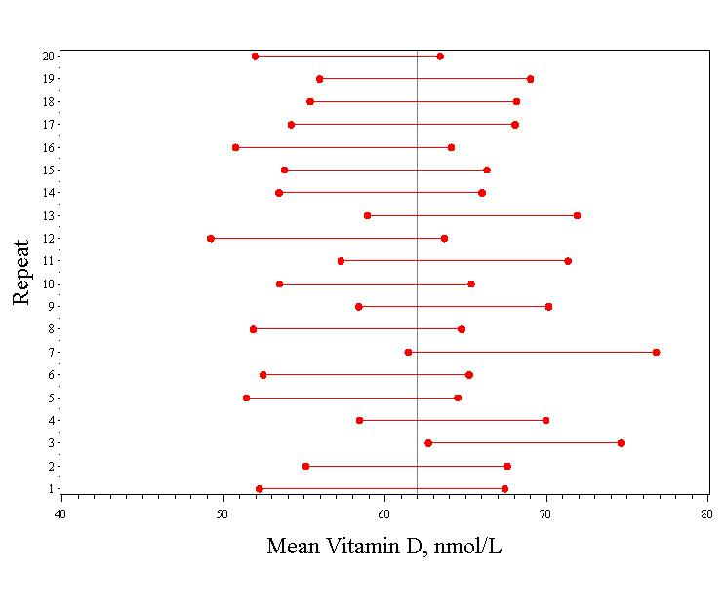
Simulation of 20 studies of 100 people
Vertical line indicates the true mean (62)
95% confidence intervals for the mean vitamin D for each of the simulated studies.
Only 1 confidence interval missed the true mean.

Slide 49
Confidence Intervals give:
A plausible range of values for a population parameter.
The precision of an estimate.(When sampling variability is high, the confidence interval will be wide to reflect the uncertainty of the observation.)
Statistical significance (if the 95% CI does not cross the null value, it is significant at .05)

Slide 50
Confidence Intervals
The value of the statistic in my sample (eg., mean, odds ratio, etc.)
point estimate ± (measure of how confident we want to be) × (standard error)
From a Z table or a T table, depending on the sampling distribution of the statistic.
Standard error of the statistic.

Slide 51
Confidence Intervals
The value of the statistic in my sample (eg., mean, odds ratio, etc.)
point estimate ± (measure of how confident we want to be) × (standard error)
From a Z table or a T table, depending on the sampling distribution of the statistic.
Standard error of the statistic.

Slide 52
4. Hypothesis Testing

Slide 53
Hypothesis test
1. Is the mean vitamin D in middle-aged and older European men lower than 100 nmol/L (the “desirable” level)?
2. Is cognitive function correlated with vitamin D?

Slide 54
Is the mean vitamin D different than 100?
Start by assuming that the mean = 100
This is the “null hypothesis”
This is usually the “straw man” that we want to shoot down
Determine the distribution of statistics assuming that the null is true…

Slide 55
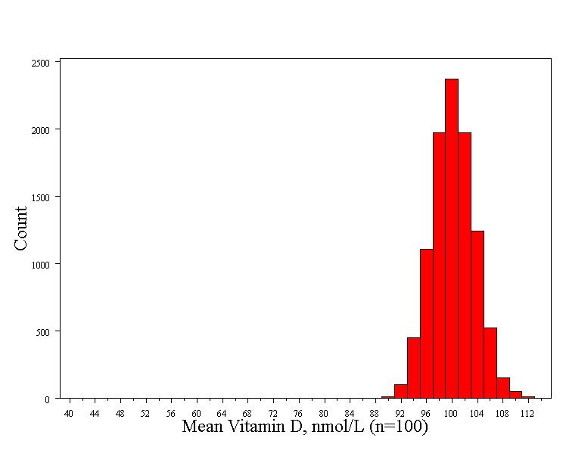
Computer simulation (10,000 repeats)
This is called the null distribution!
Normally distributed
Std error = 3.3
Mean = 100

Slide 56
Compare the null distribution to the observed value
This is the p-value!
P-value < 1/10,000

Slide 57
Calculating the p-value with a formula
Because we know how normal curves work, we can exactly calculate the probability of seeing an average of 63 nmol/L if the true average weight is 100 (i.e., if our null hypothesis is true):
Z= 11.2, P-value << .0001

Slide 58
The P-value
P-value is the probability that we would have seen our data (or something more unexpected) just by chance if the null hypothesis (null value) is true.
Small p-values mean the null value is unlikely given our data.
Our data are so unlikely given the null hypothesis (<<1/10,000) that I’m going to reject the null hypothesis! (Don’t want to reject our data!)

Slide 59
P-value < .0001 means
The probability of seeing what you saw or something more extreme if the null hypothesis is true (due to chance)<.0001
P(empirical data/null hypothesis) <.0001

Slide 60
The P-value
By convention, p-values of <.05 are often accepted as “statistically significant” in the medical literature; but this is an arbitrary cut-off.
A cut-off of p<.05 means that in about 5 of 100 experiments, a result would appear significant just by chance (“Type I error”).

Slide 61
Summary: Hypothesis testing
The Steps:
Define your hypotheses (null, alternative)
The null hypothesis is the “straw man” that we are trying to shoot down.
Null here: “mean vitamin D level = 100 nmol/L”
Alternative here: “mean vit D < 100 nmol/L” (one-sided)
Specify your sampling distribution (under the null)
If we repeated this experiment many, many times, the mean vitamin D would be normally distributed around 100 nmol/L with a standard error of 3.3
3. Do a single experiment (observed sample mean = 63 nmol/L)
4. Calculate the p-value of what you observed (p<.0001)
5. Reject or fail to reject the null hypothesis (reject)

Slide 62
Confidence intervals vs hypothesis tests
Confidence intervals give the same information (and more) than hypothesis tests…
Duality with hypothesis tests
99% confidence interval
Null value
50 60 70 80 90 100
Null hypothesis: Average vitamin D is 100 nmol/L
Alternative hypothesis: Average vitamin D is not 100 nmol/L (two-sided)
P-value < .01

Slide 63
Is cognitive function correlated with vitamin D?
Null hypothesis: r = 0
Alternative hypothesis: r ≠ 0
Two-sided hypothesis
Doesn’t assume that the correlation will be positive or negative.

Slide 64
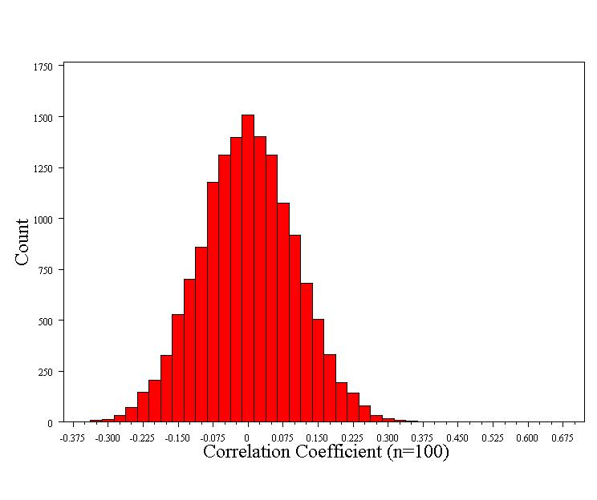
Computer simulation (15,000 repeats)
Null distribution:
Normally distributed
Std error = 0.1
Mean = 0

Slide 65
What’s the probability of our data?
Even when the true correlation is 0, we get correlations as big as 0.15 or bigger 7% of the time.

Slide 66
What’s the probability of our data?
Our results could have happened purely due to a fluke of chance!

Slide 67
Formal hypothesis test
1. Null hypothesis: r=0
Alternative: r ≠ 0 (two-sided)
2. Determine the null distribution
Normally distributed
Standard error = 0.1
3. Collect Data, r=0.15
4. Calculate the p-value for the data:
Z =
5. Reject or fail to reject the null (fail to reject)

Slide 68
Or use a confidence interval to see statistical significance
95% CI = -0.05 to 0.35
Thus, 0 (the null value) is a plausible value!
P>.05

