Slide 1
CS639: Data Management for Data Science
Lecture 17: Evaluating Machine Learning Methods
Theodoros Rekatsinas

Slide 2
Announcements
You can see your exams during office hours
Homework will be announced later this week; we will have only two more projects not three

Slide 3
Today
Evaluating ML models

Slide 4
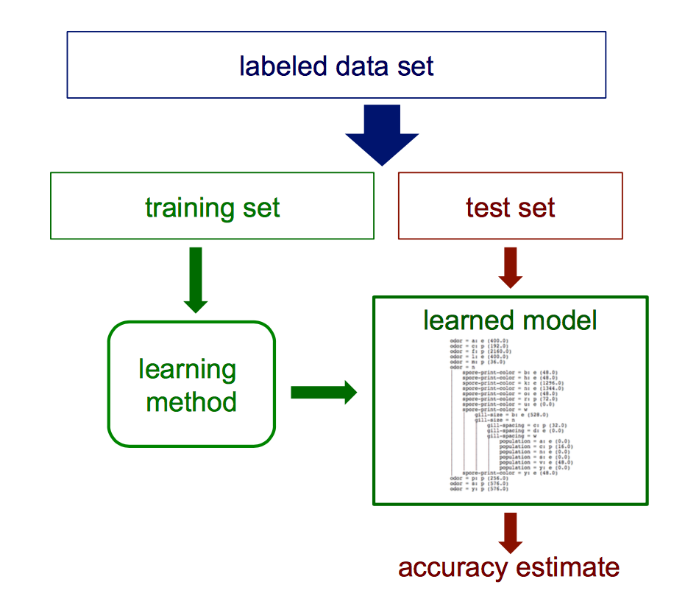
How can we get an unbiased estimate of the accuracy of a learned model?

Slide 5
Test sets
How can we get an unbiased estimate of the accuracy of a learned model?
When learning a model, you should pretend that you don’t have the test data yet
If the test-set labels influence the learned model in any way, accuracy estimates will be biased

Slide 6
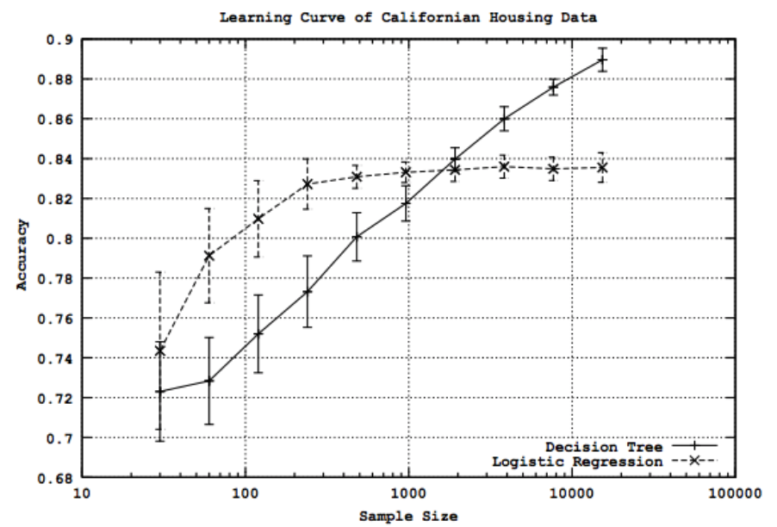
Learning curves
How does the accuracy of a learning method change as a function of the training-set size?
This can be assessed by learning curves

Slide 7
Learning curves
Given a training/test set partition
For each sample size s on the learning curve
(optionally) repeat n times
Randomly select s instances from the training set
Learn the model
Evaluate the model on the test set to determine accuracy a
Plot (s,a)

Slide 8
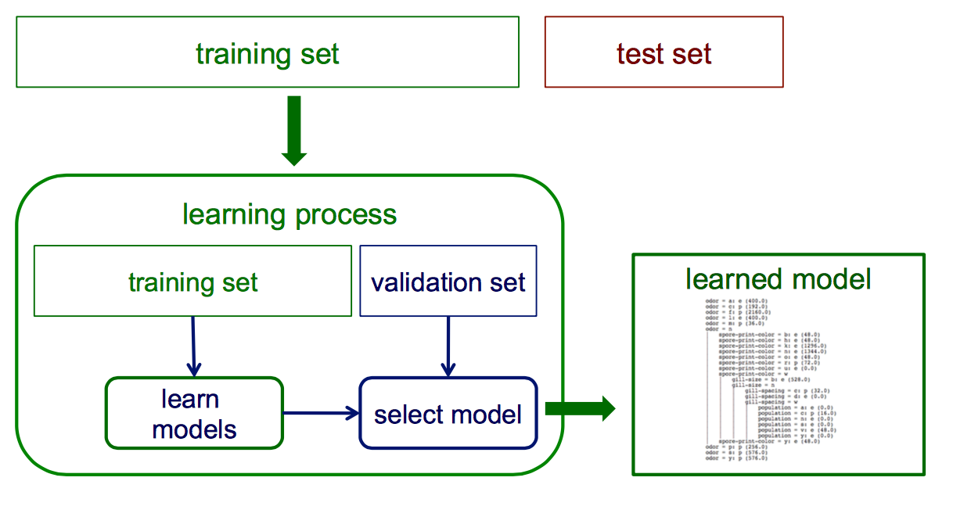
Validation (tuning) sets
Suppose we want unbiased estimates of accuracy during the learning process (e.g. to choose the best level of decision-tree pruning)?
Partition training data into separate training/validation sets

Slide 9
Limitations of using a single training/test partition
We may not have enough data to make sufficiently large training and test sets
A larger test set gives us more reliable estimates of accuracy (i.e., a lower variance estimate)
But… a larger training set will be more representative of how much data we actually have for learning process
A single training set does not tell us how sensitive accuracy is to a particular training sample

Slide 10
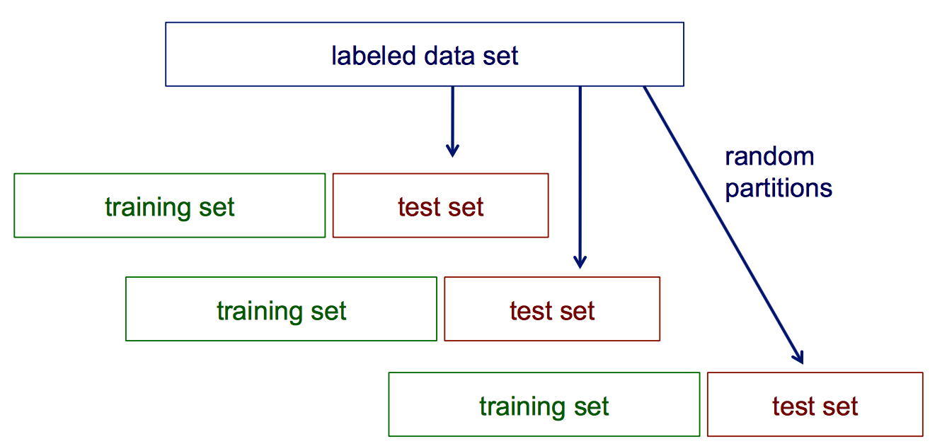
Random resampling
We can address the second issue by repeatedly randomly partitioning the available data into training and set sets.

Slide 11
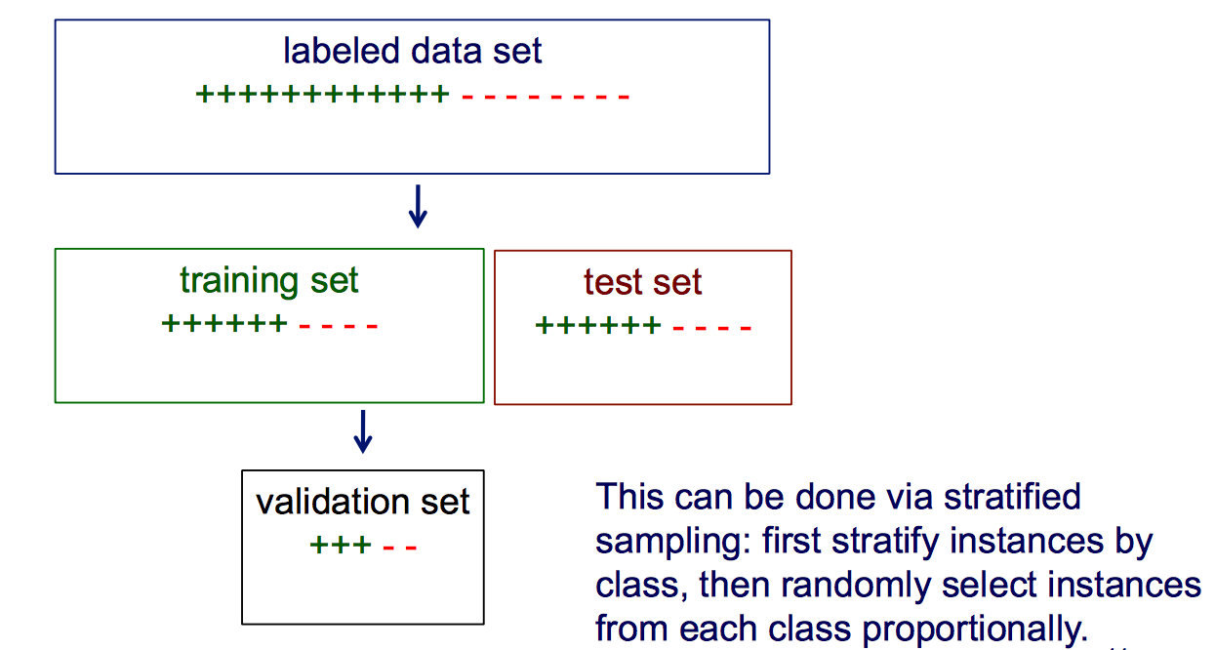
Stratified sampling
When randomly selecting training or validation sets, we may want to ensure that class proportions are maintained in each selected set

Slide 12
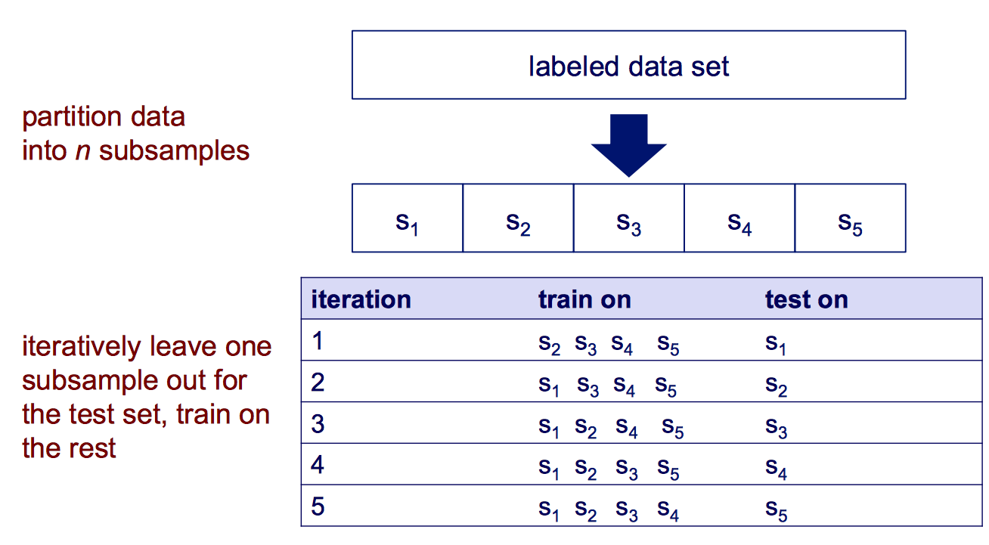
Cross validation

Slide 13
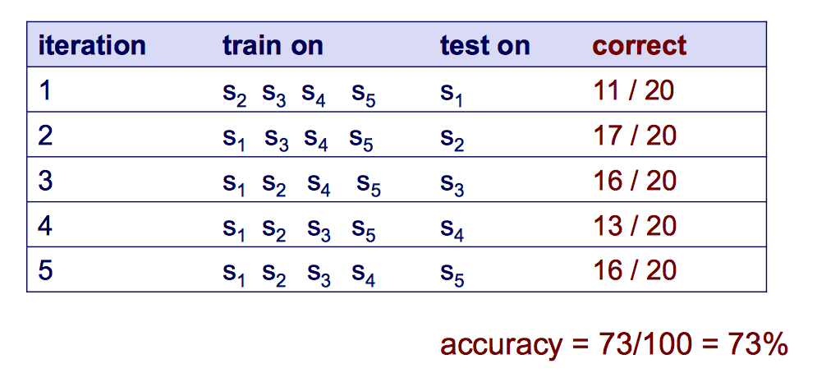
Cross validation example
Suppose we have 100 instances, and we want to estimate accuracy with cross validation

Slide 14
Cross validation example
10-fold cross validation is common, but smaller values of n are often used when learning takes a lot of time
In leave-one-out cross validation, n=#instances
In stratified cross validation, stratified sampling is used when partitioning the data
CV makes efficient use of the available data for testing
Note that whenever we use multiple training sets, as in CV and random resampling, we are evaluating a learning method as opposed to an individual learned model

Slide 15
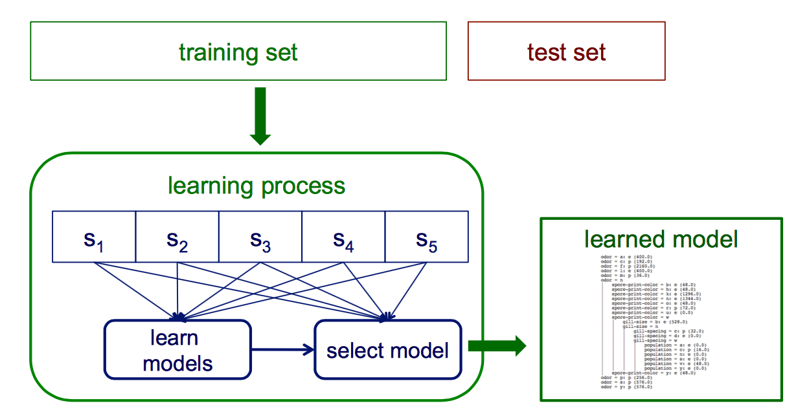
Internal cross validation
Instead of a single validation set, we can use cross-validation within a training set to select a model (e.g. to choose the best level of decision-tree pruning)

Slide 16
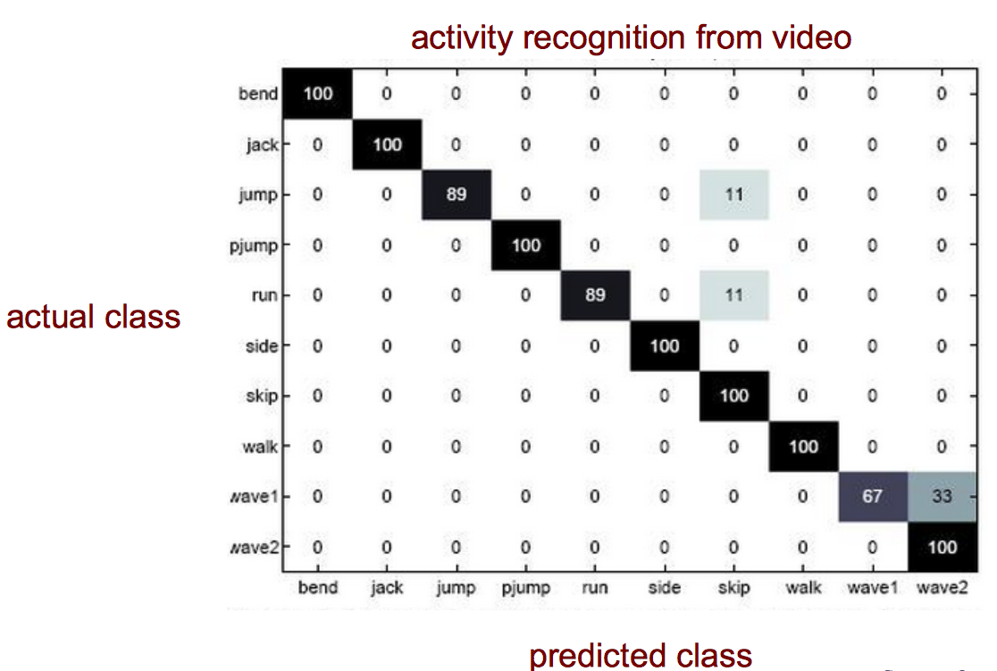
Confusion matrices
How can we understand what types of mistakes a learned model makes?

Slide 17
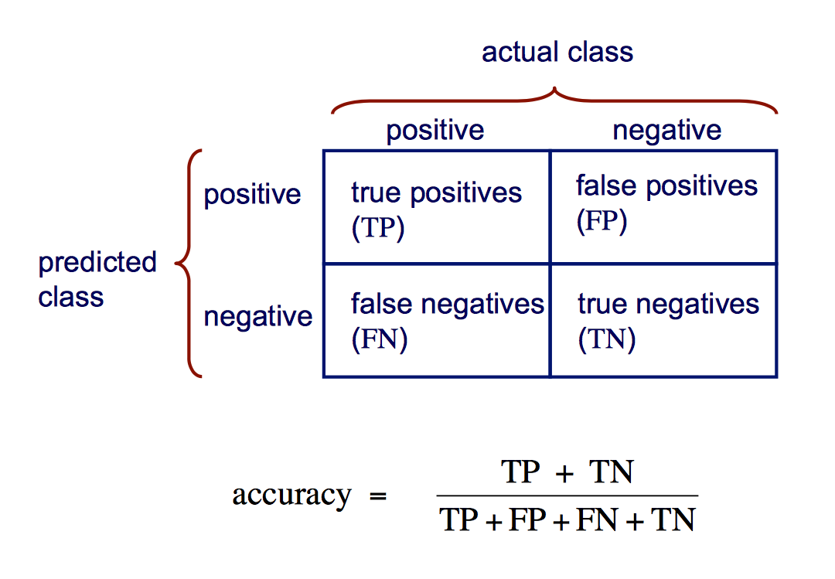
Confusion matrix for 2-class problems

Slide 18
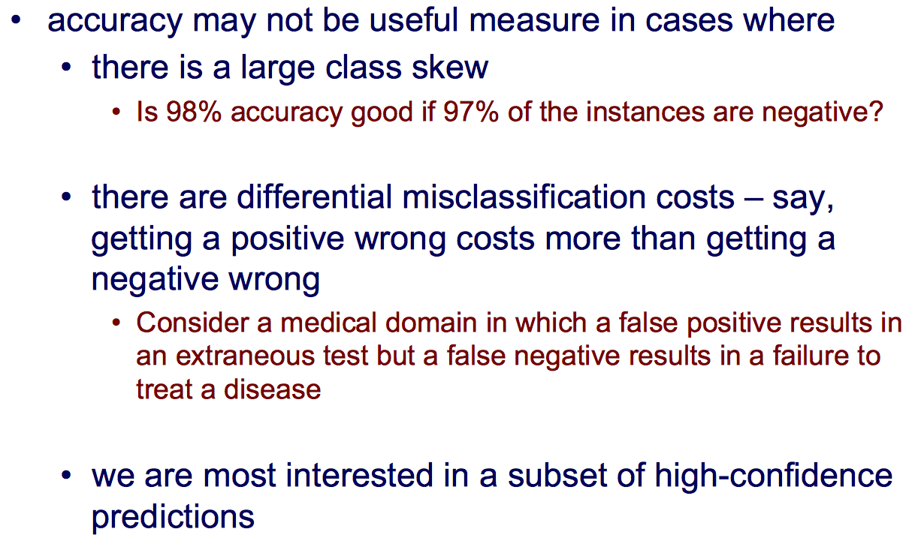
Is accuracy an adequate measure of predictive performance?

Slide 19
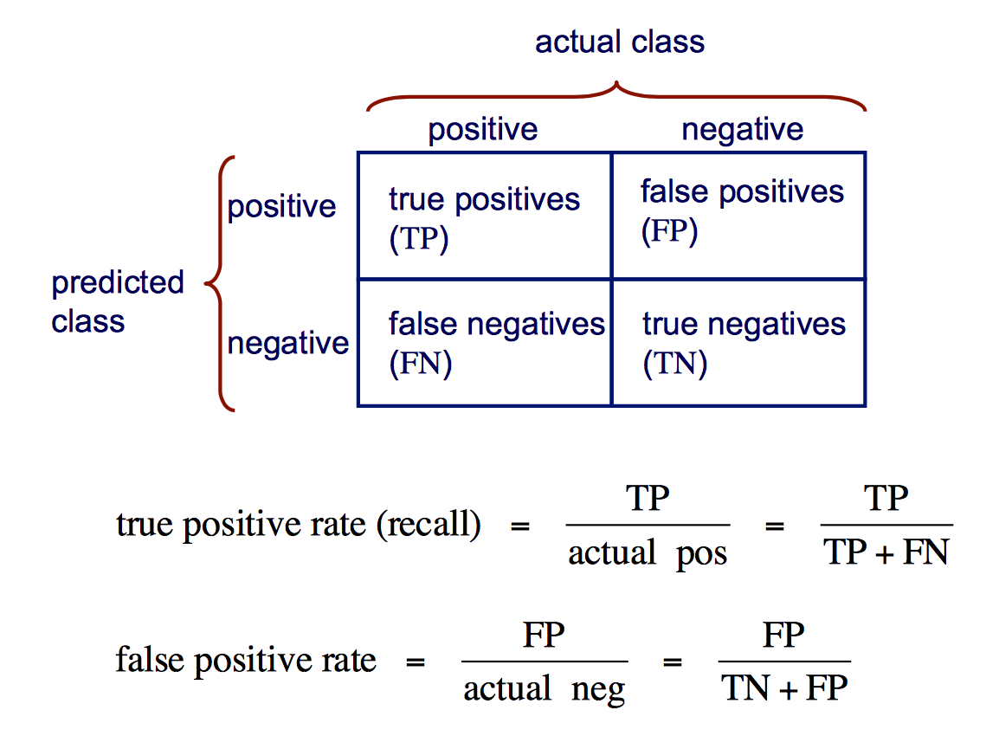
Other accuracy metrics

Slide 20
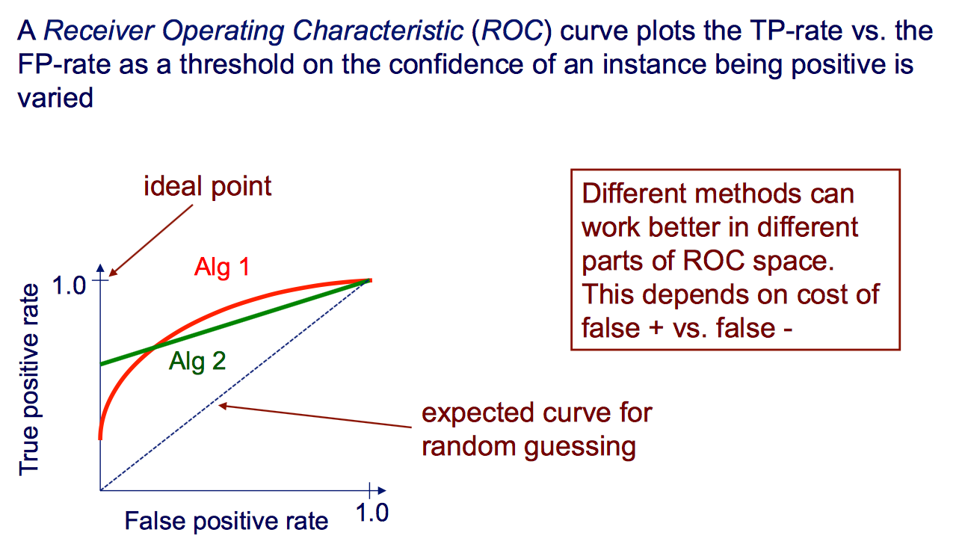
ROC curves

Slide 21
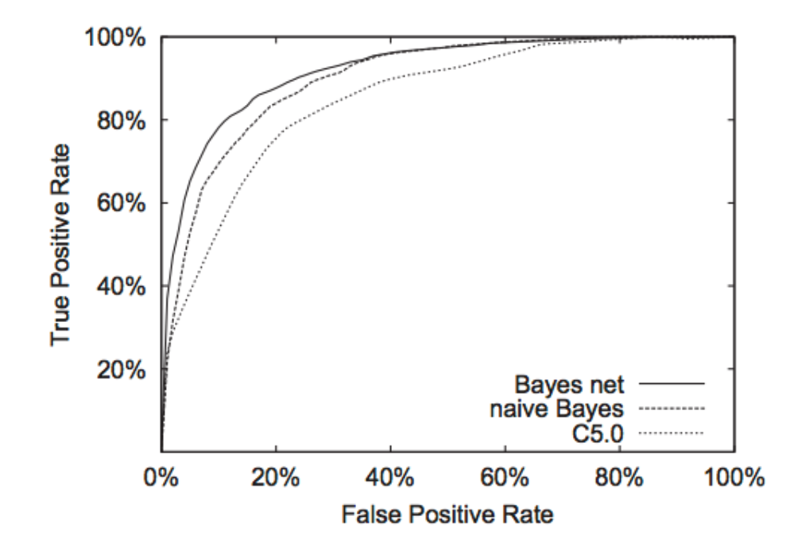
ROC curve example

Slide 22
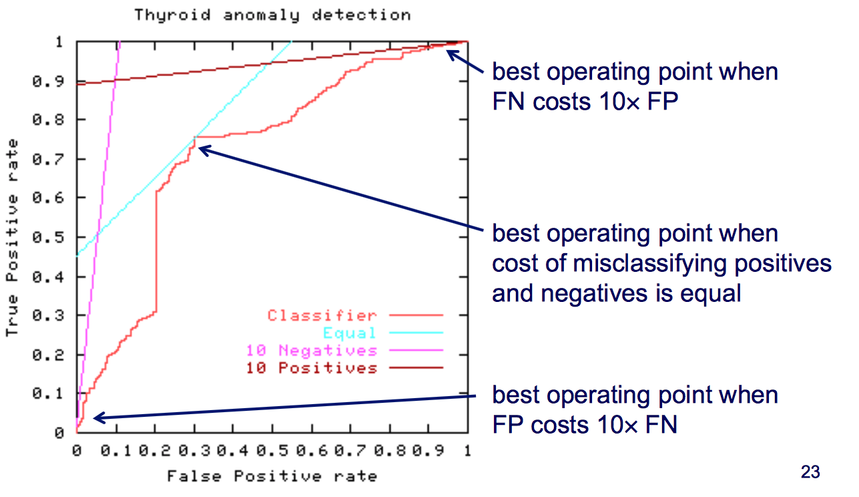
ROC curves and misclassification costs

Slide 23
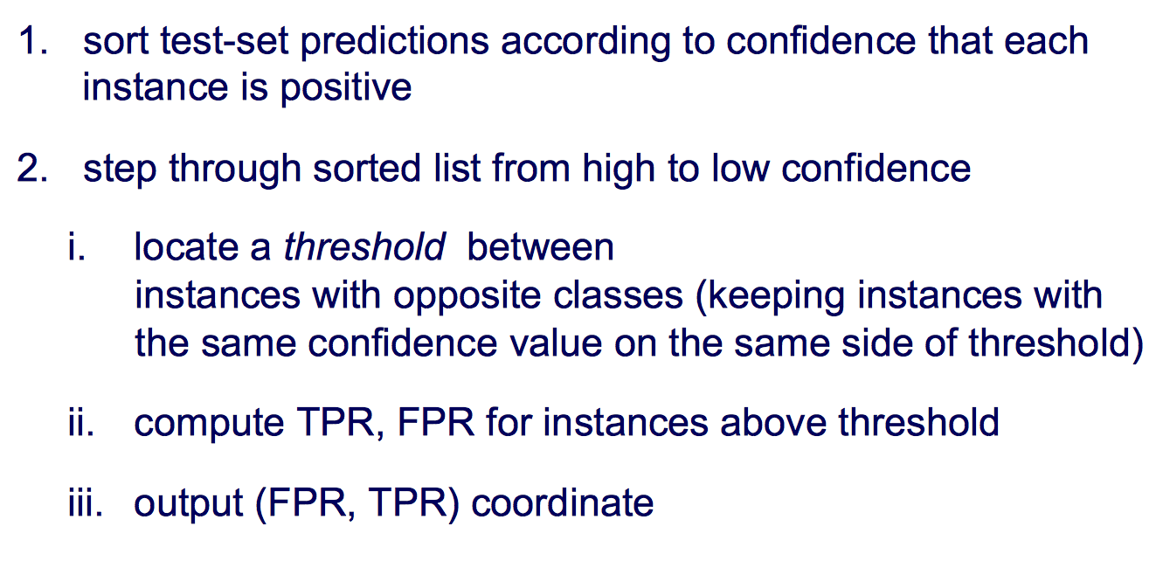
Algorithm for creating an ROC curve

Slide 24
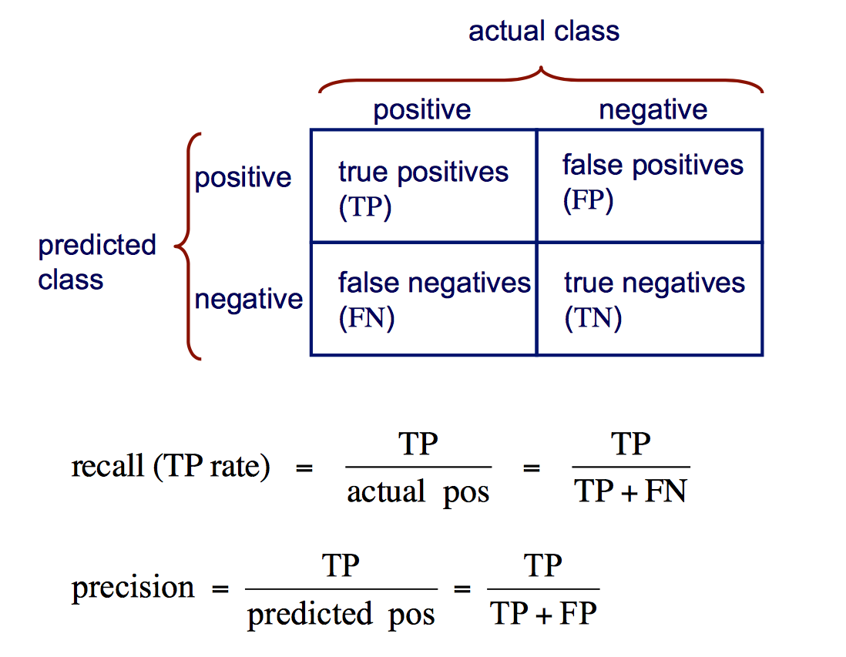
Other accuracy metrics

Slide 25
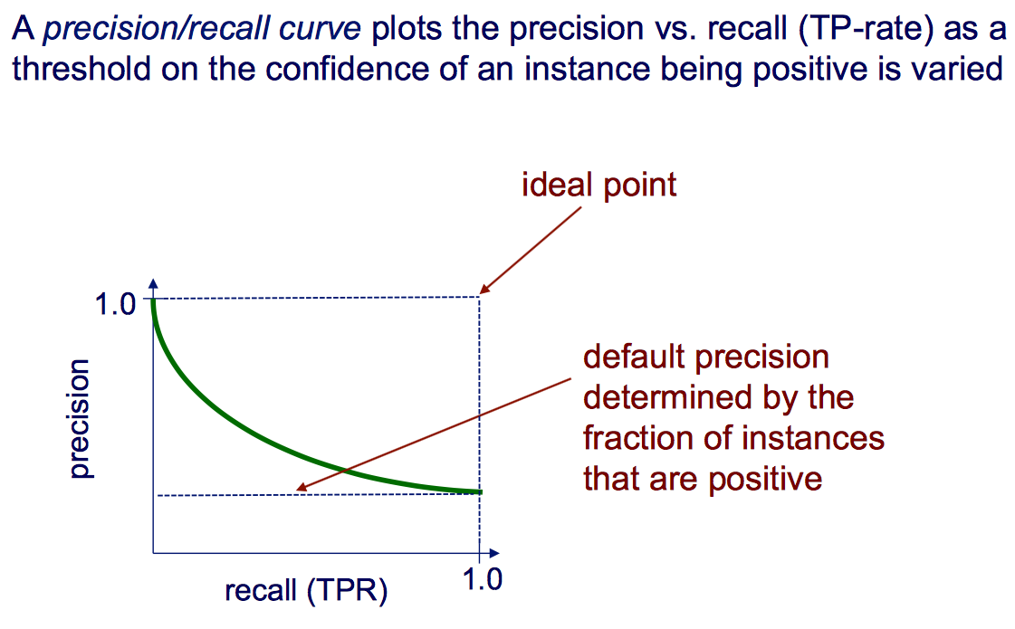
Precision/recall curves

Slide 26
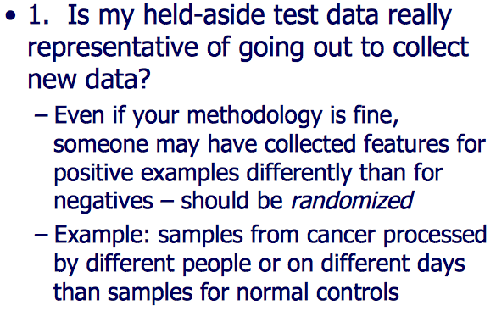
To Avoid Cross-Validation Pitfalls

Slide 27
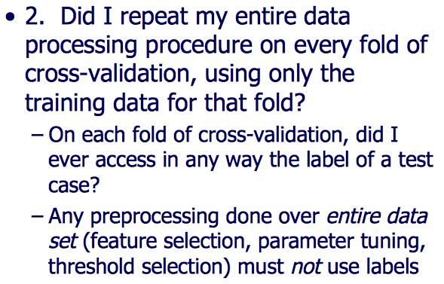
To Avoid Cross-Validation Pitfalls

Slide 28
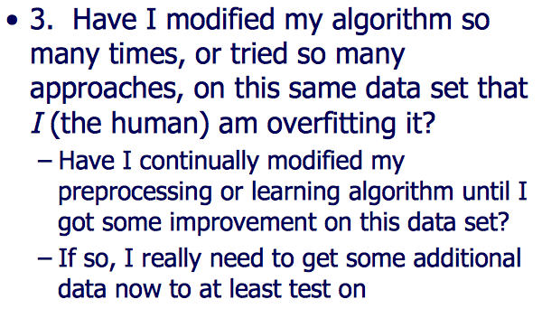
To Avoid Cross-Validation Pitfalls

Slide 29
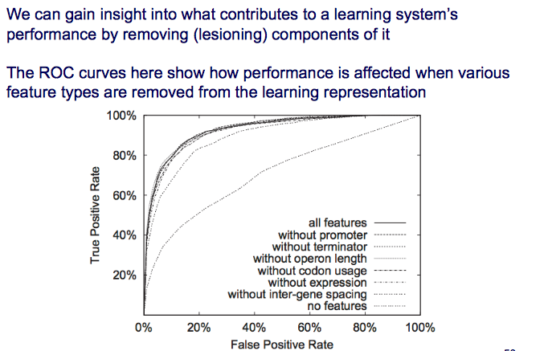
Ablation Studies

