Slide 1
CS639: Data Management for Data Science
Lecture 8: Reasoning about Scale
& The MapReduce Abstraction
Theodoros Rekatsinas

Slide 2
Logistics/Announcements
Submission template for PA2
Bonus problem for PA2
Other questions on PA2?

Slide 3
Today’s Lecture
Scalability and Algorithmic Complexity
Data-Parallel Algorithms
The MapReduce Abstraction

Slide 4
1. Scalability and Algorithmic Complexity

Slide 5
What does scalable mean?
Operationally:
Works even if the data does not fit in main memory
Use all available resources (cores/memory) on a single node (aka scale up)
Can make use of 1000s of cheap computers (cloud) – elastic (aka scale out)
Algorithmically:
If you have N data items you should not perform more than N^{m} operations (polynomial complexity)
In many cases it should be N*log(N) operations (streaming or too large data)
If you have N data items, you must do no more than N^{m}/k operations for some large k (k = number of cores/threads)

Slide 6
A sketch of algorithmic complexity
Example: Find matching string sequences
Given a set of string sequences
Find all sequences equal to “GATTACGA”

Slide 7



Example: Find matching string sequences
GATTACGA

Slide 8


Example: Find matching string sequences
GATTACGA
TACCTGCC
Time = 0: TACCTGCC ? GATTACGA

Slide 9
Example: Find matching string sequences
GATTACGA
TACCTGCC
Time = 0: TACCTGCC ? GATTACGA
No move cursor to next data entry

Slide 10
Example: Find matching string sequences
GATTACGA
EFTAAGCA
Time = 1: EFTAAGCA ? GATTACGA
No move cursor to next data entry

Slide 11
Example: Find matching string sequences
GATTACGA
Time = 2: XXXXXXX ? GATTACGA
No move cursor to next data entry

Slide 12
Example: Find matching string sequences
GATTACGA
Time = n: GATTACGA ? GATTACGA
Yes! Output matching sequence

Slide 13
Example: Find matching string sequences
GATTACGA
If we have 40 records we need to perform 40 comparisons

Slide 14
Example: Find matching string sequences
GATTACGA
For N records we perform N comparisons
The algorithmic complexity is order N: O(N)

Slide 15



What if we knew the sequences are sorted
Increasing Lexicographic Order
GATTACGA

Slide 16



What if we knew the sequences are sorted
Increasing Lexicographic Order
GATTACGA
Time = 0: Start at 50% mark CTGTACA < GATTACGA

Slide 17




What if we knew the sequences are sorted
Increasing Lexicographic Order
GATTACGA
Time = 1: Start at 50% mark CTGTACA < GATTACGA
Skip to 75% mark (you know your sequence is in the second half)

Slide 18

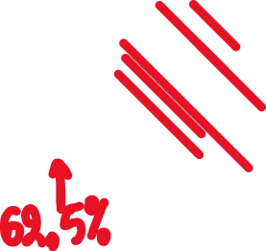

What if we knew the sequences are sorted
Increasing Lexicographic Order
GATTACGA
Time = 2: We are at the 75% mark TTGTCCA > GATTACGA
Skip to 62.5% mark Match: GATTACGA = GATTACGA
We find our sequence in three steps. Now we can scan entries sequentially.

Slide 19

What if we knew the sequences are sorted
Increasing Lexicographic Order
GATTACGA
How many comparisons?
For N records we did log(N) comparisons
The algorithm has complexity O(log(N)) — much better scalability

Slide 20
2. Data-Parallel Algorithms

Slide 21
New task: Trim string sequences
Given a set of string sequences
Trim the final n characters of each sequence
Generate a new dataset

Slide 22

New task: Trim string sequences (last 3 chars)
TACCTGCC
Time = 0: TACCTGCC -> TACCTG

Slide 23
New task: Trim string sequences (last 3 chars)
GATTCTGC
Time = 1: GATTCTGC -> GATTC

Slide 24
New task: Trim string sequences (last 3 chars)
CCCGAAT
Time = 2: CCCGAAT -> CCCG
Can we use a data structure to speed this operation?

Slide 25
New task: Trim string sequences (last 3 chars)
CCCGAAT
Time = 2: CCCGAAT -> CCCG
Can we use a data structure to speed this operation?
No. We have to touch every record! The task is O(N).

Slide 26
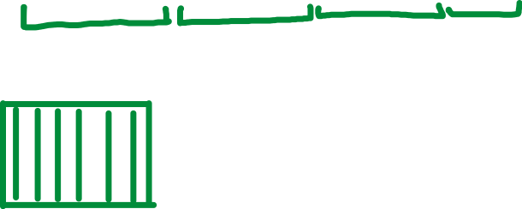


New task: Trim string sequences (last 3 chars)

Slide 27

New task: Trim string sequences (last 3 chars)

Slide 28




New task: Trim string sequences (last 3 chars)
Time = 1: Process first element of each group

Slide 29




New task: Trim string sequences (last 3 chars)
Time = 2: Process second element of each group

Slide 30




New task: Trim string sequences (last 3 chars)
Time = 3: Process third element of each group
Etc.. How much time does this take?

Slide 31




New task: Trim string sequences (last 3 chars)
We only need O(N/k) operations where k is the number of groups (workers)

Slide 32
Schematic of Parallel Algorithms
1. You are given a set of “reads”. You have to process them and generate a “write”
2. You distribute the reads among k computers (workers)

Slide 33




Schematic of Parallel Algorithms
2. You distribute the reads among k computers (workers)
Function f
Function f
Function f
Function f
3. Apply function f to each read (for every item in each chunk)
4. Obtain a big distributed set of outputs

Slide 34
Applications of parallel algorithms
Convert TIFF images to PNG
Run thousands of simulations for different model parameters
Find the most common word in each document
Compute the word frequency of every word in a single document
Etc….

Slide 35
Applications of parallel algorithms
Convert TIFF images to PNG
Run thousands of simulations for different model parameters
Find the most common word in each document
Compute the word frequency of every word in a single document
Etc….
There is a common pattern in all these applications

Slide 36
Applications of parallel algorithms
A function that maps a string to a trimmed string
A function that maps a TIFF images to a PNG image
A function that maps a set of parameters to simulation results
A function that maps a document to its most common word
A function that maps a document to a histogram of word frequencies

Slide 37
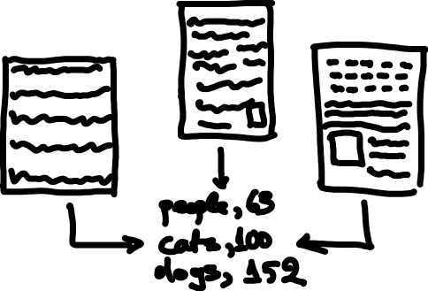
Applications of parallel algorithms
What if we want to compute the word frequency across all documents?

Slide 38
3. The MapReduce Abstraction

Slide 39














Compute the word frequency across 5M documents

Slide 40















Compute the word frequency across 5M documents

Slide 41
Challenge: in this task
How can we make sure that a single computer has access to every occurrence of a given word regardless of which document it appeared in?
Ideas?

Slide 42







Compute the word frequency across 5M documents

Slide 43










Compute the word frequency across 5M documents

Slide 44




Compute the word frequency across 5M documents

Slide 45

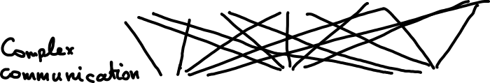
Compute the word frequency across 5M documents
A hash function is any function that can be used to map data of arbitrary size to a data of a fixed size

Slide 46
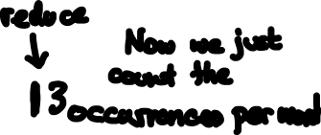

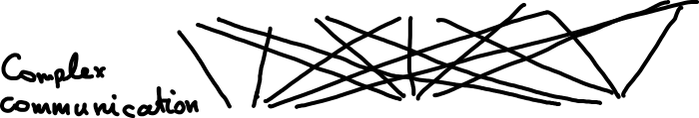
Compute the word frequency across 5M documents

Slide 47
The Map Reduce Abstraction for Distributed Algorithms
Distributed Data Storage
Map
(Shuffle)
Reduce

