Slide 1
CS639: Data Management for Data Science
Midterm Review 1: Relational Databases and Relational Algebra
Theodoros Rekatsinas

Slide 2
Today’s Lecture
Review Relational Databases and Relational Algebra
Next Lecture: Review MapReduce and NoSQL systems

Slide 3
Data science workflow
Section 2
https://cacm.acm.org/blogs/blog-cacm/169199-data-science-workflow-overview-and-challenges/fulltext

Slide 4
Uncertainty and Randomness
Section 2
Data represents the traces of real-world processes.
The collected traces correspond to a sample of those processes.
There is randomness and uncertainty in the data collection process.
The process that generates the data is stochastic (random).
Example: Let’s toss a coin! What will the outcome be? Heads or tails? There are many factors that make a coin toss a stochastic process.
The sampling process introduces uncertainty.
Example: Errors due to sensor position due to error in GPS, errors due to the angles of laser travel etc.

Slide 5
Models
Section 2
Data represents the traces of real-world processes.
Part of the data science process: We need to model the real-world.
A model is a function f_{θ}(x)
x: input variables (can be a vector)
θ: model parameters

Slide 6
Modeling Uncertainty and Randomness
Section 2
Data represents the traces of real-world processes.
There is randomness and uncertainty in the data collection process.
A model is a function f_{θ}(x)
x: input variables (can be a vector)
θ: model parameters
Models should rely on probability theory to capture uncertainty and randomness!

Slide 7
The Relational Model: Schemata
Relational Schema:
Students(sid: string, name: string, gpa: float)
Relation name
String, float, int, etc. are the domains of the attributes
Attributes

Slide 8
The Relational Model: Data
Student
An attribute (or column) is a typed data entry present in each tuple in the relation
sid | name | gpa
001 | Bob | 3.2
002 | Joe | 2.8
003 | Mary | 3.8
004 | Alice | 3.5
The number of attributes is the arity of the relation

Slide 9
The Relational Model: Data
Student
sid | name | gpa
001 | Bob | 3.2
002 | Joe | 2.8
003 | Mary | 3.8
004 | Alice | 3.5
The number of tuples is the cardinality of the relation
A tuple or row (or record) is a single entry in the table having the attributes specified by the schema

Slide 10
The Relational Model: Data
Student
sid | name | gpa
001 | Bob | 3.2
002 | Joe | 2.8
003 | Mary | 3.8
004 | Alice | 3.5
In practice DBMSs relax the set requirement, and use multisets.
A relational instance is a set of tuples all conforming to the same schema

Slide 11
To Reiterate
A relational schema describes the data that is contained in a relational instance
Let R(f₁:Dom₁,…,f_{m}:Dom_{m}) be a relational schema then,
an instance of R is a subset of Dom₁ x Dom₂ x … x Dom_{n}
In this way, a relational schema R is a total function from attribute names to types

Slide 12
One More Time
A relational schema describes the data that is contained in a relational instance
A relation R of arity t is a function: R : Dom₁ x … x Dom_{t} → {0,1}
I.e. returns whether or not a tuple of matching types is a member of it
Then, the schema is simply the signature of the function
Note here that order matters, attribute name doesn’t…
We’ll (mostly) work with the other model (last slide) in which attribute name matters, order doesn’t!

Slide 13
A relational database
A relational database schema is a set of relational schemata, one for each relation
A relational database instance is a set of relational instances, one for each relation
Two conventions:
We call relational database instances as simply databases
We assume all instances are valid, i.e., satisfy the domain constraints

Slide 14
RDBMS Architecture
How does a SQL engine work ?
SQL Query
Relational Algebra (RA) Plan
Optimized RA Plan
Execution
Declarative query (from user)
Translate to relational algebra expression
Find logically equivalent- but more efficient- RA expression
Execute each operator of the optimized plan!

Slide 15
Relational Algebra (RA)
Five basic operators:
Selection: σ
Projection: Π
Cartesian Product: ×
Union: ∪
Difference: -
Derived or auxiliary operators:
Intersection, complement
Joins (natural,equi-join, theta join, semi-join)
Renaming: ρ
Division

Slide 16
Note that RA Operators are Compositional!
Students(sid,sname,gpa)
SELECT DISTINCT
sname,
gpa
FROM Students
WHERE gpa > 3.5;
$$Π_{sname,gpa}(σ_{gpa>3.5}(Students))$$
$${σ_{gpa>3.5}(Π}_{sname,gpa}( Students))$$
How do we represent this query in RA?
Are these logically equivalent?

Slide 17


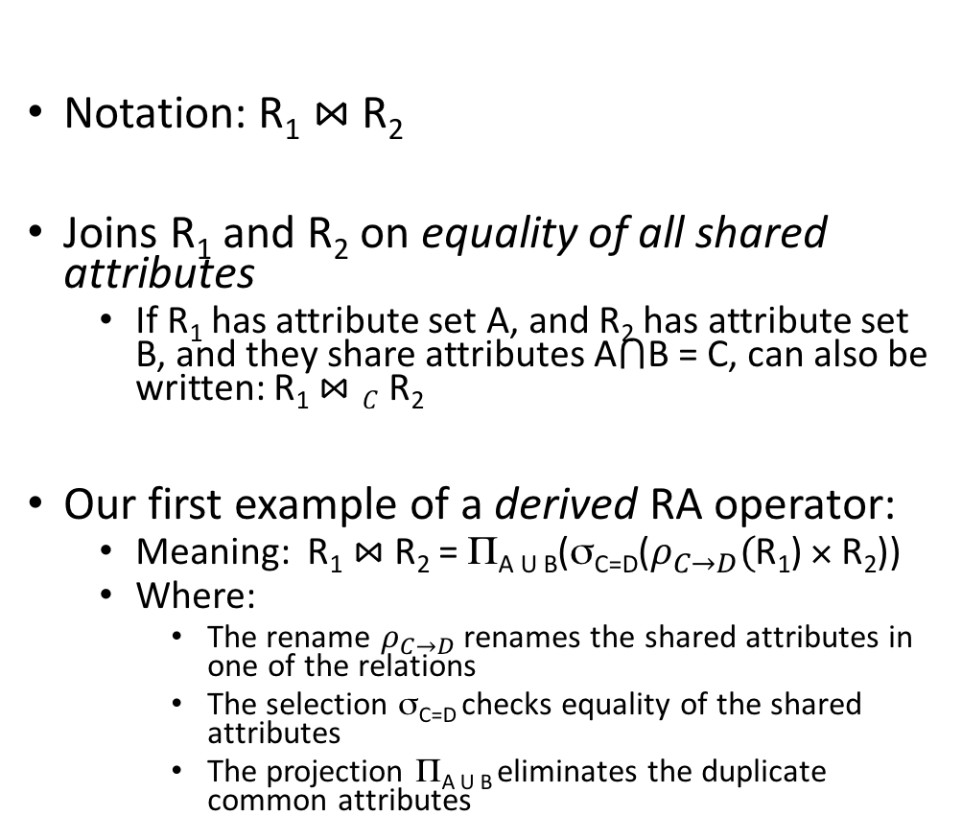
Natural Join ($⋈$)
Students(sid,name,gpa)
People(ssn,name,address)
SQL:
Notation: R₁ $⋈$R₂
Joins R₁ and R₂ on equality of all shared attributes
If R₁ has attribute set A, and R₂ has attribute set B, and they share attributes A$⋂$B = C, can also be written: R₁ $⋈C$R₂
Our first example of a derived RA operator:
Meaning: R₁ $⋈$ R₂ = Π_{A U B}(σ_{C=D}($ρ_{C→D}($R₁) × R₂))
Where:
The rename $ρ_{C→D}$ renames the shared attributes in one of the relations
The selection σ_{C=D} checks equality of the shared attributes
The projection Π_{A U B} eliminates the duplicate common attributes
SELECT DISTINCT
ssid, S.name, gpa,
ssn, address
FROM
Students S,
People P
WHERE S.name = P.name;
RA:
$$Students ⋈ People$$

Slide 18

Example: Converting SQL Query -> RA
Students(sid,sname,gpa)
People(ssn,sname,address)
SELECT DISTINCT
gpa,
address
FROM Students S,
People P
WHERE gpa > 3.5 AND
sname = pname;
$$Π_{gpa,address}(σ_{gpa>3.5}(S⋈P))$$

Slide 19
RA Expressions Can Get Complex!
Π _{name}
buyer-ssn=ssn
pid=pid
seller-ssn=ssn
Π _{ssn}
Π _{pid}
σ_{name=fred}
σ_{name=gizmo}
Person Purchase Person Product

Slide 20
RA has Limitations !
Cannot compute “transitive closure”
Find all direct and indirect relatives of Fred
Cannot express in RA !!!
Need to write C program, use a graph engine, or modern SQL…
Name1 | Name2 | Relationship
Fred | Mary | Father
Mary | Joe | Cousin
Mary | Bill | Spouse
Nancy | Lou | Sister

Slide 21
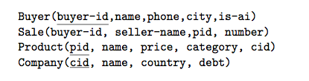
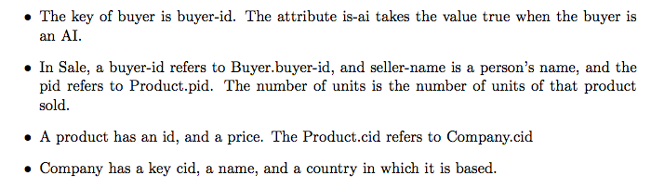
SQL Time!

Slide 22
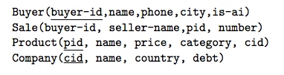
SQL Time!
Find all the distinct names of all companies that are based in Japan.

Slide 23

SQL Time!
Find all the distinct names of all companies that are based in Japan.

Slide 24
SQL Time!
Find the distinct names of all companies that are based in Japan and that sold a product to an AI based in Cupertino.

Slide 25
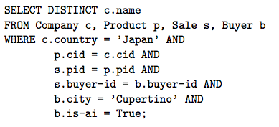
SQL Time!
Find the distinct names of all companies that are based in Japan and that sold a product to an AI based in Cupertino.

Slide 26
SQL Time!
Find the distinct names of all companies that have sold at least six distinct products.

Slide 27
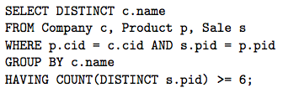
SQL Time!
Find the distinct names of all companies that have sold at least six distinct products.

Slide 28
SQL Time!
Find the distinct names of all companies that have not sold even a single product.

Slide 29
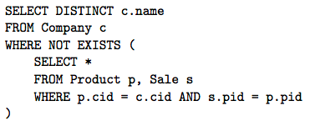
SQL Time!
Find the distinct names of all companies that have not sold even a single product.

Slide 30
SQL Time!
Find the distinct names of all companies such that every product they have ever sold costs at least 10 thousand dollars. Companies that have not sold any products should not be counted, as they are losers.

Slide 31
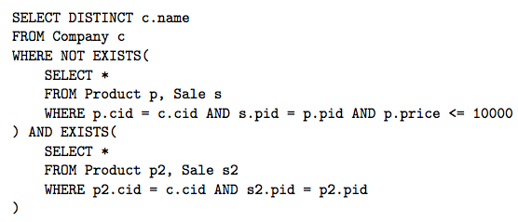
SQL Time!
Find the distinct names of all companies such that every product they have ever sold costs at least 10 thousand dollars. Companies that have not sold any products should not be counted, as they are losers.

Slide 32
Logical vs. Physical Optimization
SQL Query
Relational Algebra (RA) Plan
Logical optimization (we will only see this one):
Find equivalent plans that are more efficient
Intuition: Minimize # of tuples at each step by changing the order of RA operators
Physical optimization:
Find algorithm with lowest IO cost to execute our plan
Intuition: Calculate based on physical parameters (buffer size, etc.) and estimates of data size (histograms)
Optimized RA Plan
Execution

Slide 33
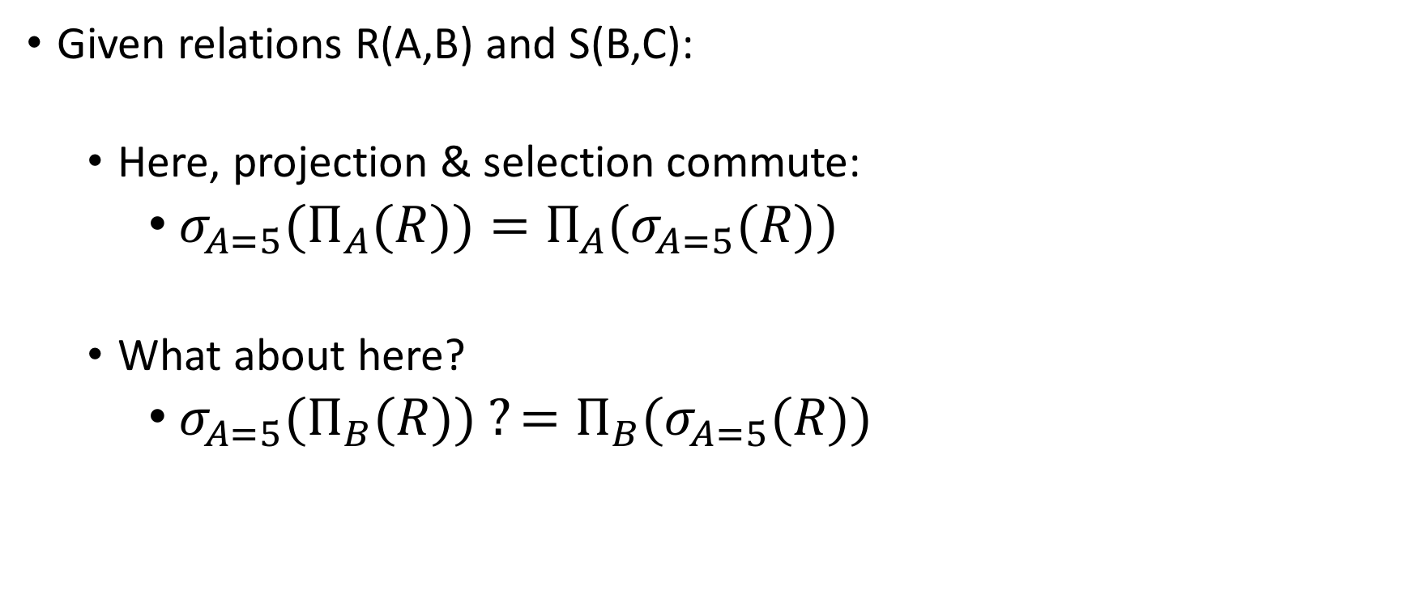
Recall: Logical Equivalence of RA Plans
Given relations R(A,B) and S(B,C):
Here, projection & selection commute:
${σ_{A=5}(Π}_{A}(R))=Π_{A}(σ_{A=5}(R))$
What about here?
${σ_{A=5}(Π}_{B}(R)) ?=Π_{B}(σ_{A=5}(R))$

Slide 34

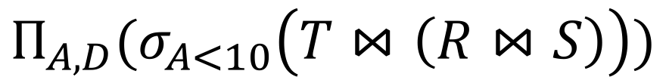
Translating to RA
R(A,B) S(B,C) T(C,D)
$$Π_{A,D}$$
SELECT R.A,S.D
FROM R,S,T
WHERE R.B = S.B
AND S.C = T.C
AND R.A < 10;
σ_{Α<10}
T(C,D)
R(A,B)
S(B,C)
$$Π_{A,D}(σ_{A<10}\left(T⋈\left(R⋈S\right)\right))$$

Slide 35
Logical Optimization
Heuristically, we want selections and projections to occur as early as possible in the plan
Terminology: “push down selections” and “pushing down projections.”
Intuition: We will have fewer tuples in a plan.
Could fail if the selection condition is very expensive (say runs some image processing algorithm).
Projection could be a waste of effort, but more rarely.

Slide 36
Optimizing RA Plan
Push down selection on A so it occurs earlier
R(A,B) S(B,C) T(C,D)
$$Π_{A,D}$$
SELECT R.A,S.D
FROM R,S,T
WHERE R.B = S.B
AND S.C = T.C
AND R.A < 10;
σ_{Α<10}
T(C,D)
R(A,B)
S(B,C)
$$Π_{A,D}(σ_{A<10}\left(T⋈\left(R⋈S\right)\right))$$

Slide 37

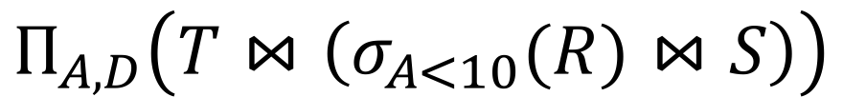
Optimizing RA Plan
Push down selection on A so it occurs earlier
R(A,B) S(B,C) T(C,D)
SELECT R.A,S.D
FROM R,S,T
WHERE R.B = S.B
AND S.C = T.C
AND R.A < 10;
$$Π_{A,D}$$
T(C,D)
σ_{Α<10}
S(B,C)
$$Π_{A,D}\left(T⋈\left(σ_{A<10}(R)⋈S\right)\right)$$
R(A,B)

Slide 38
Optimizing RA Plan
Push down projection so it occurs earlier
R(A,B) S(B,C) T(C,D)
SELECT R.A,S.D
FROM R,S,T
WHERE R.B = S.B
AND S.C = T.C
AND R.A < 10;
$$Π_{A,D}$$
T(C,D)
σ_{Α<10}
S(B,C)
$$Π_{A,D}\left(T⋈\left(σ_{A<10}(R)⋈S\right)\right)$$
R(A,B)

Slide 39
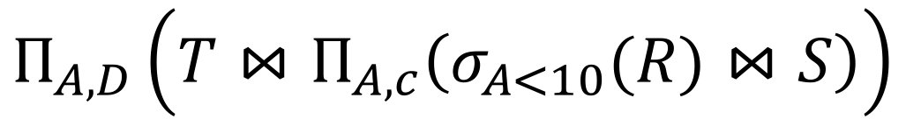


Optimizing RA Plan
We eliminate B earlier!
R(A,B) S(B,C) T(C,D)
In general, when is an attribute not needed…?
$$Π_{A,D}$$
SELECT R.A,S.D
FROM R,S,T
WHERE R.B = S.B
AND S.C = T.C
AND R.A < 10;
$$Π_{A,C}$$
T(C,D)
$$Π_{A,D}\left(T⋈Π_{A,c}\left(σ_{A<10}(R)⋈S\right)\right)$$
σ_{Α<10}
S(B,C)
R(A,B)

Slide 40
Please go over the examples here:
https://courses.cs.washington.edu/courses/cse544/99sp/homeworks/sample/sample.html
Only the first 4 questions!

Slide 41
Transaction Properties: ACID
Atomic
State shows either all the effects of txn, or none of them
Consistent
Txn moves from a state where integrity holds, to another where integrity holds
Isolated
Effect of txns is the same as txns running one after another (ie looks like batch mode)
Durable
Once a txn has committed, its effects remain in the database
ACID continues to be a source of great debate!

Slide 42
ACID: Atomicity
TXN’s activities are atomic: all or nothing
Intuitively: in the real world, a transaction is something that would either occur completely or not at all
Two possible outcomes for a TXN
It commits: all the changes are made
It aborts: no changes are made

Slide 43
Transactions
A key concept is the transaction (TXN): an atomic sequence of db actions (reads/writes)
Atomicity: An action either completes entirely or not at all
Acct | Balance
a10 | 20,000
a20 | 15,000
Transfer $3k from a10 to a20:
Debit $3k from a10
Credit $3k to a20
Acct | Balance
a10 | 17,000
a20 | 18,000
Written naively, in which states is atomicity preserved?
Crash before 1,
After 1 but before 2,
After 2.
DB Always preserves atomicity!

Slide 44
ACID: Consistency
The tables must always satisfy user-specified integrity constraints
Examples:
Account number is unique
Stock amount can’t be negative
Sum of debits and of credits is 0
How consistency is achieved:
Programmer makes sure a txn takes a consistent state to a consistent state
System makes sure that the txn is atomic

Slide 45
ACID: Isolation
A transaction executes concurrently with other transactions
Isolation: the effect is as if each transaction executes in isolation of the others.
E.g. Should not be able to observe changes from other transactions during the run

Slide 46
Challenge: Scheduling Concurrent Transactions
The DBMS ensures that the execution of {T₁,…,T_{n}} is equivalent to some serial execution
One way to accomplish this: Locking
Before reading or writing, transaction requires a lock from DBMS, holds until the end
Key Idea: If T_{i} wants to write to an item x and T_{j} wants to read x, then T_{i}, T_{j} conflict. Solution via locking:
only one winner gets the lock
loser is blocked (waits) until winner finishes
A set of TXNs is isolated if their effect is as if all were executed serially
What if T_{i} and T_{j} need X and Y, and T_{i} asks for X before T_{j,} and T_{j} asks for Y before T_{i}?
-> Deadlock! One is aborted…
All concurrency issues handled by the DBMS…

Slide 47
ACID: Durability
The effect of a TXN must continue to exist (“persist”) after the TXN
And after the whole program has terminated
And even if there are power failures, crashes, etc.
And etc…
Means: Write data to disk

Slide 48
Ensuring Atomicity & Durability
DBMS ensures atomicity even if a TXN crashes!
One way to accomplish this: Write-ahead logging (WAL)
Key Idea: Keep a log of all the writes done.
After a crash, the partially executed TXNs are undone using the log
Write-ahead Logging (WAL): Before any action is finalized, a corresponding log entry is forced to disk
We assume that the log is on “stable” storage
All atomicity issues also handled by the DBMS…

Slide 49
Challenges for ACID properties
In spite of failures: Power failures, but not media failures
Users may abort the program: need to “rollback the changes”
Need to log what happened
Many users executing concurrently
Can be solved via locking (we’ll see this next lecture!)
And all this with… Performance!!

