Slide 1
CS639: Data Management for Data Science
Lecture 11: Spark
Theodoros Rekatsinas

Slide 2
Logistics/Announcements
Questions on PA3?

Slide 3
Today’s Lecture
MapReduce Implementation
Spark

Slide 4
MapReduce Implementation

Slide 5
Recall: The Map Reduce Abstraction for Distributed Algorithms
Distributed Data Storage
map
map
map
map
map
map
Map
(Shuffle)
reduce
reduce
reduce
reduce
Reduce

Slide 6
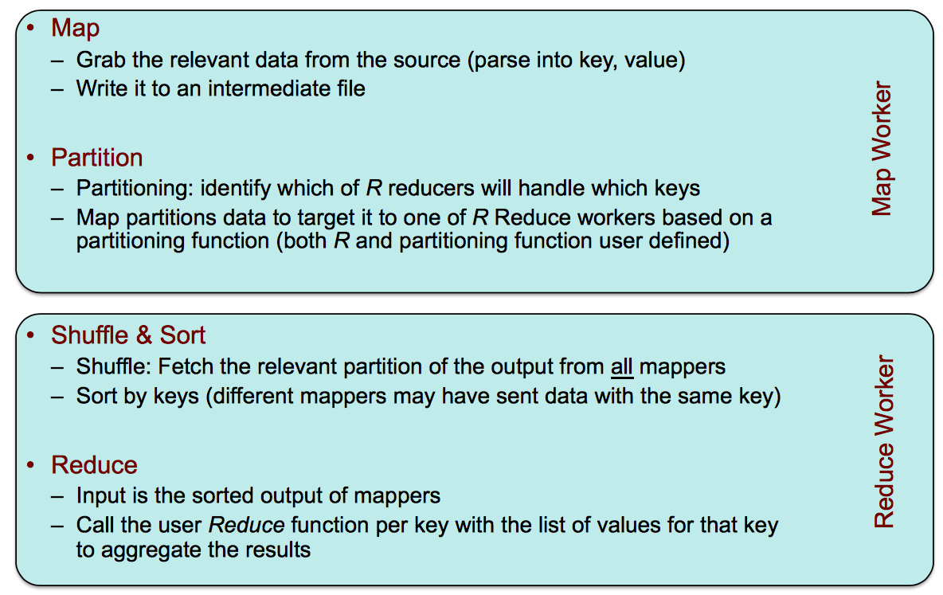
MapReduce: what happens in between?

Slide 7
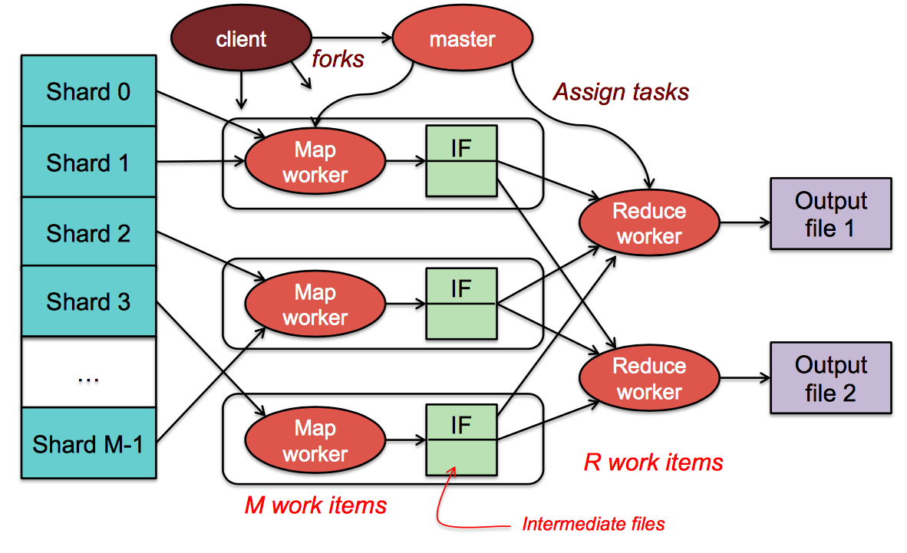
MapReduce: the complete picture

Slide 8
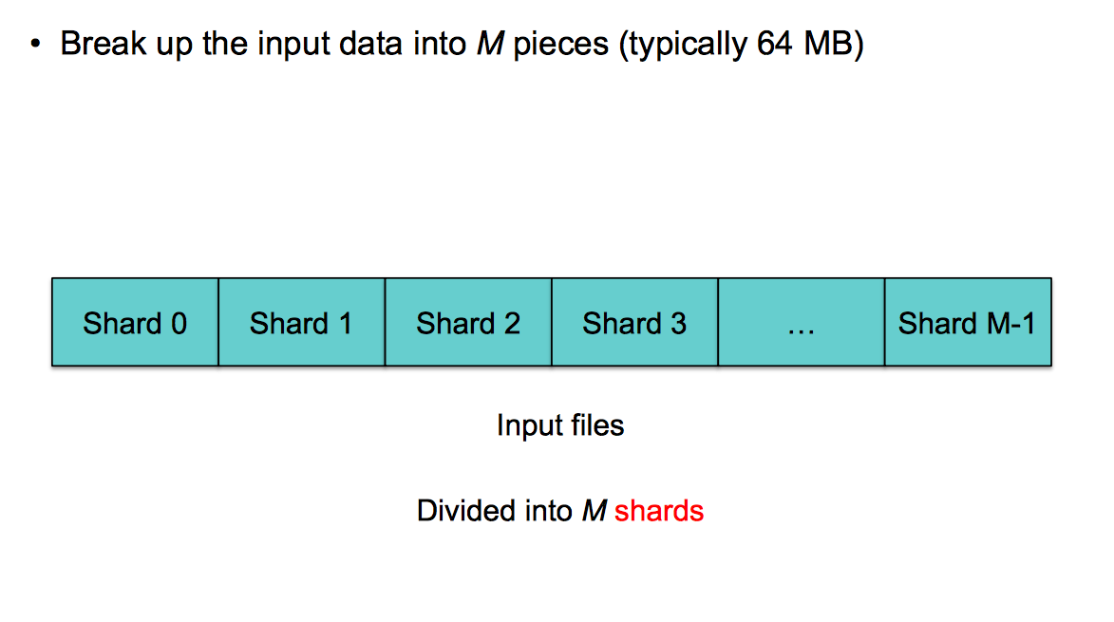
Step 1: Split input files into chunks (shards)

Slide 9
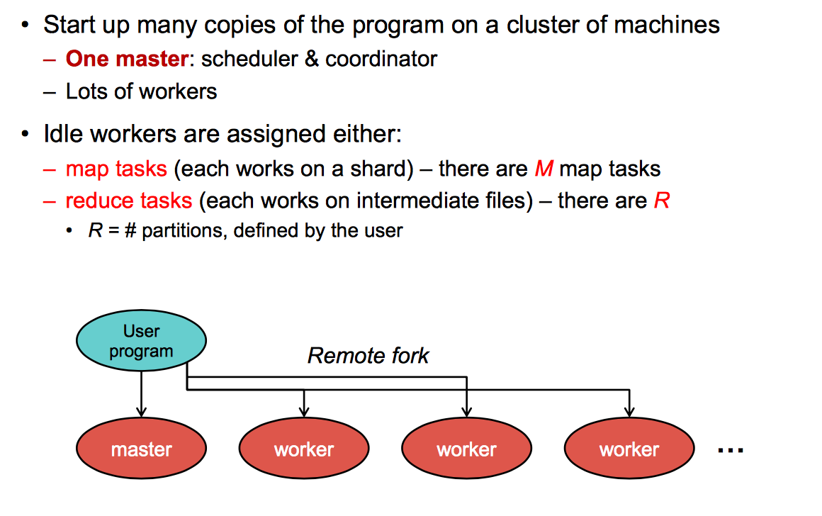
Step 2: Fork processes

Slide 10
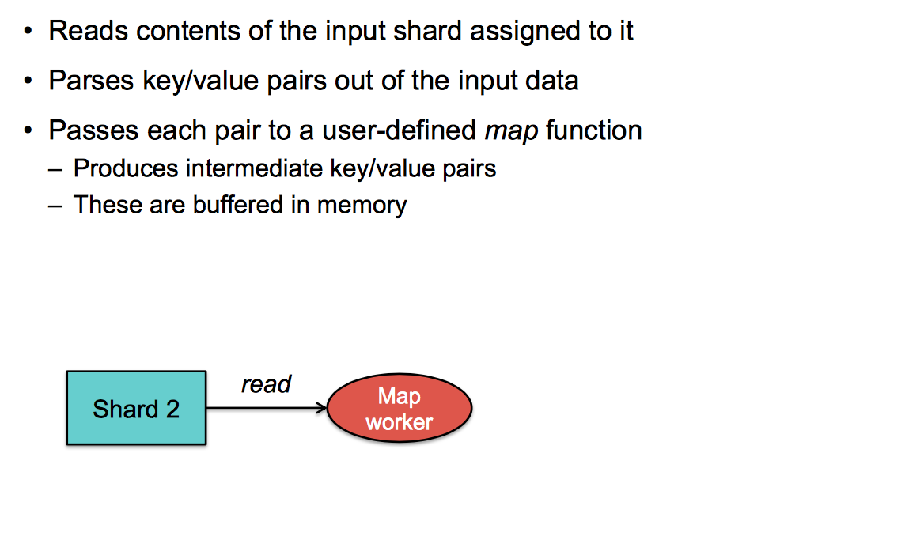
Step 3: Run Map Tasks

Slide 11
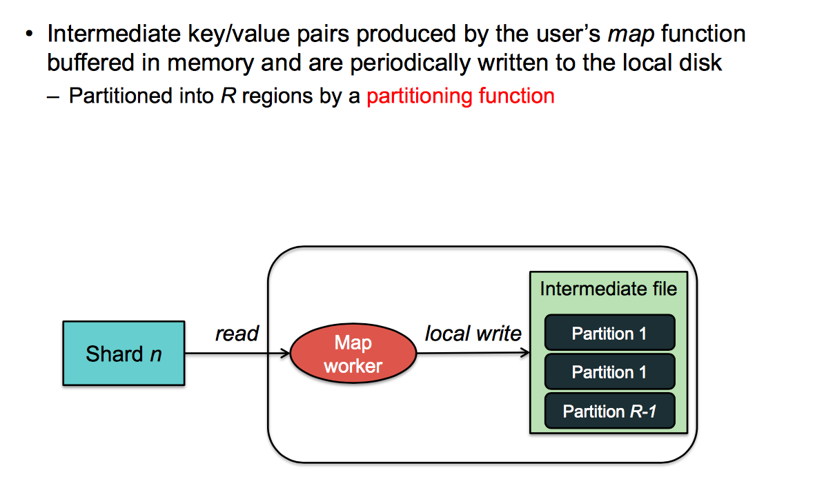
Step 4: Create intermediate files

Slide 12
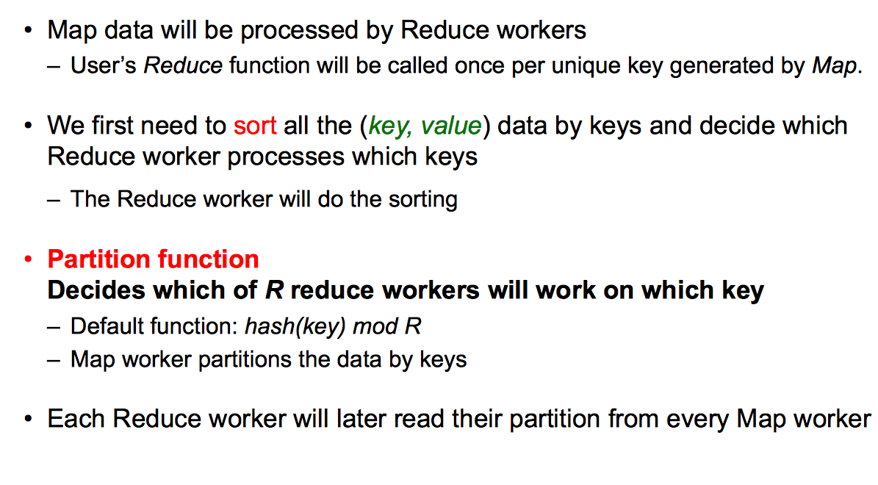
Step 4a: Partitioning

Slide 13
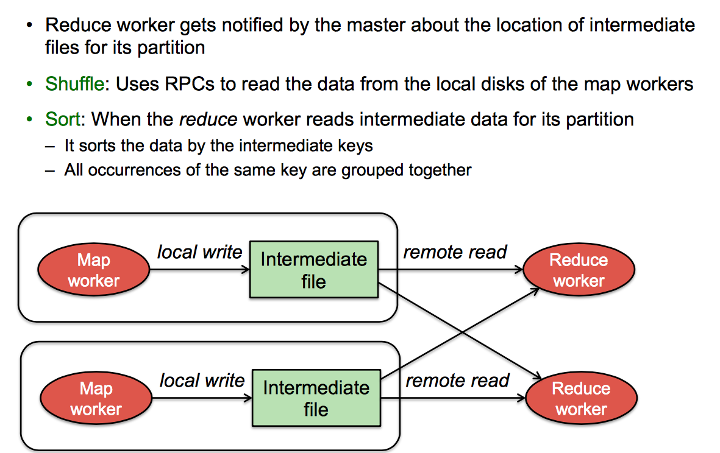
Step 5: Reduce Task - sorting

Slide 14
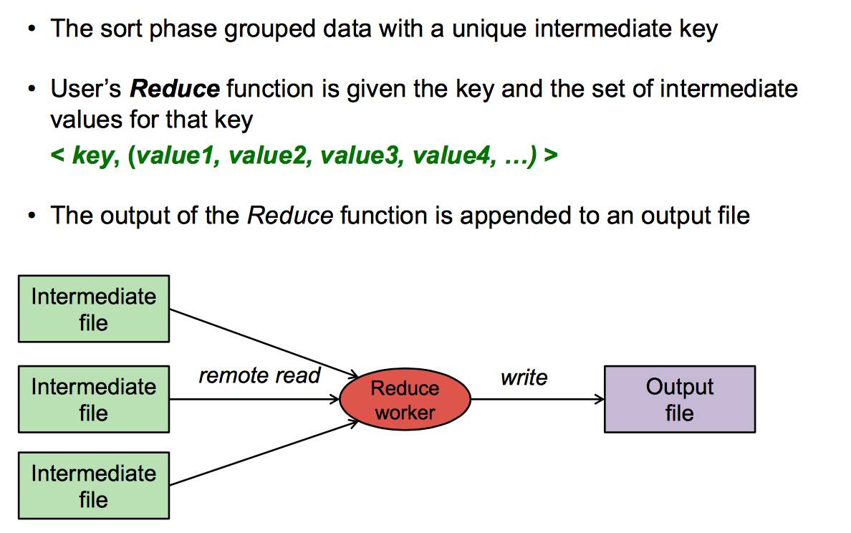
Step 6: Reduce Task - reduce

Slide 15
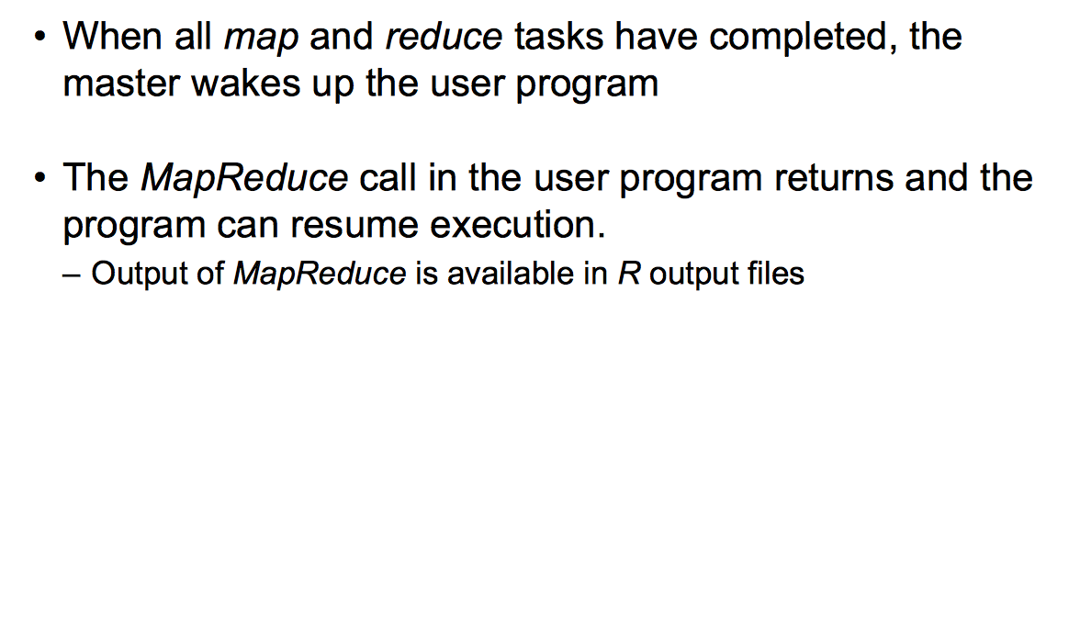
Step 7: Return to user

Slide 16
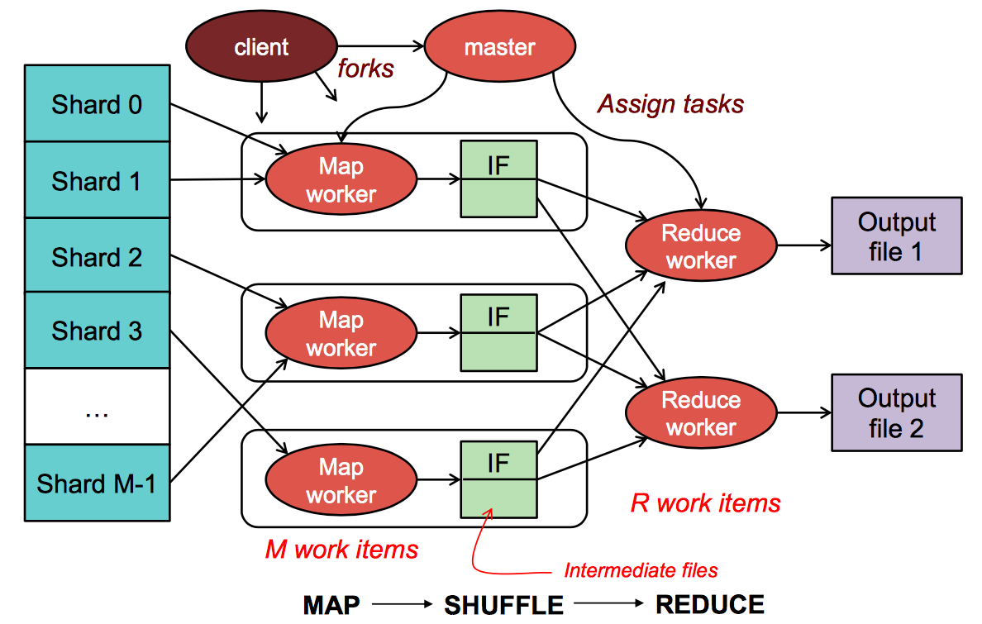
MapReduce: the complete picture
We need a distributed file system!

Slide 17
2. Spark

Slide 18
Intro to Spark
Spark is really a different implementation of the MapReduce programming model
What makes Spark different is that it operates on Main Memory
Spark: we write programs in terms of operations on resilient distributed datasets (RDDs).
RDD (simple view): a collection of elements partitioned across the nudes of a cluster that can be operated on in parallel.
RDD (complex view): RDD is an interface for data transformation, RDD refers to the data stored either in persisted store (HDFS) or in cache (memory, memory+disk, disk only) or in another RDD

Slide 19
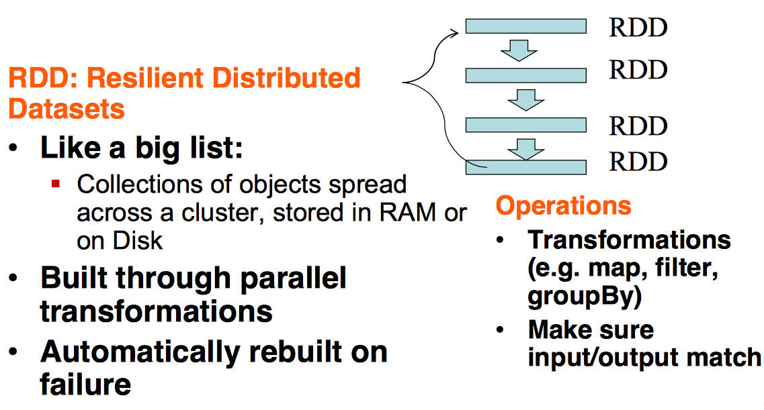
RDDs in Spark

Slide 20
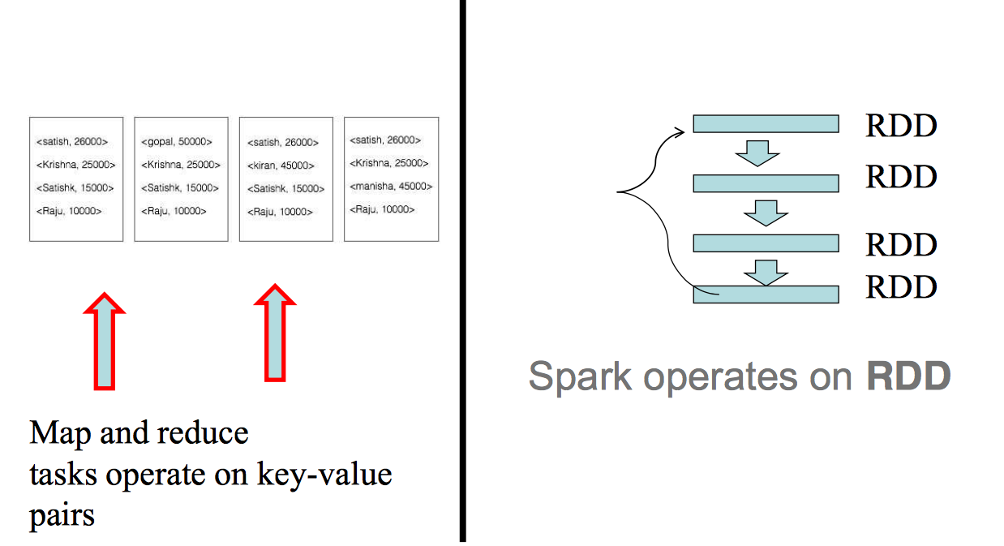
MapReduce vs Spark

Slide 21
RDDs
Partitions are recomputed on failure or cache eviction
Metadata stored for interface:
Partitions – set of data splits associated with this RDD
Dependencies – list of parent RDDs involved in computation
Compute – function to compute partition of the RDD given the parent partitions from the Dependencies
Preferred Locations – where is the best place to put computations on this partition (data locality)
Partitioner – how the data is split into partitions

Slide 22
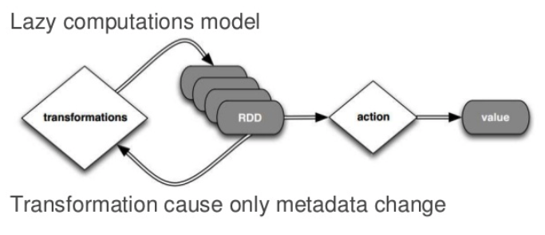
RDDs

Slide 23
DAG
Directed Acyclic Graph – sequence of computations performed on data
Node – RDD partition
Edge – transformation on top of the data
Acyclic – graph cannot return to the older partition
Directed – transformation is an action that transitions data partitions state (from A to B)

Slide 24
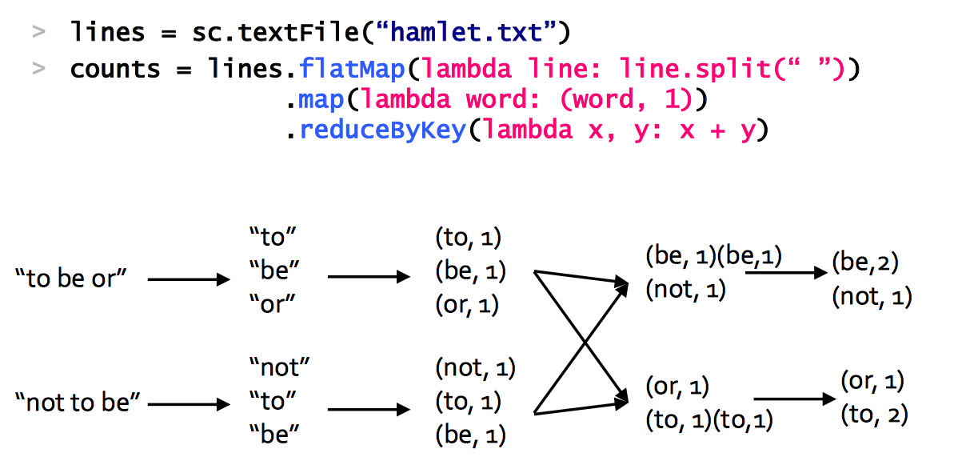
Example: Word Count

Slide 25
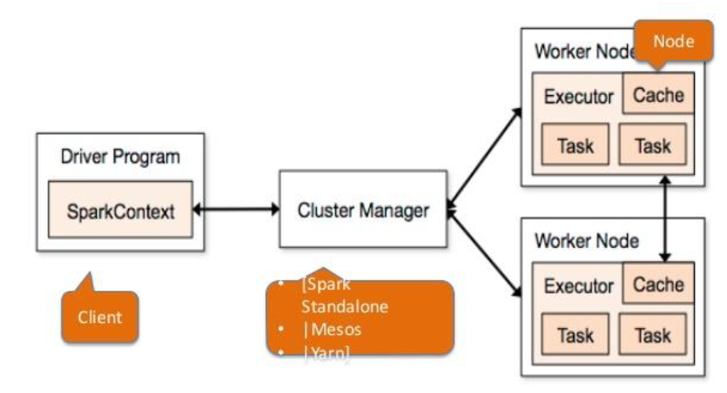
Spark Architecture

Slide 26
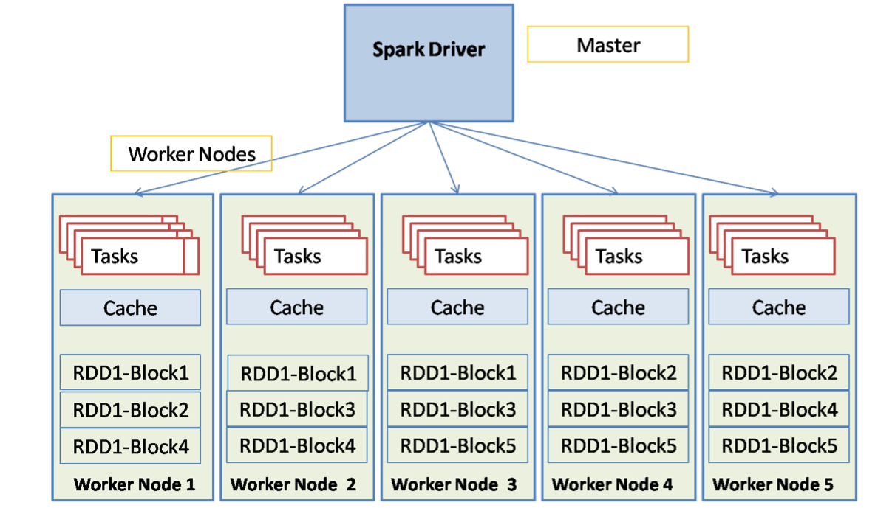
Spark Components

Slide 27
Spark Driver
Entry point of the Spark Shell (Scala, Python, R)
The place where SparkContext is created
Translates RDD into the execution graph
Splits graph into stages
Schedules tasks and controls their execution
Stores metadata about all the RDDs and their partitions
Brings up Spark WebUI with job information

Slide 28
Spark Executor
Stores the data in cache in JVM heap or on HDDs
Reads data from external sources
Writes data to external sources
Performs all the data processing

Slide 29
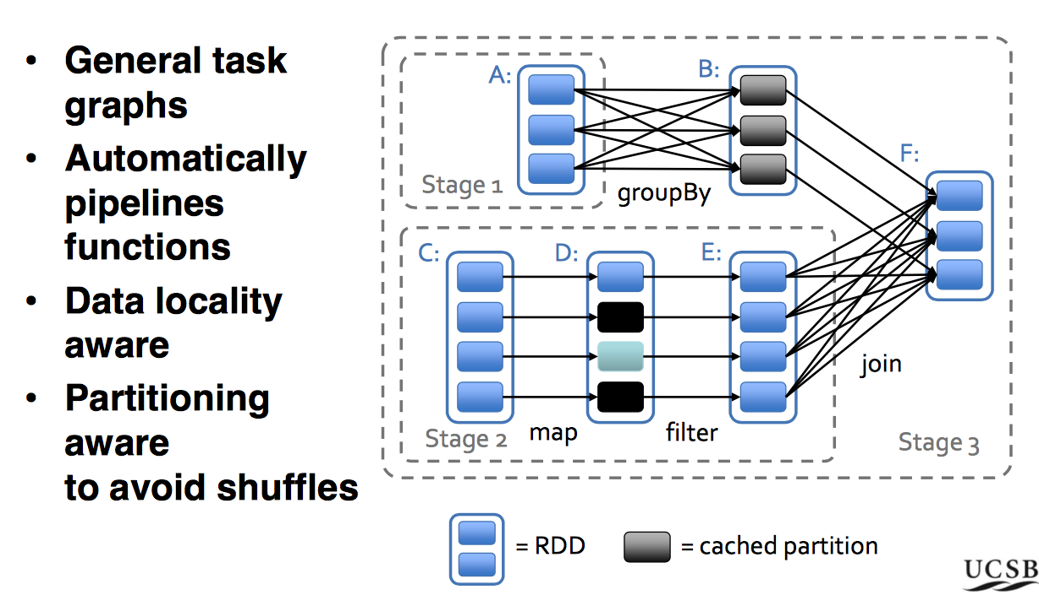
Dag Scheduler

Slide 30
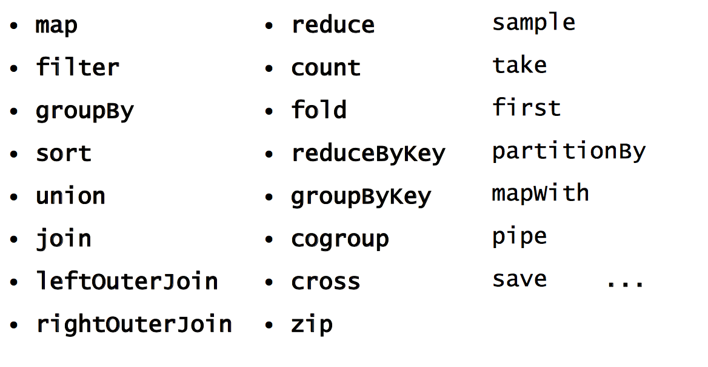
More RDD Operations

Slide 31
Spark’s secret is really the RDD abstraction

Slide 32
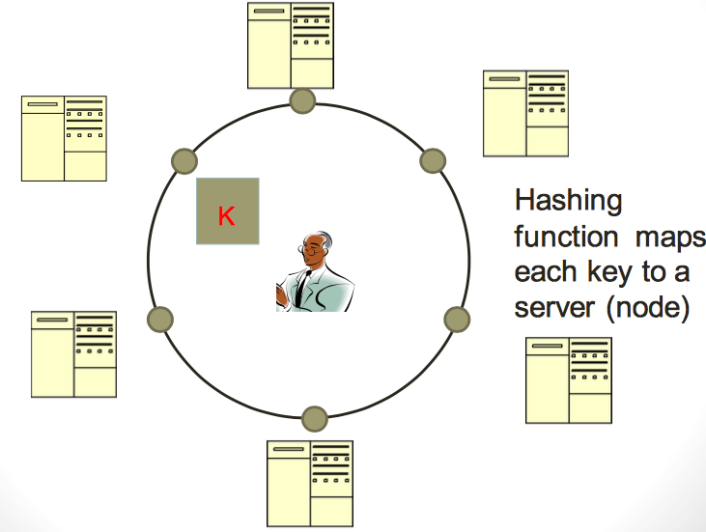
Typical NoSQL architecture

Slide 33
CAP theorem for NoSQL
What the CAP theorem really says: If you cannot limit the number of faults and requests can be directed to any server and you insist on serving every request you receive then you cannot possibly be consistent
How it is interpreted: You must always give something up: consistency, availability or tolerance to failure and reconfiguration

Slide 34
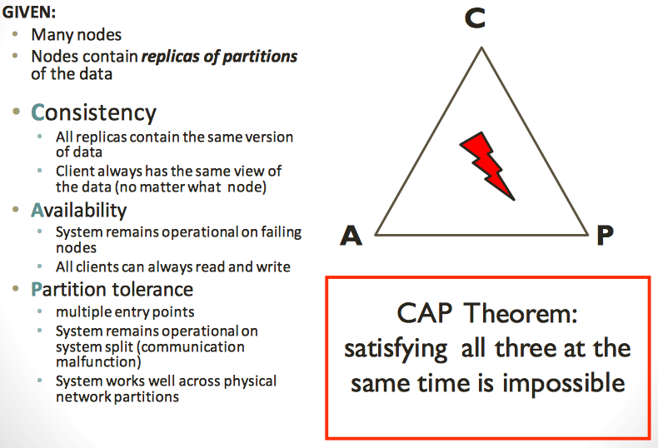
CAP theorem for NoSQL

Slide 35
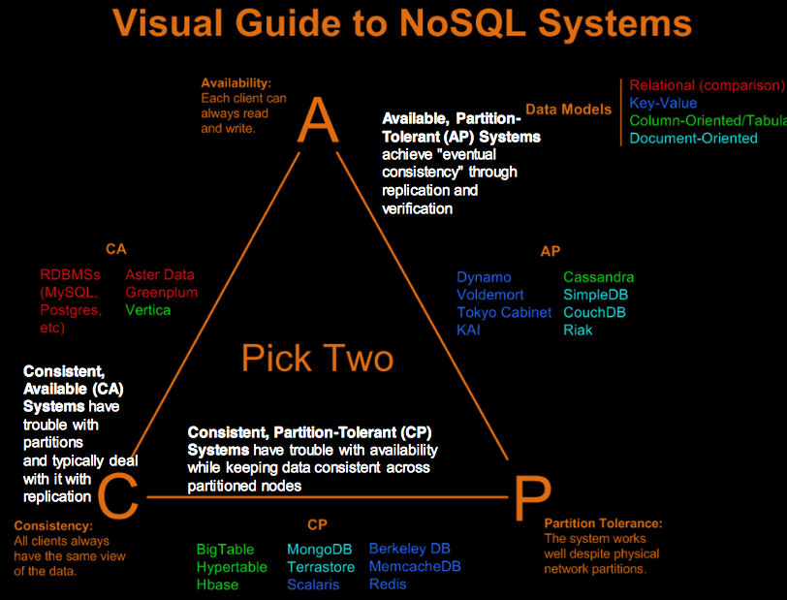

Slide 36
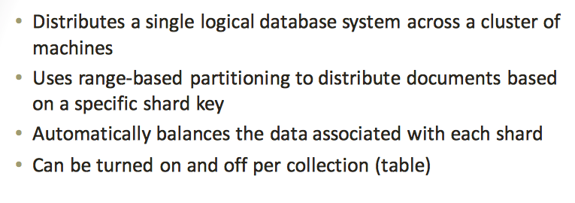
Sharding of data

Slide 37
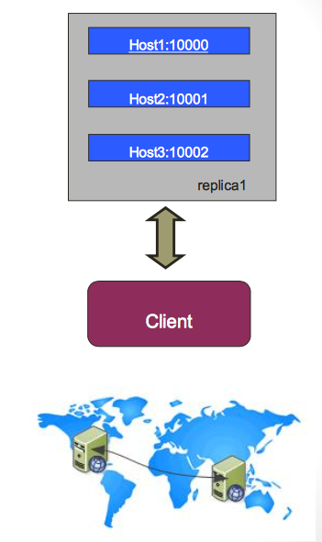
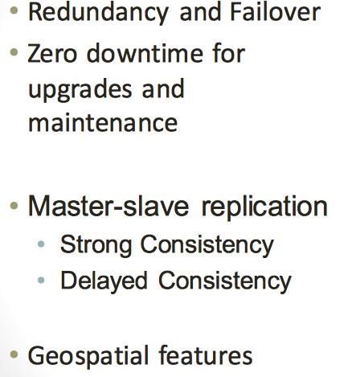
Replica Sets

Slide 38
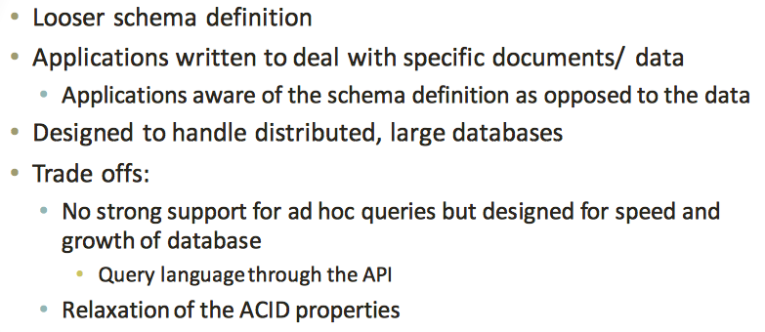
How does NoSQL vary from RDBMS?

Slide 39
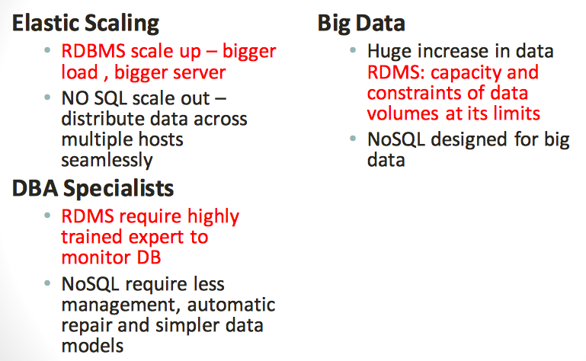
Benefits of NoSQL

Slide 40
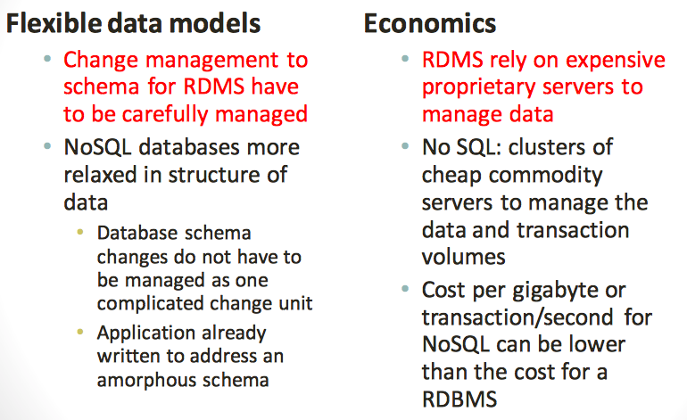
Benefits of NoSQL

Slide 41
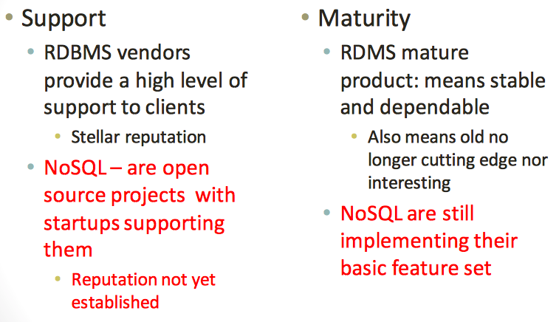
Drawbacks of NoSQL

Slide 42
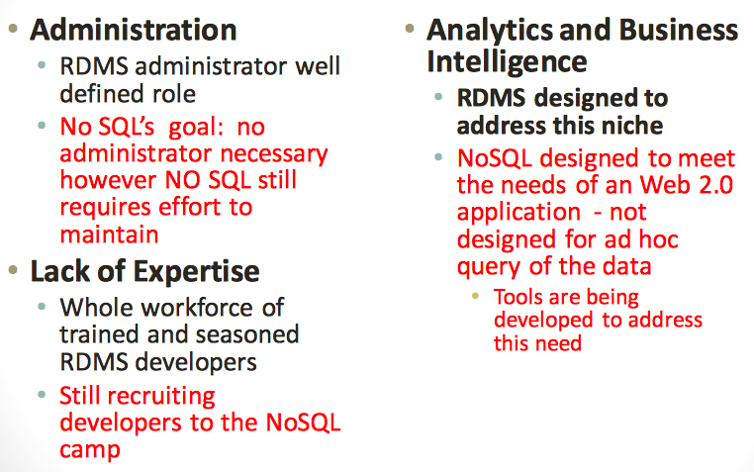
Drawbacks of NoSQL

Slide 43
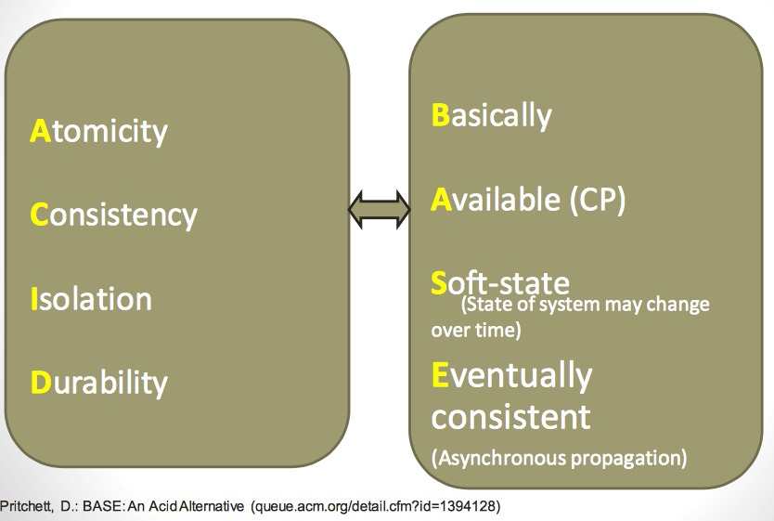
ACID or BASE

