Slide 1
CS639: Data Management for Data Science
Lecture 12: NoSql and KeyValue stores
Theodoros Rekatsinas
Slides borrowed by Kathleen Durant

Slide 2
Today’s Lecture
Intro to NoSQL
NoSQL Assumptions and the CAP Theorem
Strengths and weaknesses of NoSQL
Example: MongoDB

Slide 3
Intro to NoSQL

Slide 4
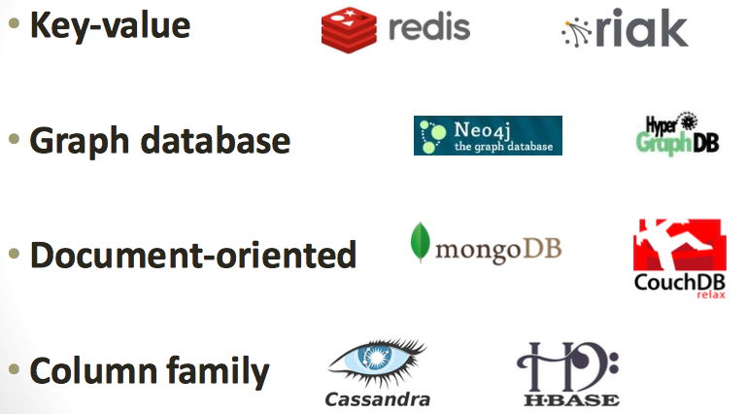
Taxonomy of NoSQL

Slide 5
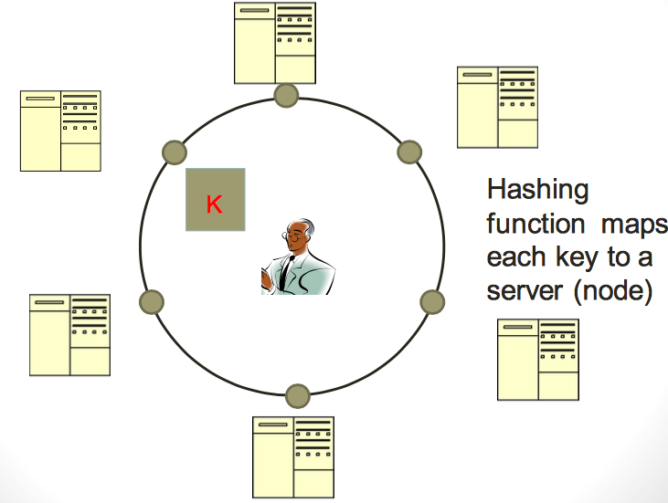
Typical NoSQL architecture

Slide 6
2. NoSQL Assumptions and the CAP Theorem

Slide 7
CAP theorem for NoSQL
What the CAP theorem really says: If you cannot limit the number of faults and requests can be directed to any server and you insist on serving every request you receive then you cannot possibly be consistent
How it is interpreted: You must always give something up: consistency, availability or tolerance to failure and reconfiguration

Slide 8
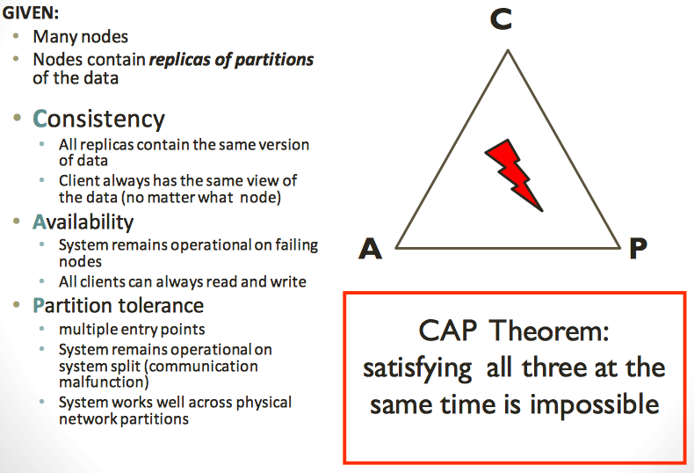
CAP theorem for NoSQL

Slide 9
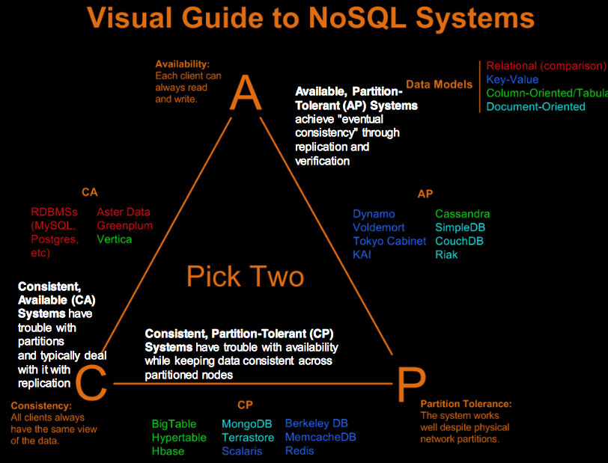

Slide 10
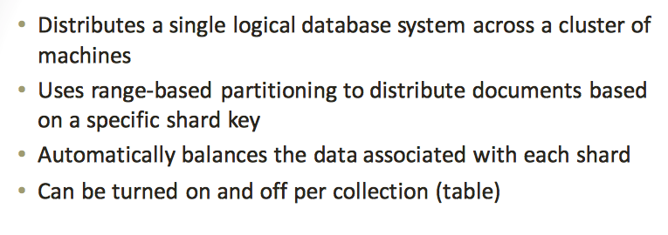
Sharding of data

Slide 11
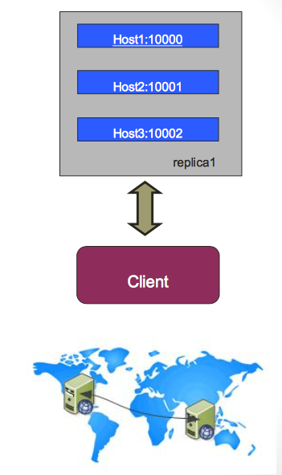
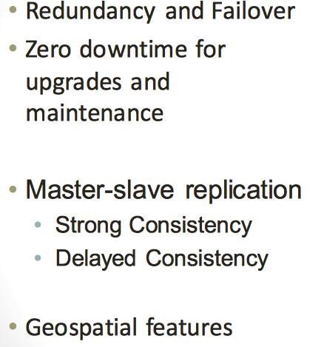
Replica Sets

Slide 12
3. Strengths and weaknesses of NoSQL

Slide 13
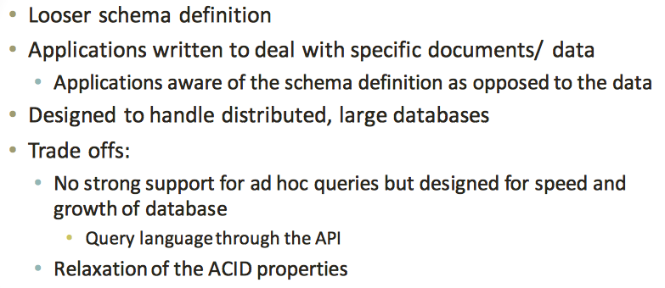
How does NoSQL vary from RDBMS?

Slide 14
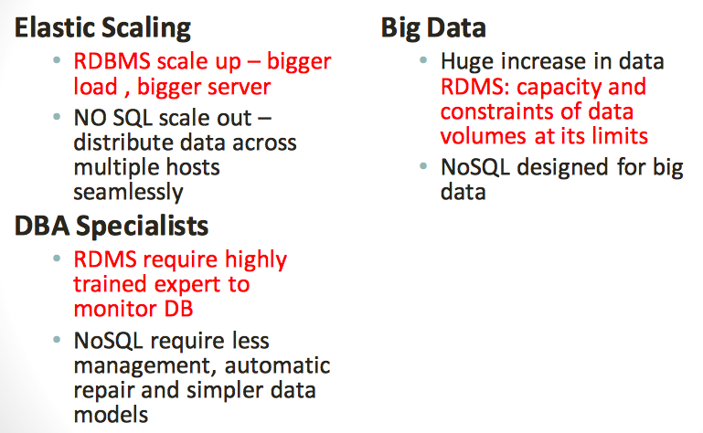
Benefits of NoSQL

Slide 15
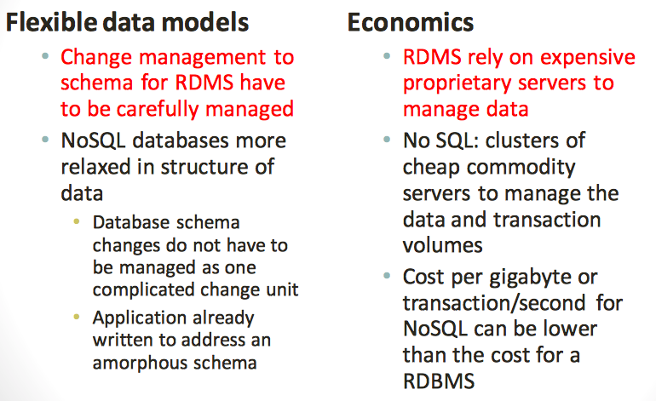
Benefits of NoSQL

Slide 16
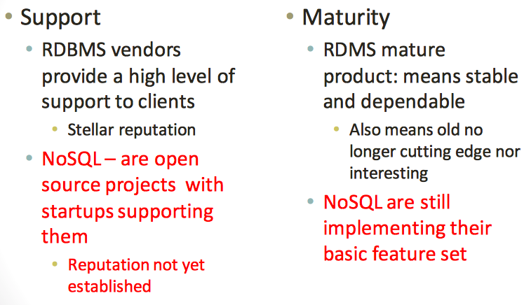
Drawbacks of NoSQL

Slide 17
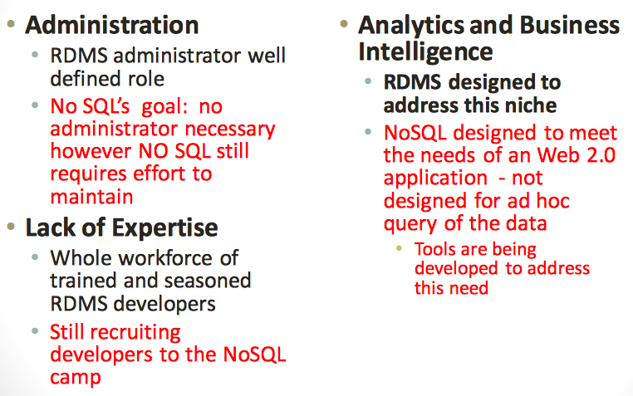
Drawbacks of NoSQL

Slide 18
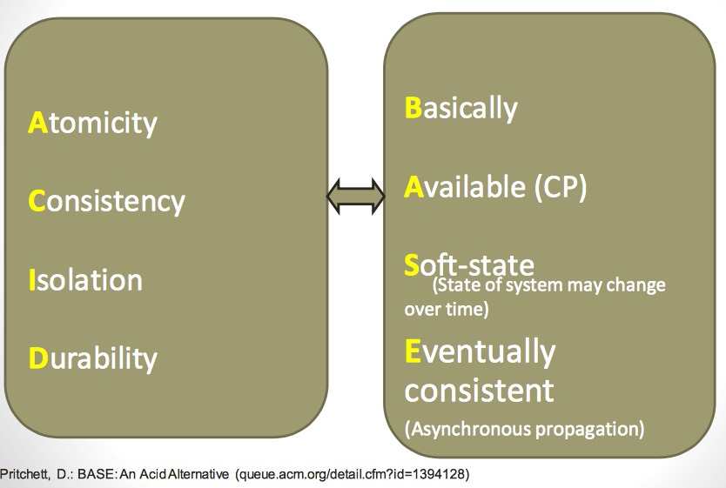
ACID or BASE

Slide 19
4. MongoDB

Slide 20
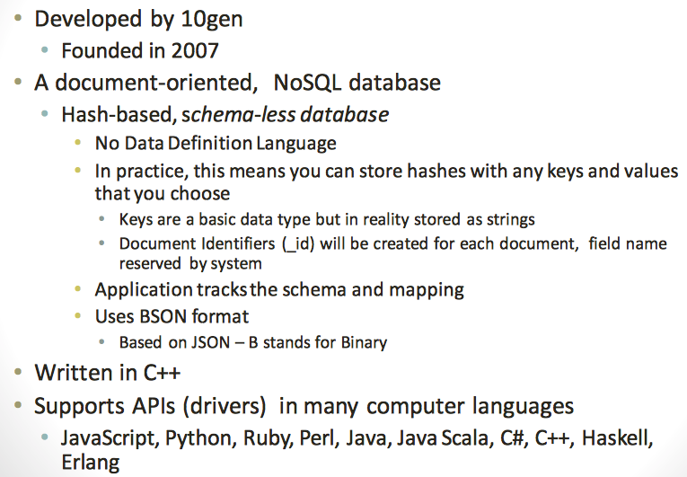
What is MongoDB?

Slide 21
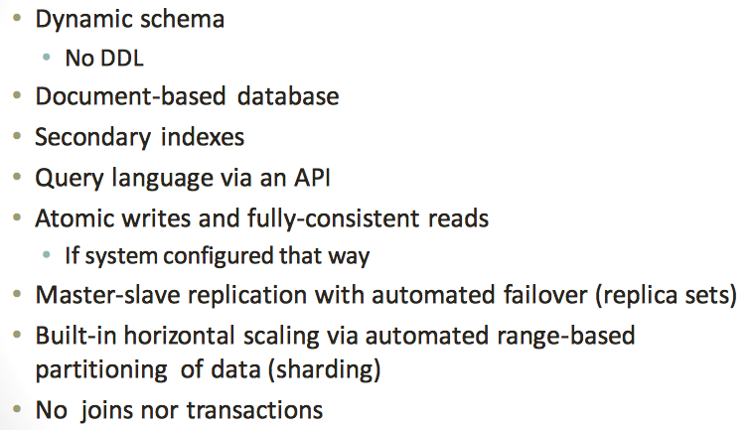
Functionality of MongoDB

Slide 22
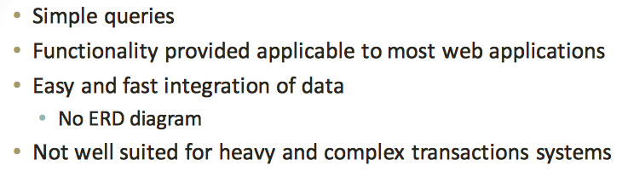
Why use MongoDB?

Slide 23
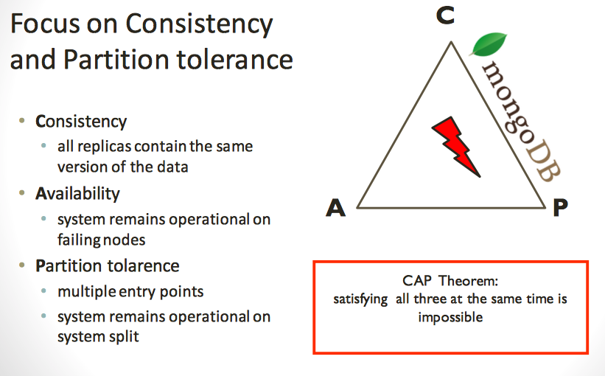
MongoDB: CAP approach

Slide 24
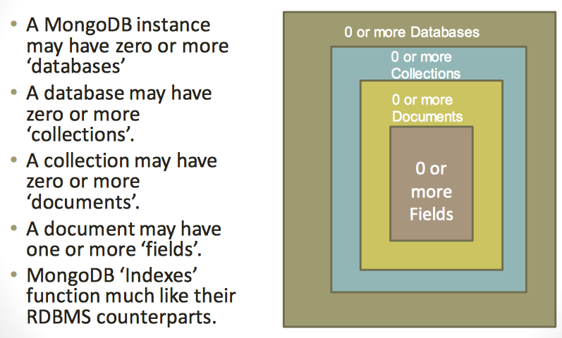
MongoDB Data model: Hierarchical Objects

Slide 25
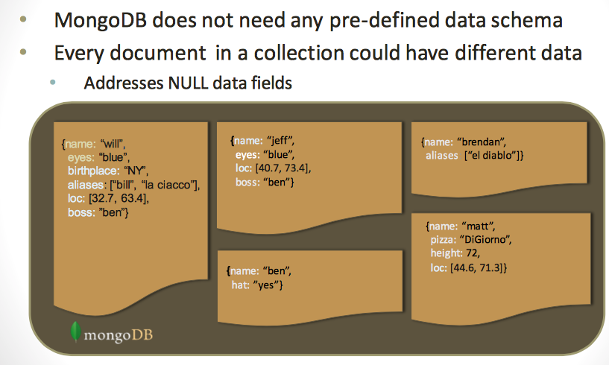
Schema Free

Slide 26
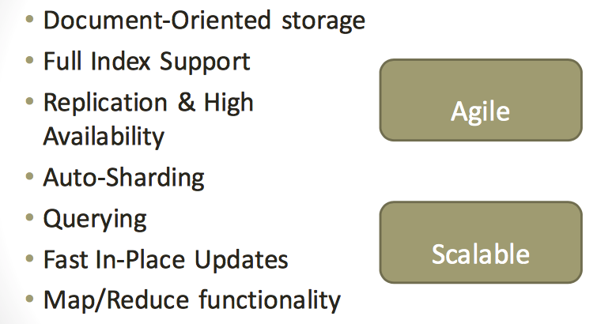
MongoDB Features

Slide 27
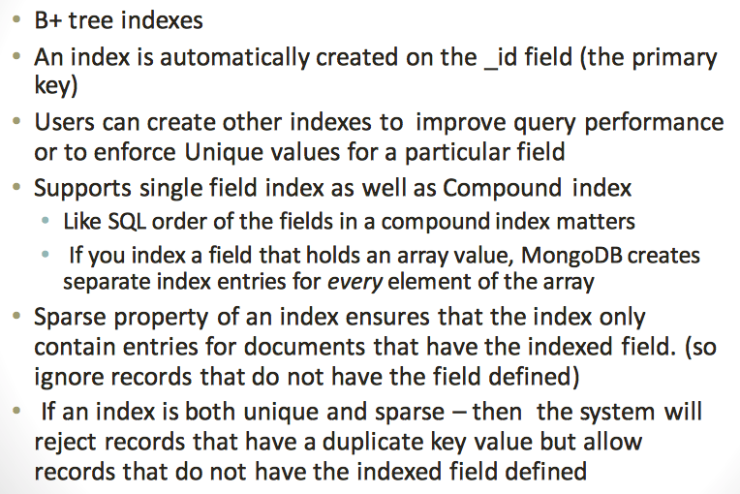
Index Functionality

Slide 28
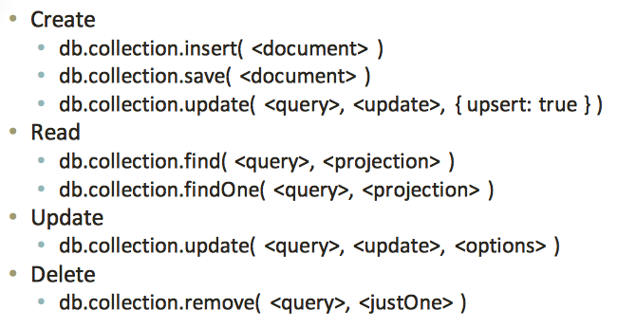
CRUD operations

Slide 29
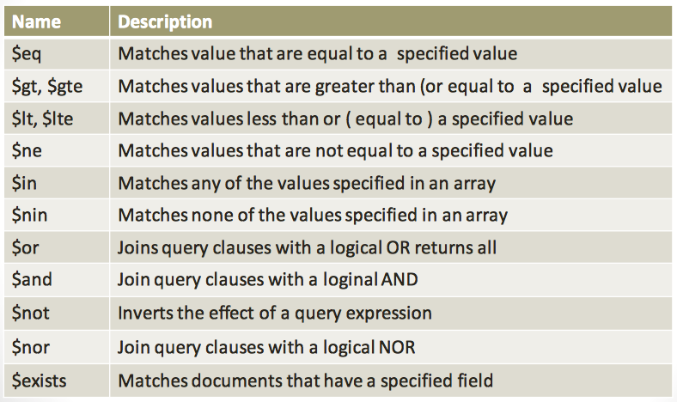
Query operations

Slide 30
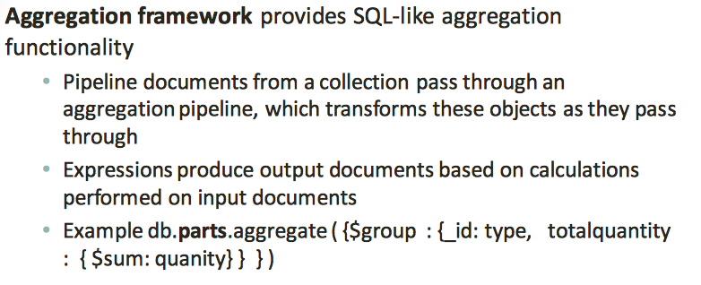
Aggregated functionality

Slide 31
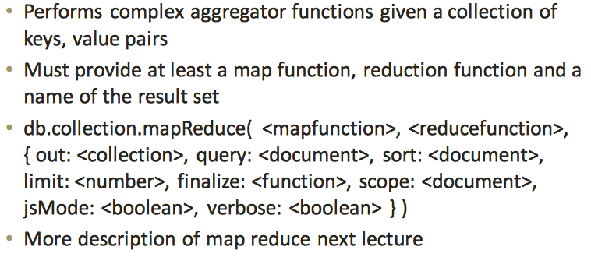
Map reduce functionality

Slide 32
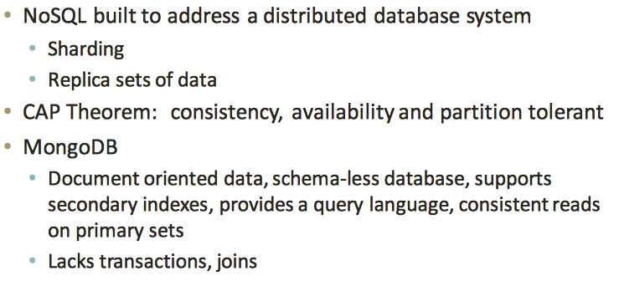
Summary

