Slide 1
CS639: Data Management for Data Science
Lecture 15: Bayesian Methods
Theodoros Rekatsinas

Slide 2
Announcements
We will release grades of Midterm by the end of day today.

Slide 3
Today – Bayesian Methods
Motivation and Introduction
Bayes Theorem
Bayesian inference

Slide 4
Motivation
Statistical inference: Drawing conclusions based on data that is subject to random variation (observational errors and sampling variation)
So far we saw the “frequentists” point of view.
Bayesian inference provides a different way to draw conclusions from data.

Slide 5
Basic Idea
Leverage prior information and update prior information with new data to create a posterior probability distribution.
Three steps:
Form prior (a probability model)
Condition on observed data (new data from your sample)
Evaluate the posterior distribution

Slide 6
Basic Idea
“The central feature of Bayesian inference [is] the direct quantification of uncertainty” (Gelman et al. 2014, 4).
Less emphasis on p-value hypothesis testing. More emphasis on the confidence and probability intervals.
Many researchers actually interpret ‘frequentist’ confidence intervals as if they were Bayesian probability intervals.

Slide 7
Uncertainty in Freq. and Bayesian Approaches
Both involve the estimation of unknown quantities of interest
The estimates they produce have different interpretations.
Frequentist: 95% Confidence interval: Repeated samples will contain the true parameter within the interval 95% of the time.
Bayesian: 95% Probability (credible) interval: There is a 95% probability that the unknown parameter is actually in the interval.

Slide 8
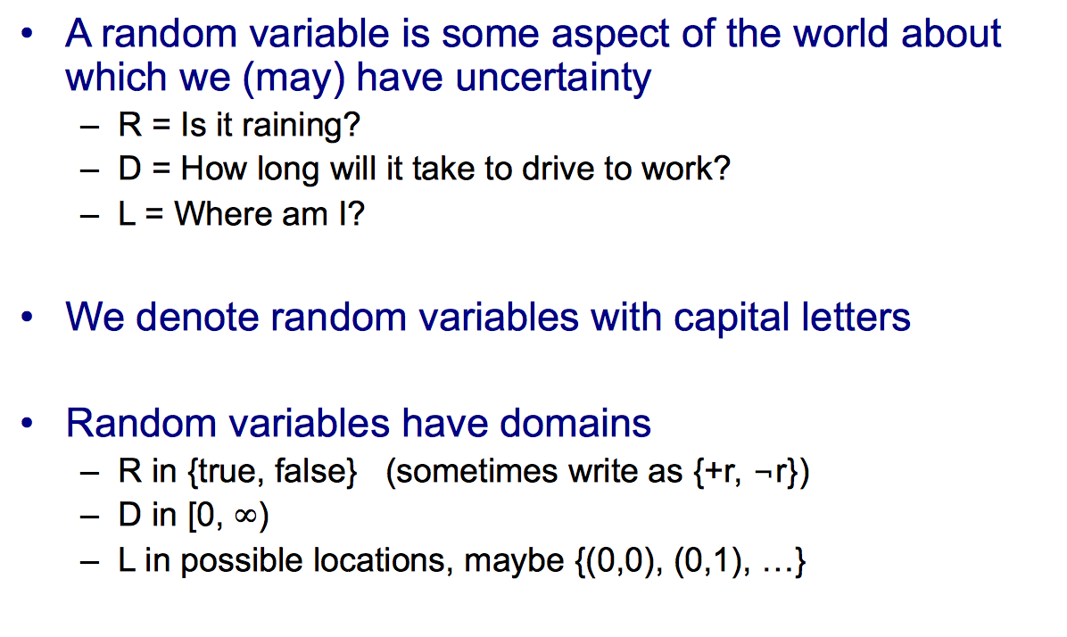
Random Variables

Slide 9
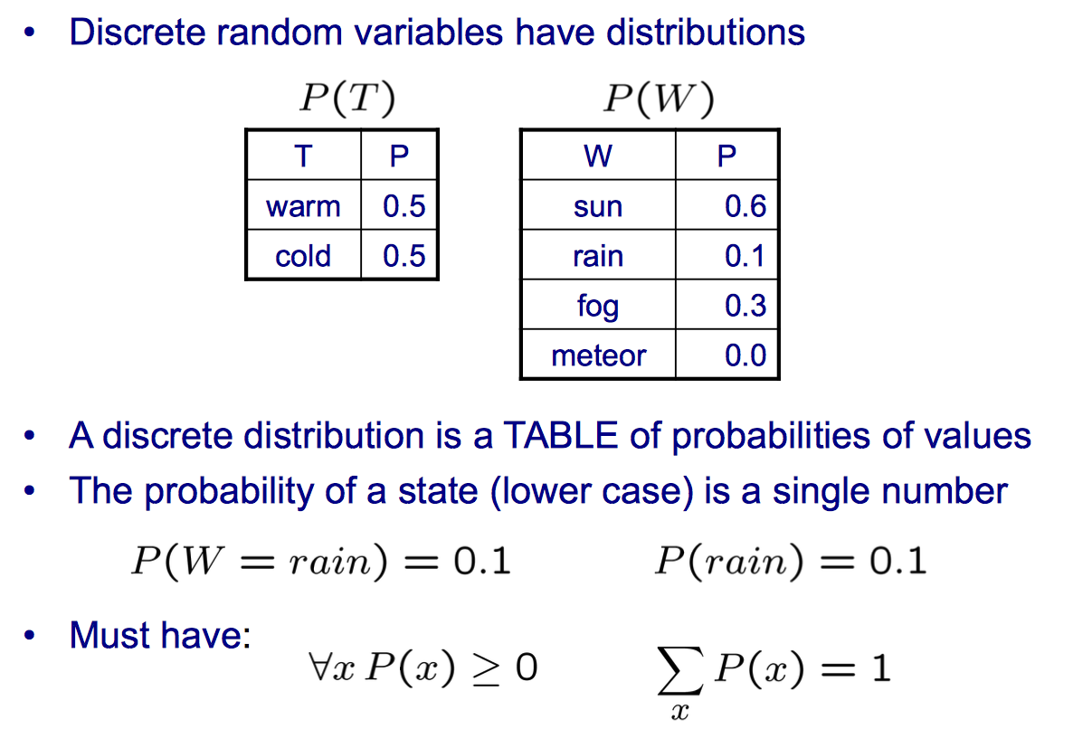
Probability Distributions

Slide 10
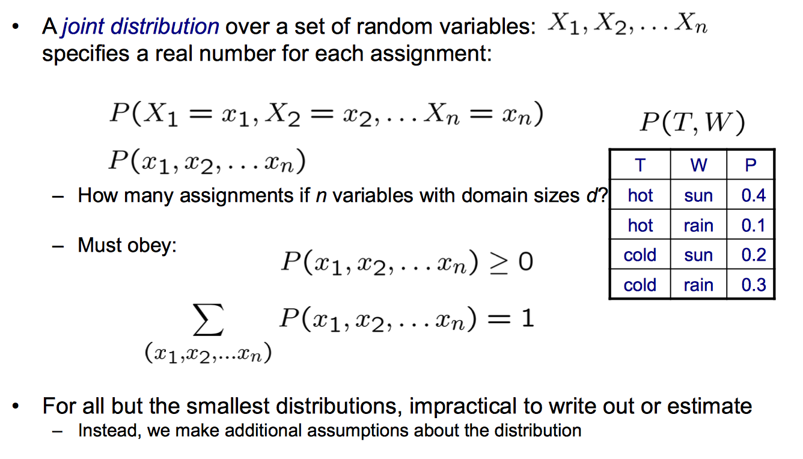
Joint Distributions

Slide 11
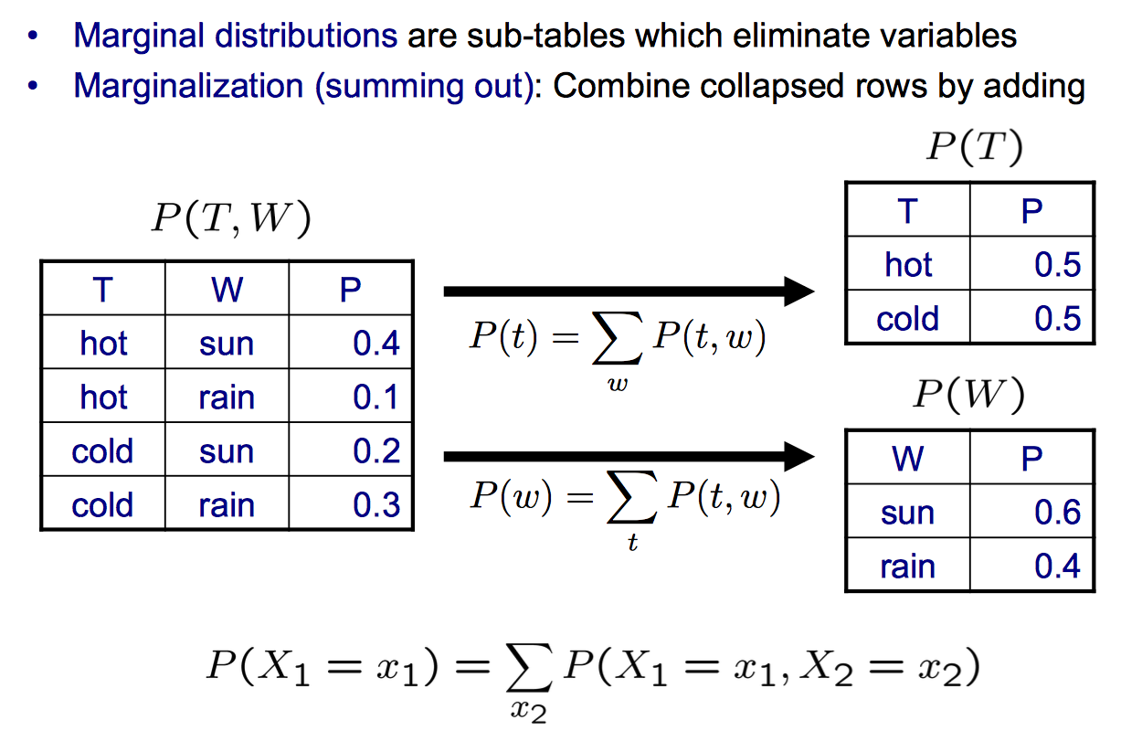
Marginal Distributions

Slide 12
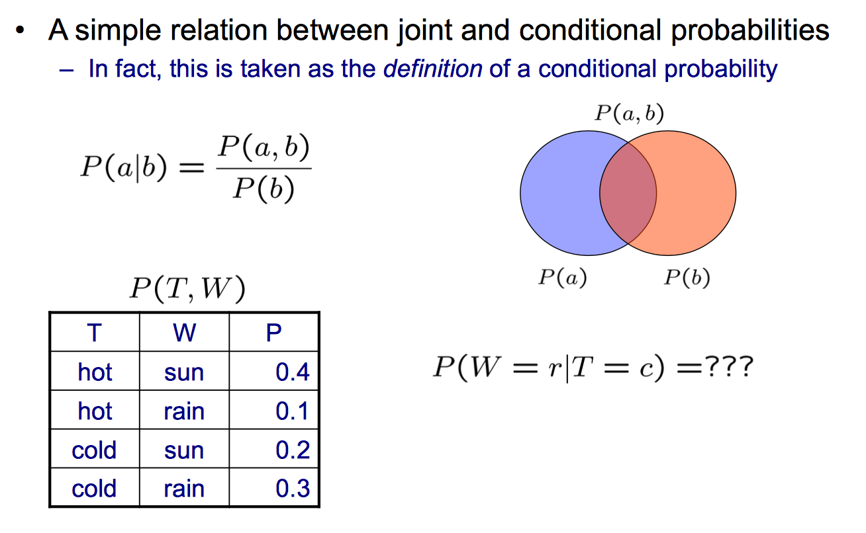
Conditional Probabilities

Slide 13
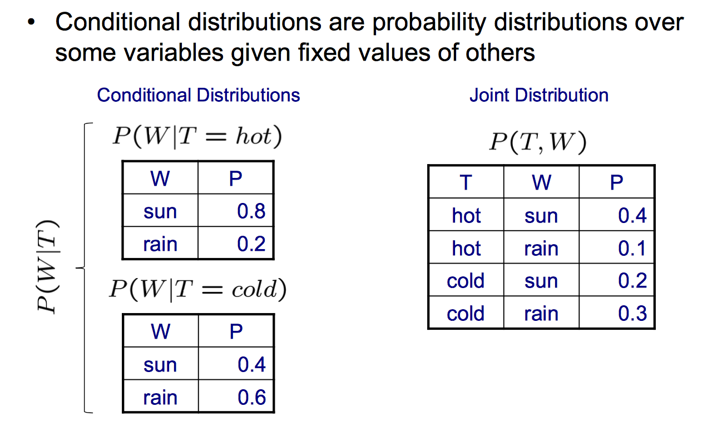
Conditional Probabilities

Slide 14
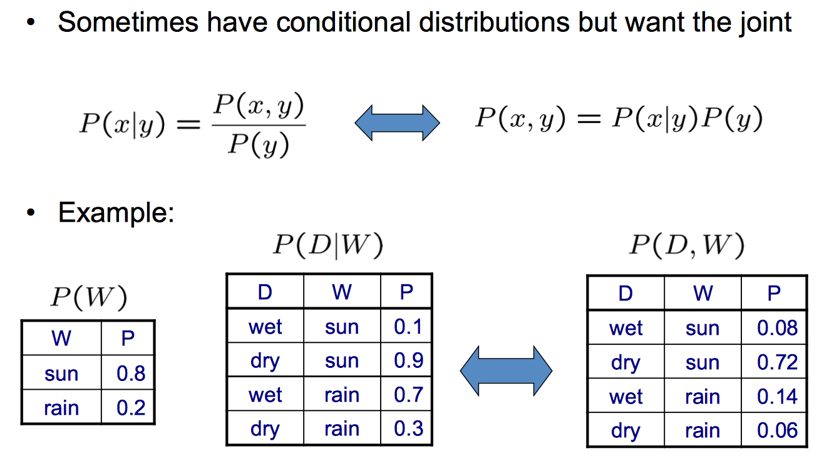
The Product Rule

Slide 15
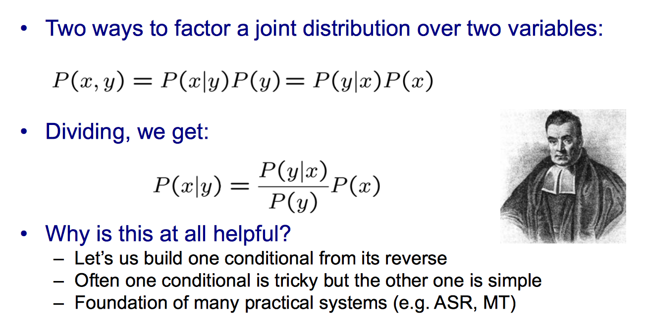
Bayes’ Rule

Slide 16
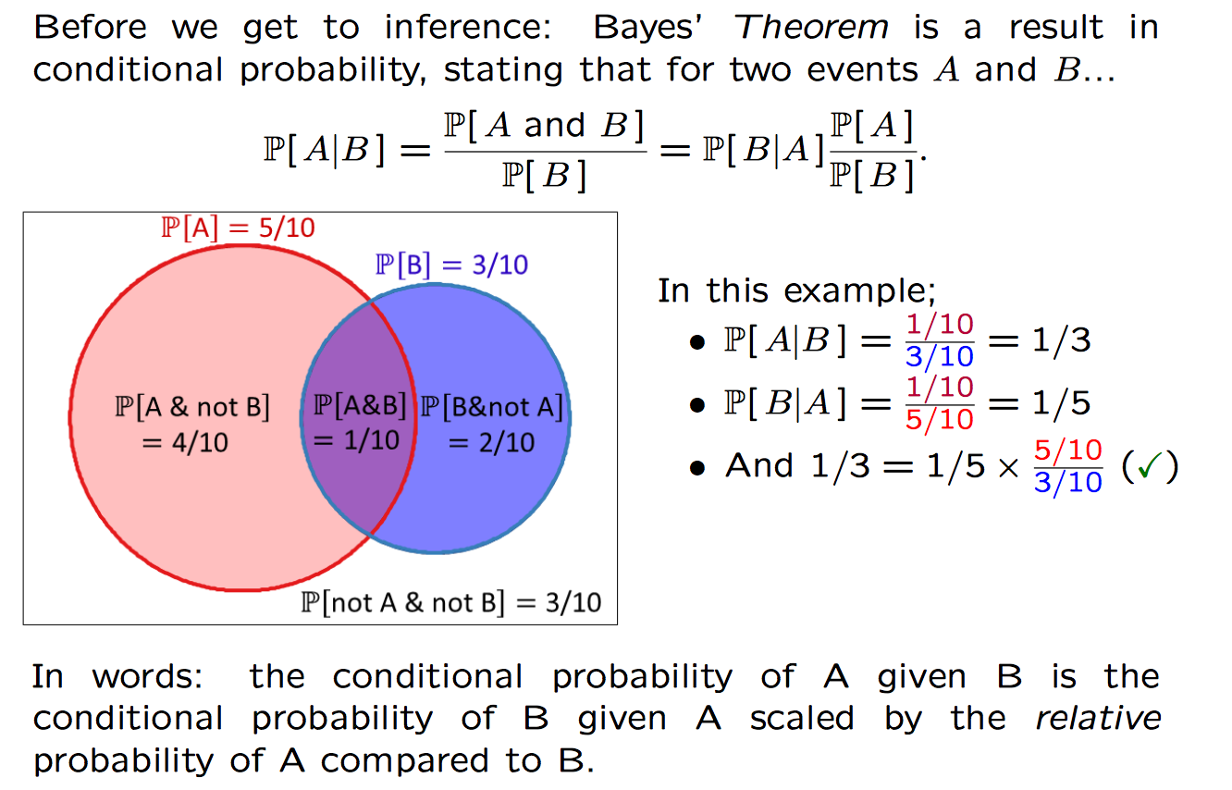
Bayes’ Theorem

Slide 17
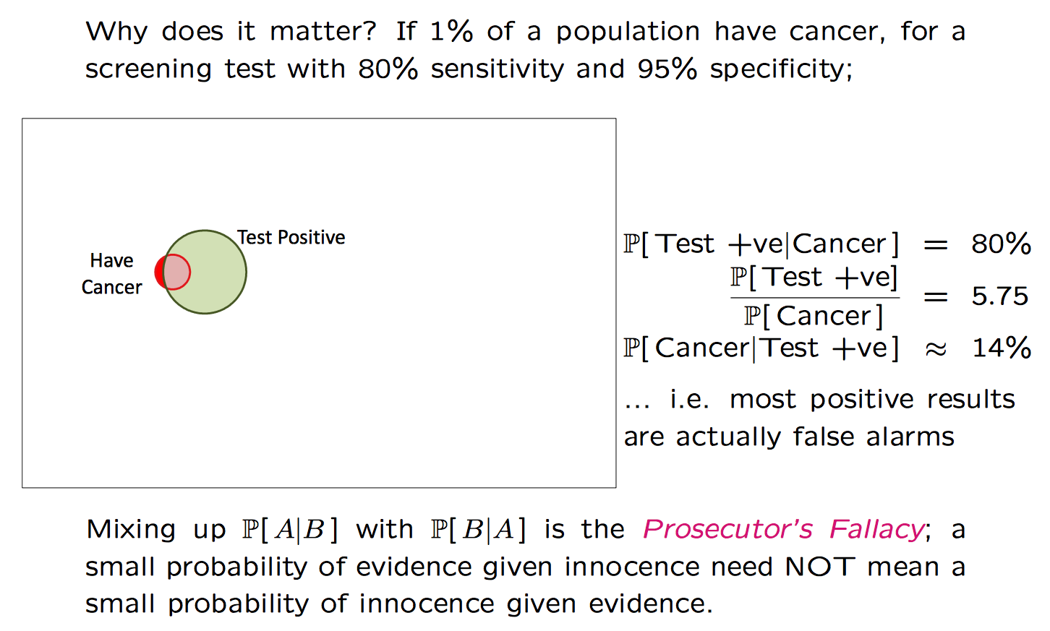
Bayes’ Theorem

Slide 18
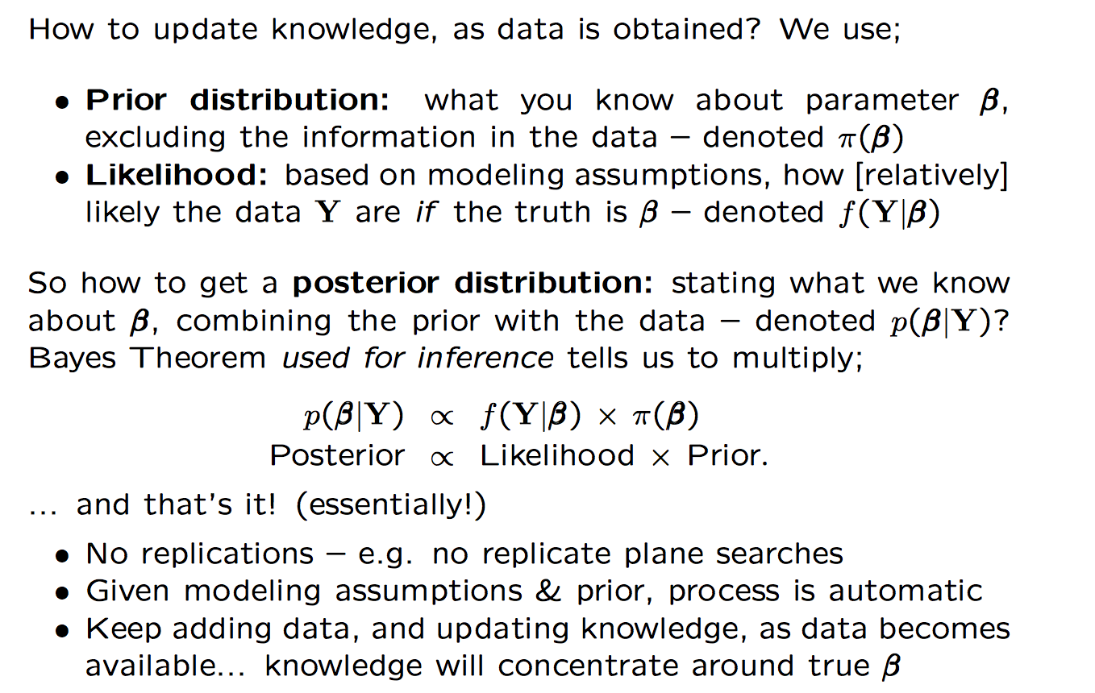
Bayesian Approach

Slide 19
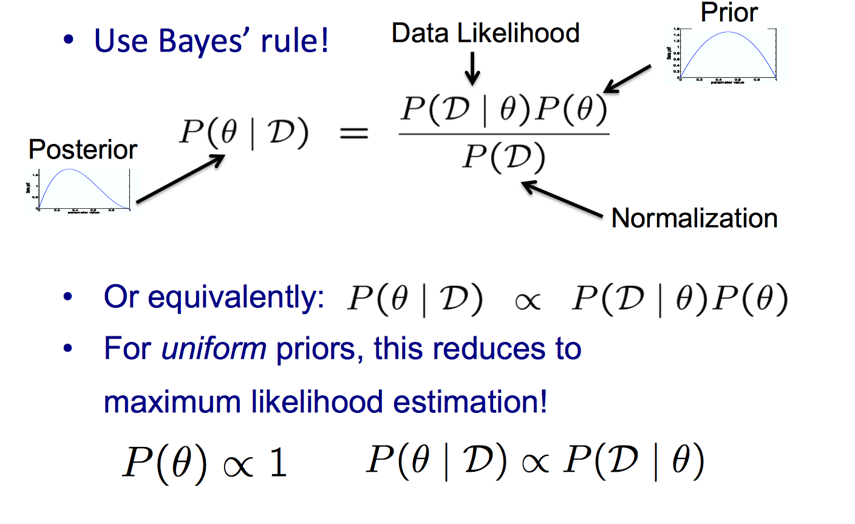
Bayesian Learning

Slide 20
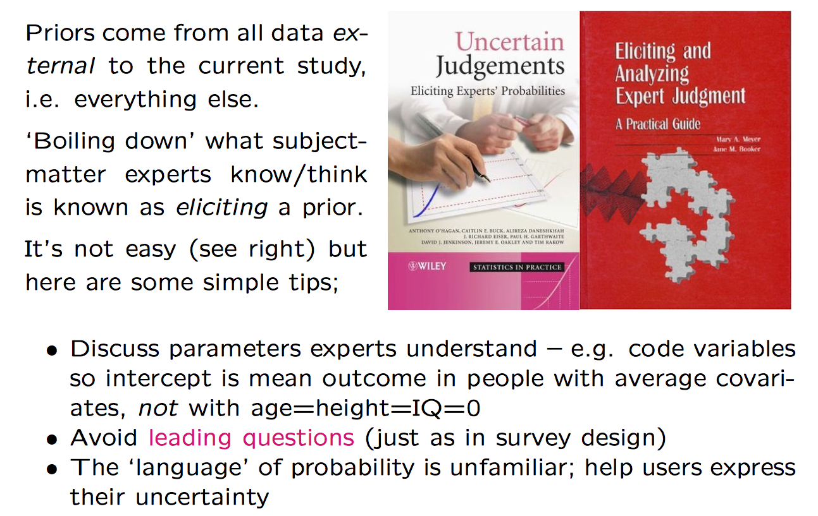
Where do priors come from?

Slide 21
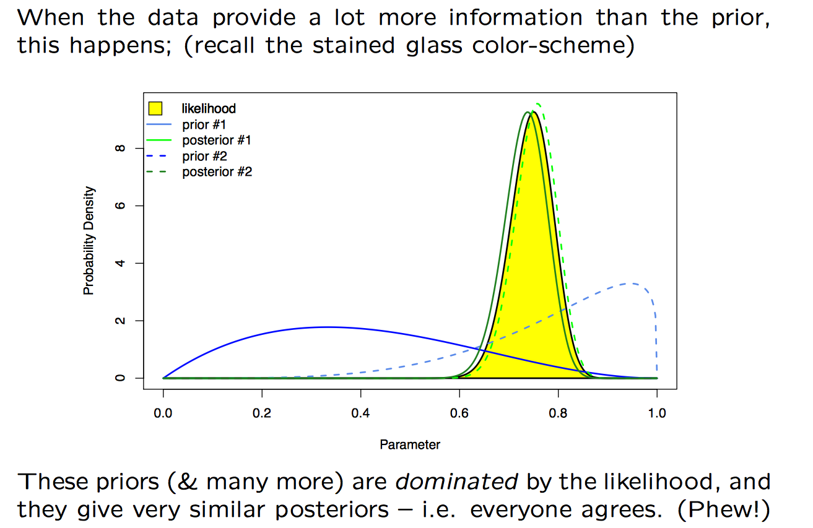
When don’t prior matter (much)?

Slide 22
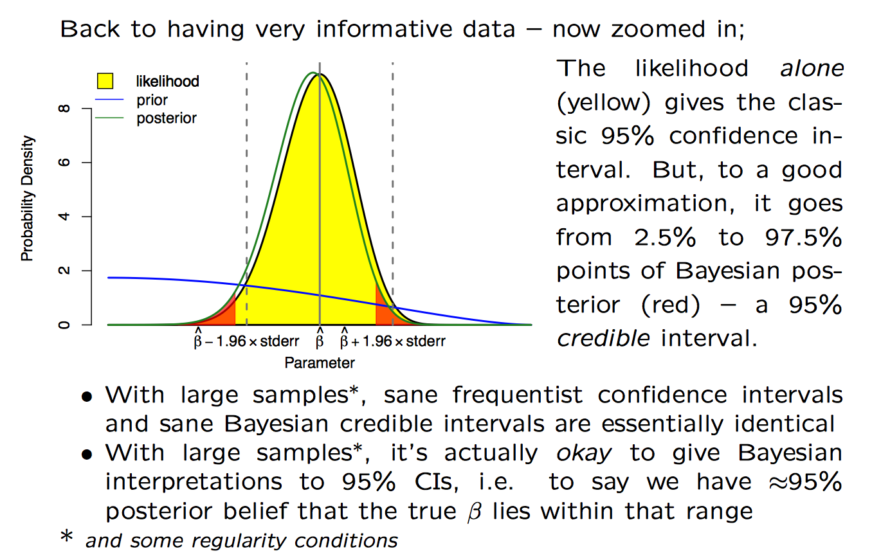
When don’t prior matter (much)?

Slide 23
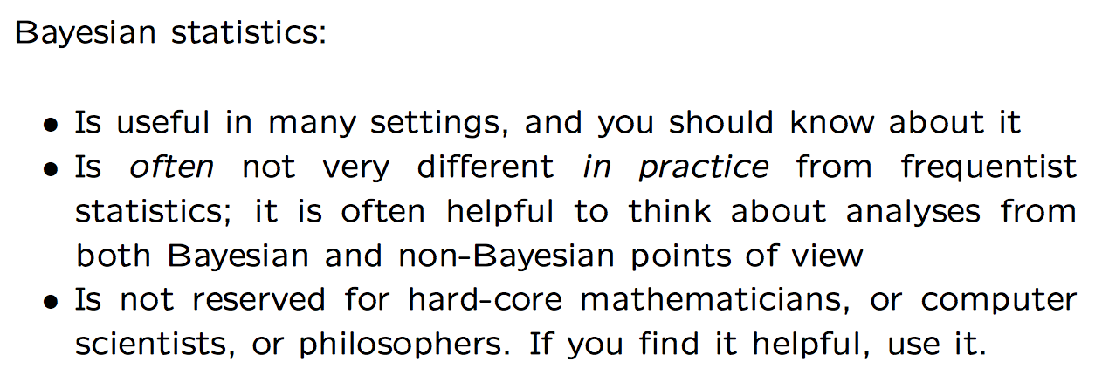
Summary

