Slide 1

BUILDING
Rally Apps
(
)
Extending the Platform
with javascript
Hackathon
Dev Environment
Github + Cloud9 IDE + Rally App Builder

Slide 2
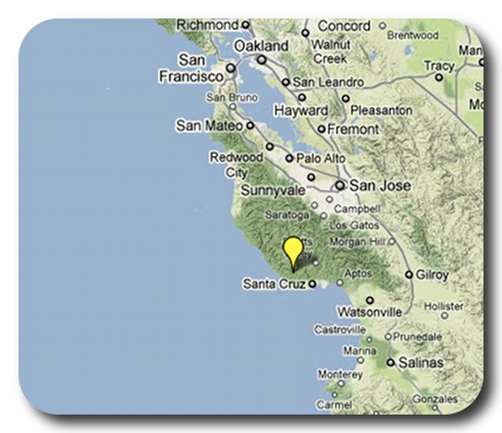
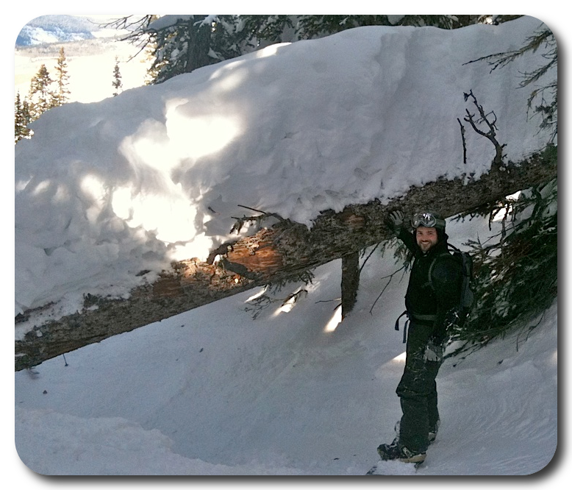
David P Thomas
dthomas@rallydev.com
ME
ABOUT
Notes:
Things that are nice to include in your introduction or things you might think about:
Where are you from?
Where do you work?
A funny Story.
Use some images that show who you are.

Slide 3
Usage:
3+ years
6 Customer Hackathons
2 Internal Hackathons
Tools
GitHub – Online Source Code Repositories
http://github.com
Create this account first if you don’t have one already!
Cloud9 IDE – Online Code Editor
http://c9.io
Login with github credentials; do not create an c9 acct.
Rally App Builder – Create set of files for a Rally App
http://developer.rallydev.com

Slide 4
This slide intentionally left blank
(except for this text)

