Slide 1
Windows PowerShell: Batch Files on Steroids
Doug Hennig
Stonefield Software Inc.

Slide 2


About Me
CTO of Stonefield Software Inc.
More than 40 years experience in IT industry
Author of award-winning Stonefield Query
Author of several books and over 100 articles
15-time Microsoft MVP

Slide 3

Sponsors

Slide 4
Introduction
Can’t automate GUI tasks
BAT files have shortcomings
Windows PowerShell included with Windows 7 and later

Slide 5
Introduction (continued)
Two versions:
“Classic” (5.1 latest version):
Built on .NET framework: Windows only
No longer developed
C:\Windows\System32\WindowsPowerShell\v1.0\PowerShell.exe
PowerShell Core (7.3.4 latest version):
Built on .NET Core: Windows, MacOS, Linux
Not installed by default
C:\Program Files\PowerShell\7\Pwsh.exe

Slide 6
Introduction (continued)
Key things to know:
Based on .NET
Full access to COM and WMI
Interpreted and interactive
Dynamically typed
Everything is an object

Slide 7
What is PowerShell Good For?
Server management
Web server management
Workstation management
Application management
Anything else you want to automate

Slide 8
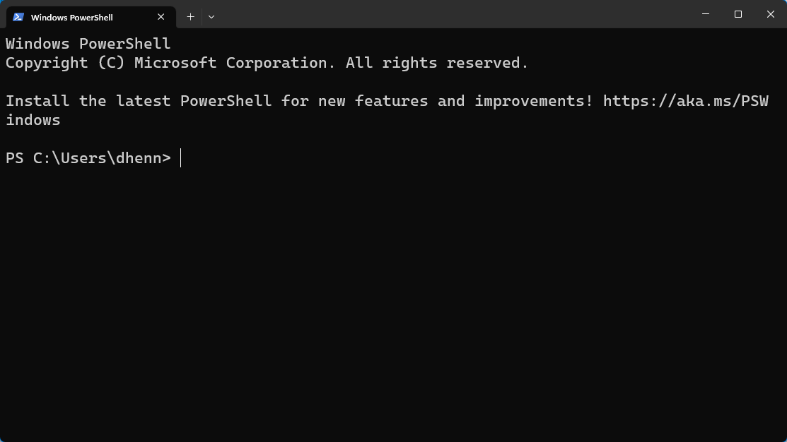
Starting with PowerShell
Windows Start, “powershell” (“powershell 7”)
Type “powershell” (“pwsh”) in address bar
Any cmd.exe command works

Slide 9
Variables
Names:
Start with $
Case-insensitive
Any character except !, @, #, %, &, comma, period, space
Avoid reserved words
Normal convention: camelCase

Slide 10
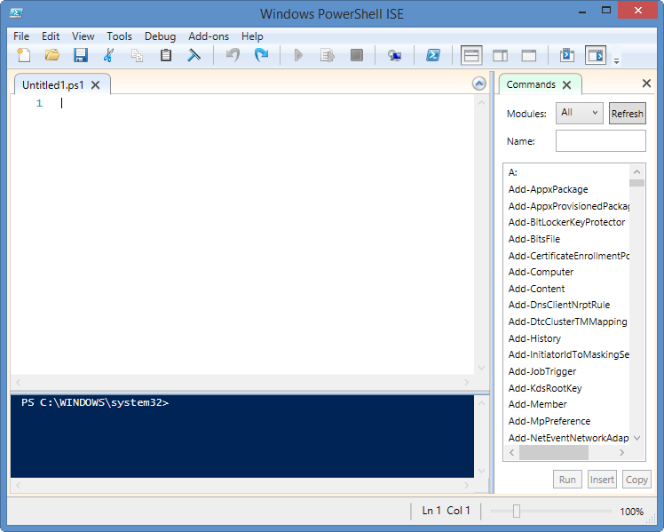
PowerShell ISE
For PowerShell (use VS Code with PS extension for PowerShell Core)
Console pane, script editor, debugger, commands pane, IntelliSense
Launch: edit ps1 file or “powershell_ise” in Windows Explorer address bar
Tab completion handy

Slide 11
Commands
Four types:
Native commands
Cmdlets
Scripts
Functions

Slide 12
Cmdlets
Built-in commands
Verb-noun syntax
Case-insensitive
Aliases

Slide 13
Scripts
ps1 file
Execution policy prevents execution

Slide 14
Functions
function HelloWorld($name)
{
return "Hello, $name"
}

Slide 15
Modules
Scripts (psm1) that provide functions to other scripts
$env:psModulePath shows paths
Import-Module loads a module
Get-Module lists loaded modules
PowerShell Gallery: https://www.powershellgallery.com

Slide 16
Comparison Operators
Comparisons case-insensitive
Use “c” prefix for case-sensitive
Operator | Description
-eq | Equals
-ne | Not equals
-gt | Greater than
-lt | Less than
-ge | Greater than or equals
-le | Less than or equal
-like | Like; you can use “*” as a wildcard character.
-notlike | Not like
-contains | Contains
-notcontains | Does not contain
-in | In a list
-notin | Not in a list

Slide 17
Other Operators
Logical: -not (or !), -and, -or
Assignment operators: =, ++, --, +=

Slide 18
Branching Code
if:
if (some condition)
{
statement(s)
}
elseif (some condition)
{
statement(s)
}
else
{
statement(s)
}

Slide 19
Branching Code (continued)
switch:
switch (expression)
{
value1
{
statement(s)
}
default
{
statement(s)
}
}

Slide 20
Loops
do while/while:
$i = 1
do
{
Write-Host $i
$i++
}
while ($i -le 5)

Slide 21
Loops (continued)
do until:
$i = 1
do
{
Write-Host $i
$i++
}
until ($i -gt 5)

Slide 22
Loops (continued)
for:
for ($i = 1; $i -lt 6; $i++)
{
Write-Host $i
}

Slide 23
Loops (continued)
foreach:
$currFolder = Get-Location
foreach($item in (Get-ChildItem –Path
$currFolder -Recurse -File))
{
$source = $item.DirectoryName + "\" + $item
Write-Host $source
}
break and continue

Slide 24
Error Handling
try/catch/finally
$? contains status of last statement
$Error contains information about error

Slide 25
Pipelining
Use | to send output of one command to input of another
Use $input for pipelined values
Filter removes items ($_ is current item)
e.g. Where-Object acts like WHERE clause in SQL

Slide 26
Working with .NET and COM
New-Object instantiates object
-ArgumentList to pass parameters to ctor
[Class]::Member calls static method
New-Object –ComObject instantiates COM object

Slide 27
Examples
Automating application installation
Backing up files
Backing up SQL Server databases

Slide 28
Resources
GIYF: “how do I <something> in PowerShell”
Microsoft’s PowerShell documentation: https://learn.microsoft.com/en-us/powershell

Slide 29
Summary
Can automate just about anything
Relatively easy to learn
Tons of resources available
Session materials at https://github.com/DougHennig/PowerShell

Slide 30
Doug Hennig Stonefield Software Inc. doug@doughennig.com https://DougHennig.com

