Slide 1

“Plotly” Human prompt to charting and graphing Demo
Example Prompts and Results

Slide 2
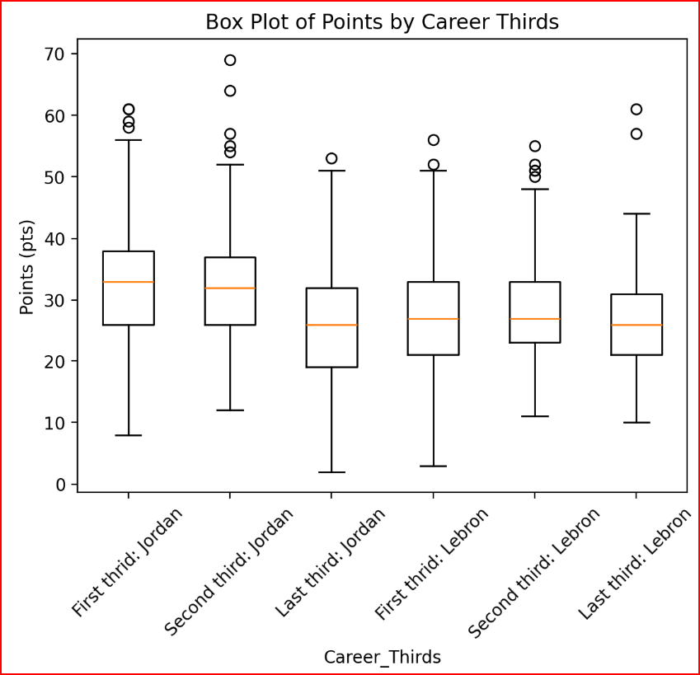
Will Plotly do Box Plots? Jordan versus Labron - NBA
Both played close to 1100 games. Used
1 to 366 as First Third
367 to 734 as Second Third and
> 734 as Last Third

Slide 3

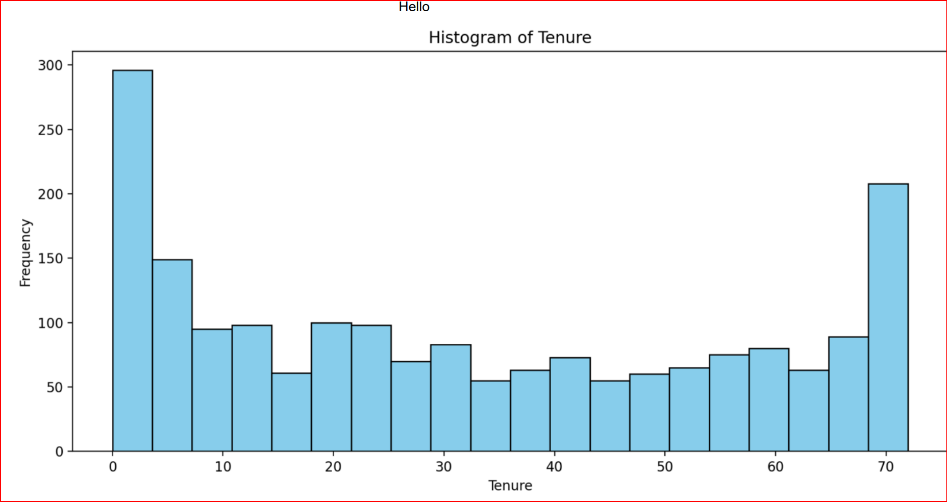
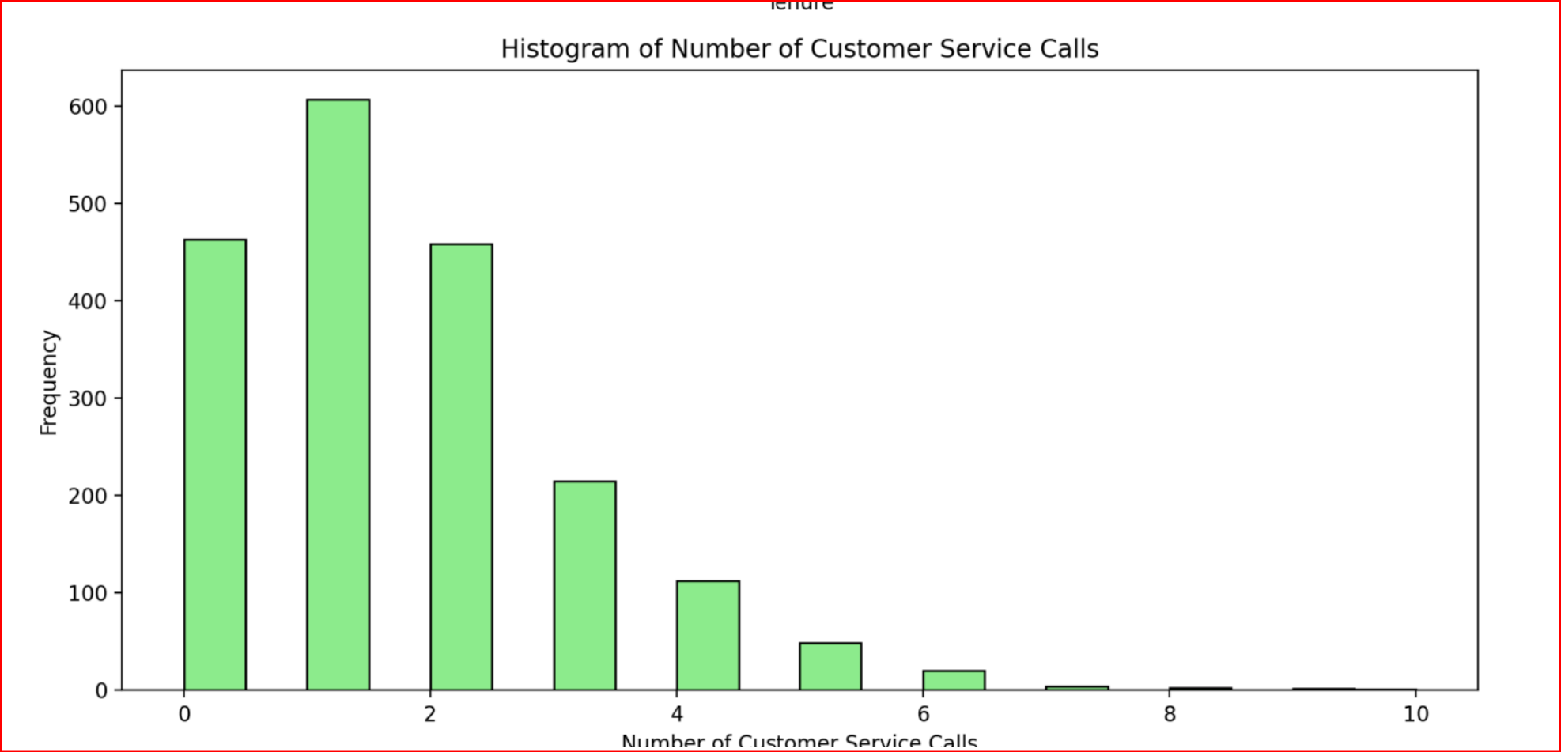
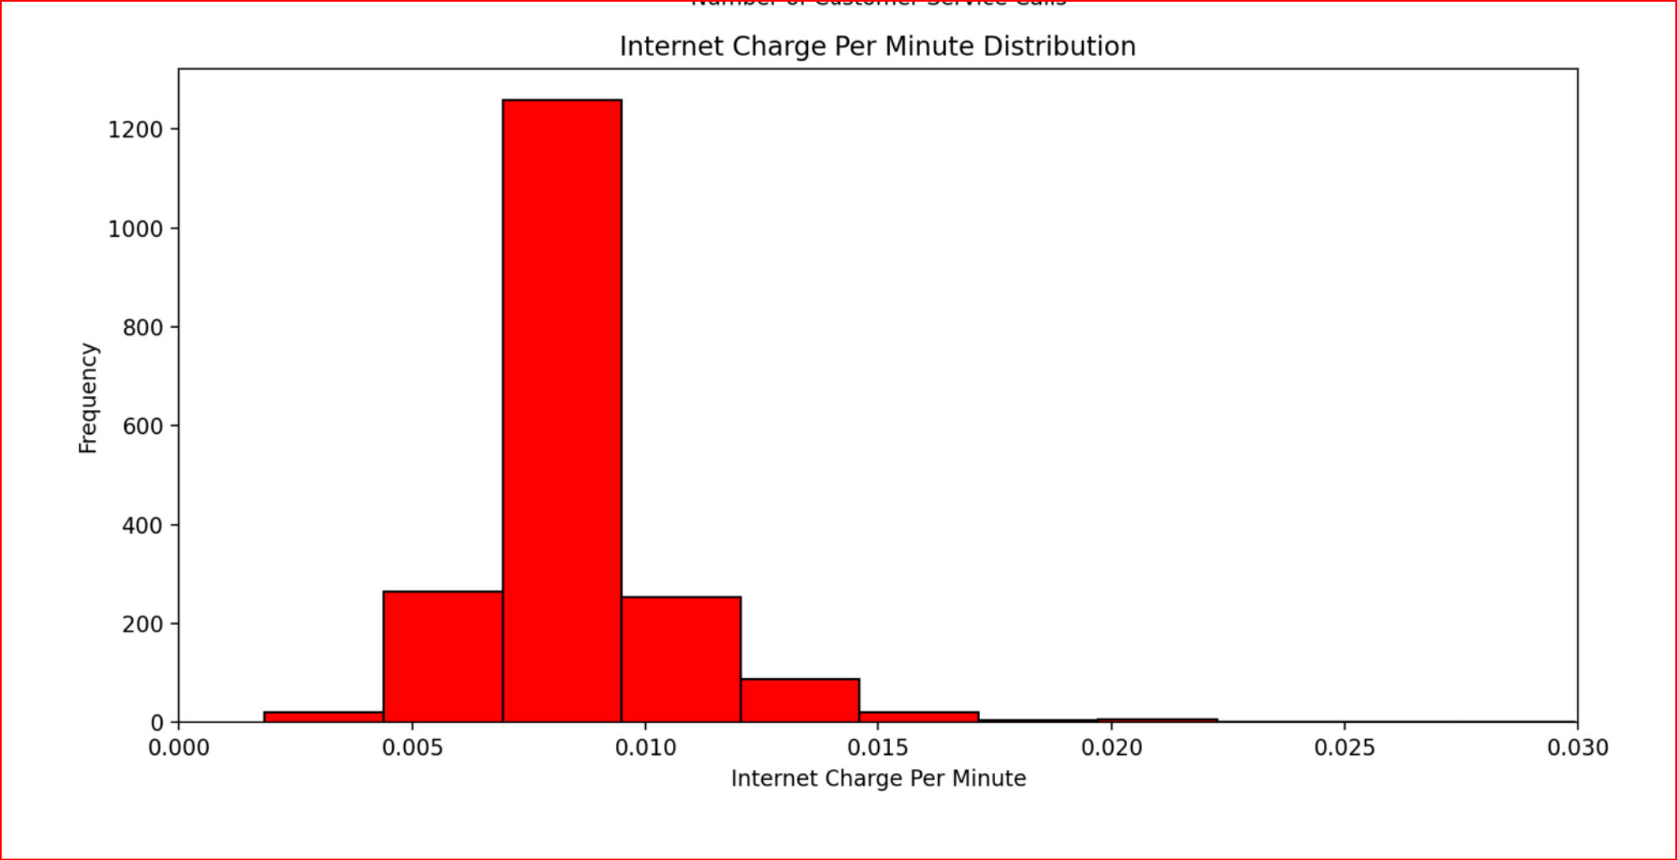
Will multiple requests work? Customer Churn data

Slide 4
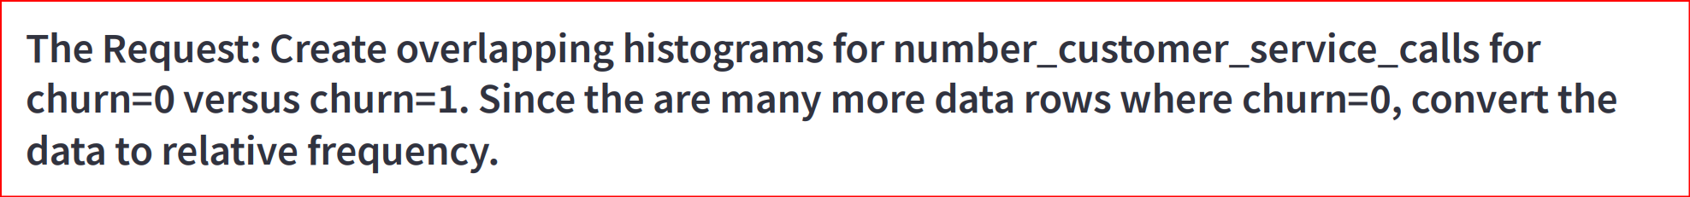
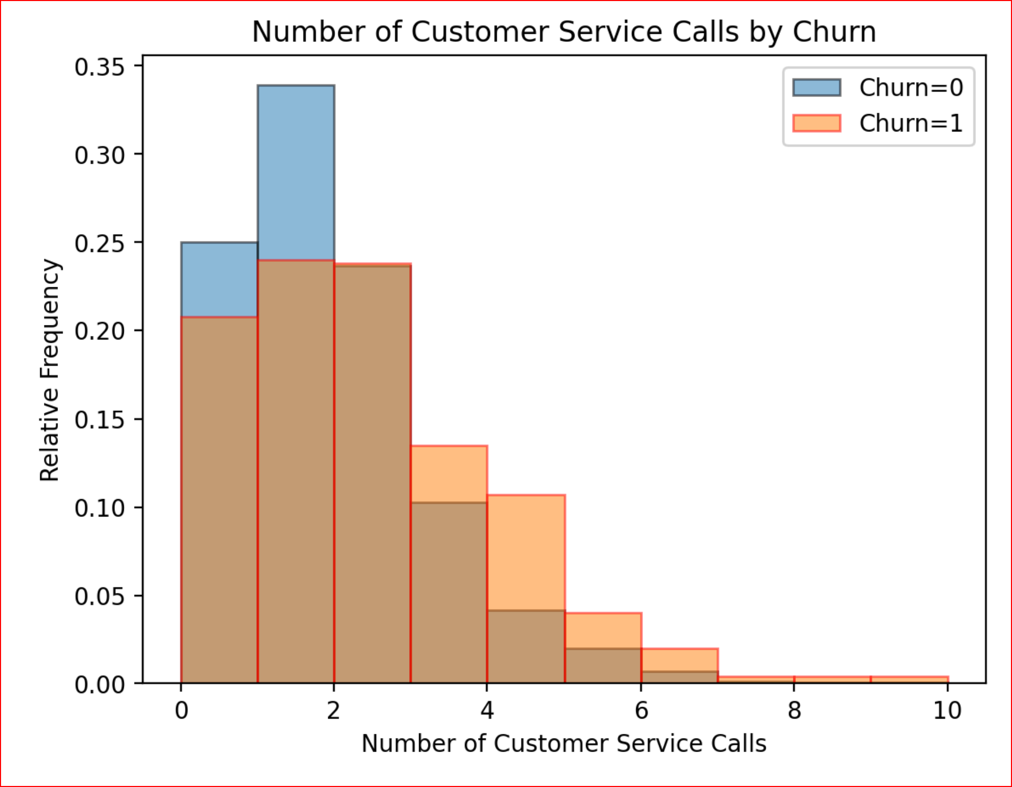
How about histogram, but with relative frequency. Customer Churn data

Slide 5
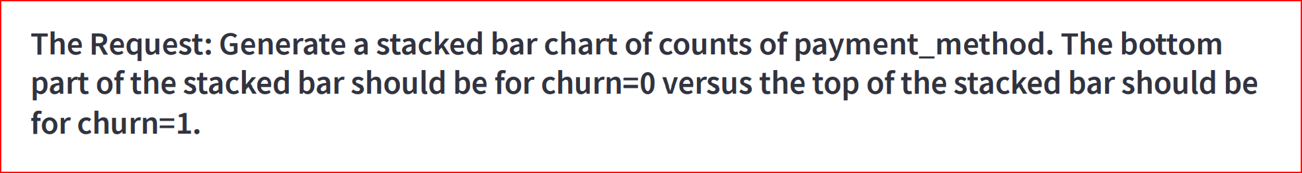
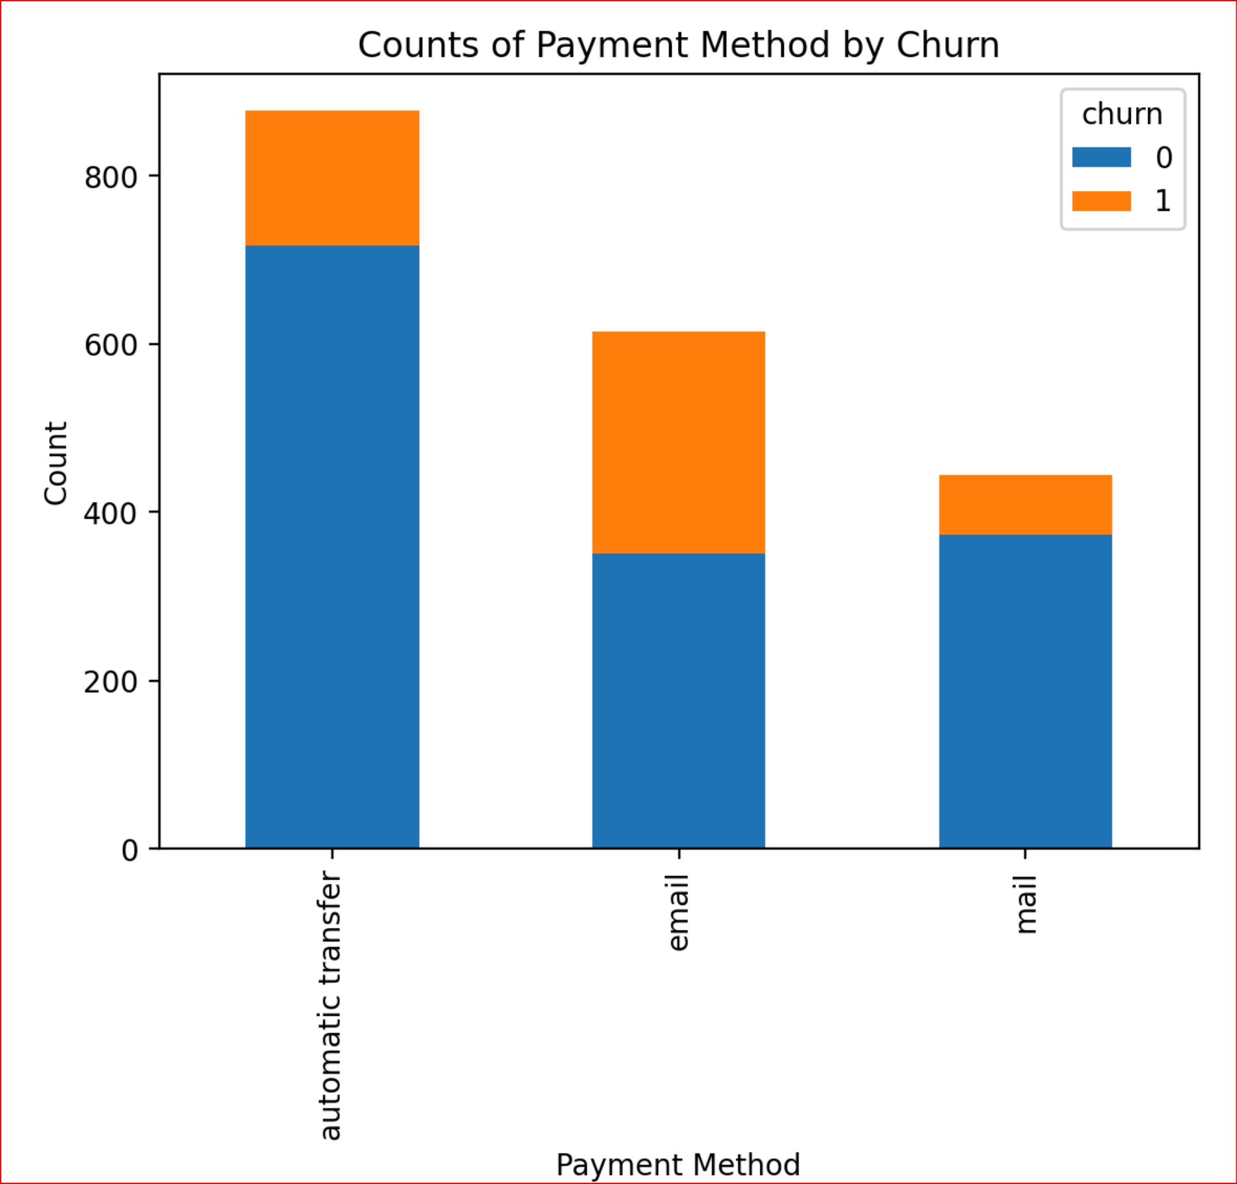
How about Stacked Bar charts?: Customer Churn Data

Slide 6
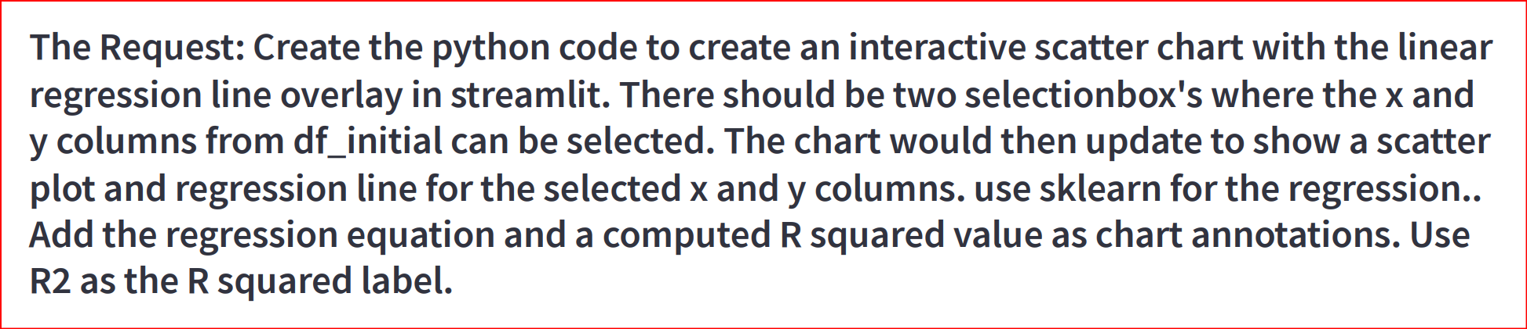
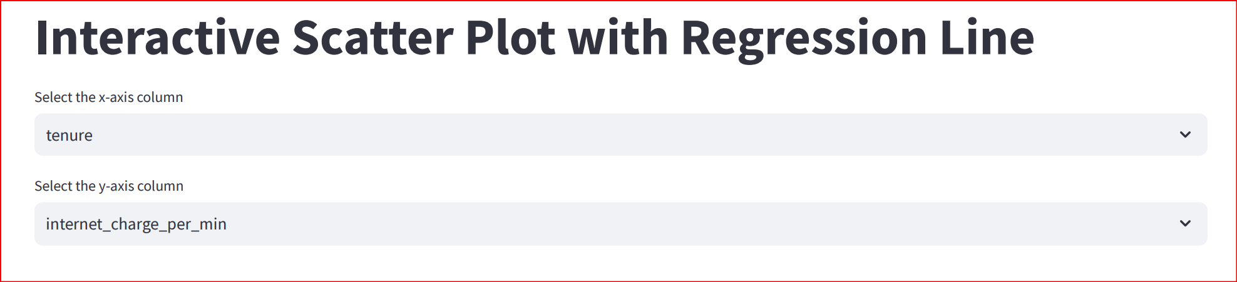
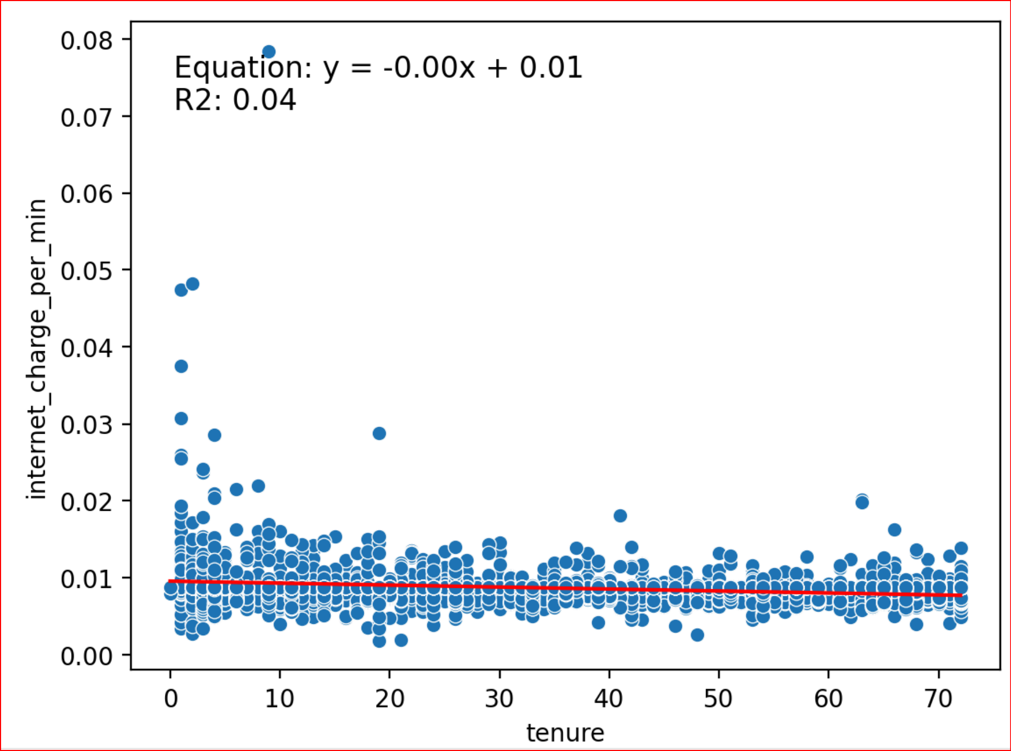
How about Using Selection Boxes to Customize Linear Regression Plots? Customer Churn Data

Slide 7
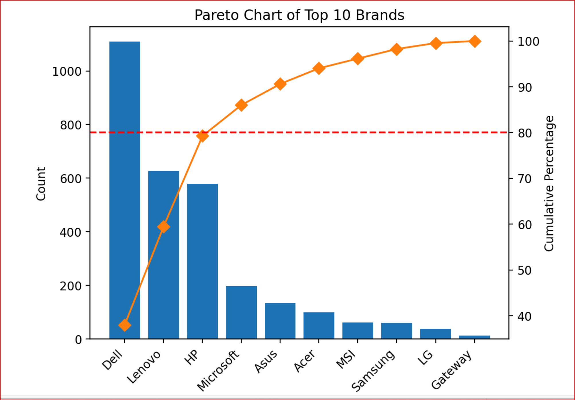
How about Using Selection Boxes to Customize Linear Regression Plots? Laptop Pricing and Sales Data

