Slide 1
Preliminary Investigations into Sparse DNNs
Douglas Hu

Slide 2
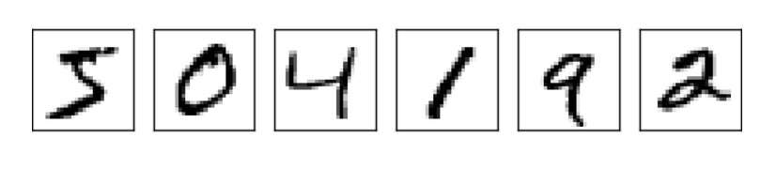
Dataset
MNIST
Images: 28 x 28 = 784 pixels
Digits: 0 – 9
Training data: 50,000
Validation data: 10,000
Test data: 10,000

Slide 3
Neural Network features
Sigmoid neurons
Cross-Entropy cost function
SGD
Backpropagation algorithm
L2 Regularization
I’m trying to keep it simple for the FPGA…

Slide 4
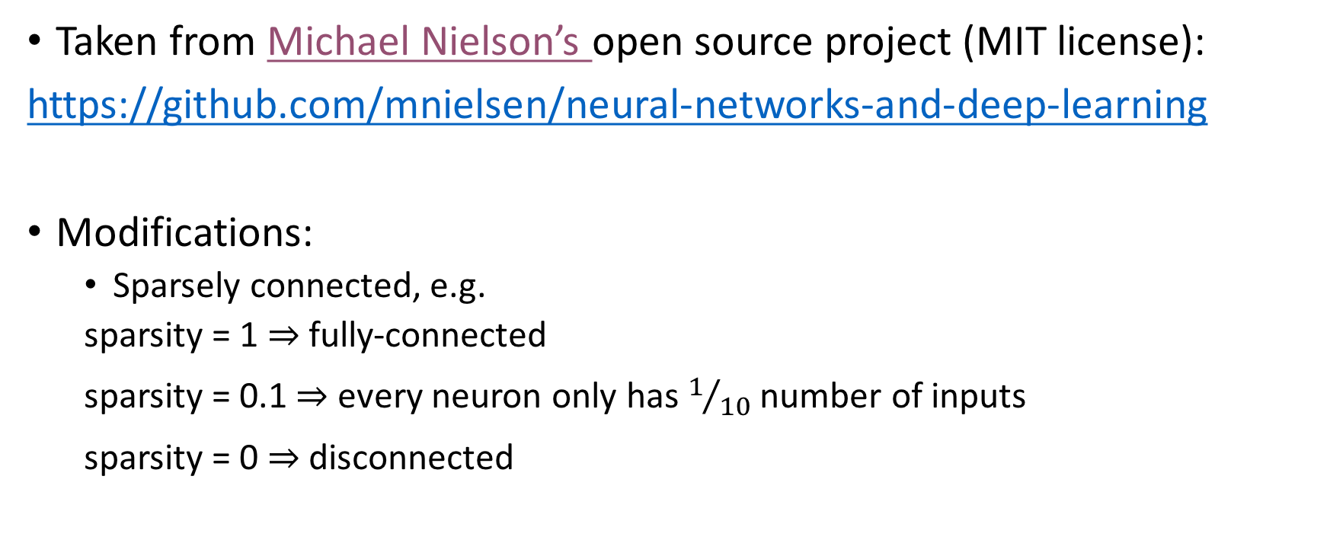
Python implementation
Taken from Michael Nielson’s open source project (MIT license):
https://github.com/mnielsen/neural-networks-and-deep-learning
Modifications:
Sparsely connected, e.g.
sparsity = 1 fully-connected
sparsity = 0.1 every neuron only has $1/{10}$ number of inputs
sparsity = 0 disconnected

Slide 5
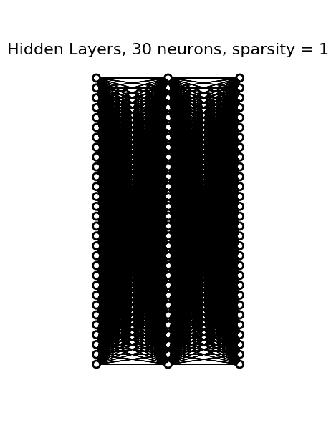
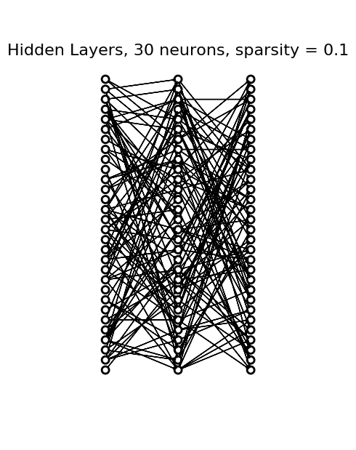


Slide 6
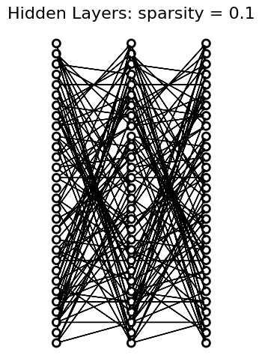
Weight matrix
W₁ W₂

Slide 7

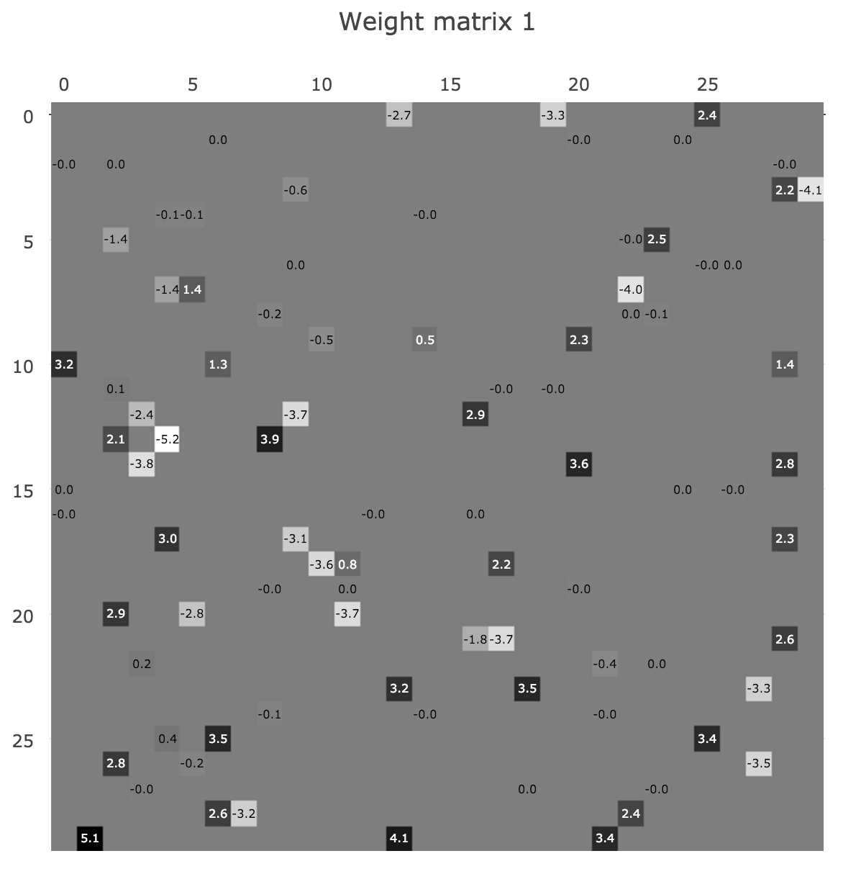
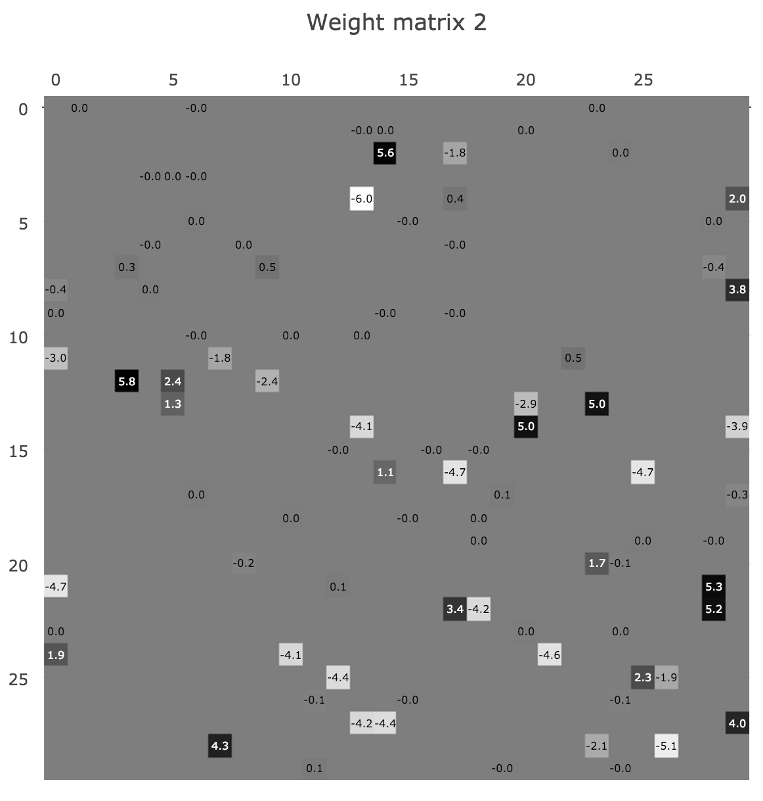
Weight matrix (heatmaps)
Pos
0
Neg
W₁
W₂

Slide 9
Shorthand
30x30
30x30
3x30
3x30
30
30
30
30
30
30

Slide 10
Shorthand (including input & output layers)
784x30
30x30
30x30
30x10
784
30
30
30
10
78x30
3x30
3x30
3x10
784
30
30
30
10

Slide 11
Shorthand (including input & output layers)
2
2
784x30
30x30
30x10
78x30
3x30
3x10
784
30
30
10
784
30
30
10

Slide 12
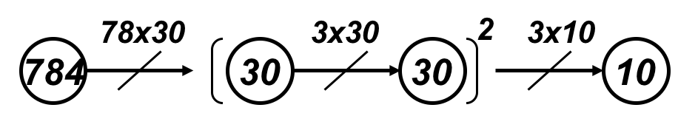






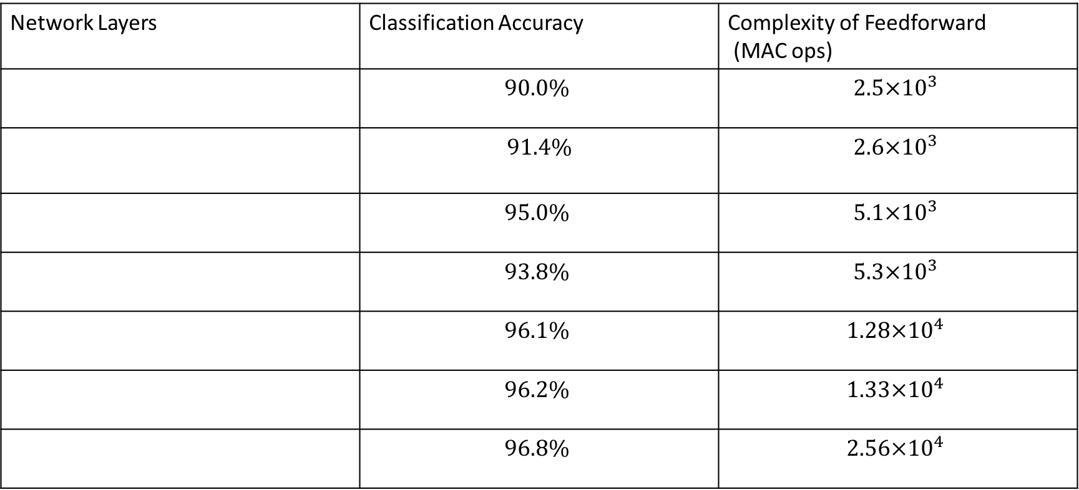
Summary of Results
Network Layers | Classification Accuracy | Complexity of Feedforward (MAC ops)
 | $$90.0\%$$ | $$2.5×{10}^{3}$$
 | $$91.4\%$$ | $$2.6×{10}^{3}$$
 | $$95.0\%$$ | $$5.1×{10}^{3}$$
 | $$93.8\%$$ | $$5.3×{10}^{3}$$
 | $$96.1\%$$ | $$1.28×{10}^{4}$$
 | $$96.2\%$$ | $$1.33×{10}^{4}$$
 | $$96.8\%$$ | $$2.56×{10}^{4}$$

Slide 13
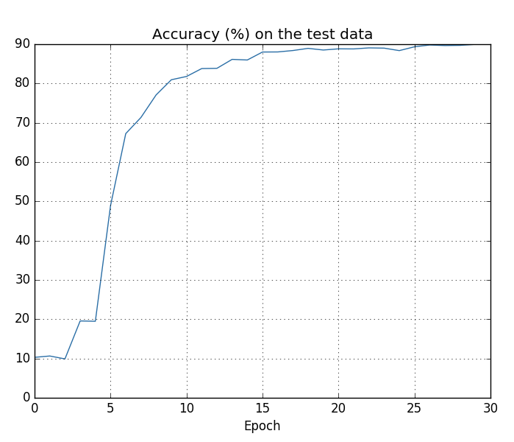
Preliminary investigations
Parameters:
sparsity = 0.1
# neurons/ layer: [784, 30, 30, 30, 10]
mini-batch size*: 10
epochs*: 30
*taken from Nielson’s tutorial

Slide 14
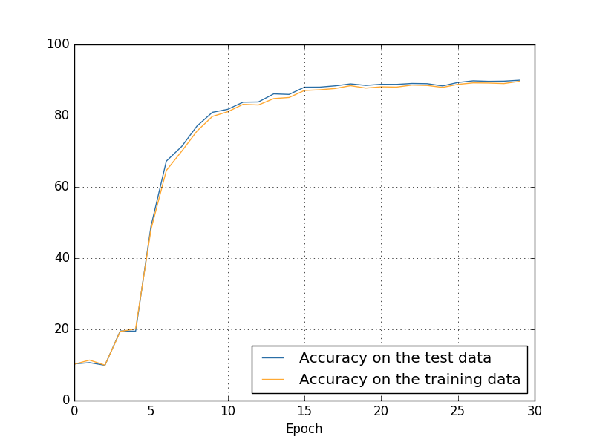
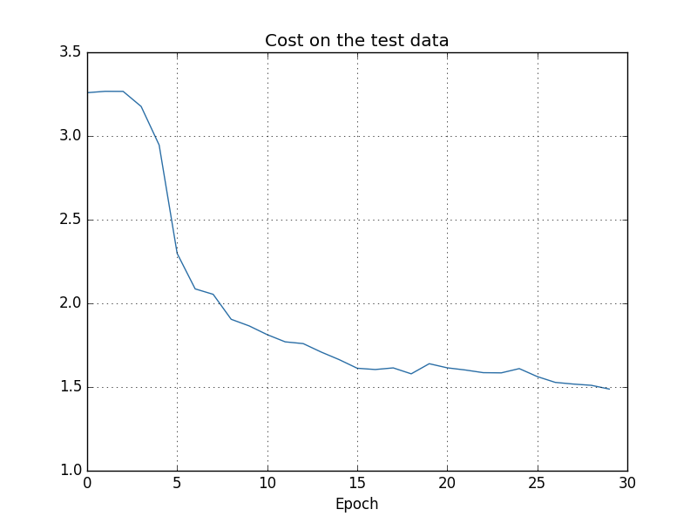
Not overfitting

Slide 15
Performance comparison
Sparsity = 0.1
Sparsity = 1

Slide 16
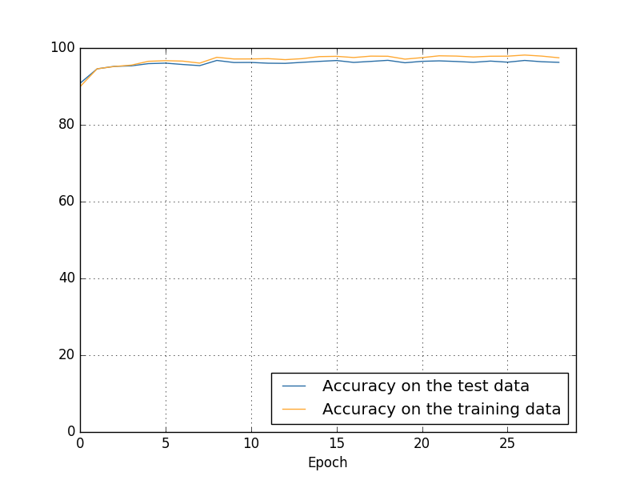
Performance comparison
Sparsity = 0.1, 90.0% accuracy
Sparsity = 1, 96.8% accuracy

Slide 17
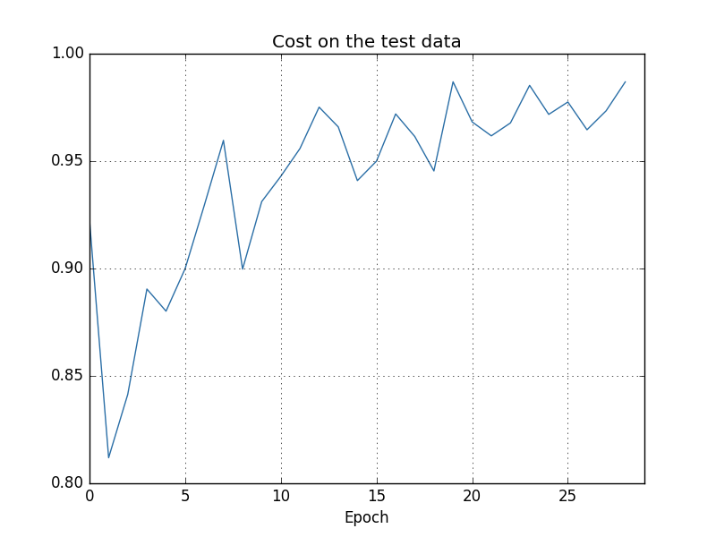
Performance comparison
Sparsity = 0.1
Sparsity = 1

Slide 18
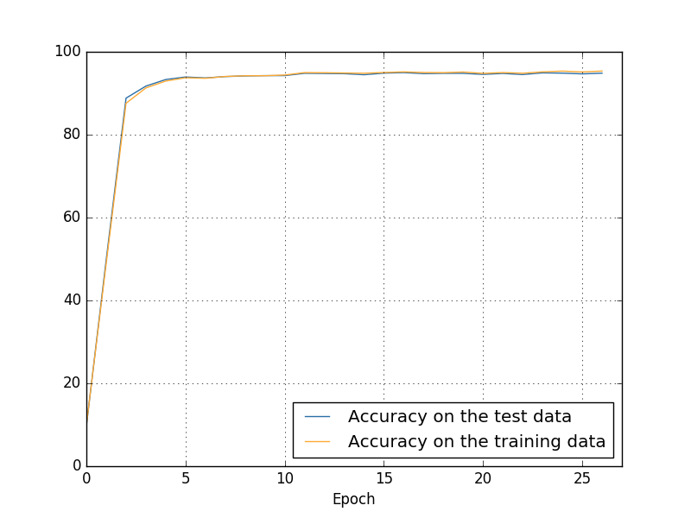
Performance comparison
Sparsity = 0.2, 95.0% accuracy
Sparsity = 1, 96.8% accuracy

Slide 19
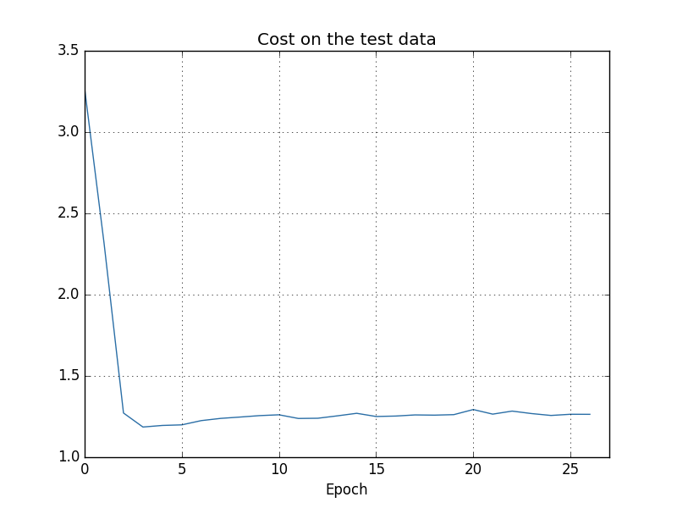
Performance comparison
Sparsity = 0.2
Sparsity = 1

Slide 20
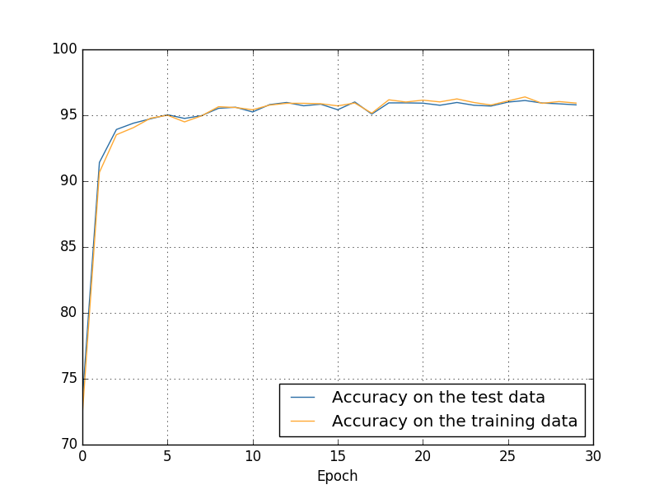
Performance comparison
Sparsity = 0.5, 96.1% accuracy
Sparsity = 1, 96.8% accuracy

Slide 21
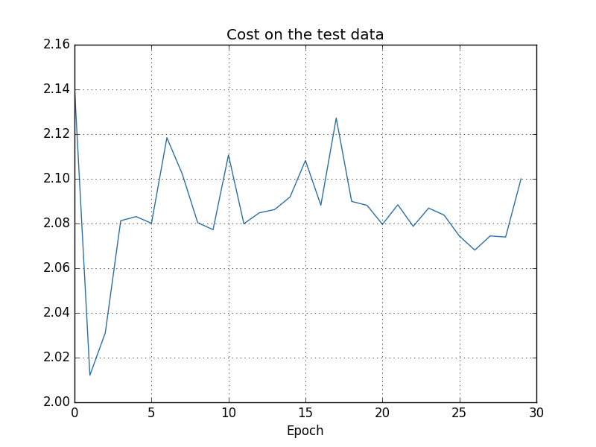
Performance comparison
Sparsity = 0.5
Sparsity = 1

Slide 22
Deeper networks, Sparsity = 0.5
4 Hidden Layers
3 Hidden Layers

Slide 23
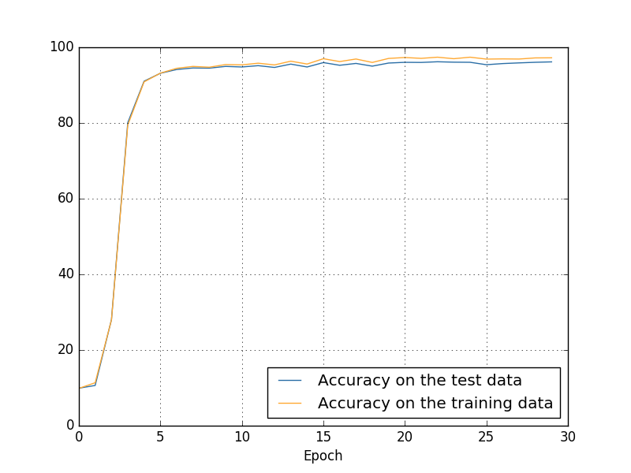
Deeper networks, Sparsity = 0.5
4 Hidden Layers, 96.18% accuracy
3 Hidden Layers, 96.10% accuracy

Slide 24
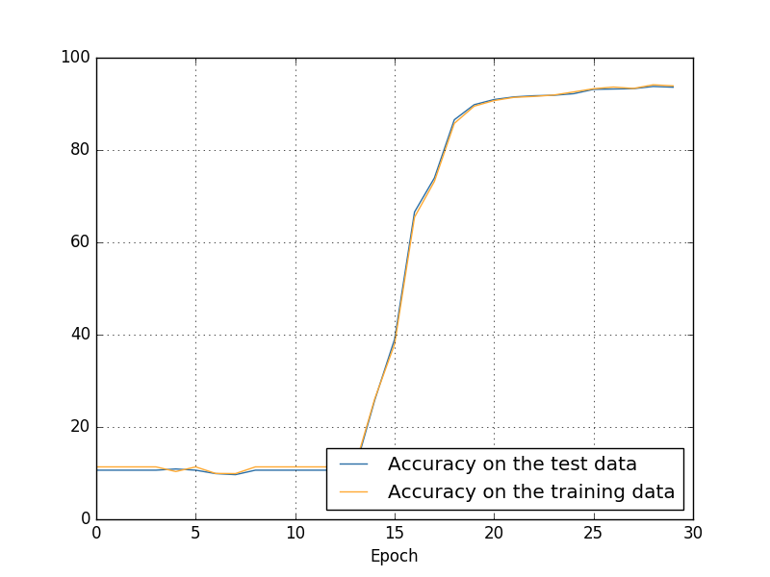
Deeper networks, Sparsity = 0.2
4 Hidden Layers, 93.77% accuracy
3 Hidden Layers, 95.0% accuracy

Slide 25
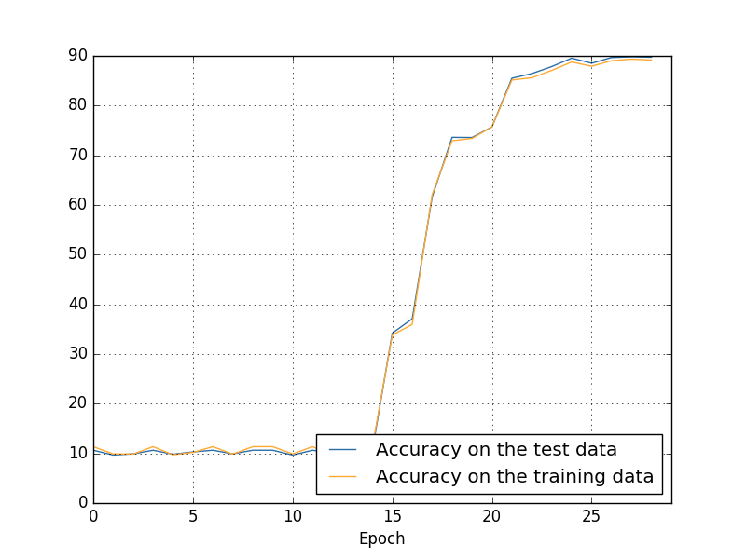
Deeper networks, Sparsity = 0.1
4 Hidden Layers, 91.38% accuracy*
3 Hidden Layers, 96.8% accuracy
*Mini-batch size = 1 (online learning)

Slide 26
Doug’s Action Items
Priorities:
Instead of randomly choosing adjacency matrix, randomly choose a Cyclic Permutation Matrix
See IEEE LDPC Structure (Chugg, DNN Hardware Acceleration, Slide 16)
Plot histograms of trained weights – Is it Gaussian? What variance?
Investigate: theoretically, what properties of adjacency matrices are required to be a universal approximator?
Reach goals:
Investigate: can we counteract vanishing gradient by making earlier layers more sparse than later layers? Different densities at each layer

