Slide 1

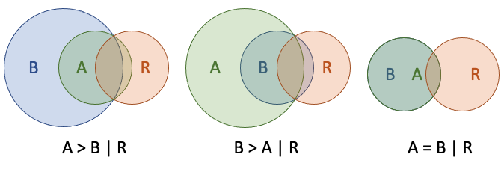
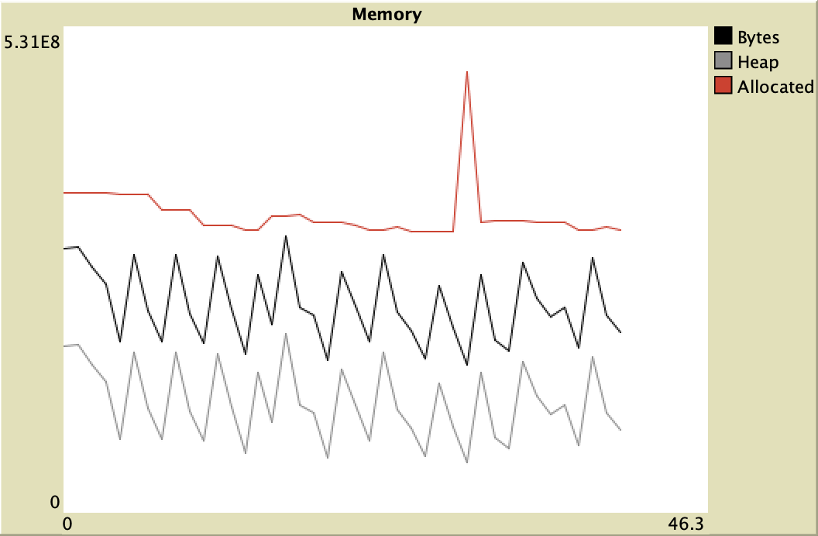
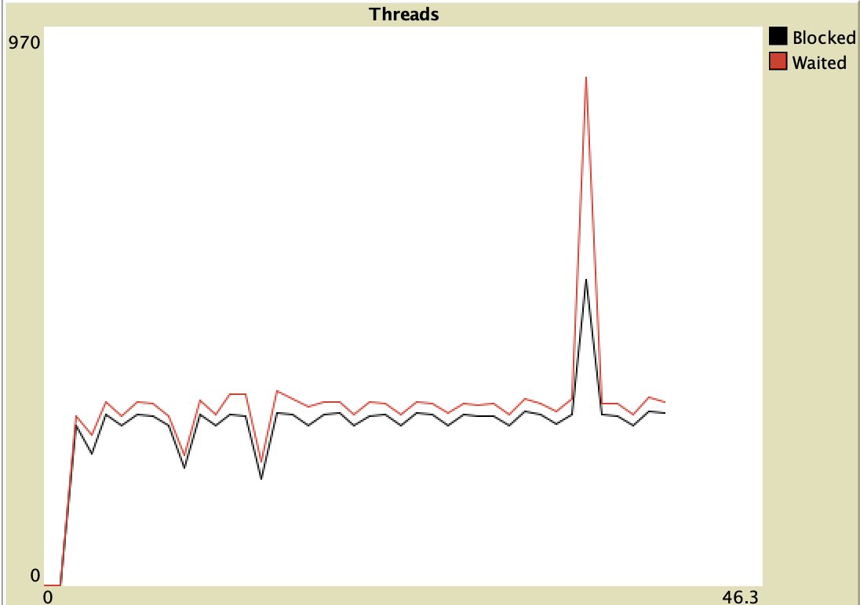
Four Netlogo extensions
Publicly available Netlogo extensions that provide a case-base reasoning framework, table look up with categorical variables, access to the precision Java math library and programmatically accessing real time information about the underlying virtual machine.
Doug Salt¹, Gary Polhill¹, Gordon Stephen2, Ben Mccormick³
¹The James Hutton Institute, address of site, Aberdeen or Dundee
Email: doug.salt@hutton.ac.uk
Introduction
This poster describes four extensions to Netlogo. All four
are available in Netlogo's extensions tab; run on Windows, OSX and
Linux, and have publicly accessible repositories in which there is
extensive documentation and worked examples. The extensions are cbr, an
extension that implements a framework for case-based reasoning; lkt, a table
extension that uses categorical variables to predicate outcomes; math which
provides direct programmatic access to the Java math library in order to
obviate cumulative, transitive mathematical imprecision, and mgr can interrogate programmatically the Java virtual machine.
The case based reasoner, cbr provides a framework to create a case base,
consisting of a series of cases, each containing of a series of conditions, a
decision and an outcome. This case base is then consulted for the best matches
a given set of conditions and the decision. This is done by a "distance"
function, a default version of which is provided, based on common Netlogo data
types. This function may be overwritten if required. This extension provides
ageing, collision avoidance, ranking and deletion of individual cases.
The look up extension, lkt allows the definition of categorical variables
using a "tree" definition file and a data file using these variables to
predicate outcomes in a tabular form.
The math extension has muliple zero arity functions, single argument and double
arity functions for precision maths. These include direct calls to Java's math
library for repeated arithmetic operations and trigonometric functions. The
latter correctly orientate to zero (not North) and use radians.
Lastly there is the mgr extension which allows access to statistics on thread
and memory usage in the underlying java virtual machine, allowing the
real-time inspection of heap, allocated and total memory, access to statistics
about the number of threads and their state and finally how much CPU time is
being used.
My flat is an an absolute mess at t. I
My flat is an an absolute mess at the nt. I
cbr
Normally a case base consists of a series of cases, each of these cases consist of
state
decision/activity
outcome
The state can be anything such as the bank balance of the agent. The decision/activity might be to install central heating. The outcome might be straight forwardly yes or no. It might be probability, or it might some arbitrary decision/activity metric for use elsewhere.
A state and decision/activity are presented to the case base. The case base is searched for the closest match (if there is one) and the outcome of that match is given.
A NetLogo case consists of a state in any of the standard Netlogo variables, such as list, number, string, etc. This is strictly defined by the `cbr:lambda` which is the comparator program used to determine the "distance" the three cases:
case A
case B
referent case R
are relative to ecah other. That is, if:
the case A is 'closer' to the referent case R than the case B using `cbr:lamda` to the referent case R then `cbr:lt` is returned
the case B is 'closer' to the referent case R than the case A using `cbr:lamda` to the referent case R then `cbr:gt` is returned
the case B is 'same distance' to the referent case R than the case A using `cbr:lamda` to the referent case R then `cbr:eq` is returned
the case B is 'closer' using `cbr:lamda` to the referent case R then `cbr:lt` is returned
The `cbr:lamda` is then used by `cbr:match` or `cbr:matches` to determine a single closest match of a "hypothetical" case that is presented to `cbr:match` or more or one equally close matches if `cbr:matches` is used. The case will consists of a state and decison and returning the 'best match' base on the repeated use of `cbr:lamda` to determine which is the closest match. If the match does not meet a suitable criterion then `cbr:incmp` is returned.
When using `cbr:match`, then if there are more than one match then the case with the highest rank is returned, or failing that the oldest. If both these conditions are equal then the result is a random selection from among those cases. More than one case may be returned if `cbr:matches` is used.
If no `cbr:lamba` is provided then a default lambda is used.
Sub Head
Body Copy
lkt
Body Copy
Sub Head
Player_1 | Player_2 | Outcome
--------- ---------- --------
Rock | Rock | 0
Rock | Paper | 2
Paper | Rock | 1
Rock | Scissors | 1
Scissors | Rock | 2
Scissors | Scissors | 0
Paper | Scissors | 2
Scissors | Paper | 1
Paper | Paper | 0
```
This is two players, `Player_1` and `Player_2` playing the game rock, paper, scissors.
So the dimensions are `Player_1` and `Player_2`. These dimensions may only
contain the values `Rock`, `Paper` and `Scissors` and the outcomes are
+ 0 - nobody wins
+ 1 - Player_1 wins
+ 2 - Player_2 wins.
Thus to implement a look up table we must have two files. First a file is
required that defines the dimensions and the allowable values for those
dimensions. We denote this the tree file. The second files, denoted the data
file, is a tab delimited file using these dimension with the last column of
such a file predicating the outcome from the previous dimension values.
The dimensions are defined by in the tree file like the following.
```
group_name_1 (group)
dimension_1 (dimension)
dimension_1_value_1 (value)
dimension_1_value_2
...
dimension_2
dimension_2_value_1
dimension_2_value_2
...
...
group_name_2
dimension_3_value_1
...
...
```
This is a tree with the topmost node at the top of the file and the dimensions
represent additional layers to the tree, with the symbols that make up those
layers forming the nodes or branches of the tree.
And the data file would look similar to the following:
```
| Dimension_1 | Dimension_2 | Dimension_3 | Outcome |
--------------------- --------------------- --------------------- -----------
| dimension_1_value_1 | dimension_2_value_1 | dimension_3_value_1 | outcome_1 |
| dimension_1_value_2 | dimension_2_value_1 | dimension_3_value_1 | outcome_2 |
| dimension_1_value_1 | dimension_2_value_2 | dimension_3_value_1 | outcome_3 |
. . . .
. . . .
. . . .
```
There is one reserved character which is the "*" character allowing the mapping
of defaults. This must appear in both the input and the data file of the tree.
## HOW IT WORKS
This is a reference program to show a simple implementation of the `lkt` extension
If the "Test" button is selected and no error messages are displayed then the extension is working as expected.
## HOW TO USE IT
The extensions has the following primitives.
1. new
2. dimensions
3. first-dimension
4. get-dimension
5. more-dimensions?
6. symbols
7. first-symbol
8. get-symbol
9. more-symbols?
10. get
11. states
12. first-state
13. get-state
14. more-states?
15. group
16. set
17. default
My flat is an an absolute mess at the moment. I
My flat is an an absolute mess at the moment. I
math
Body Copy
Sub Head
## Zero argument commands
+ `e` -- return the nearest double-precision floating-point number to the base of natural logarithms
+ `pi` -- return the nearest double-precision floating-point number to _pi_
+ `random` -- return a random number in the range [0, 1[
## One argument commands
+ `abs` -- return the absolute value of the argument
+ `acos` -- return the arc cosine of the argument in the range [0, _pi_]
+ `asin` -- return the arc sine of the argument in the range [- _pi_ / 2, _pi_ / 2]
+ `atan` -- return the arc tangent of the argument in the range [- _pi_ / 2, _pi_ / 2]
+ `cbrt` -- return the cube root of the argument
+ `ceil` -- return the smallest integer (as a double) greater than or equal to the argument
+ `cos` -- return the cosine of the argument (in radians)
+ `cosh` -- return the hyperbolic cosine of the argument
+ `decrement-exact` -- decrement the integer argument (by one), throwing an exception on integer underflow
+ `exp` -- return the base of natural logarithm raised to the power of the argument
+ `expm1` -- return one less than the base of the natural argument raised to the power of the argument
+ `floor` -- return the largest integer (as a double) less than or equal to the argument
+ `get-exponent` -- return the exponent of the (double) argument (an integer)
+ `increment-exact` -- increment the integer argument (by one), throwing an exception on integer overflow
+ `log` -- return the logarithm (base _e_) of the argument
+ `log10` -- return the logarithm (base 10) of the argument
+ `log1p` -- return the logarithm (base _e_) of the argument + 1
+ `negate-exact` -- return the (integer) negation of the (integer) argument, throwing an exception on overflow
+ `next-down` -- return the next double-precision floating-point number after the argument in the direction of negative infinity
+ `next-up` -- return the next double-precision floating-point number after the argument in the direction of positive infinity
+ `rint` -- return the (double) integer closest to the argument
+ `round` -- return the closest `int` to the argument (which is cast to a `float` first)
+ `signum` -- return the sign of the argument in {0, -1, 1} (as doubles), for {zero, negative, positive} numbers respectively
+ `sin` -- return the sine of the argument (in radians)
+ `sinh` -- return the hyperbolic sine of the argument
+ `sqrt` -- return the square root of the argument
+ `tan` -- return the tangent of the argument (in radians)
+ `tanh` -- return the hyperbolic tangent of the argument
+ `to-degrees` -- convert the argument (in radians) to degrees
+ `to-int-exact` -- convert the argument to an integer, throwing an exection on overflow (calls `round` without casting to `float`, returning a `long`, which is then converted to an integer)
+ `to-radians` -- convert the argument (in degrees) to radians
+ `ulp` -- returns the size of the 'units in the last place' of the argument
mgr
Body Copy
Commands
mgr:mem` The total amount of (heap and non-heap) memory used, in bytes.
mgr:mem-p` The amount of heap and non-heap memory used as a proportion of the amount allocated.
mgr:mem-pct-str` A string reporting `mgr:mem-p` as an integer percentage (ending with a "%" character).
mgr:heap-used` Amount of heap memory used (in bytes). Heap memory is the memory allocated by the JVM to storage of Java objects.
mgr:non-heap-used` Amount of non-heap memory used. 'Non-heap' memory is memory allocated by the JVM for classes and metadata.
mgr:heap-alloc` Amount of heap memory allocated ('committed' in Java jargon). See [Java documentation](https://docs.oracle.com/javase/8/docs/api/java/lang/management/MemoryUsage.html) for more information.
mgr:non-heap-alloc` Amount of non-heap memory allocated.
mgr:heap-init` Initial amount of heap memory the JVM requested from the operating system. (May be undefined.)
mgr:non-heap-init` Initial amount of non-heap memory the JVM requested from the operating system. (May be undefined.)
mgr:heap-max` Maximum amount of heap memory that can be used for memory management. (May be undefined.)
mgr:non-heap-max` Maximum amount of non-heap memory that can be used for memory management. (May be undefined.)
mgr:mem-str` The heap and non-heap memory used in a human-readable string.
mgr:heap-used-str` The heap memory used in a human-readable string.
mgr:non-heap-used-str` The non-heap memory used in a human-readable string.
mgr:alloc-str` The heap and non-heap memory allocated in a human-readable string.
mgr:threads` The number of currently running threads.
mgr:peak-threads` The highest number of concurrent threads.
mgr:all-threads` The total number of threads that the JVM has ever started.
mgr:thread-cpu` The total amount of CPU time the thread associated with the caller has been running for.
mgr:thread-user` The amount of CPU time the thread associated with the caller has spent running user code.
mgr:thread-system` The amount of CPU time the thread associated with the caller has spent running operating system code (e.g. for file I/O).
mgr:cpu-time` The total amount of CPU time all threads have been running for.
mgr:user-time` The total amount of CPU time all threads have spent running user code.
mgr:system-time` The total amount of CPU time all threads have spent running operating system code.
mgr:blocked-time` The total amount of time threads have spent being blocked from execution (i.e. waiting to enter `synchronized` code currently occupied by another thread)
mgr:blocked-count` A count of the number of times threads have been blocked from execution.
mgr:waited-time` The total amount of time threads have spent waiting for a signal from another thread.
mgr:waited-count` A count of the number of times threads have waited for a signal from another thread.
mgr:jvm-start-time` The (approximate) start time of the JVM in seconds since midnight UTC on 1 January 1970.
mgr:jvm-uptime` The (approximate) amount of time the JVM has been running for (in seconds)
mgr:gc-count` A count of the number of garbage collections the JVM has done.
mgr:gc-time` The amount of time in seconds spent on garbage collection.
mgr:jvm-proc-count` The number of cores available to the JVM.
mgr:system-load` The average system load over the last minute. See the [Java documentation](https://docs.oracle.com/javase/8/docs/api/java/lang/management/OperatingSystemMXBean.html#getSystemLoadAverage--) for more information.
mgr:jvm-name` The name of the JVM. There's no guaranteed information contained here.
mgr:cpu-time-str` A human-readable string option for `mgr:cpu-time`.
user-time-str` A human-readable string option for `mgr:user-time`.
system-time-str A human-readable string option for system-time.
waited-time-str A human-readable string option for waited-time.
blocked-time-str A human-readable string option for `mgr:blocked-time`.
jvm-uptime-str A human-readable string option for `mgr:jvm-uptime`.
Figure 2 Figure Title
Acknowledgements
Special thanks go to
Conclusions
Body Copy

