Slide 1

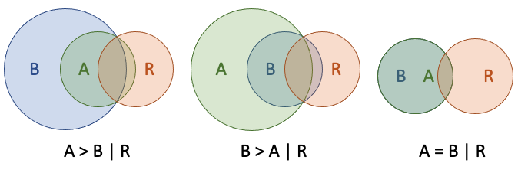
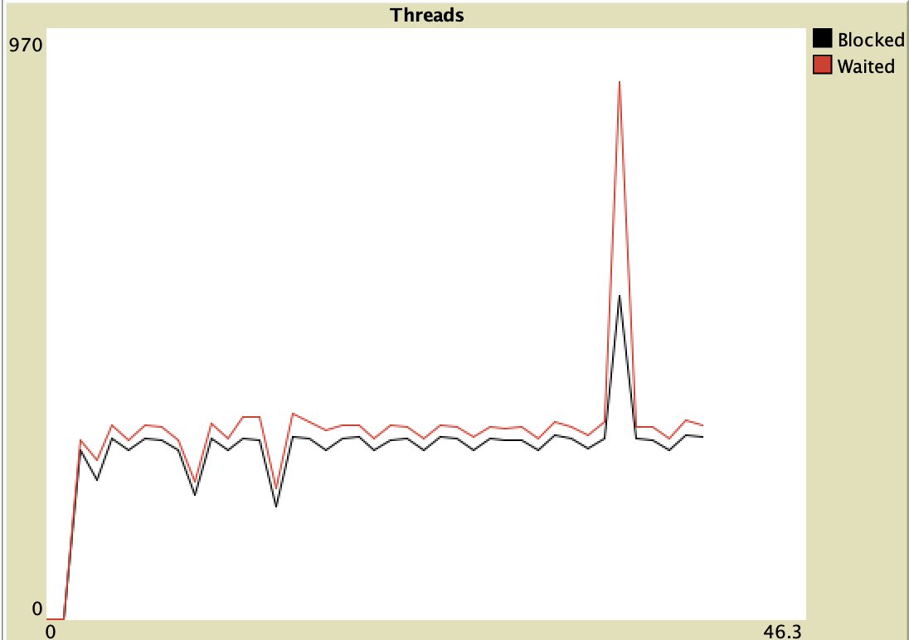
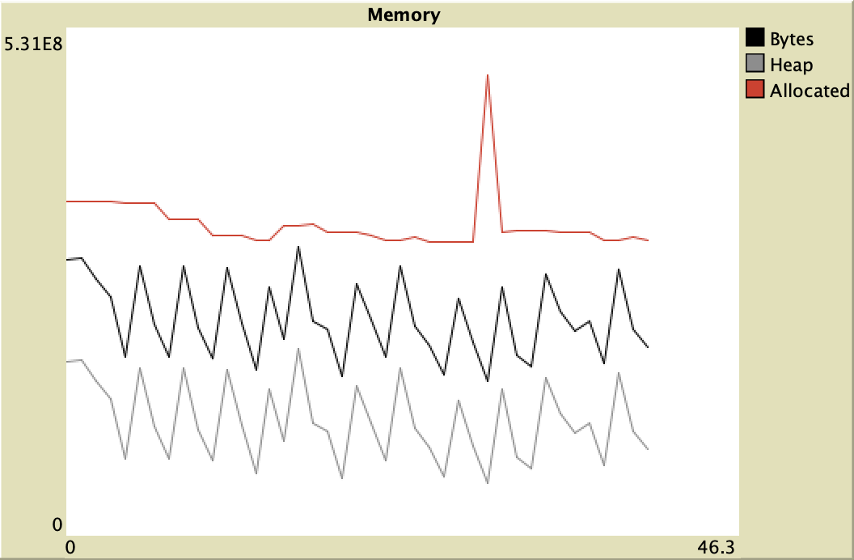
Four Netlogo extensions
Publicly available Netlogo extensions that provide a case-base reasoning framework, table look up with categorical variables, access to the precision Java math library and programmatically accessing real time information about the underlying virtual machine.
Doug Salt¹ and Gary Polhill¹
¹The James Hutton Institute, address of site, Aberdeen or Dundee
Email: doug.salt@hutton.ac.uk
My flat is an an absolute mess at t. I
My flat is an an absolute mess at the nt. I
Introduction
This poster describes four extensions to Netlogo. All four are available in Netlogo's extensions tab; run on Windows, OSX and Linux, and have publicly accessible repositories in which there is extensive documentation and worked examples. The extensions are cbr, an extension that implements a framework for case-based reasoning; lkt, a table extension that uses categorical variables to predicate outcomes; math which provides direct programmatic access to the Java math library in order to obviate cumulative, transitive mathematical imprecision, and mgr can interrogate programmatically the Java virtual machine.
The case based reasoner, cbr provides a framework to create a case base, consisting of a series of cases, each containing of a series of conditions, a decision and an outcome. This case base is then consulted for the best matches a given set of conditions and the decision. This is done by a "distance” function, a default version of which is provided, based on common Netlogo data types. This function may be overwritten if required. This extension provides ageing, collision avoidance, ranking and deletion of individual cases. The look up extension, lkt allows the definition of categorical variables using a "tree" definition file and a data file using these variables to predicate outcomes in a tabular form.
The math extension has multiple zero arity functions, single argument and double arity functions for precision maths. These include direct calls to Java's math library for repeated arithmetic operations and trigonometric functions. The latter correctly orientate to zero (not North) and use radians.
Lastly there is the mgr extension which allows access to statistics on thread and memory usage in the underlying java virtual machine, allowing the real-time inspection of heap, allocated and total memory, access to statistics about the number of threads and their state and finally how much CPU time is being used.
cbr
Normally a case base consists of a series of cases, each of these cases consist of
state
decision/activity
outcome
The state can be anything such as the bank balance of the agent. The decision/activity might be to install central heating. The outcome might be straight forwardly yes or no. It might be probability, or it might some arbitrary decision/activity metric for use elsewhere.
A state and decision/activity are presented to the case base. The case base is searched for the closest match (if there is one) and the outcome of that match is given.
A NetLogo case consists of a state in any of the standard Netlogo variables, such as list, number, string, etc. This is strictly defined by the `cbr:lambda` which is the comparator program used to determine the "distance" the three cases:
case A
case B
referent case R
are relative to each other. That is, if:
the case A is 'closer' to the referent case R than the case B using `cbr:lamda` to the referent case R then cbr:lt is returned
the case B is 'closer' to the referent case R than the case A using `cbr:lamda` to the referent case R then cbr:gt is returned
the case B is 'same distance' to the referent case R than the case A using `cbr:lamda` to the referent case R then `cbr:eq` is returned
the case B is 'closer' using `cbr:lamda` to the referent case R then `cbr:lt` is returned
The `cbr:lamda` is then used by `cbr:match` or `cbr:matches` to determine a single closest match of a "hypothetical" case that is presented to `cbr:match` or more or one equally close matches if `cbr:matches` is used. The case will consists of a state and decison and returning the 'best match' base on the repeated use of `cbr:lamda` to determine which is the closest match. If the match does not meet a suitable criterion then `cbr:incmp` is returned.
When using `cbr:match`, then if there are more than one match then the case with the highest rank is returned, or failing that the oldest. If both these conditions are equal then the result is a random
selection from among those cases. More
than one case may be returned if
cbr:matches` is used.
If no `cbr:lamba` is provided then a
default lambda is used.
Player_1 | Player_2 | Outcome
Rock | Rock | 0
Rock | Paper | 2
Paper | Rock | 1
Rock | Scissors | 1
Scissors | Rock | 2
Scissors | Scissors | 0
Paper | Scissors | 2
Scissors | Paper | 1
Paper | Paper | 0
lkt
This is two players, `Player_1` and `Player_2`
playing the game rock, paper, scissors. The
dimensions are `Player_1` and `Player_2`.
These dimensions may only contain the values
`Rock`, `Paper` and `Scissors` and the outcomes are
0 - nobody wins;
1 - Player_1 wins, and
2 - Player_2 wins.
To implement a look up table we must have two files. First a file is required that defines the dimensions and the allowable values for those dimensions. We denote this the tree file. The second files, denoted the data file, is a tab delimited file using these dimension with the last column of such a file predicating the outcome from the previous dimension values.
The dimensions are defined by in the tree file like the following.
group_name_1 (group)
dimension_1 (dimension)
dimension_1_value_1 (value)
dimension_1_value_2
...
dimension_2
dimension_2_value_1
dimension_2_value_2
...
...
group_name_2
dimension_3_value_1
...
...
This is a tree with the topmost node at the top of the file and the dimensions
represent additional layers to the tree, with the symbols that make up those
layers forming the nodes or branches of the tree.
And the data file would look similar to the following:
There is one reserved character which is the "*" character allowing the mapping
of defaults. This must appear in both the input and the data file of the tree.
The extensions has the following commands.
Dimension_1 | Dimension_2 | Dimension_3 | Outcome
dimension_1_value_1 | dimension_2_value_1 | dimension_3_value_1 | outcome_1
dimension_1_value_2 | dimension_2_value_1 | dimension_3_value_1 | outcome_2
dimension_1_value_1 | dimension_2_value_2 | dimension_3_value_1 | outcome_3
… | … | … | …
new
dimensions
first-dimension
get-dimension
more-dimensions?
Symbols
first-symbol
get-symbol
more-symbols?
get
states
first-state
get-state
more-states?
group
set
default
My flat is an an absolute mess at the moment. I
My flat is an an absolute mess at t. I
math
e - return the nearest double-precision floating-point number to the base of natural logarithms
pi - return the nearest double-precision floating-point number to _pi_
random - return a random number in the range [0, 1[
abs - return the absolute value of the argument
acos - return the arc cosine of the argument in the range [0, _pi_]
asin - return the arc sine of the argument in the range [- _pi_ / 2, _pi_ / 2]
atan - return the arc tangent of the argument in the range [- _pi_ / 2, _pi_ / 2]
cbrt - return the cube root of the argument
ceil - return the smallest integer (as a double) greater than or equal to the argument
cos - return the cosine of the argument (in radians)
cosh - return the hyperbolic cosine of the argument decrement-exact` -- decrement the integer argument (by one), throwing an exception on integer underflow
exp - return the base of natural logarithm raised to the power of the argument
expm1 - return one less than the base of the natural argument raised to the power of the argument
floor - return the largest integer (as a double) less than or equal to the argument
get-exponent - return the exponent of the (double) argument (an integer)
increment-exact - increment the integer argument (by one), throwing an exception on integer overflow
log - return the logarithm (base _e_) of the argument
log10 - return the logarithm (base 10) of the argument
log1p - return the logarithm (base _e_) of the argument + 1
negate-exact`- return the (integer) negation of the (integer) argument, throwing an exception on overflow
next-down - return the next double-precision floating-point number after the argument in the direction of negative infinity
next-up - return the next double-precision floating-point number after the argument in the direction of positive infinity
rint - return the (double) integer closest to the argument
round - return the closest `int` to the argument (which is cast to a `float` first)
signum - return the sign of the argument in {0, -1, 1} (as doubles), for {zero, negative, positive} numbers respectively
sin - return the sine of the argument (in radians)
sinh - return the hyperbolic sine of the argument
sqrt - return the square root of the argument
tan - return the tangent of the argument (in radians)
tanh -- return the hyperbolic tangent of the argument
to-degrees - convert the argument (in radians) to degrees
to-int-exact - convert the argument to an integer, throwing an execution on overflow (calls round without casting to `float`, returning a `long`, which is then converted to an integer)
to-radians - convert the argument (in degrees) to radians
ulp - returns the size of the 'units in the last place' of the argument
mgr
mgr:mem` The total amount of (heap and non-heap) memory used, in bytes.
mgr:mem-p` The amount of heap and non-heap memory used as a proportion of the amount allocated.
mgr:mem-pct-str` A string reporting `mgr:mem-p` as an integer percentage (ending with a "%" character).
mgr:heap-used` Amount of heap memory used (in bytes). Heap memory is the memory allocated by the JVM to storage of Java objects.
mgr:non-heap-used` Amount of non-heap memory used. 'Non-heap' memory is memory allocated by the JVM for classes and metadata.
mgr:heap-alloc` Amount of heap memory allocated ('committed' in Java jargon). See [Java documentation](https://docs.oracle.com/javase/8/docs/api/java/lang/management/MemoryUsage.html) for more information.
mgr:non-heap-alloc` Amount of non-heap memory allocated.
mgr:heap-init` Initial amount of heap memory the JVM requested from the operating system. (May be undefined.)
mgr:non-heap-init` Initial amount of non-heap memory the JVM requested from the operating system. (May be undefined.)
mgr:heap-max` Maximum amount of heap memory that can be used for memory management. (May be undefined.)
mgr:non-heap-max` Maximum amount of non-heap memory that can be used for memory management. (May be undefined.)
mgr:mem-str` The heap and non-heap memory used in a human-readable string.
mgr:heap-used-str` The heap memory used in a human-readable string.
mgr:non-heap-used-str` The non-heap memory used in a human-readable string.
mgr:alloc-str` The heap and non-heap memory allocated in a human-readable string.
mgr:threads` The number of currently running threads.
mgr:peak-threads` The highest number of concurrent threads.
mgr:all-threads` The total number of threads that the JVM has ever started.
mgr:thread-cpu` The total amount of CPU time the thread associated with the caller has been running for.
mgr:thread-user` The amount of CPU time the thread associated with the caller has spent running user code.
mgr:thread-system` The amount of CPU time the thread associated with the caller has spent running operating system code (e.g. for file I/O).
mgr:cpu-time` The total amount of CPU time all threads have been running for.
mgr:user-time` The total amount of CPU time all threads have spent running user code.
mgr:system-time` The total amount of CPU time all threads have spent running operating system code.
mgr:blocked-time` The total amount of time threads have spent being blocked from execution (i.e. waiting to enter `synchronized` code currently occupied by another thread)
mgr:blocked-count` A count of the number of times threads have been blocked from execution.
mgr:waited-time` The total amount of time threads have spent waiting for a signal from another thread.
mgr:waited-count` A count of the number of times threads have waited for a signal from another thread.
mgr:jvm-start-time` The (approximate) start time of the JVM in seconds since midnight UTC on 1 January 1970.
mgr:jvm-uptime` The (approximate) amount of time the JVM has been running for (in seconds)
mgr:gc-count` A count of the number of garbage collections the JVM has done.
mgr:gc-time` The amount of time in seconds spent on garbage collection.
mgr:jvm-proc-count` The number of cores available to the JVM.
mgr:system-load` The average system load over the last minute. See the [Java documentation](https://docs.oracle.com/javase/8/docs/api/java/lang/management/OperatingSystemMXBean.html#getSystemLoadAverage--) for more information.
mgr:jvm-name` The name of the JVM. There's no guaranteed information contained here.
mgr:cpu-time-str` A human-readable string option for `mgr:cpu-time`.
user-time-str` A human-readable string option for `mgr:user-time`.
A human-readable string option for system-time.
waited-system-time-strtime-str A human-readable string option for waited-time.
blocked-time-str A human-readable string option for `mgr:blocked-time`.
jvm-uptime-str A human-readable string option for `mgr:jvm-uptime`.
Figure 2 Figure Title
Acknowledgements
Special thanks go to
Conclusions
Four new Netlogo extensions
Represents The James Hutton’s Institute continued development of NetLogo as a “serious” tool for modelling.
Toolset development (often underfunded or ignored)
Theory implementation in the cbr and lkt extensions
Pragmatic implementations in the math and mgr extensions
Conclusions

