Slide 1
PUBLIC TRANSPORT MANAGEMENT
Using GPS-GSM Integration

Slide 2
Sagar Sangodkar 11ECE069
Shivraj Mhalshekar 11ECE114
Shubham R.Phadte 11ECE064

Slide 3
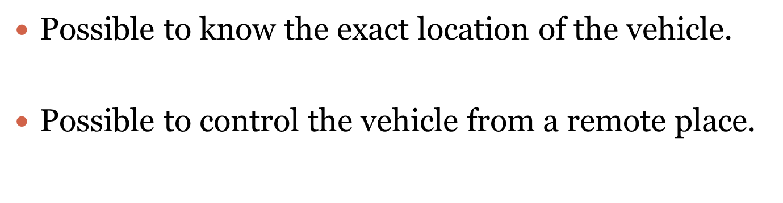
WHY this project ?

Slide 4
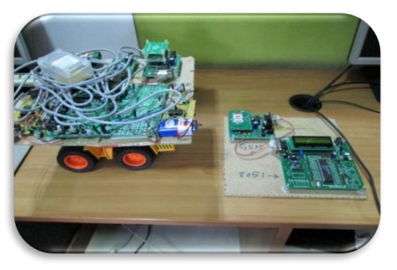
OVERVIEW

Slide 5
Where this concept can be used ?
for defense purposes
by courier service providers
By transportation departments

Slide 6
GPS is used as a positioning device .
GSM is used as communication link between different modules.
Modules include Base Station ,In-Bus ,Bus Station and Stop Module.

Slide 7
1. BUS STATION MODULE
Activated where the vehicle is turned on for service.
Contains GSM module interfaced to uC .
Transmits unique identification code of the vehicle to BASE Station.

Slide 8
2. IN-BUS MODULE
Transmits the position of the vehicle to the BASE Station.
Notify BASE Station of the status of the vehicle.

Slide 9
3. BASE STATION MODULE
Receives real time position of the vehicle .
Involves Decision Making as well as Interfacing.
Comprises of Microcontroller and GSM Based Modules.
Interacts with several GSM users as well as BUS STOP Modules to provide vehicle location.

Slide 10
4. BUS STOP MODULE
Provides information regarding vehicle to people waiting at the stop.
Information displayed using 7 segment display or LCD Display.

Slide 11
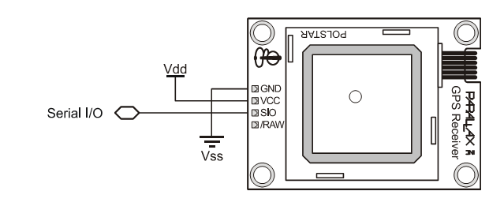
HARDWARE REQUIREMENTS
1. GPS RECEIVER
Determines latitude, longitude , altitude, time, date and speed .

Slide 12
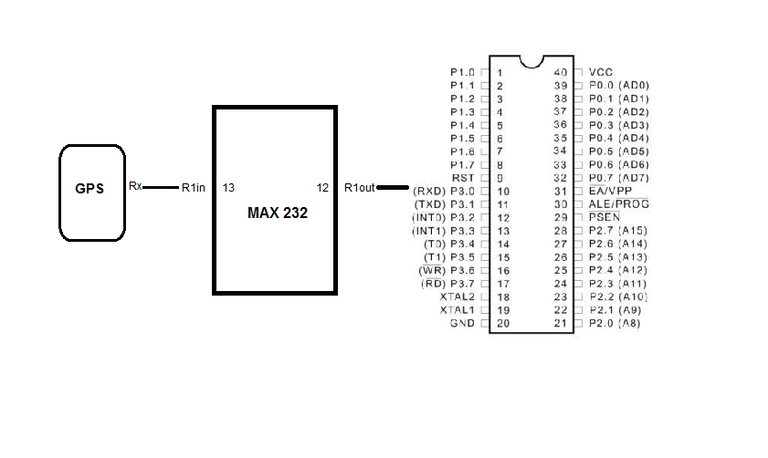
INTERFACING GPS WITH 8051

Slide 13
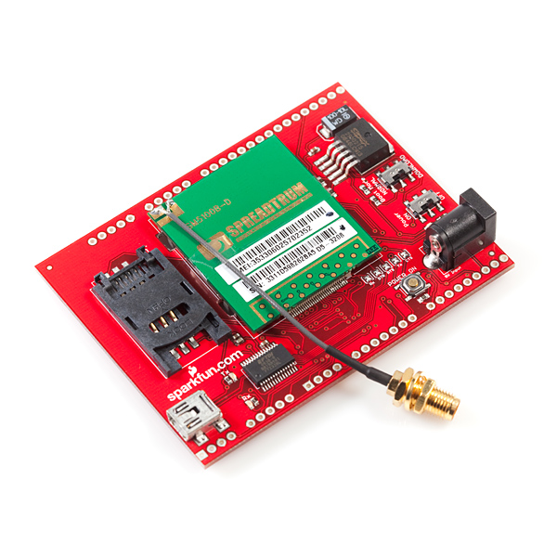
2. GSM (Global System for Mobile Communications)
GSM/GPRS Module - SM5100B
You can use this module to accomplish almost anything a normal cell phone can - SMS text messages, GSM/GPRS, TCP/IP, and more!

Slide 14
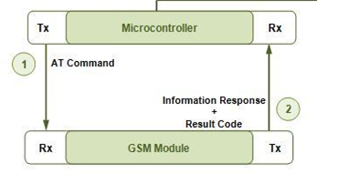
INTERFACING GSM WITH 8051

Slide 15
3. MICROCONTROLLER 8051
ADC ,DAC , Interrupt Controller , I/O Interfaces such as serial port or parallel port counter or timers on a single chip.
4. POWER BACKUP
5. ALARMS
In Bus Module has various Alarms to indicate the status of vehicle such as stoppage, getting late, route deviation etc.

Slide 16
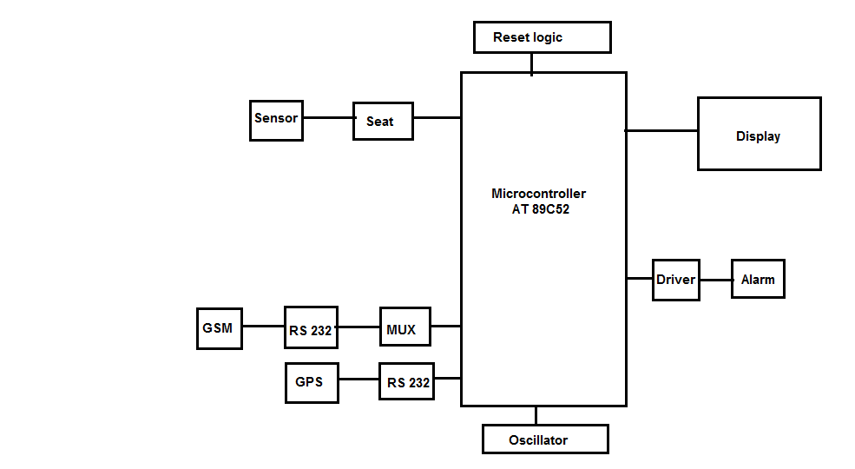
System Block Diagram

Slide 17
Further Scope
We are thinking of interfacing camera in addition to gps to track the surroundings of the vehicle.

Slide 18
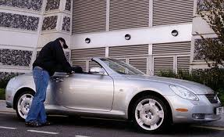

Slide 19
THANK YOU

