Slide 1


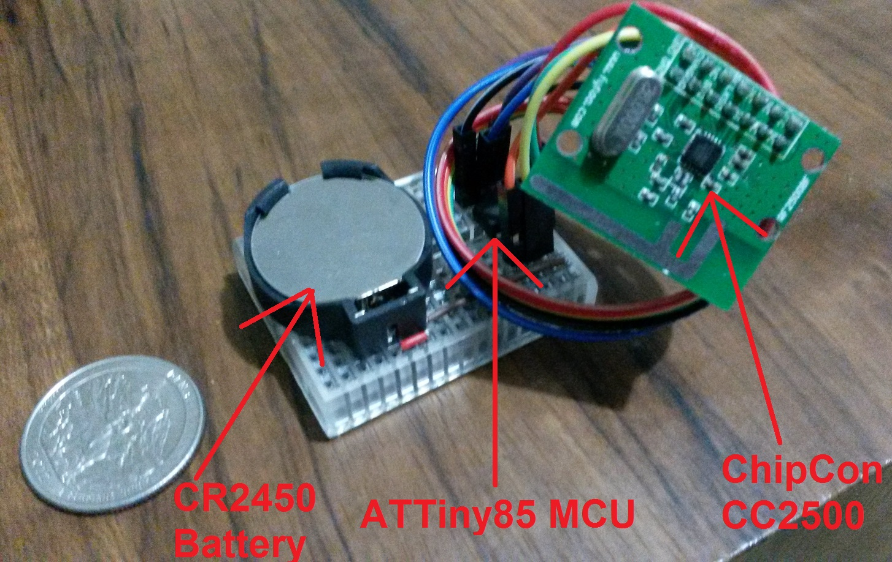

GumboNodes: Exploring Sensor Networks Cheaply
Zachary Rubin (zarubin@ucsc.edu), H. Blake Skinner (hskinner@ucsc.edu) Baskin School of Engineering
University of California, Santa Cruz
Intro
Proof of Concepts and Prototypes
Challenges
Want to investigate wireless sensor networks
Too Expensive per-node
$100-150 per mote for Telos motes
Want to evaluate more than just 1-2 nodes
Target: 20 Nodes for <$150
Hardware too small to support an OS like Tiny or Contiki
Zigbee compatible transceivers too expensive
Low Packet Error Rate surprisingly difficult
TX, RX, and Sleep
Bad data propagates quickly.
Multihop = bad data always ‘fresh’
Contiki
Heartbeats
Random intervals
Hardware
The protypes sat on a breadboard ($1.20/unit). The total cost per node was $7.59 after accounting for shipping and tax.
2 Types of Nodes:
GumboTiny, the proposed hardware
GumboUno, the wireless chip attached to an Arduino Uno for data output over serial
CC2500 provided numerous hardware features. A 16 bit preamble and 2 byte checksum were added to each packet, and link quality indicator was used to determine utility of data from other nodes.
ContikiOS was used to simulate the nodes and investigate network throughput as well as overall performance between various types of communication.
Atmel ATTiny85 MCU @ 1MHz
Low Power Sleep Modes
5 I/O pins
TI CC2500 2.4GHz Wireless Transceiver
Low Power, Non-Zigbee
Outputs LQI and RSSI
3v 660MAH CR2450 Battery
Future Work
Having Contiki nodes interact with real nodes
Determining a way to prevent bad data from propagating.
ContikiOS Investigation: Simulation of Heartbeats vs Random Intervals
Deciding between TX, RX, and Sleep
Built 20 GumboNodes: 18 GumboTinys and 2 GumboUnos
Simple heartbeat
Sleep Current: 2.5mA
TX/RX Current: 16.mA
Lifetime: 2.5 Days and counting!
Stuff blew
We dropped them into a fan
Results
Simulation
Contiki the OS
Not a raft
References
Your mom
Notes:
1

