Slide 1
Effect of “Activating Factor 42” Treatment on Gene Expression
Exploratory Data Analysis
Douglas Dally
24/3/2023

Slide 2
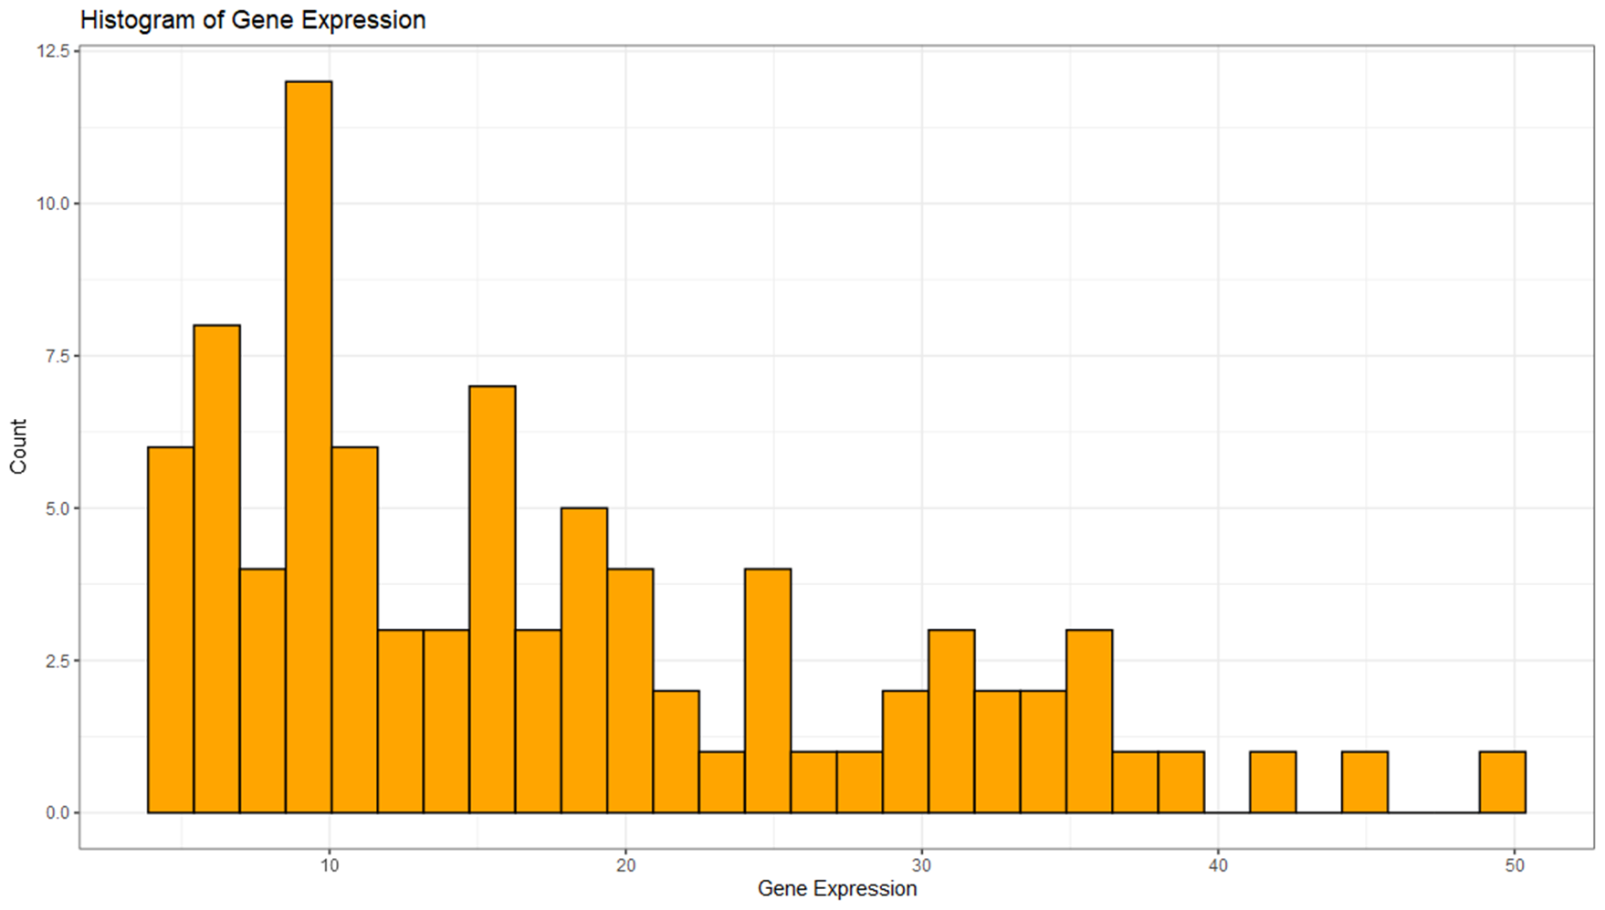
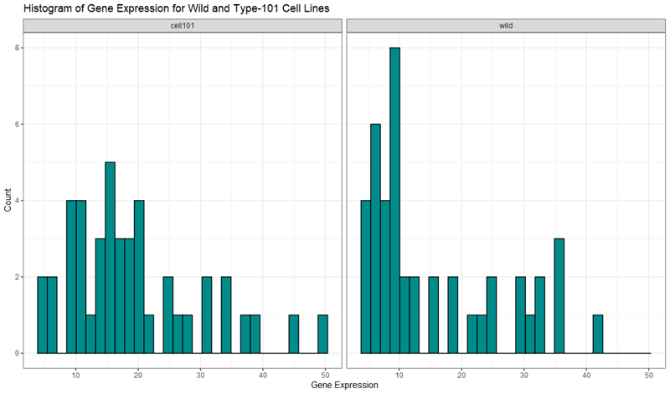
Histograms
Figure 1
Look at distribution of Gene Expression.
Figure 1 shows multi-modal right-skewed distribution across both treatment groups and cell lines.
Figure 2 separates data by cell line, and shows that there is more variability in gene expression for the type-101 cell line, visualised by slightly more even spread.
Lower gene expressions are more frequent in the wild type cell line.
Potential outliers exist in gene expression levels above 40.
Figure 2

Slide 3
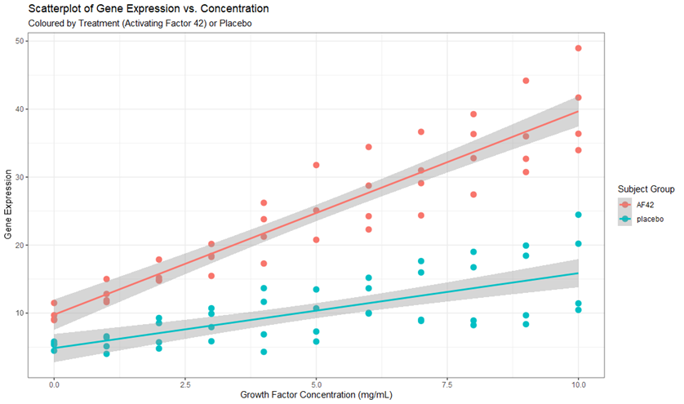
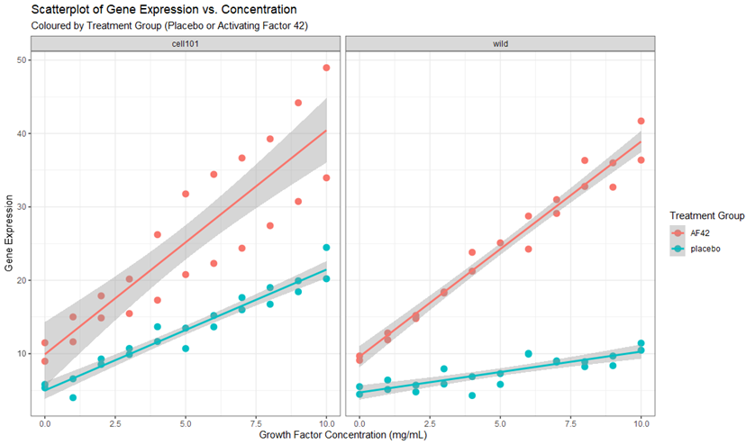
Scatterplots
Figure 3
Look at distribution of gene expression against growth factor concentration (mg/mL).
Figure 3 shows:
There is a positive linear relationship between gene expression and growth factor concentration for both treatment groups.
Evidence of non-constant variance, as the data appears more scattered as growth factor concentration is increased.
Figure 4 separates data by cell line, and confirms that there is more variability in gene expression for the type-101 cell line, visualised by the significant spread around the AF42 treatment group trendline.
Roughly the same growth rate of gene expression under AF42 treatment for both cell lines.
Different gene expression growth rates under placebo treatment.
Want to investigate the AF42 treatment group for the type-101 cell line further to see why this variation is present.
Figure 4

Slide 4
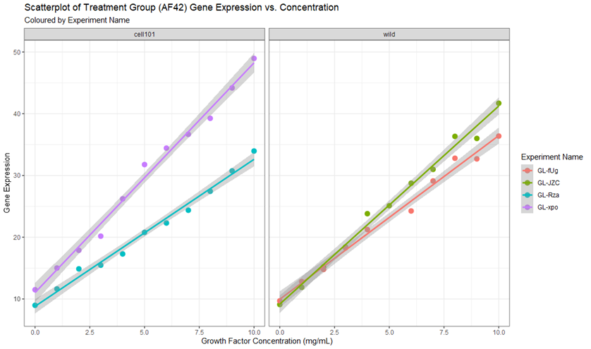
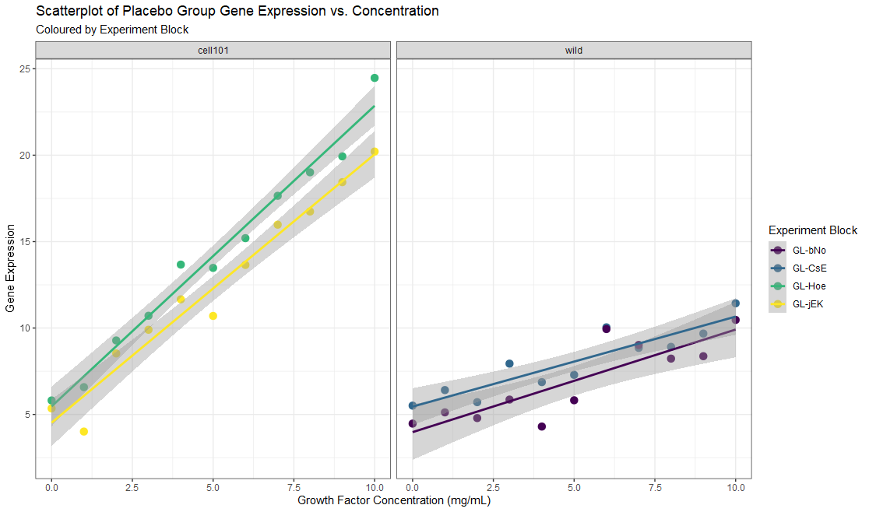
Scatterplots
Figure 5
Figures 5 & 6 decompose Figure 4 into the treatment groups (AF42 and placebo), and colour points by the individual experiments from which the data was collected.
From Figure 5, we see that:
Wild type cell line has similar relationships across the two experiments (similar growth rates and intercept).
Type-101 cell line exhibits significantly different behaviour, visualised by the growth rates of gene expression from experiments GL-xpo and GL-Rza.
Figure 6 shows that there is no significant differences in the experiments from the placebo group within each cell line. Seen by approx. equal growth rate and intercept of gene expression within each cell line.
Different growth rates between cell lines, larger range of gene expression from type-101 cell line.
The variability seen in gene expression for type-101 cell line from Figures 3 and 4 is mainly due to these differences in the two experiments (GL-xpo and GL-Rza from Figure 5) that were conducted to obtain the results.
Figure 6

Slide 5
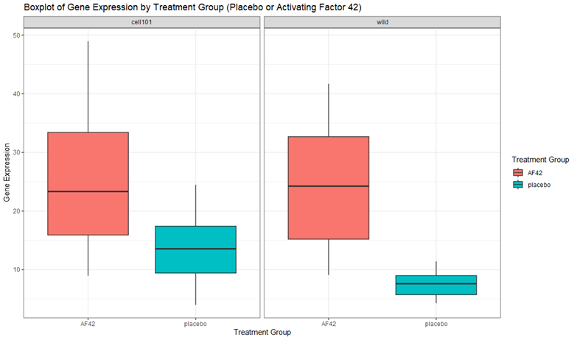
Side-by-side Boxplot
Looking at the differences in distribution of gene expression for each treatment group within each cell line.
Figure 7 shows that:
All 4 boxplots have a roughly symmetrical distribution, except for the AF42 treatment group for the type-101 cell line, which is slightly right skewed.
The placebo group for the type-101 cell line has an interquartile range (IQR) of more than double the IQR of the wild type.
The IQR of the AF42 treatment group for both cell lines is roughly the same at approx. 17 with similar medians (approx. 24).
there is some slight overlap between the IQR of AF42 and placebo groups for the type-101 cell line, but no overlap for the wild type cell line.
Median of type-101 cell placebo group lies outside IQR of the AF42 treatment.
There is evidence to suggest there is a significant difference in gene expression between the placebo and AF42 treatment.
Figure 7

Slide 6
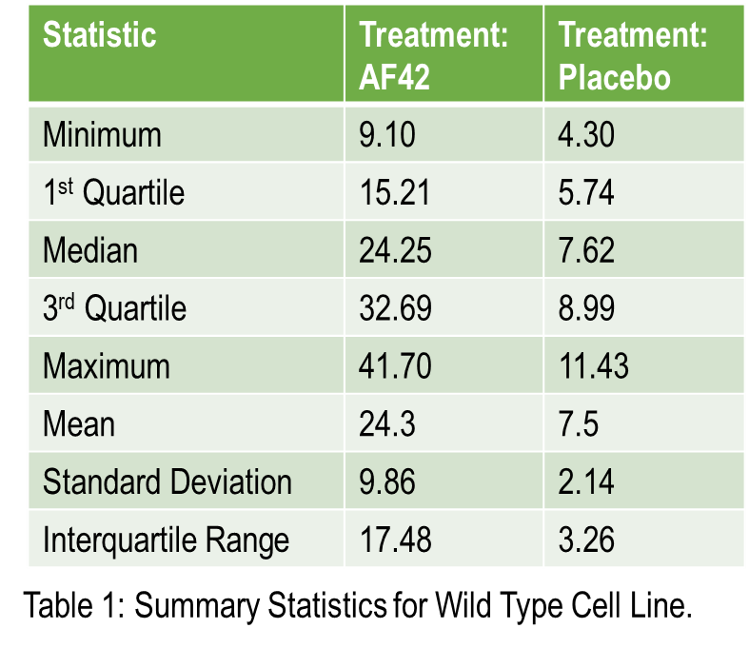
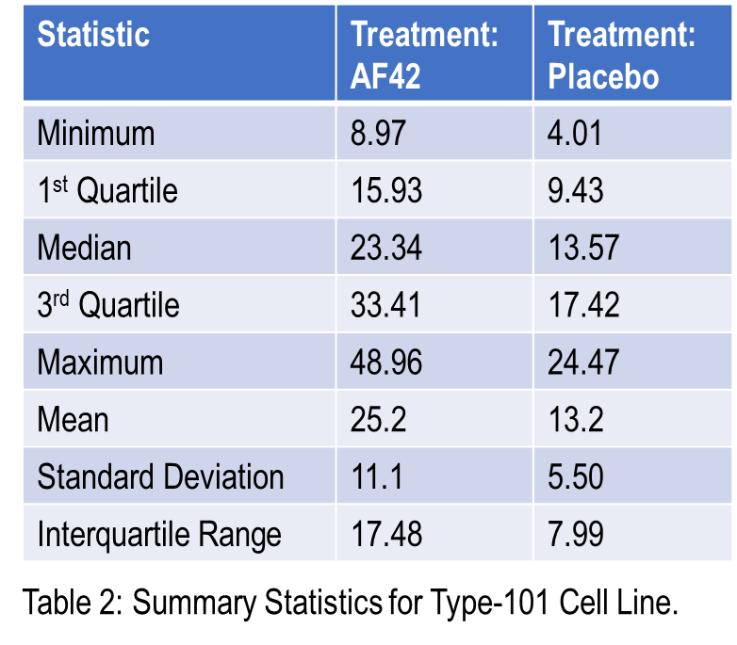
Summary Statistics for Gene Expression
Summary Statistics included are: five number summary (quartiles), mean, standard deviation and interquartile range (IQR).
Table 1 gives gene expression summary statistics for type-101 cell line.
Table 2 gives gene expression summary statistics for wild type cell line.
IQR, standard deviation and mean for AF42 treatment group are approx. the same for both cell lines.
IQR, standard deviation and mean significantly different for placebo treatment group between the two cell lines.

