Slide 1
Project 2-Covid Data Analysis
Douglas Lam
Evan Laferriere
Youngjung Kim
Rudy Esquerra
Patrick Froerer

Slide 2
Project Overview
Clean data
Analyze
Visualize
Run analysis with jar file
Use logging to track errors and keep application clean
Answer 10 analysis questions using visualization

Slide 3
Technologies Used
Scala 2.12.10
Spark 3.1.2
IntelliJ
Tableau
WSL/Ubuntu
HDFS/YARN

Slide 4
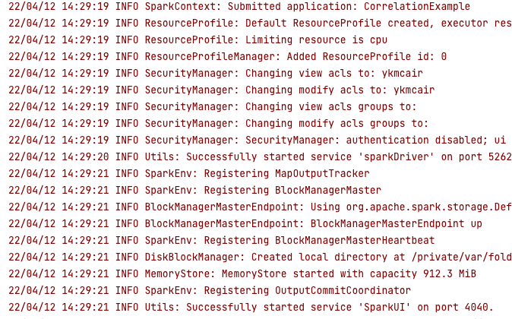
Logging
Implemented logging to clear the program of unwanted Info messages appearing during runtime

Slide 5
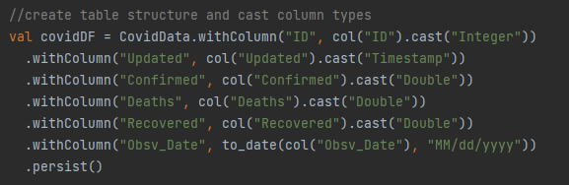
Data Cleaning
Load the data from our CSV into our dataframe
Type data before putting into our view and dataframe
Simplified the data to contain no rows with unknown or null values
Notes:
To import and clean the data, we started by simply loading the data into a dataframe, inferring the schema and titling the columns. From there we used the .withColumn function to type all of the rows so queries could be run properly with dates, etc. Once all of the data was successfully loaded and typed, we cleaned it by using the filter function and select statements to make a new dataframe that we would be able to query from. This new set of data had all unknown and null values removed to simplify the data and keep our query results consistent. We did run into some issues regarding some entries that had both a county and state or City and Province input in the Province_State column that may have ended up leaving some results out of location specific queries, but those rows were kept since they wouldn’t affect broader query questions.

Slide 6
.jar implementation
How to run the app using spark-submit in WSL-Ubuntu
Start the Hadoop DFS daemons, the namenode and datanodes with => startdfs
Start the resource manager with => startyarn
create src/main/source directories in your home directory (/home/username/src/main/source) using the following command: hdfs dfs -mkdir -p src/main/source
Jump into the directory where the jar is located (e.g. /mnt/c/Users/username/Desktop)
run the following command => spark-submit --class QueryTesting project2_2.12-0.1.0.jar

Slide 7
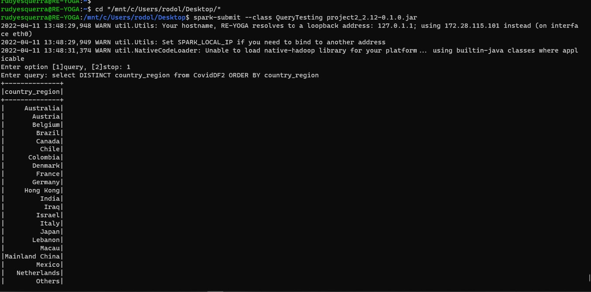
.jar implementation image

Slide 8
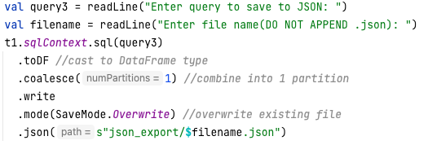
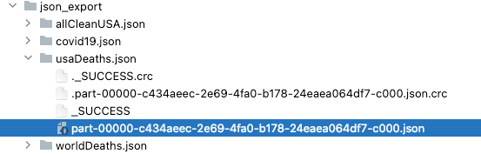
Export to Json
“write” method write a JSON file.
Import SaveMode from spark.sql
Used mode(SaveMode.Overwrite) to overwrite previously created file
Used internal directory to save files
Internal directory

Slide 9
Tableau Use
Read JSON files into Tableau
Utilize Tableau to visualize query results
Create graphs to compare queries
Effectively illustrate findings

Slide 10
Tableau Links
Death Map US (Link)
Confirmed Map US (Link)
Utah with and w/o Mask (1, 2, 3)
Daily Confirmed in California (Link)
Death vs Row (Link)
Lag Trent (Link)
Monthly Confirmed US vs Global (Link)
Massachusetts Phases(1, 2, 3A, 3B)

Slide 11
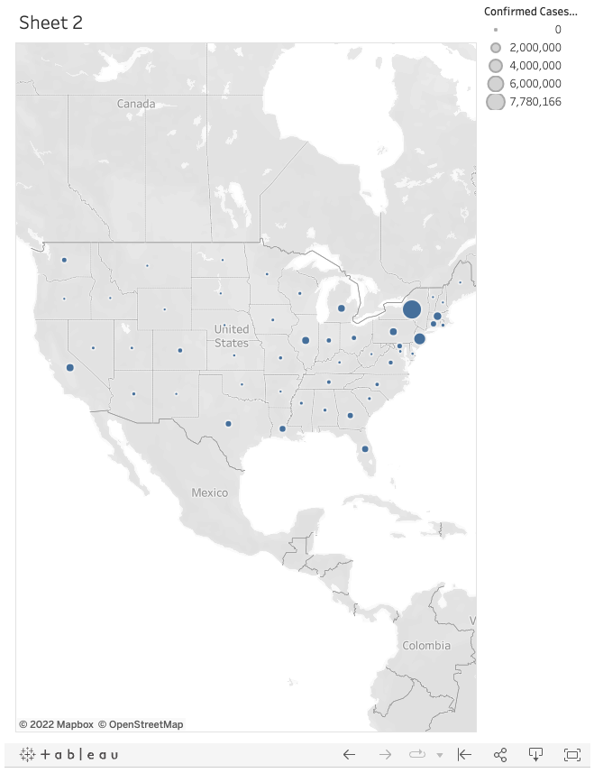
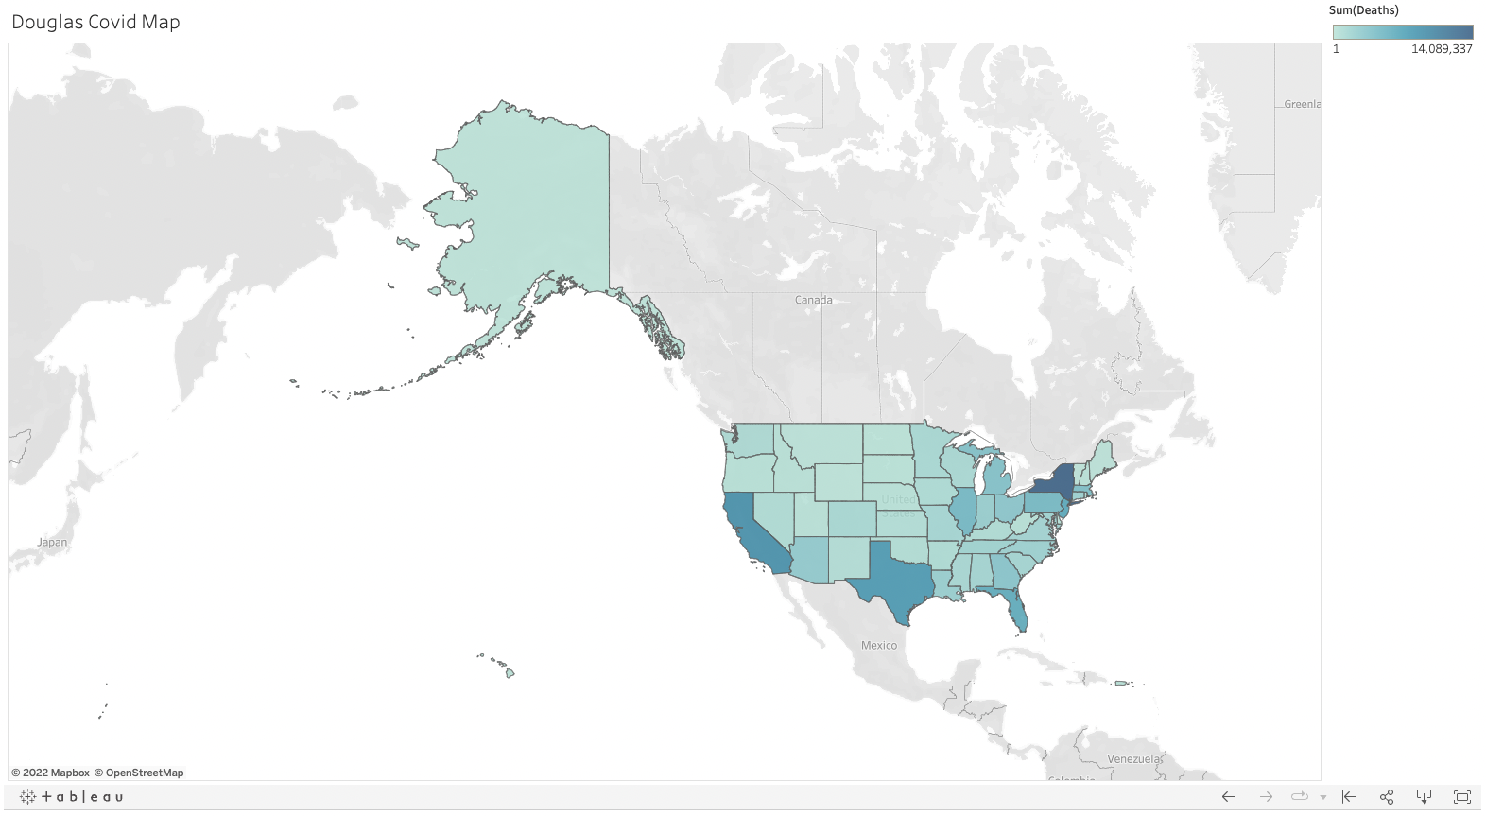
Tableau Graph Overviews
US Confirmed vs Death Map

Slide 12
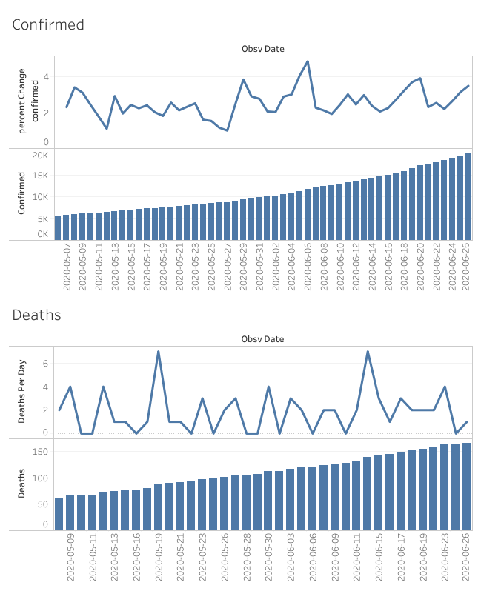
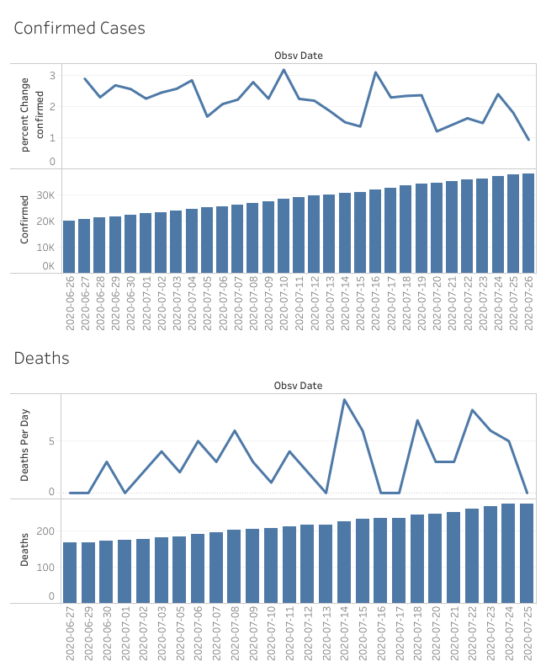
Utah Before/After Masks Encouraged
Notes:
The questions I wanted to ask called for 4 different queries, all asking similar questions just at different times. I wanted to see how confirmed cases and deaths changed after a generally well known and liked Senator highly encouraged masks. The data above shows confirmed cases and deaths 1 month before and after the Senator’s mask endorsement, as well as deaths per day and the percent change in cases per day. The results above showed that the percent change in cases did start to drop, and was seen on an overall decline the month after the change, while deaths remained relativelyt similar, averaging around 5 per day. Also since the reporting of deaths will alway sbe delayed, it’s hard to draw a conclusion within a 1 month period.

Slide 13
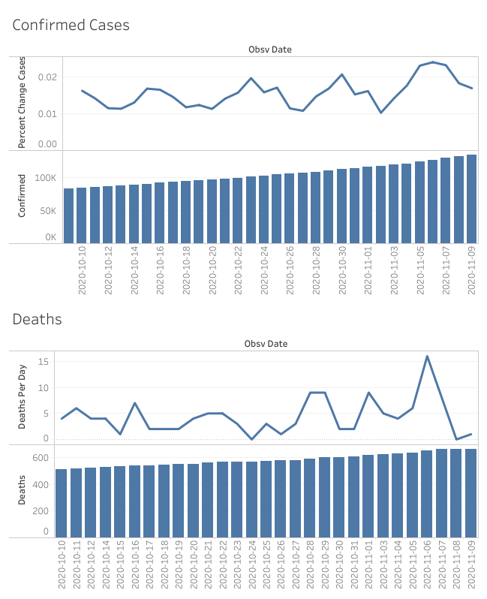
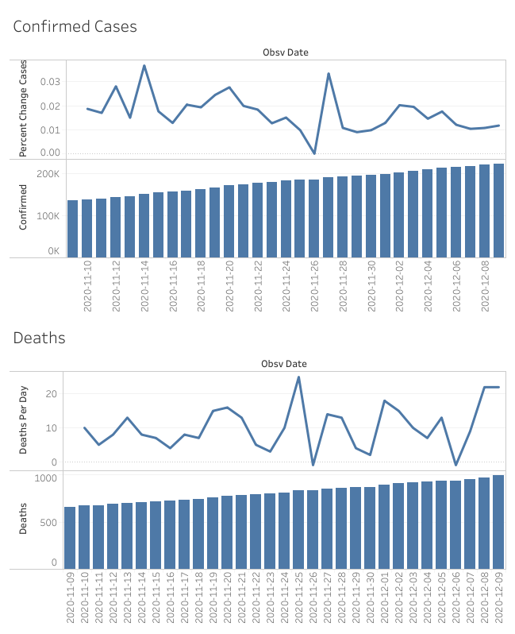
Utah Before/After Mask Mandate
Notes:
This graph shows the same data, percent change in cases as well as deaths per day, but a month before and after the state’s actual mask mandate. Again we can see that the percent change in cases was on a general downward trend after the mandate, though it did reach new peaks by virtue of being later into the pandemic. Deaths were again inconclusive, or had an overall insignificant change.

Slide 14
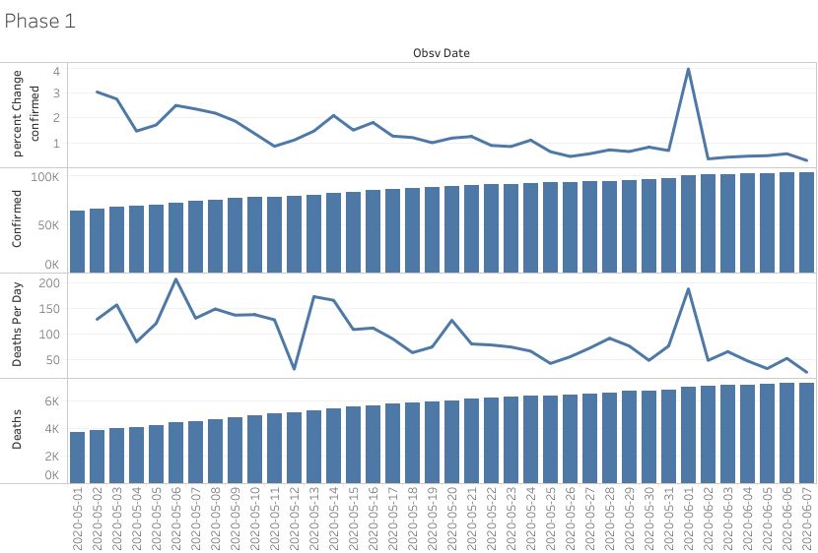
Massachusetts Phases- Phase 1

Slide 15
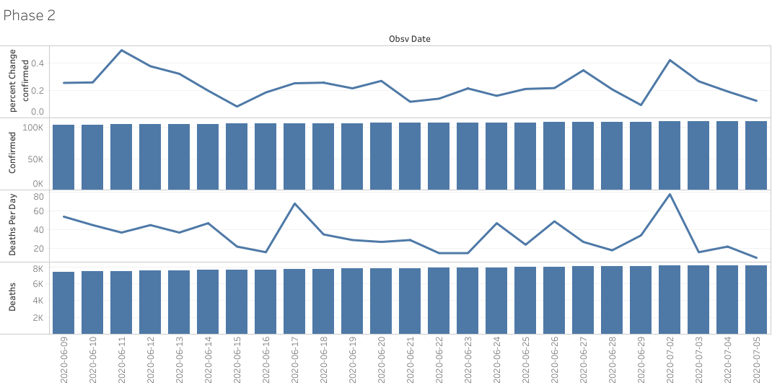
Phase 2

Slide 16
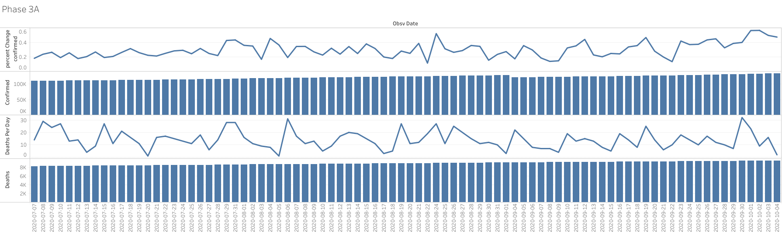
MA Phase 3A

Slide 17
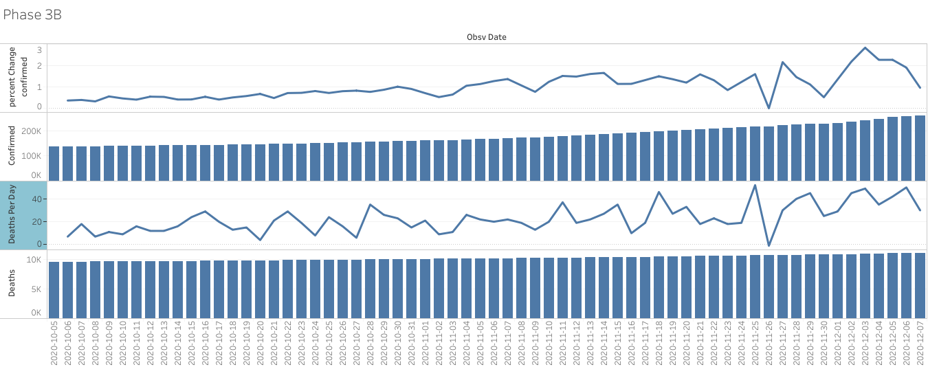
MA Phase 3B

Slide 18
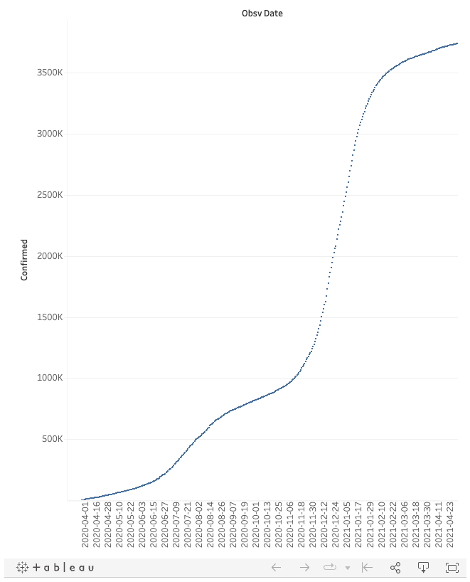
Tableau Graph Overviews
Daily Confirmed in California

Slide 19
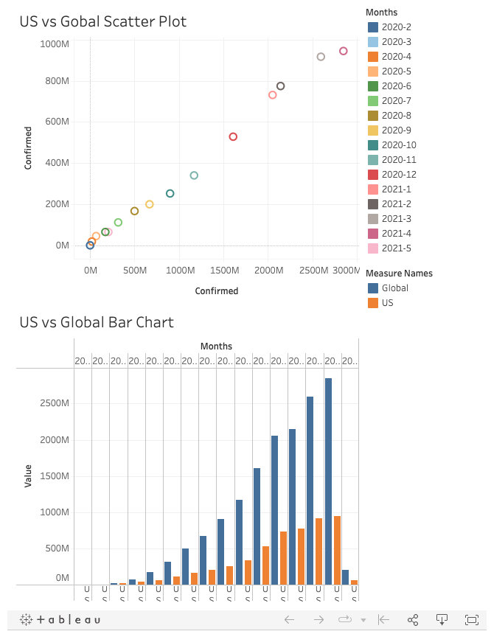
Tableau Graph Overviews
Monthly Confirmed US vs Global

Slide 20
Machine Learning
Spark MLlib library
Linear Regression
Feature Engineering - Created time-step and lag columns
Graph totalDeaths vs time-step and totalDeaths vs lag
Create Trend line
Notes:
In our project we were able to implement machine learning. Spark has a built in library called MLlib, that provides access to a variety of algorithms. For our implementation, we used Linear Regression. Linear Regression pairs well with time-series type data. It provides the ability to potentially forecast future results. The Linear Regression model input does not take date type data, and will only accept two column types;labels and features. Specific to time-series data, we can create two types of derived columns; Time-step and lag.This process is called Feature Engineering. Once we’ve created our new columns, we can then graph them against out totalDeaths column, and from there, create a trend line.

Slide 21
Machine Learning
Create SparkSession
Load Data
Create DataFrame Structure
Cast column types
Filter Null values
Create a View to query (.createOrReplaceTempView())
Use SQL for Feature Engineering
Unique time-series features - Time-Step, lag
MLlib takes row based data, NOT columnar Group; Separate our columns into two groups: a Label, and Features
Use VectorAssembler() to take an Array of all columns we want to use, and combine it into a single column with each row’s values;Our Features
Specify the Label when we instantiate the machine learning algorithm LinearRegression()
Call .fit(data) on the LinearRegression() instance to fit the data
Print the results
Notes:
Here we have the basic steps to setting up machine learning. We first go through the basic steps of cleaning, sorting, and filtering our data. We then use SQL to create our new features time-step and lag. Linear Regression only takes two inputs, that MUST be named label and features. We use vectorAssembler to take our features, however many, place it in an Array, and output a single column with all the values.

Slide 22
Machine Learning
Time-Step - derived directly from the time index(datetime). The most basic time-step feature is the time dummy, which counts off time steps in the series from beginning to end.
Time-step features let you model time dependence. A series is time dependent if its values can be predicted from the time they occured.
source:https://www.kaggle.com/code/ryanholbrook/linear-regression-with-time-series
Notes:
Time step lets us see if the data may be seasonal.

Slide 23
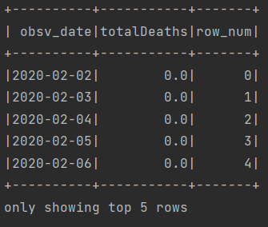
Machine Learning
SELECT obsv_date, SUM(Deaths) as totalDeaths , ROW_NUMBER() OVER (ORDER BY obsv_date) - 1 row_num FROM cleanUSA GROUP BY obsv_date ORDER BY obsv_date"
Notes:
Here is the time-step SQL statement, and its output, row_num, where it starts at zero, and increments each day.
row_number() over (order by obsv_date) - 1 AS row_num

Slide 24
Machine Learning
Lag - shifts the observations of the target series so that they appear to have occurred later in time
Lag features let us fit curves to lag plots where each observation in a series is plotted against the previous observation.
Lag features let you model serial dependence. A time series has serial dependence when an observation can be predicted from previous observations.
source:https://www.kaggle.com/code/ryanholbrook/linear-regression-with-time-series
Notes:
Lag lets us see if each observation is dependent on the previous observation

Slide 25
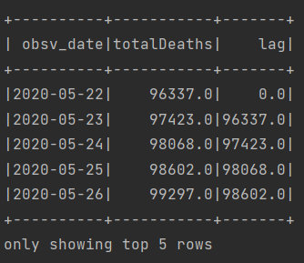
Machine Learning
SELECT obsv_date, SUM(Deaths) as totalDeaths , lag(SUM(Deaths),1,0) over (order by obsv_date) as lag FROM cleanUSA GROUP BY obsv_date ORDER BY obsv_date"
Notes:
lag(SUM(Deaths),1,0) over (ORDER BY obsv_date) as lag
This output is from a later range of dates to show how the lag column is derived from the totalDeaths column, moved forward one day.

Slide 26
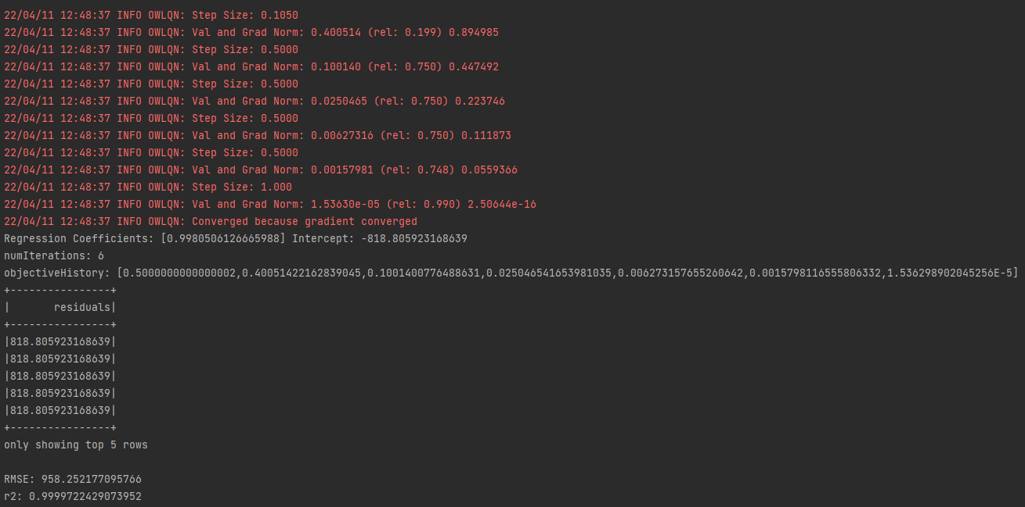
Machine Learning
Notes:
Linear regression
target = weight_1 * feature_1 + weight_2 * feature_2 + bias
Weight == regression coefficients
Bias == intercept of y-axis
Root Mean Square Error ==difference between the predicted value and the actual value. Its size is dependent on the data range
r^2 how well our model fit. Range is usually between 0 and 1

Slide 27
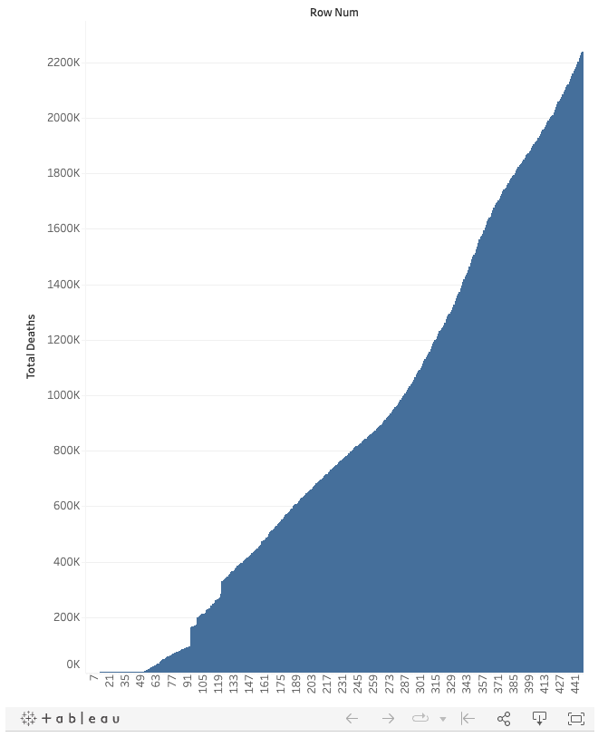
Machine Learning
US Deaths vs Time-Step Row
Notes:
There’s a lot to learn in machine learning, and it does require some knowledge in statistics to correctly interpret.

Slide 28
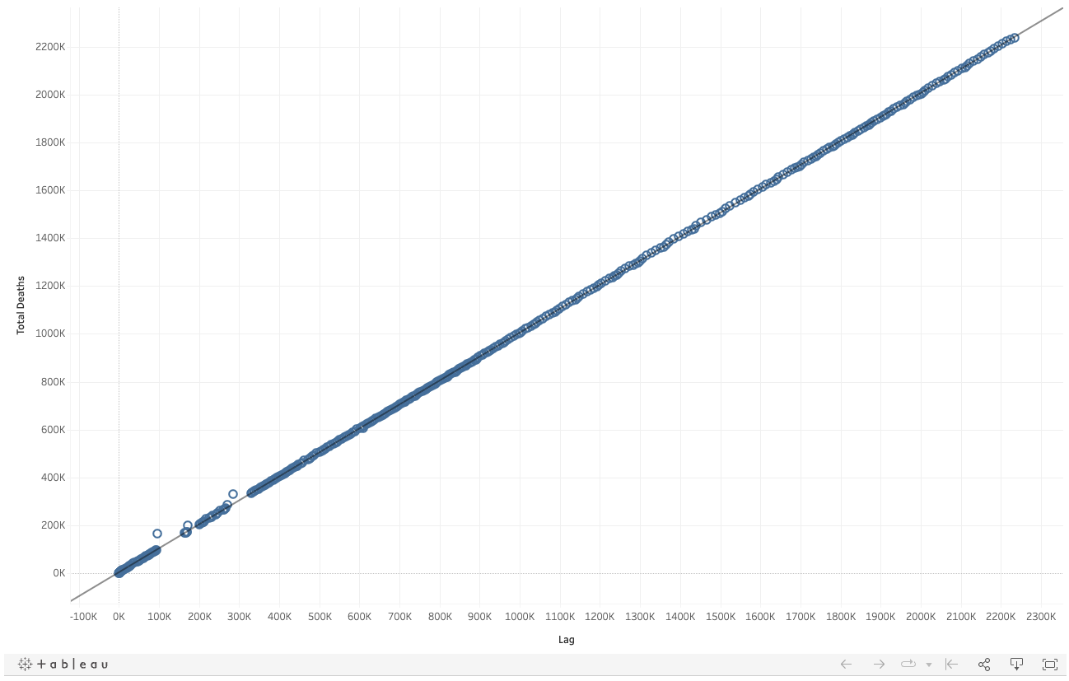
Machine Learning
US Deaths Lag Trend
Notes:
There’s a lot to learn in machine learning, and it does require some knowledge in statistics to correctly interpret.

Slide 29
Conclusion

