Slide 1
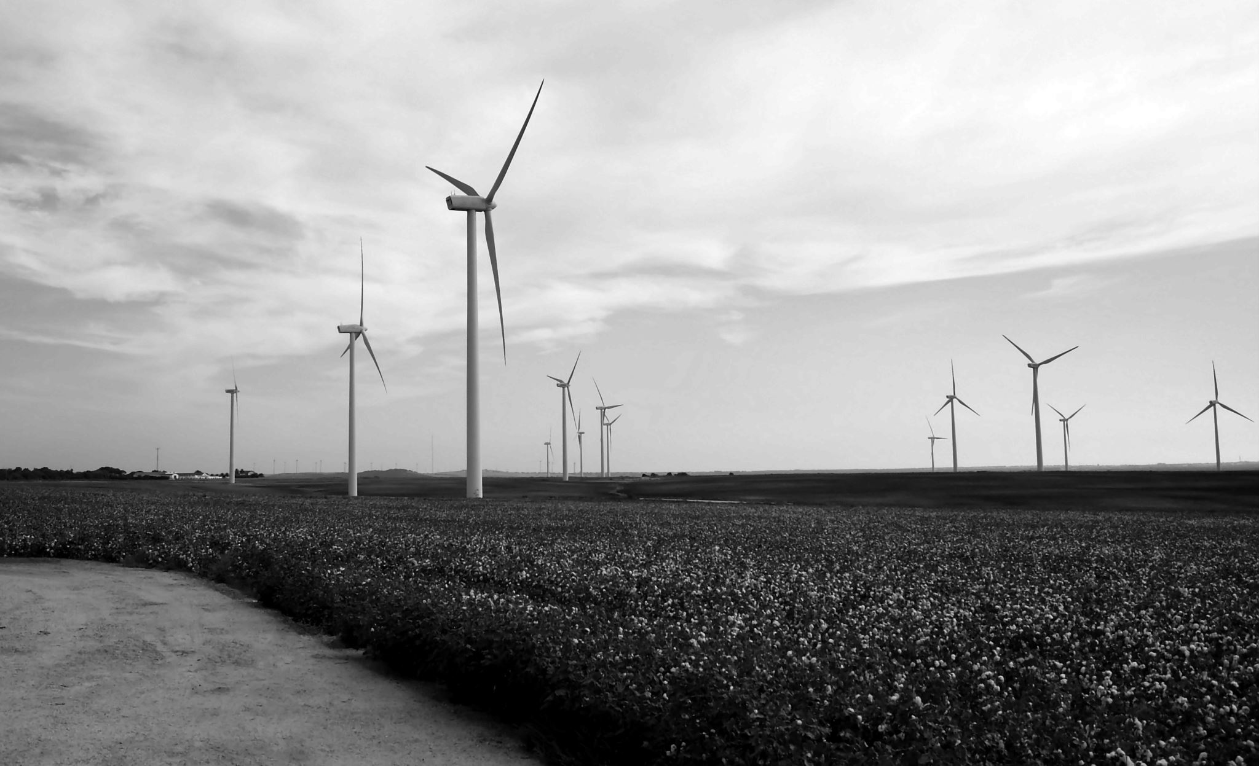

Alberta Advances in Renewable Technologies
Doug UpSkilling Data Analytics May 14, 2024
Notes:
The types of renewable technologies include solar, wind, hydro, and nuclear.

Slide 2
Small Nuclear Reactors and Limitations
Looking at the feasibility of small reactors to help power Alberta's electricity grid.
Clean energy transition needed to become carbon neutral.
Four provinces have agreed to collaborate on the advancement of SMR's as a clean energy option.
SMR's carry a very serious range of negative trade-offs.
Beyond the cost of waste management nuclear power presents too much risk to warrant consideration in Canada.
Notes:
Here we will discuss the long range life span of reactors and the long term effects of uranium mining on the eco system and how we dispose of nuclear waste.

Slide 3
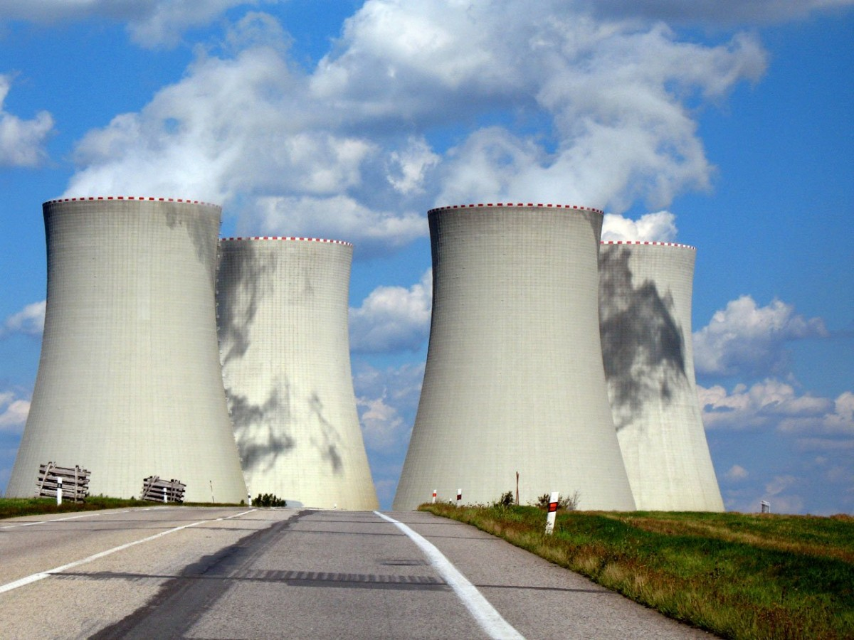
Threats Outside of Maintenance
Catastrophic Accidents
Safety
Security
Weapons Proliferations
Further Outside Risks
Notes:
Canada would be a good place to locate reactors as the land is stable. We can consider the fact that there are few to no earthquakes in the northern areas of the artic shield.

Slide 4
Very Serious Trade-Offs for SMR's
Initial Capital Costs
Management of Nuclear Waste
Impact of Uranium Mining
Provinces Willing to Engage in Nuclear Power in Canada
New Brunswick | Ontario
Saskatchewan | Alberta
Taxation
https://www.foronuclear.org/en/press-room/press-releases/nuclear-power-plants-are-not-amortized-and-nuclear-generation-is-currently-incurring-losses/#:~:text=Nuclear%20power%20plants%20are%20not%20amortized.
4
Notes:
This is a good place to start discussion about the immense initial cost of reactors and how the expense is absorbed by the economy through taxation.

Slide 5
