Slide 1
CHAPTER 4: Conditional Structures
Introduction to Computer Science Using Ruby

Slide 2
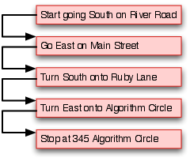
Flow of Execution
Every algorithm has a logic flow
There is a start, steps that happen in chronological order, and an end
There is a graphical way to describe program flow
Understanding control flow is essential to creating and testing an implementation of an algorithm
Figure 4.1:
This chart has a one directional flow (each step is performed once before the next), but some algorithms can have multiple possible execution flows
Notes:
Beginning course details and/or books/materials needed for a class/project.

Slide 3
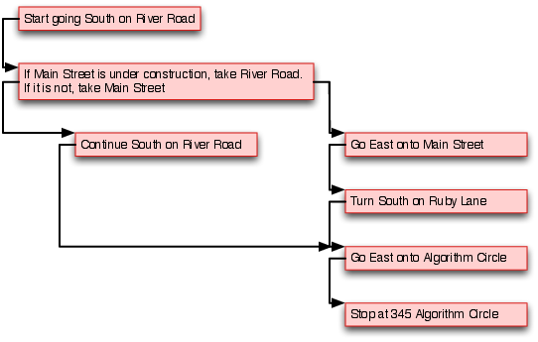
Flow of Execution: Multiple Path Logic Flow (Figure 4.2)
Decision Step
Conditional flow: a certain condition must be met to perform the next step
After doing the first step, follow the path that matches the given condition, then the rest of the flow is one directional
Notes:
A schedule design for optional periods of time/objectives.

Slide 4
Conditional Control
A condition is an expression defined using relational and Boolean operators
A condition has a Boolean value, either True or False
irb(main):001:0> 5 == 5
=> true
irb(main):002:0> 5 == 6
=> false
irb(main):003:0> 5 <= 5
=> true
irb(main):004:0> 5 != 5
=> false

Slide 5
Relational Operators (Table 4.1)
Relational Operators | Meaning
== | Is equal to
!= | Not equal to
< | Less than
> | Greater than
<= | Less than or equal to
>= | Greater than of equal to

Slide 6
Conditional Control
The “!” operator is the negation of a condition or Boolean value
“!” can work on any true or false statement or conditional
Usually referred to as “not”
Boolean operators operate on Boolean values, creating expressions that evaluate to True or False
Operators include: and, or, not
The results of the operators are described by truth tables

Slide 7
Truth Tables for “and” and “or” (Table 4.2)
A | B | A and B | A or B
 |  | A && B | A || B
true | true | true | true
true | false | false | true
false | true | false | true
false | false | false | false

Slide 8
Example: Boolean Expressions
irb(main) :001:0> !false
=>true
irb(main) :002:0> !(true or false)
=> false
irb(main) :003:0> first = true
=> true
irb(main) :004:0> second = false
=> false
irb(main) :005:0> (first and second or !(first and second)
=> true

Slide 9
Conditional Flow: If Statements
Ruby uses an if statement for basic conditional control flow (Example 4.3)
1 if (condition)
2 # section 1
3 end
Input value of 11 (Example 4.4):
1 # if a number is even, print out "Even"
2 puts "Enter a number”
3 number = gets.to_i
4 if (number % 2 == 0) # evaluates to false
5 puts "Even” # does not execute
6 end
Section 1 is executed when the condition evaluates to true or is skipped when the condition evaluates to false

Slide 10
Conditional Flow: If-Then-Else Statements
Provides a second flow option
If the original condition is not met, then the second flow option is taken (Example 4.5)
1 if (condition)
2 # section 1 executes if true
3 else
4 # section 2 executes if false
5 end

Slide 11
Example of Program that Determines Prices of Movie Tickets (Example 4.6)
1 puts "Enter the customer's age: “
2 # Get an integer age value from the user
3 age = gets.to_i
4
5 # Determine the cost based on age
6 if (age < 12)
7 cost = 9
8 else
9 cost = 18
10 end
11
12 # Print out the final cost
13 puts "Ticket cost: " + cost.to_s

Slide 12
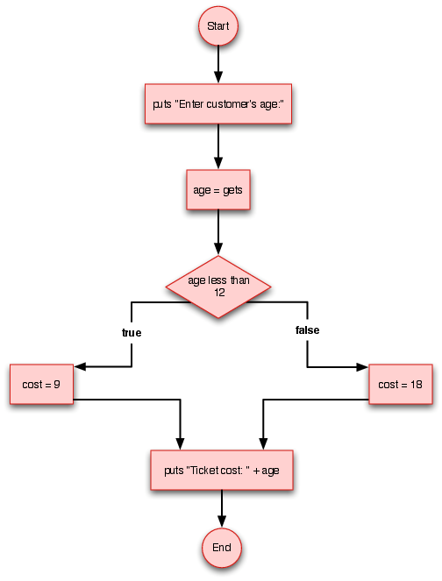
If-Else Statement Logic Flow
To test the program, input one value for each logic flow option
Test the edge or boundary conditions (most errors occur here)
Figure 4.4

Slide 13
Movie Ticket Example: Input Value of 8 (Example 4.6)
1 puts "Enter the customer's age: "
2 # Get an integer age value from the user
3 age = gets.to_i
4
5 # Determine the cost based on age
6 if (age < 12) # evaluates to true
7 cost = 9 # so the If portion Executes
8 else
9 cost = 18 # This portion DOES NOT
10 end
11
12 # Print out the final cost
13 puts "Ticket cost: " + cost.to_s

Slide 14
Movie Ticket Example: Input Value of 25 (Example 4.6)
1 puts "Enter the customer's age: "
2 # Get an integer age value from the user
3 age = gets.to_i
4
5 # Determine the cost based on age
6 if (age < 12)# Evaluates to false
7 cost = 9 # This DOES NOT execute
8 else
9 cost = 18 # Executes
10 end
11
12 # Print out the final cost
13 puts "Ticket cost: “ + cost.to_s

Slide 15
Movie Ticket Example: Input Value of 12 (Figure 4.9)
1 puts "Enter the customer's age: "
2 # Get an integer age value from the user
3 age = gets.to_i
4
5 # Determine the cost based on age
6 if (age < 12) # Evaluates to false
7 cost = 9
8 else
9 cost = 18 # Executes
10 end
11
12 # Print out the final cost
13 puts "Ticket cost: " + cost.to_s
The correct outcome should be 9 because a child is considered 12 or under, so the program is incorrect. To correct the error (“bug”), the conditional test in the program needs to be
“age <= 12”

Slide 16
Elsif Statements
Conditional flow can have more than two flow options
There are various ways to implement a multi-flow control
One of them is using an elsif statement

Slide 17
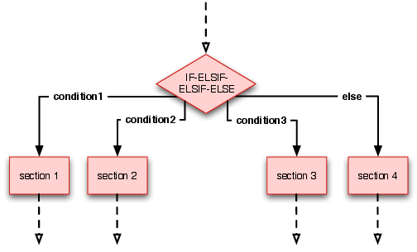
Elsif Statement Logic Flow (Figure 4.5)
Only the first condition that evaluates to true gets executed

Slide 18
Program that Discounts Tickets for Children & Senior Citizens (Example 4.9)
1 puts "Enter the customer's age: "
2 # Get an integer age value from the user
3 age = gets.to_i
4
5 # Determine the cost based on age
6 if (age <= 12)
7 cost = 9
8 elsif (age >= 65)
9 cost = 12
10 else
11 cost = 18
12 end
13
14 # Print out the final cost
15 puts "Ticket cost: " + cost.to_s
Note: The program needs another condition for senior citizens

Slide 19
Review: Original Movie Ticket Program (Example 4.6)
1 puts “Enter the customer's age:”
2 # Get an integer age value from the user
3 age = gets.to_i
4
5 # Determine the cost based on age
6 if (age <= 12)
7 cost = 9
8 else
9 cost = 18
10 end
11
12 # Print out the final cost
13 puts "Ticket cost: " + cost.to_s

Slide 20
Alternatives
Alternative Syntax
Alternative Program
1 puts "Enter the customer's age:”
2 # Get an integer age value from the user
3 age = gets.to_i
4 cost = 18
5 # Determine the cost based on age
6 if (age <= 12)then cost = 9 end
7 # Print out the final cost
8 puts "Ticket cost: " + cost.to_s
1 puts "Enter the customer's age:”
2 # Get an integer age value from the user
3 age = gets.to_i
5 # Determine the cost based on age
6 if (age<=12)then (cost=9)else (cost = 18 ) end
12 # Print out the final cost
13 puts "Ticket cost: " + cost.to_s
SYNTACTIC SUGAR IN ACTION:
Alternative syntax designed for ease of programming and readability

Slide 21
Case Statements
The case statement handles multiple options
Alternative to if-elsif statements
Useful for a large number of options
Case statements evaluate in order
Only the first when clause that evaluates to true gets executed
If none evaluates to true, then the else clause is executed
Figure 4.11:
1 case
2 when (expression1)
3 # section 1
4 when (expression2)
5 # section 2
6 else
7 # section 3
8 end

Slide 22
Movie Ticket Program: Rewritten Using a Case Statement (Example 4.12)
1 puts "Enter the customer's age: "
2 # Get an integer age value from the user
3 age = gets.to_i
4
5 # Determine the cost based on age
6 case
7 when (age <= 12)
8 cost = 9
9 when (age >= 65)
10 cost = 12
11 else
12 cost = 18
13 end
14
15 # Print out the final cost
16 puts "Ticket cost: " + cost.to_s

Slide 23
Debugging: Incorrect Movie Ticket Program (Example 4.13)
Example 1: The cost will always be 9
1 puts "Enter the customer's age: "
2 # Get an integer age value from the user
3 age = gets.to_i
4
5 # Determine the cost based on age
6 case
7
8 when (age = 12) then # Always evaluates to true
9 cost = 9
10 when (age >= 65) then
11 cost = 12
12 else
13 cost = 18
14 end
15
16 # Print out the final cost
17 puts "Ticket cost: " + cost.to_s
# '=' is assignment NOT equality test '=='

Slide 24
Debugging: Incorrect Movie Ticket Program (Example 4.14)
Example 2:
1 puts "Enter the customer's age: "
2 # Get an integer age value from the user
3 age = gets.to_i
4 # DEBUG
5 puts age
6
7 # Determine the cost based on age
8 case
9 # '=' is assignment NOT equality test '=='
10 when (age = 12) then
11 cost = 9
12 when (age >= 65) then
13 cost = 12
14 else
15 cost = 18
16 end

Slide 25
Debugging
Uses puts statements to help identify errors.
Show variable values where they are not changing
Example 4.14 cont’d:
17 # DEBUG
18 puts age # Shows that age always equals 12
19
20 # Print out the final cost
21 puts "Ticket cost: " + cost.to_s

Slide 26
Debugging: Alternatives
Programs can also be debugged using constants
In each section, there is an if statement with a debugging constant as the flag
The flag determines whether a put statement is executed
When a section is judged to be correct, the constant is set to false
There is no need to check variables
The debug output should be fully descriptive
puts “debug – age” + age.to_s
NOT puts “age”

Slide 27
Debugging (Example 4.15)
1 # Flag for debugging (change the false when finished debugging)
2 DEBUG_MODULE_1 = true # Initialize and define a flag constant as true.
3
4 puts "Enter the customer's age: "
5 # Get an integer age value from the user
6 age = gets.to_i
7
8 # Determine the cost based on age
9 if DEBUG_MODULE_1 # Changed to false if this section is correct
10 puts age # Prints age if the section is still # not debugged
11 end
12 case
13 # '=' is assignment NOT equality test '=='
14 when (age = 12) then
15 cost = 9

Slide 28
Debugging (Example 4.15 Cont’d)
16 when (age >= 65) then
17 cost = 12
18 else
19 cost = 18
20 end
21 if DEBUG_MODULE_1 # Changed to false if
# this section is correct
22 puts age # prints age if the section is
# still not debugged incorrect
23 end
24
25 # Print out the final cost
26 puts "Ticket cost: " + cost.to_s

Slide 29
Summary
Every program follows a control flow, which is determined by the logic flow of its algorithms
Logic and control flow can often be one directional or conditional
The relational operators are the key operators to creating conditional flows
Another way to create conditional flow is by employing if, elsif, and case statements

