Slide 1
Chapter 5: Loop Structures
Introduction to Computer Science Using Ruby

Slide 2
While Loops
A loop performs an iteration or repetition
A while loop is the simplest form of a loop
Occurs when a condition is true

Slide 3
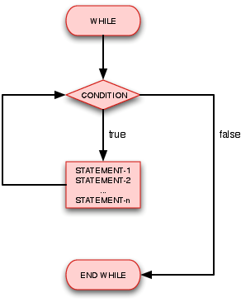
While Loops
Figure 5.1:
1 while (condition)
2 # statement 1
3 # statement 2
4 # ...
5 # statement n
6 end

Slide 4
While Loops
Control flow enters the while loop at the instruction: while (condition)
The condition is evaluated
Each of the statements within the loop are executed if the condition is true
Otherwise, the control flow skips the loop
The while (condition) is reevaluated after the control flow reaches the end
Control flow will repeat the loop from the first to the last statement if the condition evaluates to true
This will continue until the condition evaluates to false

Slide 5
Infinite Loops
Every while loop must lead to the condition eventually becoming false; otherwise, there will an infinite loop
An infinite loop is a loop that does not terminate
Small mistakes can cause infinite loops

Slide 6
Infinite Loops
The program will not terminate
To terminate the program, hold the control key (CTRL) and then press C
This sequence means cancel
Figure 5.6:
1 puts "Count up from 0 to ? ”
2 n = gets.to_i
3 i = 5
4 while (i > 0) # always true
5 i = i + 2
6 # no provision to change the condition to false
7 end

Slide 7
Until Loops
Until loops are the opposite of while loops
The until loop executes until a condition is true
In other words, until loops execute while a condition is false
Until loops execute similarly to while loops
Until loop conditionals map to logical opposites of while loop conditionals (Table 5.1)
Operator | Opposite Operator
== | !=
> | <=
< | >=

Slide 8
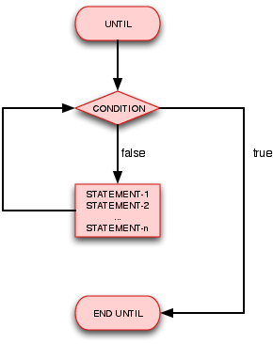
Until Loops
Figure 5.3
1 until (condition)
2 # statement 1
3 # statement 2
4 # ...
5 # statement n
6 end

Slide 9
Based of Figures 5.1 and 5.3
While and until loops are interchangeable
These two loops should be used based on clarity
Use “until this is true” instead of “while this is not true” and vice versa

Slide 10
For Loops and Nested Loops
For Loops
Nested Loops
Execute the statement or statements in the loop once for each iteration element
Figure 5.4:
1 for num in 0..5
2 puts num
3 end
A loop inside a loop
For loops are most commonly used in nested loops

Slide 11
Figure 5.5: For Loops and Nested Loops
1 for i in 1..3
2 puts "Outer loop: i = " + i.to_s
3 for k in 1..4
4 puts "Inner loop: k = " + k.to_s
5 end # for k
6 end # for i
Note: Indentation and end labeling by comments (For clarity and documentation only)

Slide 12
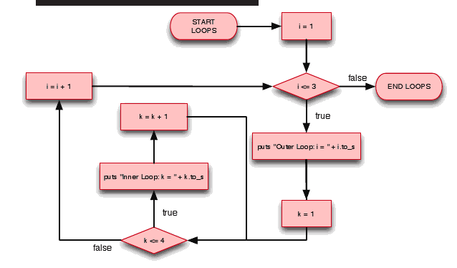
Figure 5.5: For Loops and Nested Loops
The first loop will initialize, then the second will follow
The second loop will finish before the first goes on to the next iteration

Slide 13
Example: Finding Prime Numbers
A prime number can only be divided by one and itself
This program determines whether a number is prime or not
Only numbers less than half the given value need to be checked
This reduces the number of possible loop iterations by half

Slide 14
Figure 5.7: Finding Prime Numbers
1 # Initialize our counter
2 i = 1
3
4 # i: [0, 100]
5 while (i <= 100)
6 # Initialize prime flag
7 prime_flag = true
8 j = 2
9 # Test divisibility of i from [0, i/2]
10 while (j <= i / 2)
11 # puts " i ==> " + i.to_s + " j ==> " + j.to_s
12 if (i % j == 0)
13 prime_flag = false
14 # break
15 end
16 j = j + 1
17 end

Slide 15
Figure 5.7 Cont’d: Finding Prime Numbers
18 # We found a prime!
19 if prime_flag
20 puts "Prime ==> " + i.to_s
21 end
22 # Increment the counter
23 i += 1
24 end

Slide 16
1 # Initialize our counter
2 i = 1
3
4 # i: [0, 100]
5 while (i <= 100)
6 # Initialize prime flag
7 prime_flag = true
8 j = 2
9 # Test divisibility of i from [0, i/2]
10 while (j <= i / 2)
11 # puts " i ==> " + i.to_s + " j ==> " + j.to_s
12 if (i % j == 0)
13 prime_flag = false
14 # break
15 end
16 j = j + 1
17 end
Starts the outer loop for searching
Uncomment for debugging

Slide 17
Example: Finding Prime Numbers
Good debugging statements show the most information with the least output statements
Having many statements can make it harder to find errors
Sometimes, debugging statements are commented out or disabled by Boolean conditions, but not deleted
Could be used later on for debugging or other code might accidentally get deleted with it

Slide 18
1 # Initialize our counter
2 i = 1
3
4 # i: [0, 100]
5 while (i <= 100)
6 # Initialize prime flag
7 prime_flag = true
8 j = 2
9 # Test divisibility of i from [0, i/2]
10 while (j <= i / 2)
11 # puts " i ==> " + i.to_s + " j ==> " + j.to_s
12 if (i % j == 0)
13 prime_flag = false
14 # break
15 end
16 j = j + 1
17 end
Tests to see if j is a factor of i
Flag is switched to signal that i is not prime
Uncomment to make the loop terminate immediately
Increments j
Ends the inner loop
The break command simply ends the loop regardless of the condition tested.
It reduces the number of iterations performed and stops the loop once i is determined not to be prime.

Slide 19
18 # We found a prime!
19 if prime_flag
20 puts "Prime ==> " + i.to_s
21 end
22 # Increment the counter
23 i += 1
24 end
Shorthand notation for
i = i + 1
Converts i to a string and outputs it when its a prime

Slide 20
Example: Finding Prime Numbers
The syntax for the shorthand notation can be used with “+”, “-”, “*”, or “/” operators
Stores the result of the operation in the variable used
Output for the program: modified to check numbers up to 25
Prime → 1
Prime → 2
Prime → 3
Prime → 5
Prime → 7
Prime → 11
Prime → 13
Prime → 17
Prime → 19
Prime → 23

Slide 21
Summary
Loop structures instruct the computer to repeat a set of steps until a condition is met
While loops, until loops, and for loops can be used to create a loop structure
Nested loops are loops within loops

