Slide 1
CHAPTER 8: USING OBJECTS
Introduction to Computer Science Using Ruby

Slide 2
Ruby: Philosophy & Implementation
Ruby is the latest in the family of Object Oriented Programming Languages
As such, its designer studied the problems and promises of past languages
Ruby is an extreme implementation of such a language, containing large complexity on one hand and the ability to ignore any such complexity on the other hand

Slide 3
Ruby: Philosophy & Implementation
Eliminate ANY unnecessary statements, declarations and complexity
Startup has to be very simple
Complexity increase has to be unlimited
Development is supported by interactive capability
Portability is assured via an interpretive implementation

Slide 4
Classes
Programs can be millions of lines of code
Eventually, they become very difficult to debug and maintain
Classes are created to organize programs and data based on functionality

Slide 5
Objects
Classes define the characteristics and behaviors of objects belonging to them
Classes provide an abstraction of possible objects
Objects are the instantiation of classes
They have a name and possess all the properties of the class
Example: Simple variables and their methods

Slide 6
Classes & Objects
Classes are designed to separate key activities in a program
Objects instantiated from classes provide the implementation of the program
Activities are isolated
Communicate information without knowing how it is produced
Classes enable programs to be compartmentalized
Programmers can work at the same time on different classes without running into each other

Slide 7
Methods
Classes have their own private chunks of data and actions
Actions that an object instantiated from a class may perform are referred to as Methods that belong to that Class

Slide 8
Built-in Classes & their Objects
Everything in Ruby is an Object, even a simple variable
As such, it has to be instantiated from a Class
In Ruby, instantiation is many times done automatically, using “hidden” Class definitions
This is one of the ways to eliminate declarations and various auxiliary and obscure statements

Slide 9
Built-in Classes
A Class defines the characteristics and behaviors of an object
Contains the variables and the code necessary to implement the operations (Methods) of the object
Examples of Built-in Classes:
Array
Fixnum
Float
String

Slide 10
Built-in Objects – Classes
There are many more classes than these
It is not required that you know HOW they do what they do, but it is required that you know WHAT they do, how to find them, and how to deploy them

Slide 11
Built-in Classes & their Objects
In Ruby, instantiation can be done automatically using “hidden” Class definitions, or can be done explicitly, using the proper method
This is an automatic creation of an Object (in this case: arr)
No class name is used → Class is hidden → no method
Example: # Automatic creation – no Class name....
arr = [1,2,3,”Wow”]

Slide 12
Built-in Classes & their Objects
In Ruby, instantiation is done automatically many times, using “hidden” Class definitions, or can be done explicitly.
This is an explicit creation of an Object
In this case arr: instantiating it from the class Array using the built-in method “new”
Example: # instantiate an object from the class Array
arr = Array.new

Slide 13
Built-in Classes & their Methods
You can understand Class functionality by looking at the Ruby API, or Application Program(ming) Interface
API allows the use of built-in functionality (that is, the built-in classes and their methods) without knowing the specifics of the implementation

Slide 14
Figure 8.1: String API Documentation
The next slides show the API documentation for the String class
It is taken straight out of the book – which is taken straight from the Ruby public information (with proper attribution)

Slide 15
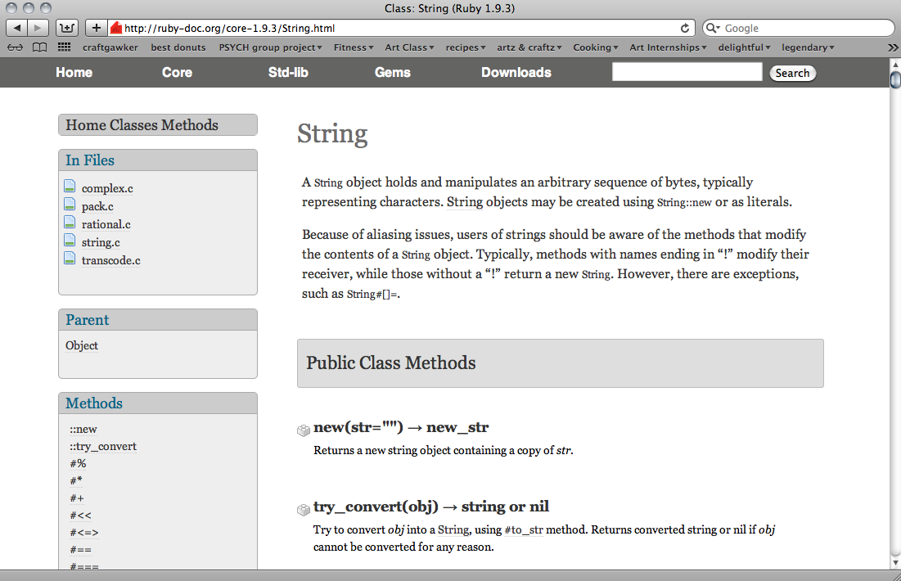
Figure 8.1: String API Documentation
http://ruby-doc.org/core-1.9.3/String.html

Slide 16
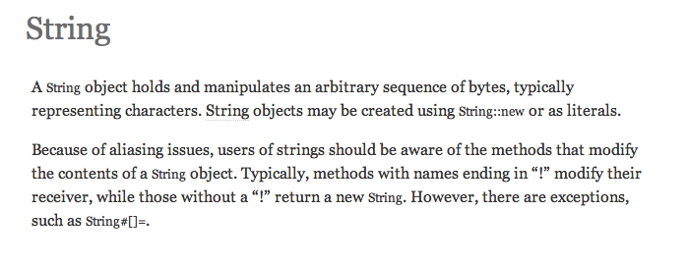
Description of the String class

Slide 17
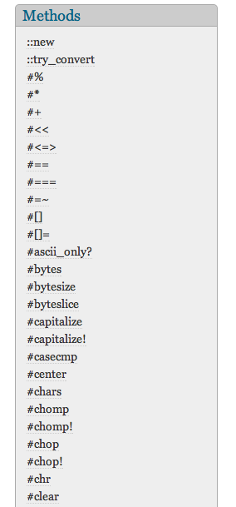
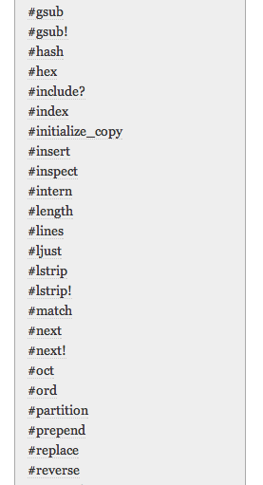
Click each link to get description of methods
We’ll take a look at using the length method
(on left hand side)

Slide 18
Built-in Methods
The length method descriptor is “str.length => integer”
Means that the method will return an integer
irb(main):001:0> "hello".length => 5

Slide 19
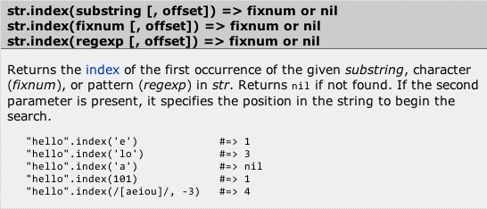
Built-in Methods
Not all methods are this simple:

Slide 20
Built-in Methods
There are multiple ways to call this method

Slide 21
Built-in Methods
This method requires outside data to execute

Slide 22
Parameter Passing
Parameters are data supplied to a method (or to a Class – see later)
See the API for the description of the built-in methods that require parameter(s) (variable(s) in parenthesis
Methods with parameters send the value of the variable to the implementing code

Slide 23
Example 8.1: Parameter Passing
Look at the made up multiplier method:
1 x = 3
2 y = x.multiplier(4)
3 puts "The number is: " + y.to_s
It multiplies the value of the parameter by x
Output: The number is 12.

Slide 24

Parameter Passing
The method works like a black box
The program inside is not known and doesn’t matter
Only the function, thus the output, is important
Figure 8.4: Black Box for Multiplier Method

Slide 25
Example 8.2: Parameter Passing
Example of Split (an actual Ruby built-in method):
This method splits strings into array elements based on the parameter passed
1 my_string = "Good;day;sir!"
2 arr = my_string.split(";")
3 puts arr
4
5 # The following array is created:
6 # arr[0]: "Good"
7 # arr[1]: "day"
8 # arr[2]: "sir!”

Slide 26
Example 8.2: Split Example #1
1 my_string = "Good;day;sir!"
2 arr = my_string.split(";")
3 puts arr
4
5 # The following array is created:
6 # arr[0]: "Good"
7 # arr[1]: "day"
8 # arr[2]: "sir!”
Calls method to use “;” as the parameter for splitting

Slide 27
Example 8.2: Split Example #1
1 my_string = "Good;day;sir!"
2 arr = my_string.split(";")
3 puts arr
4
5 # The following array is created:
6 # arr[0]: "Good"
7 # arr[1]: "day"
8 # arr[2]: "sir!”
Outputs the array
Output:
Good
Day
Sir!

Slide 28
Example 8.3: Split Example #2
Change the parameter to “a”:
1 my_string = "Good;day;sir!"
2 arr = my_string.split("a")
3 puts arr
4
5 # The following array is created:
6 # arr[0]: "Good;d"
7 # arr[1]: "y;sir!”
Output:
Good;d
y;sir!

Slide 29
Example 8.4: Split Example #3
A parameter not found in the string will result in an array containing a string that isn’t split
1 my_string = "Good;day;sir!"
2 arr = my_string.split("z")
3 puts arr
4
5 # The following array is created:
6 # arr[0]: "Good;day;sir!”
Output:
Good;day;sir!

Slide 30
Summary
Classes define the characteristics and behaviors of objects belonging to the class
Objects are instantiations of a class: they have a name and possess all the properties of the class, namely the variables and the methods
The application user interface, or API, is an interface used to communicate with some underlying functionality
Parameter passing is used to transfer information to an object

