Slide 1
INFOCODING BASICS & EXAMPLES OF CURRENT USE
Introduction to Computer Science Using Ruby

Slide 2
ASCII: Tables & Description
American Standard Code for Information Interchange
Computers represent data as numbers, so an ASCII code is the numerical representation of a character such as ‘a’ or ‘@’ or an action of some sort
ASCII was introduced more then half a century ago, so it includes non-printing characters that are rarely used for their original purpose
See enclosed the ASCII character table(s) which include descriptions of the first 32 non-printing characters
Originally, ASCII was designed for use with teletypes and so the descriptions are somewhat obscure

Slide 3
ASCII: Tables and Descriptions
If an ASCII format document is requested, this means that the document should contain just ‘plain’ text with no formatting such as tabs, bold, or underscoring (raw format)
This is usually done so that such document can easily be imported into almost all applications
Notepad creates ASCII text, or in MS Word you can save a file as ‘text only’ (.txt)

Slide 4
ASCII
Originally used 128 codes (7 bits)
The 8 bit ASCII was 7 bit info and one bit for data assurance (parity bit)
Later extended to 256 codes (8 bits)
The extension was divided into two parts:
“Unused” codes 128-159
“Allowed” codes 160-255
Never really observed, THUS ISO 8859!!

Slide 5
ASCII & UNICODE
ASCII is still heavily used today
Being gradually replaced by a new coding standard called UNICODE
Comes in different encodings
Most prevalent are UTF-8 (one byte codes) and UTF-16 (two byte codes)

Slide 6
UNICODE: UTF-8 & UTF-16
The first 128 codes in UTF-8 are identical to the ASCII codes
ASCII coded files can usually be processed by programs that assume UTF-8 coding
UTF-16 coding covers non-Latin character sets
Far Eastern character sets (i.e., Indian, Thai, Japanese Kana)
Ideograms (i.e., Korean)
Pictograms (i.e., Chinese, Japanese Kanji)
As symbols evolve and change, so does UNICODE (i.e., simplified Chinese)

Slide 7
ASCII Code
Standardized under ISO 8859, creating standard extended codes (codes 128-255)
Major variants are:
ISO 8859 - 1 Latin
ISO 8859 - 2 Eastern European
ISO 8859 - 3 Cyrillic
Microsoft has its own ASCII version called “code page 1252” which is ISO 8859 – 1 compatible, but uses the “unused” codes 128-159

Slide 8
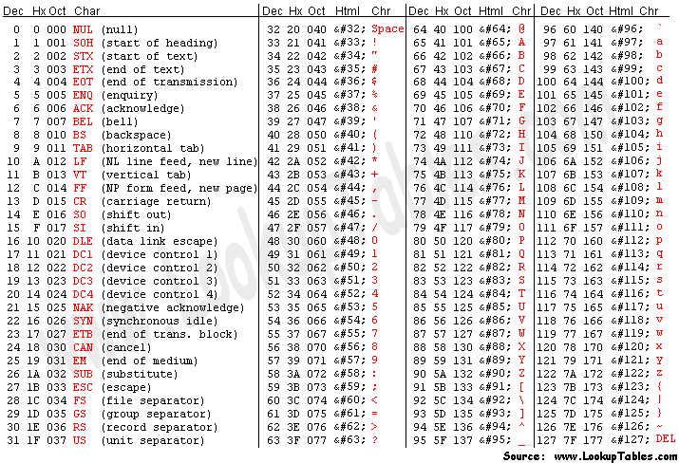
ASCII: Generic

Slide 9
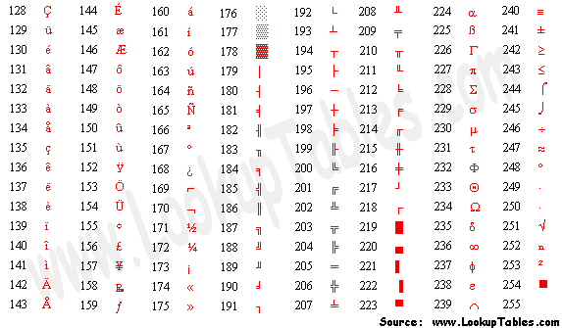
Extended ASCII Codes

Slide 10
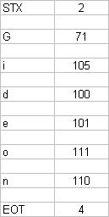

Slide 11
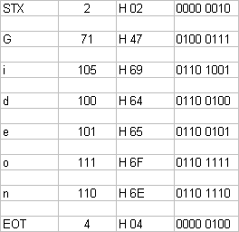

Slide 12
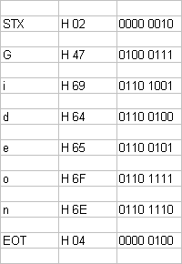

Slide 13
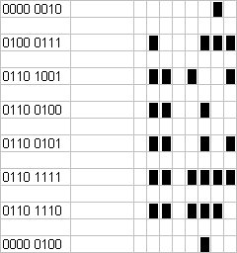

Slide 15
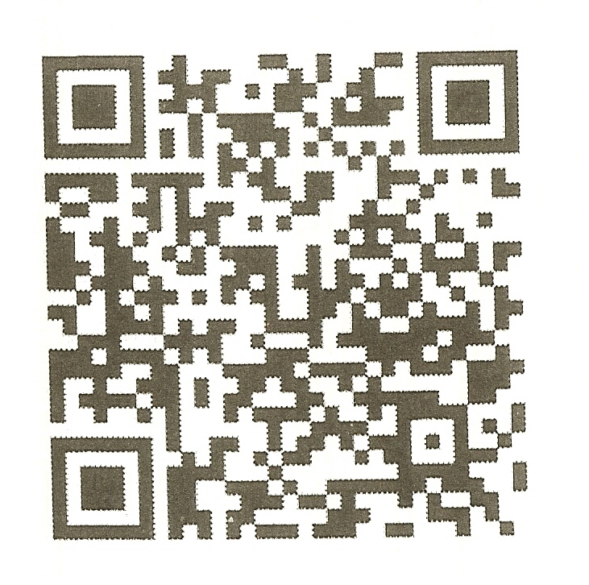

Slide 16
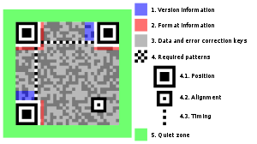
Structure of QR Code & Highlights of Functional Elements
From Wikipedia 2011

