Slide 1

Using the Java™ Management Extensions (JMX™) API for Monitoring and Management
Rima Patel Sriganesh
  Staff Engineer
    Sun Microsystems

Slide 2
Agenda
Introduction to the JMX™ API
Defining your own instrumentation
Accessing your instrumentation remotely
New features in Java SE 6

Slide 3
Adding JMX instrumentation to your app
Remote manager
Application
JMX
manages

Slide 4
MBeans
An MBean is a named managed object representing a resource
  application configuration setting
  program module
  user identity
  device
  etc
An MBean can have:
  attributes that can be read and/or written
  operations that can be invoked
  notifications that the MBean can send

Slide 5
MBean example
CacheControlMBean
Used: int
Size: int
R
RW
attributes
save(): void
dropOldest(int n): int
operations
“com.example.config.change”
“com.example.cache.full”
notifications

Slide 6
Naming MBeans
Every MBean has a name
A name is an instance of the ObjectName class (javax.management.ObjectName)
A name has a domain and one or more key properties
com.example:type=CacheControl
com.example:type=CacheControl,name=whatsitCache
java.lang:type=Threading
java.lang:type=MemoryPool,name=PS Perm Gen
domain
key properties

Slide 7
MBean Server
To be useful, an MBean must be registered in an MBean Server
Each MBean is registered with its ObjectName
Usually, the only access to MBeans is through the MBean Server
You can have more than one MBean Server per Java™ Virtual Machine (JVM™ machine)
But usually, as of Java SE 5, everyone uses the Platform MBean Server
  java.lang.management.ManagementFactory.
  getPlatformMBeanServer()

Slide 8
MBean Server
MBean Server
CacheControlMBean
...
com.example:type=CacheControl

Slide 9
MBean Server
Local clients
MBeanServer mbs;
mbs.createMBean(...);
mbs.invoke(...);
mbs.queryMBeans(...);
MBean Server

Slide 10
MBean Server
Connector clients
Connector client
MBeanServerConnection
mbs;
mbs.createMBean(...);
mbs.invoke(...);
mbs.queryMBeans(...);
RMI, IIOP, ...
Connector server
MBean Server

Slide 11
MBean Server
Connector notes
Connectors defined by the JMX Remote API (JSR 160)
Unrelated to the J2EE™ Connector Architecture
Java SE architecture includes RMI and RMI/IIOP connectors
JSR 160 also defines a purpose-built protocol, JMXMP
  Fits into existing security infrastructures via SASL
Future work: a SOAP-based connector for the Web Services world (JSR 262)

Slide 12
MBean Server
Adaptor clients
Adaptor client
SNMP, HTML, ...
Adaptor
MBean Server

Slide 13

Mapping SNMP or CIM to JMX API
SNMP MIB/
CIM model
skeleton
MBeans
final
MBeans
generation
tool
implement
semantics
Generation not currently standard
  proprietary solutions exist (Sun's is JDMK)
Implementing semantics may mean mapping to another, “native” JMX API model
Automated reverse mapping from JMX API to SNMP or CIM gives poor results

Slide 14
JMX API Services
JMX API includes a number of pre-defined services
  Services are themselves MBeans
Monitoring service (thresholding)
  javax.management.monitor
Relation service (relations between MBeans)
  javax.management.relation
Timer service
  javax.management.timer
M-let service
  javax.management.loading

Slide 15
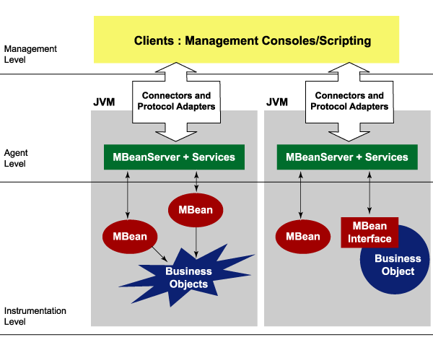
JMX Architecture
Courtsey: Borislav Iordanov

Slide 16
Agenda
Introduction to the JMX™ API
Defining your own instrumentation
Accessing your instrumentation remotely
New features in Java SE 6

Slide 17
Standard MBeans
By far the simplest way to define an MBean
Create a Java™ interface called SomethingMBean that defines the MBean's attributes and operations
Create a Java™ class called Something that implements that interface

Slide 18
Standard MBeans: example (1/3)
CacheControlMBean.java
public interface CacheControlMBean {
// a read-write attribute called Size
// of type int
public int getSize();
public void setSize(int size);
// a read-only attribute called Used
// of type int
public int getUsed();
// an operation called save with no parameters
// and no return value
public void save() throws IOException;
}

Slide 19
Standard MBeans: example (2/3)
CacheControl.java – attributes
public class CacheControl
implements CacheControlMBean {
public CacheControl(Cache<?> cache) {
this.cache = cache;
}
public int getSize() {
return cache.getSize();
}
public void setSize(int size) {
cache.setSize(size);
}
public int getUsed() {
return cache.getUsed();
}
...
private Cache<?> cache;
}
MBean Server

Slide 20
Standard MBeans: example (3/3)
CacheControl.java – operations
public class CacheControl
implements CacheControlMBean {
public CacheControl(Cache<?> cache) {
this.cache = cache;
cache.setSize(prefs.getInt(“CacheSize”,
cache.getSize()));
}
public void save() {
prefs.putInt(“CacheSize”, cache.getSize());
}
...
private static final Preferences prefs =
Preferences.userNodeForPackage(
CacheControl.class);
// one way to do persistence
}

Slide 21
Registering your MBean
MBeanServer mbs = ManagementFactory.getPlatformMBeanServer();
ObjectName name =
new ObjectName(“com.example:type=CacheControl”);
CacheControl cc = new CacheControl(cache);
mbs.registerMBean(cc, name);
mbs.createMBean(GaugeMonitor.class.getName(), name);
There is also a createMBean operation
  mostly interesting for remote clients

Slide 22
Agenda
Introduction to the JMX™ API
Defining your own instrumentation
Accessing your instrumentation remotely
New features in Java SE 6

Slide 23
Running a Java app with remote access to JMX instrumentation
With Sun's JDK 5.0 on supported platforms:
> java -Dcom.sun.management.jmxremote MainClass
Then, in another window on the same machine:
> jconsole
With NetBeans JMX plugin this is one button
Accessing from a remote machine is also possible with a bit more work
In JDK 6 you won't need the property any more

Slide 24
Agenda
Introduction to the JMX™ API
Defining your own instrumentation
Accessing your instrumentation remotely
New features in Java SE 6

Slide 25
MXBeans: Problem statement (1)
An MBean interface can include arbitrary Java™ programming language types
When values must be grouped atomically
public interface ThreadMBean {
public ThreadInfo getThreadInfo();
}
public class ThreadInfo {
public String getName();
public long getBlockedCount();
public long getBlockedTime();
...
}

Slide 26
MXBeans: Problem statement (2)
An MBean interface can include arbitrary Java™ programming language types
Client must have these classes
What about generic clients like jconsole?
What about versioning?
public interface ThreadMBean {
public ThreadInfo getThreadInfo();
}

Slide 27
Open MBeans
JMX™ API defines Open MBeans
  javax.management.openmbean
Predefined set of basic types
  Integer, String, Date, ObjectName, ...
Complex types made using arrays and/or two predefined compositional types
  CompositeData
  TabularData

Slide 28
MXBeans (1)
MXBeans were designed for the instrumentation of the VM itself (JSR 174)
  Already exist in java.lang.management
  User-defined MXBeans are new in Mustang
Management interface still a bean interface
Can reference arbitrary types, with some restrictions
JMX™ API wraps an instance of this interface in an Open MBean

Slide 29
MXBeans (2)
public interface ThreadMXBean {
public ThreadInfo getThreadInfo();
}
public class ThreadMXBeanImpl implements ThreadMXBean {
// Do not need Something/SomethingMXBean naming
public ThreadInfo getThreadInfo() {
return new ThreadInfo(...);
}
}
ThreadMXBean mxbean = new ThreadMXBeanImpl();
ObjectName name =
new ObjectName("java.lang:type=Threading");
mbs.registerMBean(mxbean, name);

Slide 30






MXBeans (3)
Generic client can access as Open MBean
Model-aware client can make ThreadMXBean proxy
MBean Server
Generic Client
Open MBean Wrapper
CompositeData
CompositeData
CompositeData
convert
unconvert
ThreadInfo
ThreadInfo
ThreadInfo
ThreadMXBean
ThreadMXBean
ThreadMXBean Proxy

Slide 31

MXBean References (1)
public interface ProductMXBean {
ModuleMXBean[] getModules();
}
ProductMXBean
ModuleMXBean[ ]
ModuleMXBean

Slide 32


MXBean References (2)
MBean Server
Generic Client
ObjectName[ ]
“P1”
“P1”
“P1”
ObjectName[ ]
{“M1”, “M2”}
ObjectName[ ]
{“M1”, “M2”}
“M1”
“M2”
ProductMXBean
ProductMXBean Proxy
ProductMXBean
ModuleMXBean[ ]
ModuleMXBean[ ]
ModuleMXBean[ ]
ModuleMXBean
ModuleMXBean Proxy
ModuleMXBean

Slide 33
MXBean References (3)
Navigating from a starting point
InstallationManagerMXBean
Products
Licenses
ProductMXBean
Modules
ModuleMXBean
LicenseMXBean
Notes:
I tweaked the colors of the different kinds of MXBean here by using different levels of transparency but this only allows me to get lighter shades of blue. Artists could change the colors arbitrarily, though I'd rather not have too much color contrast. The pairs of boxes that have the same color should continue to have the same color.

Slide 34




Descriptors
version
“2.5”
CacheControlMBean
designer
“data model group”
Used: int
Size: int
R
RW
units
“whatsits”
minValue
0
maxValue
16
save(): void
dropOldest(int n): int
since
“2.3”
“com.example.config.change”
“com.example.cache.full”
severity
5

Slide 35



Descriptors and Generic Clients
(like jconsole)
Used: int
R
units
“whatsits”
minValue
0
maxValue
16
Used
16
whatsits
0

Slide 36
Descriptor details
Classes MBeanInfo, MBeanAttributeInfo, etc., now have an optional Descriptor
Every attribute, operation, notification can have its own Descriptor
Descriptor is set of (key,value) pairs
Some keys have conventional meanings
Users can add their own keys
Descriptors have always existed in Model MBeans

Slide 37
Descriptor Annotations
public interface CacheControlMBean {
@Units("whatsits") @Range(minValue=0, maxValue=16)
public int getUsed();
}
With definitions like:
public @interface Range {
@DescriptorKey("minValue")
public int minValue();
@DescriptorKey("maxValue")
public int maxValue();
}
Used: int
R
units
“whatsits”
minValue
0
maxValue
16

Slide 38
Some Other changes in Java SE 6
Generified at last!
  Set<ObjectName> queryNames(...)
More powerful ObjectName wildcards
  domain:type=Dir,path="/root/*"
Simpler Notification use
  NotificationBroadcasterSupport(MBeanNotificationInfo[])
  class StandardEmitterMBean extends StandardMBean
Monitor attributes of complex type
  MonitorMBean.setObservedAttribute("ThreadInfo.size")
  http://jdk6.dev.java.net

Slide 39
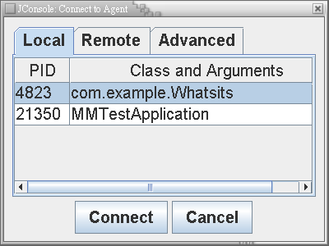
In case the demo doesn't work (1/3)

Slide 40
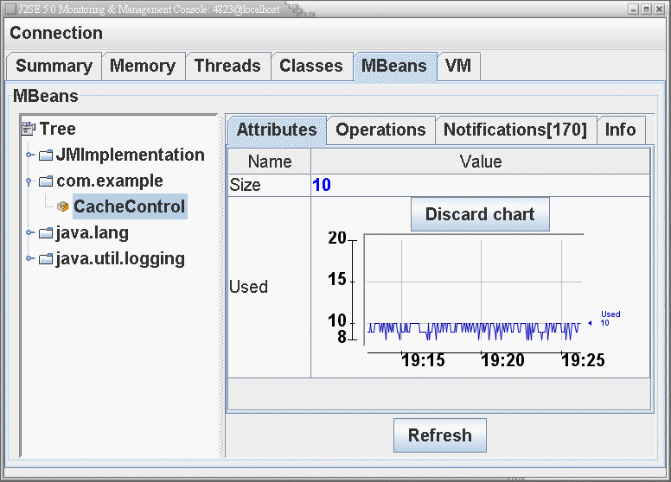
In case the demo doesn't work (2/3)

Slide 41
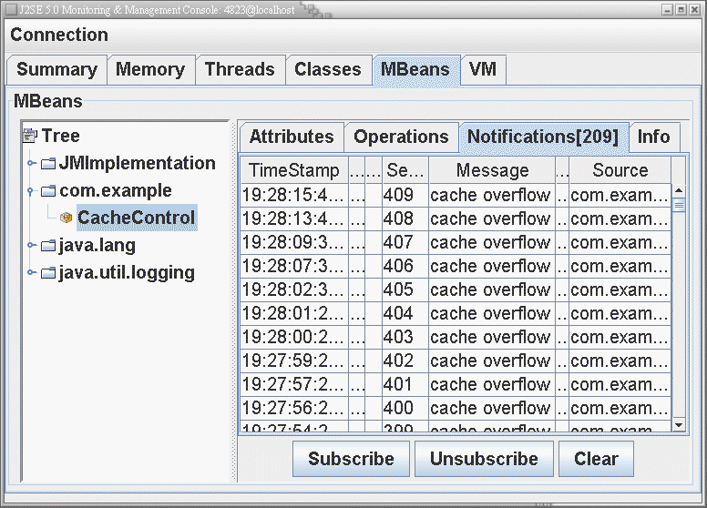
In case the demo doesn't work (3/3)

Slide 42
For More Information
http://java.sun.com/jmx
jmx-forum@java.sun.com
JMX Expert (JSR spec lead)
  Eamonn.McManus@Sun.Com
http://weblogs.java.net/blog/emcmanus
Netbeans JMX plugin
  http://www.netbeans.org/kb/articles/jmx-getstart.html
  jean-francoise.denise@sun.com

Slide 43
Using the Java™ Management Extensions (JMX™) API for Monitoring and Management
Rima Patel Sriganesh
  rima.patel@sun.com
    Sun Microsystems

Slide 44
Standard MBeans: example (4)
CacheControl.java – notification outline
public class CacheControl
extends NotificationBroadcasterSupport
implements CacheControlMBean {
public CacheControl(final Cache<?> cache) {
this.cache = cache;
Thread t = new Thread() {
public void run() {
while (true) {
cache.waitForOverflow();
Notification n = new Notification(
“com.example.cache.overflow”,
CacheControl.this, seqNo++,
“cache overflow”);
sendNotification(n);
}
}
};
t.start(); // or cache could support callbacks
...

