Slide 1

Building Applications on the NetBeans Platform
Tim Boudreau
Staff Engineer
Sun Microsystems
Bangkok, Thailand – January 2006

Slide 2
What is the NetBeans Platform?
Generic desktop application
  Provides services almost all desktop application need
  Lets you concentrate on your business logic
  Saves years of development time
  Does for the desktop what app servers do for the server

Slide 3
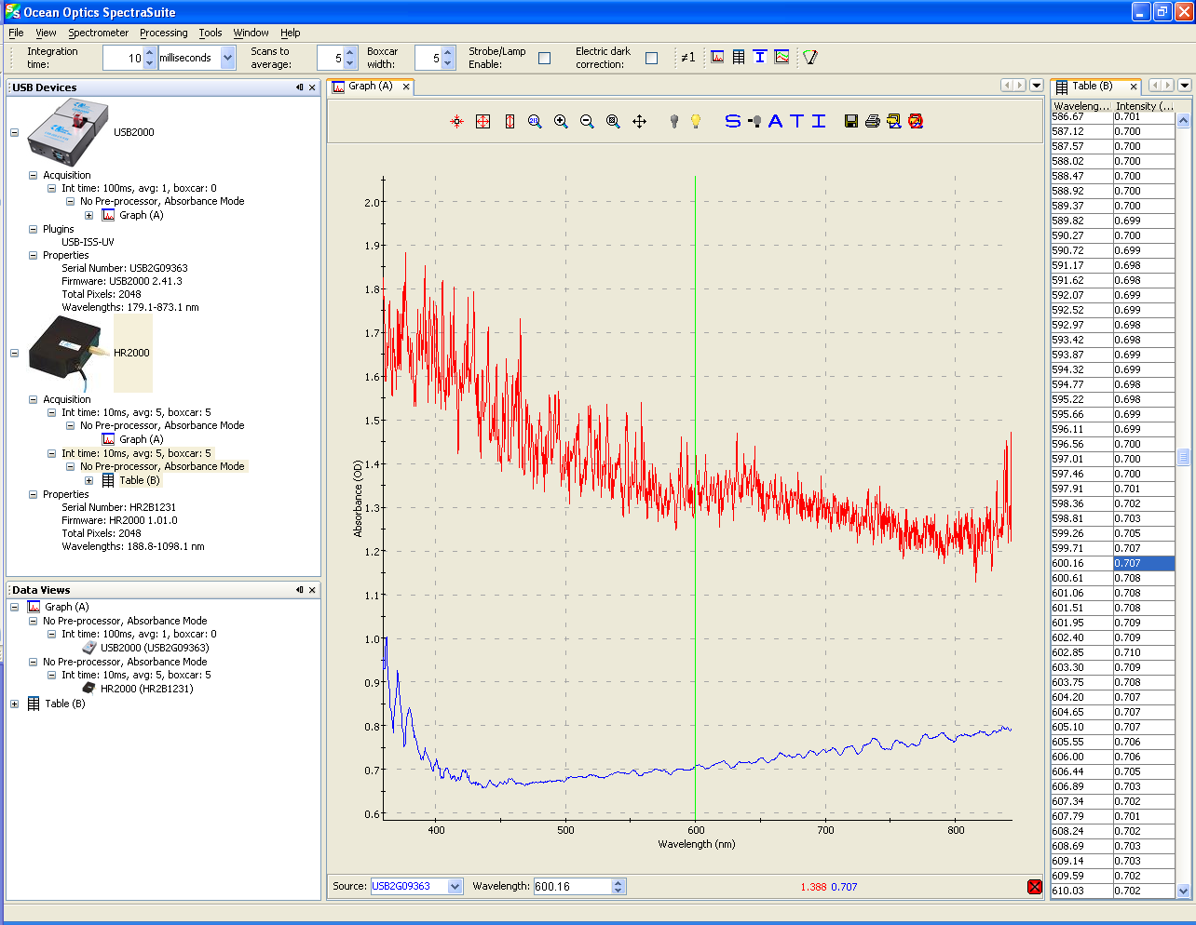
Examples – SpectraSuite

Slide 4
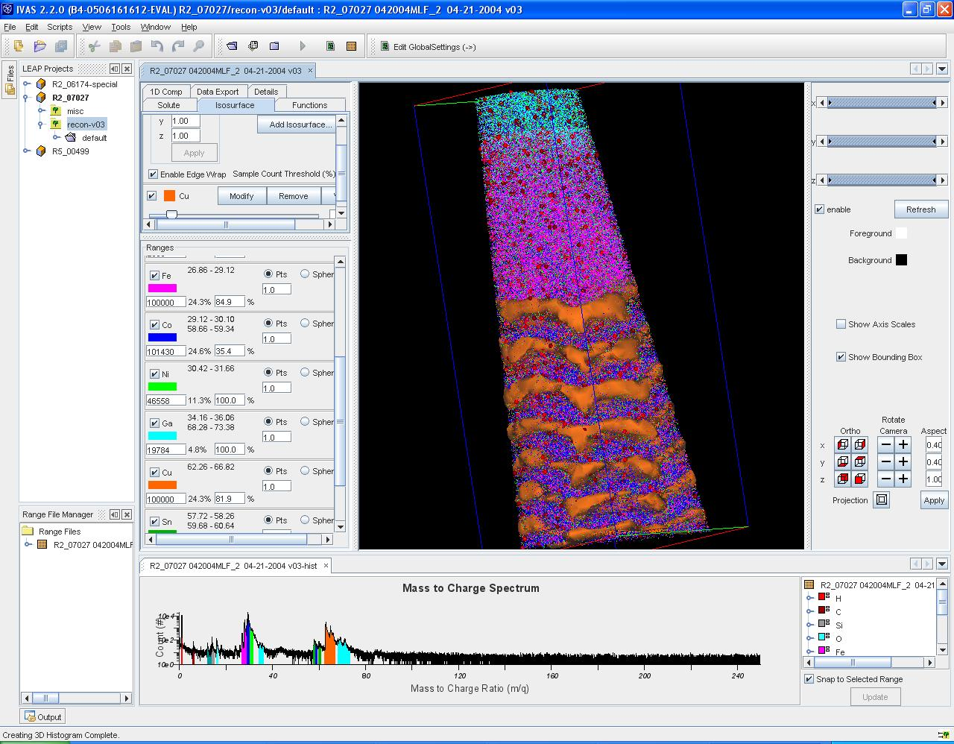
Examples – IVAS

Slide 5
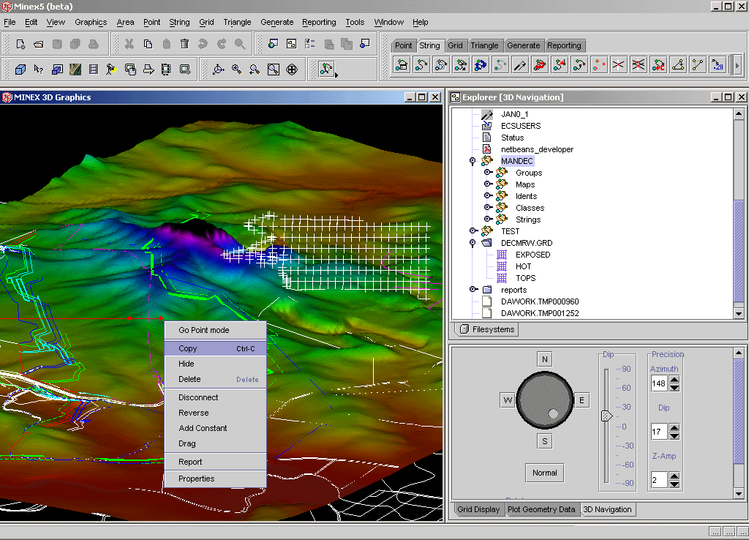
Examples – Minex

Slide 6
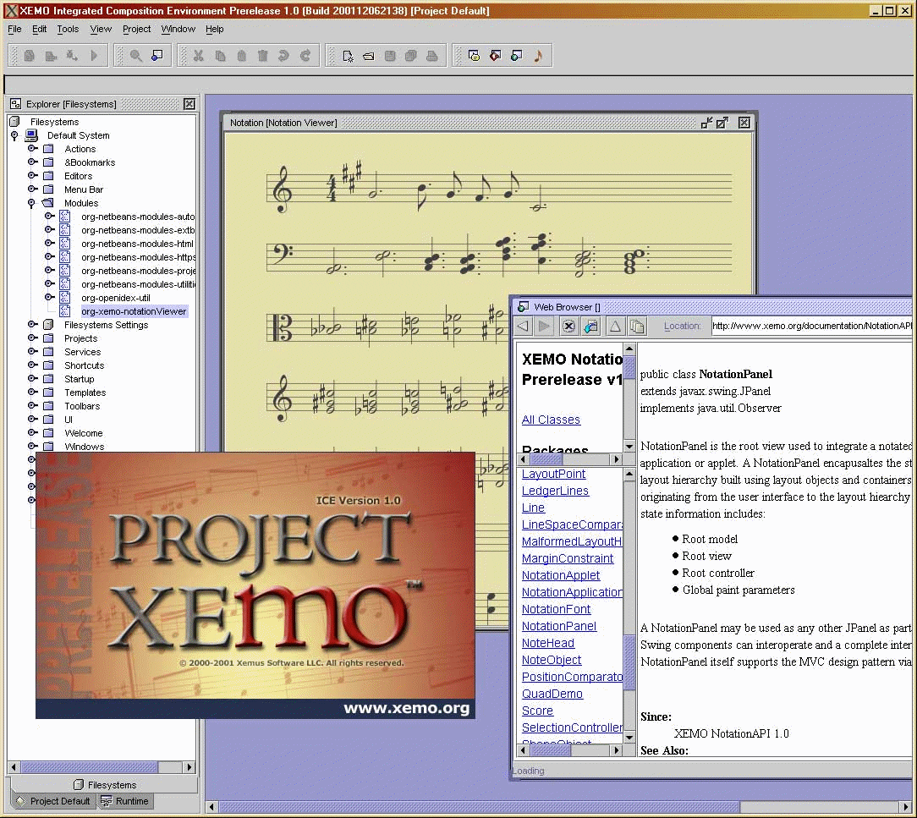
Examples – XEMO

Slide 7
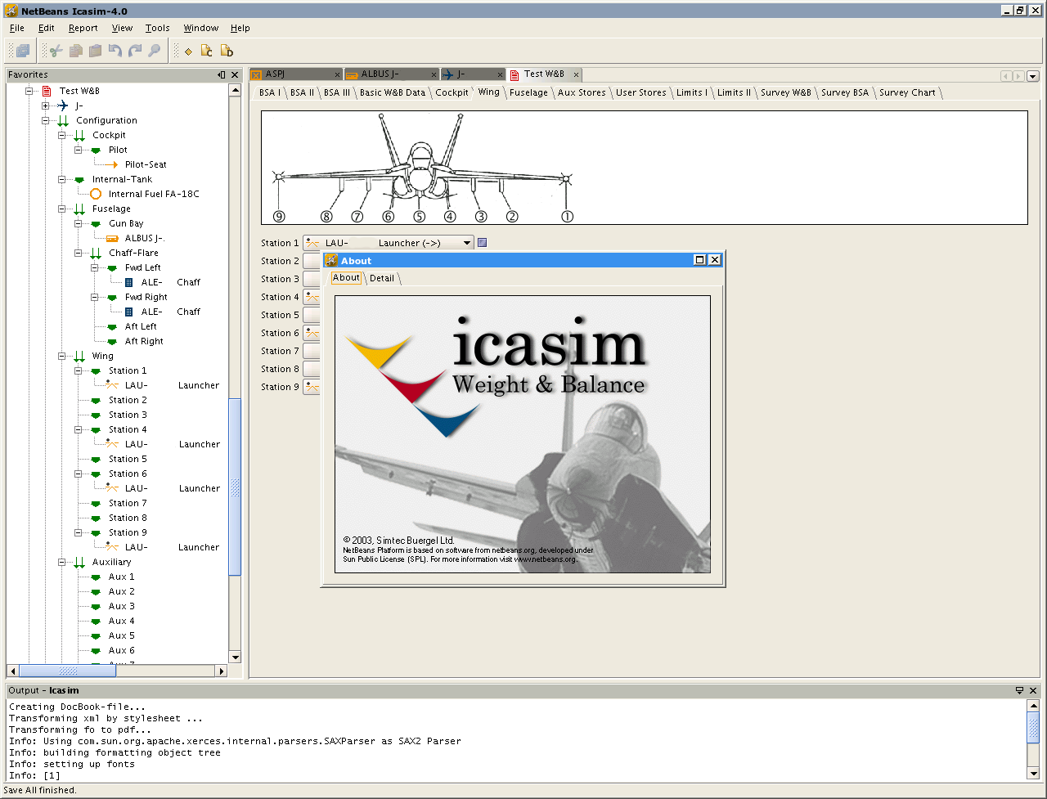
Examples – Icasim

Slide 8
What does a Rich Client Platform do for you?
Saves years of development time
  Menus, actions, settings, windowing – no fun and easy to have bugs
    The platform gives you all of this
    8 years of development – it's mature and well tested
Gives you free stuff
Gives you better software
  Modularity helps maintainability

Slide 9
NetBeans Modules and Platform
Platform == “shell”
Platform + IDE modules == NetBeans IDE
Platform + your modules == Your Application

Slide 10
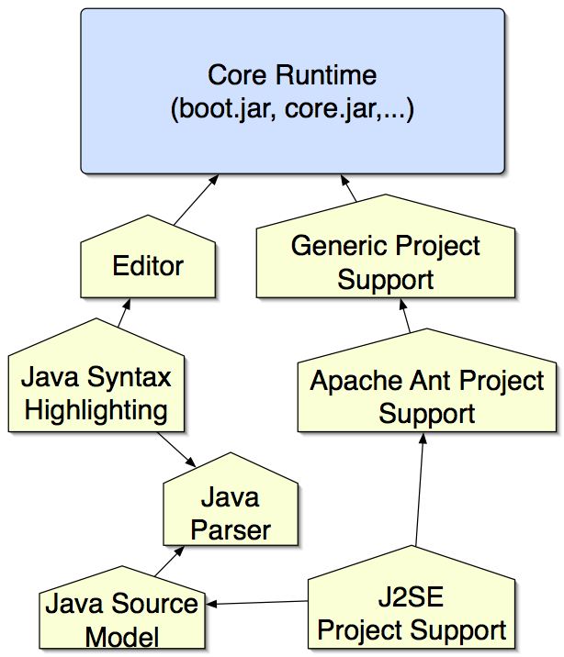
Everything is a Module (Plug-in)

Slide 11
Modular does not have to look modular!
A little UI design...
And a little thought...
And some good APIs...
An application composed of pieces does not have to look like a pile of spare parts

Slide 12
5.0 - Plugin Development Support
Plug-in from a template
Plug-in “suites”
Build/run/debug within the IDE
Hot-redeploy plugins
Debug "fix and continue" (hotswap) for plug-ins
Configuration GUI
Branding
JNLP (Java WebStart)
NetBeans API class templates

Slide 13
Demos
A very simple application
Creating a plug-in

Slide 14
ClassLoader Partitioning
A module that has an API lists some “public packages”
Other modules can only see classes in those packages
  You can have public classes that are public only inside their own JAR
  You can design much cleaner APIs this way – small packages
If a module wants to use classes from another module, it must say it depends on that module

Slide 15
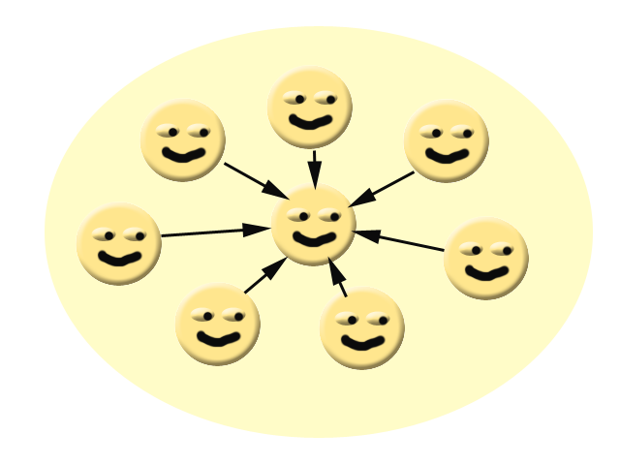
Why modular applications?
Version 1.0 is cleanly designed

Slide 16
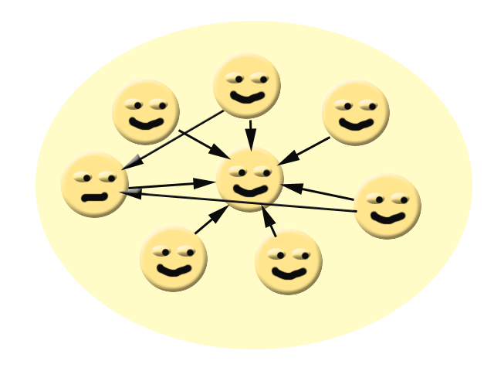
Why modular applications?
Version 1.1...a few expedient hacks...we'll clean those up in 2.0

Slide 17
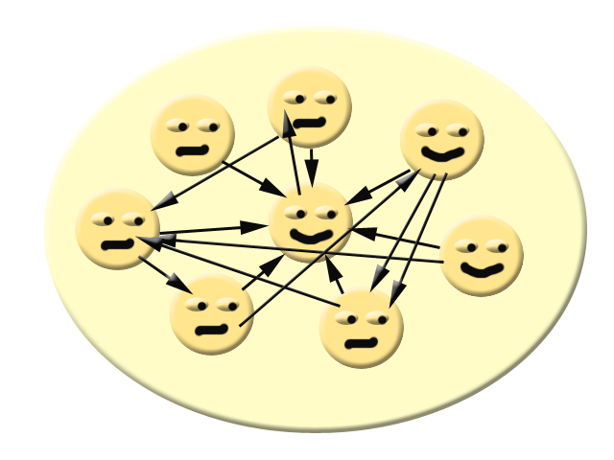
Why modular applications?
Version 2.0...oops...but it works!

Slide 18
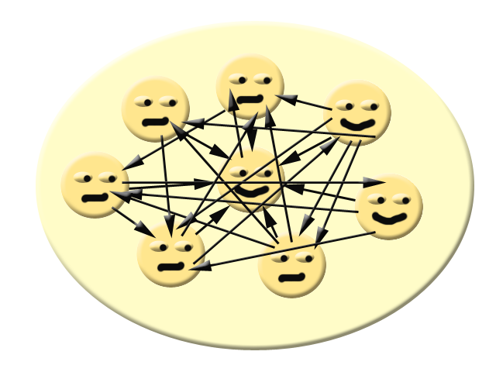
Why modular applications?
Version 3.0...Help! Whenever I fix one bug, I create two more!

Slide 19
Why modular applications?
Version 4.0 is cleanly designed. It's a complete rewrite. It was a year late, but it works...

Slide 20
Why modular applications?
Version 4.1...does this look familiar?....

Slide 21

Why modular applications?
TO BE CONTINUED...

Slide 22
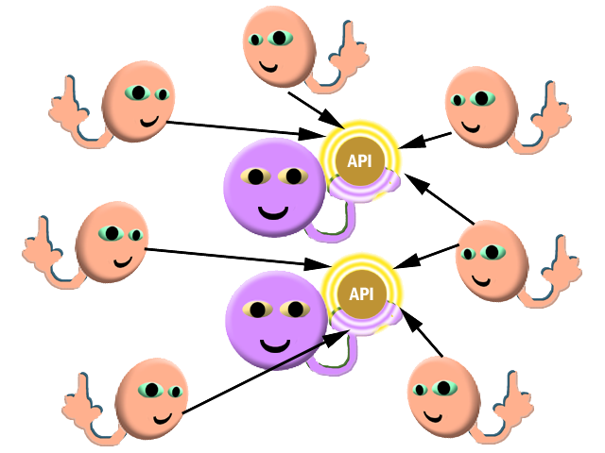
Why modular applications?
Healthy APIs make Healthy Applications!

Slide 23
Example – an extensible application
DEMO

Slide 24
What is a plug-in (module)
JAR file with some special manifest entries
OpenIDE-Module: org.netbeans.modules.project.ant/1
OpenIDE-Module-Specification-Version: 1.6
OpenIDE-Module-Implementation-Version: 050219
OpenIDE-Module-Public-Packages: org.netbeans.api.project.ant.*, org.ne
tbeans.spi.project.ant.*
OpenIDE-Module-Module-Dependencies: org.netbeans.modules.projectapi/1,
org.netbeans.modules.queries/1, org.openide.loaders
OpenIDE-Module-Localizing-Bundle: org/netbeans/modules/project/ant/Bun
dle.properties

Slide 25
What is a plug-in (module)
Module code-name
OpenIDE-Module: org.netbeans.modules.project.ant/1
OpenIDE-Module-Specification-Version: 1.6
OpenIDE-Module-Implementation-Version: 050219
OpenIDE-Module-Public-Packages: org.netbeans.api.project.ant.*, org.ne
tbeans.spi.project.ant.*
OpenIDE-Module-Module-Dependencies: org.netbeans.modules.projectapi/1,
org.netbeans.modules.queries/1, org.openide.loaders
OpenIDE-Module-Localizing-Bundle: org/netbeans/modules/project/ant/Bun
dle.properties

Slide 26
What is a plug-in (module)
Modules have version numbers
OpenIDE-Module: org.netbeans.modules.project.ant/1
OpenIDE-Module-Specification-Version: 1.6
OpenIDE-Module-Implementation-Version: 050219
OpenIDE-Module-Public-Packages: org.netbeans.api.project.ant.*, org.ne
tbeans.spi.project.ant.*
OpenIDE-Module-Module-Dependencies: org.netbeans.modules.projectapi/1,
org.netbeans.modules.queries/1, org.openide.loaders
OpenIDE-Module-Localizing-Bundle: org/netbeans/modules/project/ant/Bun
dle.properties

Slide 27
What is a plug-in (module)
Modules can expose APIs
OpenIDE-Module: org.netbeans.modules.project.ant/1
OpenIDE-Module-Specification-Version: 1.6
OpenIDE-Module-Implementation-Version: 050219
OpenIDE-Module-Public-Packages: org.netbeans.api.project.ant.*, org.ne
tbeans.spi.project.ant.*
OpenIDE-Module-Module-Dependencies: org.netbeans.modules.projectapi/1,
org.netbeans.modules.queries/1, org.openide.loaders
OpenIDE-Module-Localizing-Bundle: org/netbeans/modules/project/ant/Bun
dle.properties

Slide 28
What is a plug-in (module)
Modules can use APIs from other modules
OpenIDE-Module: org.netbeans.modules.project.ant/1
OpenIDE-Module-Specification-Version: 1.6
OpenIDE-Module-Implementation-Version: 050219
OpenIDE-Module-Public-Packages: org.netbeans.api.project.ant.*, org.ne
tbeans.spi.project.ant.*
OpenIDE-Module-Module-Dependencies: org.netbeans.modules.projectapi/1,
org.netbeans.modules.queries/1, org.openide.loaders
OpenIDE-Module-Localizing-Bundle: org/netbeans/modules/project/ant/Bun
dle.properties

Slide 29
What is a plug-in (module)
Everything is localized
OpenIDE-Module: org.netbeans.modules.project.ant/1
OpenIDE-Module-Specification-Version: 1.6
OpenIDE-Module-Implementation-Version: 050219
OpenIDE-Module-Public-Packages: org.netbeans.api.project.ant.*, org.ne
tbeans.spi.project.ant.*
OpenIDE-Module-Module-Dependencies: org.netbeans.modules.projectapi/1,
org.netbeans.modules.queries/1, org.openide.loaders
OpenIDE-Module-Localizing-Bundle: org/netbeans/modules/project/ant/Bun
dle.properties

Slide 30
Demos
Integrating a Hex Editor

Slide 31
Discovery – how plugins install things
You don't want to run code on startup, it slows things down
There are declarative ways to install things in NetBeans
  System Filesystem – a virtual filesystem, XML – you put “files” that represent java classes (MyClass.instance) in “folders” that have different functions
  Java Extension Mechanism – a file in the JAR's META-INF/Services directory names the interface, its content names the implementation

Slide 32
Resources
http://www.netbeans.org - Main NetBeans web site
http://platform.netbeans.org - Plugin developer resources
Plugin development mailing list:
  dev@openide.netbeans.org – subscribe on the web site, or
  news://news.gmane.org – mirrors the mailing lists

Slide 33
Lookup API
A way to find objects (dependency injection)
  Global singletons or services
    Lookup.getDefault().lookup(SomeInterface.class)
  Objects belonging to another object
    node.getLookup().lookup(SomeInterface.class)
    dataObject.getCookie(SomeInterface.class)
Why lookup?
  Lazy instantiation – create on demand
  Evolution/Decoupling
    Its hard to add/remove methods
    Its easy to change what lives in an object's Lookup

Slide 34
Lookup Patterns
“Glue” between disparate APIs
  Lookup.getDefault().lookup ( MyService.class );
Common pattern: To ask an object for an implementation of some interface
  SomeObject.getLookup().lookup( SomeIFace.class );
  SomeObject.getCookie(SomeIFace.class);

Slide 35
Elements of a GUI application - selection
Each “tab” (TopComponent) has an activated Node
  which represents something in a model
  has a display name, actions, etc. - human readable things
  has a Lookup (a Map where the keys are .class objects)
There is a global Lookup which changes as focus changes:
  Utilities.actionsGlobalContext.lookup( OpenCookie.class );

Slide 36
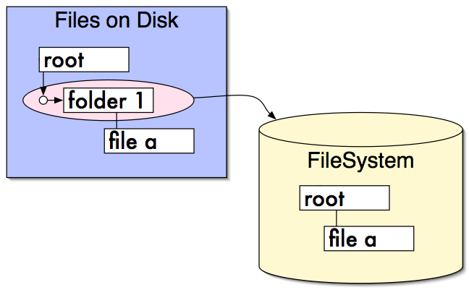
Filesystems – virtual files

Slide 37
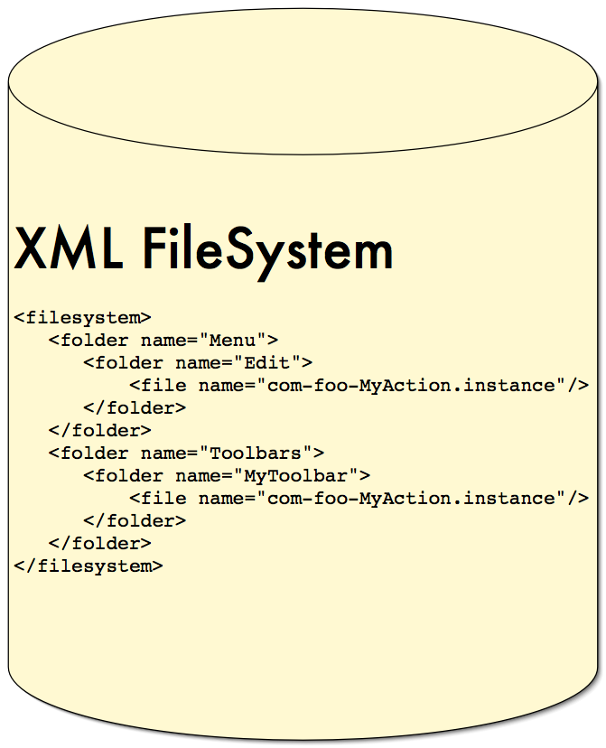
XML Filesystems – very virtual files

Slide 38
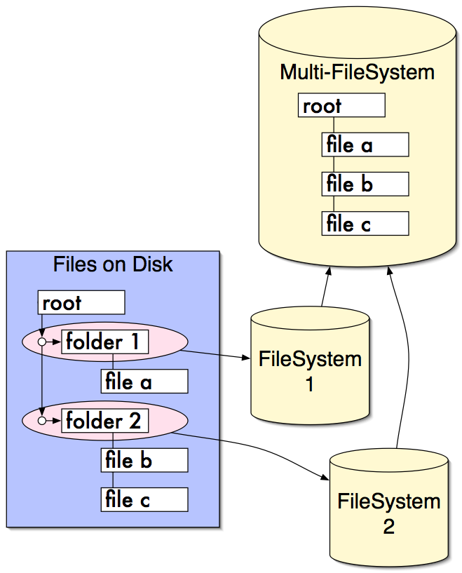
Layered Filesystem

Slide 39
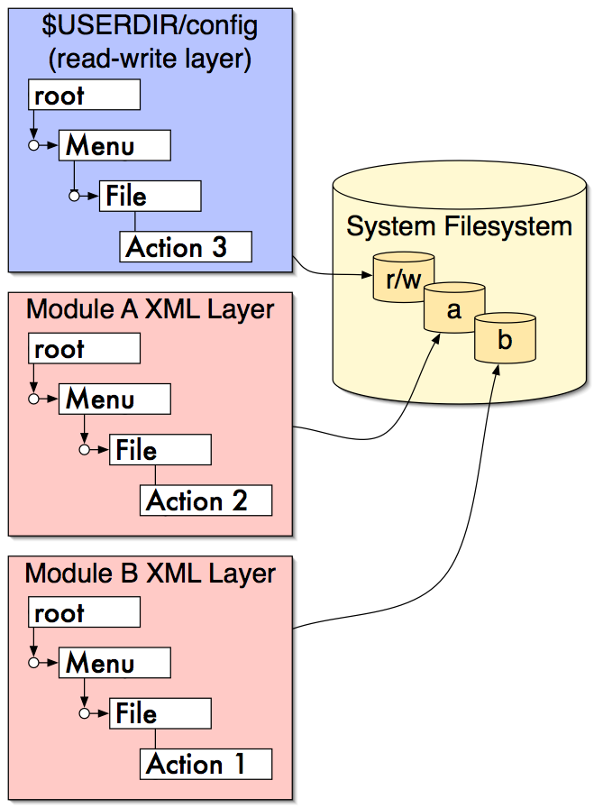
System (configuration) Filesystem

Slide 40
Manipulating the Platform
Demo: Hiding the Help Menu

Slide 41
Modules create their own extension points
System Filesystem
  Define a folder in the System Filesystem
  (Optionally) define an interface for what goes there
  Let other modules add files there
Global Lookup
  Define an interface
  Let modules register interfaces in META-INF/services

Slide 42
A Tour of the System Filesystem
DEMO: Browsing the System Filesystem

Slide 43
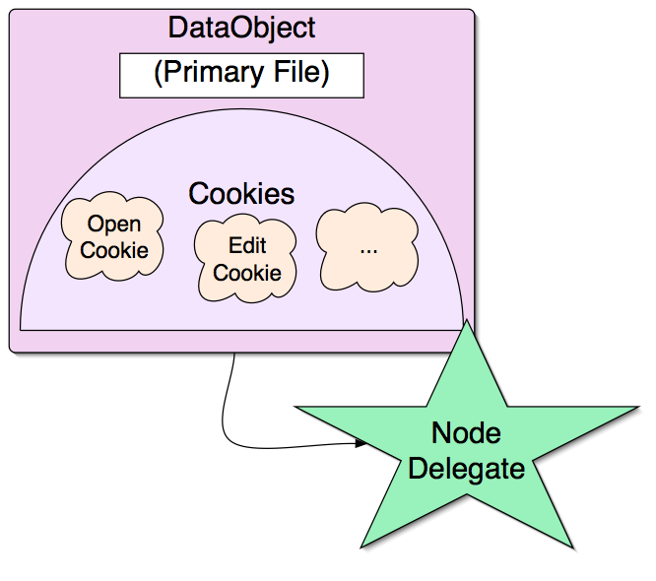
DataObjects wrap FileObjects
DataObject.getCookie(
OpenCookie.class)

Slide 44
DataSystems API
DataObjects – wrap 1 or more FileObjects
  “Typed” files – knows what the content is
    DataObject subclass :: MIME type
  Programmatic access to file contents
    Structural or parsed representation of contents
    Support for editing, etc.
DataLoaders
  Factories for DataObject
  Recognize and claim FileObjects by extension or contents

Slide 45
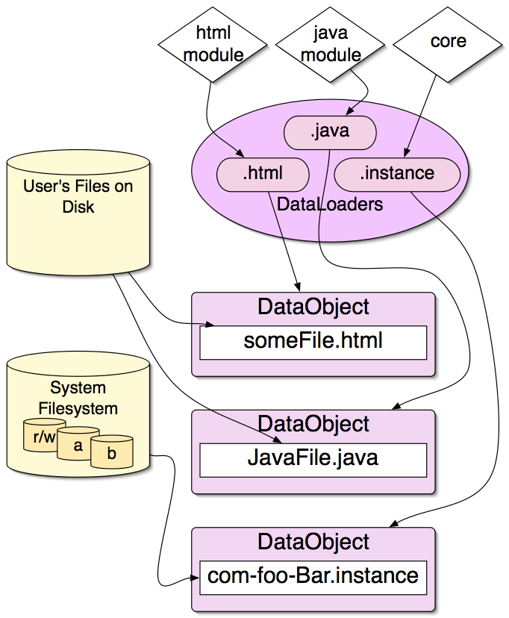
DataSystems

Slide 46
What is a Node
A node has
  Human readable display name
  Icon
  Actions
  Cookies (objects that can be requested from its Lookup)

Slide 47
Nodes API
Presentation layer on top of DataObjects
Generic hierarchy API
Displayed to user with the Explorer API
  Tree, List, Combo, Menu, TreeTable and other views
Don't have to represent files
Global selection context
  Each tab has an “activated node”

Slide 48
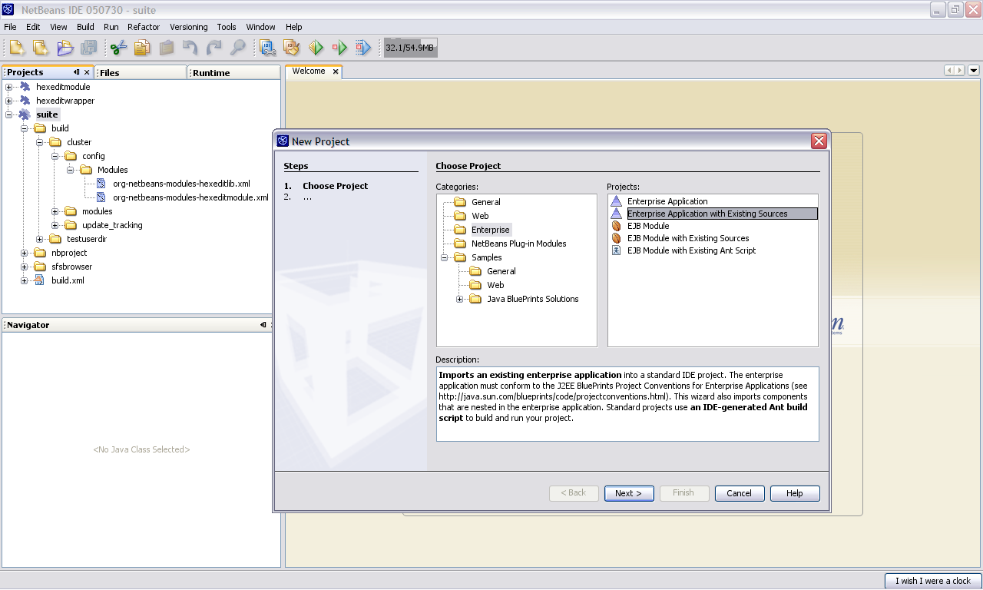
These are Nodes

Slide 49
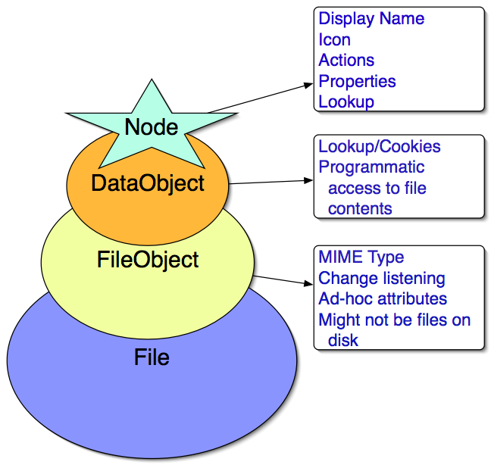
From Files to Nodes

Slide 50
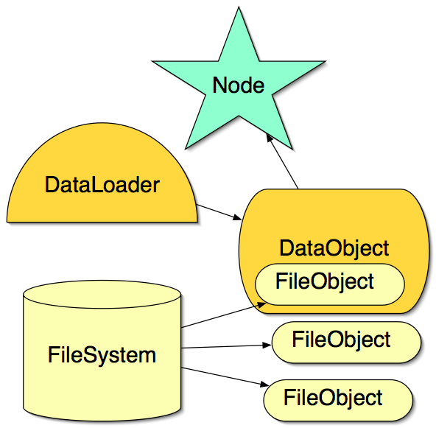
Factory Relationships – Files to Nodes

Slide 51
Global Lookup Registration
Instance file in system filesystem:
<folder name=”services”>
  <file name=”org-foo-mymodule-MyService.instance”/>
</folder>
META-INF/services entry in jar:
  A single file that names the interface implemented
    META-INF/services/org.openide.awt.StatusDisplayer
  With a single line of text naming the implementation class
    com.mycom.mymodule.MyStatusDisplayer

Slide 52
Global Lookup Registration
StatusDisplayer.getDefault() does this:
public static StatusDisplayer getDefault() {
return Lookup.getDefault().lookup (
StatusDisplayer.class);
}
...and finds com.mycom.mymodule.MyStatusDisplayer

Slide 53
It's like Jini
Don't think “I want to listen to that object”
Think: “I want to watch this space and...”
  See what's in it
  React when objects appear or disappear
Lookup.getDefault() is the global space
Any object can own its own space – someObject.getLookup()...
and many do (Nodes, Projects, ...)

Slide 54
What's in a Node's Lookup?
Everything that's in its DataObject's lookup
Objects that implement known interfaces, such as
  OpenCookie to open a file
  Abstract syntax tree of a Java file
  DOM tree of an XML file
  SaveCookie if the file is modified
  Whatever you want to put there...

Slide 55
getLookup() vs. getCookie()
Newer idiom
    someobject.getLookup().lookup(SomeClass.class)
Older idiom
    someobject.getCookie(SomeClass.class)
Principle difference
    Lookup is more generic
    Objects in a Lookup don't have to implement the marker interface Node.Cookie

Slide 56
Things to remember
Many things have two purposes
  FileSystems/DataSystems
    FileObjects/DataObjects represent the user's files
    FileObjects/DataObjects represent configuration data
  Lookup
    Global services, singletons
    Objects belonging to some other object
The system filesystem is just another filesystem

Slide 57
Questions and Answers
Q&A

Slide 58
Productivity with NetBeans, Matisse and the NetBeans Platform
Tim Boudreau
Staff Engineer
Sun Microsystems
Sao Paulo, Brazil – Nov. 2005

