Slide 1

JavaBeans
Notes:
Welcome to Servlet advanced session. We learned basic concepts of Servlet in our previous class. Today we are going to learn advanced concepts of Servlet.

Slide 2
Topics
JavaBean as a software component model
Core concepts of JavaBeans
Properties
Event model
Introspection
Bean persistence
Bean persistence in XML

Slide 3
JavaBean as a
Software Component Model
Notes:
Now let's talk about how to include another web resource.

Slide 4
Software Component
Software components are self-contained, reusable software units
Visual software components
  Using visual application builder tools, visual software components can be composed into applets, applications, servlets, and composite components
  You perform this composition within a graphical user interface, and you can immediately see the results of your work.
Non-visual software components
  Capture business logic or state

Slide 5
What is a JavaBean?
JavaBeans™ is a portable, platform-independent component model written in the Java programming language
With the JavaBeans API you can create reusable, platform-independent components
Using JavaBeans-compliant application builder tools such as NetBeans or Eclipse, you can combine these components into applets, applications, or composite components.

Slide 6
What is a JavaBean?
JavaBean components are known as beans.
Beans are dynamic in that they can be changed or customized
Through the design mode of a builder tool, you use the property sheet or bean customizer to customize the bean and then save (persist) your customized beans.

Slide 7
Core Concepts of JavaBeans
Notes:
Now let's talk about how to include another web resource.

Slide 8
Builder Tools & Introspection
Builder tools discover a bean's features (that is, its properties, methods, and events) by a process known as introspection.
Beans support introspection in two ways:
  By adhering to specific rules, known as design patterns, when naming bean features
  By explicitly providing property, method, and event information with a related bean information class.

Slide 9
Properties
Properties are the appearance and behavior characteristics of a bean that can be changed at design time
Beans expose properties so they can be customized at design time
Builder tools introspect on a bean to discover its properties and expose those properties for manipulation
Customizing is supported in two ways:
  by using property editors
  by using more sophisticated bean customizers

Slide 10
Events
Beans use events to communicate with other beans
A bean that is to receive events (a listener bean) registers with the bean that fires the event (a source bean)
Builder tools can examine a bean and determine which events that bean can fire (send) and which it can handle (receive)

Slide 11
Persistence
Persistence enables beans to save and restore their state
After changing a bean's properties, you can save the state of the bean and restore that bean at a later time with the property changes intact
The JavaBeans architecture uses Java Object Serialization to support persistence.

Slide 12
JavaBean Method
A bean's methods are no different from Java methods, and can be called from other beans or a scripting environment
By default all public methods are exported

Slide 13
Examples of Beans
GUI (graphical user interface) component
Non-visual beans, such as a spelling checker
Animation applet
Spreadsheet application

Slide 14
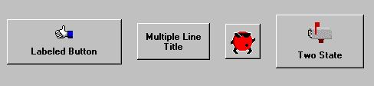
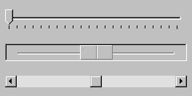
Examples of GUI Beans
Button Beans
Slider Bean

Slide 15
Properties
Notes:
Now let's talk about how to include another web resource.

Slide 16
Properties
A bean property is a named attribute of a bean that can affect its behavior or appearance
Examples of bean properties include color, label, font, font size, and display size.

Slide 17
Types of Properties
Simple – A bean property with a single value whose changes are independent of changes in any other property.
Indexed – A bean property that supports a range of values instead of a single value.
Bound – A bean property for which a change to the property results in a notification being sent to some other bean.
Constrained – A bean property for which a change to the property results in validation by another bean. The other bean may reject the change if it is not appropriate.

Slide 18
Event Model
Notes:
Now let's talk about how to include another web resource.

Slide 19
JavaBeans Event Model
Based the Java 1.1 event model
An object interested in receiving events is an event listener – sometimes called event receiver
An object that generates (fire) events is called an event source – sometimes called event sender
Event listeners register their interest of receiving events to the event source
  Event source provides the methods for event listeners to call for registration
The event source maintains a list of listeners and invoke them when an event occurs

Slide 20
Registration of Event Listeners
Event listeners are registered to the event source through the methods provided by the event source
  addXXXListener
  removeXXXListener

Slide 21
Steps of Writing Event Handling
Write Event class
  Create your own custom event class, named XXXEvent or use an existing event class
  There are existing event class (i.e. ActionEvent)
Write Event listener (Event handler or Event receiver)
  Write XXXListener interface and provide implementation class of it
  There are built-in listerner interfaces (i.e. ActionListener)
Write Event source (Event generator)
  Add an addXXXListener and removeXXXListener methods, where XXX stands for the name of the event
  These methods are used by event listeners for registration
  There are built-in event source classes

Slide 22
Steps of Adding Event Handling
Write a glue class
  Register event listener to the event source through addXXXListener() method of the event source

Slide 23
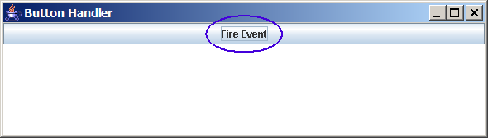
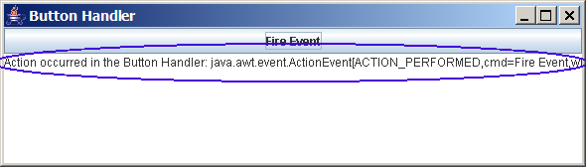
Example 1: Button Handler

Slide 24
1. Write Event Class
We are going to use ActionEvent class which is already provided in JDK

Slide 25
2. Write Event Listener Class
We are going to use ActionListener interface which is already provided in JDK
We are going to write ButtonHandler class which implements ActionListener interface

Slide 26
2. Write Event Listener Class
public class ButtonHandler implements ActionListener {
/**
* Component that will contain messages about
* events generated.
*/
private JTextArea output;
/**
* Creates an ActionListener that will put messages in
* JTextArea everytime event received.
*/
public ButtonHandler( JTextArea output ) {
this.output = output;
}
/**
* When receives action event notification, appends
* message to the JTextArea passed into the constructor.
*/
public void actionPerformed( ActionEvent event ) {
this.output.append( "Action occurred in the Button Handler: " + event + '\n' );
}
}

Slide 27
3. Write Event Source Class
We are going to use Button class which is event source class and is already provided in JDK
Button class already has the following methods
  addActionListener
  removeActionListener

Slide 28
4. Write Glue Code
Create object instances
Register event handler to the event source

Slide 29
4. Write Glue Code
public class ActionEventExample {
public static void main(String[] args) {
JFrame frame = new JFrame( "Button Handler" );
JTextArea area = new JTextArea( 6, 80 );
// Create event source object
JButton button = new JButton( "Fire Event" );
// Register an ActionListener object to the event source
button.addActionListener( new ButtonHandler( area ) );
frame.add( button, BorderLayout.NORTH );
frame.add( area, BorderLayout.CENTER );
frame.pack();
frame.setDefaultCloseOperation( WindowConstants.DISPOSE_ON_CLOSE );
frame.setLocationRelativeTo( null );
frame.setVisible( true );
}
}

Slide 30
What Happens When an Event Occurs?
Event source invokes event handling method of all Event handlers (event listener) registered to it
  actionPerformed() method ButtonHandler will be invoked

Slide 31
Introspection
Notes:
Now let's talk about how to include another web resource.

Slide 32
What is Introspection?
Introspection is the automatic process of analyzing a bean's design patterns to reveal the bean's properties, events, and methods
  This process controls the publishing and discovery of bean operations and properties
By default, introspection is supported by reflection, where you name methods with certain naming patterns, like set/getProperty() and add/removeListener()

Slide 33
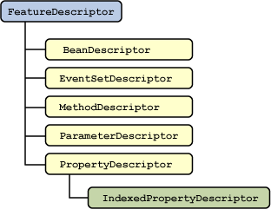
FeatureDescriptor

Slide 34
Things That Can be Found through Introspection
Simple property
  public void setPropertyName(PropertyType value);
  public PropertyType getPropertyName();
Boolean property
  public void setPropertyName(boolean value);
  public boolean isPropertyName();
Indexed property
  public void setPropertyName(int index, PropertyType value);
  public PropertyType getPropertyName(int index);
  public void setPropertyName(PropertyType[] value);
  public PropertyType[] getPropertyName();

Slide 35
Things That can be found through Introspection
Multicast events
  public void addEventListenerType(EventListenerType l);
  public void removeEventListenerType(EventListenerType l);
Unicast events
  public void addEventListenerType(EventListenerType l) throws TooManyListenersException;
  public void removeEventListenerType(EventListenerType l);
Methods
  public methods

Slide 36
Bean Persistence
Notes:
Now let's talk about how to include another web resource.

Slide 37
Bean Persistence
Through object serialization
Object serialization means converting an object into a data stream and writing it to storage.
Any applet, application, or tool that uses that bean can then "reconstitute" it by deserialization. The object is then restored to its original state
For example, a Java application can serialize a Frame window on a Microsoft Windows machine, the serialized file can be sent with e-mail to a Solaris machine, and then a Java application can restore the Frame window to the exact state which existed on the Microsoft Windows machine.

Slide 38
Bean Persistence in
XML
Notes:
Now let's talk about how to include another web resource.

Slide 39
XMLEncoder Class
Enable beans to be saved in XML format
The XMLEncoder class is assigned to write output files for textual representation of Serializable objects
  XMLEncoder encoder = new XMLEncoder(
  new BufferedOutputStream(
  new FileOutputStream( "Beanarchive.xml" ) ) );
  encoder.writeObject( object );
  encoder.close();

Slide 40
XMLDecoder Class
XMLDecoder class reads an XML document that was created with XMLEncoder:
  XMLDecoder decoder = new XMLDecoder(
  new BufferedInputStream(
  new FileInputStream( "Beanarchive.xml" ) ) );
  Object object = decoder.readObject();
  decoder.close();

Slide 41
Example: SimpleBean
import java.awt.Color;
import java.beans.XMLDecoder;
import javax.swing.JLabel;
import java.io.Serializable;
public class SimpleBean extends JLabel
implements Serializable {
public SimpleBean() {
setText( "Hello world!" );
setOpaque( true );
setBackground( Color.RED );
setForeground( Color.YELLOW );
setVerticalAlignment( CENTER );
setHorizontalAlignment( CENTER );
}
}

Slide 42
Example: XML Representation
<?xml version="1.0" encoding="UTF-8" ?>
<java>
<object class="javax.swing.JFrame">
<void method="add">
<object class="java.awt.BorderLayout" field="CENTER"/>
<object class="SimpleBean"/>
</void>
<void property="defaultCloseOperation">
<object class="javax.swing.WindowConstants" field="DISPOSE_ON_CLOSE"/>
</void>
<void method="pack"/>
<void property="visible">
<boolean>true</boolean>
</void>
</object>
</java>

Slide 43
JavaBeans
Notes:
Welcome to Servlet advanced session. We learned basic concepts of Servlet in our previous class. Today we are going to learn advanced concepts of Servlet.

