Slide 1


JUnit Testing Framework
Notes:
Welcome to Servlet advanced session. We learned basic concepts of Servlet in our previous class. Today we are going to learn advanced concepts of Servlet.

Slide 2
Topics
What is and Why JUnit framework?
JUnit mechanics
Fixtures
Test suites
Test runners
JUnit classes
Best practice guidelines
Design patterns for testing
Extensions

Slide 3
What is and Why
JUnit Testing Framework?
Notes:
Welcome to Servlet advanced session. We learned basic concepts of Servlet in our previous class. Today we are going to learn advanced concepts of Servlet.

Slide 4
Acknowledgment
This presentation is a modified (and enhanced) version of Orlando Java User's Group presentation on the same subject by Matt Weber

Slide 5
Why test?
Automated tests prove features
Tests retain their value over time and allows others to prove the software still works (as tested).
Confidence, quality, sleep
Effective, open source, integrated
Get to code sooner by writing tests.

Slide 6
What is JUnit?
JUnit is a regression testing framework
Used by developers to implement unit tests in Java (de-facto standard)
Integrated with Ant
  Testing is performed as part of nightly build process
Goal: Accelerate programming and increase the quality of code.
Part of XUnit family (HTTPUnit, Cactus), CppUnit

Slide 7
Why JUnit?
Without JUnit, you will have to use println() to print out some result
  No explicit concept of test passing or failure
  No mechanism to collect results in a structured fashion
  No replicability
JUnit addresses all these issues

Slide 8
Key Goals of JUnit
Easy to use to create tests
Create tests that retain their value over time
Leverage existing tests to write new ones (reusable)

Slide 9
What does JUnit provide?
API for easily creating Java test cases
Comprehensive assertion facilities
  verify expected versus actual results
Test runners for running tests
Aggregation facility (test suites)
Reporting

Slide 10
How to Write JUnit
Testing Code?
Notes:
Welcome to Servlet advanced session. We learned basic concepts of Servlet in our previous class. Today we are going to learn advanced concepts of Servlet.

Slide 11
How to write JUnit-based testing code (Minimum)
Include JUnit.jar in the classpath
Define a subclass of TestCase class
Define one or more public testXXX()methods in the subclass
  Write assert methods inside the testXXX methods()
Optionally define main()to run the TestCase in batch mode.

Slide 12
Rules of testXXX() methods
Test methods has name pattern testXXX()
Test methods must have no arguments
Test methods are type of void

Slide 13
Example 1: Very Simple Test
import junit.framework.TestCase;
public class SimpleTest extends TestCase {
public SimpleTest(String name) {
super(name);
}
// Test code
public void testSomething() {
System.out.println("About to call assertTrue() method...");
assertTrue(4 == (2 * 2));
}
// You don't have to have main() method, use Test runner
public static void main(String[] args){
junit.textui.TestRunner.run(SimpleTest.class);
}
}

Slide 14
How to write JUnit-based testing code (More Sophisticated)
Optionally override the setUp() & tearDown()methods
Optionally define a static suite()factory method
  Create a TestSuite containing all the tests.

Slide 15
Example 2: More Sophisticated Test case
  // Define a subclass of TestCase
  public class StringTest extends TestCase {
  // Create fixtures
  protected void setUp(){ /* run before */}
    protected void tearDown(){ /* after */ }
    // Add testing methods
  public void testSimpleAdd() {
  String s1 = new String(“abcd”);
  String s2 = new String(“abcd”);
  assertTrue(“Strings not equal”,
  s1.equals(s2));
  }
  // Could run the test in batch mode
    public static void main(String[] args){
    junit.textui.TestRunner.run (suite ());
    }

Slide 16
Example 2: Simple Testcase (cont.)
// Create TestSuite object
public static Test suite (){
suite = new TestSuite (”StringTest");
String tests = System.getProperty("tests");
if (tests == null){
suite.addTest(new
TestSuite(StringTest.class));
}else{
StringTokenizer tokens = new
StringTokenizer(tests, ",");
while (tokens.hasMoreTokens()){
suite.addTest(new
StringTest((String)tokens.nextToken()));
}
}
return suite;
}

Slide 17
Assert
Statements
Notes:
Welcome to Servlet advanced session. We learned basic concepts of Servlet in our previous class. Today we are going to learn advanced concepts of Servlet.

Slide 18
Assert statements
JUnit Assertions are methods starting with assert
Determines the success or failure of a test
An assert is simply a comparison between an expected value and an actual value
Two variants
  assertXXX(...)
  assertXXX(String message, ...) - the message is displayed when the assertXXX() fails

Slide 19
Assert statements
Asserts that a condition is true
  assertTrue(boolean condition)
  assertTrue(String message, boolean condition)
Asserts that a condition is false
  assertFalse(boolean condition)
  assertFalse(String message, boolean condition)

Slide 20
Assert statements
Asserts expected.equals(actual) behavior
  assertEquals(expected, actual)
  assertEquals(String message, expected, actual)
Asserts expected == actual behavior
  assertSame(Object expected, Object actual)
  assertSame(String message, Object expected, Object actual)

Slide 21
Assert statements
Asserts object reference is null
  assertNull(Object obj)
  assertNull(String message, Object obj)
Asserts object reference is not null
  assertNotNull(Object obj)
  assertNotNull(String message, Object obj)
Forces a failure
  fail()
  fail(String message)

Slide 22
Fixtures
Notes:
Welcome to Servlet advanced session. We learned basic concepts of Servlet in our previous class. Today we are going to learn advanced concepts of Servlet.

Slide 23
Fixtures
setup() and tearDown() used to initialize and release common test data
setup() is run before every test invocation & tearDown() is run after every test method

Slide 24
Test Suites
Notes:
Welcome to Servlet advanced session. We learned basic concepts of Servlet in our previous class. Today we are going to learn advanced concepts of Servlet.

Slide 25
Test Suites
Used to collect all the test cases
Suites can contain testCases and testSuites
  TestSuite(java.lang.Class theClass, <java.lang.String name>)
  addTest(Test test) or addTestSuite(java.lang.Class testClass)
Suites can have hierararchy

Slide 26
Example: Test Suites
  public static void main (String [] args){
  junit.textui.TestRunner.run (suite ());
  }
  public static Test suite (){
    suite = new TestSuite ("AllTests");
    suite.addTest
    (new TestSuite (AllTests.class));
    suite.addTest (StringTest.suite());
  }
  public void testAllTests () throws Exception{
assertTrue (suite != null);
  }

Slide 27
Example: Test Suites
public static Test suite() {
TestSuite suite = new TestSuite(IntTest.class);
suite.addTest(new TestSuite(FloatTest.class));
suite.addTest(new TestSuite(BoolTest.class));
return suite;
}

Slide 28
Test Runners
Notes:
Welcome to Servlet advanced session. We learned basic concepts of Servlet in our previous class. Today we are going to learn advanced concepts of Servlet.

Slide 29
TestRunners
Text
  Lightweight, quick quiet
  Run from command line
  java StringTest
  .......
  Time: 0.05
  Tests run: 7, Failures: 0, Errors: 0

Slide 30
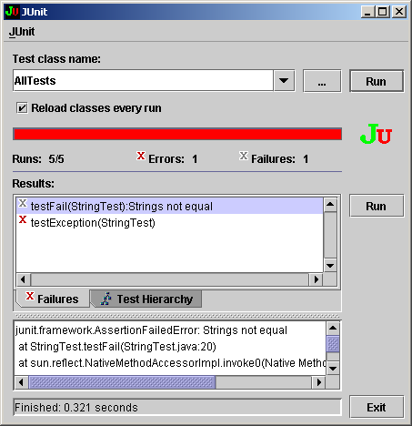
TestRunners - Swing
Run with java junit.swingui.TestRunner

Slide 31
Automating testing (Ant)
JUnit Task
<target name="test" depends="compile-tests">
<junit printsummary="yes" fork="yes">
<classpath>
<pathelement location="${build}" />
<pathelement location="${build}/test" />
</classpath>
<formatter usefile="yes" type="plain" />
<test name="AllTests" />
</junit>
</target>

Slide 32
Ant Batch mode
<target name="batchtest" depends="compile-tests">
<junit printsummary="yes" fork="yes" haltonfailure="no">
<classpath>
<pathelement location="${build.dir}" />
<pathelement location="${build.dir}/test" />
</classpath>
<formatter type="plain" usefile="yes"/>
<batchtest fork="yes" todir="">
<fileset dir="${test.dir}">
<include name="**/*Test.java" />
</fileset>
</batchtest>
</junit>
</target>

Slide 33
JUnit Classes
Notes:
Welcome to Servlet advanced session. We learned basic concepts of Servlet in our previous class. Today we are going to learn advanced concepts of Servlet.

Slide 34
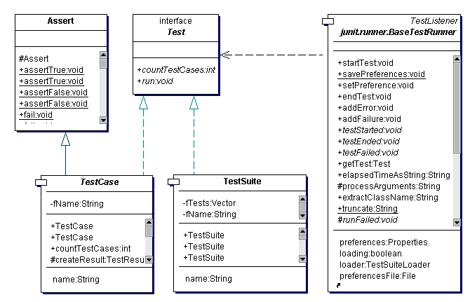
JUnit Class Diagram

Slide 35
Best Practice
Notes:
Welcome to Servlet advanced session. We learned basic concepts of Servlet in our previous class. Today we are going to learn advanced concepts of Servlet.

Slide 36
What should I test?
Tests things which could break
Tests should succeed quietly.
  Don’t print “Doing foo…done with foo!”
  Negative tests, exceptions and errors
What shouldn’t I test
  Don’t test set/get methods
  Don’t test the compiler

Slide 37
Test first and what to test
Write your test first, or at least at the same time
Test what can break
Create new tests to show bugs then fix the bug
Test driven development says write the test then make it pass by coding to it.

Slide 38
Testing for Exceptions
public void testExpectException()
{
String s1 = null;
String s2 = new String("abcd");
try{
s1.toString();
fail("Should see null pointer");
}
catch(NullPointerException ex){
assertTrue(true);
}
}

Slide 39
Test then Fix
Bugs occasionally slip through (gasp!)
Write a test first which demonstrates the error. Obviously, this test is needed.
Now, fix the bug and watch the bar go green!
Your tests assure the bug won’t reappear.

Slide 40
Test then Refactor
Once the code is written you want to improve it.
Changes for performance, maintainability, readability.
Tests help you make sure you don’t break it while improving it.
Small change, test, small change, test...

Slide 41
Design Patterns for
Testing
Notes:
Welcome to Servlet advanced session. We learned basic concepts of Servlet in our previous class. Today we are going to learn advanced concepts of Servlet.

Slide 42
Designing for testing
  Separation of interface and implementation
    Allows substitution of implementation to tests
  Factory pattern
    Provides for abstraction of creation of implementations from the tests.
  Strategy pattern
    Because FactoryFinder dynamically resolves desired factory, implementations are plugable

Slide 43
Design for testing - Factories
new only used in Factory
Allows writing tests which can be used across multiple implementations.
Promotes frequent testing by writing tests which work against objects without requiring extensive setup
  “extra-container” testing.

Slide 44
Design for testing - Mock Objects
When your implementation requires a resource which is unavailable for testing
External system or database is simulated.
Another use of Factory, the mock implementation stubs out and returns the anticipated results from a request.

Slide 45
Testing with resources (EJB/DB)
Use fixtures to request resource connection via factory, could be no-op.
Use vm args or resource bundle to drive which factory is used.
Data initialization/clearing handled by fixtures to preserve order independence of tests.

Slide 46
Extensions
Notes:
Welcome to Servlet advanced session. We learned basic concepts of Servlet in our previous class. Today we are going to learn advanced concepts of Servlet.

Slide 47
JUnit Extensions
JUnitReport
Cactus
JWebUnit
XMLUnit
MockObject
StrutsTestCase

Slide 48
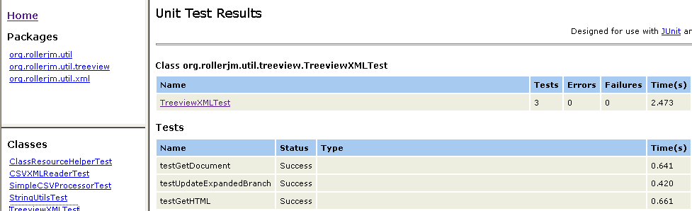
JUnitReport
Apache Ant extension task
Uses XML and XSLT to generate HTML

Slide 49
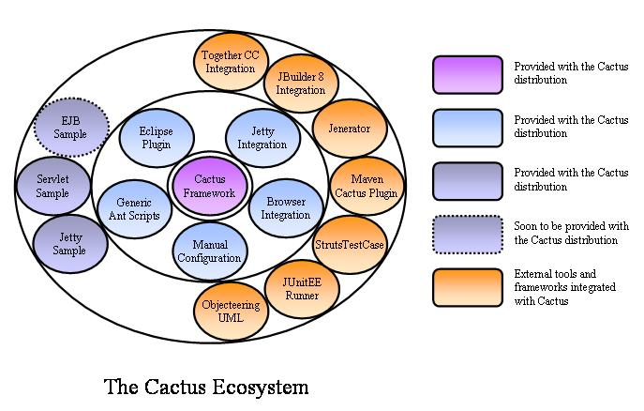
Cactus (from Jakarta)
Simple test framework for unit testing server-side Java code

Slide 50
JWebUnit
Framework that facilitates creation of acceptance tests for web applications

Slide 51
XMLUnit
Provides an XMLTestCase class which enables assertions to be made about the content and structure of XML
  Differences between two pieces of XML
  Validity of a piece of XML
  Outcome of transforming a piece of XML using XSLT
  Evaluation of an XPath expression on a piece of XML

Slide 52
Mock Objects
Generic unit testing framework whose goal is to facilitate developing unit tests in the mock object style
What is a Mock object?
  "double agent" used to test the behaviour of other objects
  Dummy object which mimics the external behaviour of a true implementation
  observes how other objects interact with its methods and compares actual behaviour with preset expectations

Slide 53
StrutsTestCase
Extends the JUnit TestCase class that
Provides facilities for testing code based on the Struts framework
You can test
  implementation of your Action objects
  mappings declarations
  form beans declarations
  forwards declarations

Slide 54
JUnit Testing Framework
Notes:
Welcome to Servlet advanced session. We learned basic concepts of Servlet in our previous class. Today we are going to learn advanced concepts of Servlet.

