Slide 1
Java Scripting:
One VM, Many Languages
Sang Shin
sang.shin@sun.com
javapassion.com
Sun Microsystems, Inc.

Slide 2
Agenda
Quick overview
Scripting API
Java SE 6 Scripting Support
Demo
Future Directions
Resources

Slide 3

Quick Overview
Notes:
Welcome to “AJAX Basics” presentation. My name is Sang Shin. I am Java technology architect and evangelist from Sun Microsystems.

Slide 4
Scripting Languages
Typically dynamically typed languages
  No need to define variables before you use them
  Many type conversions happen automagically
  Can be good...
  Can be bad...
Most scripting languages are interpreted
  Perform the script compilation and execution within the same process
Very good for fast results for small jobs
  Write application faster, execute commands repeatedly

Slide 5
Different Languages, different jobs
Perl
  Text processing, report generation
Bash, sh, ksh
  job control
Ruby
  Web based applications
Notes:
Most scripting languages are dynamically typed. You can usually create new variables without predetermining the variable type, and you can reuse variables to store values of different types. Also, scripting languages tend to perform many type conversions automatically, for example, converting the number 10 to the text "10" as necessary. Although some scripting languages are compiled, most languages are interpreted. Script environments generally perform the script compilation and execution within the same process. Usually, these environments also parse and compile scripts into intermediate code when they are first executed.
These qualities of scripting languages help you write applications faster, execute commands repeatedly, and tie together components from different technologies. Special-purpose scripting languages can perform specific tasks more easily or more quickly than can more general-purpose languages. For example, many developers think that the Perl scripting language is a great way to process text and to generate reports. Other developers use the scripting languages available in bash or ksh command shells for both command and job control. Other scripting languages help to define user interfaces or web content conveniently. Developers might use the Java programming language and platform for any of these tasks, but scripting languages sometimes perform the job as well or better. This fact doesn't detract from the power and richness of the Java platform but simply acknowledges that scripting languages have an important place in the developer's toolbox.

Slide 6
Java Programming Language and Ruby Compared
public class Filter {
public static void main(String[] args) {
List list = new java.util.ArrayList();
list.add(“Tim"); list.add(“Ike"); list.add(“Tina");
Filter filter = new Filter();
for (String item : filter.filterLongerThan(list, 3)) {
System.out.println( item );
}
}
public List filterLongerThan(List list, int length) {
List result = new ArrayList();
for (String item : list) {
if (item.length() >= length) { result.add( item ); }
}
return result;
}
}

Slide 7
Java Programming Language and Ruby Compared
Ruby!
list = [‘Tim’, ‘Ike’, ‘Tina’]
list.select {|n| n.length > 3}.each {|n| puts n}
=> ‘Tina’

Slide 8
Scripting Over
Java Platform
Notes:
.

Slide 9
Why Scripting Languages & Java together?
Combining scripting languages with the Java platform provides developers and end-users an opportunity to leverage the abilities of both environments
Use scripting languages for quick and easy development & testing for certain parts of your applications
Use Java programming language and platform for what it is known for
  Scalable and highly performing business logics

Slide 10
Why Scripting Languages & Java together?
Allows end-users to customize the applications further

Slide 11
Java Platform Supports Scripting Languages Well!
Java Language != Java Platform
  Java VM runs “language-neutral” bytecode
  Rich set of Class libraries are “language-neutral”
  “Write once run anywhere” applies to Platform
  Leverage programmer skills and advantages of particular languages
Time-tested technologies
  Open-source projects for various languages
  Jakarta BSF
Notes:
Bean Scripting Framework (BSF) is a set of Java classes which provides scripting language support within Java applications, and access to Java objects and methods from scripting languages. BSF allows one to write JSPs in languages other than Java while providing access to the Java class library. In addition, BSF permits any Java application to be implemented in part (or dynamically extended) by a language that is embedded within it. This is achieved by providing an API that permits calling scripting language engines from within Java, as well as an object registry that exposes Java objects to these scripting language engines.

Slide 12














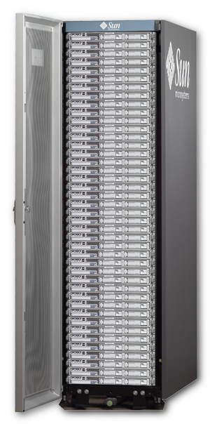

The Virtual Machine
and more...
Development
The Virtual Machine
Devices
Notes:
What the Virtual Machine does:
Eats and translates lots of bite code quickly and securely
Stroll through the virtual machine – show the sameness (a familiar world) but with different flavors)
One language they all run (Ruby, PHP, Java App)
It's faster because you don't have to build the bottom of the stack, this is already in place.
Other reasons why it's better:
+ Platform independent
+ Mobility
+ Wide range of services
+ Rock solid (nuclear powered)
Which all means for the developer:
+ Speed and ease, no worries about the end state, adapt to constant change/navigate the unknown)
And, it's community developed (segue to next slide)
+ Something Sun has done for 25 years
+ Takes things off and running (no deadlines, nothing holding you back)

Slide 13




And Announced Recently
Ruby Support from Sun
  JRuby @ Sun
  Building full Ruby and
  Rails Support right in
  the Virtual Machine
  A new team
NetBeans Tools
  Ruby and Rails
  JavaScript Support
Notes:
BIG NEWS!
JRuby @ Sun: Charles Nutter and Thomas Enebo (the chief maintainers of JRuby) will become Sun employees this month, working full time on JRuby, Ruby, Rails, other Ruby applications and Tools for all.
NetBeans: We'll be adding support for Ruby and the very popular Rails Web application framework into NetBeans. Along with our expanding support for JavaScript. PHP and others.
The future will have lots of languages and lots of platforms and that's always been OK by us.
Rails is a full-stack framework for developing database-backed web applications according to the Model-View-Control pattern. From the Ajax in the view, to the request and response in the controller, to the domain model wrapping the database, Rails gives you a pure-Ruby development environment. To go live, all you need to add is a database and a web server.
JRuby is an 100% pure-Java implementation of the Ruby programming language.

Slide 14
Client Scripting Scenarios
Class files written in other languages
  Groovy
  Jython Compiler
  Kawa Scheme
  JRuby
Java applications execute script programs
  Stand-alone interpreter
  Macro interpreters
  Web Scripting
In both cases, programs use Java Objects/Libraries

Slide 15

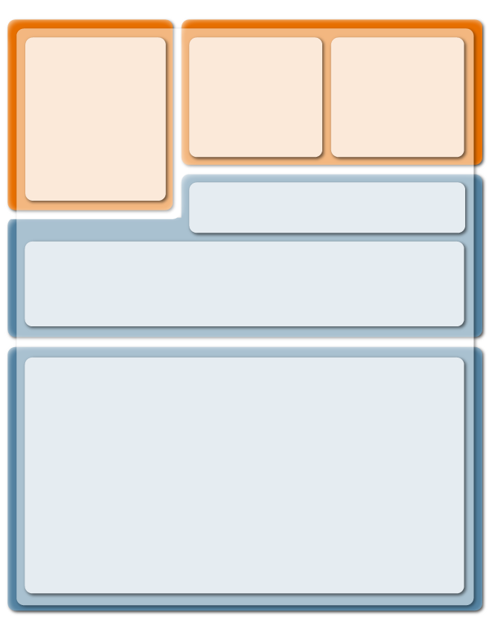
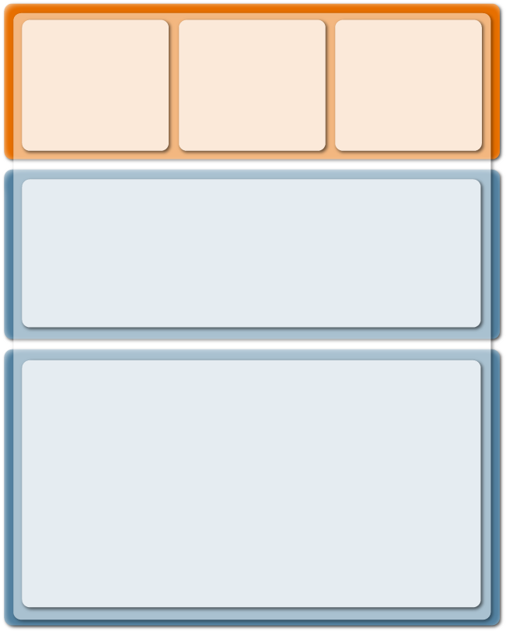







Scripting Scenarios
Java Libraries
VIRTUAL
MACHINE
VIRTUAL
MACHINE
VIRTUAL MACHINE
JAVA VIRTUAL MACHINE
Native Scripting
Java Virtual Machine
Web
The Community does Both...
(port and run)
Living the Java Lifestyle...
Leverage the VM
(multiple languages)
= You do
= We do
Notes:
The Three Worlds:
1. Native scripting
2. Javaization
3. Moving towards a third world that helps you deal with byte codes coming from all sorts of different places on all sorts of different devices (set up for the meat grinder, aka: the Byte Code Chunker)
Regardless, you'll probably always play in these three areas.

Slide 16
Scripting Framework
& API over Java Platform
Notes:
Welcome to “AJAX Basics” presentation. My name is Sang Shin. I am Java technology architect and evangelist from Sun Microsystems.

Slide 17
Scripting framework
JSR 223 defines the scripting framework
It supports pluggable framework for third-party script engines
  Resembles BSF ActiveX Scripting
  “Java application runs script programs” scenario
javax.script package
Optional javax.script.http package for Web scripting
Part of Java SE 6
Available for Java 5.0

Slide 18
Scripting API
ScriptEngine
ScriptContext, Bindings
ScriptEngineFactory
ScriptEngineManager

Slide 19
Interfaces
ScriptEngine interface—required
  Execute scripts—“eval” methods
  Map Java objects to script variables (“put” method)
Invocable interface—optional
  Invoke script functions/methods
  Implement Java interface using script functions/methods
Compilable interface—optional
  Compile Script to intermediate form
  Execute multiple times without recompilation

Slide 20
ScriptEngine API
ScriptEngine (Interface)
  eval()
  put()
  get()
  getBindings()/setBindings()
  createBindings()
  getContext()/setContext()
  getFactory()
AbstractScriptEngine
  Standard implementation of several eval() methods

Slide 21
ScriptEngineManager
Provides the ScriptEngine discovery mechanism
  getEngineByName()
  getEngineByExtension()
  getEngineByMimeType()
  getEngineFactories()
Developers can add script engines to a JRE
  with the JAR Service Provider specification

Slide 22
Example – Hello world
import javax.script.*;
public class Main {
  public static void main(String[] args) throws ScriptException {
    // Create a script engine manager
    ScriptEngineManager factory = new ScriptEngineManager();
    // Create JavaScript engine
    ScriptEngine engine = factory.getEngineByName("JavaScript");
    // Add a script variable whose value is a Java Object
    engine.put(“greeting”, new Exception(“Hello World!”));
    // Evaluate JavaScript code from String
    engine.eval("print(greeting.toString())");
  }
}

Slide 23
Example - “eval” script file
// Create script engine manager
ScriptEngineManager manager = new ScriptEngineManager();
// Create JavaScript engine
ScriptEngine engine = manager.getEngineByExtension(“js”);
// Evaluate a file (or any java.io.Reader)
engine.eval(new FileReader(“test.js”));

Slide 24
Example – Invoking functions
// JavaScript code in a String
String script = "function hello(name) { print('Hello, ' + name); }";
// Evaluate script
engine.eval(script);
// JavaScript engine implements Invocable interface
Invocable inv = (Invocable) engine;
// Invoke a global function called “hello”
inv.invoke("hello", new Object[] {"Scripting!!"} );

Slide 25
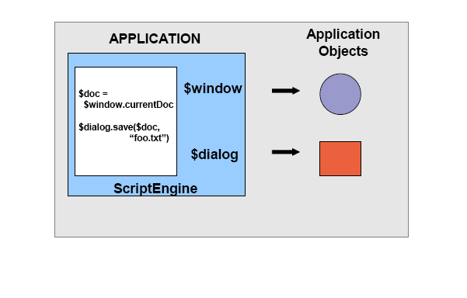
Mapping script variables to application objects

Slide 26
ScriptContext and Bindings (interface)
ScriptContext—Script’s view of host application
ScriptContext contains one or more Bindings
Bindings is subtype of Map<String, Object>
Scope is a set of named attributes
Engine Scope Bindings
  Script variables → application objects
Global Scope Bindings
  Variables shared across engines
Writers for stdout, stderr
Reader for stdin

Slide 27
ScriptContext and Bindings (cont.)
Exposes readers/writers for script engines to use for input and output
  setBindings()/getBindings()
  setAttributes()/getAttribute()
  setWriter()/getWriter()
  setReader()/getReader()
SimpleScriptContext

Slide 28
Example – Script variables
// Create script engine manager
ScriptEngineManager manager = new ScriptEngineManager();
// Create JavaScript engine
ScriptEngine engine = manager.getEngineByName(“JavaScript”);
File f = new File(“test.txt”);
// Expose File object as variable to script
engine.put(“file”, f);
// Evaluate a script string wherein the “file” variable is accessed, and a
// method is called upon it
engine.eval(“print(file.getAbsolutePath())”);

Slide 29
ScriptEngineFactory (interface)
Describe and instantiate script engines
  1-1 with ScriptEngines
Factory method—getScriptEngine
Metadata methods
  Script file extensions, mimetypes
  Implementation-specific behavior (threading)
Script generation methods
  Generate method call
  Generate “print” call

Slide 30
ScriptEngineFactory (cont.)
Each script engine has a ScriptEngineFactory
  getEngineName()
  getEngineVersion()
  getExtensions()
  getMimeTypes()
  getLanguageName()
  getProgram()
  getScriptEngine()

Slide 31
Other Scripting Classes
CompiledScript
  Compiled version of script
  No requirement for reparsing
  Associated with a script engine
ScriptException
  All checked exceptions must be wrapped in this type
  Records line number, column number, filename
Bindings/SimpleBindings
  Mapping of key/value pairs, all strings

Slide 32
Java SE 6 Scripting
Support
Notes:
Welcome to “AJAX Basics” presentation. My name is Sang Shin. I am Java technology architect and evangelist from Sun Microsystems.

Slide 33
Javascript Engine
Based on Mozilla Rhino 1.6v2
Features omitted for security/footprint reasons
  Optimizer (script-to-bytecode compiler – only interpreter support)
  E4X (XML language support) – depends on xmlbeans.jar
  Rhino command line tools (shell, debugger etc.)
Security Tweaks

Slide 34
Scripting Tools / Samples
Tools
  <JDK>/bin directory
  jrunscript
    Interactive command-line interpreter.
  jhat
    Processes heap analysis tool output
  jconsole scripting plugin
Samples
  Script notepad
    Swing application mostly implemented in Javascript
    Fancy Javascript programming.

Slide 35
Demo
Notes:
Welcome to “AJAX Basics” presentation. My name is Sang Shin. I am Java technology architect and evangelist from Sun Microsystems.

Slide 36
Demo: Scripting over Java SE
Build and run ScriptPad sample app from JDK 6 samples
  You can build and run as NetBeans project
Executing JavaScript code
Invoking Java methods from JavaScript code

Slide 37
Scripting on the
Server side
Notes:
Welcome to “AJAX Basics” presentation. My name is Sang Shin. I am Java technology architect and evangelist from Sun Microsystems.

Slide 38
Scripting in Java EE
Web-tier is a natural place for scripting
  tends to have high rate of change
JSP is already very script-like
  allow mixing of Java language and tags on HTML page
Project Phobos supports JavaScript
  as server-side web page scripting language
  as lightweight way of implementing servlets
  see phobos.dev.java.net

Slide 39
Sample JRuby Script
$response.setStatus(200)
$response.setContentType("text/html")
writer = $response.getWriter()
writer.println("<html><head><title>Hello</title></head><body>Hello from JRuby!</body></html>")
writer.flush()

Slide 40
Application Layout
/application
/controller
test.js
/module
application.js
/script
index.js
hello.rb
/template
/view
layout.ejs
test.ejs
/static
/dojo
dojo.js
/css
main.css
faq.html
release_notes.html
/environment
development.js
startup-glassfish.js

Slide 41
Future Direction
Notes:
Welcome to “AJAX Basics” presentation. My name is Sang Shin. I am Java technology architect and evangelist from Sun Microsystems.

Slide 42
Language JSRs
invokedynamic Bytecode – JSR 292
  http://www.jcp.org/en/jsr/detail?id=292
  Used for better compilation of dynamically-typed scripts
Groovy – JSR 241
  http://groovy.codehaus.org/
BeanShell – JSR 272
  http://www.beanshell.org
Notes:
JSR 292: Supporting Dynamically Typed Languages on the JavaTM Platform
Add a new bytecode, invokedynamic, that supports efficient and flexible execution of method invocations in the absence of static type information.
Groovy Object-oriented language alternative for Java platform;
BeanShell - Small, free, embeddable, source level Java interpreter with object based scripting language features, written in Java.

Slide 43
JSR 292 – invokedynamic bytecode
To enable the compilation of dynamically typed languages such as Groovy, Jruby, Jython to JVM bytecodes, a new bytecode called invokedynamic is being proposed as part of JSR 292
The invokedynamic will not require target class name, and the method signature.
It will search the specified method on the target object based on the method name
  JSR will specify how to handle method overloading in such scenario
  JSR will specify how to handle failures

Slide 44
JSR 292 – invokedynamic bytecode
There are 4 JVM bytecodes to call methods:
  invokeinterface - used to call an interface method on an object
  invokestatic - used to call a static method of a class
  invokevirtual - used to call a overridable method
  invokespecial - used to call
    constructors
    private instance methods
    super class methods (super.foo() calls in the source)

Slide 45
JSR 292 – invokedynamic bytecode
All these instructions require the specification of
  target class (or interface for invokeinterface) name
  the name of the method (or <init> for constructors)
  the signature of the method.

Slide 46
JSR 292 – invokedynamic bytecode
Impact on Groovy
Groovy today supports a flexible method dispatching mechanism
class Main {
public static void main(String[] args) {
// see Person class below..
Person p = new Person();
System.out.println("Starting...");
// call methods that are defined in Person class
p.work();
p.greet();
// call methods that are not defined in Person
// or it's superclass
p.surfTheNet();
p.writeBlog(); }}
class Person {
public void work() {
System.out.println("Okay, I'll work tomorrow!");
}
public void greet() {
System.out.println("Hello, World!");
}
public Object invokeMethod(String name,
Object args) {
System.out.println("Why are you calling " +
name + "?"); }}

Slide 47
Server-side scripting – Phobos
http://phobos.dev.java.net
Borrows from Ruby on Rails
  Speed of development
  Well-organized application structure
Access to enterprise Java
Javascript libraries
Support for other technologies
  AJAX
  RSS / Atom

Slide 48
Resources
Notes:
Welcome to “AJAX Basics” presentation. My name is Sang Shin. I am Java technology architect and evangelist from Sun Microsystems.

Slide 49
Resources - scripting.dev.java.net
BSD License
Scripting Engines
  jruby, groovy, beanshell, jacl, jaskell, java, jawk,jelly,jexl,jruby,javascript,jython,ognl,pnuts,scheme,sleep,xpath,xslt
Applications
  NetBeans Scripting module
Also see coyote.dev.java.net
  NetBeans Scripting IDE
  Jython, groovy support

Slide 50
Resources - references
JSR-223
  http://jcp.org/en/jsr/detail?id=223
A. Sundararajan's Blog
  http://blogs.sun.com/sundararajan
Roberto Chinnici's Blog (serverside scripting)
  http://weblogs.java.net/blog/robc/
JavaScript Developer Connection
  http://java.sun.com/javascript

Slide 51
Java Scripting:
One VM, Many Languages
Sang Shin
sang.shin@sun.com
javapassion.com
Sun Microsystems, Inc.

