Slide 1
Java SE 6:
Top 10 Features
Sang Shin
sang.shin@sun.com
www.javapassion.com
Sun Microsystems Inc.

Slide 2
The JDK 6 Top 10
Scripting
Web Services
Database (JDBC 4.0, Java DB)
More Desktop APIs
Monitoring and Management
Compiler Access
Pluggable Annotations
Desktop Deployment
Security
Quality, Compatibility, Stability

Slide 3

1. Scripting

Slide 4
Motivation for Scripting Support
Provides developers an opportunity to leverage the advantages of different languages in the same application
Extends scripting languages using the powerful Java technology libraries
  Reuse of code modules in other programming languages
Produces an environment in which developers and end users can collaborate to create more useful, dynamic applications
  By delivering Java applications that can be customized via scripts by users of the applications

Slide 5
Scripting
Scripting for the Java Platform (JSR 223)
  Mechanism for configuring script engines into Java SE
  APIs for mixing script fragments into Java applications
A JavaScript engine is included in Sun's implementation of Java SE 6
  Mozilla Rhino engine
Conformant scripting engines
  scripting.java.net

Slide 6
Scripting – Developer Example
// create a ScriptEngineManager
ScriptEngineManager m = new ScriptEngineManager();
// get an instance of JavaScript script engine
ScriptEngine engine = m.getEngineByName("js");
// evaluate a script
engine.eval("alert(\"Hello World!\")");

Slide 7
Demo: Scripting over Java SE
Build and run ScriptPad sample app from JDK 6 samples
  You can build and run as NetBeans project
Executing JavaScript code
Invoking Java methods from JavaScript code

Slide 8
2. Web Services

Slide 9
Web Services Support on Java SE 6 Platform
JAX-WS
Data binding using JAXB 2.0
Updates to the JAXP, which includes StaX
Standards supported
  SOAP 1.2
  WS-I Basic Profile 1.1
  XML-binary Optimized Packaging (XOP) and SOAP Message Transmission Optimization Mechanism (MTOM)
  Representational State Transfer (REST)
  Totally on XML schema
Notes:
In a nutshell, XOP is an alternate serialisation of XML that just happens to look like a MIME multipart/related package, with an XML document as the root part. That root part is very similar to the XML serialisation of the document, except that base64-encoded data is replaced by a reference to one of the MIME parts, which isn’t base64 encoded.
This allows you to avoid the bulk and overhead in processing associated with encoding, the only way that you can fit binary data directly into an XML world.
XOP can be used for any XML-based format; MTOM is just a description of how XOP is layered into the SOAP HTTP transport.

Slide 10
API Support
Java SE 6 provides support for the JAX- WS web services stack.
  For the client side: Service class for creating proxy
  For the server side: Endpoint class for publication

Slide 11
Server-Side Programming Model
Write a Plain Old Java Object (POJO) implementing the service.
Add @WebService to it.
Optionally, inject a WebServiceContext
Publish the Web service endpoint through Endpoint.publish() method
  WSDL is automatically generated at runtime
Point your clients at the Web Services Description Language (WSDL), for example:
  http://myserver/myapp/MyService?WSDL.
Notes:
A WebServiceContext makes it possible for a web service endpoint implementation class to access message context and security information relative to a request being served. Typically a WebServiceContext is injected into an endpoint implementation class using the Resource annotation.

Slide 12
Publishing Endpoint
The publish methods can be used to start publishing an endpoint, at which point it starts accepting incoming requests.
The stop method can be used to stop accepting incoming requests and take the endpoint down
Publish using the HTTP server embedded in Java SE 6.
Supports reasonable defaults for threading.
Creates WSDL and publishes it at runtime:
  http://localhost/calculator?WSDL

Slide 13
Publishing an Endpoint
@WebService
public class Calculator {
@Resource
WebServiceContext context;
public int add(int a, int b) {
return a+b;
}
}
// Create and publish an endpoint
Calculator calculator = new Calculator();
Endpoint endpoint = Endpoint.publish
(“http://localhost/calculator”,calculator);

Slide 14
Client-side Programming
Point a tool at the WSDL for the service
Generate annotated classes and interfaces through a tool
Call new on the service class.
Get a proxy using a getxxxPort method.
Invoke any remote operations.

Slide 15
Example: Java SE-based Client
// Create a Service object
CalculatorService svc = new
CalculatorService();
// Create a proxy from the Service object
Calculator proxy =
svc.getCalculatorPort();
// Invoke a Web service operation
int answer = proxy.add(35, 7);

Slide 16
Demo: Web Services over Java SE
Build and run EBay Web service and client from JDK 6 samples
  You can build and run as NetBeans project

Slide 17
3. Database

Slide 18
JDBC 4.0 Support
Updated the developer APIs (JDBC 4.0 )
  Exception handling improvement
    New subclasses of SQLException
  Enhanced BLOB/CLOB functionality
    SetClob(), createClob()
  SQLXML Data Type (from SQL 2003)
    XML is a first-class data type – no longer need to use CLOBs to access XML data element

Slide 19
Java DB
Java DB based on Apache Derby
  JDBC conformant all-Java relational database
  Bundled and pre-configured in JDK

Slide 20
4. Desktop APIs

Slide 21
4. Desktop APIs
AWT improvements
  Tray icon
  Splash screen
  Desktop class
  Dialog Modality enhancements and API
  Text printing
Swing improvement
  GroupLayout – basis for NetBeans GUI Builder (Matisse)
  JTable sorting and filtering
  SwingWorker

Slide 22



Tray Icon
Lets you access the system tray in your Java application
  SystemTray
  TrayIcon
Give you the ability to add graphics, popup menus, and floating tip functionality to the system tray

Slide 23
Tray Icon: Usage
// Construct a TrayIcon
TrayIcon trayIcon = new TrayIcon(image, "Tray Demo",
popupMenu);
// Add event listener
trayIcon.addActionListener(actionListener);
// Add the tray icon to the System tray
SystemTray.getSystemTray().add(trayIcon);

Slide 24
Splash Screen: Overview
Allows displaying a splash screen for the application instantly—before the JVM™ software starts!
  GIF, PNG, and JPEG images supported
  Transparency, translucency, and animation supported
  Closed automatically when first top-level window displays
Java API to control the splash screen from the application:
  Change image, get position, close
  Paint over the splash screen using standard java.awt.Graphics2D, for instance for progress indication
Notes:
According to Wikipedia, a splash screen is a computer term for an image that appears while a program or operating system is loading. It provides the user with a visual indicator that the program is initializing. Prior to Java SE 6 you could only offer the behavior of a splash screen by creating a window at the start of your main method and placing an image in it. Although this worked, it required the Java runtime to be fully initialized before the window appeared. This initialization included AWT and typically Swing, so that it delayed the initial graphical display. With Java SE 6, a new command-line option makes this functionality much easier. It also displays the image more quickly to the user, that is, even before the Java runtime has started. Final inclusion of the feature is subject to JCP approval.

Slide 25
Splash Screen: Usage
Display from command line
    java -splash:image.gif TheApp
Display from MANIFEST.MF
    Splashscreen-Image: image.gif
Painting
    SplashScreen splash =
    SplashScreen.getSplashScreen();
    Graphics2D g = splash.createGraphics();
    // your painting code here
    splash.update();

Slide 26
Desktop Class
New class: java.awt.Desktop
  Has an enumeration of actions that may be supported for a file or URI
  BROWSE, EDIT, MAIL, OPEN, and PRINT
Depends on platform capabilities to work:
  Desktop.isDesktopSupported()
File processing:
  Opening, editing, and printing files with applications registered in native system
Browsing:
  Opening a URL with the default browser
Email:
  Sending a message with the default mail client

Slide 27
Demo: Desktop API
Build and run sample applications
  Tray icon
  Splash screen
  Desktop class

Slide 28
Dialog Modality Enhancement
New modality model is introduced
  This new model allows the developer to scope, or limit, a dialog box's modality blocking, based on the modality type that the developer chooses
  Allows windows and dialog boxes to be truly parentless
  Solves the problem of interacting with JavaHelp in J2SE 1.5 when modal dialog box is on the front

Slide 29
Modality Types
modeless
  does not block any other window
document-modal
  blocks input to all top-level windows from the same document
application-modal
  blocks all windows from the same application
toolkit-modal
  blocks all windows that run in the same toolkit

Slide 30
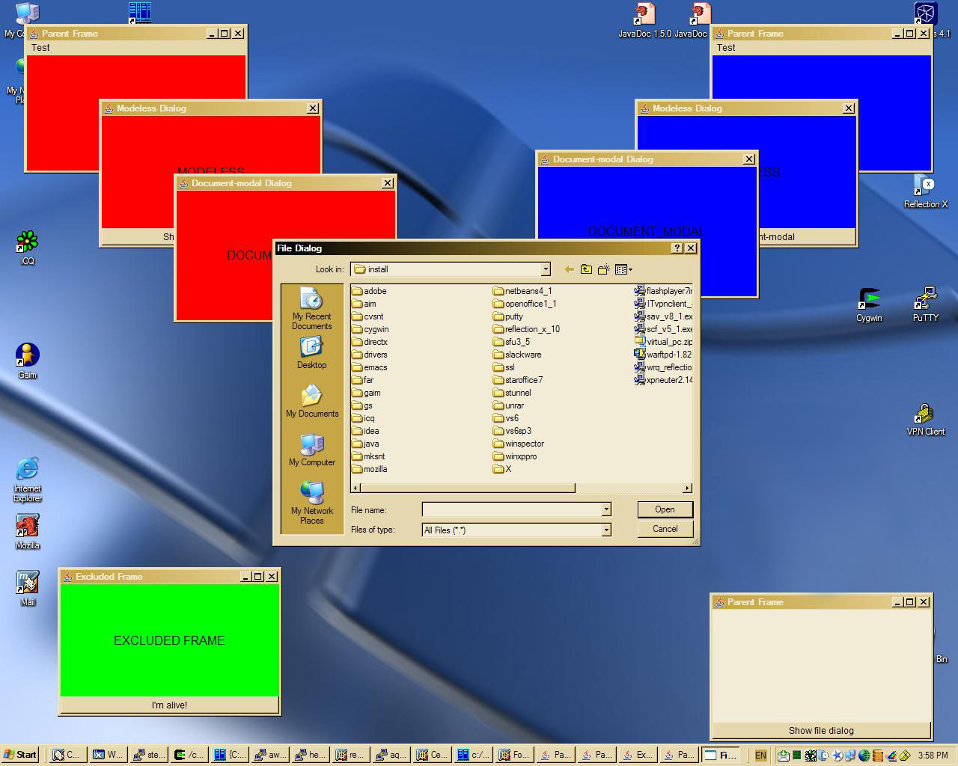
New Dialog Modality API

Slide 31
Text Printing
Easily print a Swing text component:
  Prints the entire contents of the text component
  Does not have to be visible
  javax.swing.text.JTextComponent.print();
Reformats for printed page
Optionally displays print dialog and progress box
Supports optional header/footer
Will not split lines in half!

Slide 32
SwingWorker
Easing multi-threaded applications with Swing
Makes it easy to offload work to separate threads
Makes use of concurrency package
Makes it more generic
Supports partial results
Supports PropertyChangeListener
More information:
  http://java.sun.com/docs/books/tutorial/uiswing/concurrency/index.html#SwingWorker

Slide 33
javax.swing.GroupLayout Class
New layout manager to support new Matisse GUI builder
  NetBeans™ IDE ships with Matisse
  Can also use GroupLayout in J2SE 1.5 software using stand-alone library
More capabilities for relative positioning of components
Works with horizontal and vertical layout separately

Slide 34
Layout Arrangements in GroupLayout
Hierarchically groups components to position them in a Container.
Supports two types of groups:
  A sequential group positions its child elements sequentially, one after another.
  A parallel group aligns its child elements in one of four ways.
Each group may contain any number of elements, where an element is a Group, Component, or gap.
Layout is defined for each dimension independently.

Slide 35
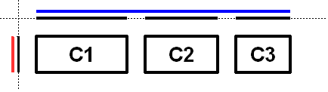
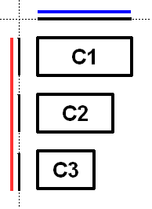
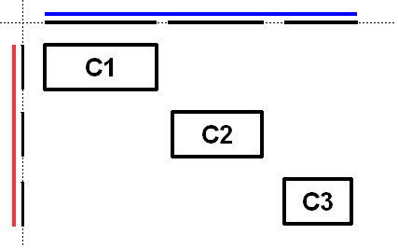
Using GroupLayout Class
Horizontal
Vertical
Both Horizontal and Vertical

Slide 36
JTable Sorting and Filtering
Add sorting to your JTable with one method call:
  setAutoCreateRowSorter(true)
Specify your own comparators
Supports secondary and tertiary sort columns
Can specify a filter to limit what is shown:
  Regular expression, number, and date
  implementations provided

Slide 37
Demo: Desktop API
Build and run sample applications
  Dialog Modality enhancements and API
  Text printing
  JTable sorting and filtering

Slide 38
5. Monitoring &
Management

Slide 39
Potential Problems That Can Be Detected
Memory leaks
Thread deadlocks
Dirty references
Infinite loops

Slide 40
Monitoring and Management
Attach on demand for
  jconsole: can connect to applications that did not start up with the JMX agent
  jstack: takes a 'photograph' of all the threads and what they are up to in their own stack frames
  jmap: takes a detailed 'photograph' of what's going on in memory at any one point in time
  jhat: forensic expert that will help you interpret the result of jmap

Slide 41
6. Compiler Access

Slide 42
Compiler Access
Opens up programmatic access to javac for in-process compilation of dynamically generated Java code
Really aimed at people who create tools for Java development and for frameworks
  JavaServer Pages (JSP) or PHP construction kit engines that need to generate a bunch of classes on demand
  Average developers will benefit indirectly from faster performing tool
    Jasper JSP engine runs JSP TCK 3.5x faster

Slide 43
7. Pluggable Annotations

Slide 44
Pluggable Annotations
JSR 175 of JDK 5 standardized how annotations are declared in Java code but annotation processing details were relegated as an implementation detail
JSR 269 of JDK 6, Pluggable Annotation Processing API, standardizes annotation processing as well
  The annotation processors act as plug-ins to the compiler, hence "pluggable annotation processing”

Slide 45
7. Pluggable Annotations
Allow developers to define new annotations...
@ForReview
public void myMethod() {...}
...and APIs to define components that process them...
import javax.annotation.processing.*;
public class ForReviewProcessor extends AbstractProcessor {..}
...and integrate them with the Java Compiler
javac -processor ForReviewProcessor MyCode.java

Slide 46
8. Desktop Deployment

Slide 47
8. Desktop Deployment
We improved actual performance
  graphics hardware acceleration on Windows
...and perceived performance
  true double buffering
We improved the native look & feels
  Updated Swing Look&Feel Windows/Unix
  LCD text rendering
We revamped Java Web Start and JRE installations
  no more scary security dialog

Slide 48
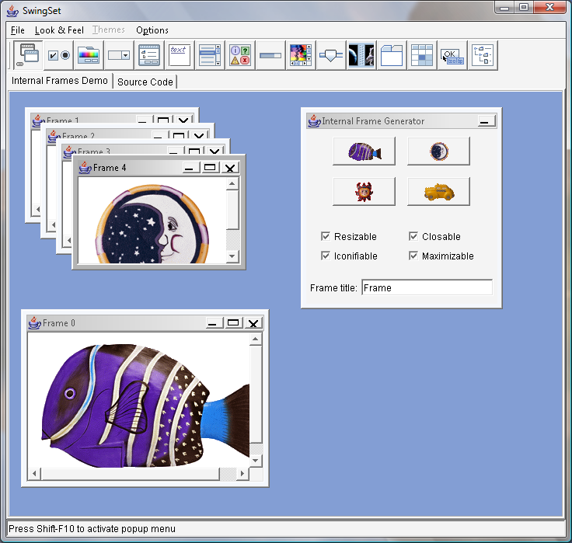
Windows Look and Feel Improvements
SwingSet on Vista with 5.0

Slide 49
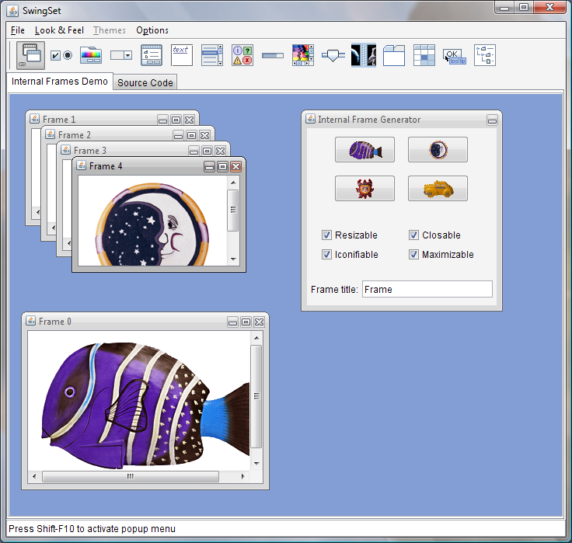
Windows Look and Feel Improvements
SwingSet on Vista with 6

Slide 50
9. Security

Slide 51
9. Security
We added important new APIs
  XML Digital Signature (XMLDSig) API (JSR 105)
  Smart Card I/O API (JSR 268)
Improved authentication schemes
  JAAS-based authentication using LDAP
  Native Platform Java GSSAPI (Generic Security Services Application Programming Interface) integration

Slide 52
10. Quality, Stability,
Compatibility

Slide 53
10. Quality, Stability, Compatibility
We are still running the Big App tests
We now have 80,000+ JCK tests
We've had good uptake of weekly builds
We ran a Regression Challenge

Slide 54
10. Performance Improvement
Client Benchmark: SwingMark

Slide 55
10. Performance Improvement
Server Benchmark: SPECjbb2000

Slide 56
Why Java SE 6?

Slide 57
Running Apps on Java SE 6
Applications run faster on the desktop and servers
New 'Dynamic Attach' diagnostics simplify troubleshooting
Expanded Solaris DTrace support provides additional value on Solaris
Improved 'native' look and feel across Solaris, Linux, and Windows
First Java platform with full support for Windows Vista

Slide 58
Building Apps on Java SE 6
JavaScript integrated and included with the platform
Scripting languages framework extends support for Ruby, Python, and other languages
Complete light-weight platform for web services, right out of the box
Simplified GUI design and expanded native platform support
Full JDBC4 implementation providing improved XML support for Databases
Java DB included with the JDK, a free to use and deploy Java Database
Full support by NetBeans IDE 5.5
Sun Developer Services available to help build more robust applications

Slide 59
Java SE 6:
Top 10 Features
Sang Shin
sang.shin@sun.com
www.javapassion.com
Sun Microsystems Inc.

