Slide 1
United Modeling
Language (UML) Basics
Notes:
Welcome to Servlet advanced session. We learned basic concepts of Servlet in our previous class. Today we are going to learn advanced concepts of Servlet.

Slide 2


Topics
What is UML?
What is Modeling?
UML Diagrams
  Use Case Diagram
  Class Diagram
  Activity Diagram
  Package Diagram
  State-Transition Diagram
  Sequence Diagram
  Collaboration Diagram
  Component Diagram
  Deployment Diagram

Slide 3

What is UML?
Notes:
Now let's talk about how to include another web resource.

Slide 4
Unified Modeling Language
The Unified Modeling Language (UML) is the standard language for specifying, visualizing, constructing, and documenting all the work products or artifacts of a software system.
It unifies the notation of Booch, Rambaugh, and Jacobson, and augmented with other contributors once submitted to OMG.
It proposes a standard for technical exchange of models and designs.

Slide 5
UML is NOT
It is not a method or methodology.
It does not indicate a particular process.
It is not a programming language.

Slide 6
Terminology

Slide 7
What is Modeling?
Notes:
Now let's talk about how to include another web resource.

Slide 8
Model
A model is a pattern of something to be made.
It is a representation of something in the real world.
  They are built quicker and easier than the objects they represent.
  They are used to simulate to better understand the objects they represent.
  They are modified to evolve as one learns about a task or problem.
  They are used to represent details of the models that one chooses to see, and others ignored.
  They are representation of real or imaginary objects in any domain.

Slide 9
Four General Elements
Icons
Two-dimensional Symbols
Paths
Strings

Slide 10
Changes in the Models
Level of Abstraction
Degree of Formality
Level of Detail

Slide 11
UML Base Diagrams
Notes:
Now let's talk about how to include another web resource.

Slide 12
UML Baseline Diagrams
Use Case Diagrams*
Class Diagrams*
Package Diagrams
Activity Diagrams
State-Transition Diagrams
Sequence Diagrams
Collaboration Diagrams
Deployment Diagrams

Slide 13
Use Case Diagram
Notes:
Now let's talk about how to include another web resource.

Slide 14
Use Case Diagram
Provides a basis of communication between end-users, stakeholders and developers in the planning of the software project.
Attempts to model the system environment by showing the external actors and their connection to the functionality of the system.

Slide 15
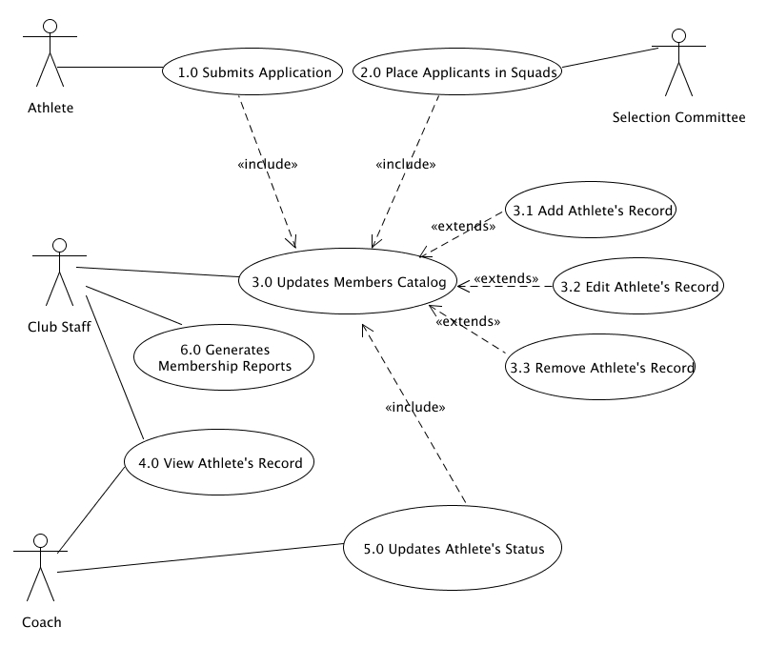
Sample Use Case Diagram

Slide 16
Class Diagram
Notes:
Now let's talk about how to include another web resource.

Slide 17
Class Diagrams
Shows the static structure of the domain abstractions of the system.
Describes the types of objects in the system and the various kinds of static relationships that exists among them.
Show the attributes and operations of a class and constraints for the way objects collaborate

Slide 18
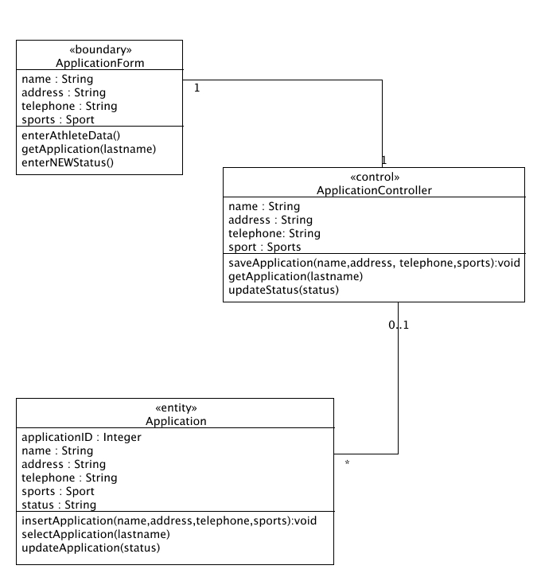
Sample Class Diagrams

Slide 19
Class representation
Each class is represented by a rectangle subdivided into three compartments
  Name
  Attributes
  Operations
Modifiers are used to indicate visibility of attributes and operations.
  ‘+’ is used to denote Public visibility (everyone)
  ‘#’ is used to denote Protected visibility (friends and derived)
  ‘-’ is used to denote Private visibility (no one)
By default, attributes are hidden and operations are visible.

Slide 20
An example of Class
Name
Account_Name
- Customer_Name
- Balance
Attributes
+addFunds( )
+withDraw( )
+transfer( )
Operations

Slide 21
OO Relationships
There are two kinds of Relationships
  Generalization (parent-child relationship)
  Association (student enrolls in course)
Associations can be further classified as
  Aggregation
  Composition

Slide 22
OO Relationships: Generalization
Supertype
Example:
Customer
Regular
Customer
Loyalty
Customer
Subtype1
Subtype2
or:
Customer
- Generalization expresses a parent/child relationship among related classes.
- Used for abstracting details in several layers
Regular
Customer
Loyalty
Customer

Slide 23
OO Relationships: Association
Represent relationship between instances of classes
  Student enrolls in a course
  Courses have students
  Courses have exams
  Etc.
Association has two ends
  Role names (e.g. enrolls)
  Multiplicity (e.g. One course can have many students)
  Navigability (unidirectional, bidirectional)

Slide 24
Association: Multiplicity and Roles
student
1
*
University
Person
0..1
*
employer
teacher
Multiplicity
Symbol Meaning
1 One and only one
0..1 Zero or one
M..N From M to N (natural language)
* From zero to any positive integer
0..* From zero to any positive integer
1..* From one to any positive integer
Role
Role
“A given university groups many people; some act as students, others as teachers. A given student belongs to a single university; a given teacher may or may not be working for the university at a particular time.”

Slide 25
Class Diagram
Name
Order
class
Multiplicity: mandatory
Attributes
-dateReceived
*
Customer
-isPrepaid
1
-number :String
-name
-price : Money
-address
Operations
+dispatch()
Association
+creditRating() : String()
+close()
1
{if Order.customer.creditRating is
Generalization
"poor", then Order.isPrepaid must
be true }
Corporate Customer
Personal Customer
Constraint
(inside braces{}}
-contactName
-creditCard#
-creditRating
Multiplicity:
Many value
-creditLimit
+remind()
+billForMonth(Integer)
Multiplicity: optional
0..1
*
*
Employee
OrderLine
-quantity: Integer
*
1
Product
-price: Money
-isSatisfied: Boolean
[from UML Distilled Third Edition]

Slide 26
Association: Model to Implementation
*
4
Student
Course
has
enrolls
Class Student {
Course enrolls[4];
}
Class Course {
Student have[];
}

Slide 27
OO Relationships: Composition
Composition: expresses a relationship among instances
of related classes. It is a specific kind of Whole-Part
relationship.
It expresses a relationship where an instance of the
Whole-class has the responsibility to create and initialize
instances of each Part-class.
It may also be used to express a relationship where instances
of the Part-classes have privileged access or visibility to
certain attributes and/or behaviors defined by the
Whole-class.
Composition should also be used to express relationship where
instances of the Whole-class have exclusive access to and
control of instances of the Part-classes.
Composition should be used to express a relationship where
the behavior of Part instances is undefined without being
related to an instance of the Whole. And, conversely, the
behavior of the Whole is ill-defined or incomplete if one or
more of the Part instances are undefined.
Whole Class
Class W
Class P₁
Class P₂
Part Classes
Example
Automobile
Engine
Transmission
[From Dr.David A. Workman]

Slide 28
OO Relationships: Aggregation
Container Class
Class C
Aggregation: expresses a relationship among instances
of related classes. It is a specific kind of Container-Containee
relationship.
It expresses a relationship where an instance of the
Container-class has the responsibility to hold and maintain
instances of each Containee-class that have been created
outside the auspices of the Container-class.
Aggregation should be used to express a more informal
relationship than composition expresses. That is, it is an
appropriate relationship where the Container and its
Containees can be manipulated independently.
Aggregation is appropriate when Container and Containees have no special access privileges to each other.
AGGREGATION
Class E₁
Class E₂
Containee Classes
Example
Bag
Apples
Milk
[From Dr.David A. Workman]

Slide 29
Aggregation vs. Composition
  Composition is really a strong form of aggregation
    components have only one owner
    components cannot exist independent of their owner
    components live or die with their owner
    e.g. Each car has an engine that can not be shared with other cars.
  Aggregations may form "part of" the aggregate, but may not be essential to it. They may also exist independent of the aggregate.
  e.g. Apples may exist independent of the bag.

Slide 30
Package Diagram
Notes:
Now let's talk about how to include another web resource.

Slide 31
Package Diagrams
Shows the breakdown of larger systems into a logical grouping of smaller subsystems.
Shows groupings of classes and dependencies among them
A dependency exists between two elements if changes to the definition of one element may cause changes to the other.

Slide 32
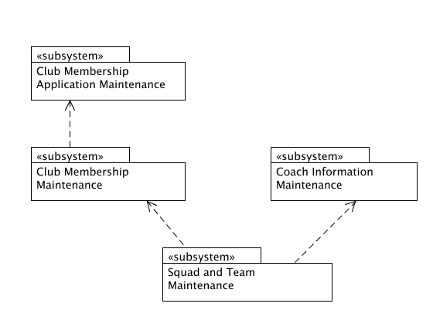
Sample Package Diagram

Slide 33
Activity Diagram
Notes:
Now let's talk about how to include another web resource.

Slide 34
Activity Diagram
Show the sequential flow of activities
  Typically, in an operation
  Also in a use case or event trace
Complement the class diagram by showing the workflow of the business (a.k.a Flowchart)
Encourage discovery of parallel processes which helps eliminate unnecessary sequences in business processes

Slide 35
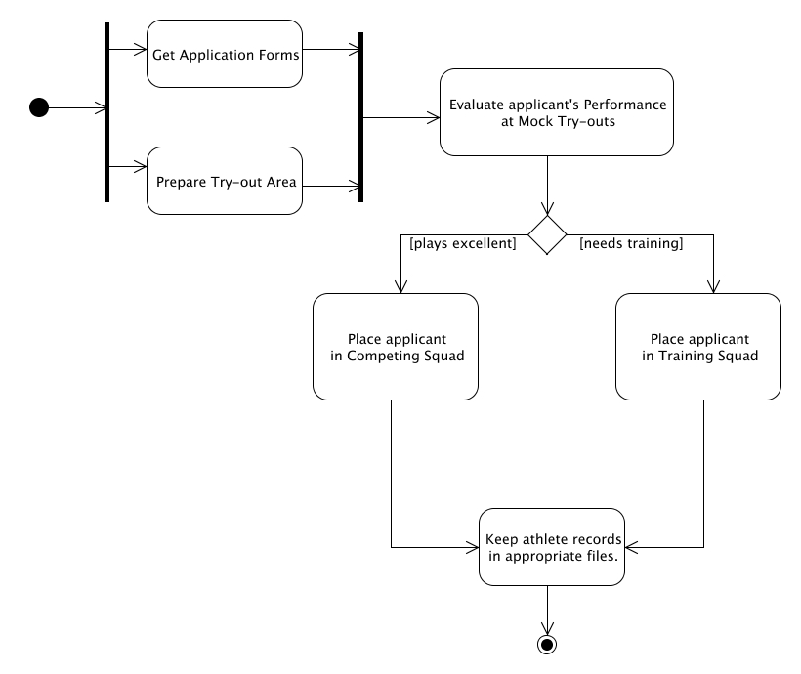
Sample Activity Diagram

Slide 36
State Transition Diagram
Notes:
Now let's talk about how to include another web resource.

Slide 37
State-Transition Diagrams
Show all the possible states that objects of the class can have and which events cause them to change
Show how the object's state changes as a result of events that are handled by the object
Good to use when a class has complex lifecycle behavior

Slide 38
Sample State-Transition Diagram
Add student[ count < 10 ]
Add Student/
Set count=0
Initialization
do: InitializeCourse
Open
entry: Register Student
exit: Increment Count
Cancel
Cancel
[ count = 10 ]
Cancel
do: Notify Registered Student
Closed
do: Finalize Course
Cancel

Slide 39
Sequence Diagram
Notes:
Now let's talk about how to include another web resource.

Slide 40
Sequence Diagrams
Show the dynamic collaboration between objects for a sequence of messages send between them in a sequence of time
Time sequence is easier to see in the sequence diagram read from top to bottom
Choose sequence diagram when only the sequence of operations needs to be shown

Slide 41
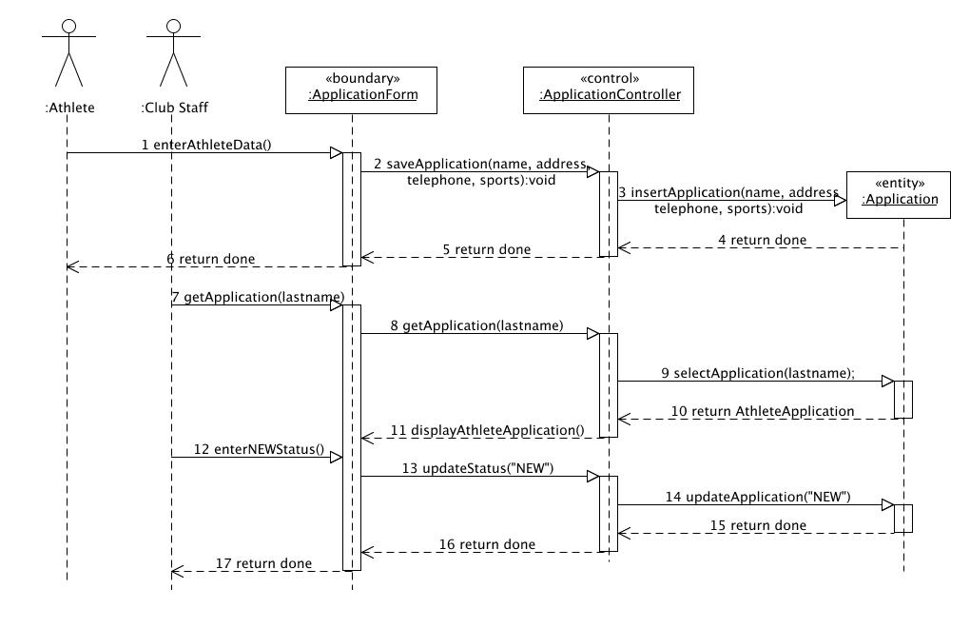
Sample Sequence Diagram

Slide 42
Collaboration Diagram
Notes:
Now let's talk about how to include another web resource.

Slide 43
Collaboration Diagram
Show the actual objects and their links, the “network of objects” that are collaborating
Time sequence is shown by numbering the message label of the links between objects
Choose collaboration diagram when the objects and their links facilitate understanding the interaction, and sequence of time is not as important

Slide 44
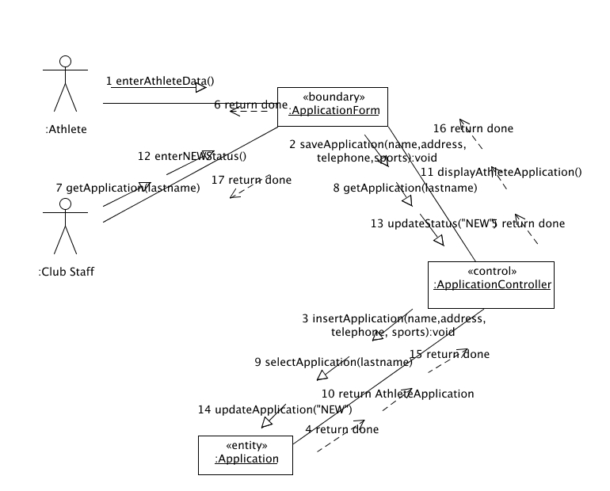
Sample Collaboration Diagram

Slide 45
Component
Diagram
Notes:
Now let's talk about how to include another web resource.

Slide 46
Component Diagram
It is used to model the components of the software.
Components may be a source code, binary code, executable code or dynamically linked libraries.
Components encapsulates implementation and shows a set of interfaces.

Slide 47
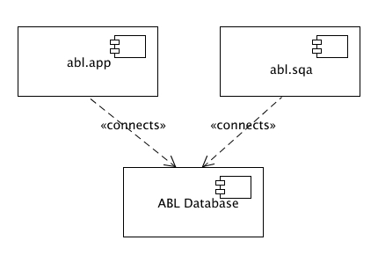
Sample Component Diagram

Slide 48
Deployment Diagram
Notes:
Now let's talk about how to include another web resource.

Slide 49
Deployment Diagram
Show the physical architecture of the hardware and software of the system
Highlight the physical relationship among software and hardware components in the delivered system
Components on the diagram typically represent physical modules of code and correspond exactly to the package diagram

Slide 50
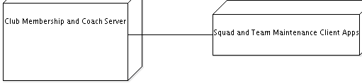
Sample Deployment

Slide 51
United Modeling
Language (UML)
Notes:
Welcome to Servlet advanced session. We learned basic concepts of Servlet in our previous class. Today we are going to learn advanced concepts of Servlet.

