Slide 1
Developing GUIs with
FOX and Ruby
Presented by
J. Lyle Johnson
At RubyConf 2001
October 12-13, 2001

Slide 2
What is FOX?
A C++-based toolkit for creating graphical user interfaces easily and effectively.
Home page at http://www.fox-toolkit.org.
Open source software, actively developed since 1998 or so by Jeroen van der Zijp and friends.
Basis of several commercial and free software applications.

Slide 3
What is FXRuby?
A C++ extension for Ruby, plus supporting Ruby modules, that provide an interface to the FOX toolkit.
Home page at http://fxruby.sourceforge.net.
Now included in the standard Ruby installer for Windows.

Slide 4
Why Another Ruby GUI?
Many Ruby developers were (are) dissatisfied with the existing GUI options for Ruby.
Tk is the standard because of its maturity and strong cross-platform support, but lacks many desirable features of more modern toolkits.
GTK+ is strong on Linux but Windows port is still considered unstable by some.
Notes:
I probably wouldn’t have looked into Ruby if it weren’t for the endorsement of Andy & Dave. About a year before I found out about Ruby I’d read The Pragmatic Programmer and it quickly became one of my favorites. When I later saw their book Programming Ruby and read about their enthusiasm for the language, I thought it would be worthwhile to investigate Ruby further.

Slide 5
FXRuby Design Goals
Primary goal is to provide a complete interface from Ruby to the FOX GUI toolkit.
Ruby programs should be able to access FOX functionality seamlessly; includes deriving Ruby classes from FOX classes and overriding their virtual functions.
As much as possible, provide for standard Ruby programming idioms.
Notes:
More than simply providing an interface between Ruby and FOX, my hope is to provide an interface that is very natural for Ruby programmers. One aspect of this is the provision of a number of aliases for the accessor methods. Another is providing each iterator methods for most list-like classes (e.g. FXList).

Slide 6
FOX Design Goals
Ease of development (orthogonality, consistency and conciseness)
Speed (e.g. deferred layout) and efficiency (e.g. low memory requirements)
“Lightweight” implementation, not wrappers around other toolkits.
Modern features

Slide 7
Ease of Development
Most widgets can be created and configured using a single line of code.
Most method arguments (especially for constructors) have sensible default values.
Provides a variety of layout managers, to avoid the burden of explicit layouts.
Target-message system allows you to “connect” widgets with ease.
Notes:
Most developers are troubled at first by the especially long argument lists for FOX widgets’ constructors. It is important to recognize that:
Most of the constructor arguments have sensible default values (and can be omitted)
Most widget attributes can be reconfigured after the widget’s constructed, using various accessor methods.

Slide 8
Speed and Efficiency
Expose or repaint events are stacked up until the system has processed all user events.
Exposed regions are composited so that in many cases, only one repaint is required.
Layout is similarly deferred until the GUI update phase, so that the system doesn’t perform a lot of unnecessary layout calculations.
Notes:
Two of the most expensive things that GUI applications have to do are drawing onto the screen and recalculating the GUI layout.
Drawing generates a lot of “traffic” and context-switching between the client and server (display). This is why, for example, Windows game designers are so keen on concepts like DirectX, for directly accessing the graphics hardware instead of going through the intermediate GDI layer on Windows.
Recalculating the GUI layout involves recursing up and down the GUI “tree”, computing widget sizes based on their fonts, etc. If that weren’t expensive enough, the new layout often leads to more drawing, which we’ve already identified as expensive.
The net effect of FOX’s delayed repaint and delayed layout optimizations is that the GUI starts up quickly and responds quickly to the user, without any unnecessary pauses for repainting or layout calculations.

Slide 9
Lightweight Approach
Some GUIs achieve cross-platform independence by “wrapping” native widgets with C++ classes (e.g. wxWindows, or Java’s AWT).
Platform-dependent code in FOX is isolated to a few core classes; most of FOX is written “in FOX”.
Notes:
The advantages of a lightweight approach are pretty-well understood by now, and this approach is used by most popular toolkits (e.g. GTK+, Qt and Java’s Swing toolkit). Widgets should exhibit the same behavior on different platforms, and you don’t have to design the API to the “lowest common denominator”.
One perceived shortcoming of the “lightweight” approach is that the widgets don’t necessarily have a native look-and-feel for the platform they’re running on. FOX’s widgets closely resemble the native Win32 controls, and FOX currently doesn’t supporting “themes” or pluggable look-and-feels.

Slide 10
Modern Features
Icons and Images (BMP, GIF, JPEG, PCX, PNG, TIFF, JPEG, XPM)
Tabbed Notebook, Tree List, Table (Spreadsheet)
Drag and Drop (XDND4 compatible on Linux)
Multiple Document Interface (MDI)
OpenGL
Notes:
Probably the two most sorely-needed widgets at this point are:
a 2-D “canvas” widget like Tk’s
An HTML or rich text display widget of some kind

Slide 11
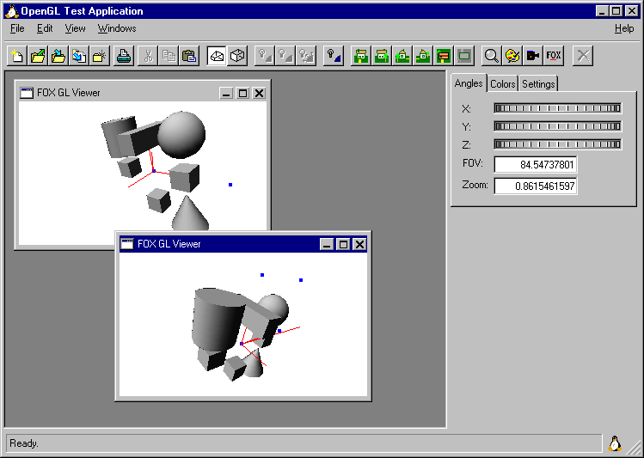
Obligatory Screenshot
Notes:
This FXRuby example program (glviewer.rb) demonstrates how to implement a lot of common GUI functionality
A menu bar with pulldown menus
A toolbar using GIF icon images
Multiple Document Interface (MDI) area
Status line and tooltips
Tabbed notebook, dial widgets
OpenGL viewers (including drag-and-drop of GL objects)

Slide 12
Target-Message System
FOX objects interact by sending messages back and forth.
Almost every FOX object (any object derived from FXObject) is capable of receiving messages.
You can designate a message target for most widgets (i.e. buttons, text fields, etc.)

Slide 13
Target-Message System (cont.)
A FOX message consists of a message type (e.g. SEL_COMMAND), identifier (e.g. ID_HIDE) and some message-specific data.
Since an object may be receiving messages from multiple senders, the message identifier can be used to distinguish between messages of the same type.

Slide 14
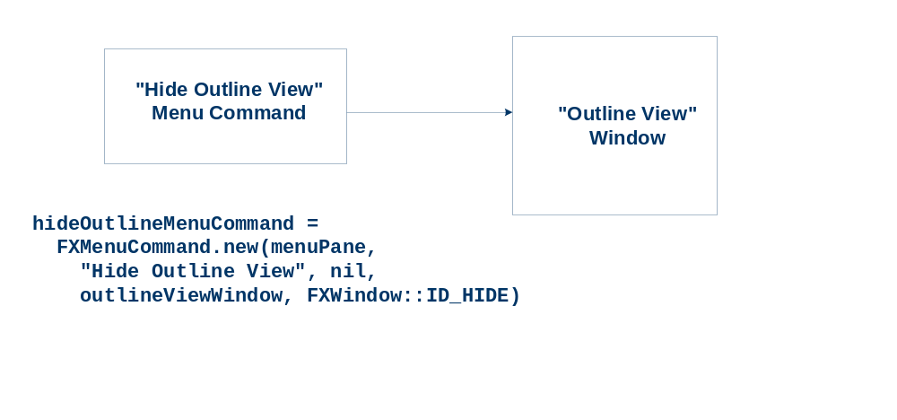
Target-Message System (cont.)

Slide 15
Automatic GUI Updates
A common problem in application design is how to update the appearance of the GUI based on the current application state.
Example: A word processor’s “Save” command should be disabled unless the document has been modified since it was last saved.

Slide 16
Automatic GUI Updates (cont.)
During application idle time, FOX sends a special “update” message to application widgets.
The handler for that update message decides how to modify the widget’s appearance, based on the current application state.
Notes:
We’ll see an example of how to use FOX’s GUI updating in the sample application walk-thru.

Slide 17
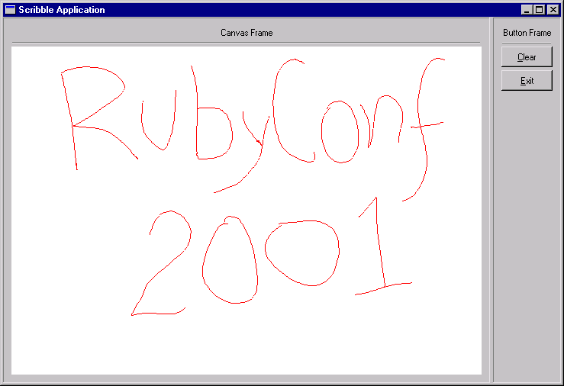
Sample Application

Slide 18
The Basics
Every FXRuby-based program begins by requiring at least the “fox” feature (which imports the Fox module):
require ‘fox’
require ‘fox/responder’
…
include Fox

Slide 19
The FXApp Object
All FOX and FXRuby programs also create an FXApp (application) object.
The application object is responsible for most “global” resource management, such as shared icons, images and cursors; chores and timers; the registry settings; and the main event loop.

Slide 20
The FXMainWindow Object
Most FOX applications also create a main window object.
Standard practice is to subclass your application’s main window class from FOX’s FXMainWindow class, and construct its contents in the initialize instance method.

Slide 21
The Main Program
For most applications the “main” program is pretty boilerplate.
Start by constructing the application object:
application = FXApp.new('Scribble',
'FoxTest')
First argument is the application name, second is vendor name (used for registry settings)
Notes:
The vendor name and application name strings are optional, but it’s good to specify them since they define keys into the FOX registry.

Slide 22
Main Program (cont.)
Initialize the application by passing the command line arguments array:
application.init(ARGV)
Construct an instance of the main window:
scribble = ScribbleWindow.new(application)
Notes:
All FOX (and FXRuby) applications accept special command-line options to enable certain features. Most notable is activating FOX’s tracing mechanism for debugging.

Slide 23
Main Program (cont.)
Create the application:
application.create
Start the main event loop:
application.run
Notes:
FOX uses a two-part construct-and-create process for all of the window system-related resources. The client-side resources (data structures) are allocated and initialized when the object is constructed, while the server-side resources (window handles, fonts, etc.) are allocated when the object is created. There are a number of reasons for this separation of client-side and server-side representation:
Since all FOX classes can be subclassed, you can’t assume that you have enough information to actually create the server-side resource(s) when it’s finished constructing the base class part.
When you’re deserializing a (previously serialized) GUI, you may need to wait until the entire widget tree is in place (in the client memory) before creating and realizing the server-side representation.
You may wish to structure your application so that it can be run in a “batch” mode, where the server-side resources are never realized.

Slide 24
Main Window Class
Typical structure is to derive your application’s main window class from FXMainWindow:
class ScribbleWindow < FXMainWindow
def initialize(app)
# Always initialize base class first!
super(app, “Scribble Application”,
nil, nil, DECOR_ALL, 0, 0, 800, 600)
# Set up main window contents, etc.
end
end

Slide 25
Layout Managers
FOX provides a variety of powerful layout managers, similar to those found in Tk, GTK+ and other GUI toolkits.
Main windows and dialog boxes are top-level windows and don’t have a “parent” window.
Most windows (widgets) are child windows and have a parent window that’s specified in the widget’s new method.
Notes:
Unlike some other toolkits, you don’t explicitly add a widget to its parent window after it’s created; the widget’s parent is specified as the first argument of its constructor. Widgets can, however, be reparented or rearranged later.

Slide 26
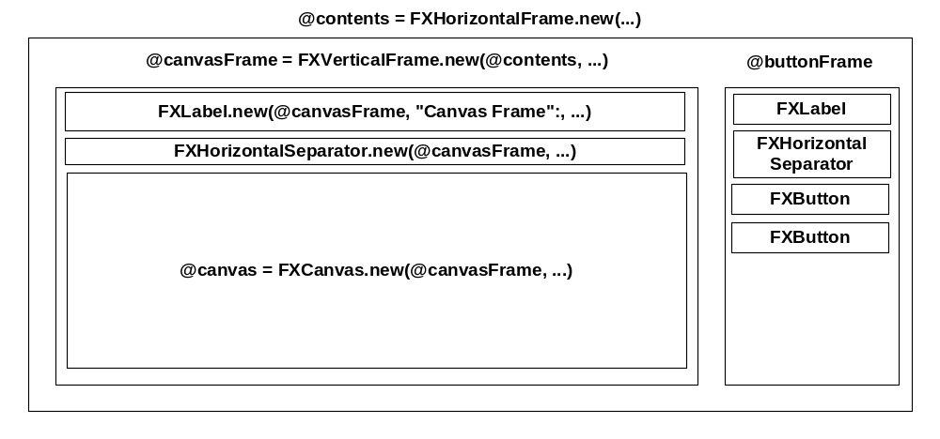
Scribble Application Layout

Slide 27
Message Identifiers
For this simple application, the main window is the message target for all the widgets.
We need to come up with unique message identifiers (class integer constants) for the canvas widget and the Clear button widget, so that the main window can distinguish between these two groups of messages.

Slide 28
Mapping Messages to Handlers
Use the FXMAPFUNC method (from the Responder mixin) to associate a message type and identifers with an instance method name, e.g.
FXMAPFUNC(SEL_PAINT,
ID_CANVAS,
“onPaint”)
Notes:
Calls to FXMAPFUNC should be placed in the class initialize method. Note that the handler method names are not hard-coded but by convention they have names like “onPaint”, “onCmdXXX”, “onUpdXXX”, and so on.

Slide 29
Mouse Buttons
Handle the event when the left mouse button goes down on the canvas:
def onMouseDown(sender, sel, ptr)
@canvas.grab
@mouseDown = true
return 1
end
Notes:
The grab method (defined by the FXWindow class) captures or “grabs” the mouse cursor so that even if the cursor leaves the window it’s grabbed to, it will still report any mouse-motion messages to the grab window. This is important in case we accidentally leave the bounds of the canvas window while drawing.
Here we’re setting a Boolean instance variable (@mouseDown) to indicate whether the left mouse button is currently up or down. We could test this directly using a FOX APIs but this is quicker.

Slide 30
Mouse Motion
Draw a line from the previous position to here:
def onMouseMove(sender, sel, event)
if @mouseDown
dc = FXDCWindow.new(@canvas)
dc.foreground = @drawColor
dc.drawLine(event.last_x, event.last_y,
event.win_x, event.win_y)
@dirty = true
end
return 1
end
Notes:
For this message type (SEL_MOTION) and many other FOX messages, the message data is a reference to the application’s FXEvent record, which contains information about the current mouse cursor position, its previous recorded position, etc. Other message types can have different data associated with them; see reference documentation for specifics.

Slide 31
Mouse Buttons (cont.)
When the mouse button up event comes in:
def onMouseUp(sender, sel, event)
@canvas.ungrab
if @mouseDown
dc = FXDCWindow.new(@canvas)
dc.foreground = @drawColor
dc.drawLine(event.last_x, event.last_y,
event.win_x, event.win_y)
@dirty = true
@mouseDown = false
end
return 1
end
Notes:
Once the mouse button goes up, they’re finished scribbling and it’s safe to ungrab the mouse. We also want to complete the drawing of this last line segment.

Slide 32
A Command Handler
When the user clicks the Clear button, it sends a SEL_COMMAND message to its message target (the main window):
def onCmdClear(sender, sel, ptr)
dc = FXDCWindow.new(@canvas)
dc.foreground = @canvas.backColor
dc.fillRectangle(0, 0,
@canvas.width, @canvas.height)
@dirty = false
return 1
end

Slide 33
An Update Handler
We’d like for the Clear button to be disabled (greyed-out) if the canvas is not “dirty”:
def onUpdClear(sender, sel, ptr)
message = @dirty ? FXWindow::ID_ENABLE :
FXWindow::ID_DISABLE
sender.handle(self,
MKUINT(message, SEL_COMMAND), nil)
return 1
end

Slide 34
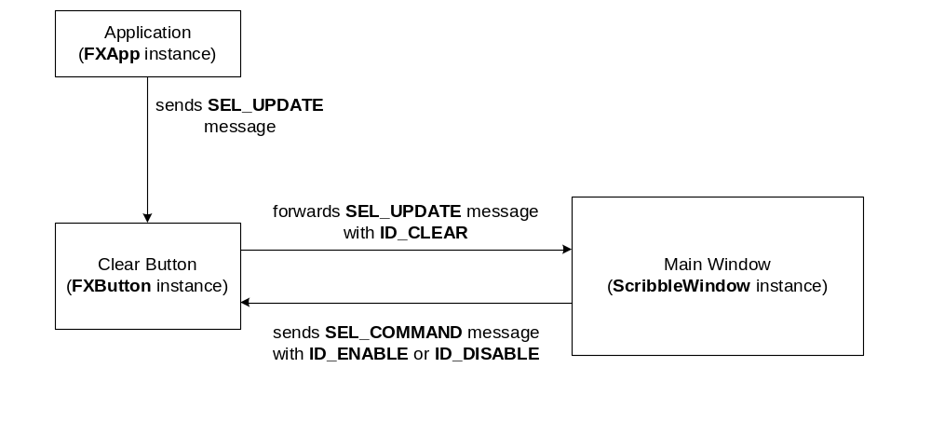
An Update Handler (cont.)

Slide 35
What’s Next?
For FOX:
Mostly feature-complete for version 1.0.
Plans for FOX 2.0 include Unicode and “themes” support.
For FXRuby:
Most pressing concern is to revamp how messages are mapped to handlers.

