Slide 1
CHAPTER 1:
INTRODUCTION TO COMPUTER SCIENCE
(c) 2012 Ophir Frieder et al
Introduction to Computer Science Using Ruby

Slide 2
What is Computer Science?
The study of algorithm design and implementation
  Algorithm: the description of the steps required to solve a problem
  The steps are expressed by instructions to the computer
(c) 2012 Ophir Frieder et al
Notes:
Beginning course details and/or books/materials needed for a class/project.

Slide 3
What is Computer Science?
Computer program: the sequence of all the instructions needed for the algorithms
Programming language: the tool to specify the computer program
  Examples: Ruby, C, C++, Python, Java
(c) 2012 Ophir Frieder et al
Notes:
A schedule design for optional periods of time/objectives.

Slide 4

What is Computer Science?
The study of algorithms helps to create solutions that yield correct results in a timely manner
Problem:
Algorithm:
Solution:
How do I
get to
Ruby Lane?
Directions
Go straight.
Take right.
Take second right.
Ruby Lane
(c) 2012 Ophir Frieder et al
Notes:
Introductory notes.

Slide 5
Application Development
Computers follow instructions, so all details must be specified.
  Example: “Spread peanut butter on one slice of bread, and jelly on another slice of bread. Then put the slices of bread together.”
    This is enough information for a human to make a peanut butter-jelly sandwich, but not enough information for a computer.
(c) 2012 Ophir Frieder et al

Slide 6
A Basic Approach to Problem Solving
Step 1: Understand the problem
Step 2: Write out the problem in plain language
Step 3: Translate the plain language into programming language
Step 4: Test the code in the computer
(c) 2012 Ophir Frieder et al

Slide 7
Step 1: Understand the Problem
Try to answer all the questions about the problem
Look for the goals, data available, and results to be derived
Example: A program that stores a list of names
  How many names will be stored?
  Do first and last names need to be stored separately?
  Are middle names needed?
  What is the maximum length that a name can be?
(c) 2012 Ophir Frieder et al

Slide 8
Step 2: Write out the Problem in English
Determine the steps necessary to go from data to results
Make an outline of the solution
Example: A program that stores a list of names
  Ask for the first name.
  Store the first name.
  Ask for the last name.
  Store the last name.
  Ask for the middle initial.
  Store the middle initial.
(c) 2012 Ophir Frieder et al

Slide 9
Step 3: Translate the English into Programming Language
Write the specification based on the English version
Include comments
  Non-executable documentation aimed to help the user
Example: A program that stores a list of names
1 puts "Enter first name: ” # Ask for the first name
2 first_name = gets # Store the first name
3 puts "Enter last name: ” # Ask for the last name
4 last_name = gets # Store the last name
5 puts "Enter middle initial: ” # Ask for middle initial
6 middle_initial = gets # Store the middle initial
(c) 2012 Ophir Frieder et al

Slide 10
Step 4: Test the Code in the Computer
See if the code runs properly
Test the code in sections as your write
(c) 2012 Ophir Frieder et al

Slide 11
Algorithms
Step-by-step methods for solving problems
Describe the process, but not each and every minutia
Example Algorithm for Directions:
  Start going South on River Road.
  Turn left (East) on Main Street.
  Take a right (South) on Ruby Lane.
  Turn left (East) toward Algorithm Circle.
  Continue until you come to 345 Algorithm Circle.
(c) 2012 Ophir Frieder et al

Slide 12
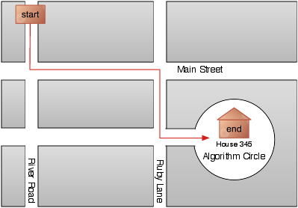
Example Algorithm for Directions (Figure 1.2)
(c) 2012 Ophir Frieder et al

Slide 13
Algorithms
Efficient algorithms reduce the number of steps needed
Improved Algorithm for Directions:
  Start going South on River Road.
  Turn lest (East) one block South of Main Street on to Algorithm Circle.
  Continue until you come to 345 Algorithm Circle.
(c) 2012 Ophir Frieder et al

Slide 14
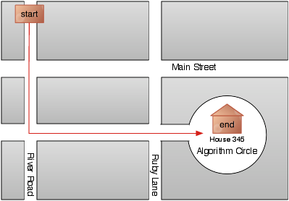
Improved Algorithm for Directions (Figure 1.3)
(c) 2012 Ophir Frieder et al

Slide 15
Summary
Algorithms: step-by-step methods for solving problems
Basic Steps for Computer Science Programs:
Computer science uses algorithms to solve problems
The computer needs every detail to solve the problem
Efficiency should be considered
Step 1: Understand the problem.
Step 2: Write out a plain language (or another pseudo-code) solution.
Step 3: Translate the plain language or pseudo-code into code.
Step 4: Test the code in the computer.
(c) 2012 Ophir Frieder et al

