Slide 1
INFOCODING
BASICS & EXAMPLES OF CURRENT USE
(c) 2010 Gideon Frieder
Introduction to Computer Science Using Ruby

Slide 2
ASCII: Tables & Description
American Standard Code for Information Interchange
Computers represent data as numbers, so an ASCII code is the numerical representation of a character such as ‘a’ or ‘@’ or an action of some sort
ASCII was introduced more then half a century ago, so it includes non-printing characters that are rarely used for their original purpose
  See enclosed the ASCII character table(s) which include descriptions of the first 32 non-printing characters
  Originally, ASCII was designed for use with teletypes and so the descriptions are somewhat obscure
(c) 2010 Gideon Frieder

Slide 3
ASCII: Tables and Descriptions
If an ASCII format document is requested, this means that the document should contain just ‘plain’ text with no formatting such as tabs, bold, or underscoring (raw format)
  This is usually done so that such document can easily be imported into almost all applications
Notepad creates ASCII text, or in MS Word you can save a file as ‘text only’ (.txt)
(c) 2010 Gideon Frieder

Slide 4
ASCII
Originally used 128 codes (7 bits)
  The 8 bit ASCII was 7 bit info and one bit for data assurance (parity bit)
Later extended to 256 codes (8 bits)
  The extension was divided into two parts:
    “Unused” codes 128-159
    “Allowed” codes 160-255
Never really observed, THUS ISO 8859!!
(c) 2010 Gideon Frieder

Slide 5
ASCII & UNICODE
ASCII is still heavily used today
Being gradually replaced by a new coding standard called UNICODE
  Comes in different encodings
  Most prevalent are UTF-8 (one byte codes) and UTF-16 (two byte codes)
(c) 2010 Gideon Frieder

Slide 6
UNICODE: UTF-8 & UTF-16
The first 128 codes in UTF-8 are identical to the ASCII codes
  ASCII coded files can usually be processed by programs that assume UTF-8 coding
UTF-16 coding covers non-Latin character sets
  Far Eastern character sets (i.e., Indian, Thai, Japanese Kana)
  Ideograms (i.e., Korean)
  Pictograms (i.e., Chinese, Japanese Kanji)
As symbols evolve and change, so does UNICODE (i.e., simplified Chinese)
(c) 2010 Gideon Frieder

Slide 7
ASCII Code
Standardized under ISO 8859, creating standard extended codes (codes 128-255)
Major variants are:
  ISO 8859 - 1 Latin
  ISO 8859 - 2 Eastern European
  ISO 8859 - 3 Cyrillic
Microsoft has its own ASCII version called “code page 1252” which is ISO 8859 – 1 compatible, but uses the “unused” codes 128-159
(c) 2010 Gideon Frieder

Slide 8

ASCII: Generic

Slide 9
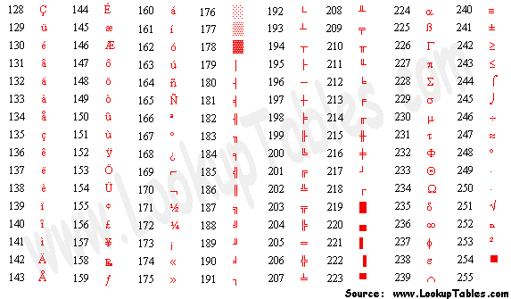
Extended ASCII Codes

Slide 10
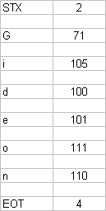
(c) 2010 Gideon Frieder

Slide 11
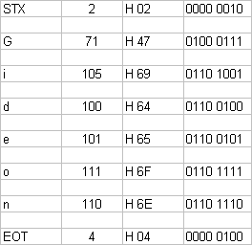
(c) 2010 Gideon Frieder

Slide 12
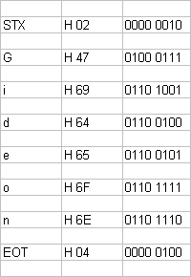
(c) 2010 Gideon Frieder

Slide 13
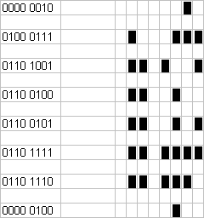
(c) 2010 Gideon Frieder

Slide 14

(c) 2010 Gideon Frieder

Slide 15
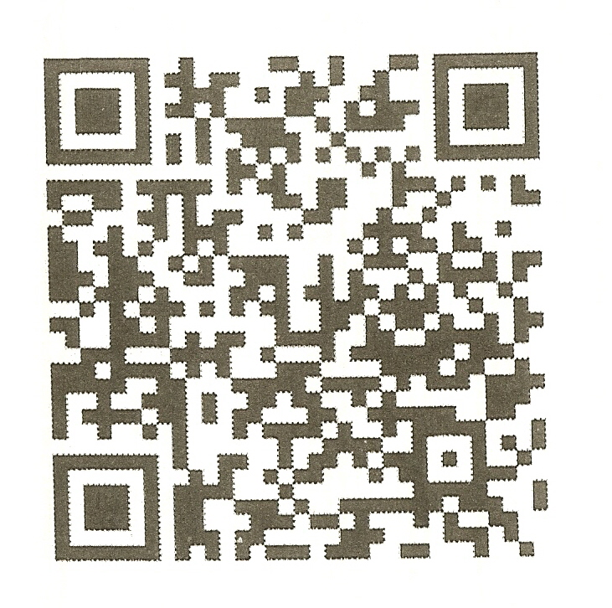

Slide 16
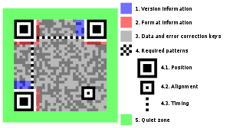
Structure of QR Code & Highlights of Functional Elements
From Wikipedia 2011

