Slide 1
Little Man Computer
There’s a little man in the mailroom that follows each instruction to the letter but he can only follow one instruction at a time.

Slide 3
What is a Computer?
a programmable electronic device designed to accept data, perform prescribed mathematical and logical operations at high speed, and display the results of these operations
Mainframes, desktop and laptop computers, tablets, and smartphones are some of the different types of computers

Slide 4
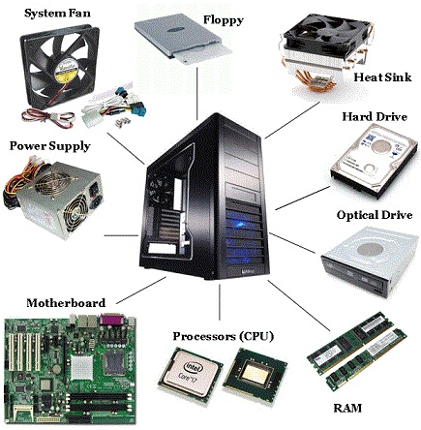
Computer Components
CPU (Central Processing Unit) – the brains of the computer, where instructions are executed
RAM (Random Access Memory) – memory that can be accessed quickly, stores running programs, but loses contents if you turn off the power
Disk – memory that is slow to access, stores files, folders and settings, does not lose contents if power is lost
Motherboard – connects all the components together

Slide 5
CPU
The CPU executes instructions
The instructions are written in binary (ones and zeroes), and they are very simple
Load information from memory or disk
Store information to memory or disk
Add two pieces of information together
Subtract two pieces of information
More complex instructions are just combining these instructions together
For example, multiplication is just repeated addition
Division is just repeated subtraction

Slide 6
Execution Cycle
Fetch => Decode => Execute

Slide 7
Little Man Computer
The Little Man Computer (LMC) is designed to show how a computer thinks at a very basic level
Programming the LMC is almost like programming a real computer in what is called “assembly” (readable version of the ones and zeroes)
LMC demonstrates that computers are only capable of executing basic instructions
They appear intelligent because they can execute those instructions much, much faster than we can

Slide 8
Assembly
Let’s say that we want to tell the computer to add two numbers
We need to give the computer the command in a format that it understands (ones and zeros)
We write the command in text: ADD 1, 3 (also known as assembly)
We then use a tool to convert this text command into its number equivalent: 913 (also known as an assembler)
This number can then be converted into ones and zeroes which the processor can execute

Slide 9
Executing One Command
Fetch an instruction from memory
Decode the instruction (determine what the instruction is)
Execute the instruction
Fetch data
Execute instruction
Return result

Slide 10
Little Man Computer
Components and Behavior

Slide 11


00-04
05-09
10-14
15-19
20-24
25-29
30-34
35-39
40-44
45-49
50-54
55-59
60-64
65-69
70-74
75-79
80-84
85-89
90-94
95-99
Instruction Location Counter
0
Input
Output
Calc
0

Slide 12
Components
The man is the “processor”. He executes the instructions
The mailboxes are RAM (the LMC does not have a disk). Each mailbox holds either data (information we want to store) or instructions
The instruction counter tells us which mailbox we need to execute
The input tray is where we get information from the user
The output tray is where we put information for the user
Calc is a temporary location we can put information to be used later

Slide 13
Instructions
Instructions are three digit numbers
The first digit is the command
The second two numbers are general the mailbox to execute the command on
For example, 1XX means take the value in the XX mailbox and add it to whatever is in the temporary location, calc

Slide 14
All Instructions
1XX – add the value in mailbox XX to calc
2XX – subtract the value in mailbox xx from calc
3XX – put the value of calc into mailbox XX
5XX – take the value of mailbox XX and put it into calc
6XX – set the instruction counter to XX
7XX – set the instruction counter to XX if calc is 0, otherwise nap
8XX – set the instruction counter to XX if calc is positive, otherwise nap
901 – grab the top item from input and put it in calc
902 – put calc into output
000 – stop and go home

Slide 15
Example – Add 2 Numbers
Get a number from input into calc
Copy that number to an unused mailbox (mailbox 20)
Get another number from input into calc
Add the number we put into a mailbox 20 to calc
Copy calc to the output
Halt

Slide 16
Example – Add 2 Numbers
INPUT
STORE 20
INPUT
ADD 20
OUTPUT
HALT
901
320
901
120
902
000

Slide 17
Example – Read / Write Two Numbers
Get a number from input into calc
Copy the number to an unused mailbox (mailbox 20)
Get a number from input into calc
Copy the number to an unused mailbox (mailbox 21)
Copy the value from mailbox 20 to calc
Copy the value in calc to output
Copy the value from mailbox 21 to calc
Copy the value in calc to output

Slide 18
Your Turn – Swap Two Numbers
Get a number from input into calc
???

Slide 19
Your Turn – First Three Multiples
Get a number from input into calc
???

Slide 20
Your Turn – First Three Multiples
1
901 INPUT 320 STORE 20 120 ADD 20 902 OUTPUT 120 ADD 20 902 OUTPUT 120 ADD 20 902 OUTPUT 000 HALT
2
901 INPUT 320 STORE 20 902 OUTPUT 120 ADD 20 902 OUTPUT 120 ADD 20 902 OUTPUT 000 HALT
3
901 INPUT 320 STORE 20 902 OUTPUT 520 LOAD 20 120 ADD 20 320 STORE 20 902 OUTPUT 520 LOAD 20 120 ADD 20 320 STORE 20 902 OUTPUT 000 HALT
4
901 INPUT 902 OUTPUT 102 ADD 2 902 OUTPUT 102 ADD 2 902 OUTPUT 000 HALT
5
?
Notes:
Think-Pair-Share: 1. Give students time to think. 2. Have students vote. 3. Have students discuss if < 80% right (“You have 1 minute: 59, 58, 57”). 4. Have students re-vote.
Programs:
1: Starts at the second multiple
2: Correct
3: Doubles each time
4: Outputs the number, then the number + 102, then the number + 204.

