Slide 1
Biblical View of Technology
Notes:
Beginning of Day 2

Slide 2
Technology
How do we define it?

Slide 3


What is Technology?
“anything that was invented after you were born”? ~computer scientist Alan Kay (tongue in cheek)
Anything with a power switch?
Blow Dryer: Creative Commons License: https://www.newegg.com/Product/Product.aspx?Item=N82E16896751255
Lock: Public Domain: http://www.gblockandkey.co.uk/
Notes:
Blow Dryer: Creative Commons License: https://www.newegg.com/Product/Product.aspx?Item=N82E16896751255
Lock: Public Domain: http://www.gblockandkey.co.uk/

Slide 4
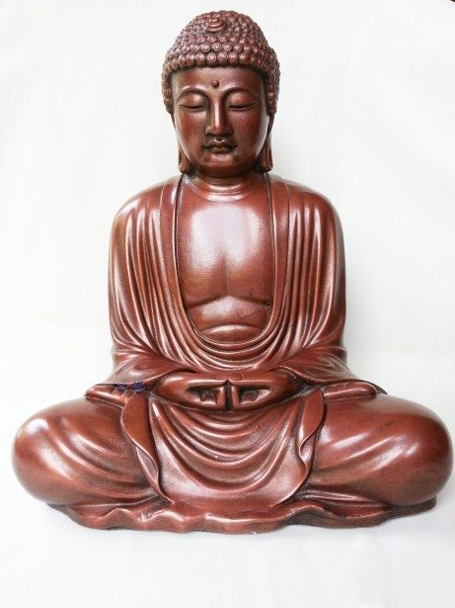
What is Technology?
Any object that improves peoples lives?
All of these definitions are too restrictive.
Public domain: http://www.lifehack.org/articles/lifestyle/7-best-alarm-clocks-wake-you-the-morning.html
Notes:
Public domain: http://www.lifehack.org/articles/lifestyle/7-best-alarm-clocks-wake-you-the-morning.html

Slide 5
Dictionary Definition
http://dictionary.com/
the branch of knowledge that deals with the creation and use of technical means and their interrelation with life, society, and the environment, drawing upon such subjects as industrial arts, engineering, applied science, and pure science
the application of this knowledge for practical ends
the terminology of an art, science, etc.; technical nomenclature
a scientific or industrial process, invention, method, or the like.
the sum of the ways in which social groups provide themselves with the material objects of their civilization

Slide 6

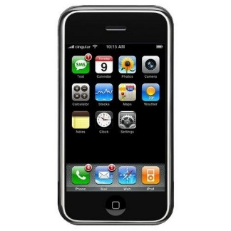
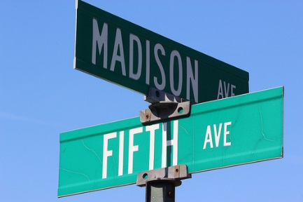
Simple Working Definition
Technology can be any item or process that we create and use for our own purposes.
Phone: public domain: http://blogigo.com/elnora5ayala98
Signs: Creative commons: https://www.flickr.com/photos/mrbeck/6945578038/
Notes:
Phone: public domain: http://blogigo.com/elnora5ayala98
Signs: Creative commons: https://www.flickr.com/photos/mrbeck/6945578038/

Slide 7
Technology in the Bible
"And his brother's name was Jubal: he was the father of all such as handle the harp and organ" (Genesis 4:21).
"And Zillah, she also bare Tubalcain, an instructer of every artificer in brass and iron” (Genesis 4:22a).
“My days are swifter than a weaver’s shuttle, and are spent without hope” (Job 7:6).
“And the rest of the acts of Hezekiah, and all his might, and how he made a pool, and a conduit, and brought water into the city” (2 Kings 20:20a).

Slide 8
Technology in the Bible
“And he made in Jerusalem engines, invented by cunning men, to be on the towers and upon the bulwarks, to shoot arrows and great stones withal” (2 Chronicles 26:15a).
“he seeketh unto him a cunning workman to prepare a graven image, that shall not be moved” (Isaiah 40:20b).

Slide 9
Implications of Technology
from Technopoly
by Neil Postman

Slide 10
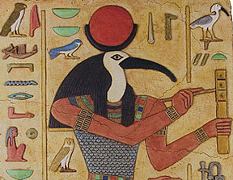
Myth of Thamus and Theuth
Thamus (tahmoos): King of Egypt
Theuth (“Thoth”): the god of writing
Thamus was not happy with the invention of writing.
Technopoly, p. 3, Neil Postman, quoting from Plato, p. 96.

Slide 11
Thamus & Theuth on Writing
“What you have discovered is a receipt for recollection, not for memory.
And as for wisdom, your pupils will have the reputation for it without the reality:
they will receive a quantity of information without proper instruction, and in consequence be thought very knowledgeable when they are for the most part quite ignorant.
And because they are filled with the conceit of wisdom instead of real wisdom they will be a burden to society.”
Technopoly, p. 4, Neil Postman, quoting from Plato, p. 96.

Slide 12
Is Technology an Improvement?
“Every technology is both a burden and a blessing; not either-or, but this-and-that.”
“Nonetheless, we are currently surrounded by throngs of . . . one-eyed prophets who see only what new technologies can do and are incapable of imagining what they will undo.”
Quoted from Technopoly, p. 5, Neil Postman.

Slide 13
Changes
Conceptual: Not only are new terms introduced, but old terms come to have new meanings.
Sociological: “ . . . those who cultivate competence in the use of a new technology become an elite group that are granted undeserved authority and prestige by those who have no such competence.”
Ecological: “A new technology does not add or subtract something. It changes everything.”
Quoted from Technopoly Chapter 1, by Neil Postman
Notes:
pp. 9-18

Slide 14
How Technology Changes Things
“New technologies alter the structure of our interests: the things we think about.
They alter the character of our symbols: the things we think with.
And they alter the nature of community: the arena in which thoughts develop.”
Quoted from Technopoly Chapter 1, by Neil Postman
Notes:
p. 20

Slide 15
Summary
Technology will advance.
Advancements have negative results.
Advancements have positive results.
Technology changes its users.

Slide 16
Technology Drawbacks
Do sermon podcasts have drawbacks?
Do electric lights have drawbacks?
Do cars have drawbacks?
Do historical documentaries have drawbacks?
Notes:
Negatives for #1: Division from church congregation; elevated expectations; division from present people.
Negatives for #2: disrupted sleep cycle, dangerous, expectation of longer work hours.
Negatives for #3: pollution, fatalities, less exercise, reduced interaction
Negatives for #4: over simplification, projection of actor to historical person, embellished details
End of Day 1

Slide 17
Don’t be Defensive!
Everything has drawbacks or trade offs.
The existence of acknowledged drawbacks does not mandate the abandonment of the technology.
You are learning how to openly discuss issues.
Objective evaluation is a sign of maturity.
Notes:
When you learn about computers, it is less time you can spend learning Spanish.
Eating ham means you have less appetite for eating beef.
We are not trying to trap you into no longer using a particular technology.

Slide 18
Biblical Philosophy of Technology Paper
Review Paper Instructions
Notes:
Beginning of Day 2

Slide 19
Understanding Proverbs

Slide 20
What is a proverb?
a short popular saying . . . that expresses effectively some commonplace truth or useful thought; adage; saw
a wise saying or precept; a didactic sentence
- dictionary.com

Slide 21
Examples of Proverbs
“Behold, every one that useth proverbs shall use this proverb against thee, saying, ‘As is the mother, so is her daughter’” (Ezekiel 16:44).
"Give a man a fish and you feed him for a day. Teach a man to fish and you feed him for a lifetime.” – Chinese proverb

Slide 22
Are Proverbs Prophecy?
Proverbs 6:32-35 - But whoso committeth adultery with a woman lacketh understanding . . . For jealousy is the rage of a man: therefore he will not spare in the day of vengeance. He will not regard any ransom; neither will he rest content, though thou givest many gifts.
Proverbs 10:3 - The LORD will not suffer the soul of the righteous to famish: but he casteth away the substance of the wicked.
Proverbs 22:6 - Train up a child in the way he should go: and when he is old, he will not depart from it.
Proverbs 15:1 - A soft answer turneth away wrath: but grievous words stir up anger.
Notes:
End of Day 2

Slide 23
Conclusion
The book of Proverbs is a guide to wise, godly living.
The paper will explore 5 areas of wise, godly living:
Communication
Friendships
Finances
Diligence
Integrity
Following the biblical patterns results in blessing.
Notes:
The bullet points are topics for the 5 paper sections and should not be altered.
There need not be punctuation after the words in the list. “When listing items one by one, one per line, following a colon, capitalization and ending punctuation are optional when using single words or phrases preceded by letters, numbers, or bullet points.” http://www.grammarbook.com/punctuation/colons.asp

