Slide 1
From the Garden to the City, Chapter IV
By Megan Hendrick and Zachary Day

Slide 2
What is technology?
The skill of makings things and the study of the skill
The tools used to make things
The objects made with those tools

Slide 3
History of Technology
Until 1650, there was a flat rate of technological change.
1650-1850, Infrastructure to communication of ideas becoming better and double population. Machines emulated human strength.
1850-1950, Information sharing became nearly instantaneous. Machines were emulating human senses.
1950-2000, Further increase in speed and power in tech. Machines were emulating the human mind.

Slide 4
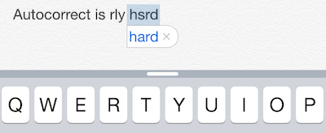
Personal Example of Technology Today.
I once was able to write a full sentence in a text message by just typing the first letter of each word I wanted to say. My phone new my tendencies so well that it could predict each word in my reply. (Megan)
This Photo by Unknown Author is licensed under CC BY-SA

Slide 5

Four Layers of Technology
Technology as Hardware—any physical object that does not occur naturally.
Paper is does not occur naturally.

Slide 6
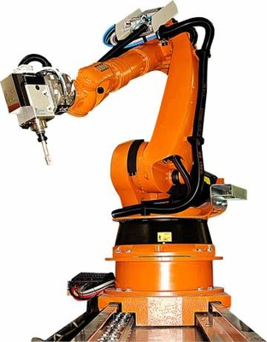
…continued
Technology as Manufacturing—objects and ideas used to create other objects
Robots assembling computers (or other objects).
This Photo by Unknown Author is licensed under CC BY-NC-ND

Slide 7

…continued
Technology as Methodology—the processes by which we make hardware and operate businesses.
Jacques Ellul believed that we apply technology instinctively because of how intertwined it became with our lives.
This Photo by Unknown Author is licensed under CC BY-SA

Slide 8
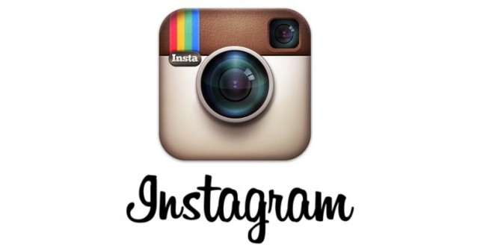
…finished.
Technology as Social Usage—The social conventions around how we use technology
Music recordings took listening to music as a big group, to smaller groups, to eventually being able to listen individually.
Also, social media.
This Photo by Unknown Author is licensed under CC BY-SA-NC

Slide 9
His Definition of Technology
The human activity of using tools to transform God’s creation for practical purposes.

Slide 10
Thanks for listening!

