Slide 1
Data Analysis
Creating Data Visualization from Raw Data
Notes:
Begun Day 20

Slide 2
Background
Excel Basics

Slide 3
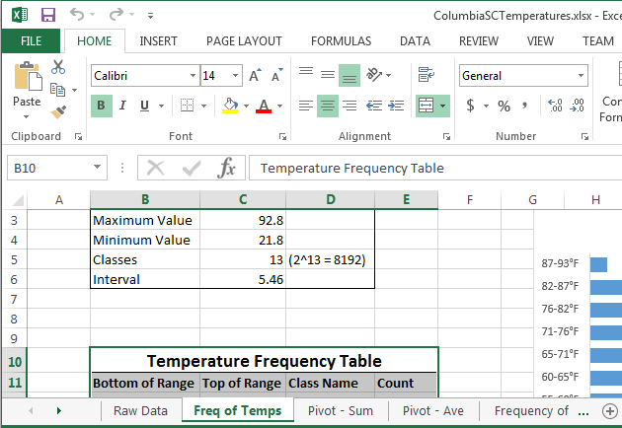
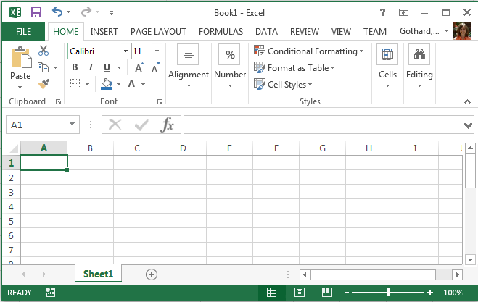
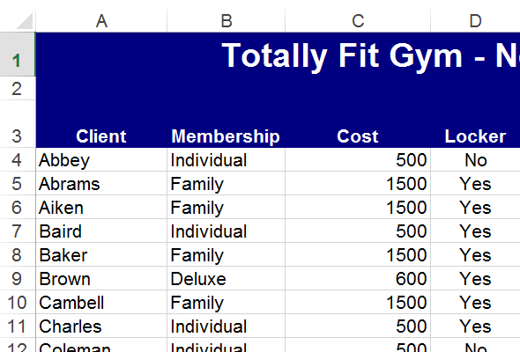
Excel – Microsoft Office Spreadsheet
Spreadsheet – a document in which data is arranged in rows and columns for manipulation and calculations
Row – a numbered horizontal line of data cells in a spreadsheet
Column – a lettered vertical line of data cells in a spreadsheet
Cell – a single location in a spreadsheet identified by column letter and row number that can hold either a value or a formula
Workbook – a single file containing one or more worksheets

Slide 4
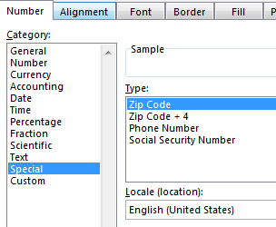
Data in Excel
Data in Excel can be in nearly any format.
Number (integer or decimal)
Currency (US or foreign)
Accounting (aligned monetary values)
Date/Time
Percentage
Fraction
Scientific notation
Text
Special numbers
Custom numbers
Notes:
End of Section 1 10/11/2017

Slide 5
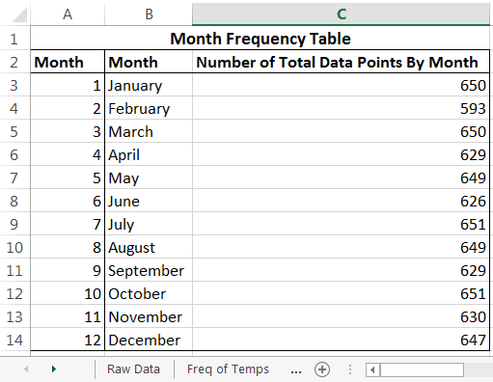
Referring to Cells In Excel
A cell is identified by its column letter and row number: B4, C2.
If a cell is in a different worksheet, type the name of the worksheet, an exclamation point, and the cell location.
Employees!D4 or ‘Raw Data’!D4
To refer to a range of cells, type the upper left cell letter and number, a colon, and the lower right cell letter and number.
A1:A23, B17:H17, B3:C14.
You can also specify entire columns or rows: A:A, C:Q, 3:3, or 5:25.

Slide 6
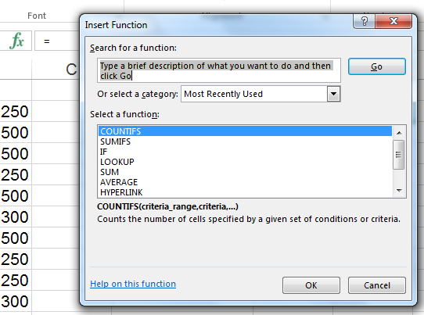
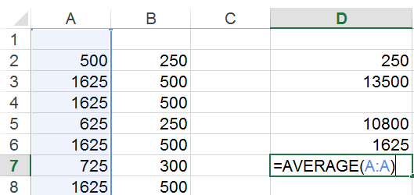
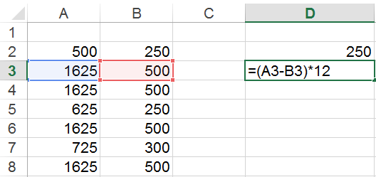
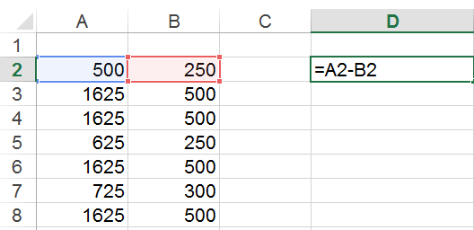
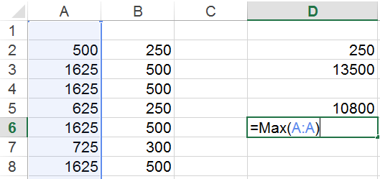
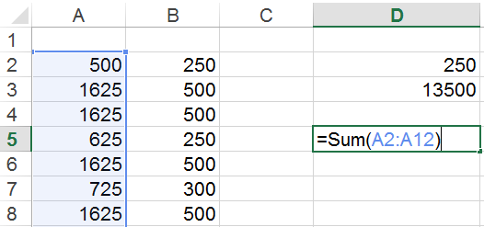
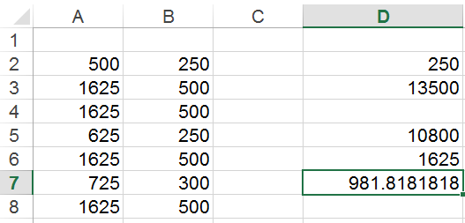
Formulas in Excel
Instead of data values, each cell can have a formula.
All formulas begin with an equals sign.
Formulas can do simple arithmetic using +, -, *, /.
Use parentheses as needed to specify the order of operations.
Formulas can incorporate provided functions with names, such as SUM, VLOOKUP, IF, COUNTIF, IFERROR, IFNA.
Click the function button to find and learn about available functions.

Slide 7
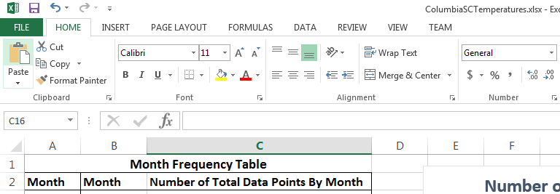
Formatting

Slide 8
Creating Charts in Excel
Excel Basics

Slide 9
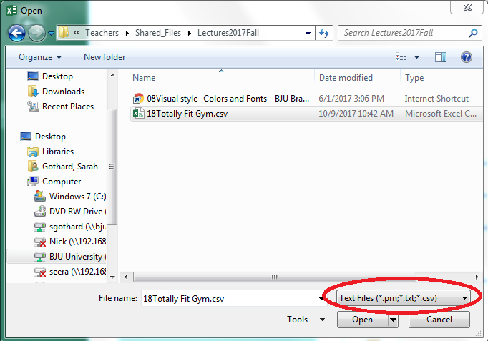
Importing Data Into Excel
Data is often provided in a text format.
Different columns can be specified by a special character (“delimiter”) or by a fixed width.
Common delimiters are commas or tabs.
Comma-delimited files are named .csv. Tab-delimited are named .txt.
After importing the text format, re-save it as an Excel document.

Slide 10
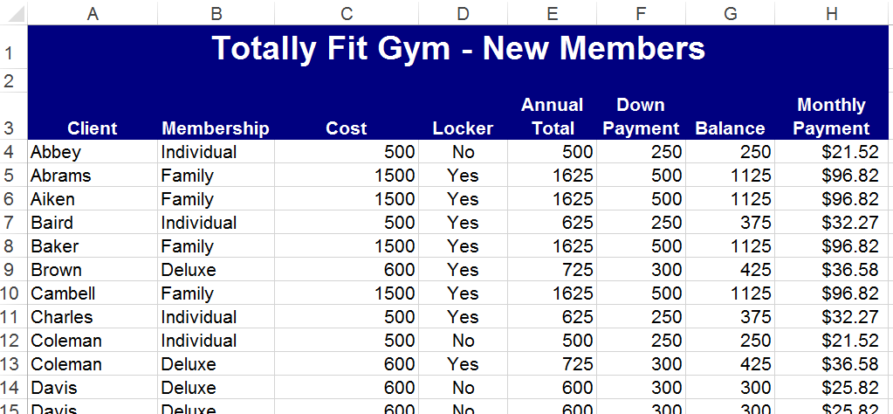
Sample Data

Slide 11
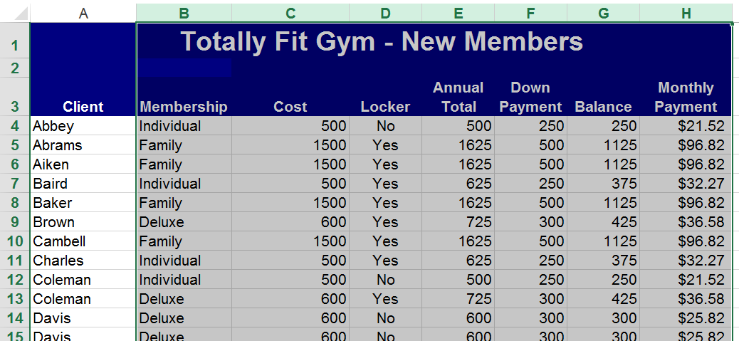
What Can Excel Do?
Notes:
Select the table with Columns B-H
Look at the 3 recommended charts
Bar Charts give bars for all of the yes and no entries for each of the membership types. Not helpful.
Pie charts give a piece of the pie for each combo of membership, locker and cost values. Thus it is using the first three columns.
Dot Plots look a little better but it is unclear as to what information is being displayed.
There are no labels for the associated values in the first 3 columns. The dots are color- coded for the right 4 columns but no association is made to the left three columns.

Slide 12
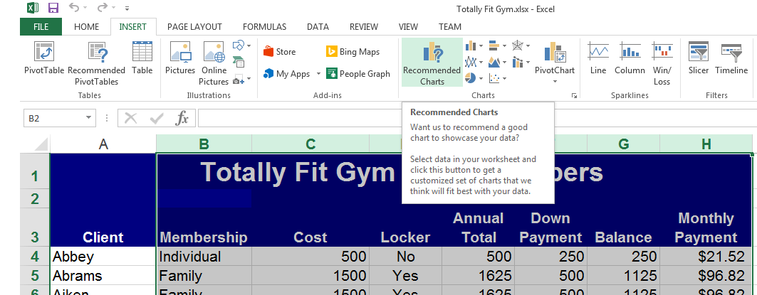
Try Recommended Charts

Slide 13
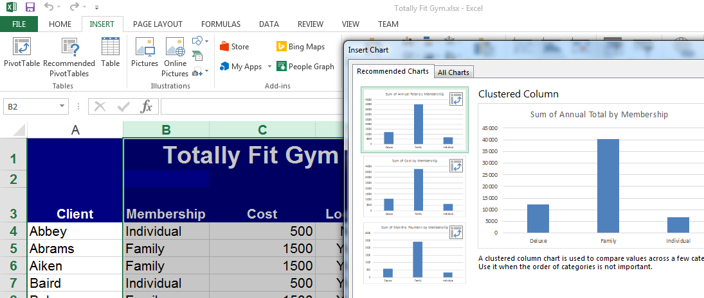
Limited Recommendations

Slide 14
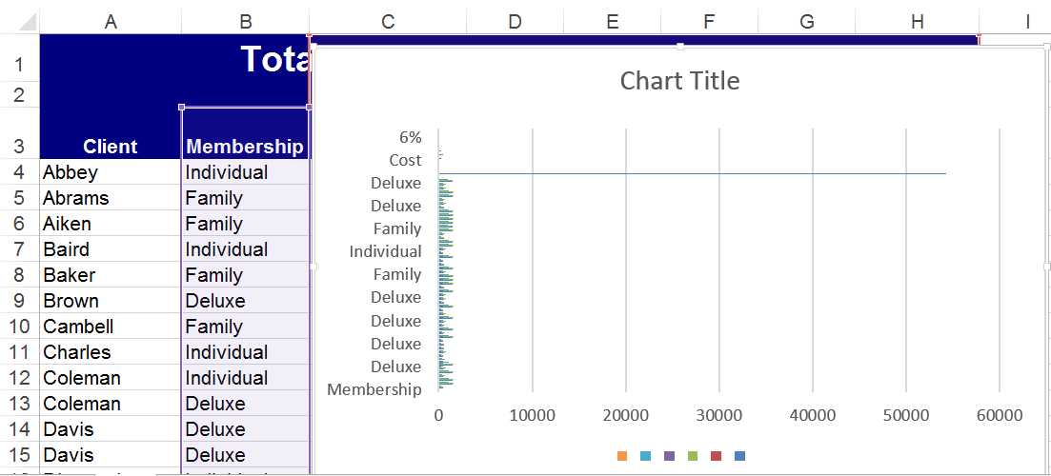
Useless Bar Charts

Slide 15
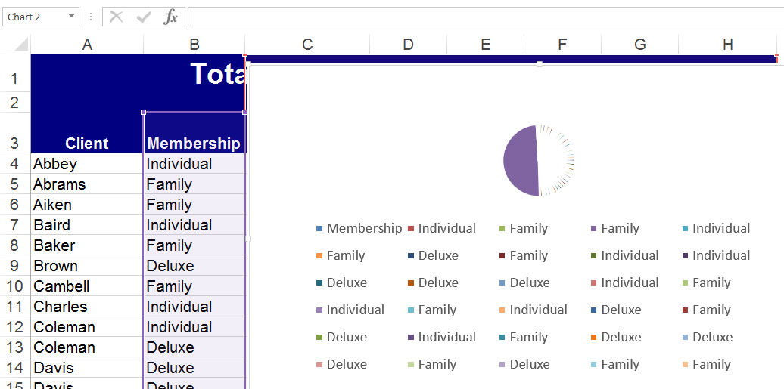
Useless Pie Charts

Slide 16
Some Pre-Processing is Necessary
We need to process the data ourselves into a more useful format.
We can build “summary tables” to summarize the raw data.
We will create 2 types of summary tables: frequency tables and pivot tables.

Slide 17
Frequency Tables
For Qualitative and Quantitative Data

Slide 18
Initial Analysis
What variables do we have?
Client – unique information; not informative to chart
Membership – Individual, Family, or Deluxe
Cost - $500, $600, or $1,500
Locker – Yes or No
Annual Total – 6 different possible values
Down Payment - $250, $300, or $500
Balance – 6 different possible values
Monthly Payment – 6 different possible values

Slide 19
Numerical vs. Non-numerical
Non-numerical
Membership – Individual, Family, or Deluxe
Locker – Yes or No
Numerical
Cost
Annual Total
Down Payment
Balance
Monthly Payment

Slide 20
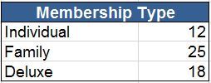

Summarizing Non-Numeric Data
We construct a frequency table.
A frequency table is a count of the occurrences of each unique value for a particular variable (column).

Slide 21
How to Create a Frequency Table
How do we obtain the counts?
We can count manually.
Error prone
Difficult for large data sets
Does not automatically update
We can have Excel count for us.

Slide 22
Computing Frequency Tables
Using Excel Formulas to Count Occurrences

Slide 23
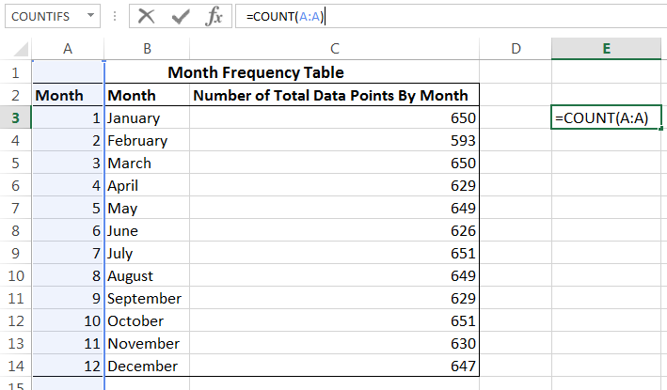
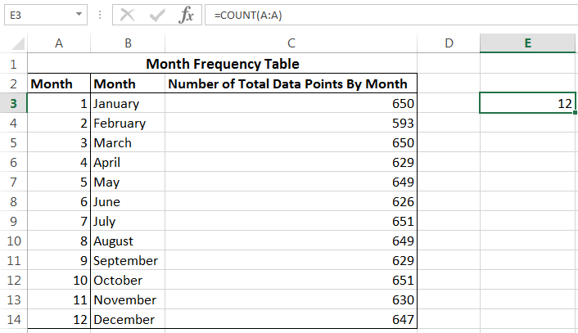
Excel COUNT Function
Counts the number of cells that contain numbers
=COUNT(B:B)
=COUNT(C2,E2,F2:G2,I2)
This function will not work for counting text values.

Slide 24
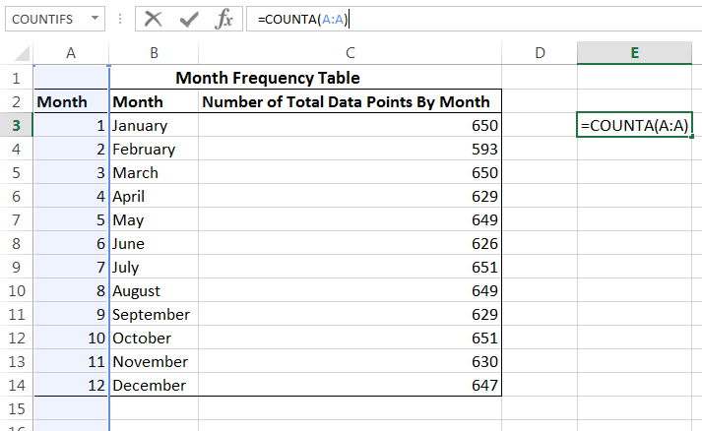
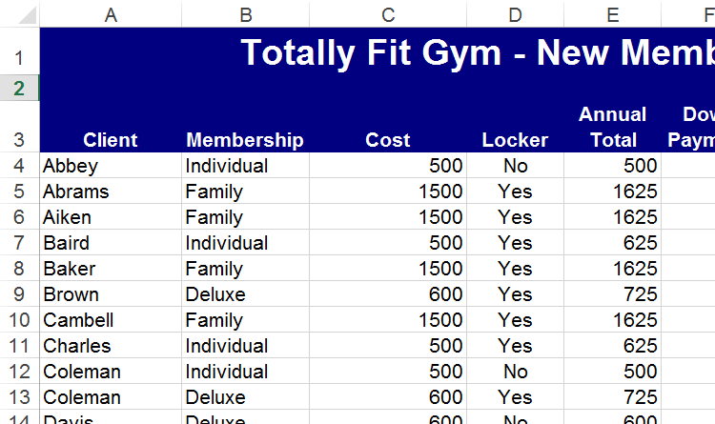
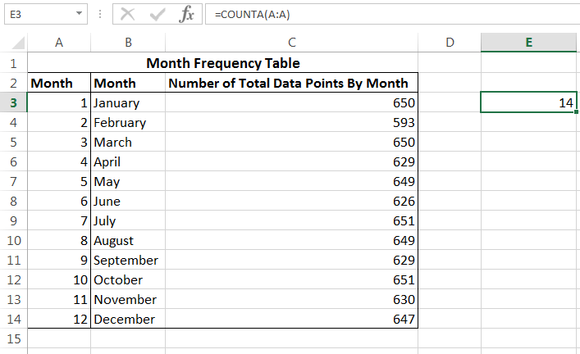
Excel COUNTA Function
Counts the number of cells that are not empty
This function will not work for counting the number of times a particular text value occurs.

Slide 25
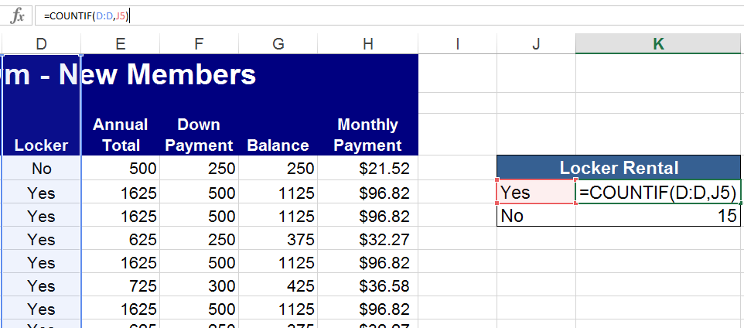
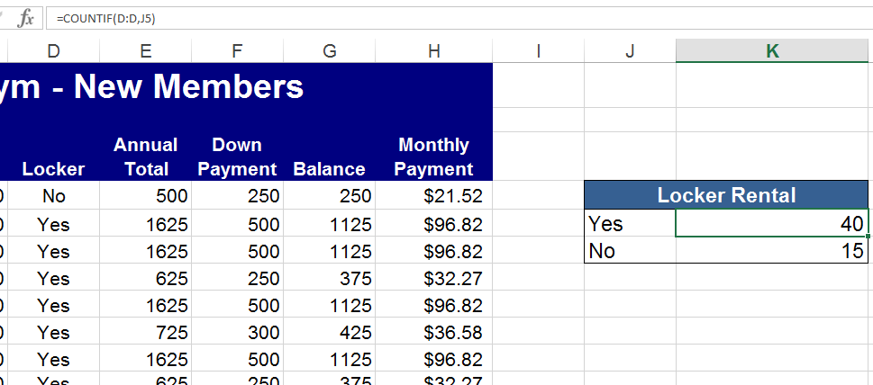
Excel COUNTIF Function
Counts the number of cells that meet a criteria
Format: COUNTIF(Range of cells to count, criteria)
=COUNTIF(B2:B76, A15)
=COUNTIF(B2:B76,">="&G3)
If the criteria is not equality, specify it in quotation marks, then use an ampersand to join it to the value to compare to.

Slide 26
Excel COUNTIFS Function
Counts the cells in a given range that meet multiple required criteria
Format: COUNTIFS(range to test, criteria1, [second range to test, criteria2]…)
=COUNTIFS(Grades!C:C,">"&N2,Grades!D:D,">"&N2)
For now, we need only COUNTIF.

Slide 27
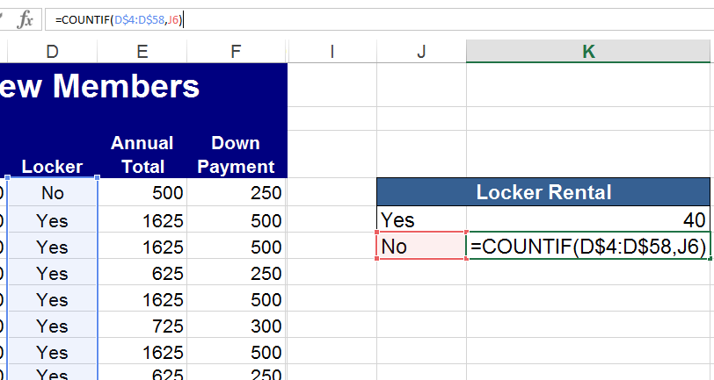
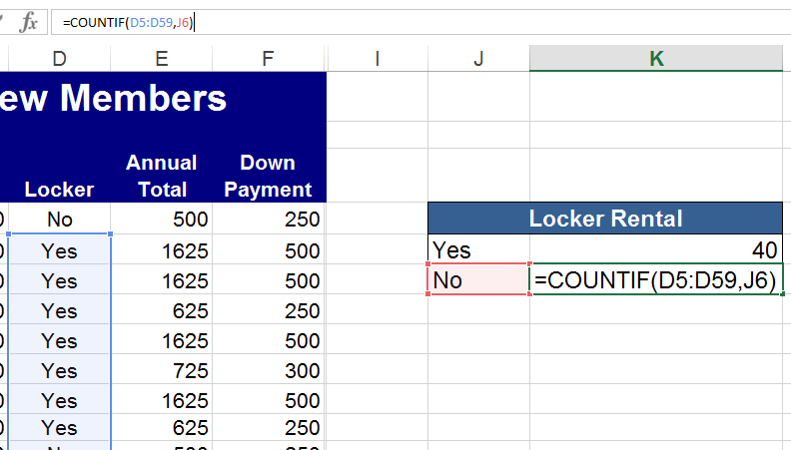
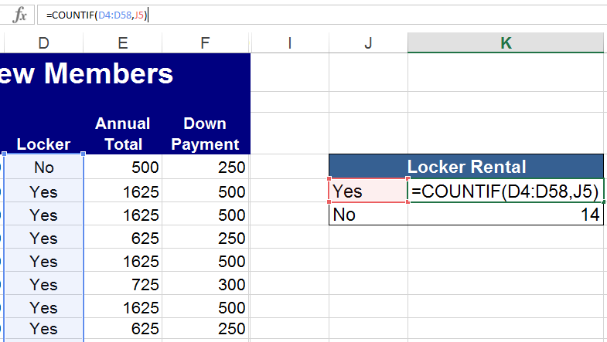
Copying Formulas
When you copy a cell with a formula to a new location, Excel updates the cells referenced by the formula relative to the new location.
To prevent Excel from changing the row, put a $ before the row number: =F$3/15.
To prevent Excel from changing the column, put a $ before the column letter: =$F3/15 =$F$3/15.
Use F4 to have Excel insert the dollar signs automatically.

Slide 28
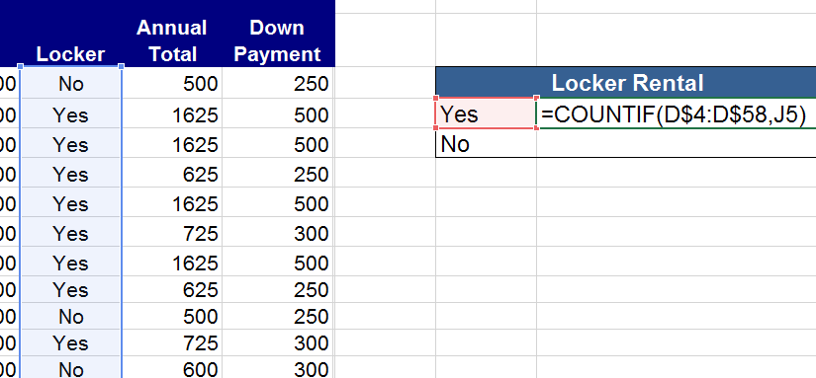
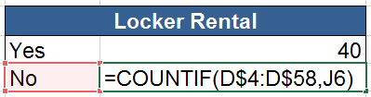
Creating the Frequency Table
Create a Heading.
List all the unique values on the left.
Use COUNTIF with the column you want to count and the value to the left as the criteria.
Copy the formula down.

Slide 29
Quantitative Data
How to Summarize Quantitative Data

Slide 30
Numeric Data from the Spreadsheet
Numeric Variables:
Cost - $500, $600, or $1,500
Annual Total – 6 different possible values
Down Payment - $250, $300, or $500
Balance – 6 different possible values
Monthly Payment – 6 different possible values
These values are not continuous.
They behave more like non-numeric data and can be summarized the same way.

Slide 31
Quantitative Data
Quantitative data is data with continuous values.
Examples:
Human statistics: heights, weights, ages, IQ’s
Medical statistics: Heart rate, blood sugar, cholesterol
Weather statistics: rain fall, temperatures, humidity
Academic statistics: grade averages, GPA, standardized test scores
Sales figures
Bank account balances
Election results

Slide 32
Summarizing Quantitative Data
So far, we have done frequency tables for non-continuous data or “qualitative” data.
For qualitative data, we simply counted the number of times each unique value occurred.
In other words, the number of “classes” equaled the number of unique values.
For quantitative data, we cannot have a class for every possible value (age 1, age 2, age 3, . . . age 121, age 122).

Slide 33
Frequency Tables for Quantitative Data
For quantitative data, we need to combine possible values into groups or “classes.”
How many classes? How many values should a class have?
We will follow the “2 to the k” Rule.
The 2^{k} Rule is a rule of thumb for choosing enough classes to clearly chart the data.
The 2^{k} Rule computes the number of classes to use based on the total number of data points.
The 2^{k} Rule basically adds a class every time the amount of data doubles.

Slide 34
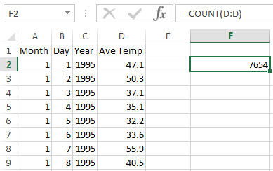
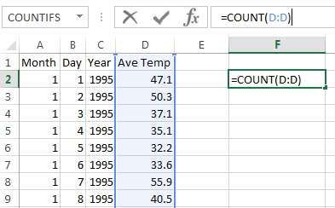
Two to the K Rule
N = the total number of data points (rows in the data)
k = the smallest number such that 2^{k} > N.
The number of classes equals k.
For example, N = 7,654.
2¹¹= 2,048. 2¹²= 4,096. 2¹³= 8,192.
k = 13.
We will group the data into 13 different classes.
Average daily temperature data for Columbia, SC
http://academic.udayton.edu/kissock/http/Weather/

Slide 35
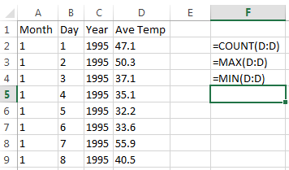
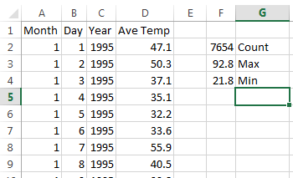


Class Intervals
Next we determine the “class interval.”
All the classes together must cover at least the distance from the lowest value in the raw data to the highest value.
i = class interval
H = highest observed value
L = lowest observed value
$$=\frac{92.8−21.8}{13}=\frac{71}{13}=5.5$$
Our class intervals will be 5.5°.
Excel can do the above computations.

Slide 36
Actual Classes for this Example
The first class starts at our lowest value: 21.8.
The first class is a count of everything ≥ 21.8 and < 27.3.
The second class is a count of everything ≥ 27.3 and < 32.7.
The third class is a count of everything ≥ 32.7 and <38.2.
The thirteenth class is a count of everything ≥ 87.3.

Slide 37
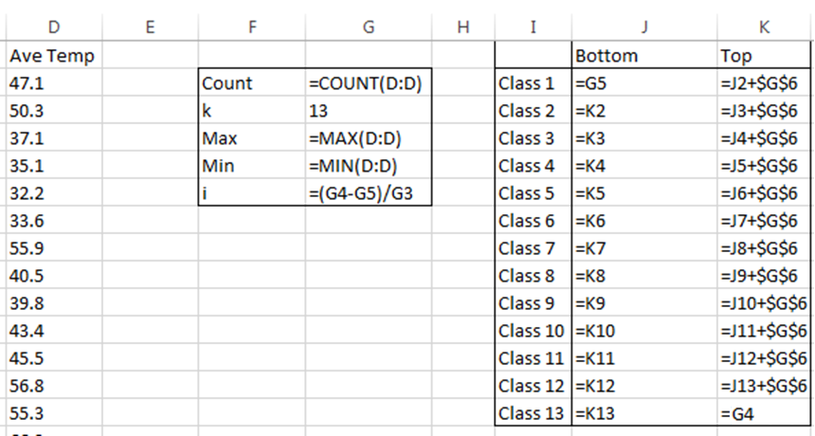
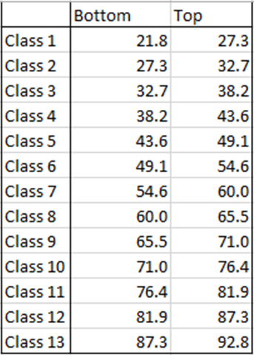
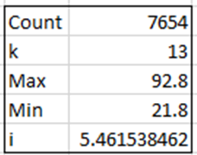
Defining the Classes in Excel

Slide 38
Counting the Frequencies
We now need to count frequencies based on two criteria: ≥ 21.8 and < 27.3, etc.
We can use the COUNTIFS function.
You can do it by hand, but I don’t recommend it.
COUNTIFS(range to test, criteria1, [second range to test, criteria2]…)
=COUNTIFS(D:D,">="&J2,D:D,"<"&K2)
=COUNTIFS(D:D,">="&J3,D:D,"<"&K3)
=COUNTIFS(D:D,">="&J4,D:D,"<"&K4)

Slide 39
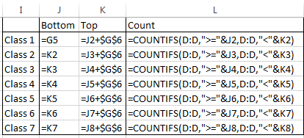
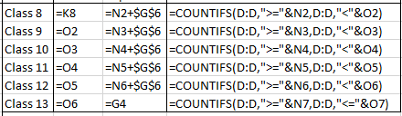
Formula in Excel

Slide 40
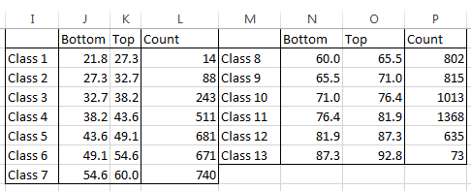
Final Temperature Frequency Table

Slide 41
Second Example
Another Demonstration of 2^{k} Rule

Slide 42
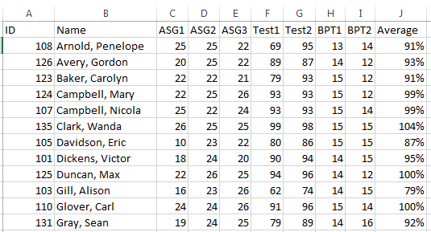
Sample Grade Book

Slide 43
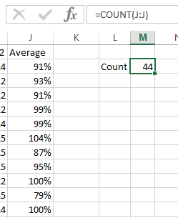
How Can We Chart Averages?
Averages are quantitative data: continuous values.
We need k classes, where k the smallest number such that 2^{k} > N.
N = 44
2⁴= 16. 2⁵= 32. 2⁶= 64.
k = 6.
We will group the 44 student averages into 6 classes.

Slide 44
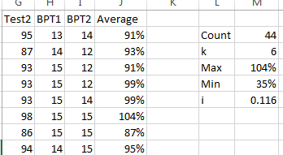

Class Intervals
Next we compute the class interval.
i = class interval
H = highest observed value
L = lowest observed value
$$i≥\frac{H−L}{k}=\frac{104−35}{6}=11.6\%$$
Our class intervals will be 11.6%.

Slide 45
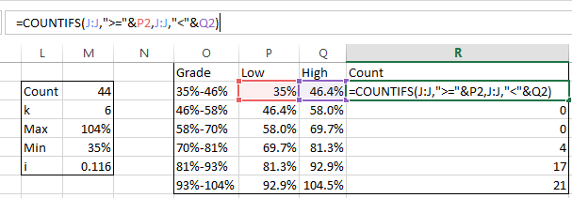
Final Classes

Slide 46
Excel Charts
Visualizing the Data

Slide 47
Chart Options
Qualitative → Bar Chart (Histogram), Pie Chart
Quantitative → Bar Chart, Pie chart, Line Graph, Scatterplot
To create a chart, select the cells (not columns) you wish to chart (along with any related headings), and select the chart type from the Insert Ribbon.

Slide 48
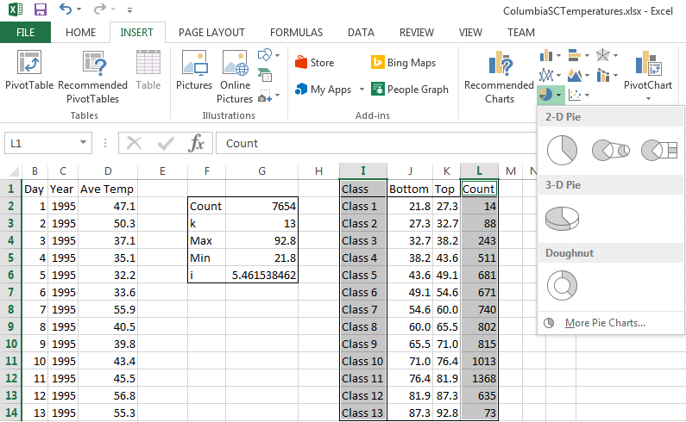
Inserting a Pie Chart

Slide 49
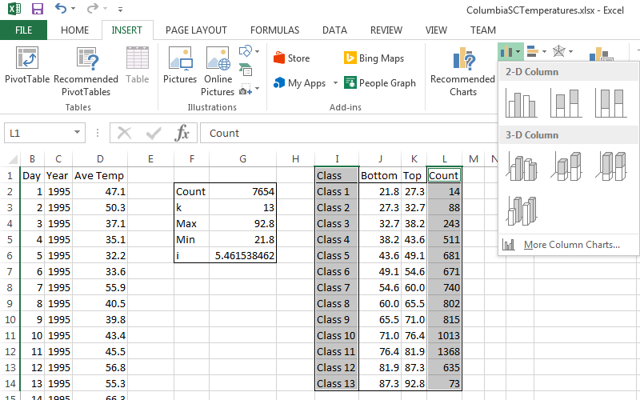
Inserting a Bar Chart

Slide 50
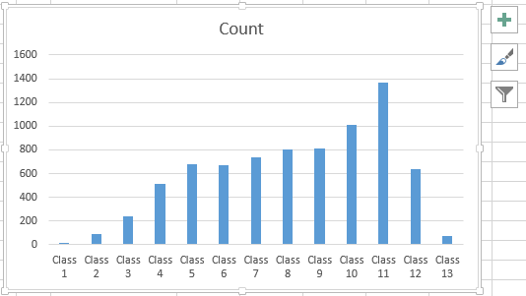
First Bar Chart Attempt
Problems:
Poor title
Useless class names
Incorrect bar chart spacing

Slide 51


New Class Names
Make the class names the lower range of each temperature?
It confuses Excel.
We could fix it, but let’s try something else.

Slide 52





Name the Classes After the Ranges
First class: 21.8-27.3
Sometimes text from different sources needs to be joined together or “concatenated.”
We join text together with an ampersand: &
Joining text is considered a formula and must begin with an equals sign.
In this case, we also should round.

Slide 53

Second Attempt
Better labels
Still bad title
Still incorrect spacing

Slide 54


Changing the Title
Select the chart title to change it.
In general, to customize any part of a chart, select the part of the chart you want to modify, and right click for format options.

Slide 55


Change the Bar Chart Spacing
Select the bars.
Right click.
Select Format Data Series.
Change the Gap Width to 50%.

Slide 56

Final Result

Slide 57
What Story Does it Tell?
Average freezing temperatures are rare in Columbia.
Average temperatures are most frequently in the 70s°-80s°.

Slide 58


Grades Pie Chart First Attempt

Slide 59

Modifications
We can update the title.
We can organize the frequencies in descending order to get the slices in clockwise order.

Slide 60

Chart Style
We can change the chart style with the Chart Design ribbon.

Slide 61

More Modifications
We can select a style with the percentages on the pie slices.
Since 2 of our categories have no values, we can remove them from the legend by selecting them and pressing delete.

Slide 62
Pivot Tables

Slide 63

Description
Pivot tables are an Excel feature for making it easy to arrange and summarize complex data.
The PivotTable tool is on the Insert ribbon.

Slide 64

Creating a Pivot Table
To create a pivot table, select the data and headings you want to use, and select Pivot Table from the Insert Ribbon.
It is recommended that you put the pivot table in a new worksheet.

Slide 65

Pivot Table Definition
Excel lets you specify the rows, columns, values, and even filters (if you wish).
The rows and columns of a pivot table should be fields with not too many different values, in order to be readable.
The data in the cells are typically quantitative data that can have sums, averages, maximums, etc.

Slide 66





Setting the Rows, Columns, and Data
Using the Pivot Table Fields Task Pane to the right, drag one field to be the rows, another to be the columns, and a third to be summarized as the data.
You may change the way the data is summarized by selecting the Value Field Settings from the drop down by the chosen Values.

Slide 67

Final Result
Pivot table summing the monthly payments by membership type and possession of a locker.
What is the story?
Family memberships with lockers are the bulk of the income.

Slide 68
Second Pivot Table Example
Employee Clock-in and Clock-out Hours

Slide 69

Hourly Work Records
We will repeat the process with employment records.
Select the data and headings you want to use, and select Pivot Table from the Insert Ribbon.

Slide 70



Create Pivot Table
We will make a table of the hours worked per employee per day.
Reminder: the rows and columns should be variables with few possible values, and the values should be quantitative data that can be summed, averaged, etc.

Slide 71

What Story Does it Tell?
Tuesday was the biggest work day that week.
Employee 111 worked the most hours.
Most employees worked overtime, with the exception of one very part-time employee.

Slide 72
Summary
Excel is a highly versatile data manipulation and computation tool.
There are too many features and functions to cover in class, but Excel offers searches and tutorials.
Sometimes we need to make summary tables (frequency tables and pivot tables) in order to better understand and visualize data.
Play around with Excel. It is helpful for finances, statistics, record keeping, and many other purposes. You will likely need to know how to use it one day.

